Slide 1
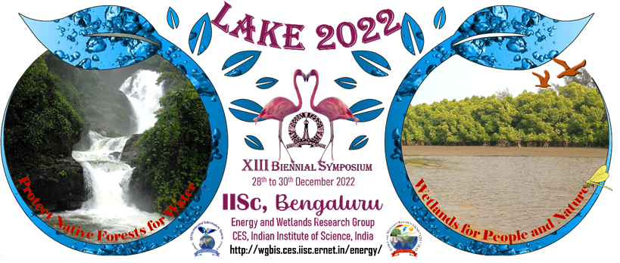

SUSTAINABLE AGRICULTURE AND ORGANIC FARMING
AMRUTH P, SHREYA VR,
IX
CBSE

Slide 2
INTRODUCTION

Slide 3
Conditions | Organic farming | Inorganic farming
Impact on the soil | Soil quality improves | Soil quality gets damaged
GMOs | Not used | Used
Fertilizers | Natural fertilizers | Chemical fertilizers
Pesticides | Natural pesticides | Chemical pesticides
Farming method | Used | Not used
Food quality | Quality is a priority | Quantity is a priority
Impact on the environment | Sustainable impact | Negative impact

Slide 4
OBJECTIVE
To do a comparative study of organic farming and inorganic farming.
To prepare an organic NPK fertilizer which is as nutrient specific as possible.

Slide 5
Materials and Methods

Slide 6
Study Area
Mr Janardhan’s farm, M Krishnasagara, Tavarekere road
Mr Vijaya Narayana’s farm, Dakshina Kannada, Puttur, Padnoor

Slide 7
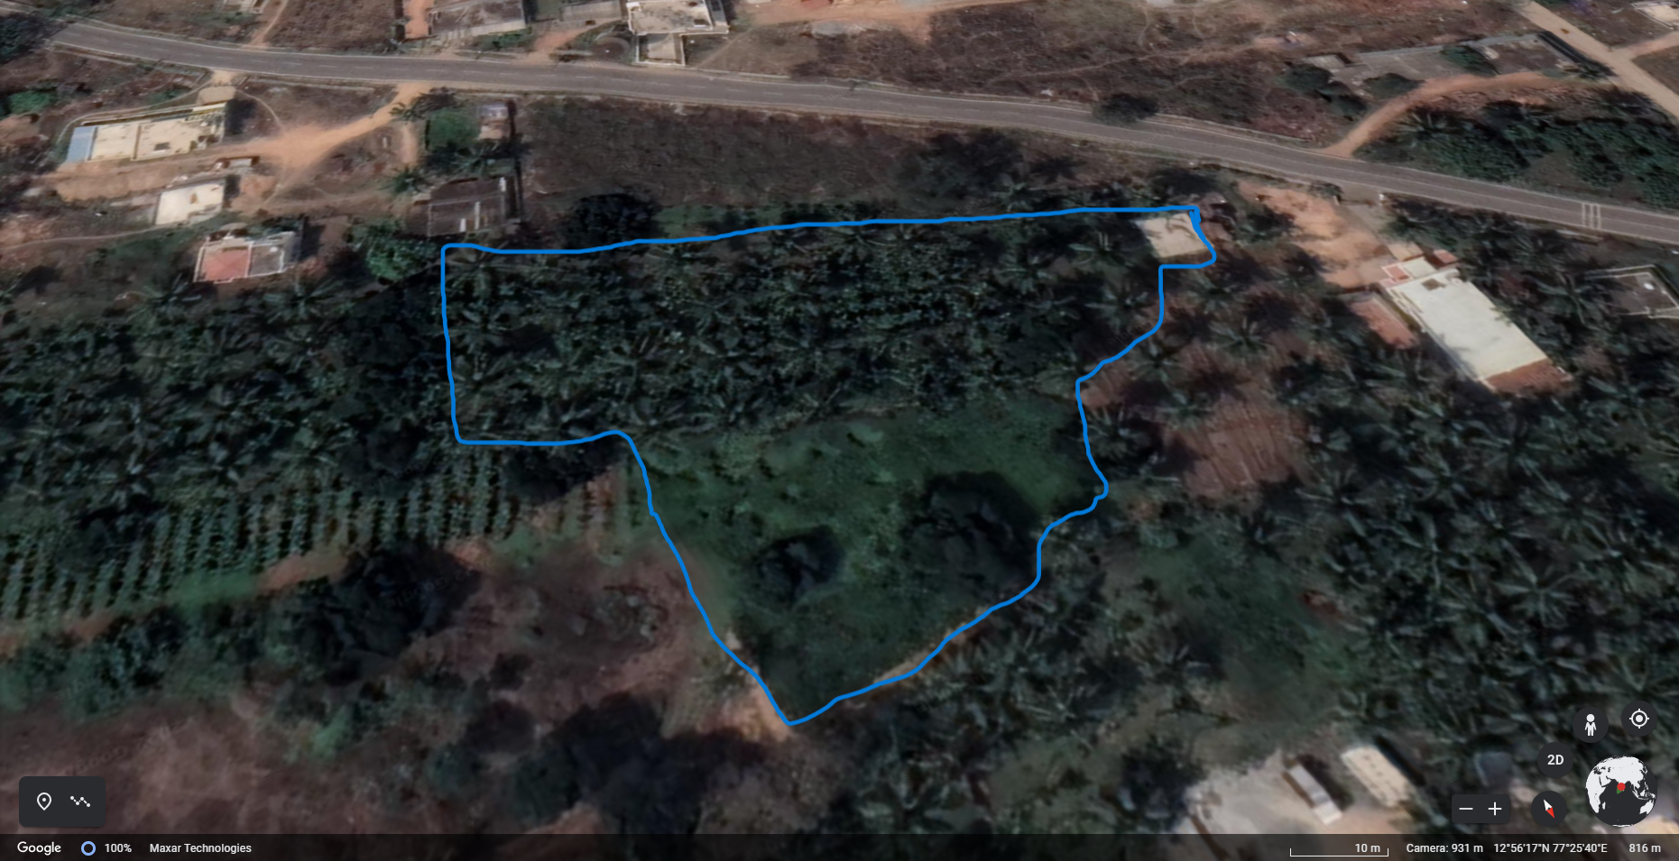
Mr Janardhan’s farm, M Krishnasagara, tavarekere road

Slide 8
COMPARITIVE STUDY

Slide 9
INTERVIEW QUESTIONS | 1ST INTERVIEW | 2ND INTERVIEW
2. What is the name of your village? | M Krishnasagara | Dakshina Kannada, Puttur, Padnoor
3. How large is your farm? | 2 acres | 10 acres
4. What are the cropsyou grow in your farm? | Betel nut, coconut, mango, Chico, banana, ragi, corn | Areca nuts, coconut, bananas, pepper
5. Do you use organic or inorganic fertilizers? | both (inorganic for betel nut, coconut, ragi and corn, organic for fruit yielding plants) | Used to use inorganic fertilizers, now uses organic fertilizers
6. Which fertilizer gives better yield? | organic fertilizers used to give good results in the past but in order to meet the demands of the markets we have to use inorganic fertilizers | If we use organic fertilizers continuously, then it gives better yield
7. Which fertilizer is within your budget? | As we have domestic animals, organic fertilizers and manure are within our budget | Organic fertilizers like – cow dung, green leaf compost and neem tree compost
8. Do pests attack your crops? | There are not many pest attacks on our field but snails and caterpillars do attack | There are not much pest attacks
9. Do you use pesticides? | We use clove oil and cow urine and also the bark of neem trees | Not really but, we spray cow urine instead of pesticides
10. How do you irrigate your land? | We have a sprinkler system | Sprinklers
11. Do you use weedicides? | No | No
12. Which fertilizer is better according to you? | I haven’t seen any bad effects on the soil by using organic fertilizers but weedicides have a negative effect on the soil as they decrease the fertility of the soil | Organic fertilizers
13. Do you follow mixed or intercropping? | We follow mixed cropping | Mixed cropping

Slide 10

1st recording
2nd recording

Slide 11
INFERENCE FROM SURVEY
From the survey, we could infer that :
From interview 1 – In order to meet the needs of marketing and selling what you have grown, you need to use inorganic fertilizers, even though organic fertilizers are more healthy and rarely give out a negative influence on the surrounding.
From interview 2 – If we use organic fertilizers continuously, we get really good yield of crops. So, organic fertilizers are naturally better than inorganic fertilizers.
Lake 2022
‹#›

Slide 12
TESTING OF SOIL
Testing of soil, from organic farm and farm with both organic and inorganic fertilizers

Slide 13
Soil type | Soil colour | Soil texture | Field density | Water content | pH | Heavy metals
Organic | red | Fine soil with clay and silt but also had some amounts of sand | 1.132g/cm³ | 29.8% | 7 | Lead =6.86mg/kg Arsenic =0.11mg/kg Mercury =1.05mg/kg Cadmium =0.05mg/kg
Inorganic | red | Fine soil with clay and silt | 1.497g/cm³ | 13.6% | 7 | Lead =11.70mg/kg Arsenic =0.14mg/kg Mercury =0.92mg/kg Cadmium =0.07mg/kg

Slide 14
NPK
NPK is an inorganic fertilizer which has the three major nutrient required for plant growth
Nitrogen (N) – Nitrogen is largely responsible for the growth of leaves on the plant.
Phosphorus (P) – Phosphorus is largely responsible for root growth and flower and fruit development.
Potassium (K) – Potassium is a nutrient that helps the overall functions of the plant perform correctly.
Inorganic NPK fertilizers are fertilizers which have a specific ratio as per the requirement of the plant.
This requirement keeps differing
3:1:2 ratio for flowering plants
5:7:3 for vegetables
34:10:10 for grass

Slide 15
Effects of inorganic NPK on environment
Inorganic nitrogen fertilizers increase the acidity of soil.
Inorganic phosphorus fertilizers increase the level of cadmium in the soil.
Steel industry wastes, recycled into fertilizers for their high levels of (essential to plant growth), wastes can include the following toxic metals: lead arsenic, cadmium, chromium and nickel.
Agricultural runoff/leaching is a major contributor to the eutrophication of freshwater bodies.

Slide 16
ORGANIC NPK

Slide 17
Materials
Banana peel (potassium)
Ground coffee bean (nitrogen)
Potato peel (potassium)
Cow dung ash (phosphorus)
Wilted flowers (nitrogen)
Chicken manure (nitrogen)
Oil pressed Groundnut cake (NPK)
Bins to compost them

Slide 18
PROCEDURE
Take individual ingredients and add each of them to different compost bins.
Take a small amount of soil and add it to each bin and mix all the materials.
Keep the mixtures damp but not water logged until the composts are ready.
Wait until the composts have completely lost their odour.
The compost is ready to be tested when it no longer gives off heat. It would have become dry, brown, crumbly and look more like soil than scraps.
Lake 2022
‹#›

Slide 19
6. Now take samples of each compost and test them for the nutrients present in them.
7. Select the composts which are rich in nitrogen, phosphorus and potassium.
8. Combine it in the ratio you want.

Slide 20
MATERIAL | MACRO NUTRIENT/S | MICRO NUTRIENT/S
Banana peel | Potassium, phosphorus | Calcium, magnesium, sulphur, nitrogen
2. Coffee grounds | Nitrogen | Potassium, phosphorus
3. Potato peel | Potassium | Phosphorus, nitrogen
4. Cow dung ash | Phosphorus, silica | Magnesium
5. Wilted flowers | Nitrogen, carbon | Calcium, phosphorus
6. Chicken manure | Nitrogen | Magnesium, potassium, zinc, calcium
7. Oil pressed groundnut cake | Nitrogen | Phosphorus, potassium

Slide 21
FUTURE PLANS
To conduct more surveys
To test the compost as it is still decomposing
To test the organic NPK composts on plants to continue the comparison with inorganic fertilizers

Slide 22
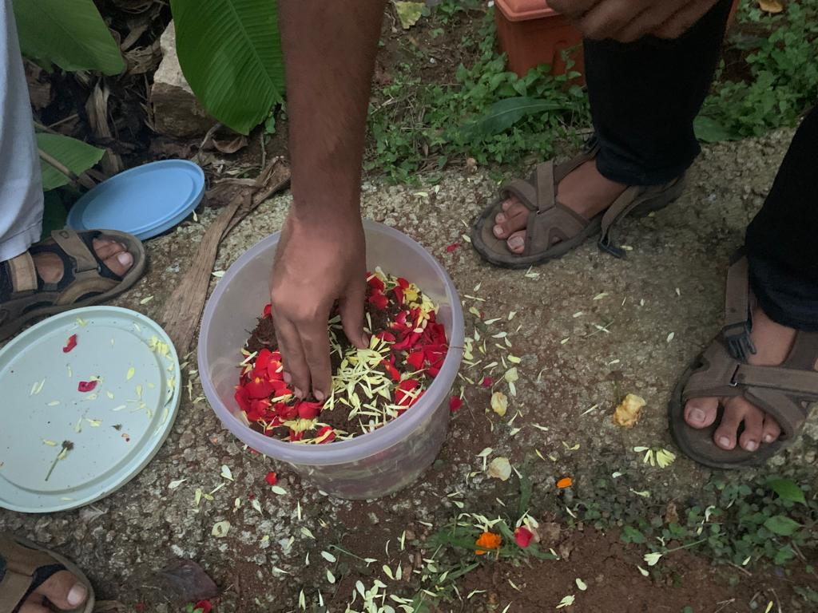
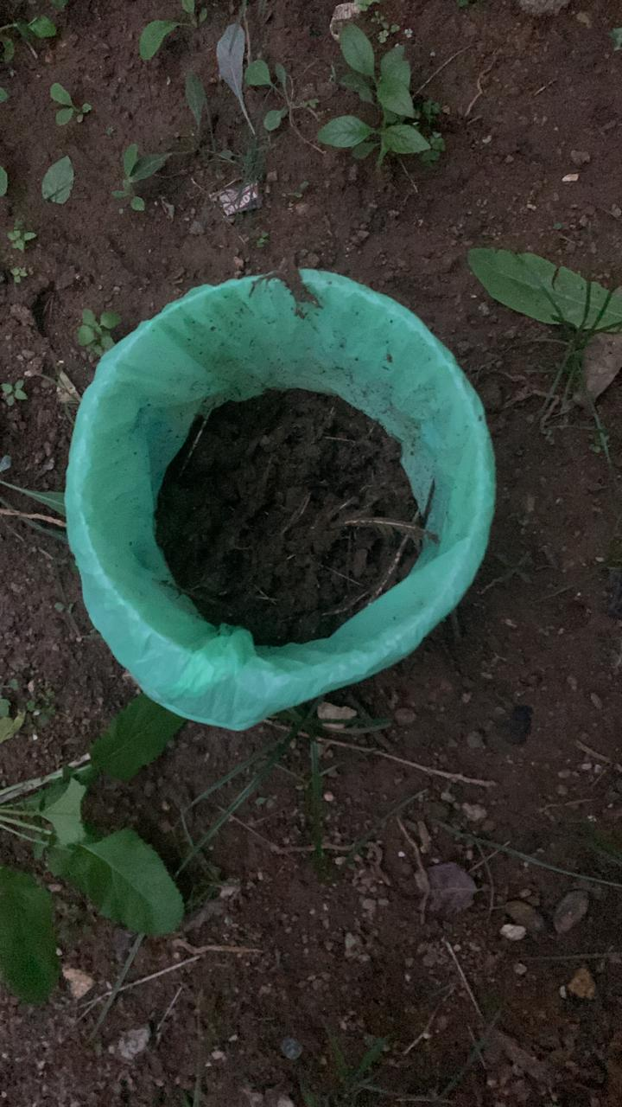
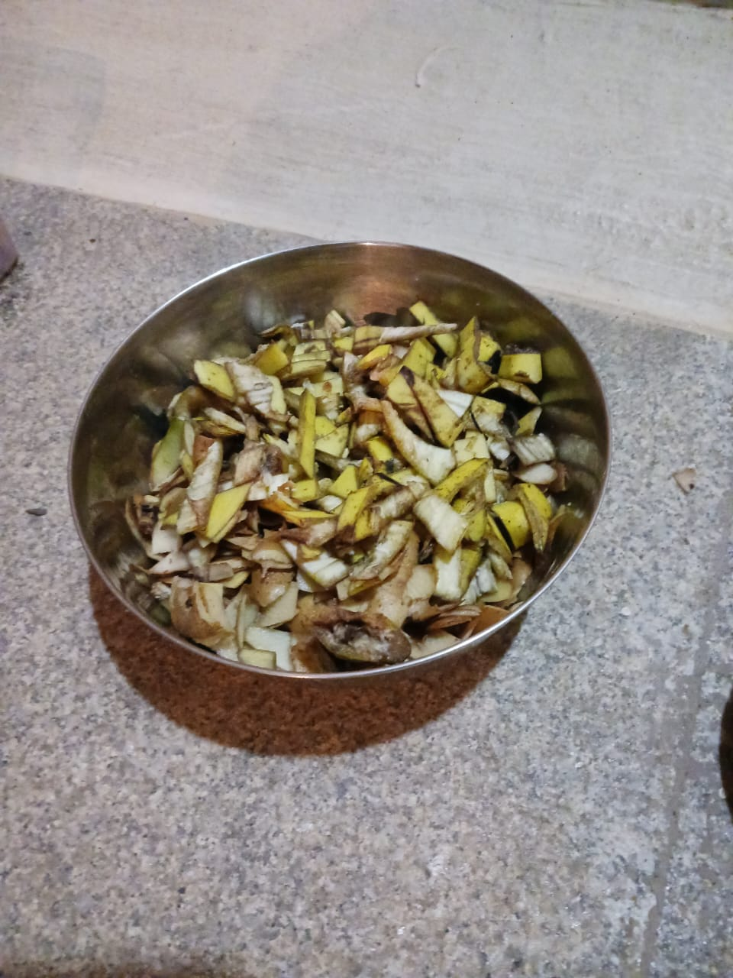
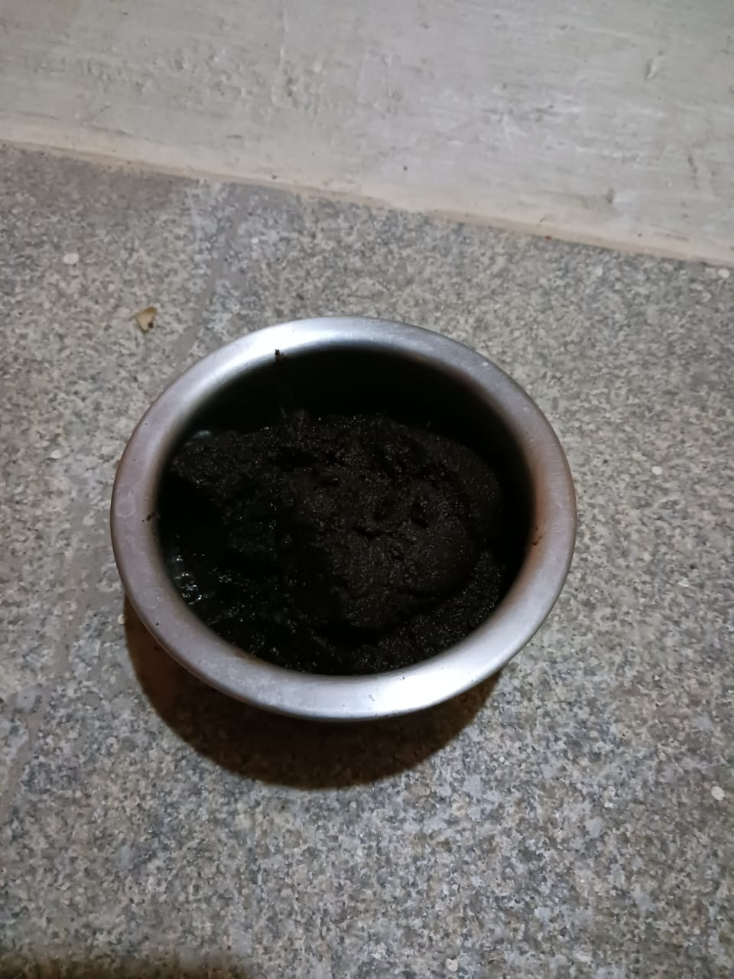
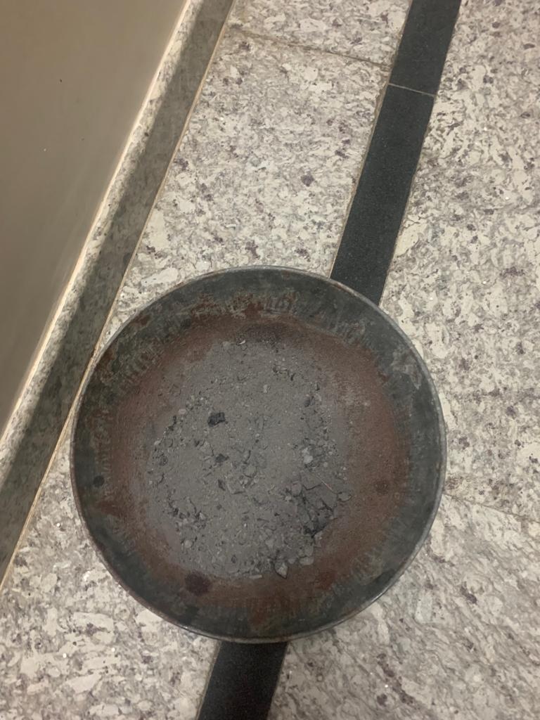
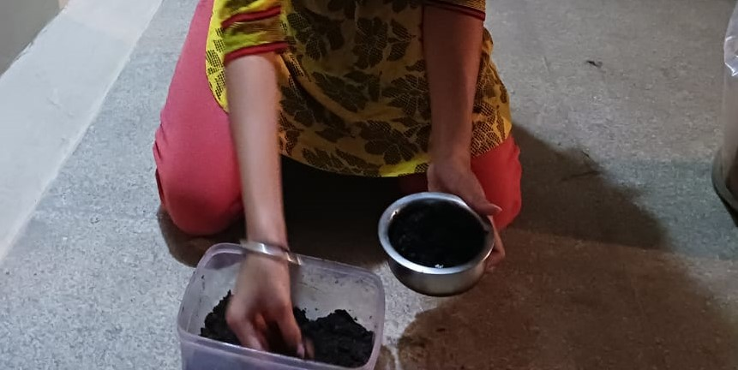
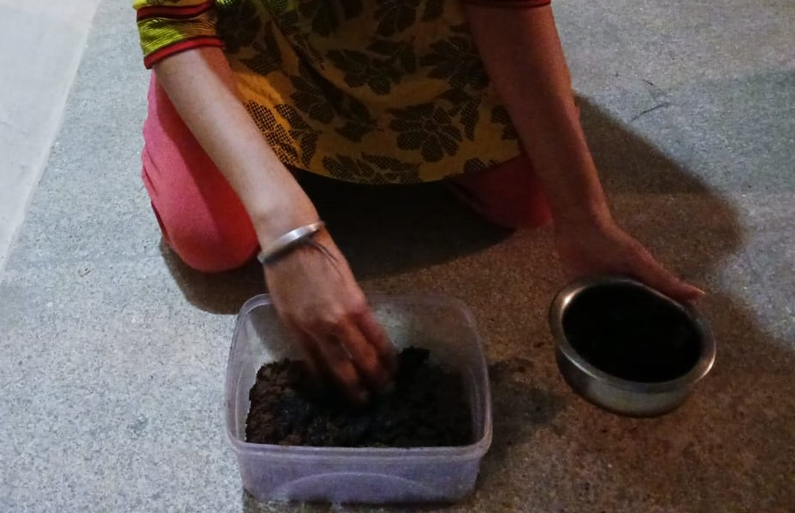
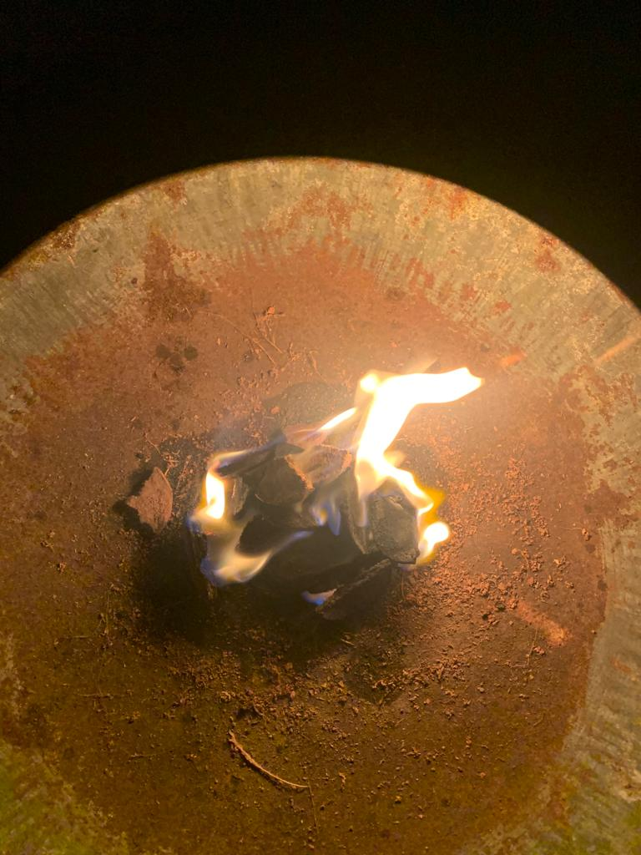
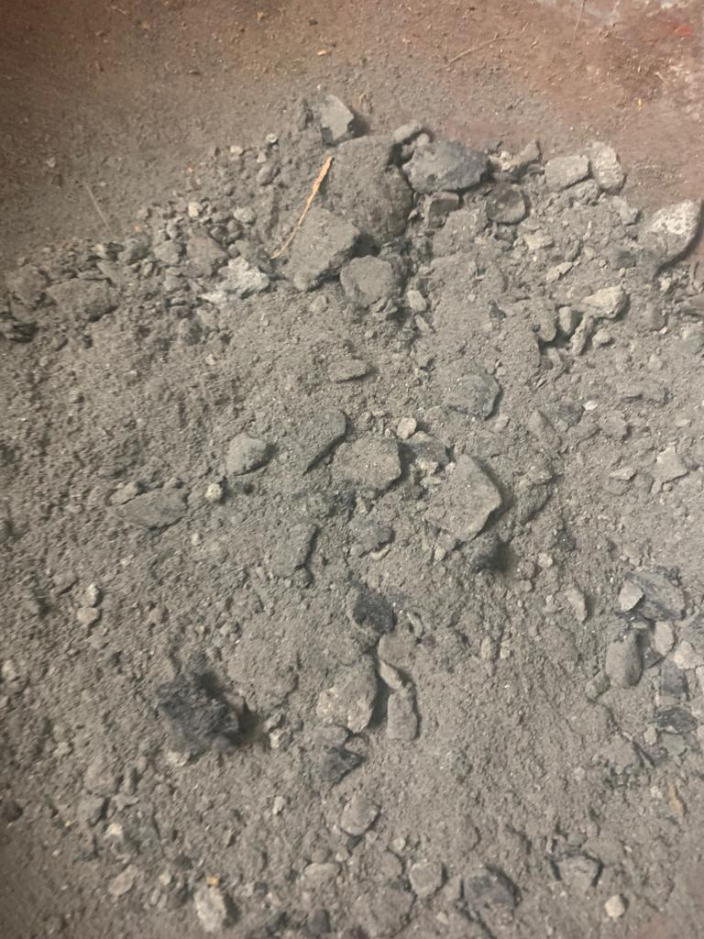
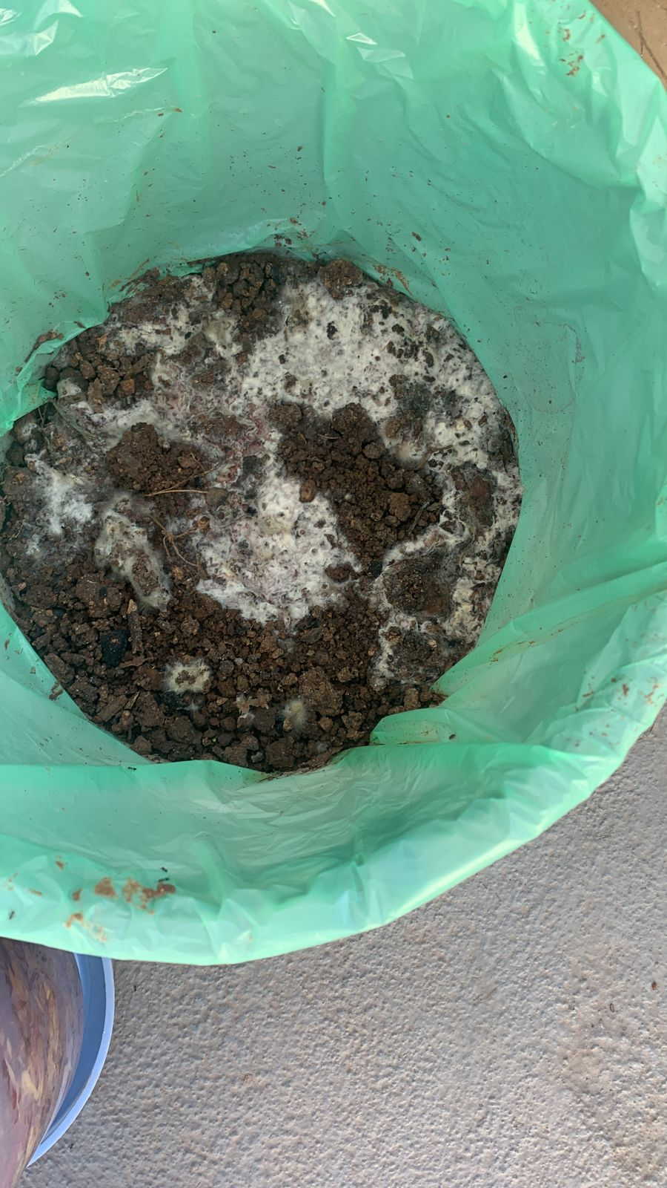
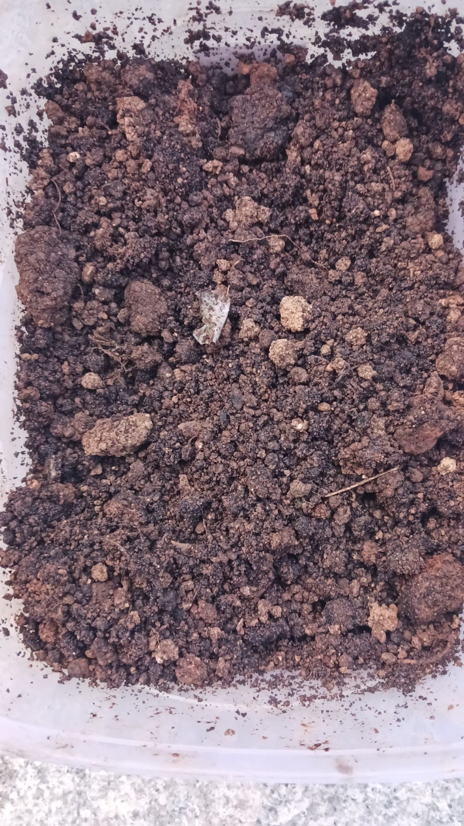
Banana and potato peels
Flower waste
Chicken manure
Coffee grounds
Cow dung ash
Oil cake of groundnut
Cow dung ash

Slide 23
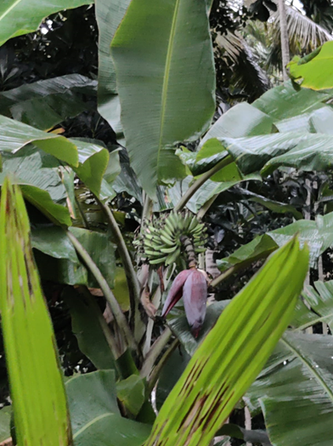
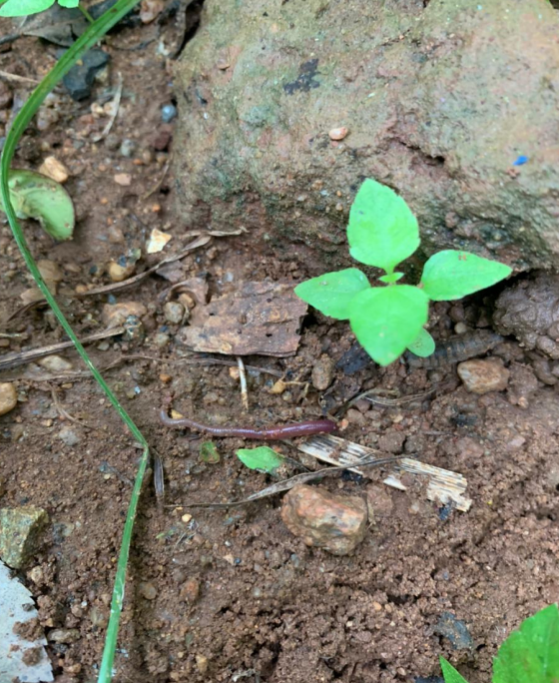
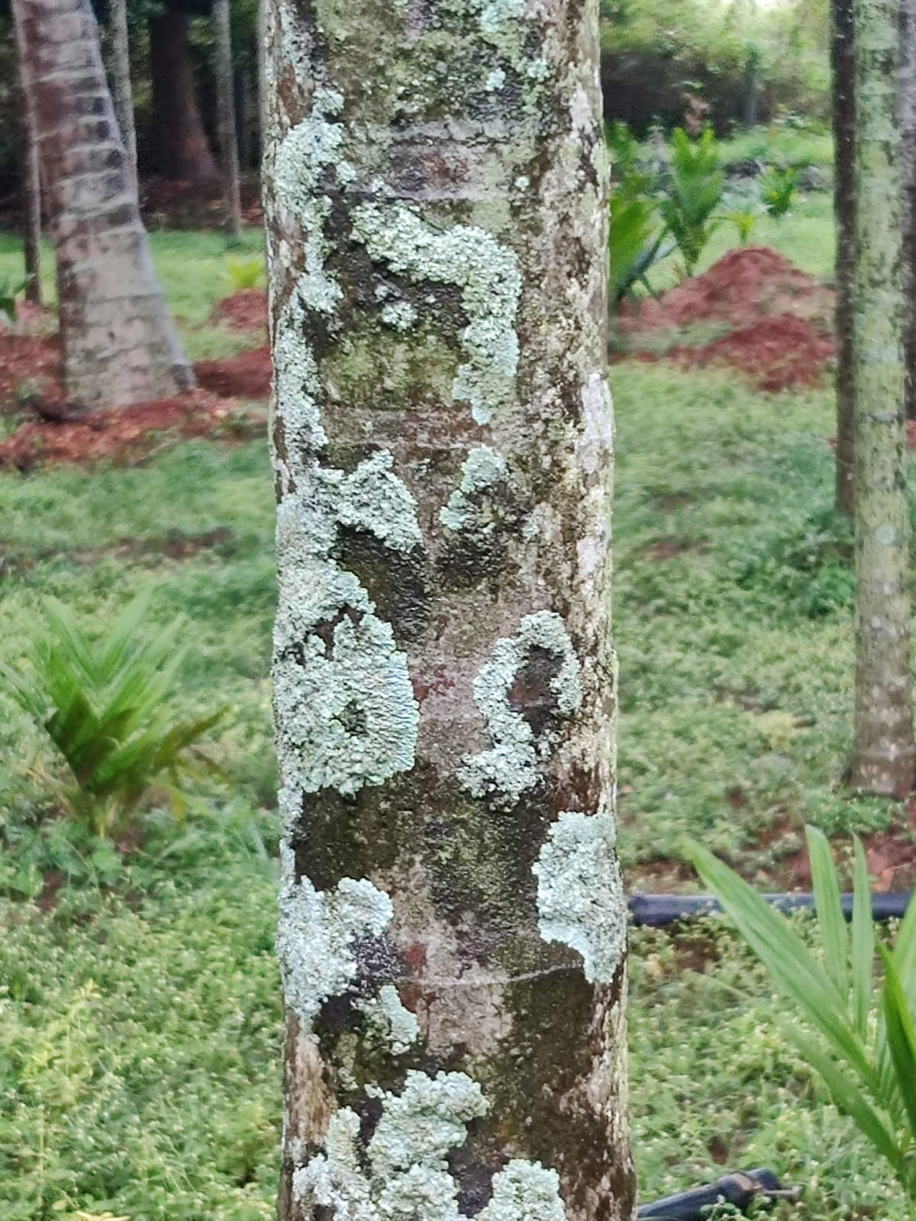
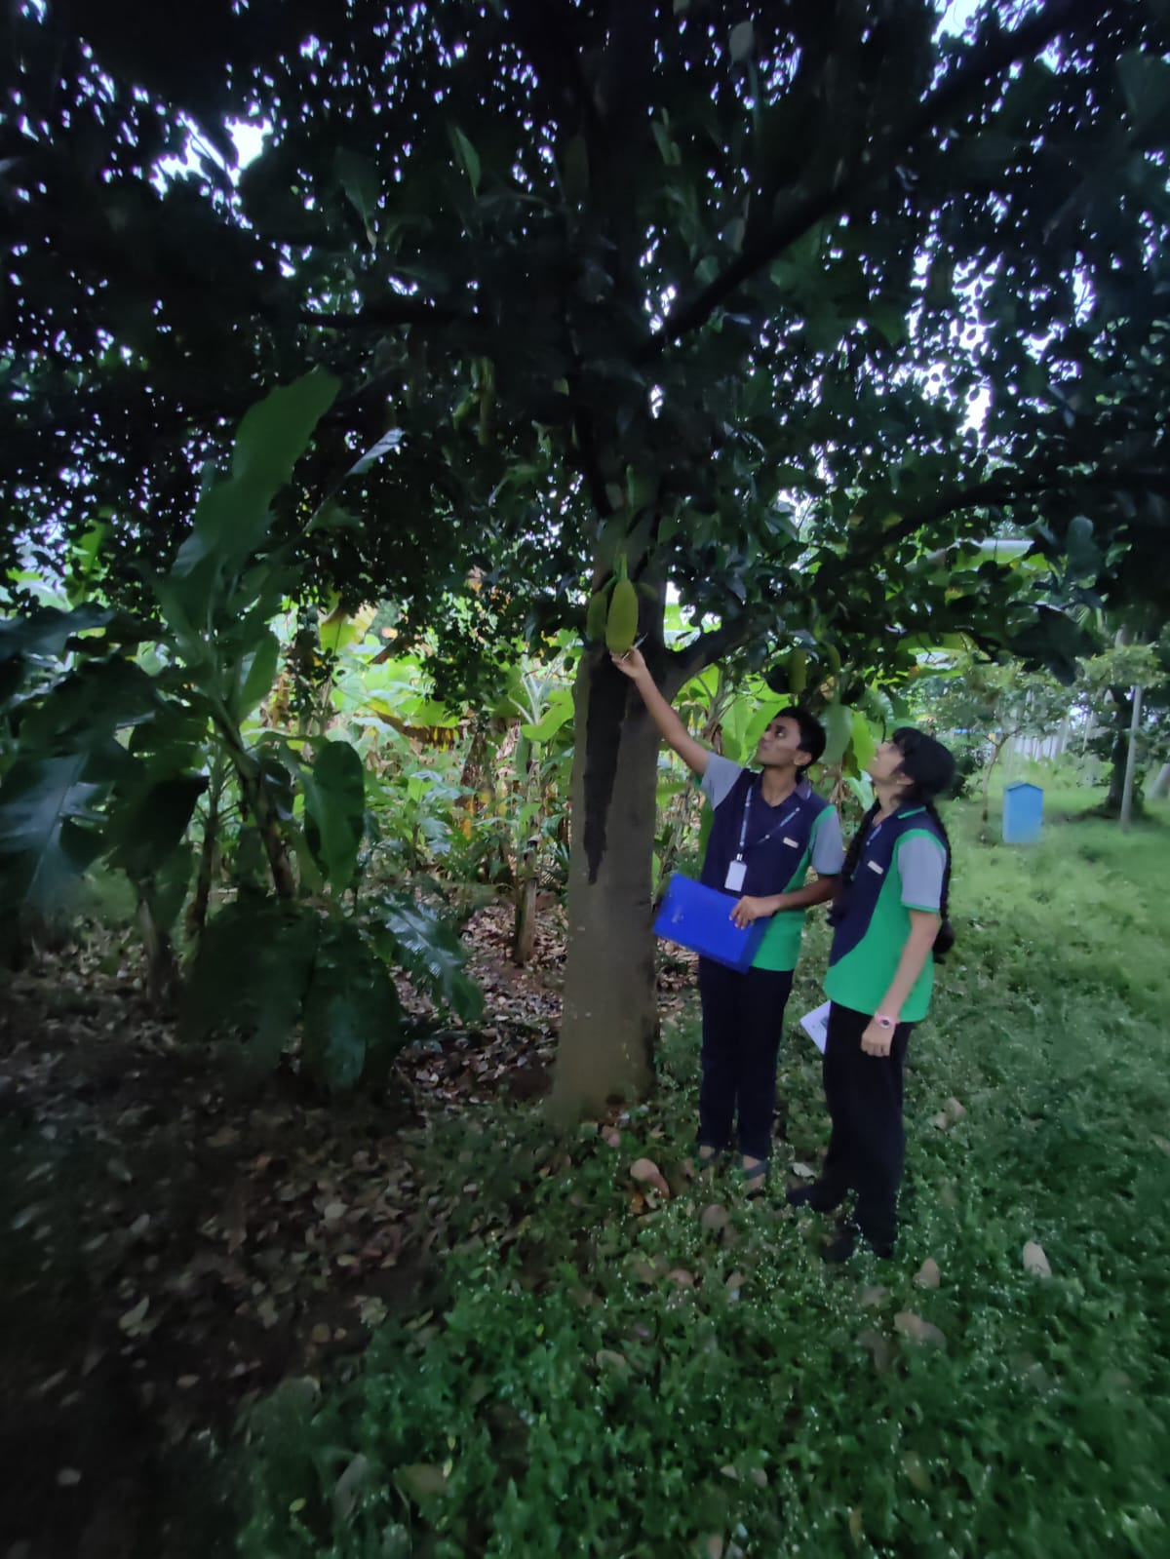
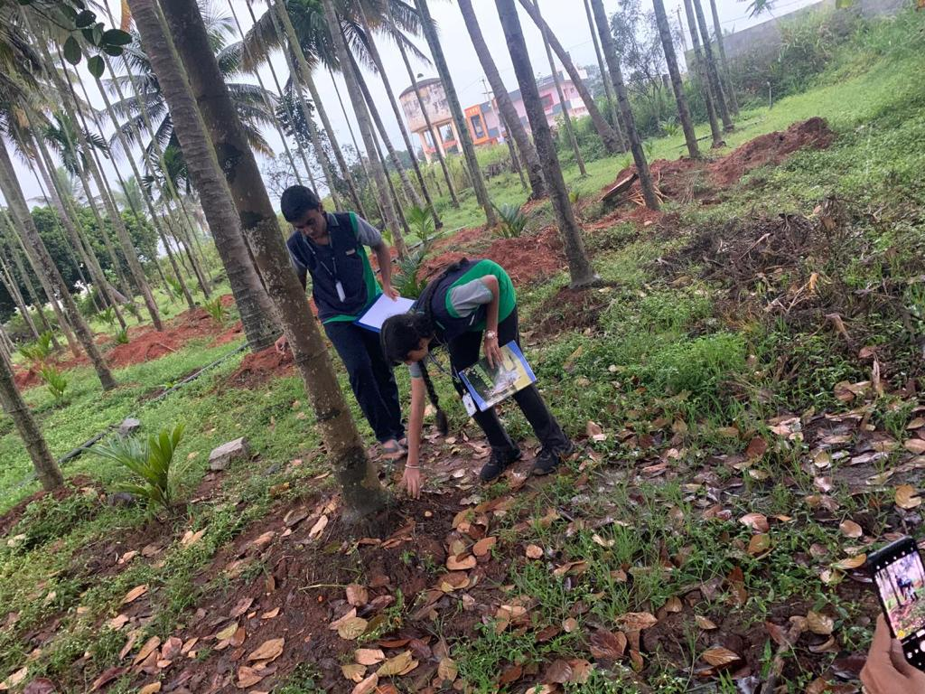
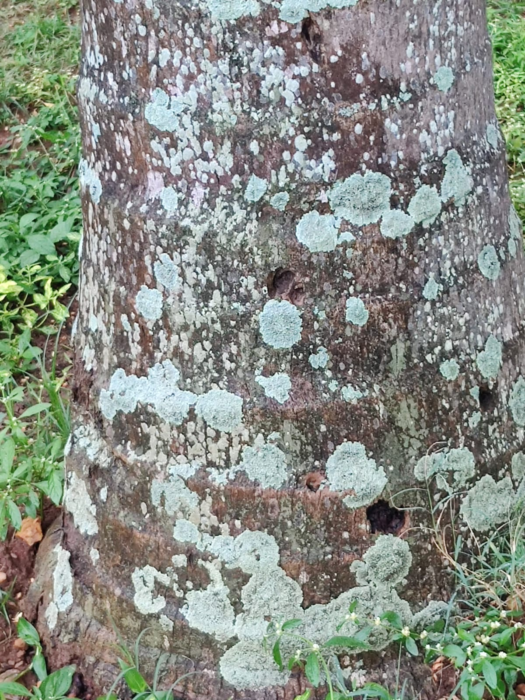
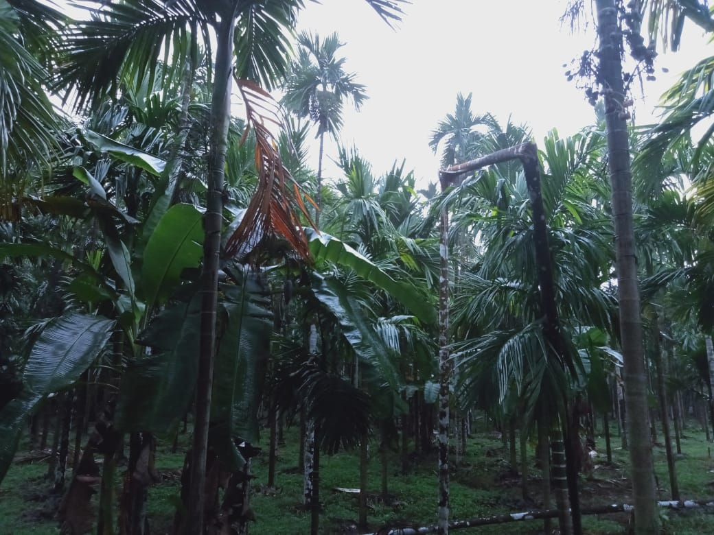
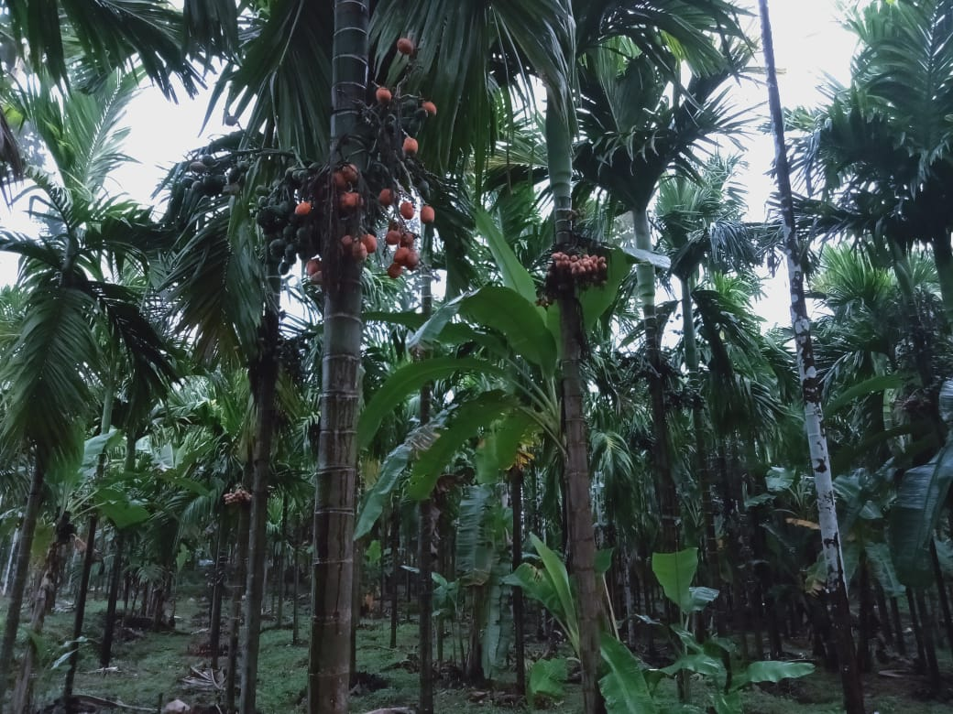
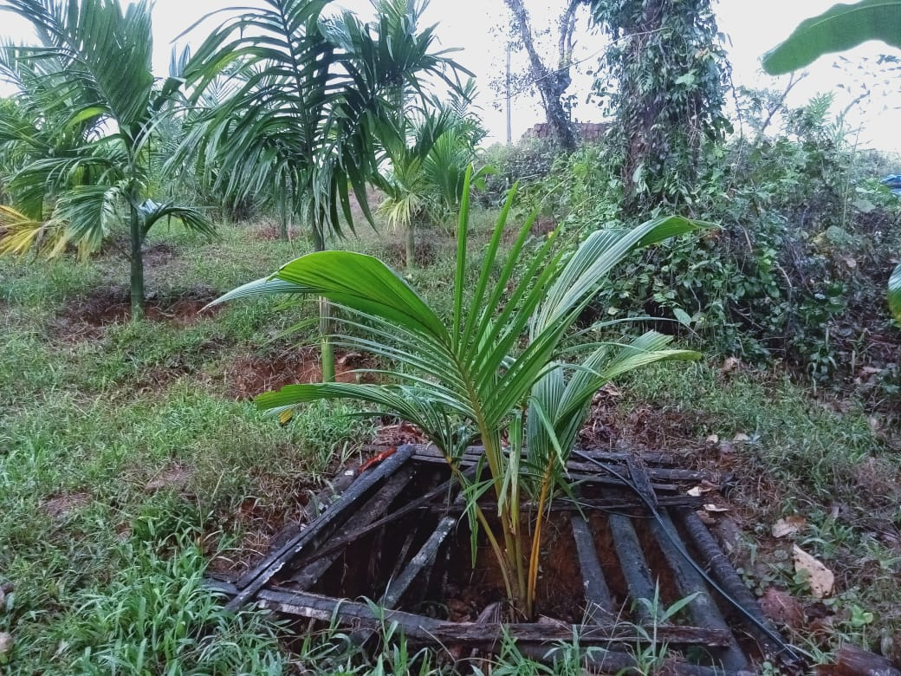
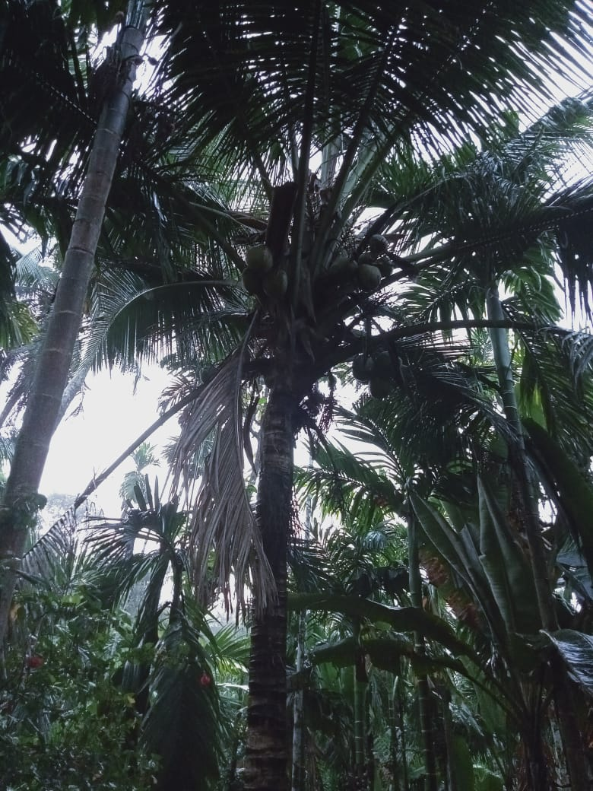
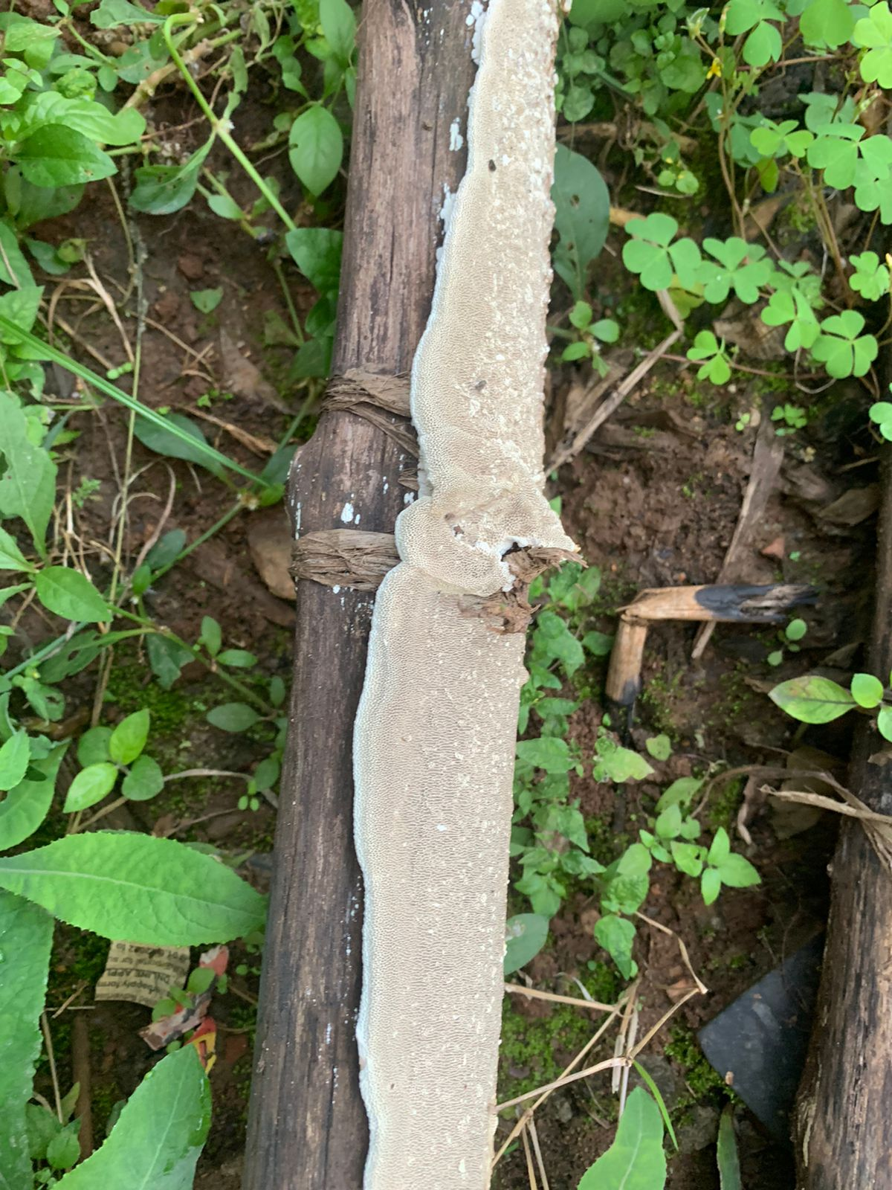
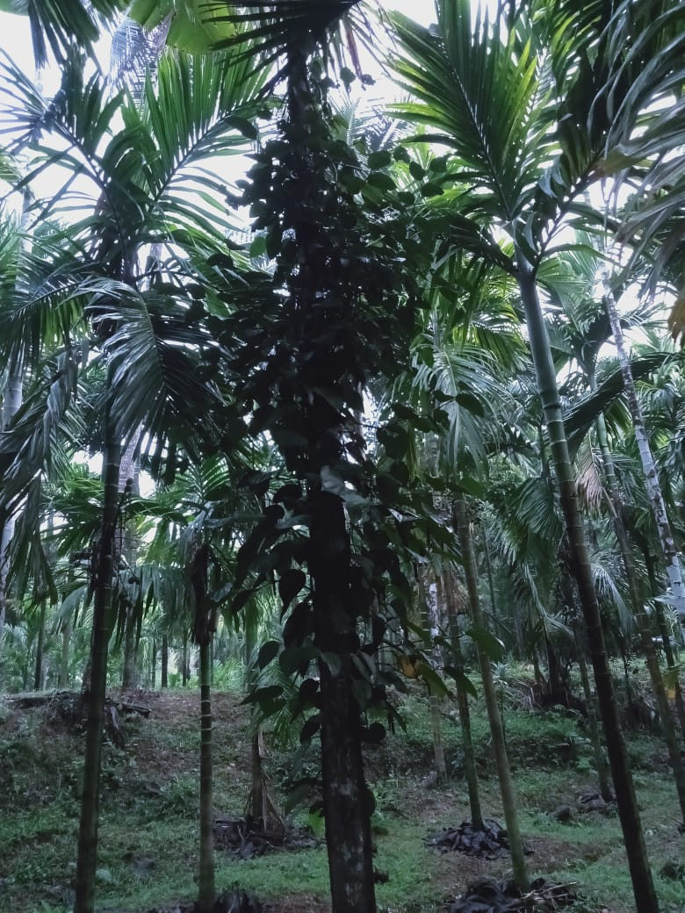
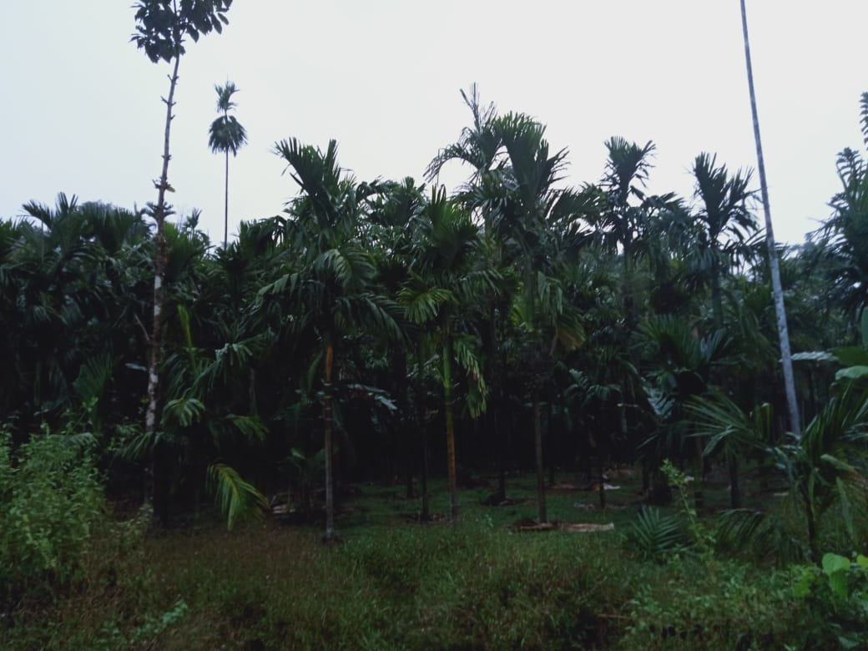
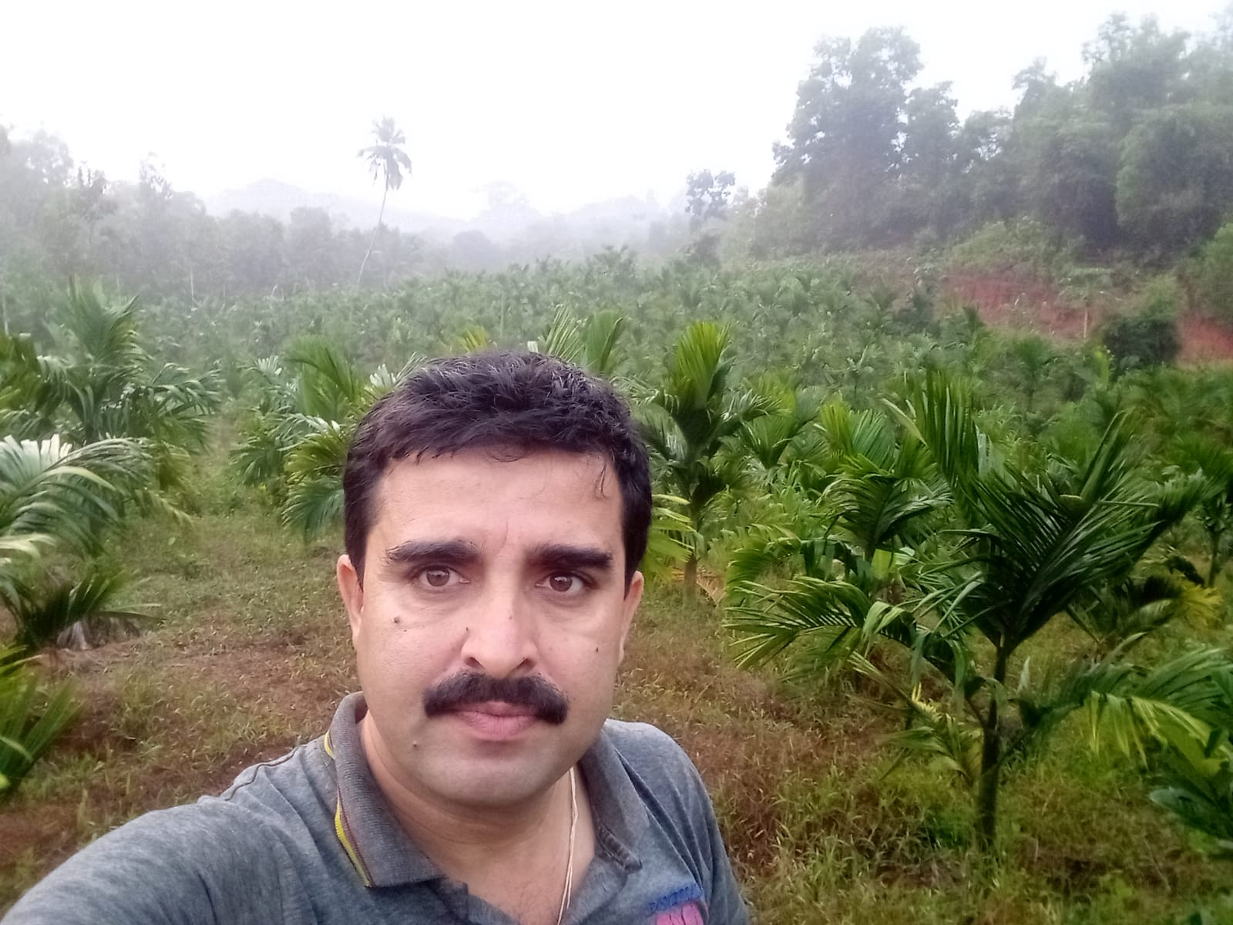
earthworm
lichen
Ladyfinger banana
PICTURE DUMP
Mixed cropping

Slide 24
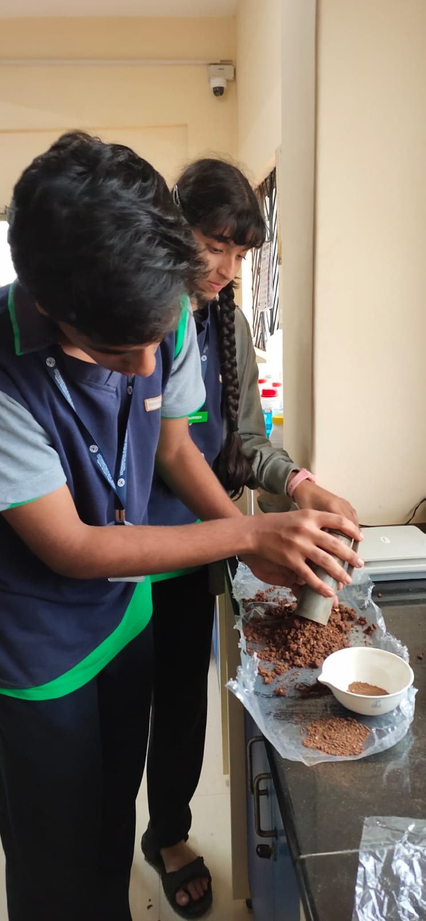
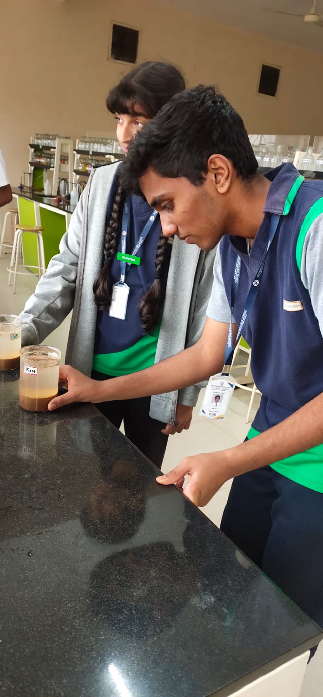
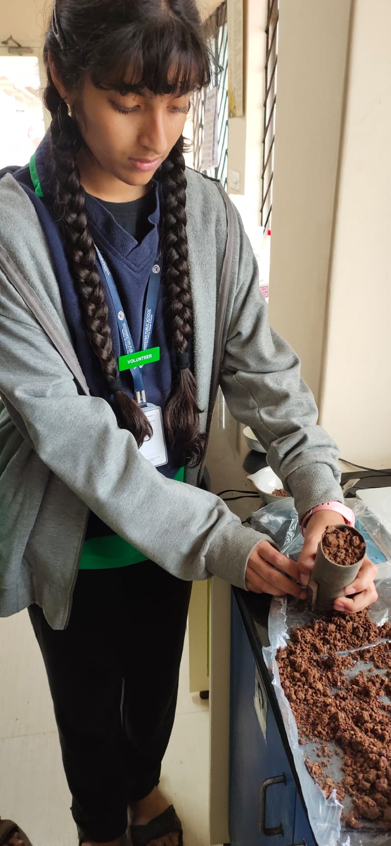
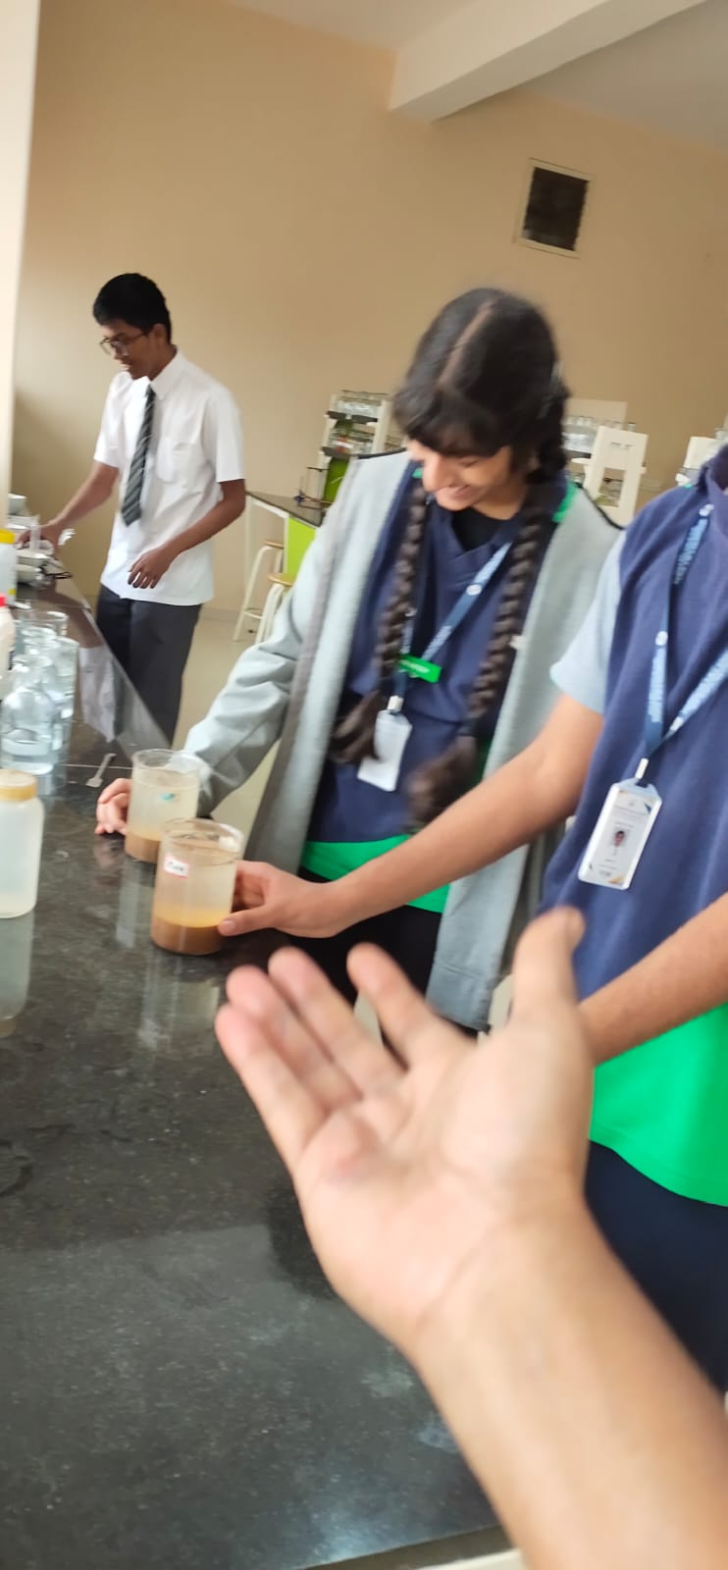

Slide 25
Acknowledgements
We would like to thank:
Vidyaniketan public school , IISC - Bangalore for giving us this opportunity to participate in the lake symposium
Janardhan K M(agriculturist)
Vijaya Narayan (agriculturist)
Roopa Ma’am
Geetha Ma’am

Slide 26
References
www.cropin.com
https://gardening.usask.ca/
https://www.zizira.com/
https://www.britannica.com/
https://www.gardenmyths.com/banana-peels-garden/
https://www.sciencedirect.com/science/article/pii/S0304389421000108#:~:text=In%20potato%20peel%20biochar%20(PPB,1.4%25%20and%2021.64%25%20respectively.
http://www.uwyo.edu/barnbackyard/_files/documents/magazine/2017/summer/plantsperk0717.pdf
https://www.sciencedirect.com/science/article/pii/S0960148121008831#:~:text=Cow%20dung%20ash%20also%20contains,of%20animal%20waste%20%5B3%5D.
https://www.webgardner.com/composting/can-dead-flowers-be-used-as-fertilizer-now-answered/
https://pubmed.ncbi.nlm.nih.gov/25362819/
Lake 2022
‹#›

Slide 27
THANK YOU

