Slide 1

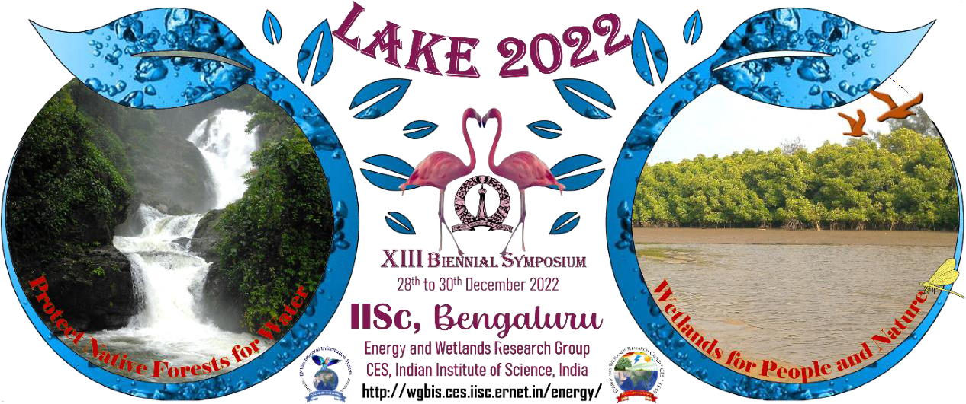
Title :Wetland study and conservation
ANANYA.R.B– 8 A, PAAVANI.R – 8A
JAYAKEERTANA.G – 8A
Vidyanikethan Public School

Slide 2
Introduction
Lakes play an integral role in aquatic ecosystems. Lakes can be described in the most practical and evident sense as a water body which is a localized water resource.
They are an important source of groundwater recharge.

Slide 3
Objectives
To check whether the lake water is suitable for living organisms to thrive in it.
To check whether any human intervention towards the lake is affecting or damaging it

Slide 4
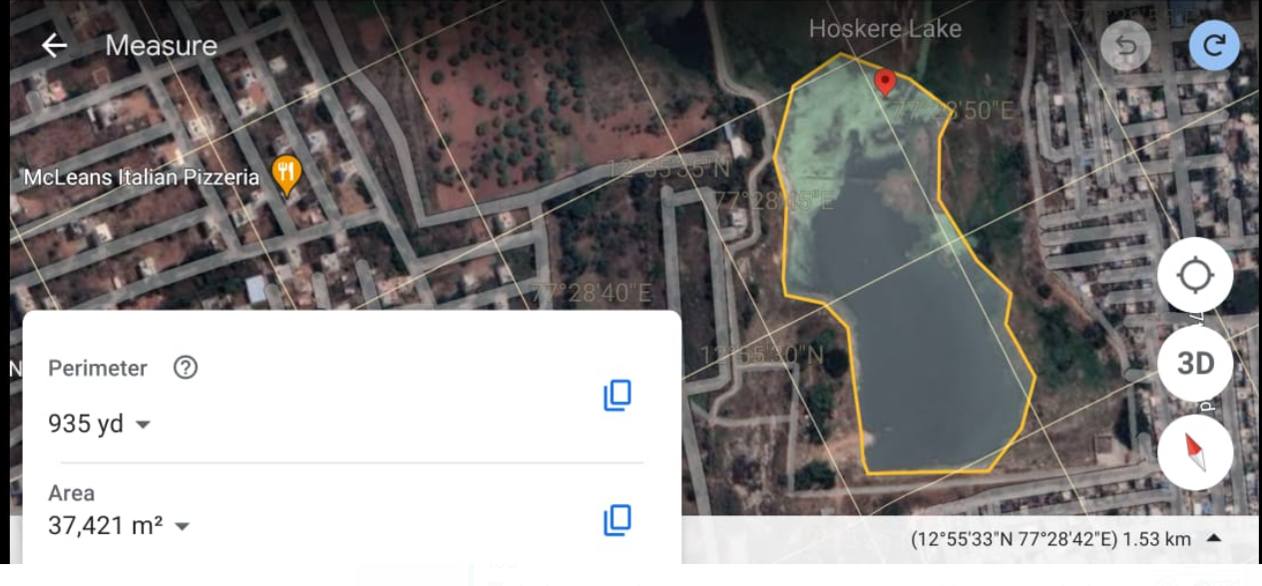
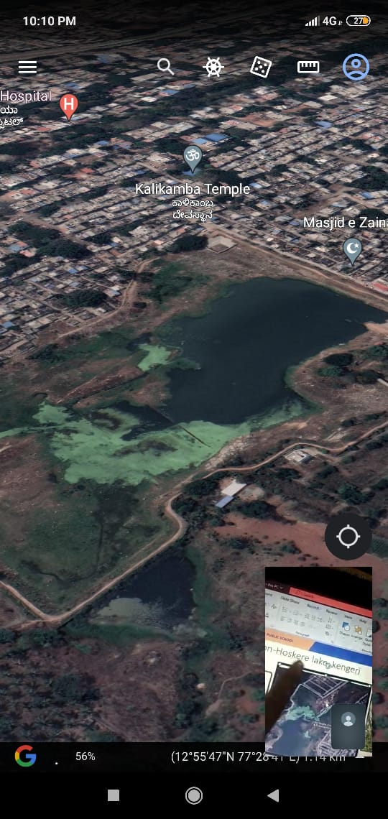
STUDY AREA
HOSKERE LAKE
Location of the collected sample
LAKE 2022: Conservation of wetlands: ecosystem-based

Slide 5
Materials and Methods
Materials:
Total hardness testing kit
Alkalinity testing kit
Dissolved oxygen testing kit
pH paper and Universal indicator

Slide 6
Materials and Methods
Methods:
Collection of water from 2 different sample sites.
Testing of pH values and physical parameters.
Testing of biological parameters using a compound microscope and identification of microbes.
Testing of chemical parameters.

Slide 7
Results and Discussion - Physical parameters
Physical Parameters | Site 1 | Site 2
Colour | Transparent | Transparent
Temperature | 24 °C | 23 °C

Slide 8
Chemical parameters
Chemical Parameters | Site 1 | Site 2
pH | 7.0 | 7.0
Hardness | 150 ppm | 250 ppm
Alkalinity | 340 ppm | ppm
Dissolved oxygen | 4 mg/l | 7 mg/l

Slide 9
BIO DIVERSITY OF THE LAKE
Flora and Fauna observed around the lake
FLORA | FOUNA
Lemna Minor | Alcedinidae (Kingfisher)
Solanum Lycopersicum | Pigeons
Typha Latifolia | Peacock

Slide 10
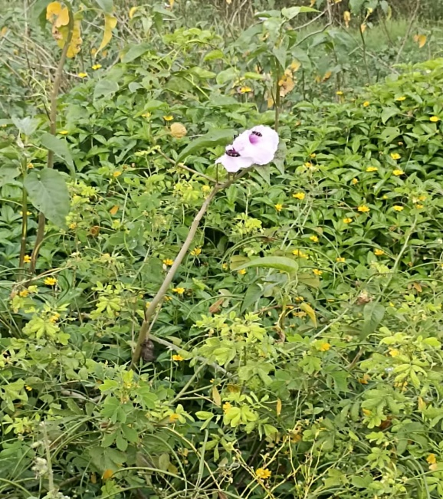
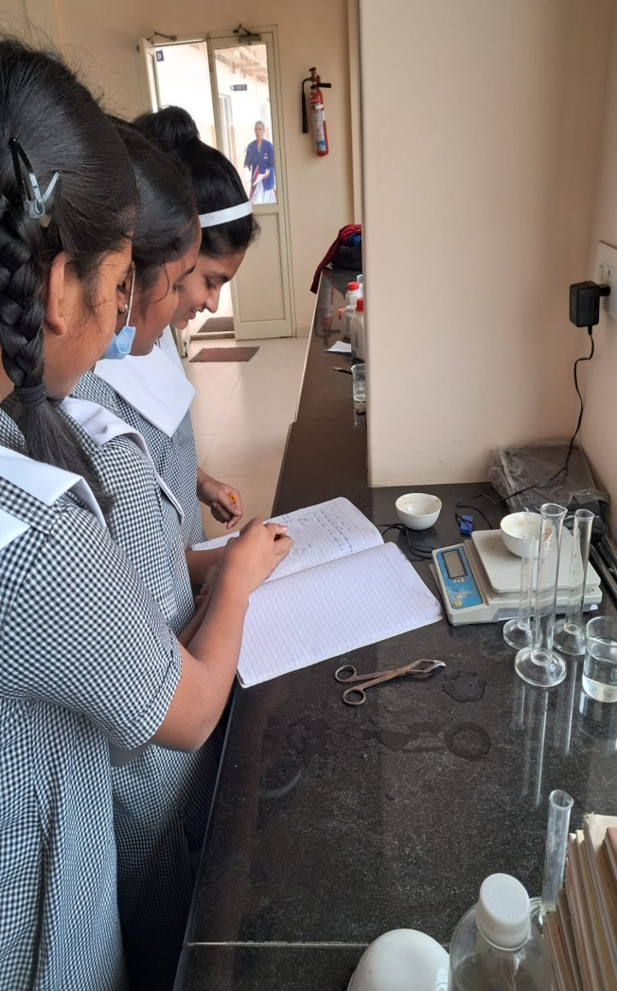
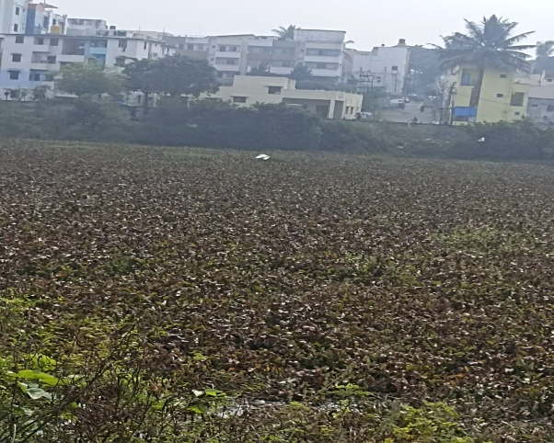
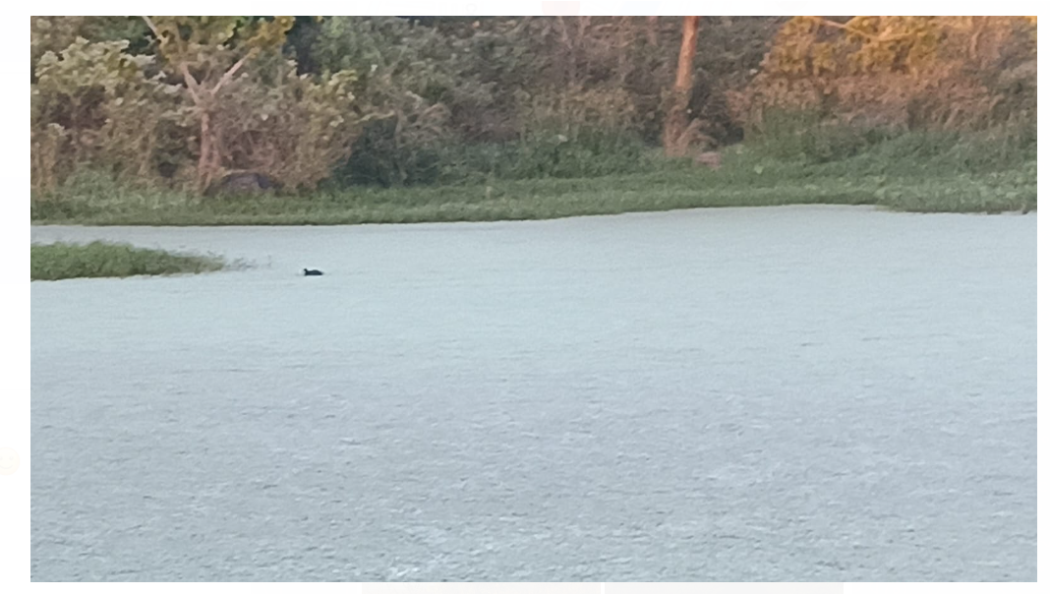
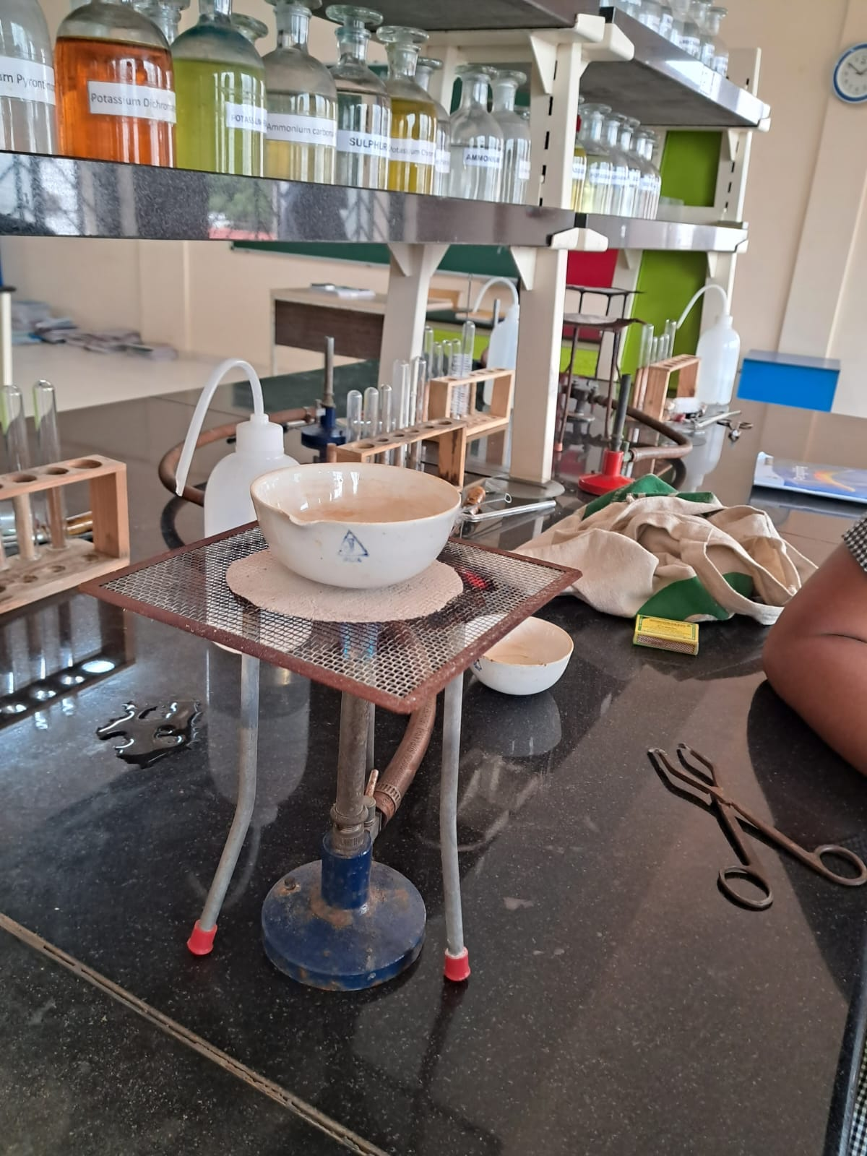
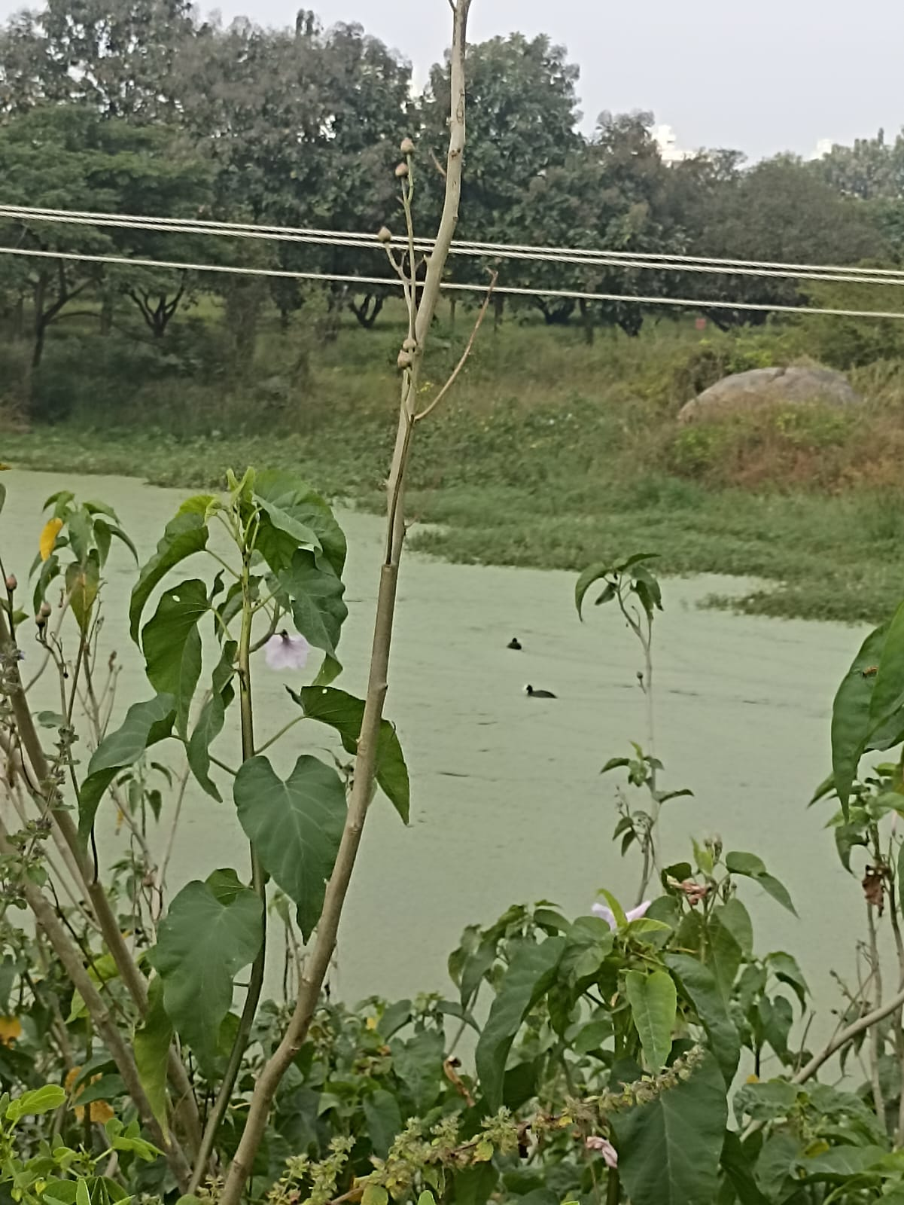
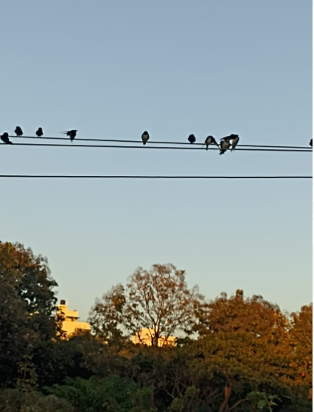
PICTURE GALLERY

Slide 11
Conclusions
Intensive growth of weeds on the surface of the lake is blocking the sunlight to enter into the lake.
Lake weeds can harm the aquatic environment directly. They can also affect the health of the environment. Lakes need a balance of plant life. This offsets the available nutrient.
Most importantly, dense lake weed growth can lead to the death of aquatic animals by depleting oxygen in the water at night.
During daylight hours, plants produce oxygen and raise the water pH, yet at the same time the plants respire, removing oxygen and adding carbon dioxide and lowering the pH.

Slide 12
Recommendations
Phyto filtration involves the plant roots or seedling for removal of metals from aqueous wastes. In Phyto stabilization, the plant roots absorb the pollutants from the soil and keep them in the rhizosphere, rendering them harmless by preventing them from leaching.

Slide 13
Acknowledgment
We are honored to be a part of the lake symposium project 2022-2023.
We would like to thank IISC team and our respected teachers of Vidyaniketan for providing us with the opportunity and for their guidance.

Slide 14
References
Scource-www.wikihow.com/
https://www.extension.iastate.edu

Slide 15
Thank You

