Slide 1
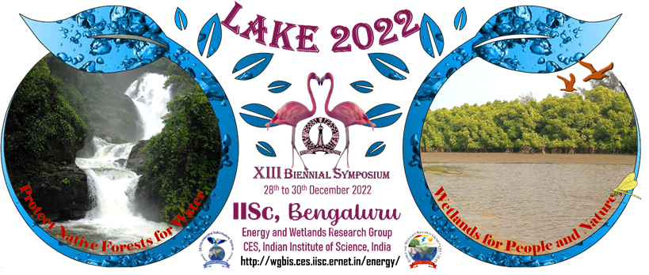
LAKE 2022:WETLANDS: RESTORATION, CONSERVATION, AND MANAGEMENT
Names:
GREESHMA BS
SANJANA S
Class : 8 B

Slide 2
Introduction:
Lakes, like every surface water source, are very important for water supply in communities, cities, agriculture and industry.
Urban lake is not stand alone entity but is the reflection of its watershed and there is a direct linkage between them.
Lake pollution has affected socially, economically, and biologically.
Lakes of Bangalore water have become unfit for drinking or for commercial purposes.

Slide 3
OBJECTIVES:
To measure different physical and chemical parameters of the lake.
To observe flora and fauna.
To suggest methods to restore the lake.

Slide 4
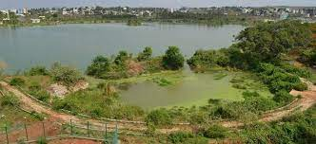
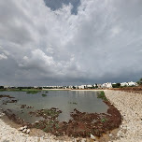
STUDY AREA : MALLATHAHALLI LAKE
Mallathahalli lake is located in Bangalore,
Near Ullal Upanagara.

Slide 5
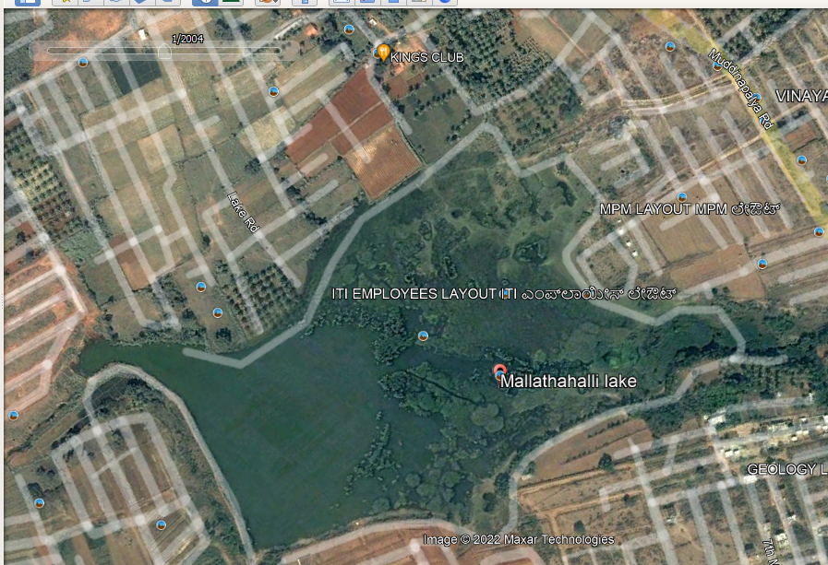
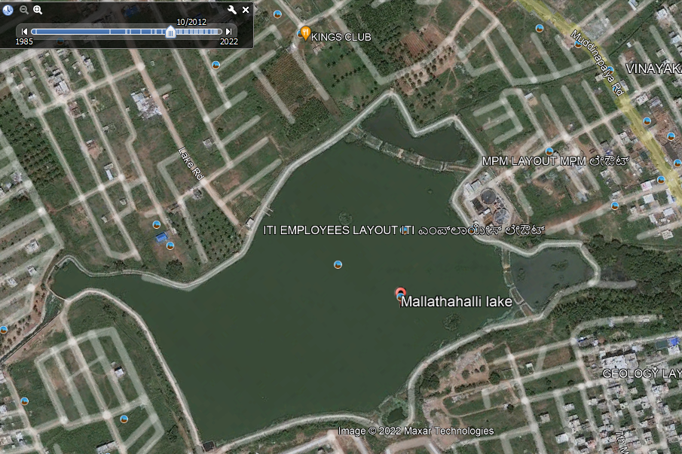
TIMELINE
LAKE IN 2004
LAKE IN 2012

Slide 6
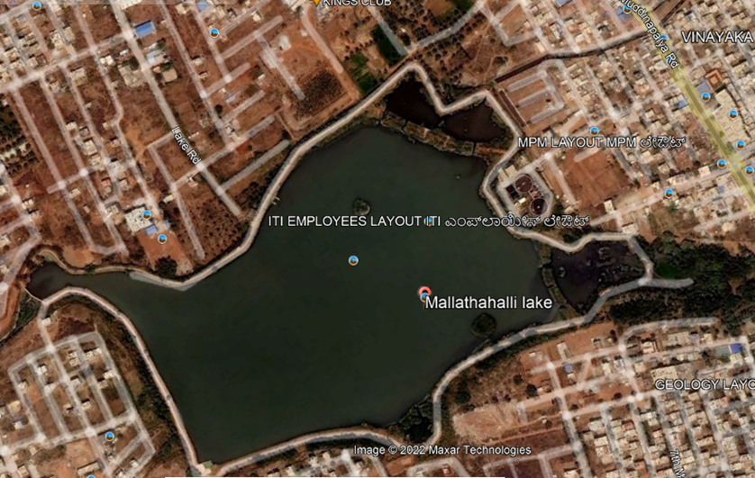
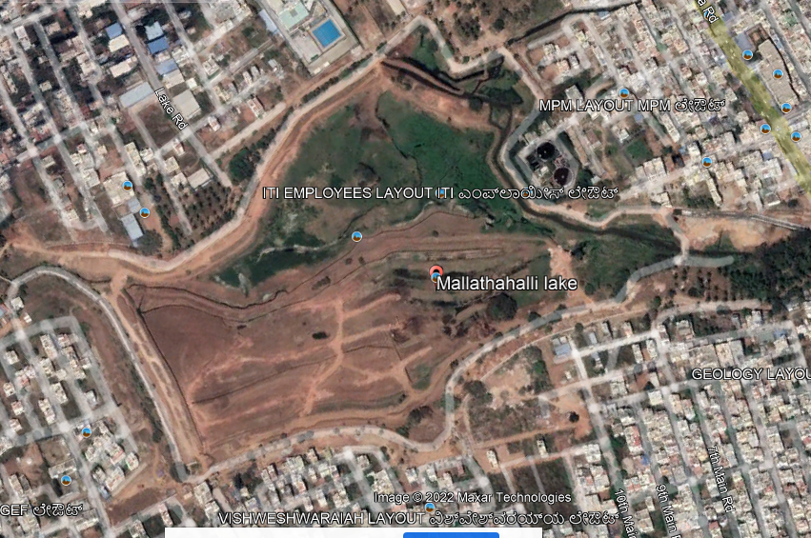
LAKE IN 2016
LAKE IN 2022

Slide 7
Methods:
Water samples are collected at two different points of the lake.
Water analysis on the samples collected from the lake was tested with the help of testing kits for the physical and chemical parameters.

Slide 8
Test for Total hardness of water
Test for Total Hardness Of Water using water testing kit
Sample No. | Sample 1 | Sample 2
No Of Drops. | 7 | 12
Final Value.(mg/L | 350 | 600

Slide 9
Test for dissolved oxygen level
Test for Dissolved Oxygen Level was done using water testing kit
Sample No. | Sample 1 | Sample 2
Syringe Reading | 6 | 4
Final Value.(mg/L) | 6 | 4

Slide 10
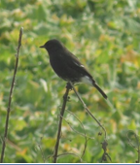
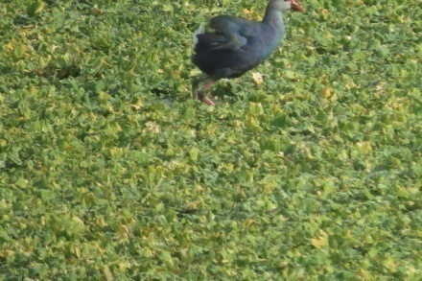
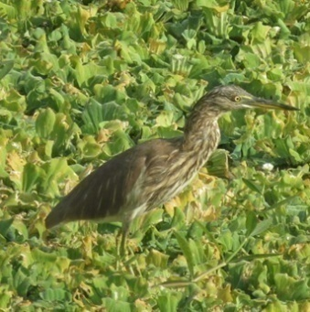
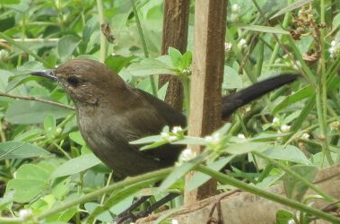
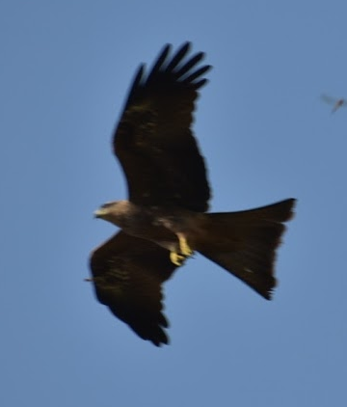
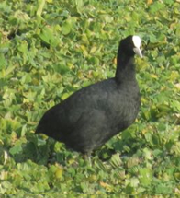
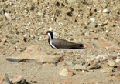
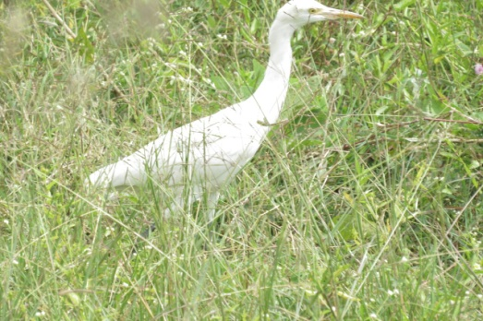
BIRDS OBSERVED IN AQUATIC STUDY AREA
Purple swamphen
Indian pond heron
Pied bushchat female
Pied bushchat
Common coot
Red wattled lapwing
Cattle egret
Black kite

Slide 11
Sl | Common name | Scientific name | Nos | Activity
1 | Cattle egret | Bubulcus ibis | 11 | Feeding on insects in between floating aquatic plants
2 | Pied bushchat | Saxicola caprata | 5 | Flying and resting
3 | Common mynah | Acridotheres tristis | 4 | Feeding on insects
4 | Jungle mynah | Acridotheres fuscus | 5 | Flying
5 | Purple Swamp hen | Porphyrio poliocephalus | 20 | Walking on floating aquatic plants
6 | Black kite | Milvus migrans | 5 | Flying and catching dragonflies
7 | White throated kingfisher | Halcyon smyrnensis | 2 | Flying and calling
8 | Pale billed flower pecker | Dicaeum erythrohynchos | 2 | Calling from bushes
9 | Common coot | Fulica atra | 3 | Resting
10 | Indian pond heron | Ardeola Grayii | 4 | Resting
11 | Ashy Prinia | Prinia socialis | 2 | Calling

Slide 12
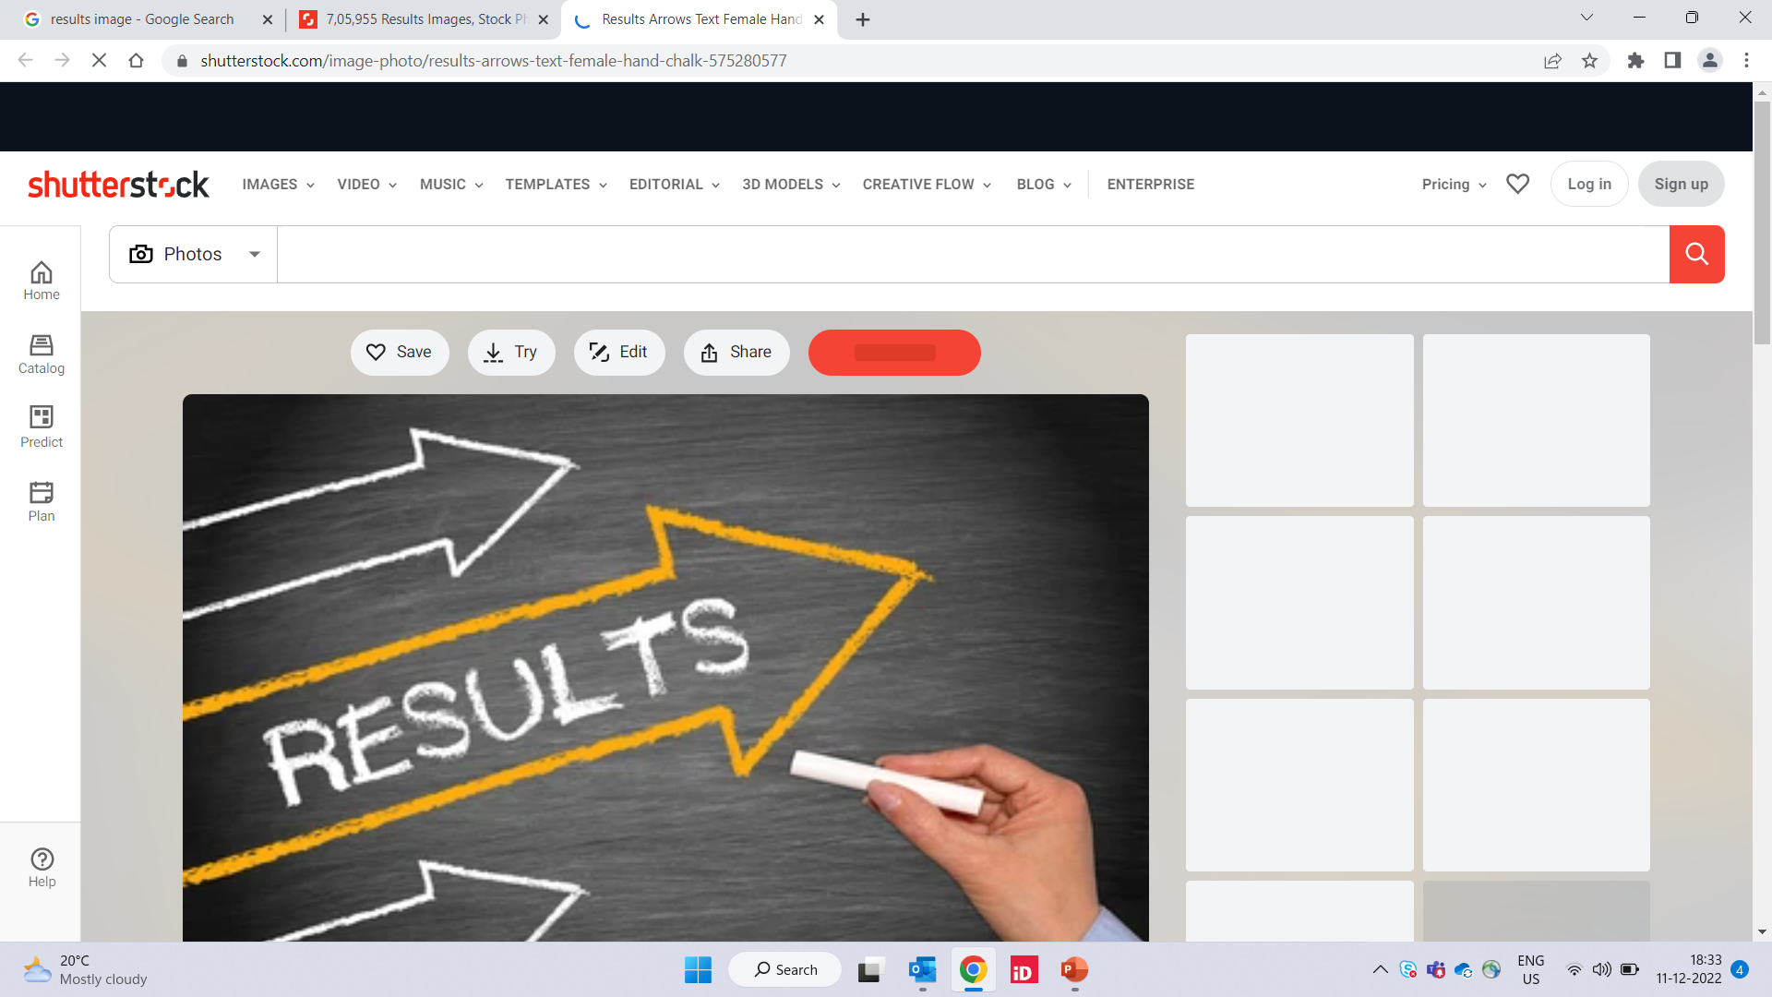
Physical Parameters | Sample 1 | Sample 2
Colour | Pale yellow | Transparent
Temperature | 24 °C | 24 °C
Odour | Pungent | Pungent
Chemical parameters | Sample 1 | Sample 2
pH | 10 | 10
Total alkalinity | 350ppm | 340ppm
Total hardness | 350ppm | 600ppm
Dissolved oxygen | 6mg/L | 4mg/L

Slide 13
Conclusion:
There is overgrown algae which reduces the amount of dissolved oxygen present in the water and puts the aquatic life in danger.
No proper management and monitoring methods are followed.

Slide 14
Methods of restoration of lake:
Step 1 - Treatment of invasive species
Begin the steps to remove invasive species. This is often done with herbicide treatment, controlled burning, or even mowing and trimming.
Step 2 - Placement of clean sand and sediment
Rebuilding the wetland using clean materials. Rebuilding efforts can include the installation of clean sand and organic black dirt.
Step 3 - Seeding and planting
After the new material has been placed and graded, it is imperative to seed the area and plant native vegetation and trees quickly. This will ensure a quicker recovery, and it will help prevent Soil erosion.
Step 4 – Management and monitoring
Once the restoration is complete, there is typically a period of time when the contractor, engineer, or owner is required to monitor the wetland.
Periodic maintenance is needed to replace plants that don’t grow or invasive species that move in while the native plants are taking root.

Slide 15
Recommendations
Reduce the growth of algae which can be by the following ways:
Plant aquatic plants such as lily pads/water cress to absorb
algae forming nutrients.
Add barley straw to the water
Introduce algae eating creatures to the lake, like tadpoles
Writing a letter to the responsible officials about the project proposed by government

Slide 16
Development plan proposed by the government:
Fund allotted- INR 81 crores
Rejuvenation of lake by carrying out De-silting and redirect the sewage channels to avoid water contact.
To create a floating island in the midst of the lake
To create a theme park with facilities like children’s play area, senior citizen’s area, jogging track, glasshouse, hanging bridge, toy train, garden with rich flora etc

Slide 17
Acknowledgements:
We are thankful to our school and in-charge teachers for helping us throughout the whole project by explaining and clarifying doubts that we had during the project.
The members of the IISC institution for giving us a golden opportunity to present our project.
References:
Books- Forest and wetlands by Eileen Lucas
Disappearing wetlands by Eileen Lucas
http://www.wikihow.com/Get-Rid-of-algae-in-ponds

Slide 18
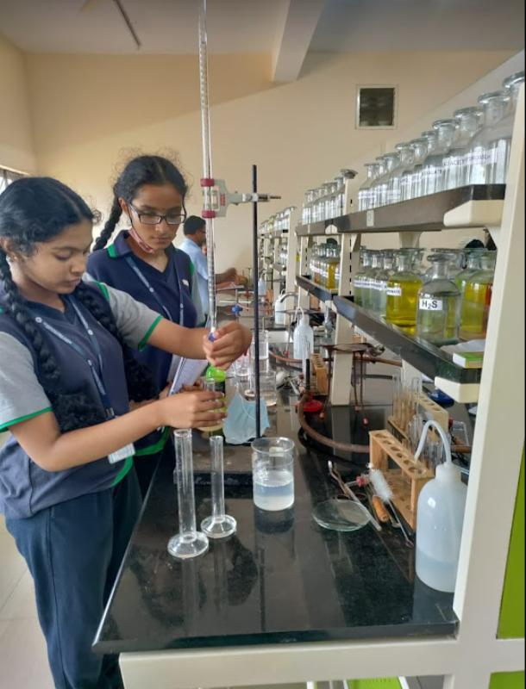
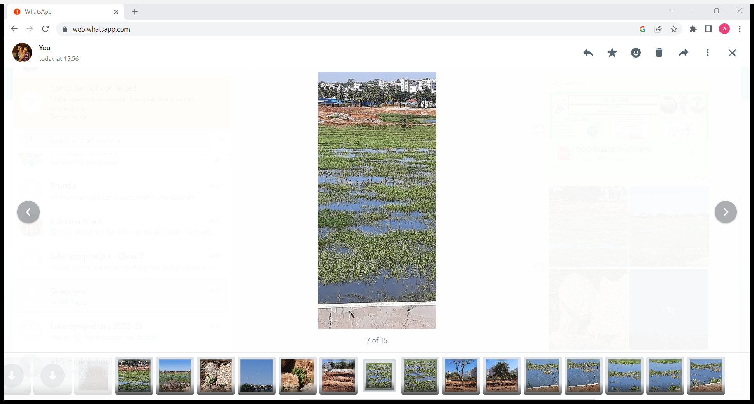
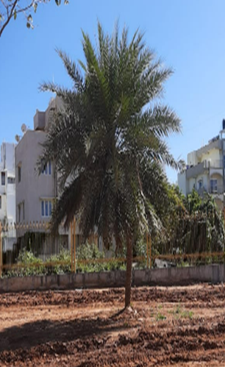
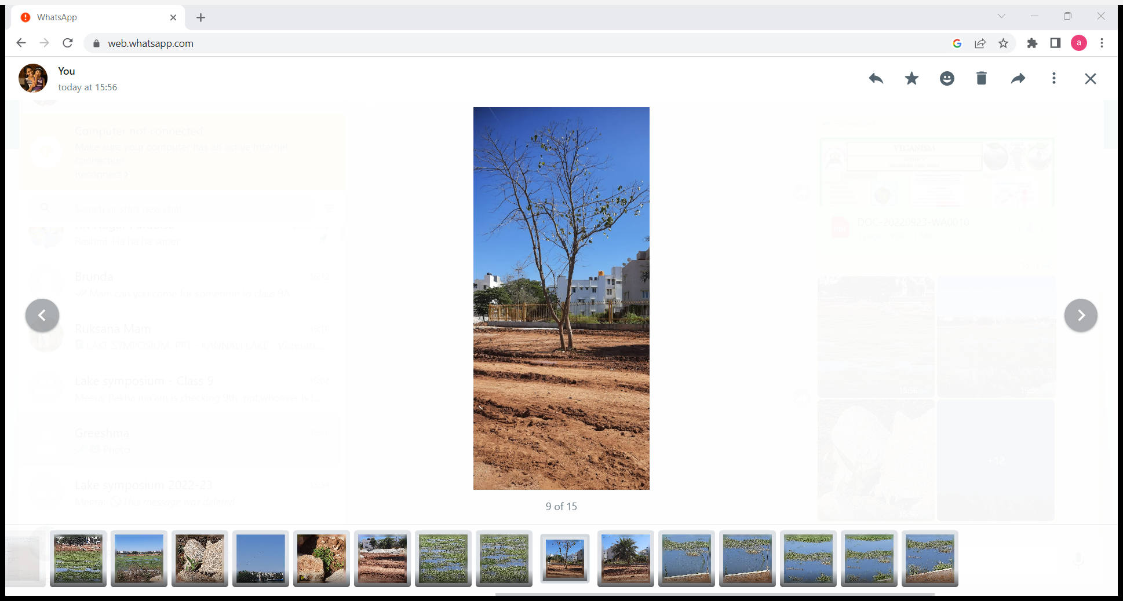
Picture Gallery

