Slide 1

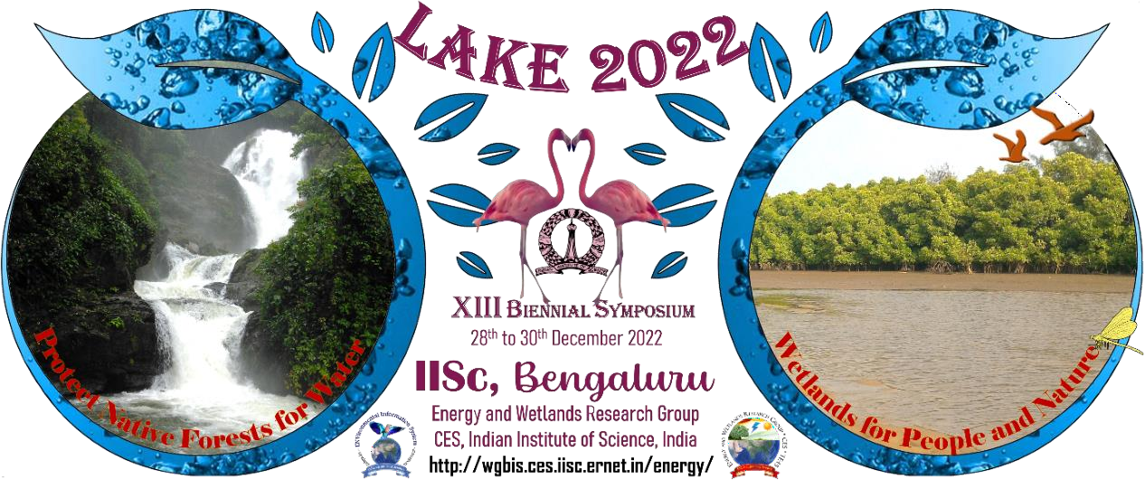
STUDY OF THE VRISHABHAVATHI RIVER
Ananya Deepak (11th Science) and Yajath Chetan Kumar (12th Comm.)
Central Board of Secondary Education
LAKE 2022:
1

Slide 2
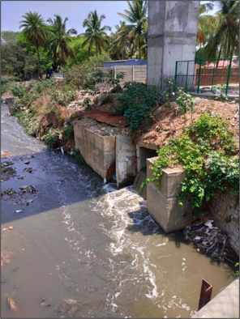
Introduction
The Vrishabhavathi river was once a place where people swam, washed their clothes, and used the water irrigate crops. But now it's known as the "Kengeri mori". The sight of black foam and horrible stink is prevalent throughout the river. The river has high levels of non-biodegradable chemicals and heavy metals.
LAKE 2022:
2

Slide 3



Objectives
To find pollutants in the river water
To discuss solutions to help clean the river
To discuss Bangalore university’s wetlands project and biopark
LAKE 2022:

Slide 4
Methods
Study Area: Vrishabhavathi River, Gnana Bharathi Main Road.
Tests of, Alkalinity, Chlorine , Fluorine, Hardness, Calcium Hardness, Residual Chlorine, Dissolved Oxygen and Heavy Metals in the river.
We interviewed Dr. T. J. Renuka Prasad, former geology professor of Bangalore University.
LAKE 2022:

Slide 5
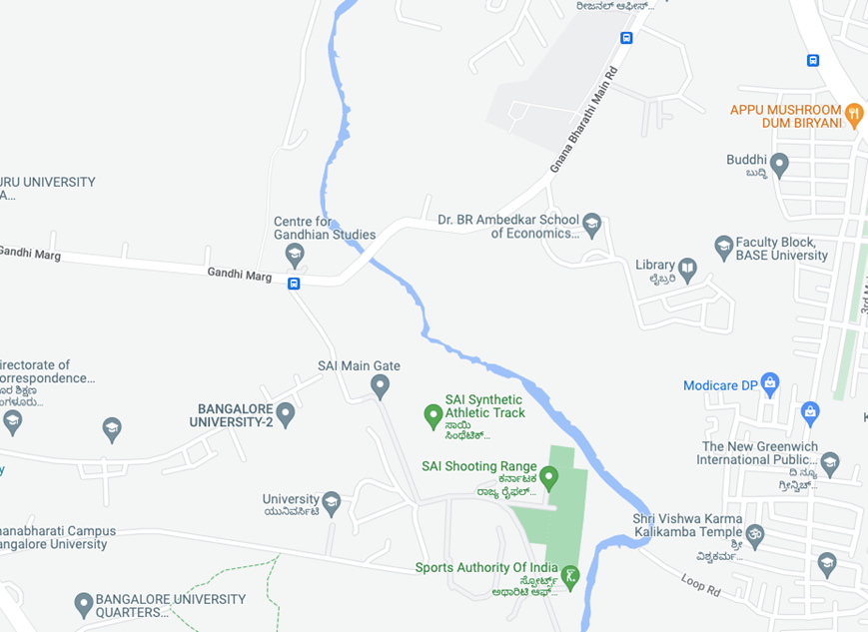
Study Area
We collected water samples from the Vrishabhavathi river (12.949346, 77.511825) at Gnana Bharathi Main Road in Bangalore University.
LAKE 2022:

Slide 6
Results and Discussion
Parameters | Findings
Temperature | 21°C (8:15 am, 15/12/22)
Alkalinity | 525 ppm
pH | Between 9 to 10
Hardness | 305 ppm
Calcium Hardness | 185 ppm
Dissolved Oxygen | 5 ppm
Chlorine | 210 ppm
Fluorine | less than 1 ppm
Residual Chlorine | below detectable limits
LAKE 2022:

Slide 7
Heavy Metals
Zinc | 0.048 mg/l
Cadmium | Below Detectable Limits
Chromium | 0.035 mg/l
Copper | 0.01mg/l
Lead | 0.02mg/l
Iron | 0.015mg/l
LAKE 2022:

Slide 8
Solution
Phytoremediation
The use of plants and associated soil microbes to reduce the concentrations or toxic effects of contaminants in the environment.
Recent studies have shown that some bamboo species have high ability to adapt to metalliferous environments and a high capacity to absorb heavy metals.
Bamboo tissues in the rhizome and culm can accumulate a large amount of heavy metals that mainly collect in the cell wall, vacuole, and cytoplasm.
LAKE 2022:

Slide 9
Bangalore University: Wetlands and Biopark project
Bangalore University, being part of a forest, is one of the most beautiful and environmentally conscious campuses of Bengaluru to a point where the temperature decreases by 2 degrees when you enter.
There, we visited the wetlands project and biopark to see how clean Vrishabhavathi River can be.
Dr. Renuka Prasad Sir, whom we interviewed, showed us the bamboo plantation he has made and how it could be used to clean the water.
LAKE 2022:

Slide 10
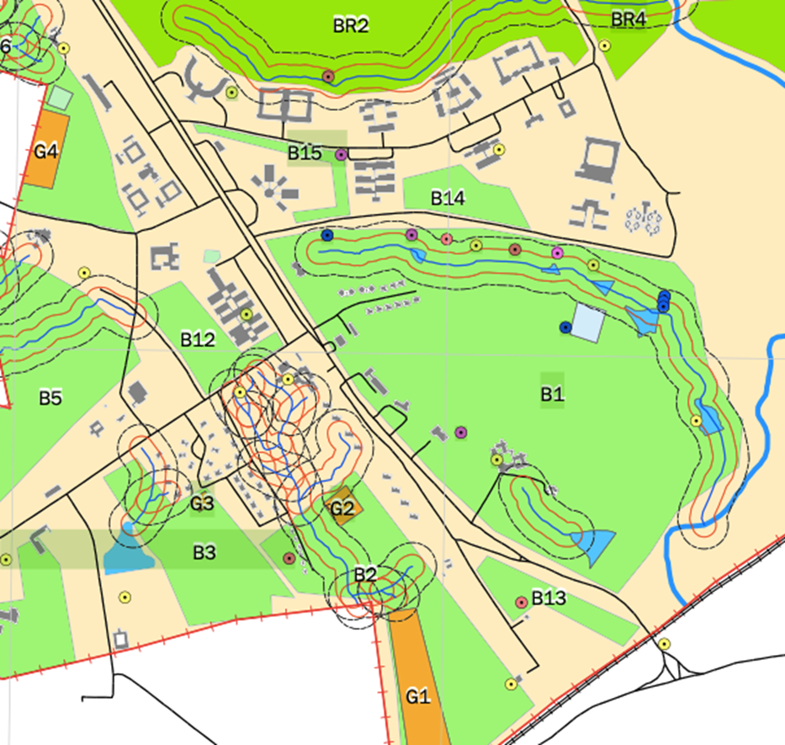
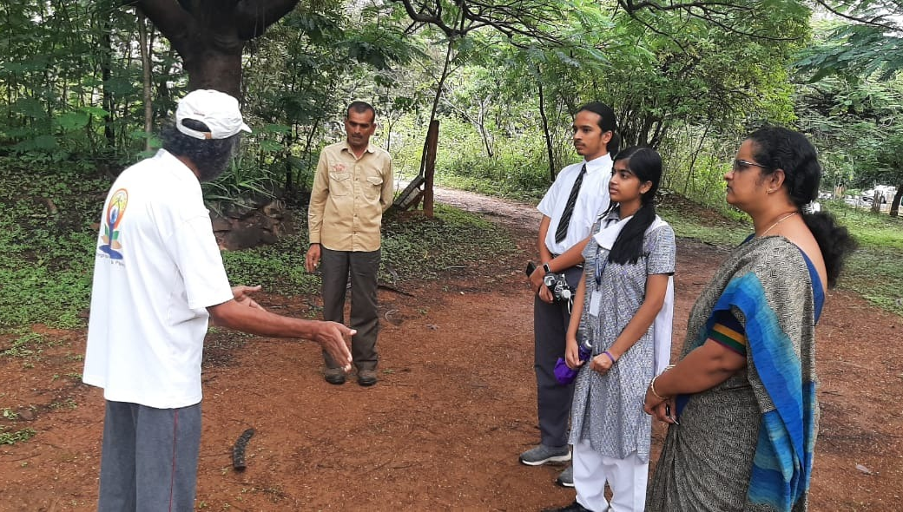
Our field visit
Map of stream with bamboo plantation.
LAKE 2022:

Slide 11
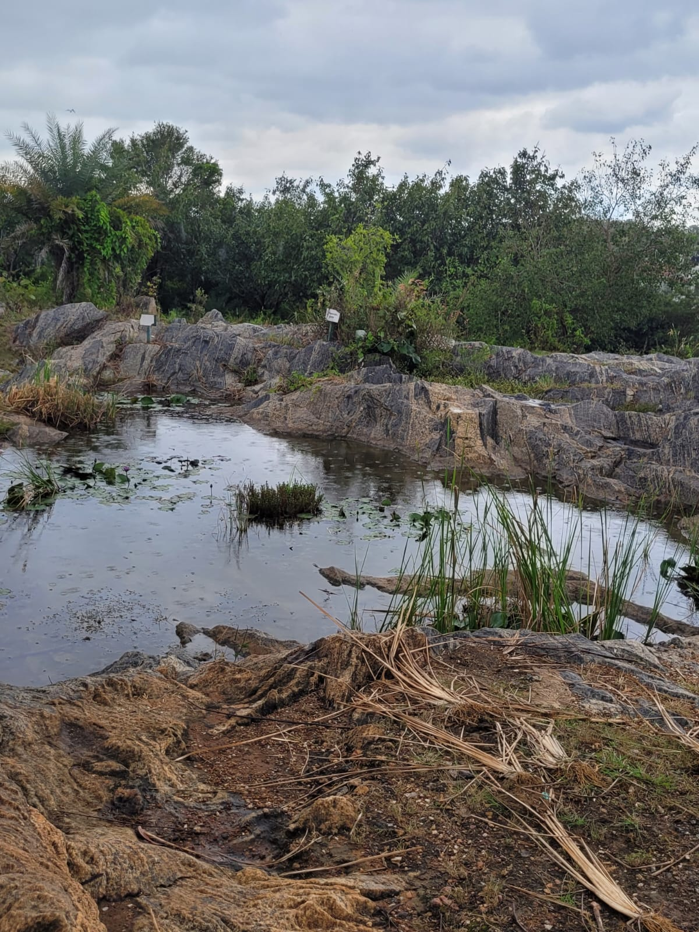
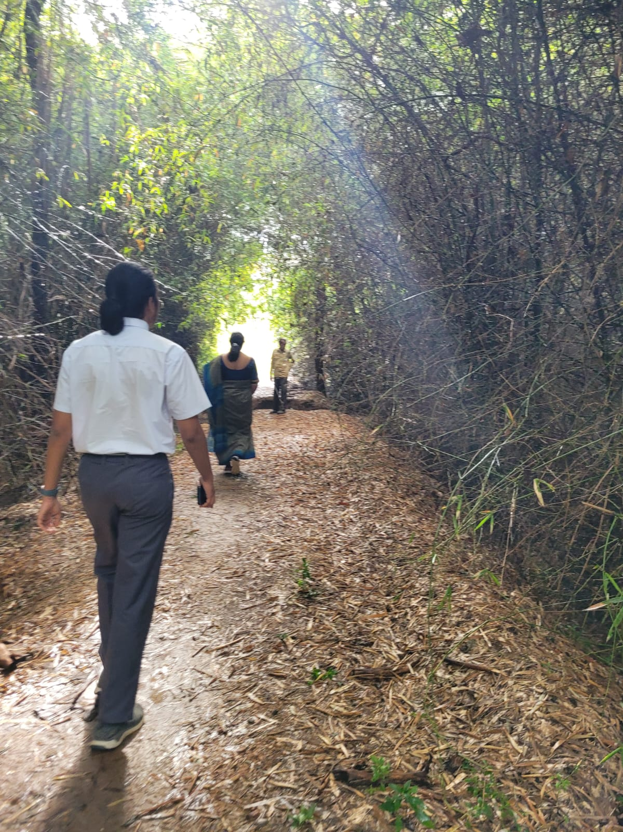
Bamboo Plantation and Biopark
LAKE 2022:

Slide 12
Conclusion
The river as we see is clearly polluted and is a major sign of the harmful effects of urbanization.
We humans cannot call ourselves “developed” if we damage our natural resources in the process.
There are plenty of ways we can directly or indirectly help the river get back to its original clean, fresh state.
We plan to make a petition to BBMP requesting them to take better measures to clean up the river and also to educate the citizens.
LAKE 2022:

Slide 13
References
China National Bamboo Research Center, Key Laboratory of State Forestry Administration on Bamboo Resources and Utilization, Hangzhou, 310012, PR China.
National Long-term Observation and Research Station for Forest Ecosystem in Hangzhou-Jiaxing-Huzhou Plain, Zhejiang, Hangzhou, 310012, PR China.
Ramachandra T V, Sudarshan Bhat and Vinay S, 2017. Constructed Wetlands for Tertiary treatment of Wastewater, ENVIS 14 Technical Report 124, Energy & Wetlands Research Group, CES, Indian Institute of Science, Bangalore 560012.
Prof. Manasa S.R., Ms. Brunda D.M.. Mr. Ranjith H.H., Ms. Arpitha M.R., Mr. Karthik G.C. Experimental Study On Waste Water Treatment Using Lab Scale Reed Bed System Using Phragmitis Australis, NDRK Institute Of Technology, Hassan, Department Of Civil Engineering. (Project Reference No.: 40s_be_0469).
Jamwal, Priyanka & Lele, Sharachchandra. (2017). Addressing Pollution in Urban Rivers: Lessons from the Vrishabhavathi River in Bengaluru.
Ramachandra, T. V., et al. "Optimal treatment of domestic wastewater through constructed wetlands." J. Biodivers 9 (2018): 81-102.
LAKE 2022:

Slide 14
Thank You
LAKE 2022:

