Slide 1
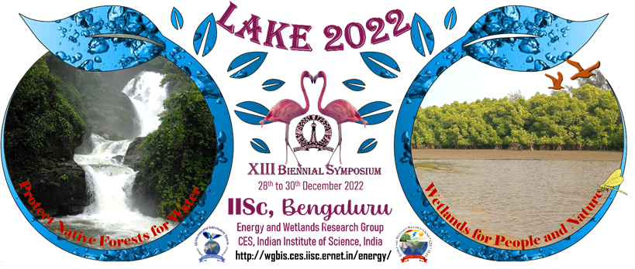
ANALYSIS OF LAKE SOIL
Ankitha G Bhat, Prasidhashri S, Sunidhi K Bhat - XII
Affiliated to Central Board of Secondary Education
LAKE 2022:Conservation of Wetlands:ecosystem based 1
Adaptation of climate change, December 28-30,2022

Slide 2
Introduction
Soil analysis gives valuable information, essential for soil quality improvement.
The main purpose of managing soil pH is to be able to adjust the acidity to the point where there are no toxic metals exposed.
In modern concept, soil quality means the ability of the soil to sustain plant and aquatic animal productivity to enhance the quality of water for plant and aquatic animal health.
LAKE 2022:Conservation of Wetlands:ecosystem based 2
Adaptation of climate change, December 28-30,2022

Slide 3
Objective
Analysis of soil in Sulikere Lake and Malathalli Lake
PARAMETERS:
Soil pH
Water holding capacity
Bulk density
Percentage of organic carbon
Chlorides
Nitrates
Sulphates
Phosphates
LAKE 2022:Conservation of Wetlands:ecosystem based 3
Adaptation of climate change, December 28-30,2022

Slide 4
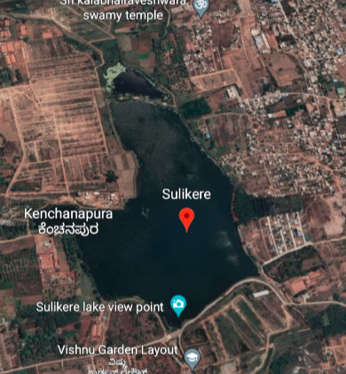
Study Area
Latitude: 12.95
Longitude: 77.459
Perimeter: 3.60 km
Area: 0.46 km²
LAKE 2022:Conservation of Wetlands:ecosystem based 5
Adaptation of climate change, December 28-30,2022

Slide 5
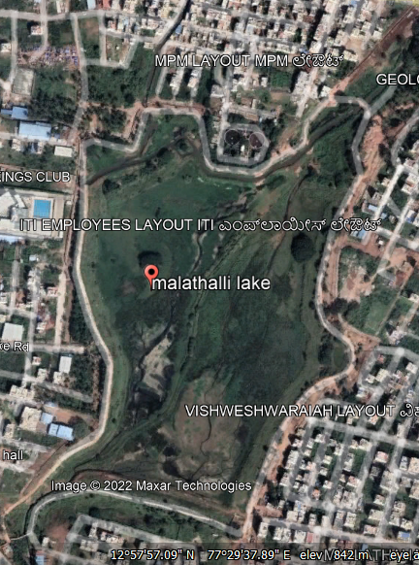
Latitude: 12.95
Longitude: 77.29
Perimeter: 2.39 km
Area: 0.21km²
LAKE 2022:Conservation of Wetlands:ecosystem based 1
Adaptation of climate change, December 28-30,2022

Slide 6
Materials
Soil sample
pH paper
Potassium dichromate standard solution (K₂Cr₂O₇)
Conc. sulphuric acid
Ferrous ammonium sulphate (FAS)
Diphenylamine indicator
Barium chloride solution
Silver nitrate solution
Conc HNO₃
Ammonium molybdate
LAKE 2022:Conservation of Wetlands:ecosystem based 1
Adaptation of climate change, December 28-30,2022

Slide 7
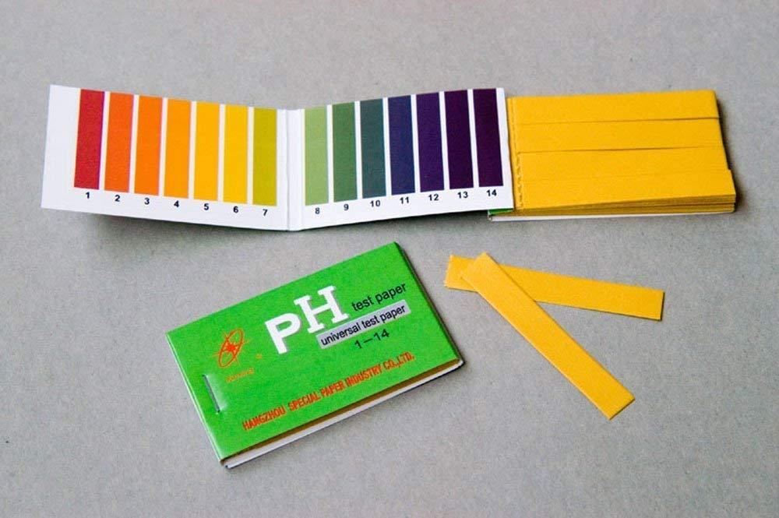
Methods
TEST 1: Soil pH
pH paper is dipped in wet soil
Change in the colour of the pH paper indicates soil’s pH
LAKE 2022:Conservation of Wetlands:ecosystem based 1
Adaptation of climate change, December 28-30,2022

Slide 8
Methods
TEST 2: Water holding capacity
water holding capacity (Mw)= Mt-Ms
WHC%= Vw/Vt*1000
Where, Mt= weight of the container with wet soil
Ms=weight of the container with dry soil
LAKE 2022:Conservation of Wetlands:ecosystem based 1
Adaptation of climate change, December 28-30,2022

Slide 9
Methods
TEST 3: Bulk Density
Bulk density = Mass / Volume

Slide 10
Methods
TEST 4: Percentage of organic carbon( Titration)
% of organic carbon in soil= [(V1-V2)*N*0.003*100/W]*C
Where, V1=volume of FAS in blank titration
V2=volume of FAS in titration
N=normality of K₂Cr₂O₇
W=weight of the sample
C= correction factor(1.334)
LAKE 2022:Conservation of Wetlands:ecosystem based 1
Adaptation of climate change, December 28-30,2022

Slide 11
Methods
TEST 5: Semi-micro qualitative analysis
DETECTION OF | PROCEDURE
CHLORIDES | Silver Nitrate Test
NITRATES | Brown Ring Test
SULPHATES | Barium Chloride Test
PHOSPHATES | Soil water + Ammonium molybdate + conc. HNO₃
LAKE 2022:Conservation of Wetlands:ecosystem based 1
Adaptation of climate change, December 28-30,2022

Slide 12
pH
Results
SAMPLE 1: (Sulikere lake)
pH - 7(neutral)
SAMPLE 2: (Mallathahalli lake)
pH-7.5
LAKE 2022:Conservation of Wetlands:ecosystem based 1
Adaptation of climate change, December 28-30,2022

Slide 13
Water Holding Capacity
SAMPLE 1: (Sulikere lake)
SAMPLE 2: (Malathalli lake)
Weight of soil (g) | Water (mL) | Capacity (mL)
5 | 10 | 3.5
5 | 10 | 3.5
Weight of soil (g) | Water (mL) | Capacity (mL)
5 | 10 | 5
5 | 10 | 5
LAKE 2022:Conservation of Wetlands:ecosystem based 1
Adaptation of climate change, December 28-30,2022

Slide 14
Bulk Density
SAMPLE 1: (Sulikere lake)
Mass of soil = 10g
Volume of soil =14.11cc
Bulk Density = 0.704g/cc
SAMPLE 2: (Malathalli lake)
Mass of soil = 15g
Volume of soil = 14.11cm³
Bulk Density= 1.06g/cc
LAKE 2022:Conservation of Wetlands:ecosystem based 1
Adaptation of climate change, December 28-30,2022

Slide 15
Percentage of Organic Carbon
SAMPLE 1: (Sulikere lake)
Burette reading (mL) | 1 |  | 2
 | With sample | Without sample | With sample | Without sample
Initial reading | 0 | 0 | 0 | 0
Final reading | 19.6 | 26 | 20 | 26.2
Volume added | 19.6 | 26 | 20 | 26.2
Percentage of organic carbon in 1st trail: 2.56%
Percentage of organic carbon in 2nd trial:2.40%
LAKE 2022:Conservation of Wetlands:ecosystem based 1
Adaptation of climate change, December 28-30,2022

Slide 16
Percentage of Organic Carbon
SAMPLE 2: (Malathalli lake)
Burette reading (mL) | 1 |  | 2
 | With sample | Without sample | With sample | Without sample
Initial reading | 0 | 0 | 0 | 0
Final reading | 10 | 23 | 10.2 | 23.2
Volume added | 10 | 23 | 10.2 | 23.2
LAKE 2022:Conservation of Wetlands:ecosystem based 1
Adaptation of climate change, December 28-30,2022

Slide 17
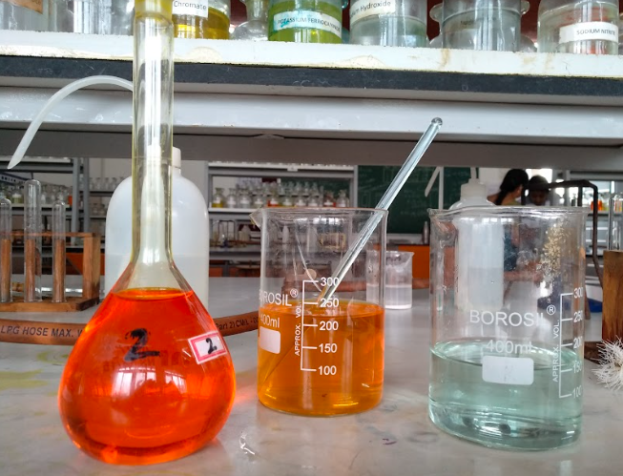
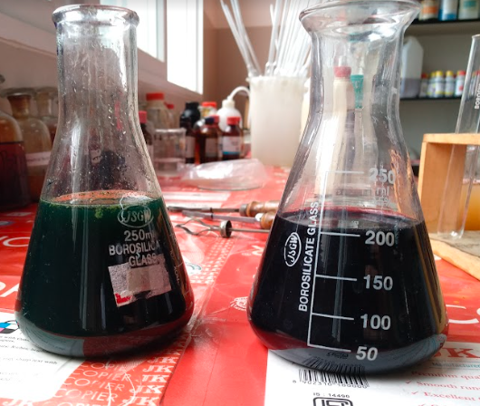
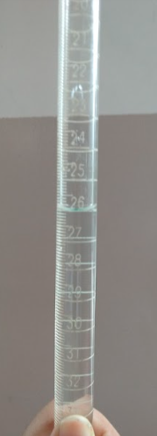

Slide 18
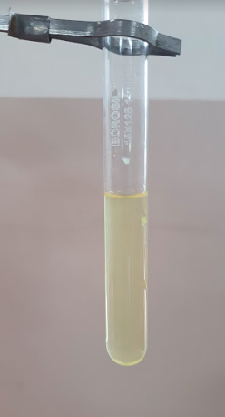
Detection of chlorides, nitrates, sulphates and phosphates
SAMPLE 1: (Sulikere lake)
Detection of ions | Observation | Inference
Chlorides | No white precipitate | Chloride is absent
Nitrates | No brown ring formed | Nitrate is absent
Sulphates | No thick white precipitate | Sulphate is absent
Phosphates | Light yellow solution | Phosphate is present
LAKE 2022:Conservation of Wetlands:ecosystem based 1
Adaptation of climate change, December 28-30,2022

Slide 19
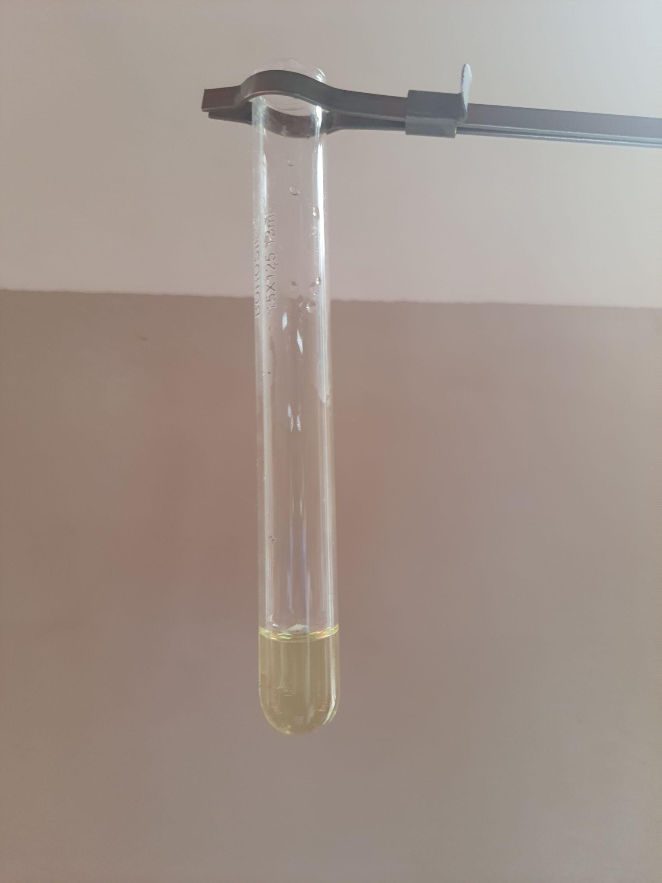
Detection of chlorides, nitrates, sulphates and phosphates
SAMPLE 2: (Malathalli lake)
Detection of | Observation | Inference
Chlorides | No white precipitate | Chloride is absent
Nitrates | No brown ring formed | Nitrate is absent
Sulphates | No thick white precipitate | Sulphate is absent
Phosphates | Light yellow solution | Phosphate is present

Slide 20
RECOMMENDATION
LAKE 2022:Conservation of Wetlands:ecosystem based 1
Adaptation of climate change, December 28-30,2022

Slide 21
CONCLUSION
pH of Sulikere lake soil was found to be neutral.
This soil has poor water holding capacity.
The percentage of organic carbon content is within the range (0.5-3%).
Absence of Chlorides, Nitrates and Sulphates.
Traces of Phosphate in soil
LAKE 2022:Conservation of Wetlands:ecosystem based 1
Adaptation of climate change, December 28-30,2022

Slide 22
REFERENCES
https://vlab.amrita.edu/
https://elementsunearthed.com/
https://www.sciencedirect.com/
http://vegetronix.com/
https://lakesofindia.com/2021/05/01/lake-eutrophication/
Chemistry lab manual-class XII
LAKE 2022:Conservation of Wetlands:ecosystem based 1
Adaptation of climate change, December 28-30,2022

Slide 23
THANK YOU
LAKE 2022:Conservation of Wetlands:ecosystem based 1
Adaptation of climate change, December 28-30,2022

