Slide 1
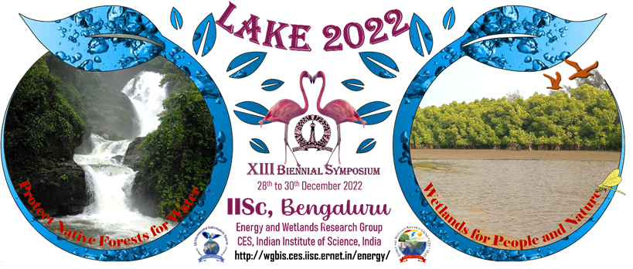
Sammith Singamsetty
Heavy metal and organic chemical bioaccumulation in wetlands
CLASS XII
CENTRAL BOARD OF SECONDARY EDUCATION

Slide 2
LAKE 2022-23
Monitoring of ecosystems – Big Data (Remote Sensing Data), Artificial Intelligence (AI), Machine Learning (ML) and Deep Learning techniques
[THE 13TH BIENNIAL LAKE SYMPOSIUM]
OBJECTIVES
To estimate amount of heavy metal and organic chemical bioaccumulation in a wetland considering all natural processes.
To determine the rate at which metal bioaccumulation takes place for a specified time period.
To determine how aquatic wildlife is affected by organic chemical concentrations.

Slide 3
Principle
Heavy metals in air, soil and water have become a global issue as a consequence of the increasing human impact in the last few decade.
Because of their toxicity, accumulative and non-biodegradable nature, heavy metals are potentially hazardous to terrestrial and aquatic ecosystems, and thus to human and animal life
Heavy metals are present in the environment as a result of natural sources and human activities (He et al., 2005; Li et al., 2009).
In natural systems, heavy metals originate from rocks, ore minerals, volcanoes, and release of metals during weathering leading to soil formation (Szyczewski et al., 2009). On the other hand, anthropogenic causes of heavy metals are mostly related to urban development, generation of electricity, and the metal industry including mining, extraction, and refining processes

Slide 4
Wetlands occupy 6% of the Earth’s ecosystems.
Wetlands have vegetation which is adapted to unique hydric soil.
Wetlands include some of the most carbon-dense ecosystems in our planet.
Peatlands, that account for just 3% of the world’s land surface, store twice as much carbon as forests.

Slide 5
Wetlands have been playing an important role in purifying the contaminated water for centuries. Majority of wetlands have been exploited for their natural cleansing capacity for assimilating various pollutants including heavy metals and pesticides.
Wetland plants, in this direction, help in accumulating various contaminants from aquatic bodies. Different metals like Cd, Cu, Cr, Co, Fe, Pb, Zn, and Mn are dissolved in wetlands.

Slide 6
Sources of heavy metals include mining, industrial production (foundries, smelters, oil refineries, petrochemical plants, pesticide production, chemical industry), untreated sewage sludge and diffuse sources such as metal piping, traffic and combustion by-products from coal-burning power stations. Wetland plants, in this direction, help in accumulating various contaminants from aquatic bodies. Different metals like Cd, Cu, Cr, Co, Fe, Pb, Zn, and Mn are dissolved in wetlands.

Slide 7
Sources of Organic chemicals include pollutants that are washed by rainfall from urban and agricultural lands and are carried overland to water bodies. Pollutants include soil particles, fertilizers, pesticides, grease and oil from cars and trucks, and road salts.
Nitrogen and phosphorus from agricultural and lawn fertilizers, pet waste, sewer and septic systems

Slide 8
Procedure
Using modelmuse and modflow it is possible to determine the amount of heavy metal bioaccumulation in wetlands for a specified time period.
The time period is taken for 1000 years and copper concentration at the start of this time period is taken as 0.05 PPM.
The simulation is run taking all natural processes as standard.
The model was built by assigning two layers of peat having an even thickness of 3.4 meters and sand and having variable thickness at different locations.

Slide 9
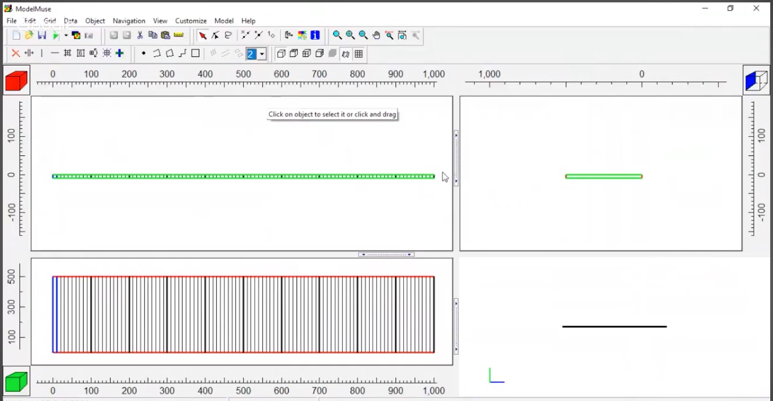

Slide 10
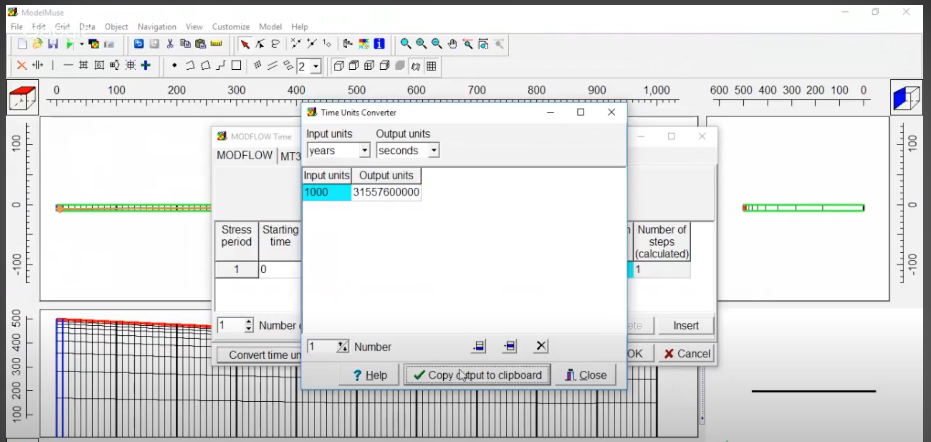

Slide 11
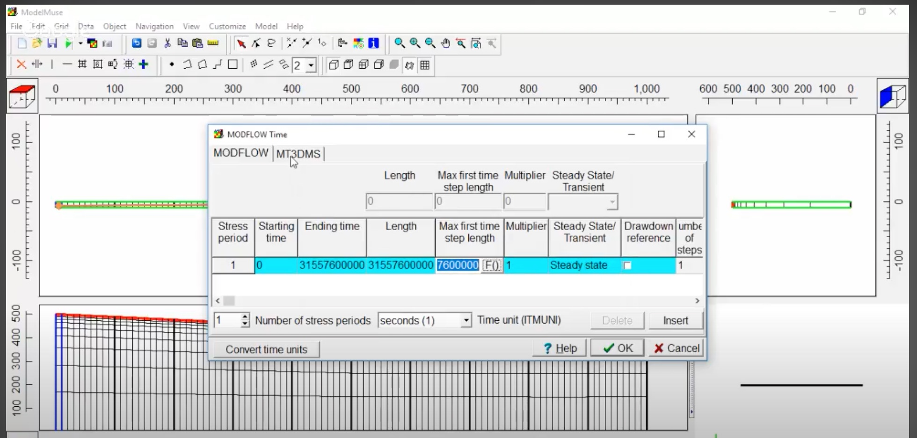

Slide 12
Result

Slide 13
Over thousands of years, the components in the soil solution tend to accumulate in wetlands, making them zones where major ions and metals are trapped.
According to the simulation and calculations, metal concentration can increase from 3 to 4 times in comparison to the original values over the time period the simulation ran for.

Slide 14
Organic chemical study
Variables kept the same as initial study with added plants, fish species and organic toxicants

Slide 15
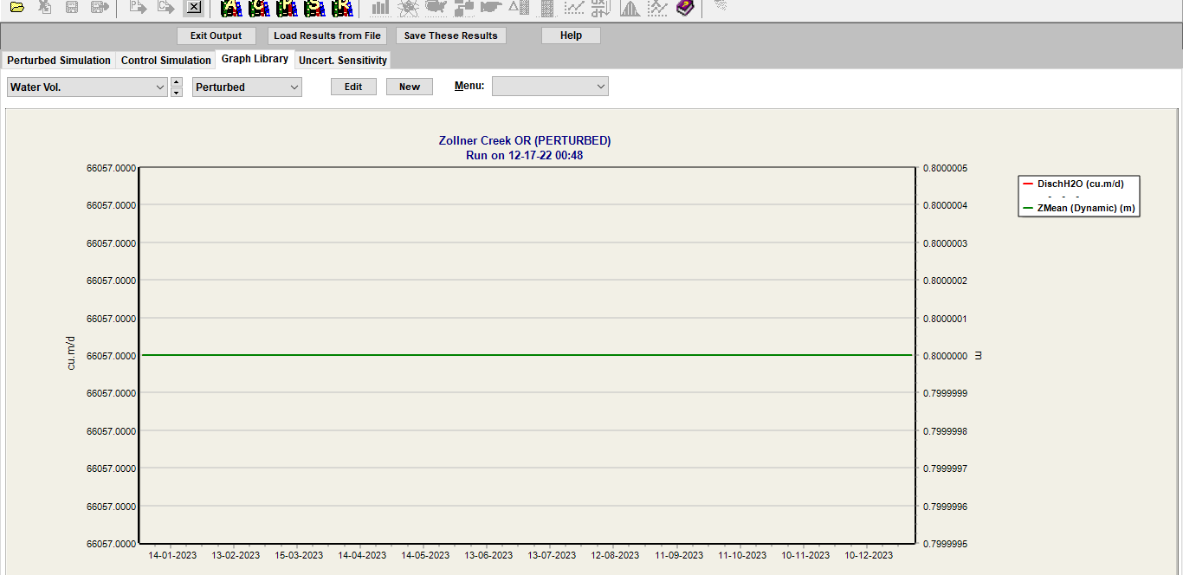
Water volume

Slide 16
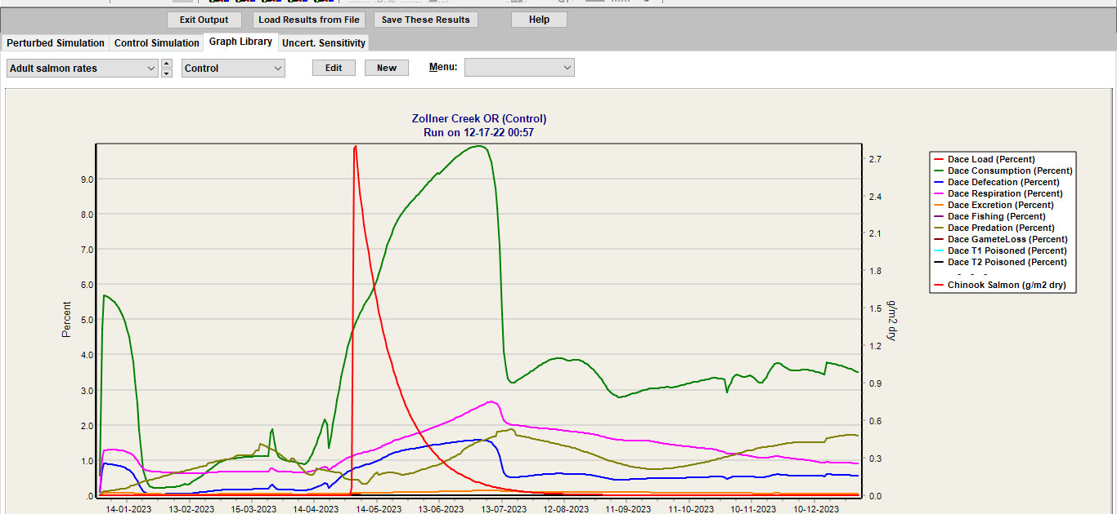
Fish populations - control

Slide 17
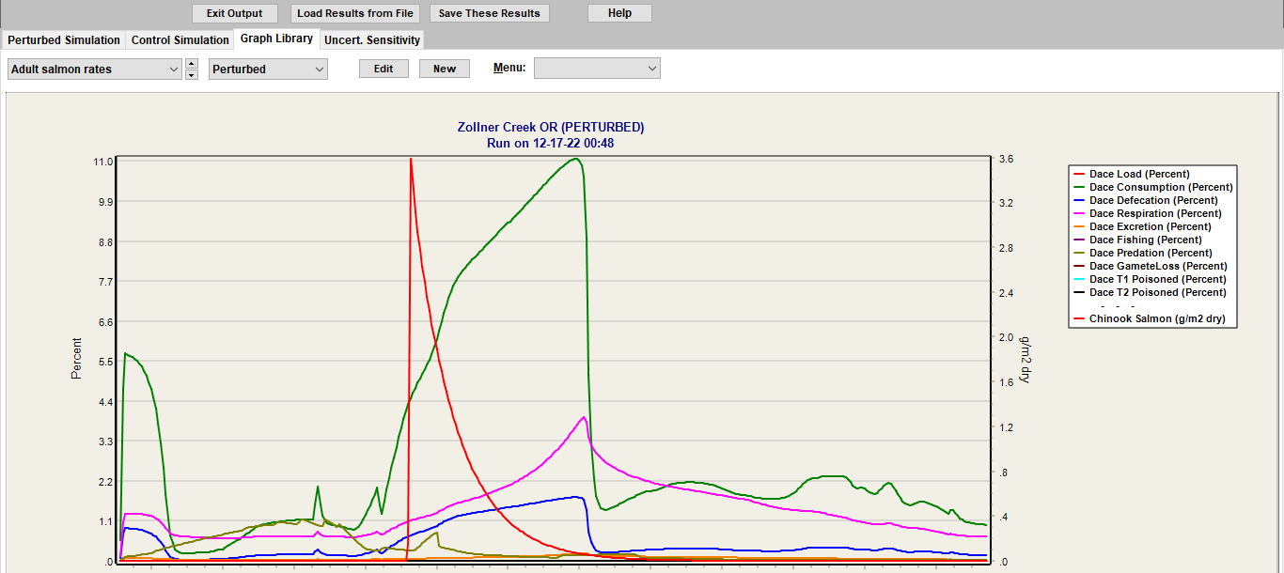
Fish populations

Slide 18
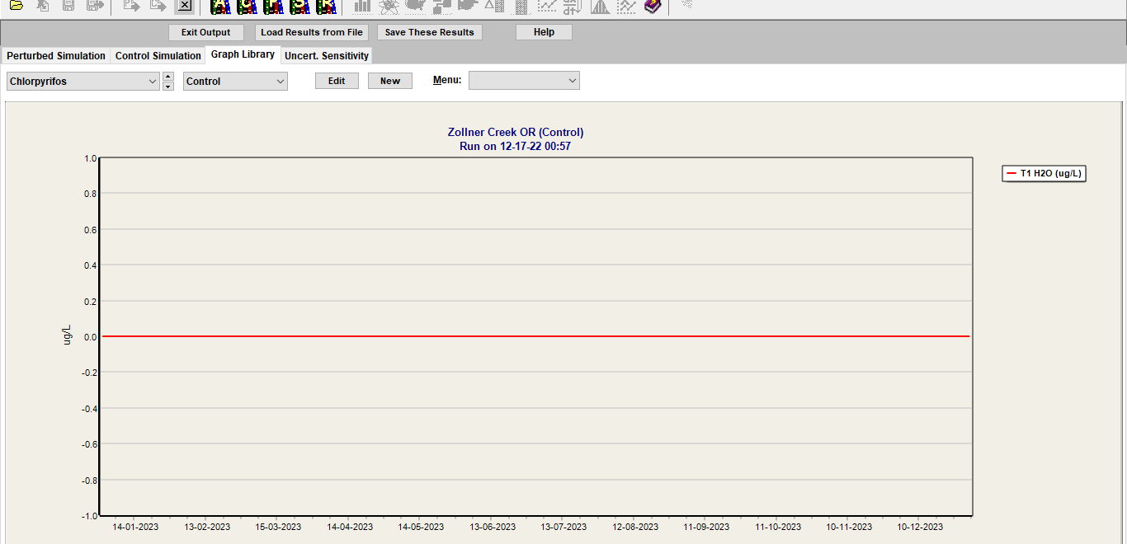
Control

Slide 19
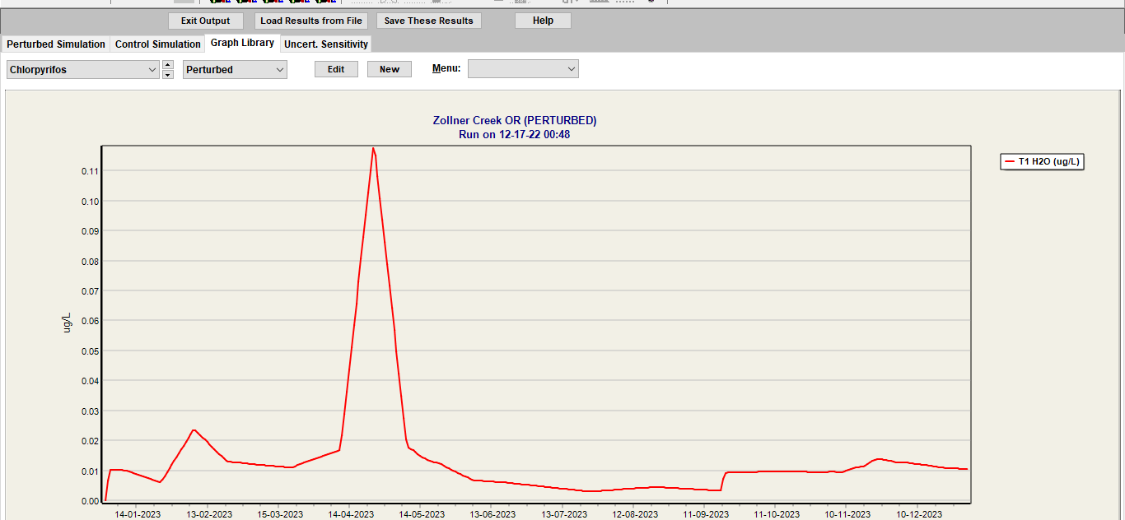
Perturbed

Slide 20

SOLUTION
A constructed wetland is "a designed and man-made complex of saturated substrates,
emergent and submergent vegetation, animal life, and water that simulates natural wetlands for human use and benefits."
A plot of land is chosen near the wastewater that is to be purified
• A shallow pond is built and plants found in natural wetlands such as cattails, reeds, and rushes are set out
• The wastewater is then routed through the wetland
• Microbial utilization and plant uptake of nutrients results in cleaner water leaving the constructed wetland than what entered

Slide 21
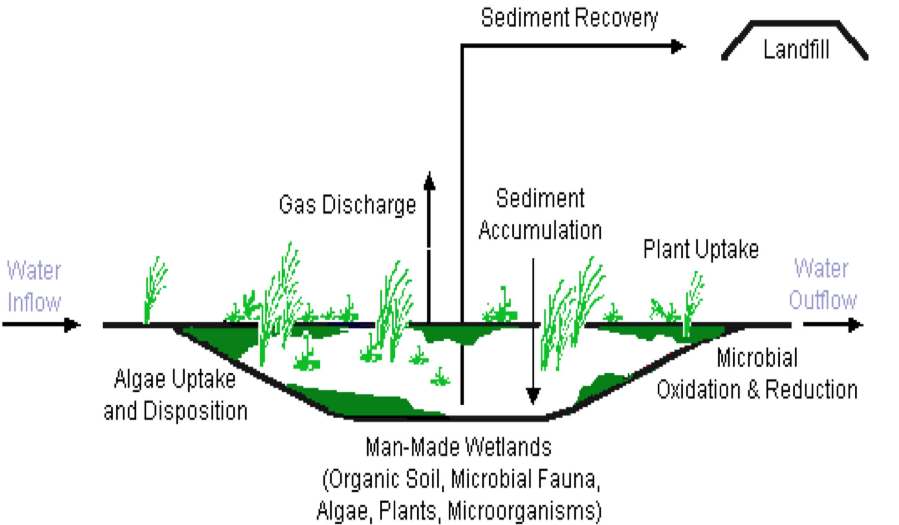

Slide 22
Conclusion :
Heavy metals are major pollutants that pose threats to wetland environments.
It is important to reduce the bioaccumulation of metals and measures should be employed to reduce this.

Slide 23
References
Levels of heavy metals in wetland and marine vascular plants and their biomonitoring potential: A comparative assessment
https://hatarilabs.com/ih-en/simulation-tutorial-of-heavy-metals-bioaccumulation-at-wetlands-with-modflow-mt3dms
https://gmd.copernicus.org/articles/14/7795/2021/gmd-14-7795-2021.pdf
http://www.anjar.nu/Education/Groundwater_modelling_exercise.pdf
https://water.usgs.gov/water-resources/software/ModelMuse/readme5_1_1.txt

Slide 24
ACKNOWLEDGEMENTS
Huge thank you to IISc and team for providing a wonderful opportunity to learn more about the environment and conduct research
Huge thank you to my teachers for giving me this wonderful opportunity and for allowing me to learn so much during the research process.

