Slide 2
LAKE 2022: CONSERVATION OF WETLANDS: ECOSYSTEM-BASED ADAPTATION OF CLIMATE CHANGE
[THE 13TH BIENNIAL LAKE SYMPOSIUM]
Phytoplanktons as bio indicators
Presented By:
Name : Amogh D and R Ravindra
Class : 12 (PCMB)
VIDYANIKETAN PUBLIC SCHOOL,
ULLAL UPNAGAR, BANGALORE - 560056

Slide 3
OBJECTIVE
Quantitative analysis of phytoplankton at Sulikere lake and their role as bio indicators .

Slide 4
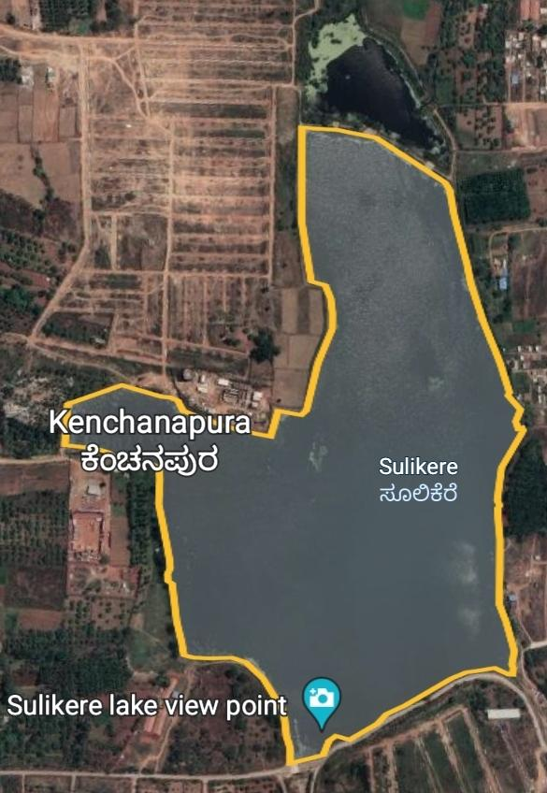
STUDY AREA (SULIKERE)
Perimeter of the lake = 3.49 km
Area if the lake = 4,92,616 m² / 106 ac / 43.0 ha
Sulikere lake is located in Bangalore South taluk of Bangalore district. The Sulikere village is situated 5km away from the sub-district headquarter Bangalore South (Tehsildar office) and 5km away from the district headquarters Bangalore.
Most of the lake in Bangalore are restored and fenced. But this lake being on the outskirts of the urban area in a realtively less populated place remains unfenced.

Slide 5
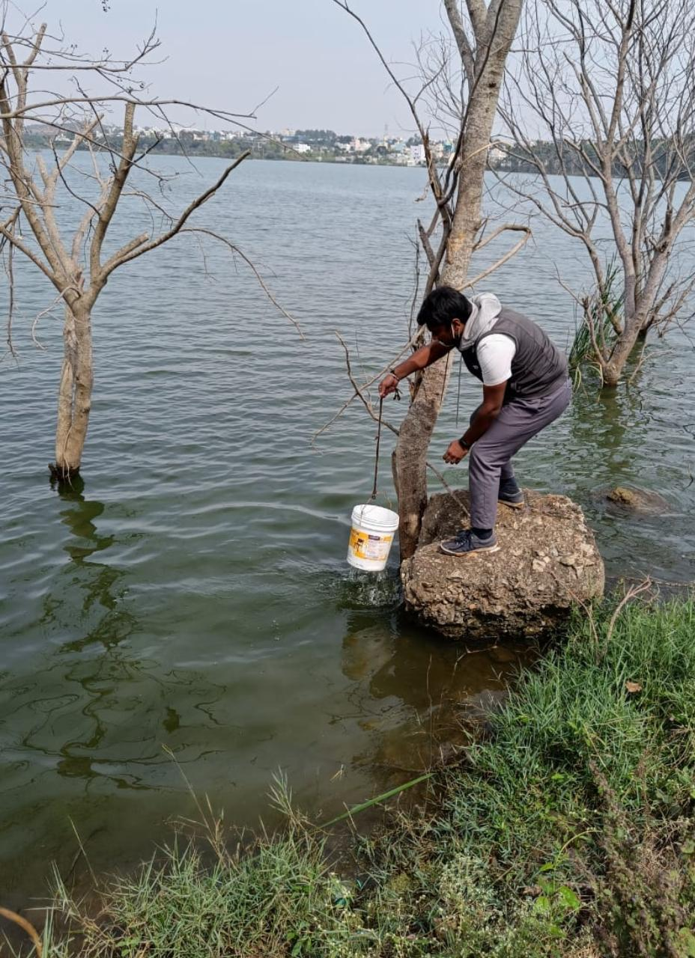
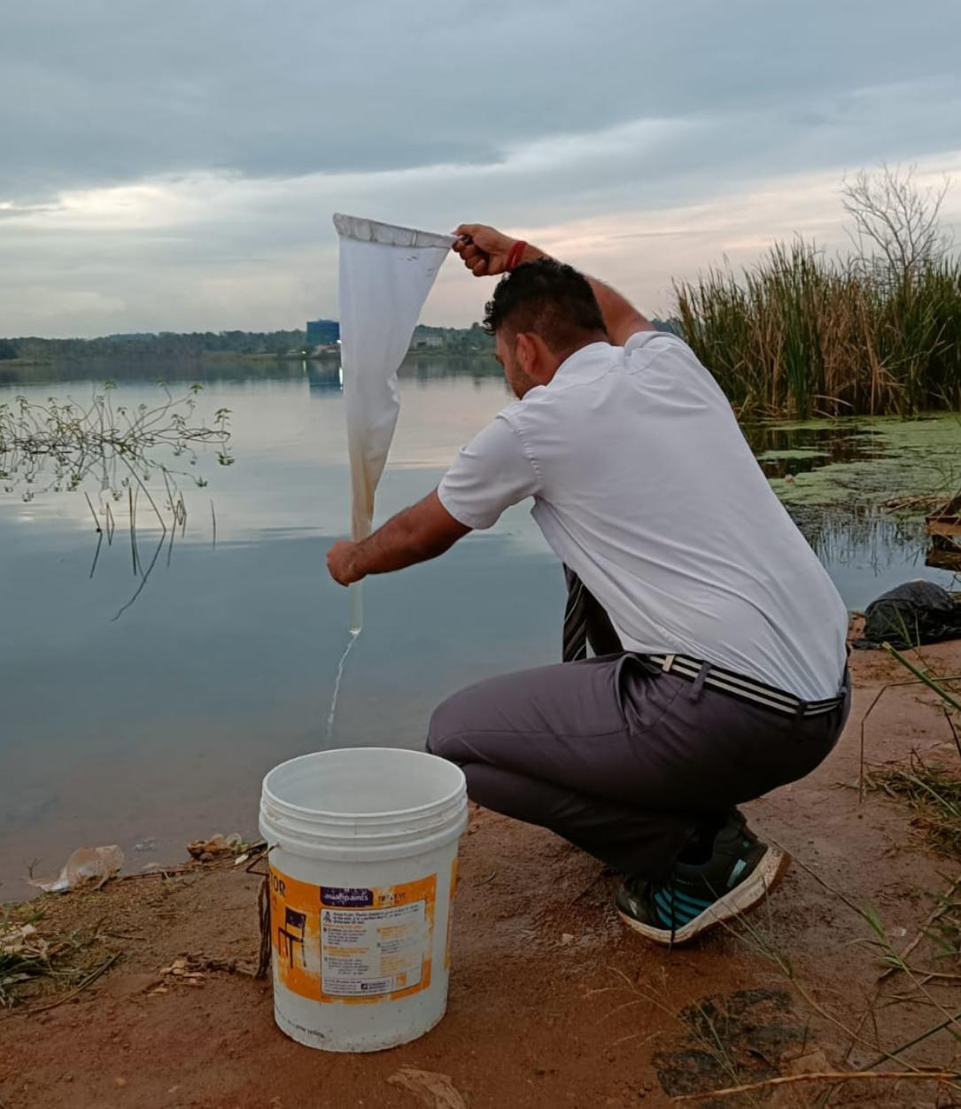
MATERIALS REQUIRED AND METHODOLOGY [QUANTITATIVE ANALYSIS OF PHYTOPLANKTON]
We visited a nearby lake [Sulikere lake] carrying along with us the plankton net of 40 mesh size fitted with a test tube at the narrow end and a plastic bucket (capacity = 10L).
One of us held the plankton net firmly a few centimeters above the water surface.
Furthere we immersed and filled the plastic bucket with water completely upto 10L mark and filtered the water through the plankton net. We repeated the process several times (10 times).
At the end we calculated the quantity of water in litres (X) filtered by multiplying the amount of water In one bucket and number of buckets of water filtered.
During this process of filtering, the planktons were collected in plankton bucket. Only the water free of plankton escapes through the mesh of the net.
Sample collection and filtration
at point 01 and 02 respectively
Date: 30/11/2022
Time: 11:20 am

Slide 6
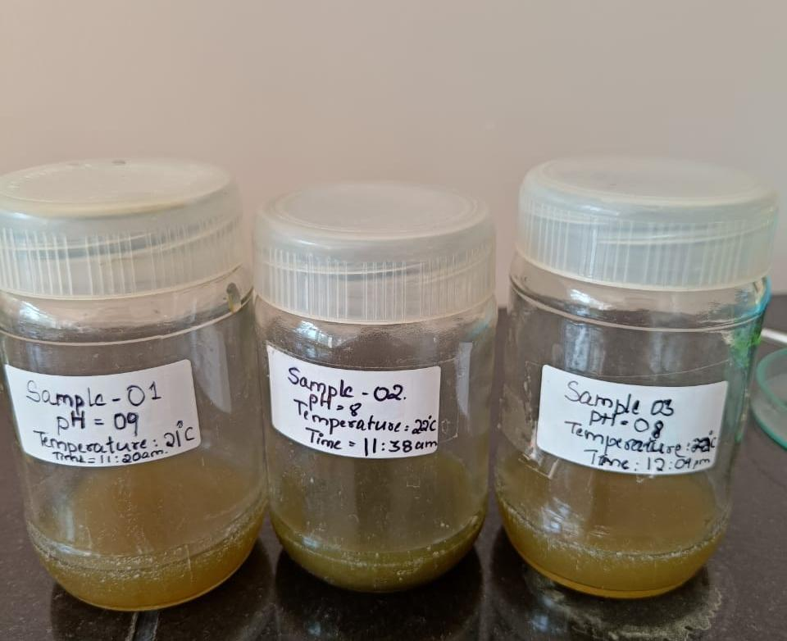
Proceeding further we splashed a few buckets of water against the net from outside taking care that no water enters into the cone from the mouth. This was done to wash all the planktons sticking against the inner will of the net into the plankton bucket.
We transfered the filtrate into a glass bottle making sure not to secure the cap of the glass bottle too tightly. This was done to provide aeration for the the sample and noted the volume of the filtrate (Y). The procedure was repeated at three points of the lake.
Besides the pH, temperature and time of the three samples we noted on the respective bottles.
In the laboratory:
With the help of 1ml pipette, we drew 1ml of filtrate and transfered it dropwise into the watch glass and counted the total number of drops that make 1ml of filtrate(A).
After transferring one drop of plankton filtrate from watch glass on to a clean slide, it was covered with square shaped cover slip.
Samples stored in glass bottles. pH, temperature and time of collection of respective samples has been specified.
Date: 30/11/2022 Time: 1:00 pm

Slide 7
Unit cells/L= [A]×[B]×[Y]×1000
[X]
where, A = no of drops in 1ml of filtrate
B = no of cells in 1 drop of filtrate
Y = volume of filtrate collected after filtration
X = total volume of water filtered

Slide 8
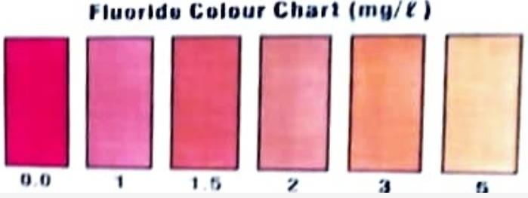
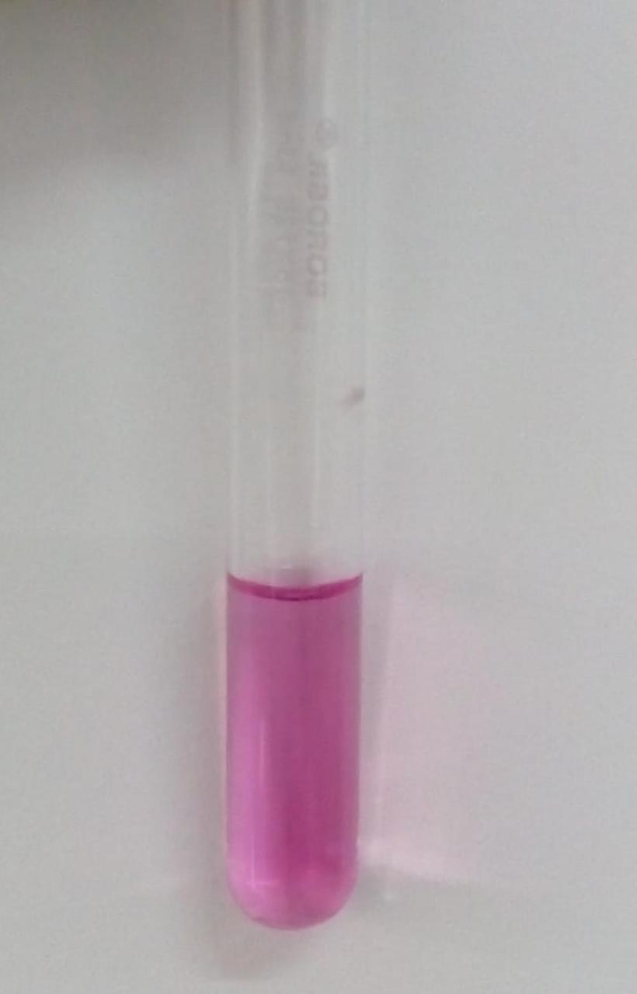
METHODOLOGY [WATER ANALYSIS]
Fluoride testing method :
We took 5ml of water sample in a test tube
Fluoride Reagent – 1 (F-1) was shaken well and 5 drops of the same was added to the water sample and the contents were mixed.
The colour that is formed wass compared with Fluoride colour chart and recorded the Fluoride value.
According to fluoride colour chart (mg/L) = 1 mg/L
Fluoride test done for water sample and comparing it with the Fluoride colour chart
Date: 02/12/2022
Time: 10:30 am

Slide 9
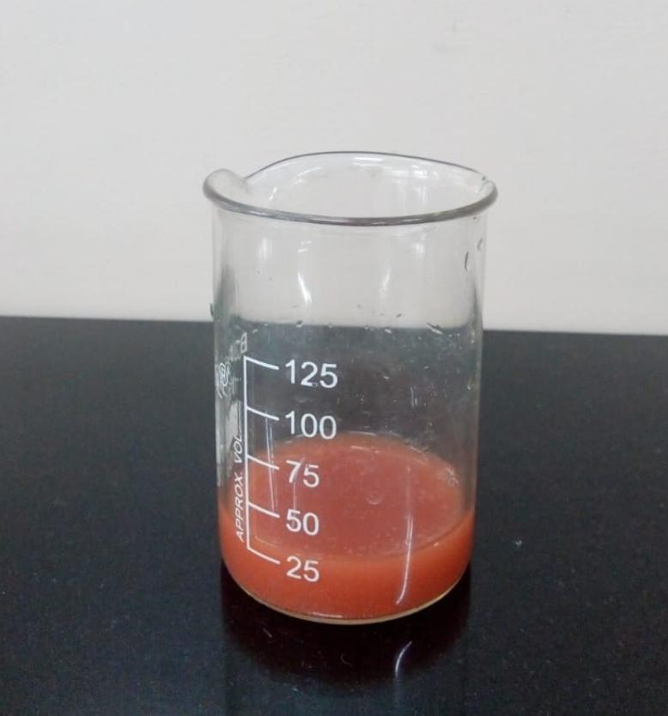
Chloride testing method :
We took 25ml of water sample in a beaker.
We added 5 drops of Chlorine Reagent-1 ( Cl-1) to the beaker and mixed well until a distinct yellow colour developed.
Further we added Chlorine Reagent-2(Cl-2), after adding each drop of the reagent, it was shaked well until the colour changes from yellow to red. We counted the no of drops of Cl-2 required for the colour change.
Chloride (as Cl), mg/L = no of drops of Cl-2 × 10
= 25 × 10 = 250 mg/L
Chloride test done for the water sample.
Date: 02/ 12 /2022
Time: 10:40 am

Slide 10
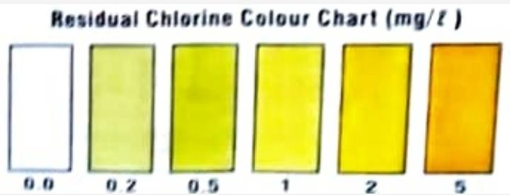
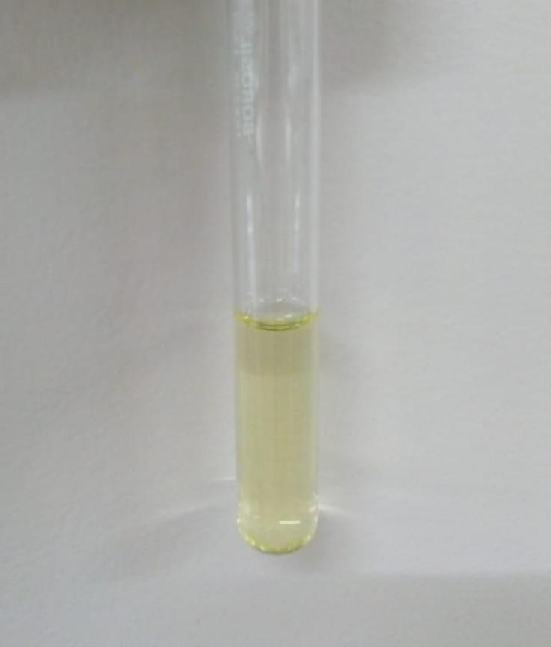
Residual Chlorine testing method :
We took 5ml of water sample in a test tube
We added 5 drops of Residual Chlorine Reagent-1 (RC-1) and mixEd the contents well. The colour that was formed was compared with Residual Chlorine colour chart and recorded the Residual Chlorine value.
According to Residual Chlorine colour chart (mg/L)= 0.2 mg/L
Residual Chloride testing done for water sample and comparing with Residual Chlorine colour chart
Date: 02/12/2022
Time: 10: 50 am

Slide 11
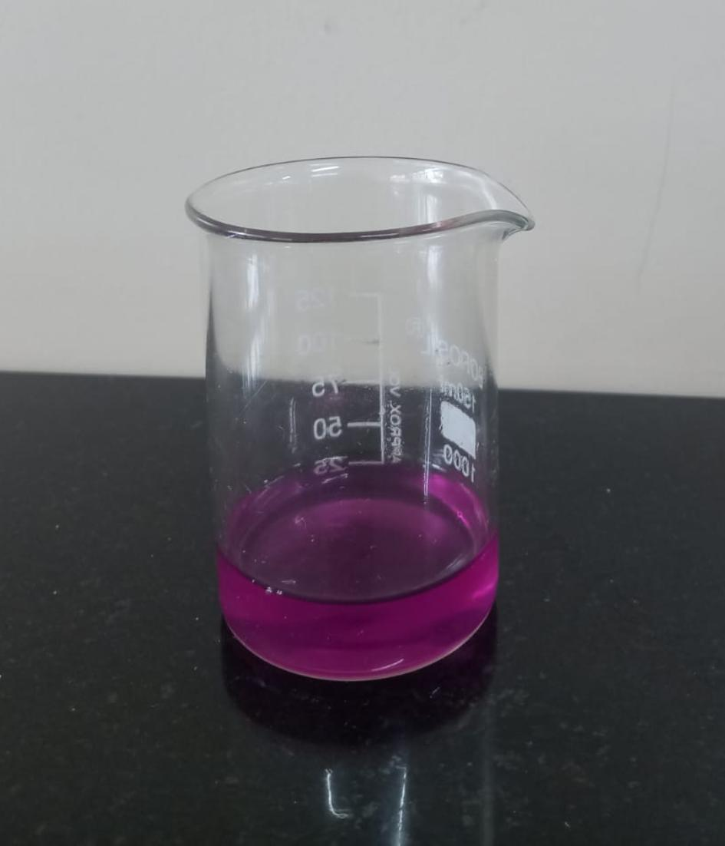
Calcium hardness test :
We took 25 mL of water sample in a beaker.
We added 10 drops of Calcium hardness reagent–2 (CH-2). Further we added 10 drops of Calcium hardness reagent-3 (CH-3) and mixEd the contents well.
Then we added afew specs of Calcium hardness reagent-1 (CH-1) and mixed it well until a distinct pink colour developed.
Finally we added Calcium hardness reagent-4 (CH-4) and after addition of each drip the contents of the beaker were shaken well until the colour changed from pink to purple. We noted down the no of drops of CH-4 added for the colour change.
Calcium hardness = no of drops × 5
^{[ppm in terms of CaCO3]}
= 21 × 5 = 105 ppm.
Calcium hardness test done for water sample.
Date: 02/12/2022
Time: 11:00 am

Slide 12
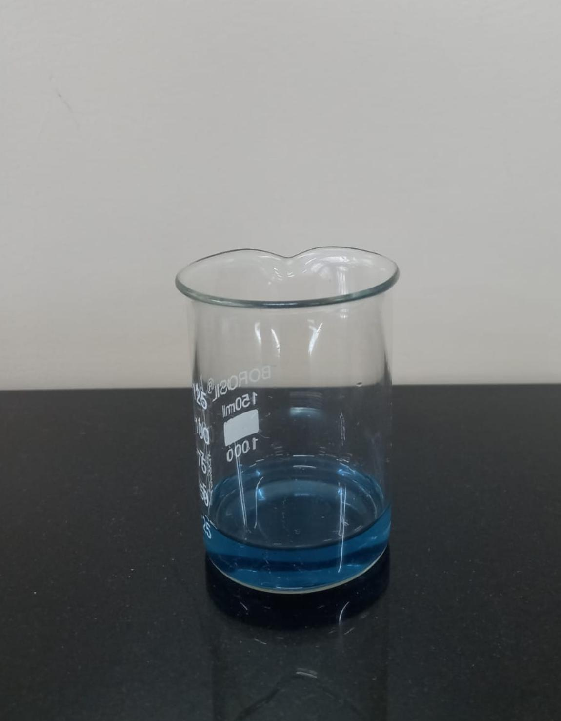
Total hardness test :
We took 25ml of water sample in a beaker.
Next we added 10 drops of Total Hardness Reagent-2 (TH-2) and mixed.
Then we added a few specs of Total Hardness Reagent-1(TH-1) And mixed it until distinct pink colour developed.
For hard water we added Total Hardness Reagent-3 (TH-3) and after adding each drop the contents were mixed well until the colour changed from pink to blue.
Finally no of drops of TH-3 added was counted and total hardness ( for had water) was calculated as follows:
Total hardness = no of drops × 5
^{(ppm.in terms of CaCO3)}
= 62× 5 = 310 ppm
Total hardness test done for water sample.
Date: 02/12/2022
Time: 11:15am

Slide 13
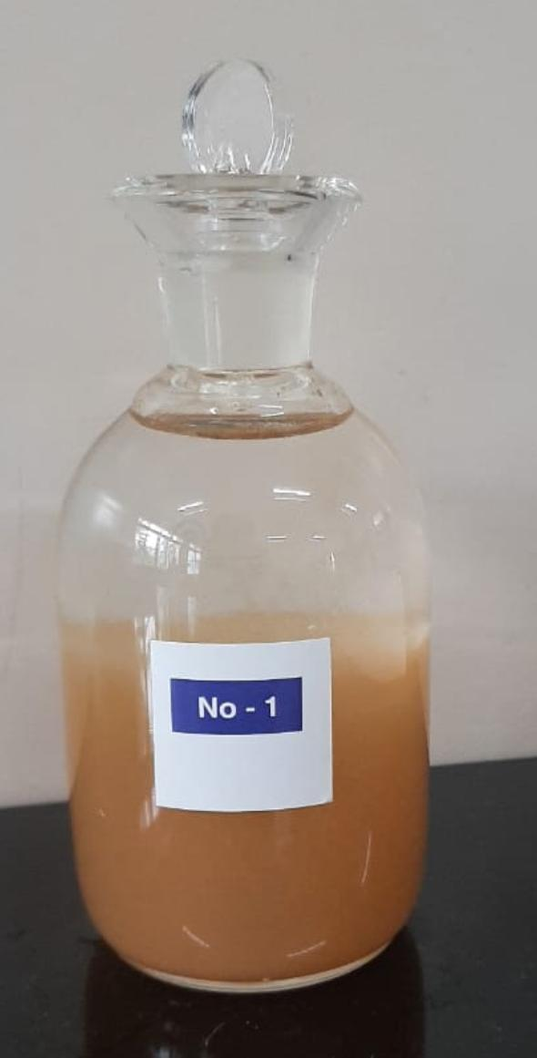
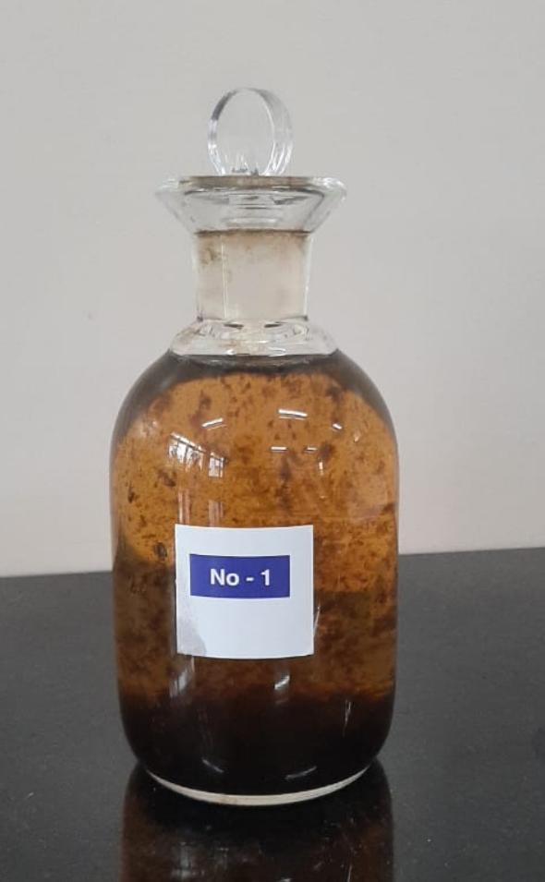
Estimation of dissolved oxygen:
We took 300 mL of water sample in test bottle
We added 2ml of Dissolved Oxygen Reagent-1 (DO-1) and the tip of the filler was dipped well below the water level.
Then we added 2ml of Dissolved Oxygen Reagent-2 (DO-2) very carefully and again the tip of the filler was dipped well below the water level.
Further we replaced the stopper without inclusion of any air bubbles and thoroughly mixed the contents by shaking the test bottle several times and allowed the precipitaTe formed to settle.
After 2-3 minutes of settling, we removed the stopper of test bottle and immediately added 2ml of Dissolved Oxygen Reagent-3 (DO-3) very carefully by runningDthe reagent down the neck of the bottle and mixEd it thoroughly to dissolve the precipitate settled completely.
(A) (B)
(A): water sample + DO-01 + DO-02. Precipitate
is allowed to settle.
(B): settled Precipitate +DO-03. The Precipitate
is dissolved.
Date: 02/12/2022
Time:11:30am

Slide 14
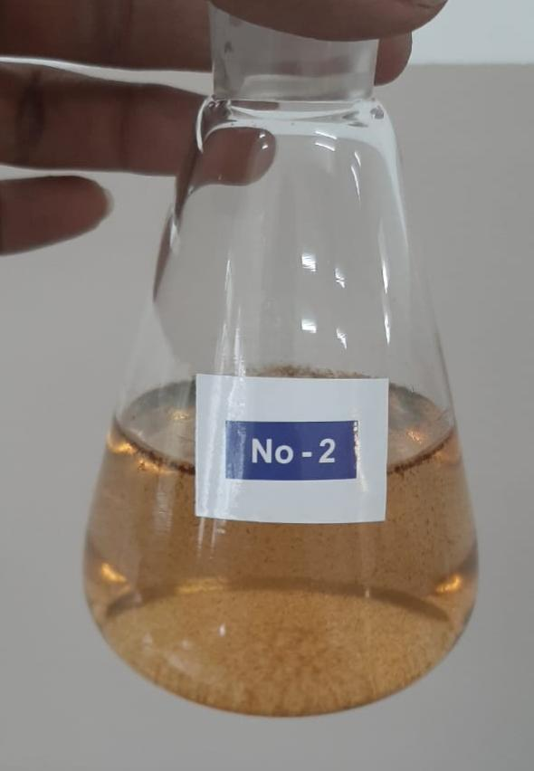
Then we took 200ml of The solution in an iodine flask and added 4 drops of Dissolved Oxygen Reagent-4 (DO-4)
Finally the solution was titrated with Dissolved Oxygen Reagent-5 (Do-5) taken in a 10 mL syringe Until the colour of the solution changed to become colourless .
Dissolved oxygen =
^{(mg/L)} Volume in ml of
Dissolved Oxygen Reagent-5 = 2mg/L
(DO-5) added For titration
After precipitate is dissolved DO- 04 is added and titrated against DO-05
Date: 02/12/2022

Slide 15
RESULTS Quantitative analysis of phytoplanktons [Aulocosiera species]
Lake point (geographical coordinates) | X (total volume of water filtered)(in L) | Y (total volume of filtrate collected)(in ml) | A (no of drops in 1ml of filtrate) | B (no of cells inml of filtrate) | Unit cells/ L [A]×[b]×[y]×1000 [x]
1 12º56^{l}52^{ll} N 77º27^{l}40^{ll}E | 100 | 25 | 20 | 388 | 19,40,000
2 12º57^{l}04^{ll} N 77º27^{l}40^{ll}E | 100 | 25 | 20 | 376 | 18,80,000
3 12º56^{I}58^{ll} N 77º27^{l}40^{ll}E | 100 | 25 | 20 | 354 | 17,70,000

Slide 16
CONCLUSION
From the values obtained through chemical analysis, we could conclude that the lake is not highly polluted. The pollution levels are at the lower limit of expected pollution concentration.
As per the literature we went through we studied that diatoms are sensitive to pH, temperature and chemical changes. They show high rate of reproduction when the habitat is congenial.If their population dwindles, that can indicate increase in pollution.
When we first collected the lake water, we found Spirulina species as a major bio component. But when we went to collect water on 30th November, within 10 days there was no trace of Spirulina, but great density of Aulocosiera species was found. We referred to articles pertaining to thus observation which gave us the information about changes in physical/ chemical parameters of the lake that affect the biodiversity of the species deeper. Further we would like to work on this aspect.

Slide 17
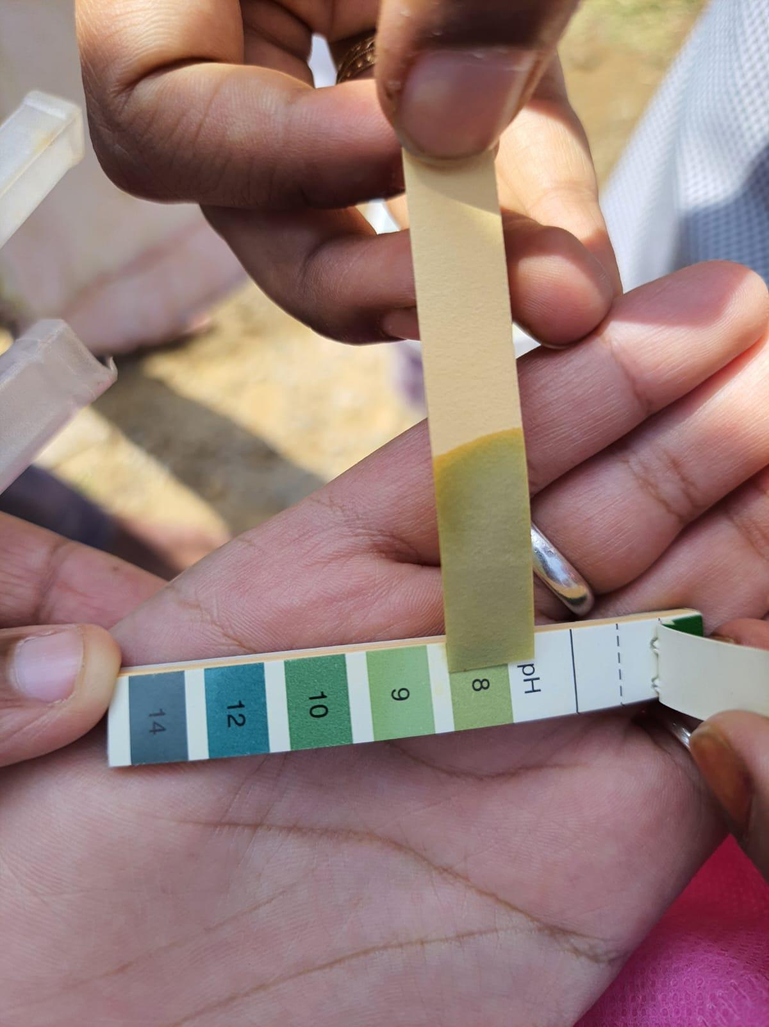
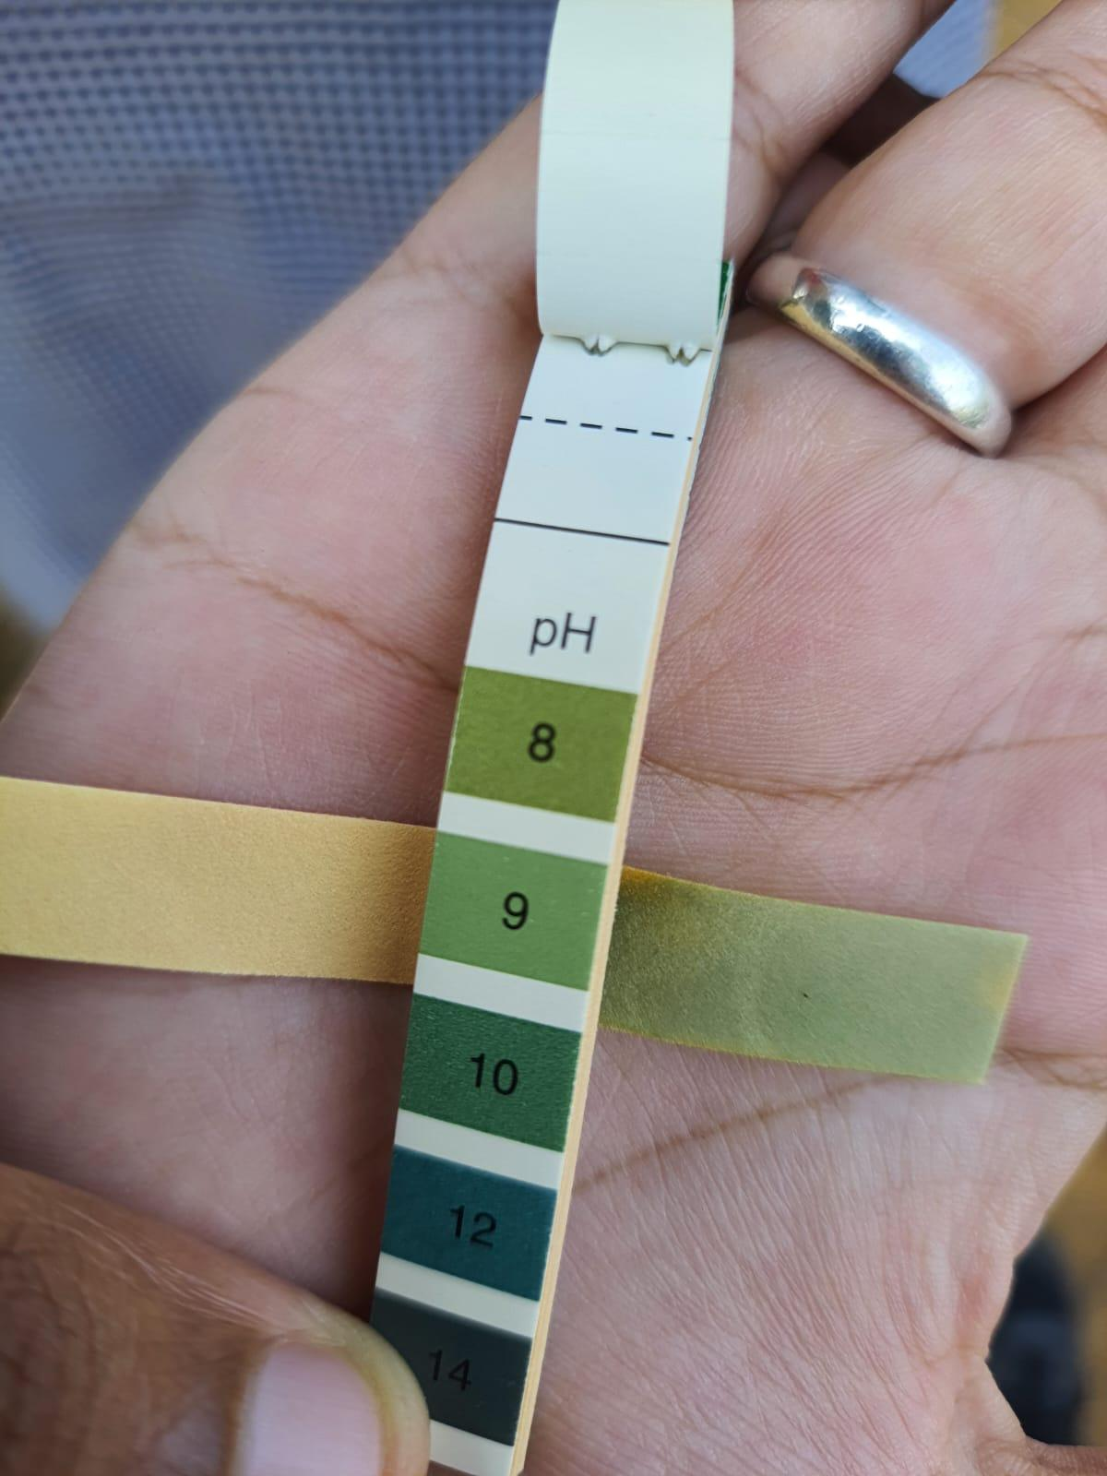
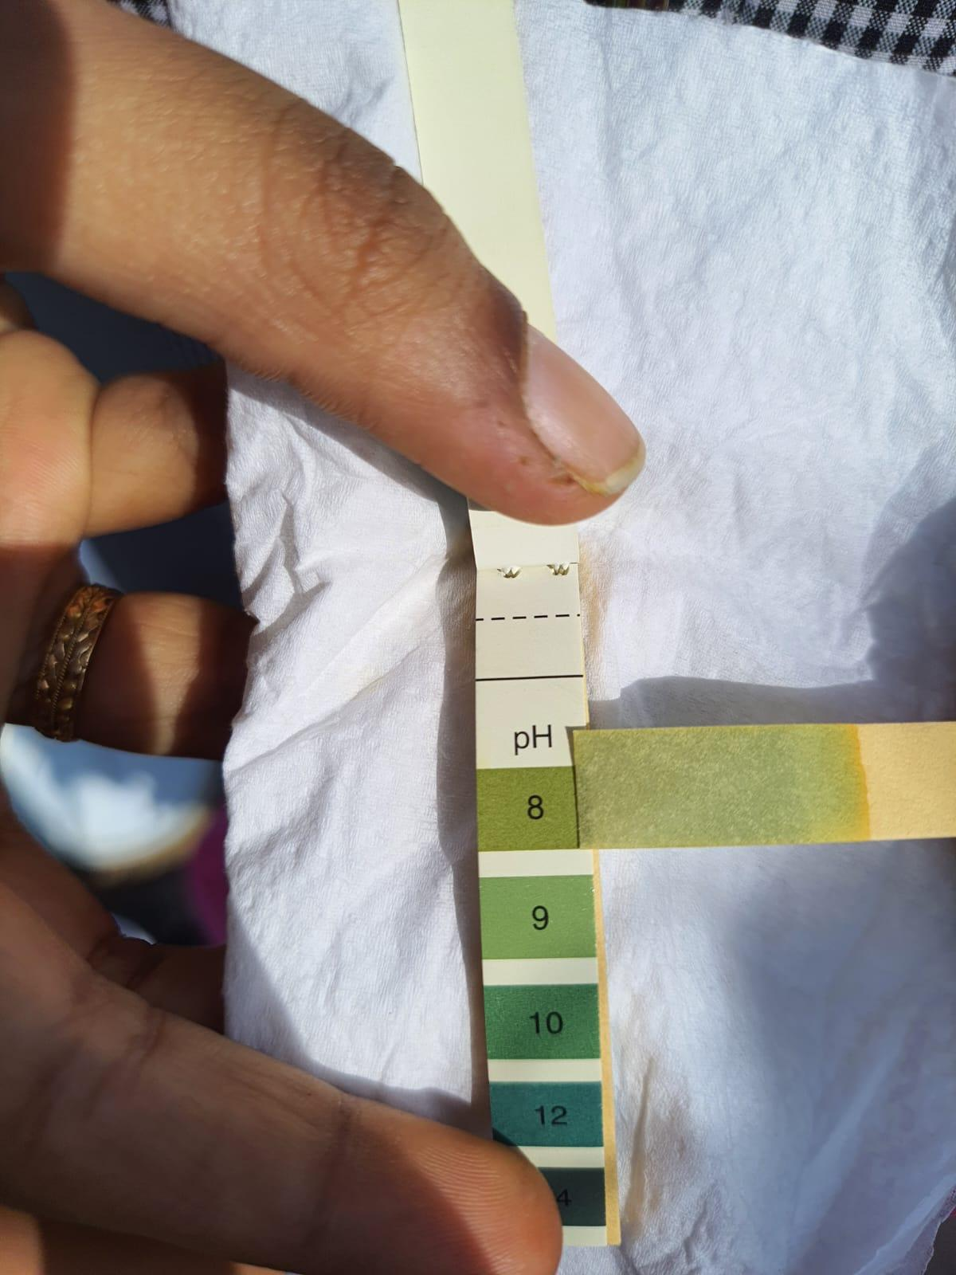
PICTURE GALLERY
Estimation of ph values at the three point of the lake
Date: 30/11/2022
Time: 11:20 am
Filtration of lake water using a plankton net at site 01
Date: 30/11/2022
Time: 12:00 Am

Slide 18
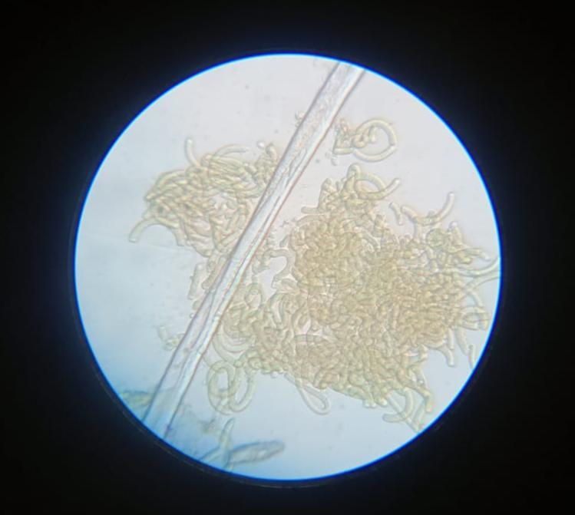
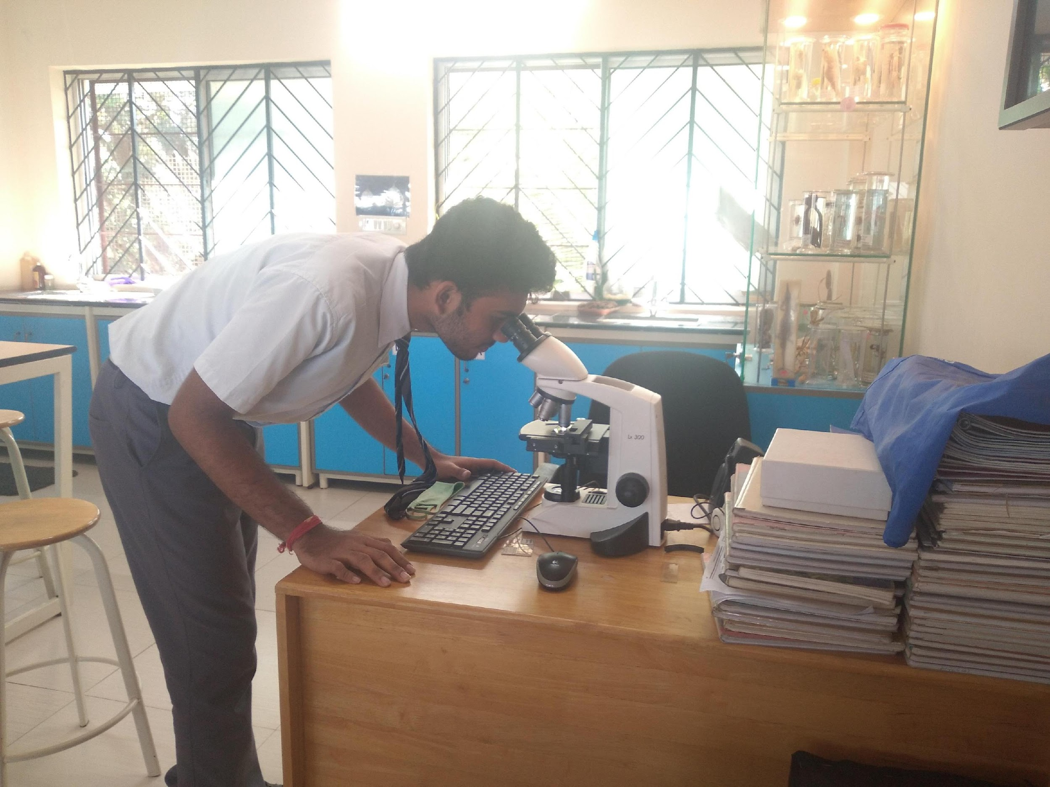
Spiulina species being observed under 45x
Date: 15/11/2022
Time: 1:30pm
Focusing and observing of Aulocosiera species under 100x magnification of compound microscope
Date: 30/11/2022
Time: 2:00 pm
Aulocosiera species being observed under 100x magnification
Date: 30/11/2022
Time: 2:00 pm

Slide 19
REFERENCES
https://wgbis.ces.iisc.ernet.in/energy/water/paper/ETR31/coimbatore%20Reposr_6Feb2009v8.pdf
https://link.springer.com/article/10.1007/s10750-020-04353-4
https://assets.researchsquare.com/files/rs-797085/v1/24295283-7031-4374-017a8a12afc5.pdf?c=1637245526
CBSE class 12 Biology lab manual.

Slide 20
ACKNOWLEDGEMENTS
Our sincere thanks to Vidyaniketan Public School for providing us with the opportunity to take part in Lake Symposium 2022. Our sincere thanks to the teachers who guided us throughout the completion of the project.
We would sincerely thank the IISC for giving us the platform to present our research papers.

