Slide 1
Title : Waste Management
ADITHYA JOIS H S AND AMOGH SHASTRY
Karnataka Pre University Board
Put here
School Logo
12/1/2022
LAKE 2022: Conservation of wetlands: ecosystem-based adaptation of climate change, December 28-30, 2022
1

Slide 2
OBJECTIVE
To analyze the waste generated in our locality.
To come out with preventive measures that can aid waste management.

Slide 3
Procedure
We have selected the area (Govindaraja Nagara) as the basis of our research and collected data of the garbage generated.
We approached the nearest BBMP office to collect information about the same.
We took pictures of the garbage that has been disposed carelessly in the area.
We collected soil near the garbage dump and conducted few tests.

Slide 4
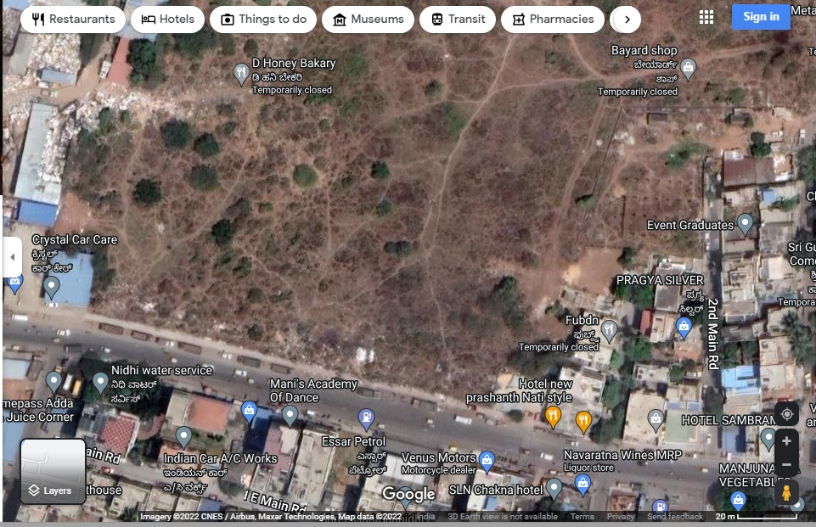
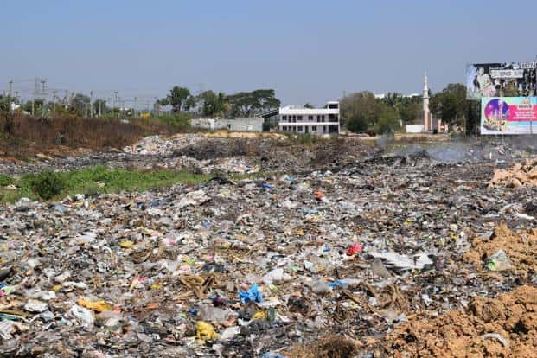
Pictures taken in the ward.
Taken on 21/11/22
Taken on 21/11/22

Slide 5
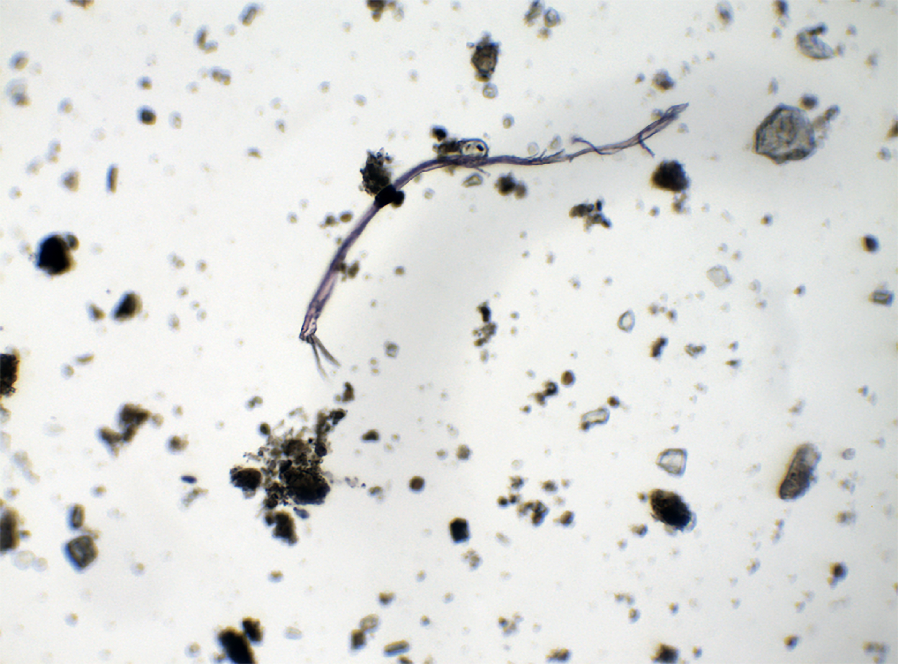
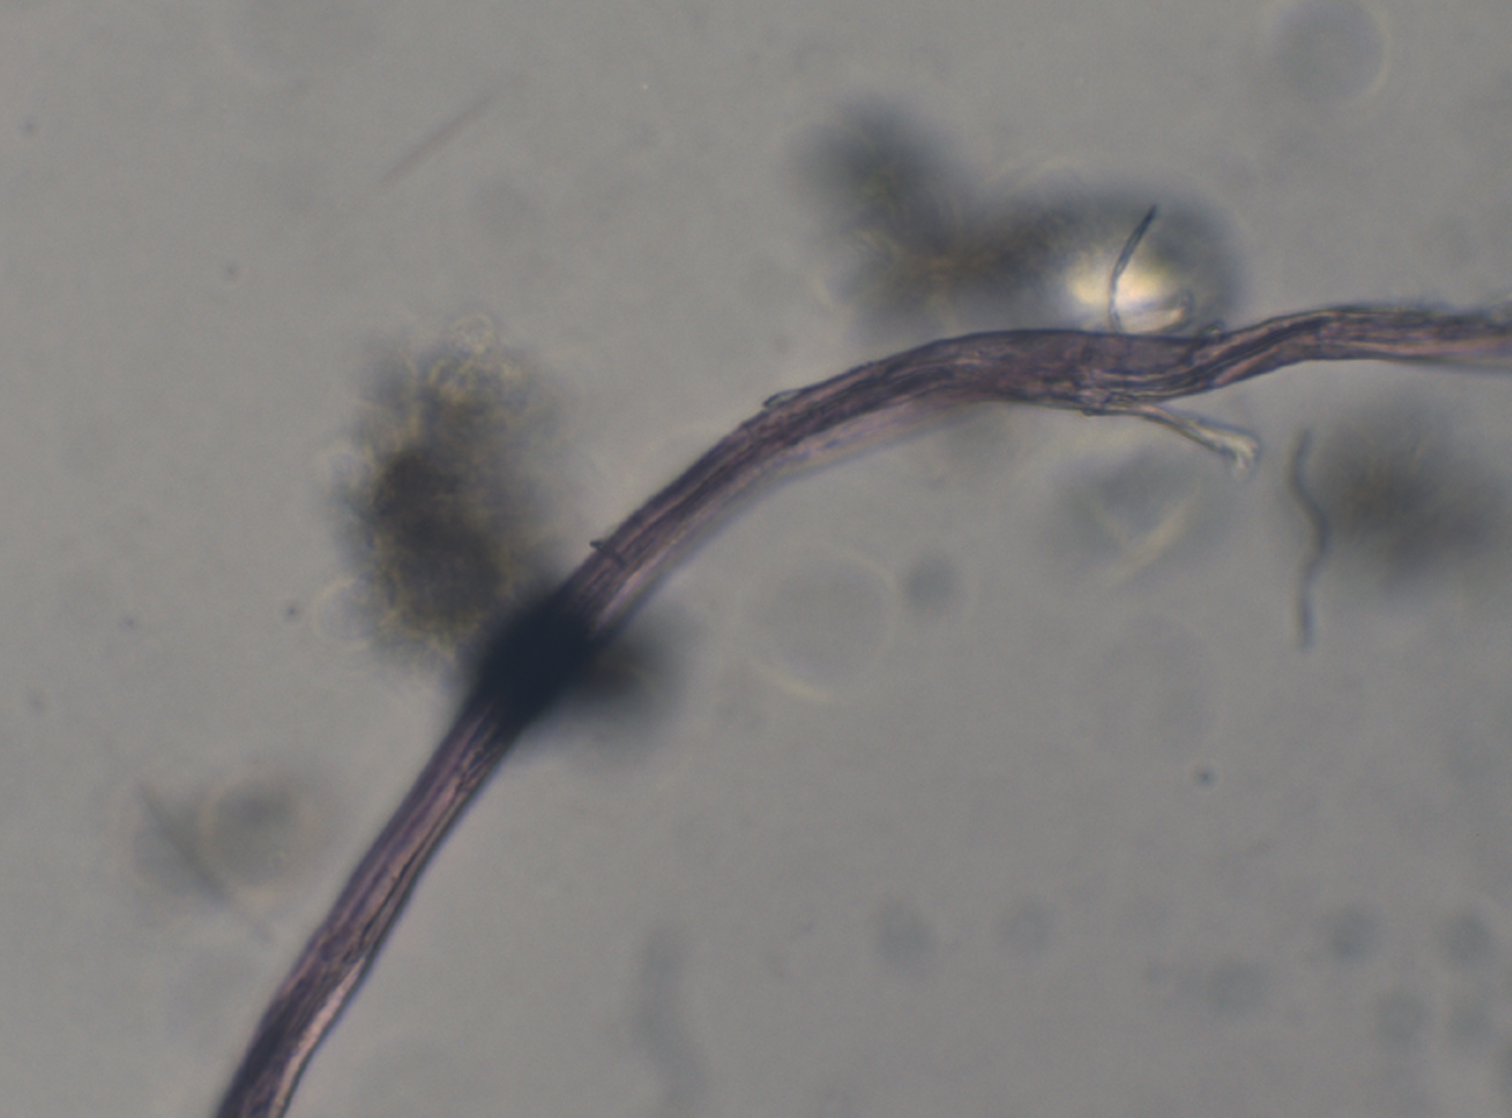
Analysis of Soil
Micro plastic detected under 10x magnification
Micro plastic detected under 40x magnification

Slide 6
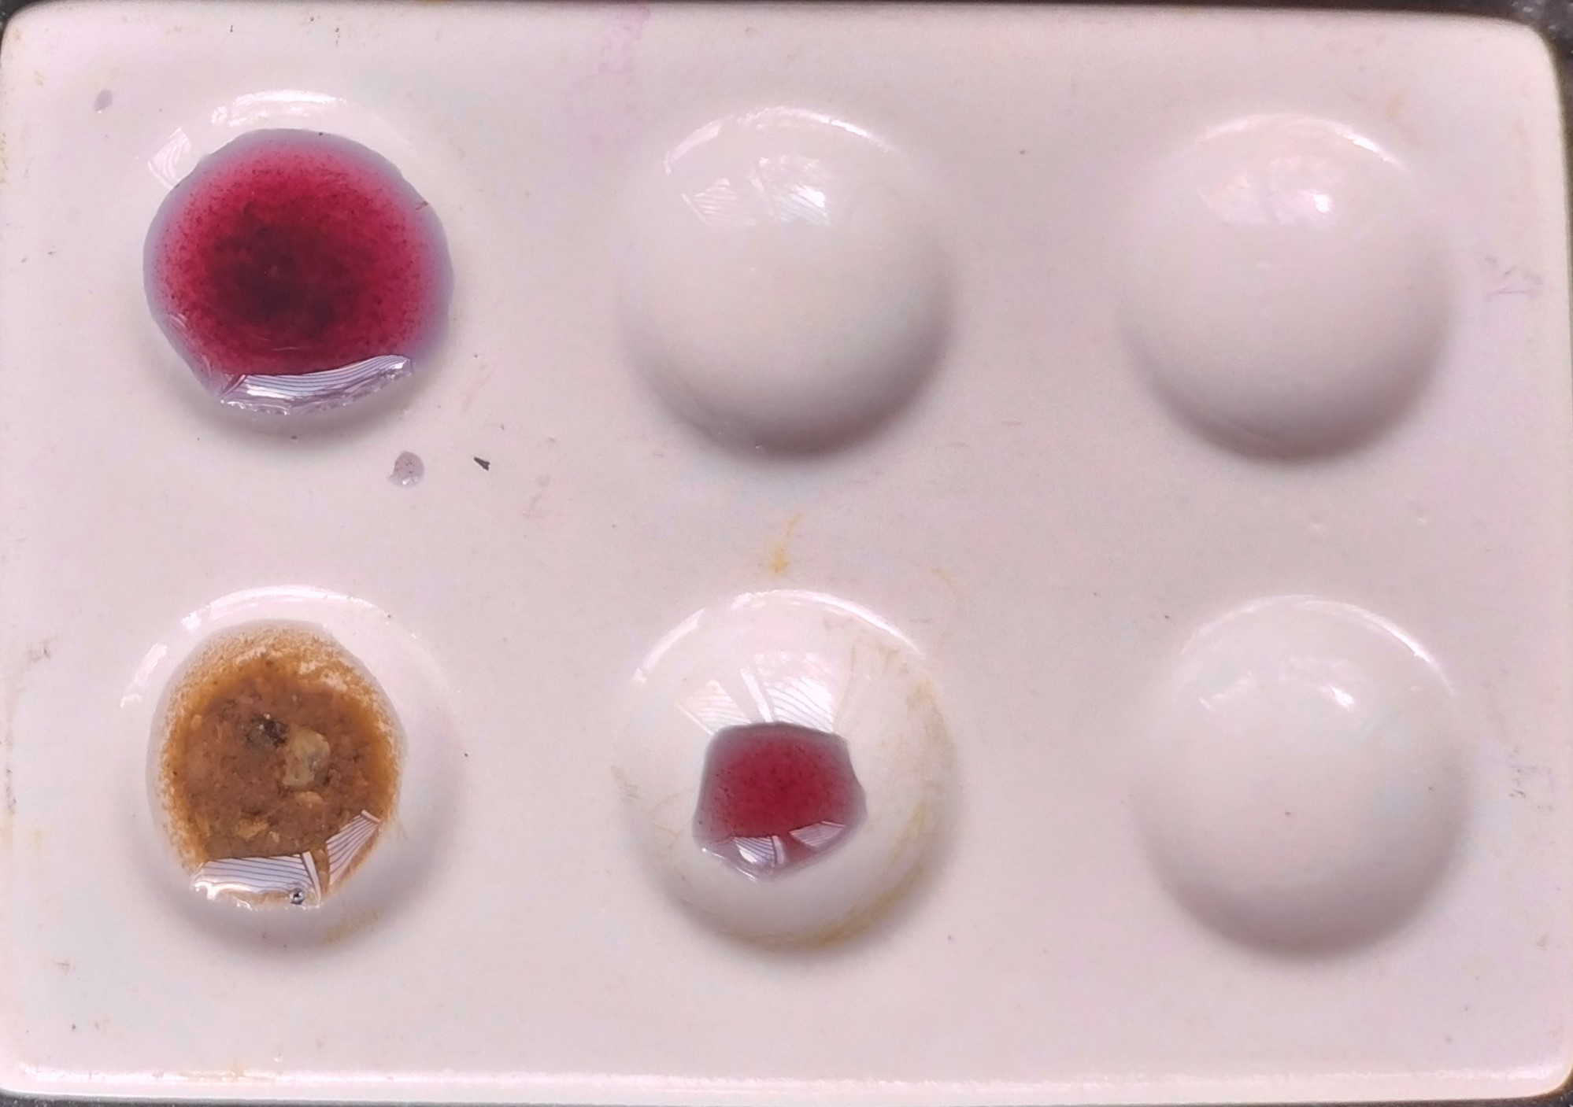
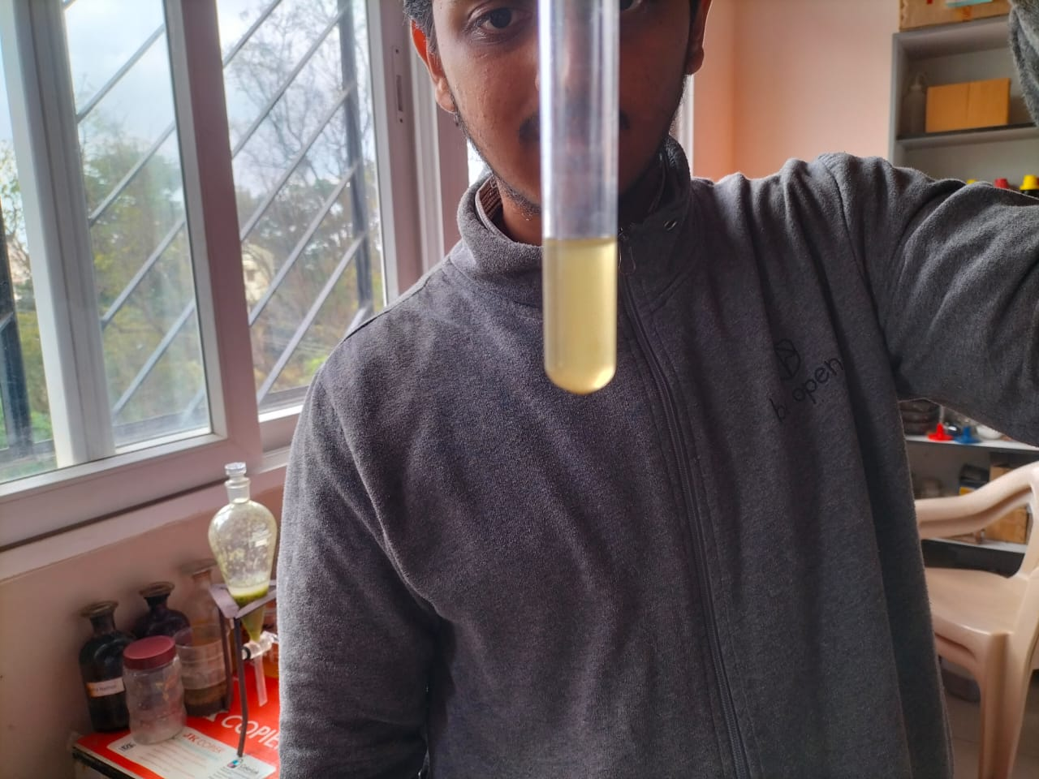
Analysis of Soil
pH value 1 (Highly acidic)
pH measured using universal indicator.
Acid radical detection
(Soil solution + Ammonium molybdate + Concentrated HNO₃)
Phosphorous detected
Yellow precipitate obtained.

Slide 7
Findings
According to BBMP the ward (Govindaraja Nagara) contributes maximum waste in the region of Bangalore South.
Waste generated by each house hold in the constituency is between 350g to 450g per day.
At our neighboring houses an average of 430g of waste is produced in a week.
Total waste generated the constituency is nearly 1,22,500 Kg by nearly 3.5 to 3.6 lakh houses.
The statistics of the waste generated in the constituency are as shown below
(From BBMP ledger):-
Types of waste generated | % of waste generated | Waste generated in kg (in a month)
Household waste | 68.5 | 83912
Commercial waste | 28.3 | 34667.5
Street sweeping | 3.1-3.2 | 3797.5

Slide 8
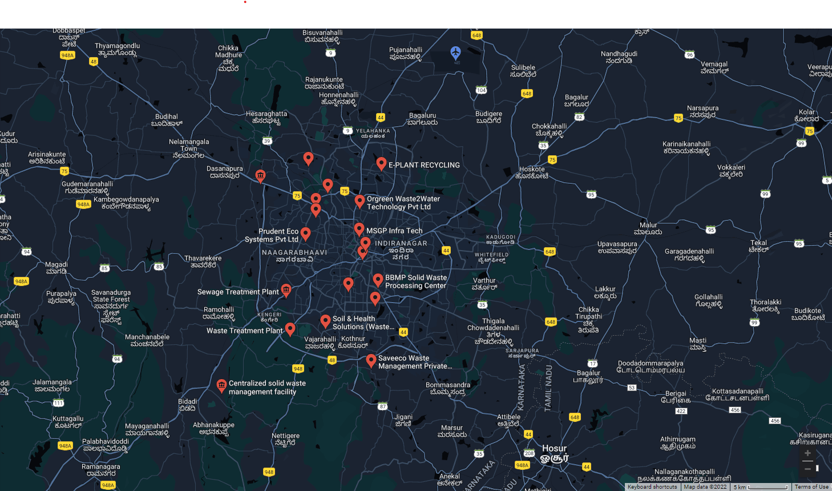
Mitigations to be adapted.
Hyper consumerism leads to increase in waste generated.
According to BBMP there are : -1) 7 wet waste processing plants
2) 15 bio methane gas plant
3) 1 sanitary land fill.
Inspite of all these measures BBMP is only able to recycle 20% to 25% of waste .

Slide 9
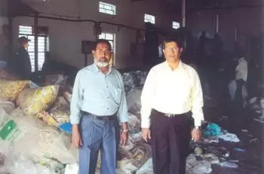
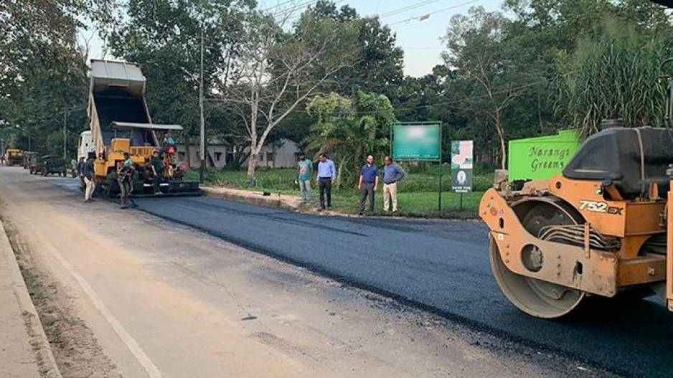
1. Turning Plastic Waste Into Functional Roads
Innovative ideas that have been adapted to enhance waste management.
Founded by Ahmed Khan and Rasool
Polyblend is used to lay roads.
Normal road lifespan-3 years
Polymerized bitumen road-6 to 7 years.
Melting point of bitumen is about 60 to 70 degrees whereas that of plastic is about 130 to 140 degrees.
Laying roads in Lucknow using polyblend.

Slide 10
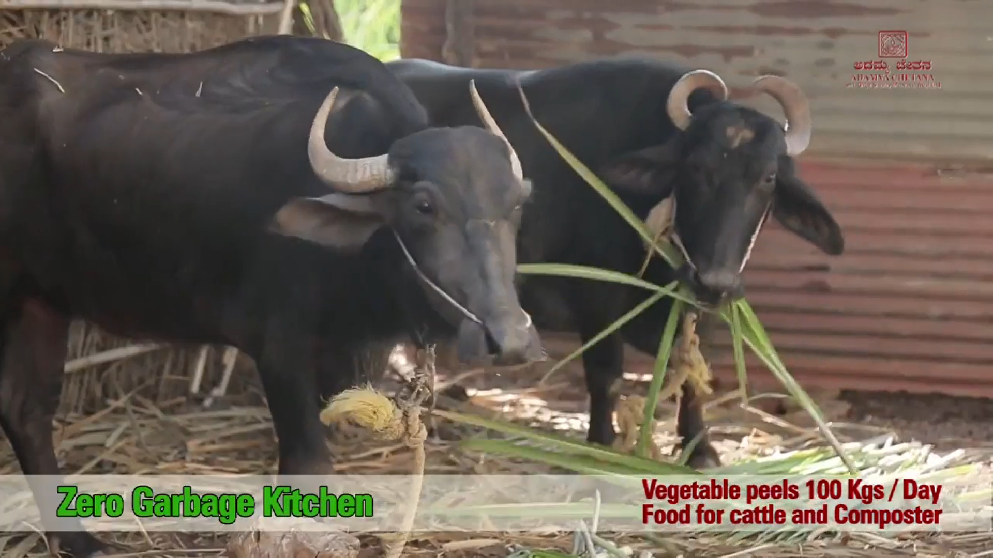
2. Adamya Chetana
NGO which aims to create sustainable, replicable model for the underprivileged.
One initiative taken is the ZERO garbage kitchen.
LPG cylinders switched over briquette fuel.
200-300 Kgs ashes generated is sent to farmers as Manure
Vegetable waste are sent to nearby Goshala.

Slide 11
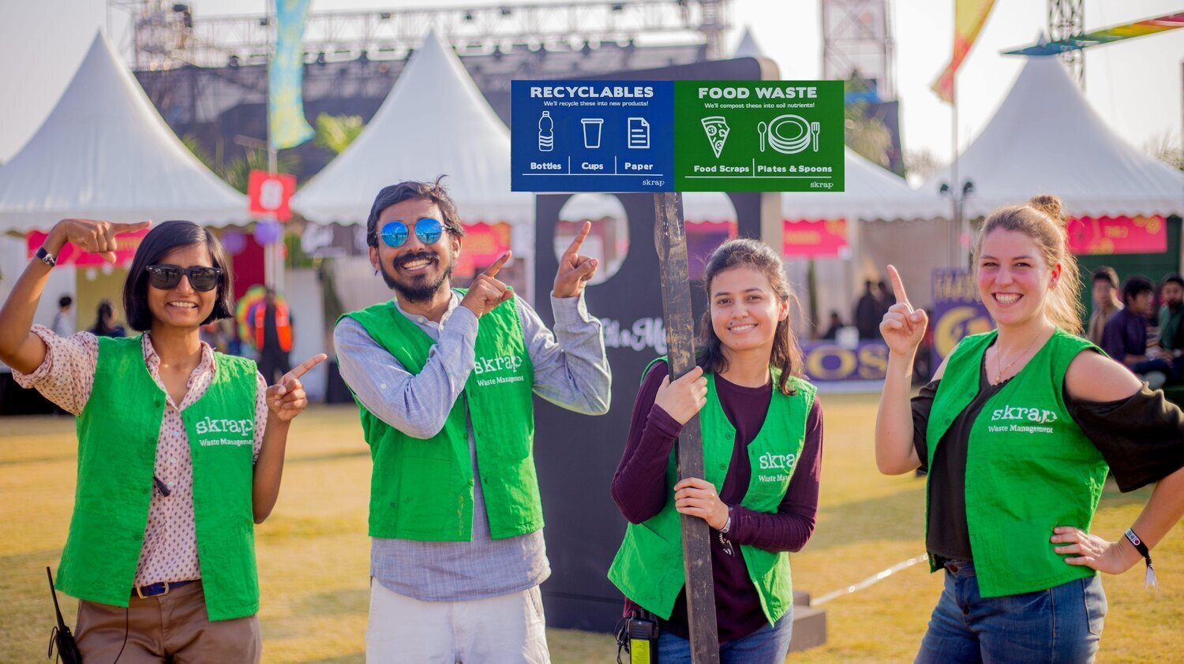
3.SKRAP
Mumbai based organization-Divya Ravi Chandra.
Plastic cutleries were replaced by bamboo cutleries in offices.
Bamboos are sustainable for nearly a year if used properly.
The offices which used to produce 250kg of waste now produces less than 7 kgs of waste per month.

Slide 12
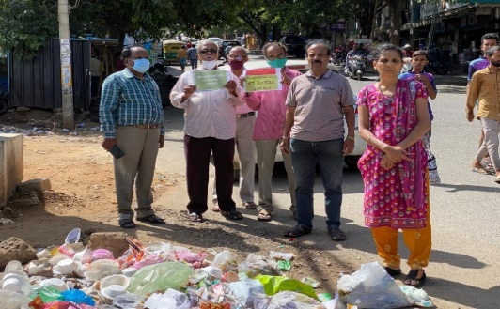
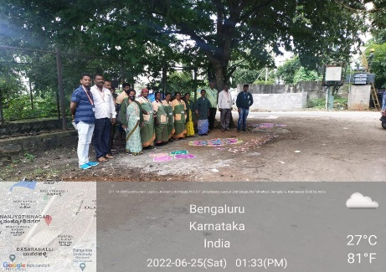
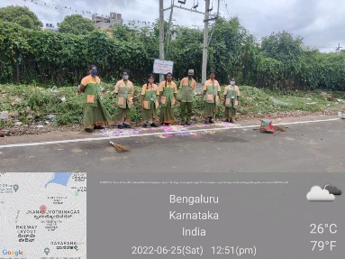
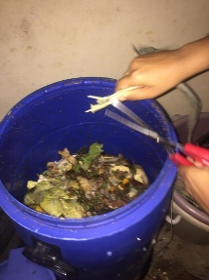
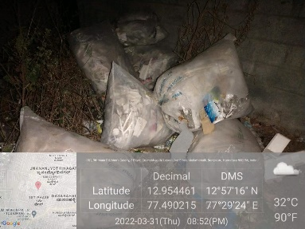
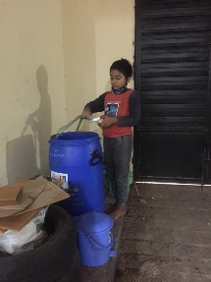
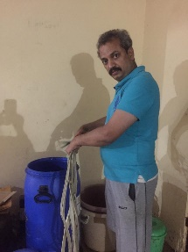
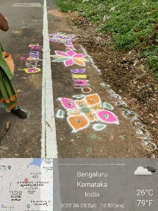
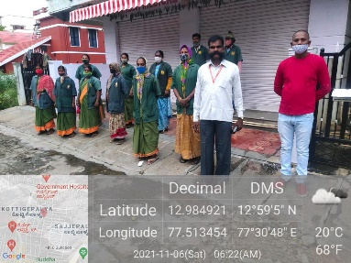
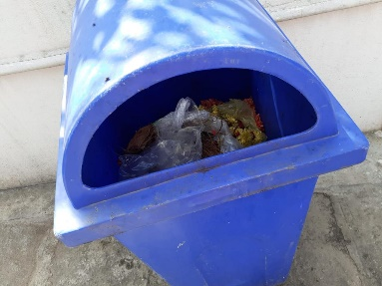
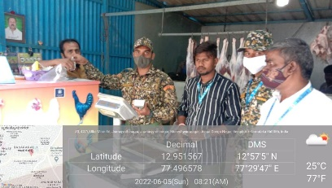
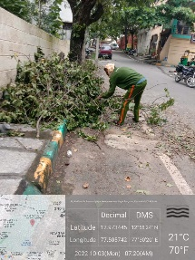
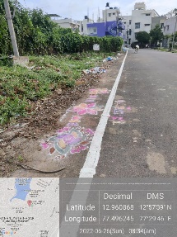
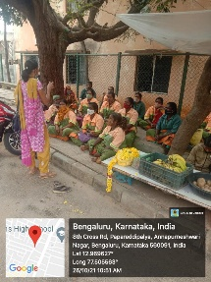
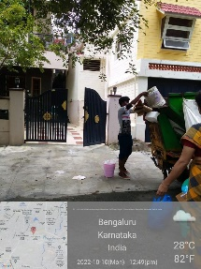
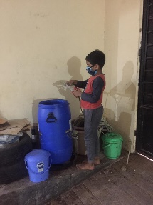
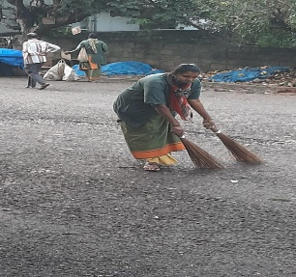
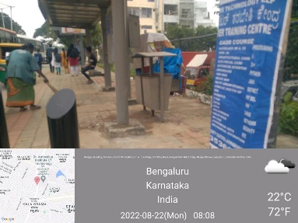
PICTURE GALLERY

Slide 13
Acknowledgements.
I would like to thank my teacher Sripoorna ma'am, and all the teachers for their valuable suggestions and guidance.
I would like to convey my gratitude to our school management and IISc for giving us such an enriching opportunity to learn.

Slide 14
Conclusion : Our venture will not end here. We will work on this issue and will try to come up with more innovative ideas in the coming days.

Slide 15
THANK YOU

Slide 16
References:
BBPM office Govindarajanagara
https://www.theweekendleader.com/Innovation/1181/plastic-smiles.html
https://adamyachetana.org/about-us/
https://www.skrap.in/
NCERT Biology textbook.

