Slide 1
LAKE 2022: CONSERVATION OF WETLANDS: ECOSYSTEM-BASED
ADAPTATION OF CLIMATE CHANGE
Likitha.N, Poorvi M.S and Yuvika.D.Patel
Standard:11th
Topic: Microplastics And Its Effects
17/12/2022
LAKE 2022: Conservation of wetlands: ecosystem-based adaptation of climate change, December 28-30, 2022
1

Slide 2
OBJECTIVE
To find out the presence of microplastic in water samples.
17/12/2022
LAKE 2022: Conservation of wetlands: ecosystem-based adaptation of climate change, December 28-30, 2022

Slide 3
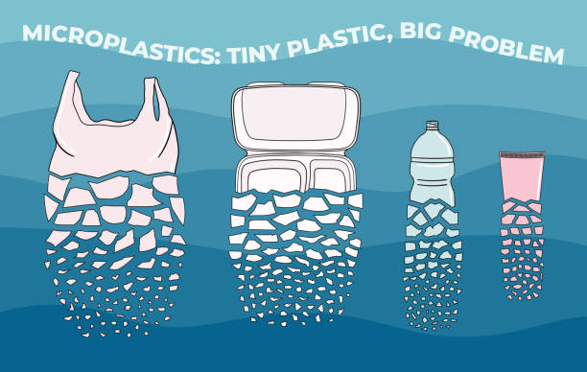
What is a microplastic?
A piece of plastic less than 5 millimeters in size, about the length of a grain of rice or smaller.
It’s very difficult to see much smaller than 5mm without close inspection or a microscope.
17/12/2022

Slide 4
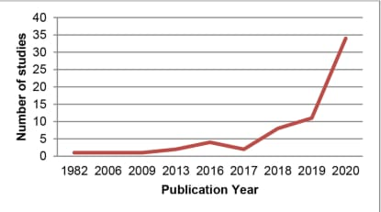
Studies on microplastics
Microplastic studies conducted in India.
17/12/2022
LAKE 2022: Conservation of wetlands: ecosystem-based adaptation of climate change, December 28-30, 2022

Slide 5
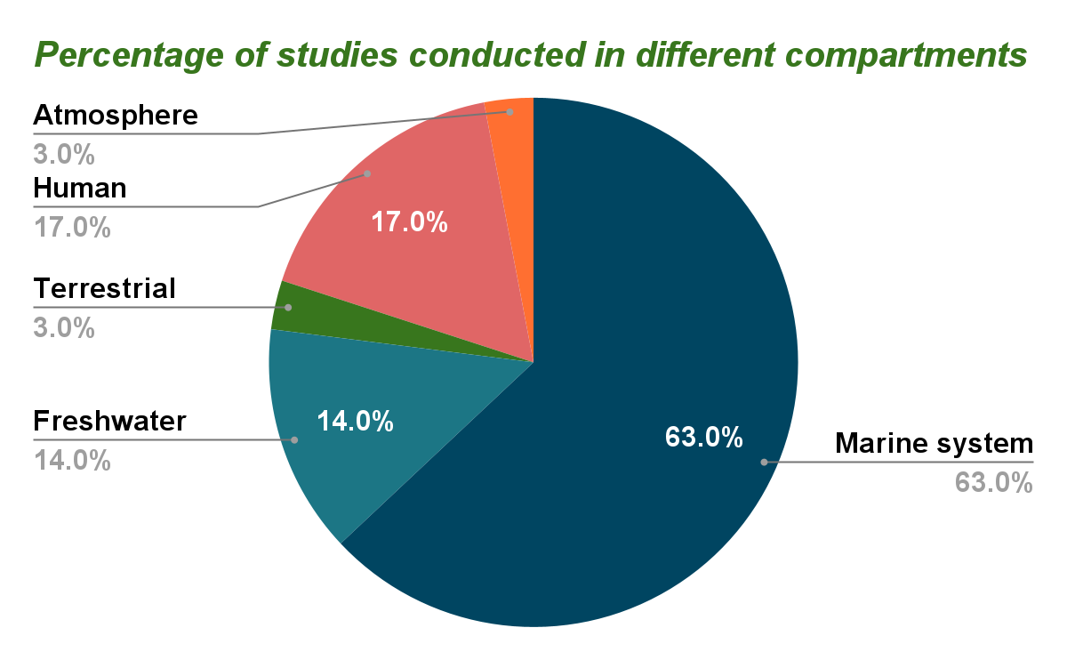
17/12/2022

Slide 6
MICROPLASTIC IN RAINWATER
Atmospheric circulation patterns are capable of transporting microplastics significant distances and they have been recorded in some of the most remote parts of the oceans and the Arctic.
17/12/2022
LAKE 2022: Conservation of wetlands: ecosystem-based adaptation of climate change, December 28-30, 2022

Slide 7
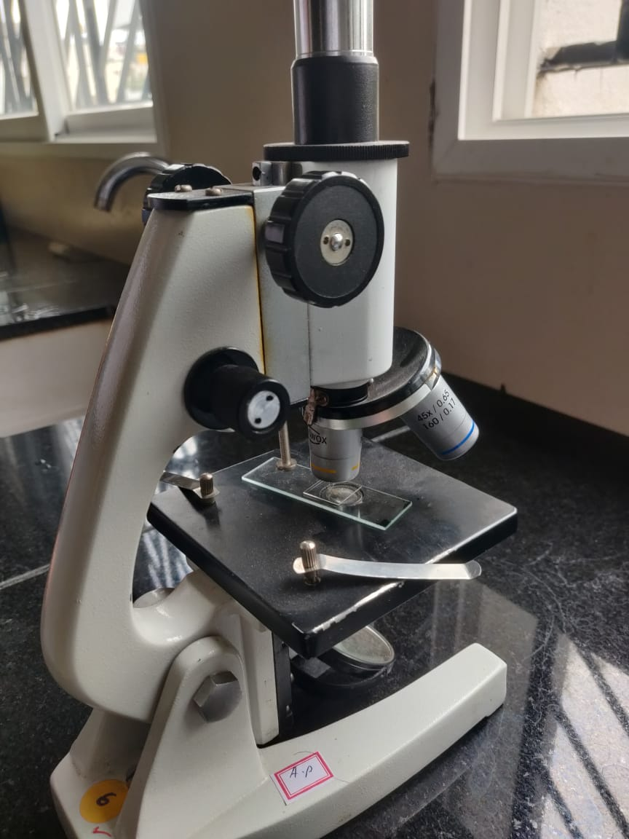
Materials Used
Temperature- Thermometer
Acidity- pH paper, universal indicator
Bacterial contamination - Microscope
17/12/2022
LAKE 2022: Conservation of wetlands: ecosystem-based adaptation of climate change, December 28-30, 2022

Slide 8
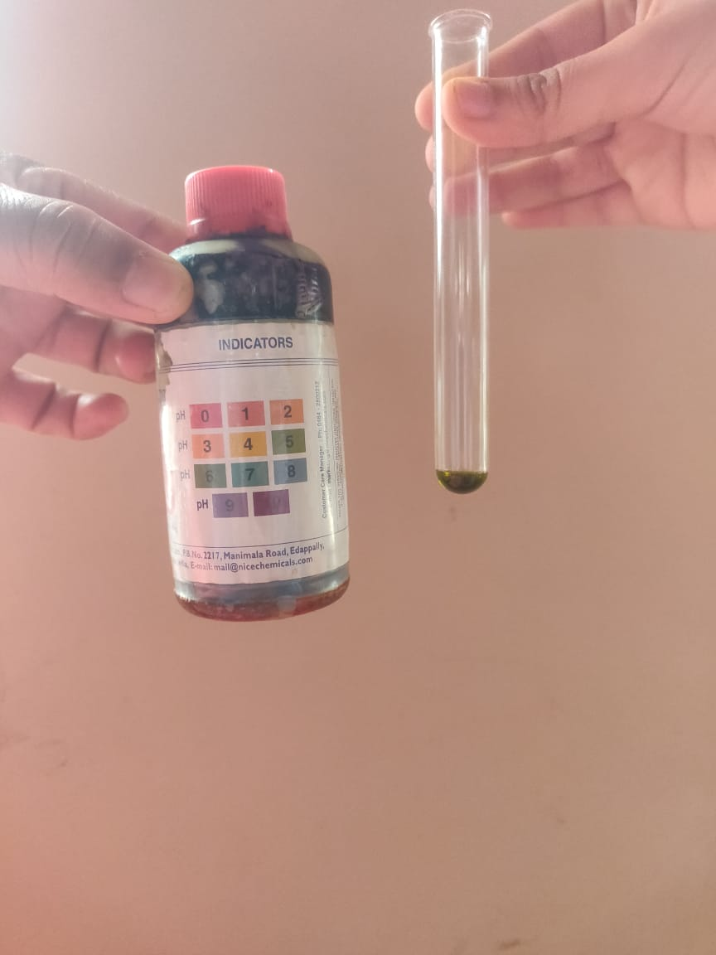
Rain Water Sample
Sample-1
Sample-2
SNo. | Parameters | Sample-1 | Sample-2
1. | Location | Nagarbhavi Bangalore | Ullal Bangalore
2. | Date | 21-Nov-2022 | 24-Nov-2022
3. | Time | 2:50pm | 12:30pm
4. | pH | 5 | 5
5. | Temperature | 21°C | 26°C
17/12/2022
LAKE 2022: Conservation of wetlands: ecosystem-based adaptation of climate change, December 28-30, 2022

Slide 9
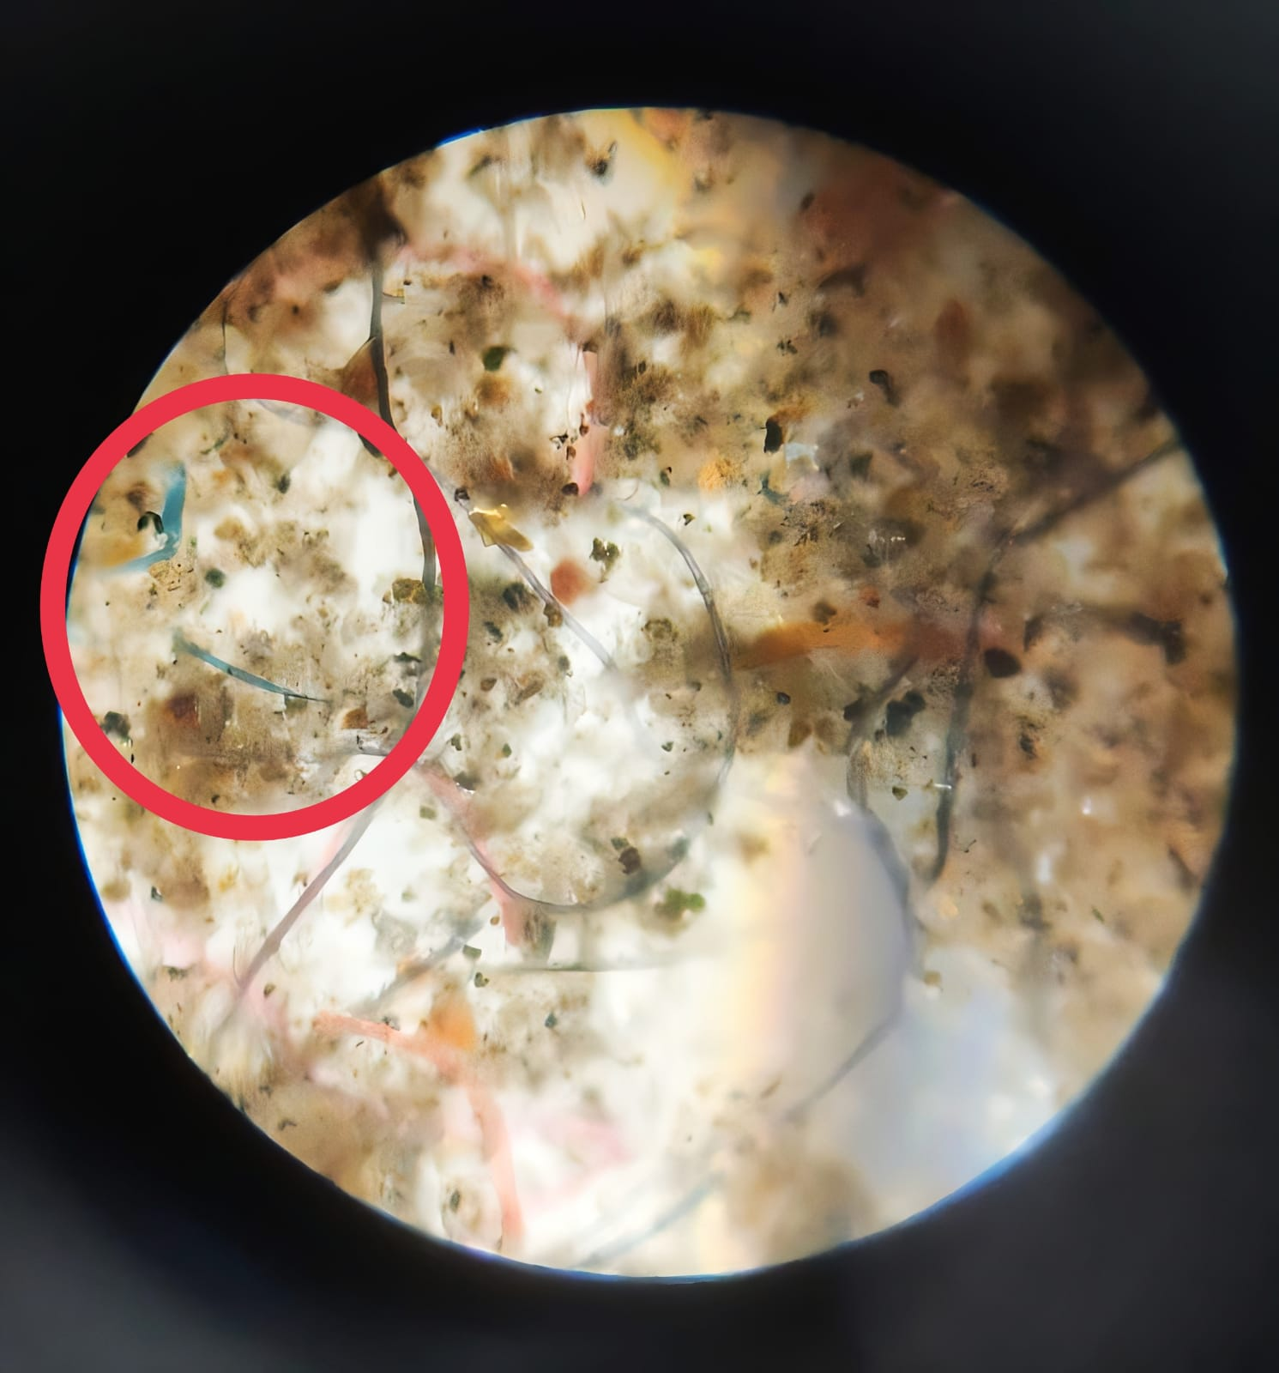
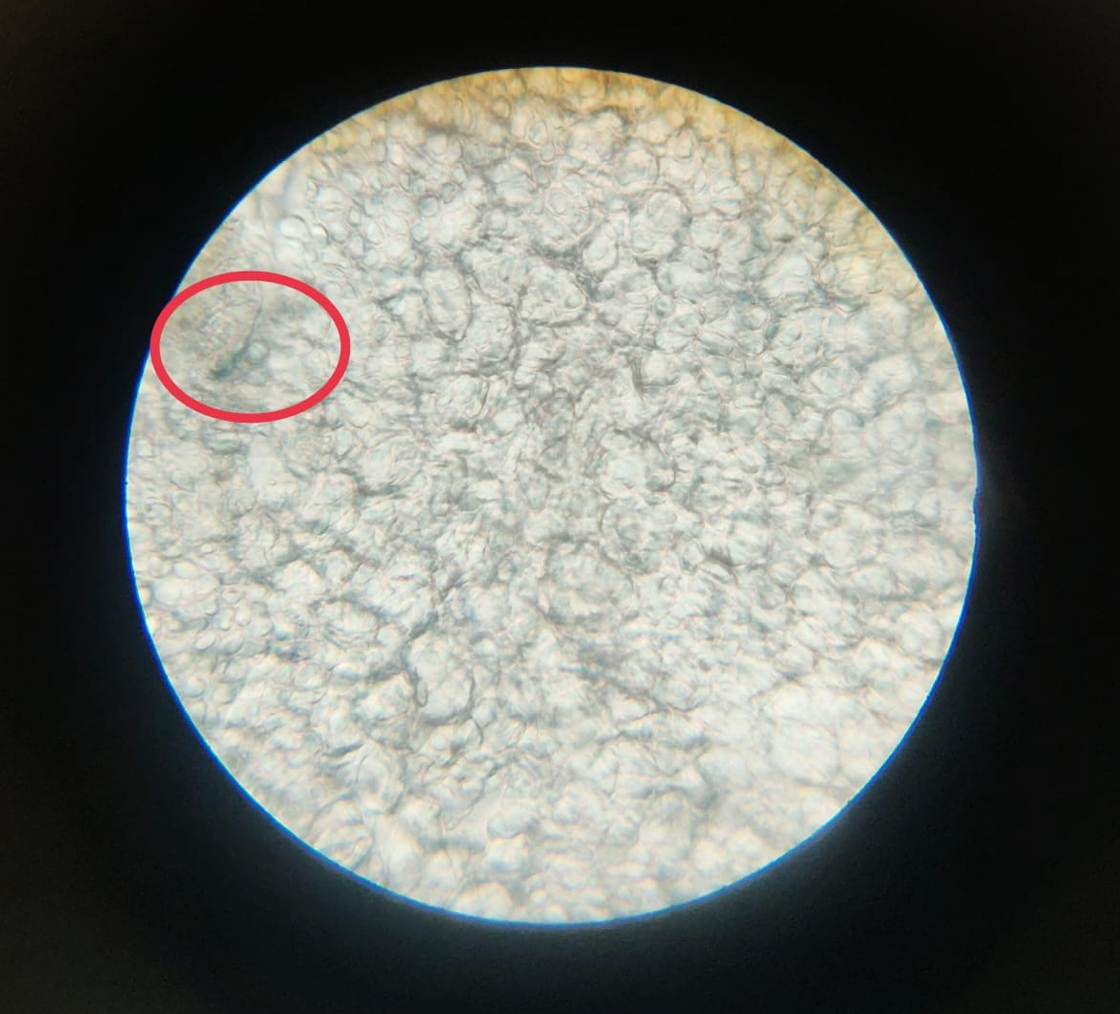
Sample gathered in Nagarbhavi,Bangalore
22-Nov-2022, 3:21pm
Sample gathered in Ullal, Bangalore
24-Nov-2022, 12:30pm
17/12/2022
LAKE 2022: Conservation of wetlands: ecosystem-based adaptation of climate change, December 28-30, 2022

Slide 10
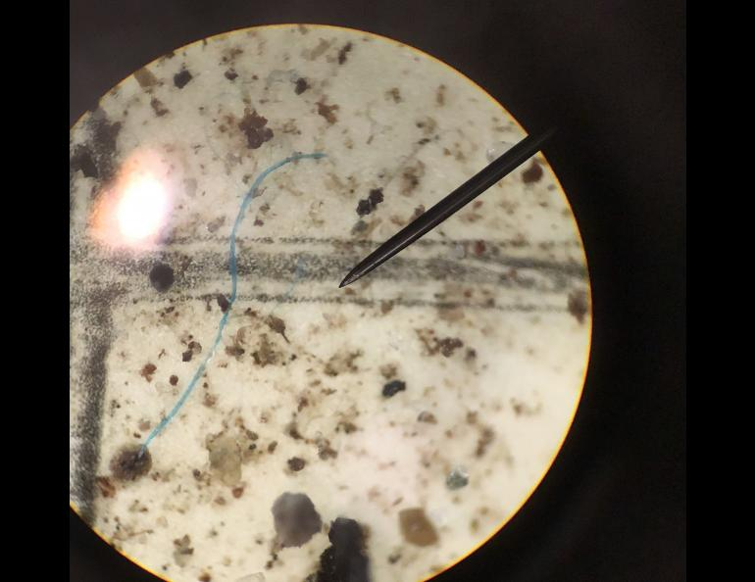
Sample gathered in Juneau, Alaska
Dec. 13, 2021
[Article: University Of Alaska Fairbanks]
17/12/2022
LAKE 2022: Conservation of wetlands: ecosystem-based adaptation of climate change, December 28-30, 2022

Slide 11
PLASTICS AND PLANKTONS
Planktons give out 50%-80% of the Earth’s oxygen.
These tiny organisms capture the Carbon through the process of photosynthesis.
Microplastics affect the ability of these organisms to grow, reproduce, capture carbon and release oxygen.
Air bubbles produced in the sea primarily by breaking waves burst at the surface to eject the jet drops into the atmosphere.
These drops are mixed upwards by turbulence to produce the well known marine sea salt aerosol.
[Article: Centre for Nature and Climate]
17/12/2022
LAKE 2022: Conservation of wetlands: ecosystem-based adaptation of climate change, December 28-30, 2022

Slide 12
Polyethylene Terephthalate (PET )
Usually used in packing water and food materials.
Due to the process of leaching many toxic chemicals and microplastics get into the food and water.
Antimony trioxide is used in the production of PET
Antimony trioxide is found out to be hazardous as it can cause:
chronic health effects,reproductive hazard, other acute health effects.
DEHP-di(2 ethylhexyl)phthalate may reasonably be anticipated to be a human carcinogen.
17/12/2022
LAKE 2022: Conservation of wetlands: ecosystem-based adaptation of climate change, December 28-30, 2022

Slide 13
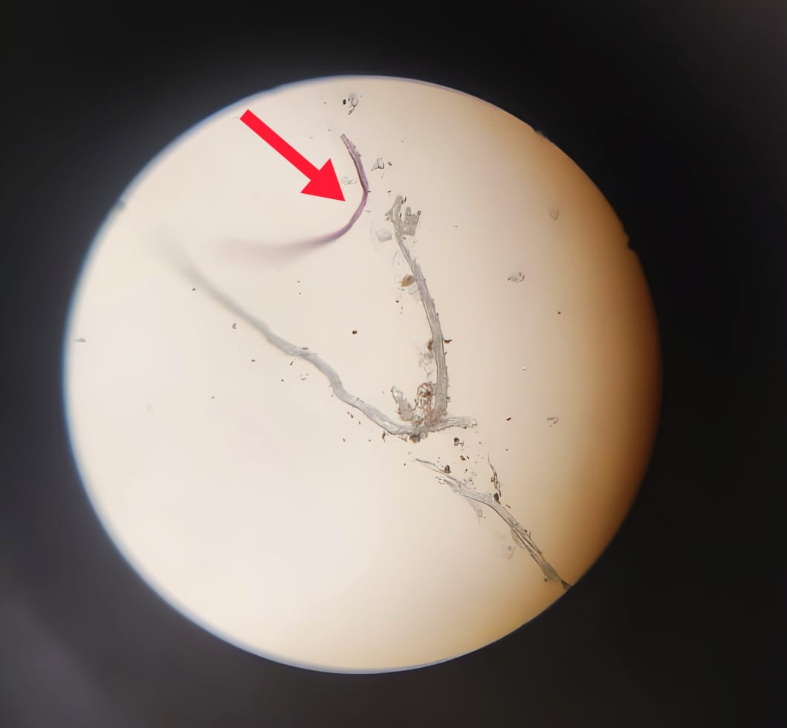
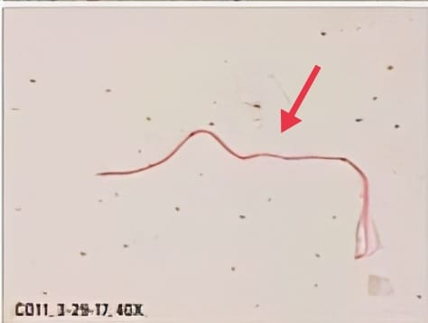
Microplastic present in water samples
Tupperware water bottle
13-Dec2022
Geological Survey(U.S)
17/12/2022
LAKE 2022: Conservation of wetlands: ecosystem-based adaptation of climate change, December 28-30, 2022

Slide 14
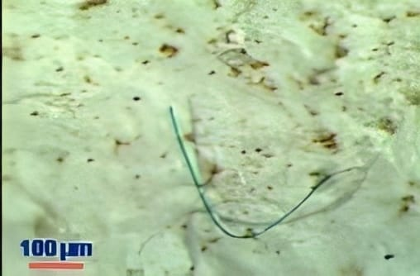
Microplastic present in water samples
Microplastic in Bay Of Bengal
Sea water from Kanyakumari
5-Dec-2022
17/12/2022
LAKE 2022: Conservation of wetlands: ecosystem-based adaptation of climate change, December 28-30, 2022

Slide 15
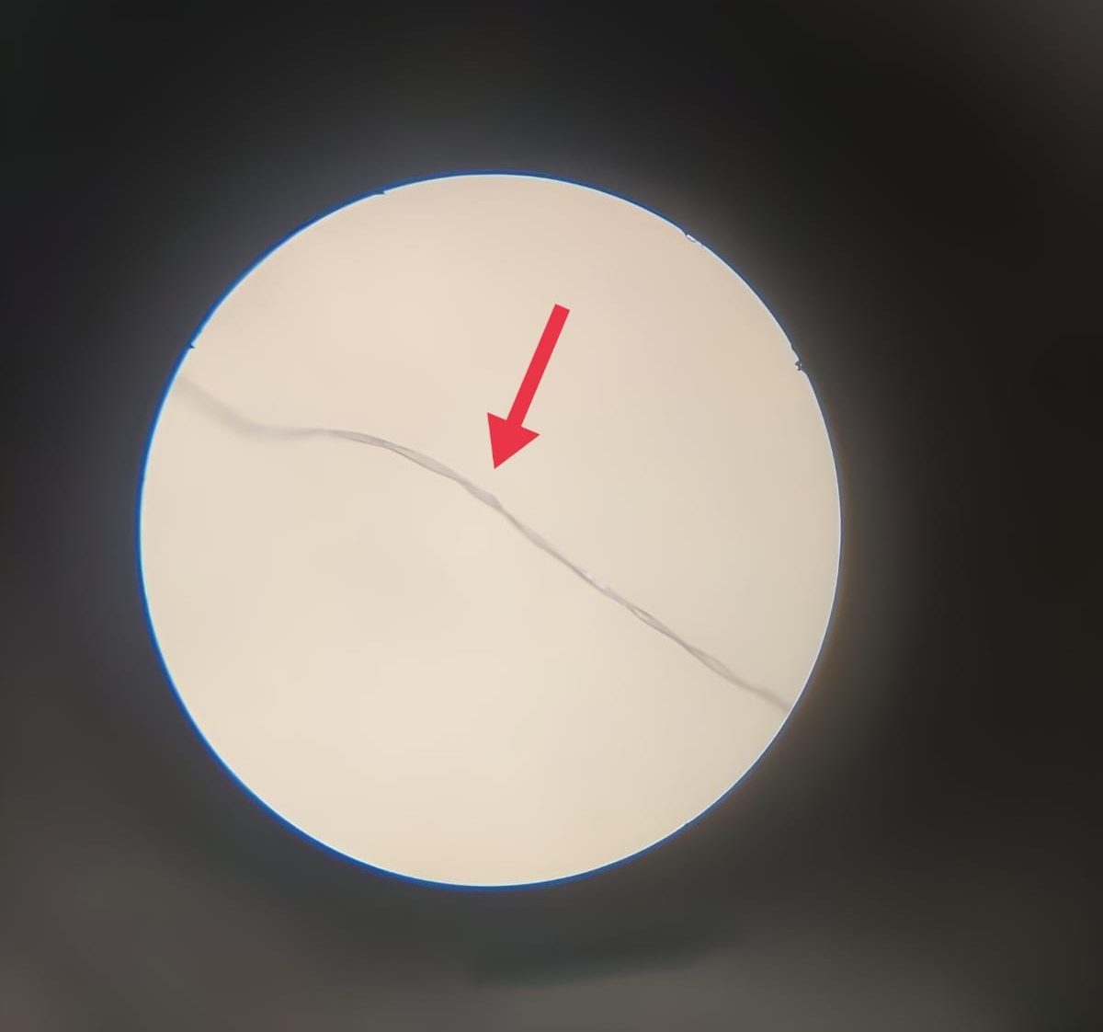
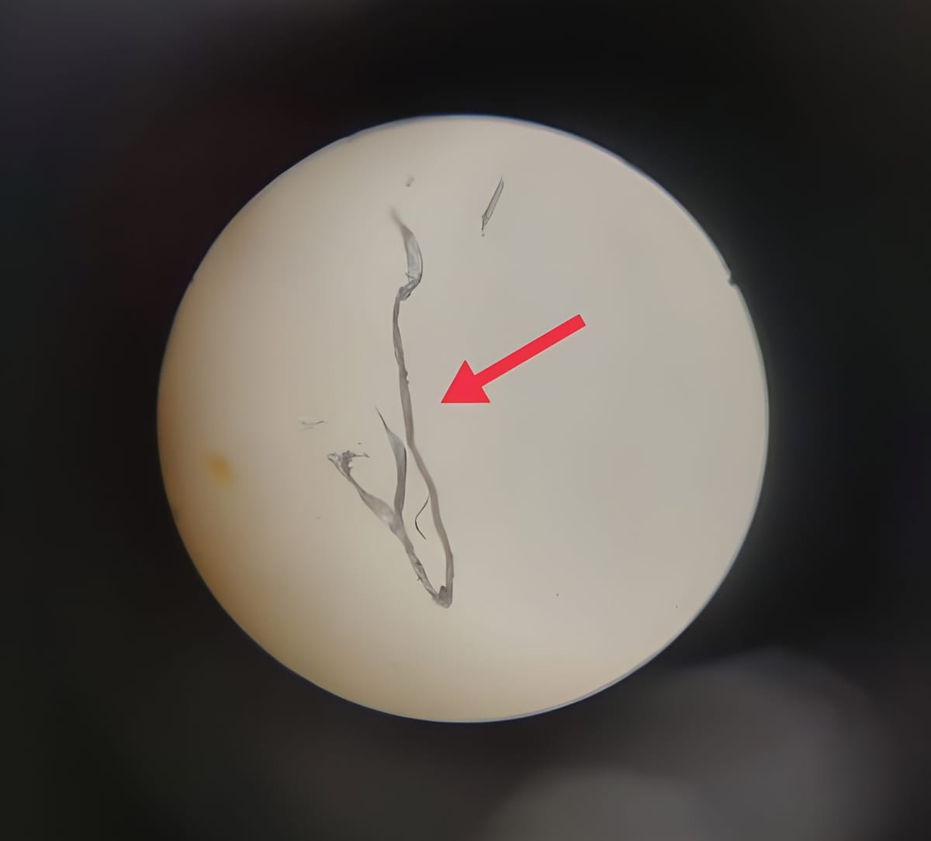
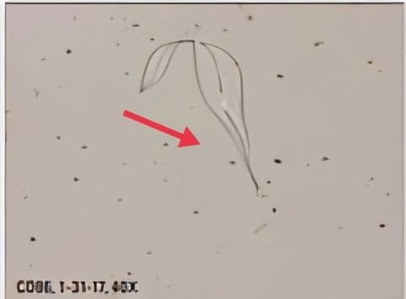
Microplastic present in water samples
Different Plastic Bottles
13-Dec-2022
Geological Survey(U.S)
17/12/2022
LAKE 2022: Conservation of wetlands: ecosystem-based adaptation of climate change, December 28-30, 2022

Slide 16
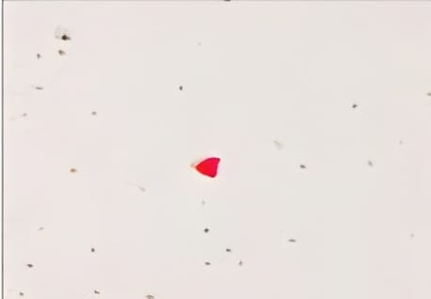
Microplastic present in water samples
Plastic bottles
13-Dec-2022
Geological Survey(U.S)
17/12/2022
LAKE 2022: Conservation of wetlands: ecosystem-based adaptation of climate change, December 28-30, 2022

Slide 17
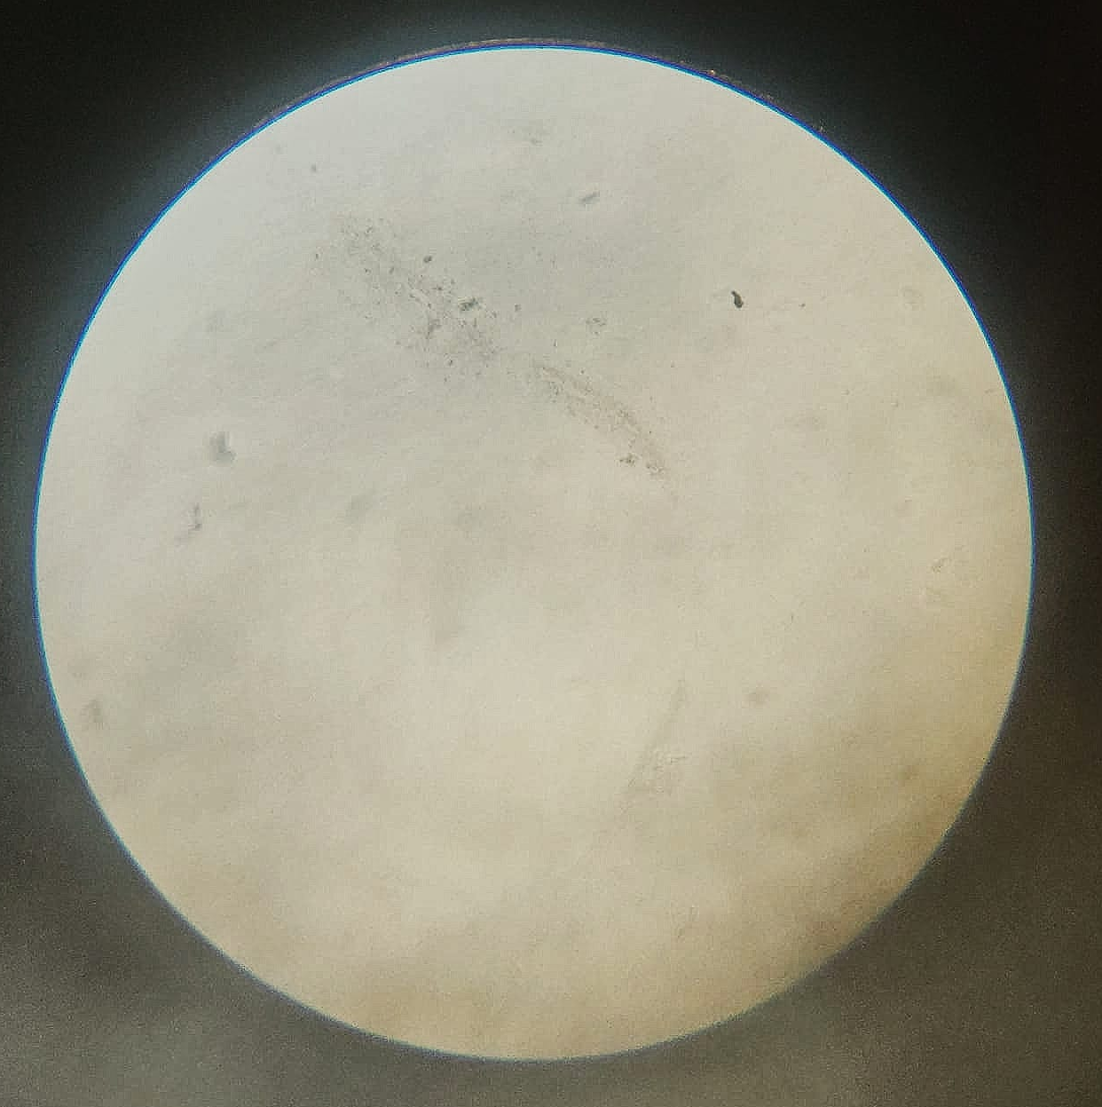
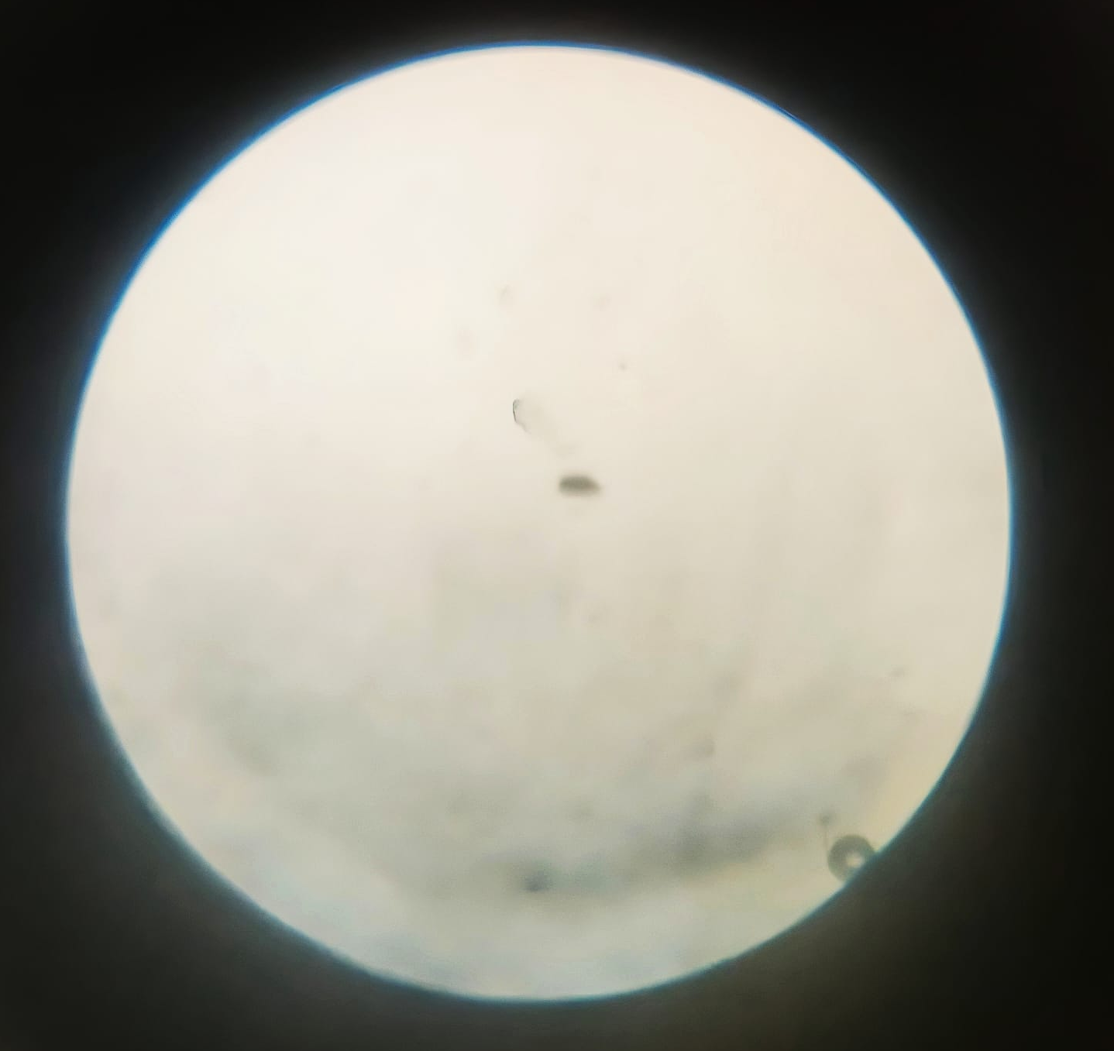
Microplastic present in water samples
Metal Water Bottles (13-Dec-2002)
17/12/2022

Slide 18
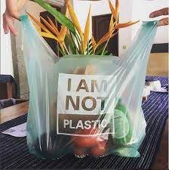
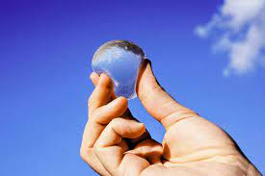
Mitigation Strategies And Adaptation
As it is said- “The future depends on what you do today!”
Biodegradable bags such as jute and cassava bags(soluble in H₂O).
Mass production of water blobs instead of plastic bottles.
17/12/2022
LAKE 2022: Conservation of wetlands: ecosystem-based adaptation of climate change, December 28-30, 2022

Slide 19
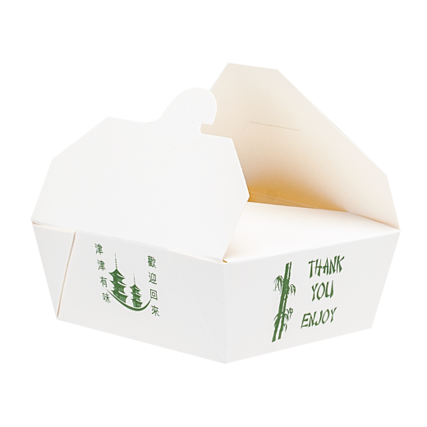
Mitigation Strategies And Adaptation
Carrying your own cutlery.(spoons, steel straws,etc..)
Develop a habit of taking a shower than using a bucket and a mug, which also helps in saving water.
Usage of solid paper packaging instead of plastic containers.
(As there is increase in e-commerce parallely there is increase in packages and delivery services which is again done using plastic.)
17/12/2022
LAKE 2022: Conservation of wetlands: ecosystem-based adaptation of climate change, December 28-30, 2022

Slide 20
CONCLUSION
Reduction of microplastic or plastic itself does not necessarily improve environment quality.
The environment only benefits from measures that actually reduce the exposure of living organisms to microplastic.
17/12/2022
LAKE 2022: Conservation of wetlands: ecosystem-based adaptation of climate change, December 28-30, 2022

Slide 21
REFERENCES
Centre for Nature and Climate.
Geological Survey(U.S).
TrAC Trends in Analytical Chemistry.
University Of Alaska Fairbanks.
17/12/2022
LAKE 2022: Conservation of wetlands: ecosystem-based adaptation of climate change, December 28-30, 2022

Slide 22
ACKNOWLEDGEMENT
We would like to express our special thanks of gratitude to all our teachers for their guidance and support in completing our Project.
We would also like to extend our gratitude to Principal Mam for providing us with all the facility that was required and also to the IISc institute for guiding us and giving us an opportunity to take part.
Thank You
17/12/2022

