Slide 1
LAKE 2022: CONSERVATION OF WETLANDS: ECOSYSTEM-BASED ADAPTATION OF CLIMATE CHANGE
[THE 13TH BIENNIAL LAKE SYMPOSIUM]
Topic : Study of water contamination , plant species and micro organisms found in Kannalli lake
m
1.BHOOMI.DEEPAK
2.MITHUN .S
3.VISHRUTH . K S

Slide 2
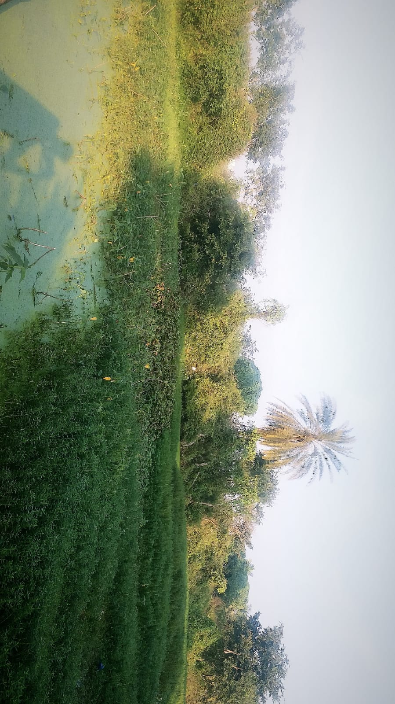
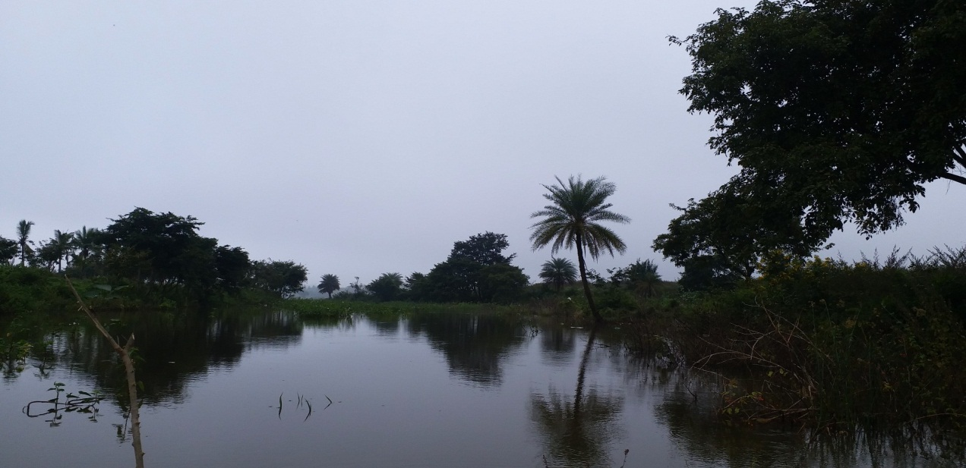
Introduction:
The main ideology of our project is to study the contamination of the Kannalli lake.
We found the cause for the contamination.
We have identified different microbes and plant species present in the lake .
In this study, we have done different types of analysis and experiments to know whether the lake is contaminated or not .
2018
2022
Then
Now

Slide 3
About the lake :
This lake is present in a small village called Kannalli.
The area of the lake is about 68 acres belonging to the survey number Kannalli 5 and Kodigehalli 86 .
This lake is considered to be one of the lakes which was identified by Kempegowda during his mission of integrating the lakes.
Longitude 12.9662° N, Latitude 77.4590° E
According to the villagers the lake is been existing from the times of Chola dynasty.
Lets now, look into the Reasons which caused pollution:
Sewage of the near by cities are directly released into the lake without sewage treatment . [lack of sewage treatment plants]
Non biodegradable wastes thrown into the lake from localities .
Lack of funds has been the reason for underdevelopment of the lake.
Lack of public interests.

Slide 4
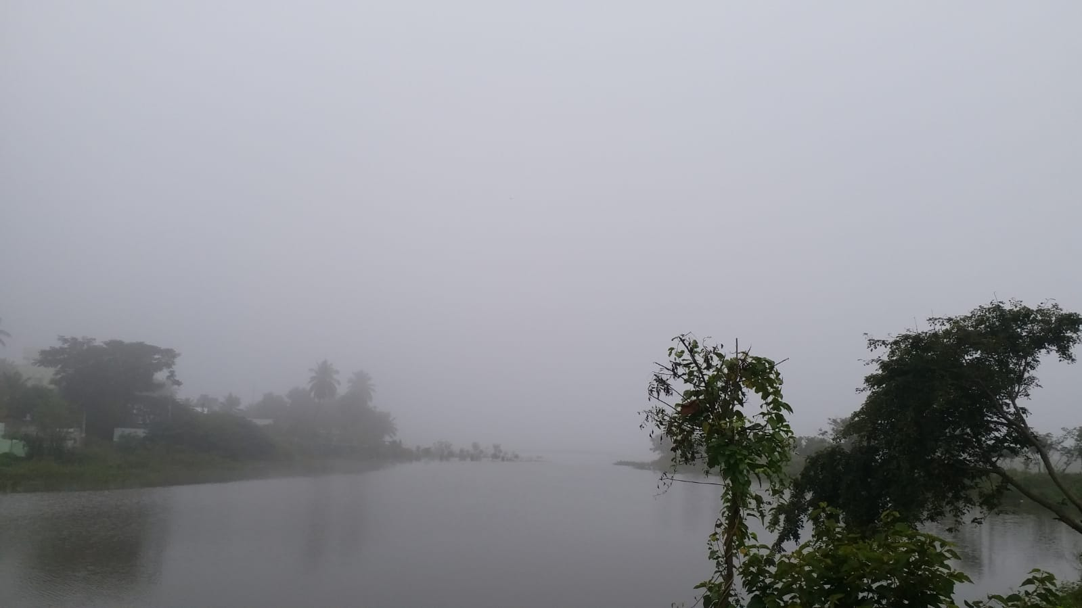
OBJECTIVE:
Kannalli lake
1. To do qualitative analysis of the water samples of Kannalli lake and to identify micro organism and plant species present in the water.

Slide 5
Materials and methods:
Materials :
Water samples that are collected at four different points of the lake.
Different plant species collected from the lake.
Methods:
Water analysis on the samples collected from the lake with the help of testing kits.
Finding the “pH” of the water .
Identification of different plant species and micro organisms using compound microscope.
D.O test for finding out contamination level with respect to parameters published by the Pollution control board .

Slide 6
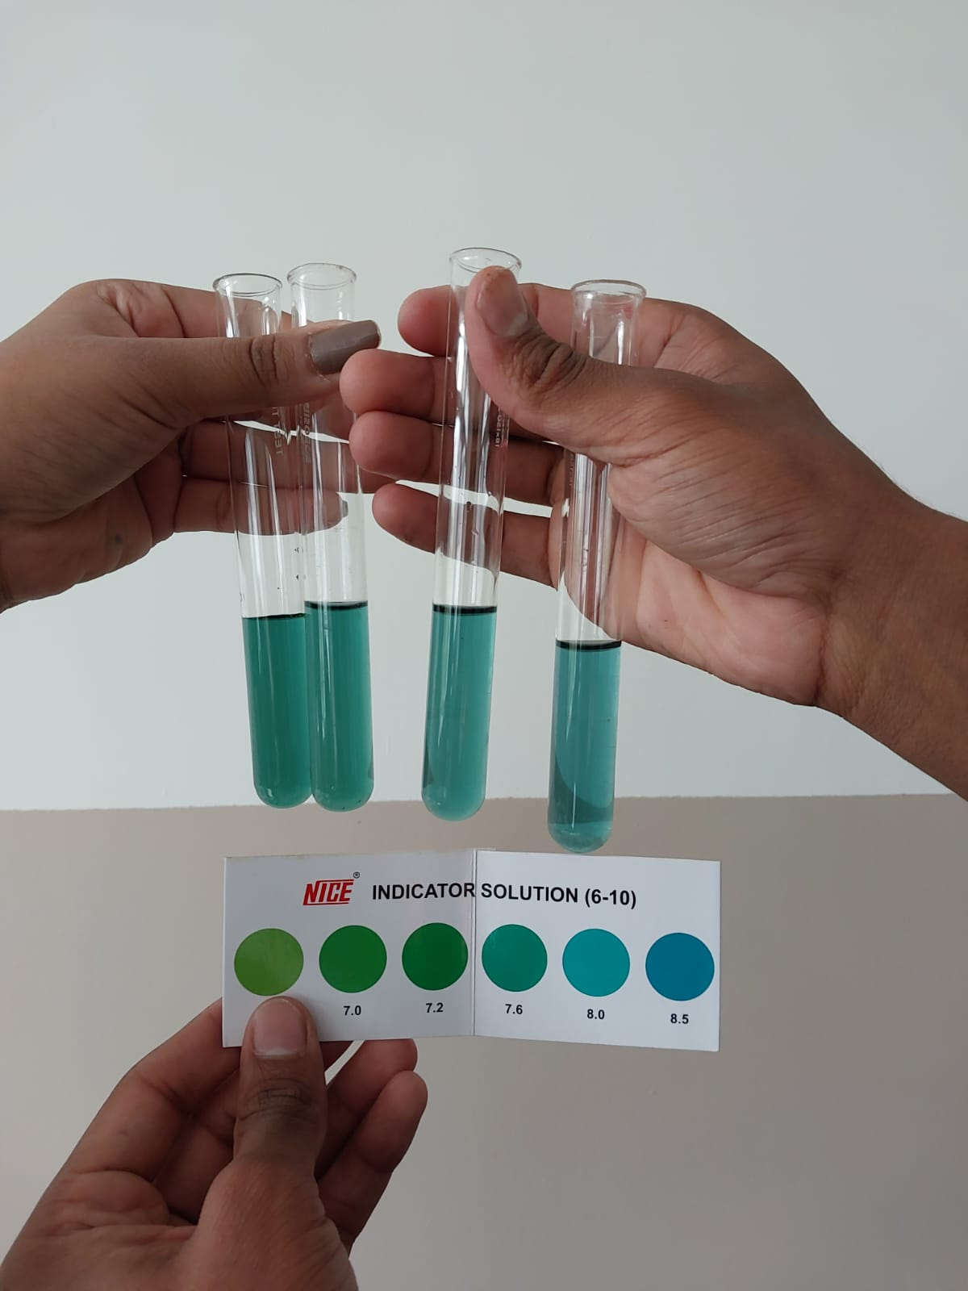
RESULTS OF THE TESTS CONDUCTED :
Tests for finding out the pH values:
Method :1) Take 10 ml of water sample in a test tube . 2) Add 3 - 4 drops of pH indicator solution (Phenol red).
3) Shake the test tube well.
4) With the help of the colour chart check the values of pH.
pH Results
Sample No. | Sample 1 | Sample 2 | Sample 3 | Sample 4
pH Value | 7.6 | 8.0 | 8.0 | 8.0

Slide 7
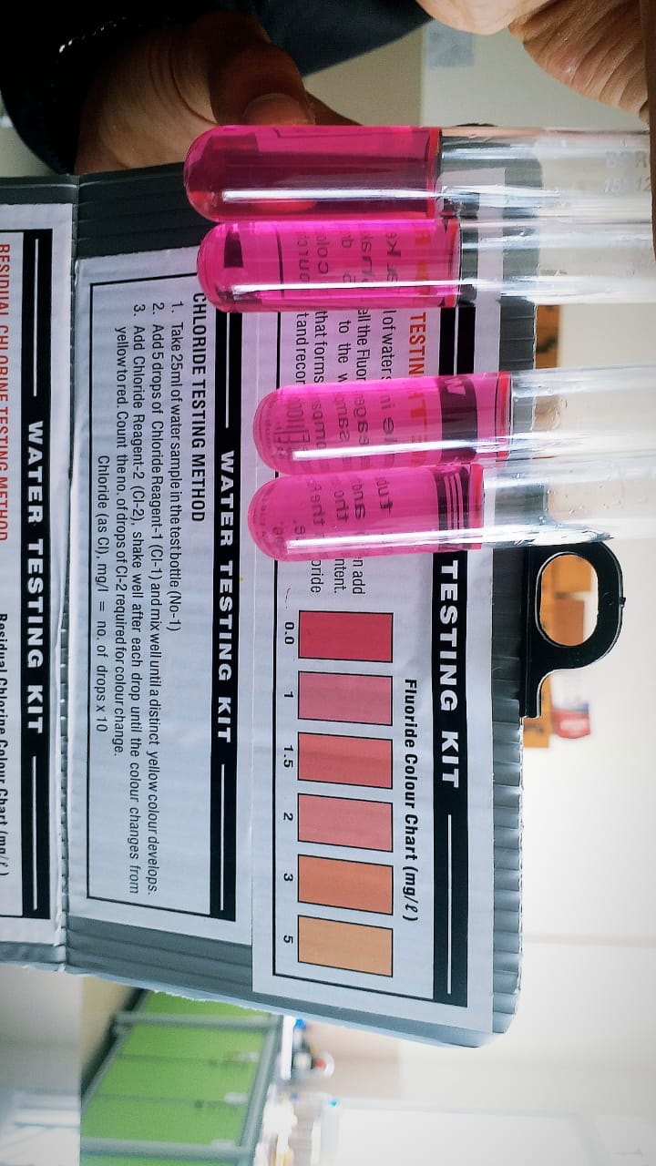
Test for fluorides:
Test for Fluoride using water testing kit
Take 5ml water sample in the test bottle.
Shake well the Fluoride Reagent-1 and then add 5 drops to the water sample.
Refer the Colour Chart for the Fluoride Value.
Results of the test :
Sample no. | Sample no.1 | Sample no.2 | Sample no.3 | Sample no.4
Values (mg/L) | 0.0 | 1 | 1 | 1

Slide 8
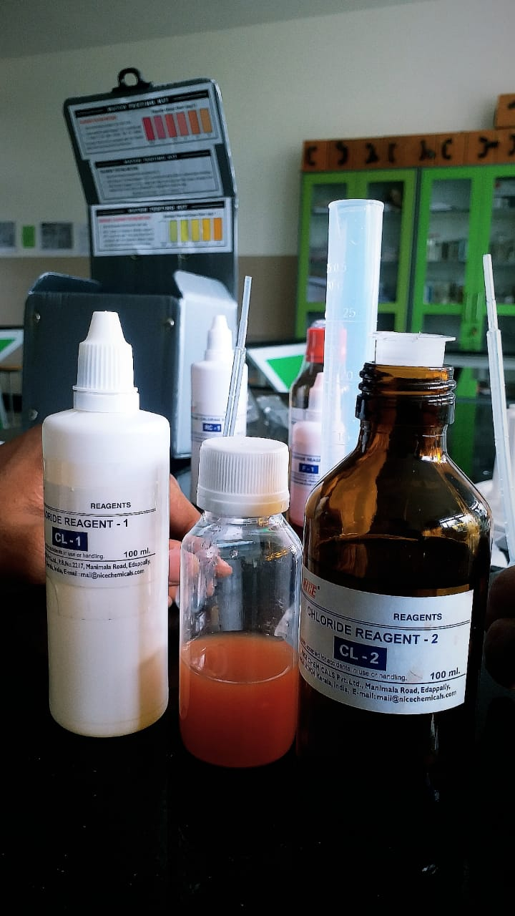
Test for Chlorides:
Test for chlorides was done using water testing kits.
Take 25ml of water sample in a test bottle.
Add 5 drops of Chloride Reagent-1 and mix well until a distinct yellow colour develops.
Add Chloride Reagent-2, Shake well after each drop until the colour changes from yellow to red. Count the number of drops of CL-2 required for colour change.

Slide 9
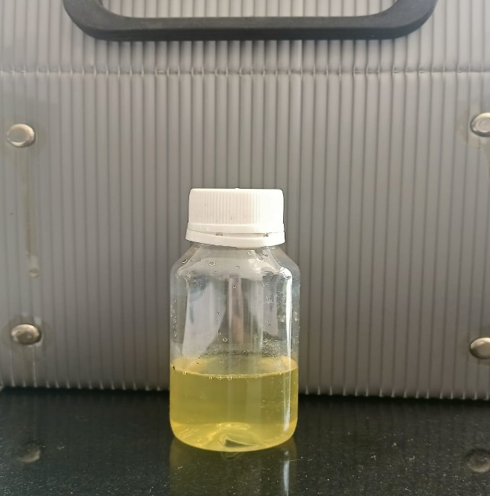
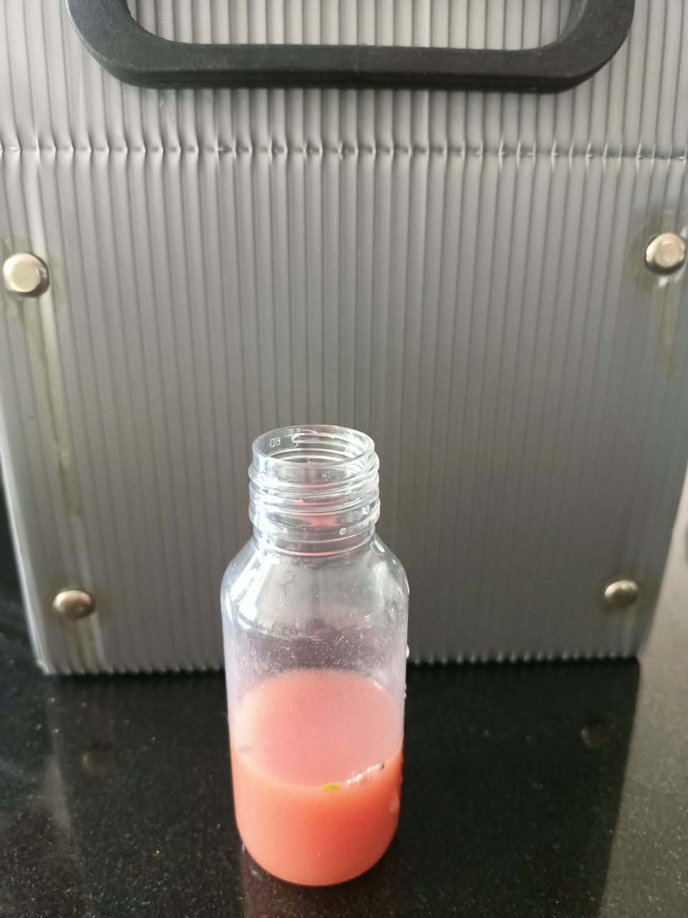
Results Of Chloride Test:
Chloride(as Cl), mg/l = no. of drops X 10
Sample No. | Sample 1 | Sample 2 | Sample 3 | Sample 4
No Of Drops. | 22 | 16 | 17 | 17
Final Value.(mg/L) | 220 | 160 | 170 | 170
Yellow Turns Red

Slide 10
Test for calcium hardness
Test for Calcium Hardness was done using water testing kit.
Take 25ml of water sample in the test bottle
Add 10 Drops of Calcium Hardness Reagent-2 and mix
Add 10 Drops Of Calcium Harness Reagent-3 and mix
Add few specs of Calcium Hardness Reagent-1 and mix until a distinct pink colour develops.
For Hard/Soft water . Add Calcium Hardness Reagent-4. Shake well after each drop until the colour changes from Pink To Purple. Count the number of drops of Reagent-4 required for colour change.

Slide 11
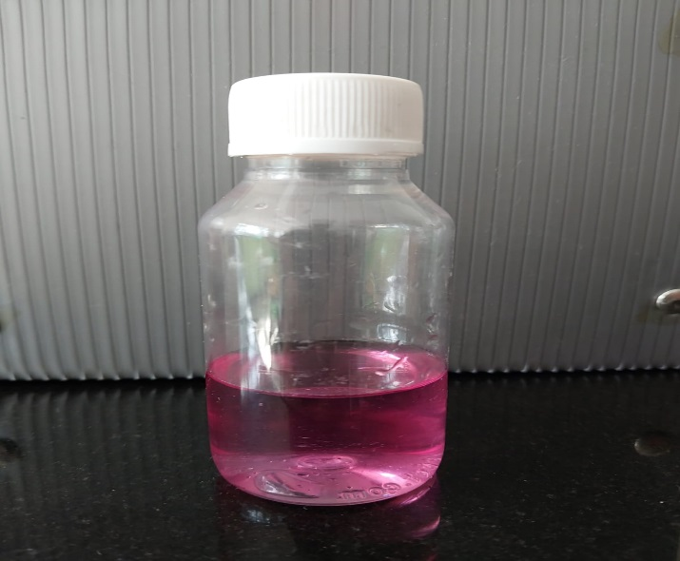
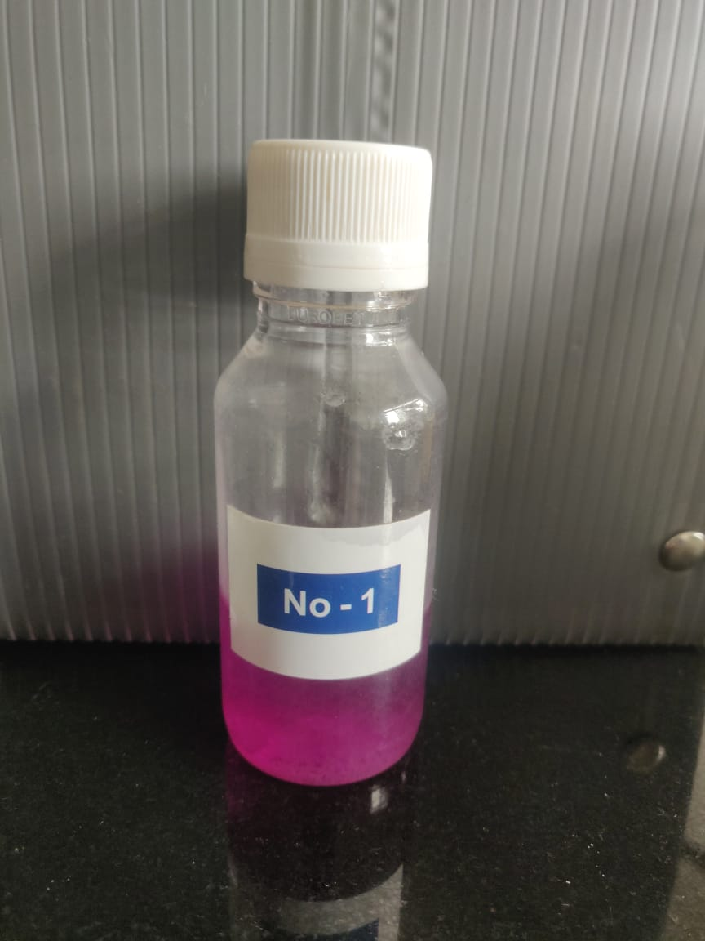
Results Of Calcium Hardness Test
Calcium Hardness = No. of Drops X 5
Sample No. | Sample 1 | Sample 2 | Sample 3 | Sample 4
No Of Drops. | 11 | 22 | 30 | 26
Final Value.(mg/L) | 55 | 110 | 150 | 130
Pink to Purple

Slide 12
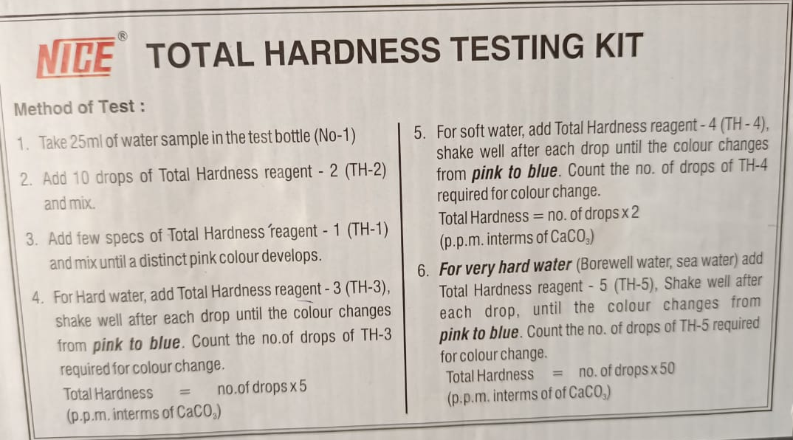
Test for Total hardness of water
Test for Total Hardness Of Water using water testing kit
Take 25ml of water sample in the test bottle.
Add 10 drops of Total Hardness Reagent-2 and mix.
Add few specs of Total Hardness Reagent-1 and mix until a distinct pink colour develops.
For Hard Water, add Total Hardness Reagent-3 , shake well after each drop until the colour changes from pink to blue. Count the number of drops of TH-3 required for colour change.
Result: In addition of reagent -3 the colour does not changes from pink to blue, thus the water is not moderately hard.

Slide 13
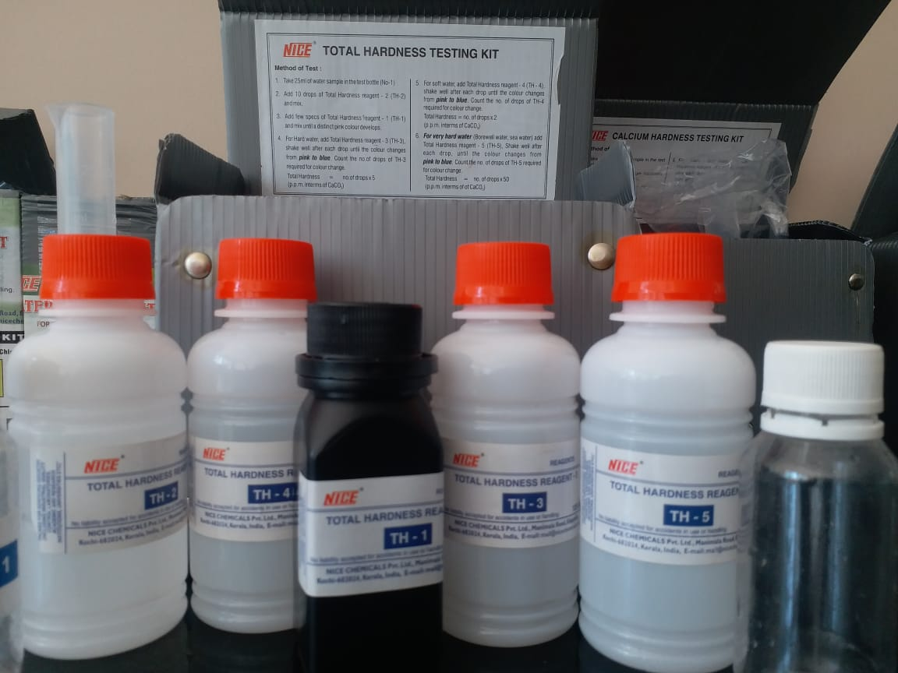
For Soft Water : Add Total Hardness Reagent-4 shake well after each drop until colour changes from pink to blue. Count the number of drops of TH-4 required for colour change.
Result :
For Very Hard Water : Add Total Hardness Reagent-5 shake well after each drop until colour changes from pink to blue. Count the number of drops of TH-5 required for colour change.
Result : In addition of reagent -5 the colour changes from pink to blue, thus the water is very hard.
In addition of reagent - 4 the colour does not changes from pink to blue, thus the water is not soft.
Materials used for testing the total hardness

Slide 14
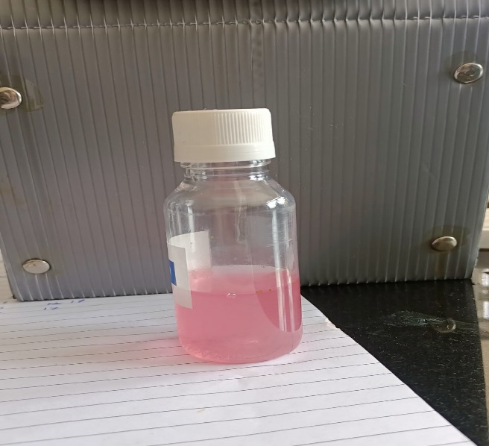
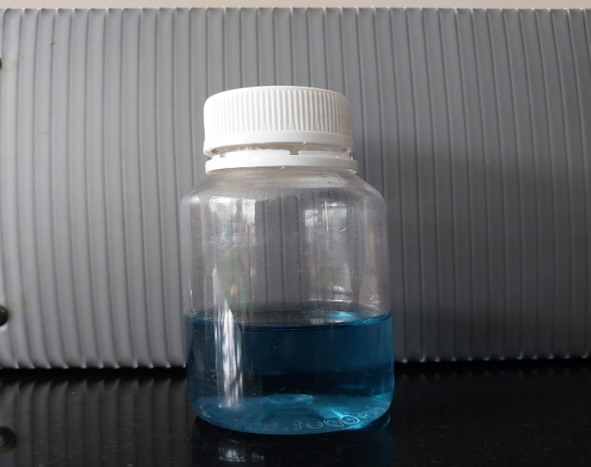
Result of total hardness:
Total Hardness = no. of drops X 50
Sample No. | Sample 1 | Sample 2 | Sample 3 | Sample 4
No Of Drops. | 12 | 12 | 15 | 14
Final Value.(mg/L) | 600 | 600 | 750 | 700
Pink To Blue
Any water with 700 ppm and above is considered to be polluted. Thus on the tests done the 3rd and 4th sample are very hard where as the 1st and 2nd sample are moderately polluted.

Slide 15
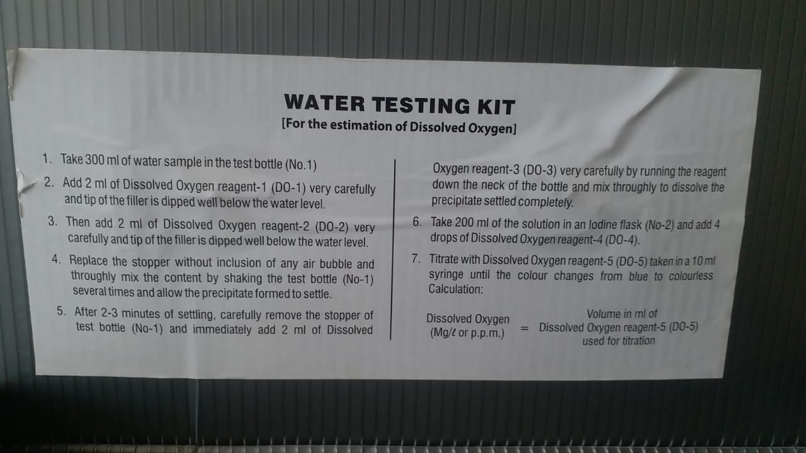
Test for dissolved oxygen level
Test for Dissolved Oxygen Level was done using water testing kit
Take 300ml of water sample in test bottle.
Add 2ml of Dissolved Oxygen Reagent-1 very carefully and the tip of the filler is dipped well below the water level.
Then add 2ml of Dissolved Oxygen Reagent-2 very carefully and the tip of the filler is dipped well below the water level.
Replace the stopper without inclusion of any air bubble and thoroughly mix the content by shaking the test bottle several times and allow the precipitate formed to settle.

Slide 16
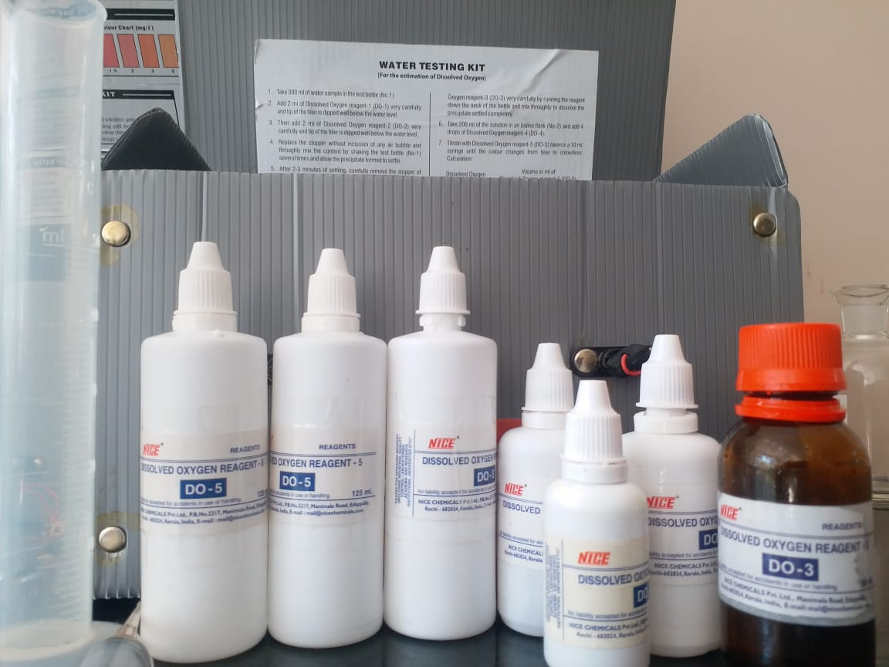
After 2-3 minutes of settling, carefully remove the stopper of test bottle and immediately add 2ml of Dissolved Oxygen Reagent-3 very carefully by running the reagent down the neck of the bottle and mix thoroughly to dissolve the precipitate settled completely.
Take 200ml of the solution in an iodine flask and add 4 drops of Dissolved Oxygen Reagent-4
Titrate with Dissolved Oxygen Reagent-5 taken in 10ml syringe until the colour changes from yellow to colourless.
Materials used for testing the dissolved oxygen

Slide 17
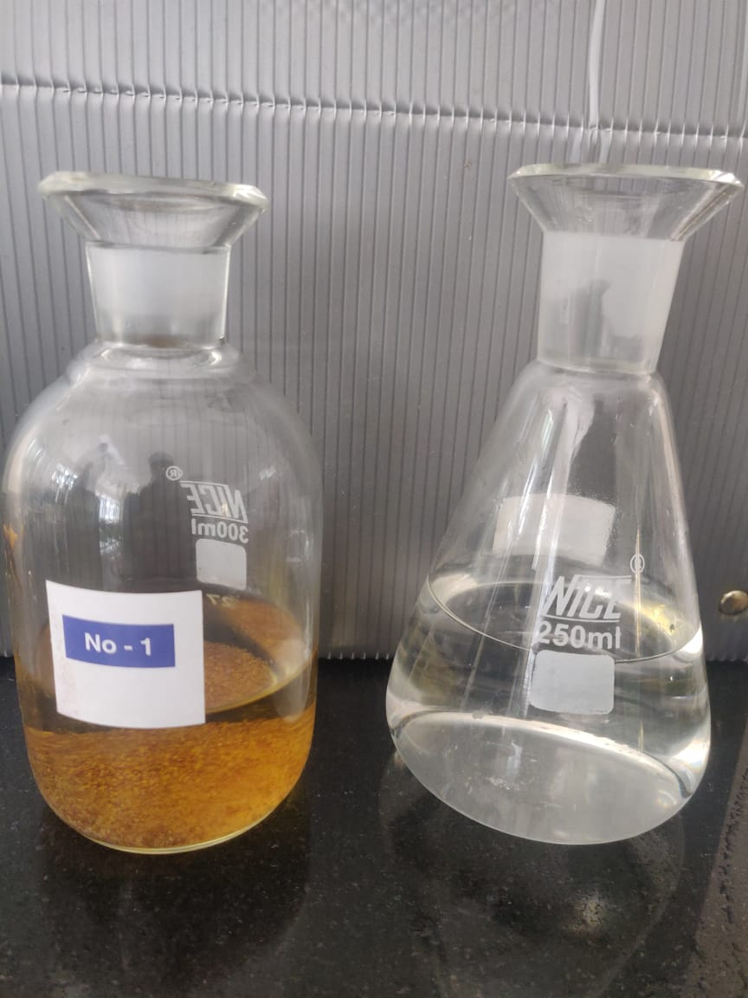
Results for dissolved oxygen level:
Dissolved Oxygen (mg/L or ppm) = Volume in ml of Dissolved Oxygen Reagent-5 Used For Titration
Sample No. | Sample 1 | Sample 2 | Sample 3 | Sample 4
Syringe Reading | 3 | 6 | 3 | 2
Final Value.(mg/L) | 3 | 6 | 3 | 2

Slide 18
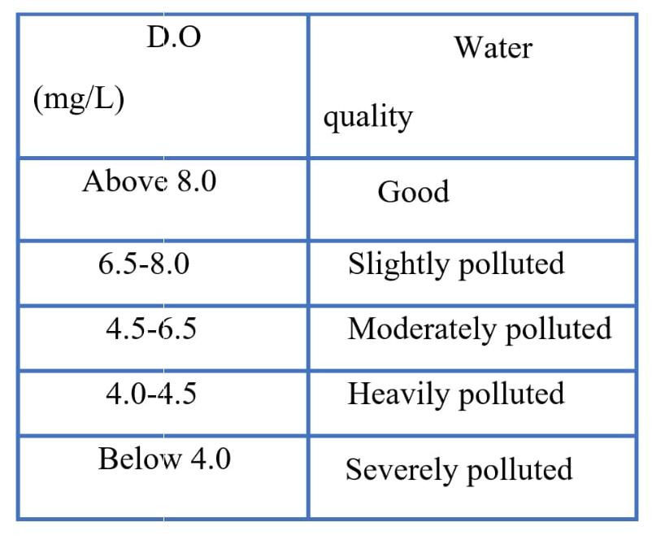
Conclusion of dissolved oxygen test:
Therefore, from above observation we can conclude that :
Sample1 is severely polluted (3 mg/L)
Sample 2 is slightly polluted (6 mg/L)
Sample 3 is severely polluted (3 mg/L)
Sample 4 is severely polluted (2 mg/L)
Hence , the 1st, 3rd, 4th sample are severely polluted whereas the 2nd sample is moderately polluted.
Parameters for identifying the polluted level

Slide 19
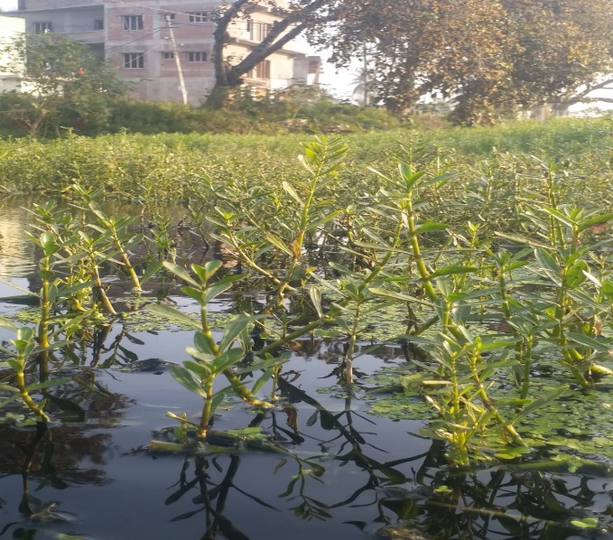
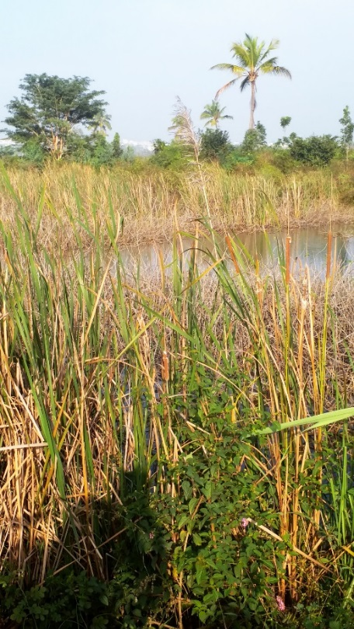
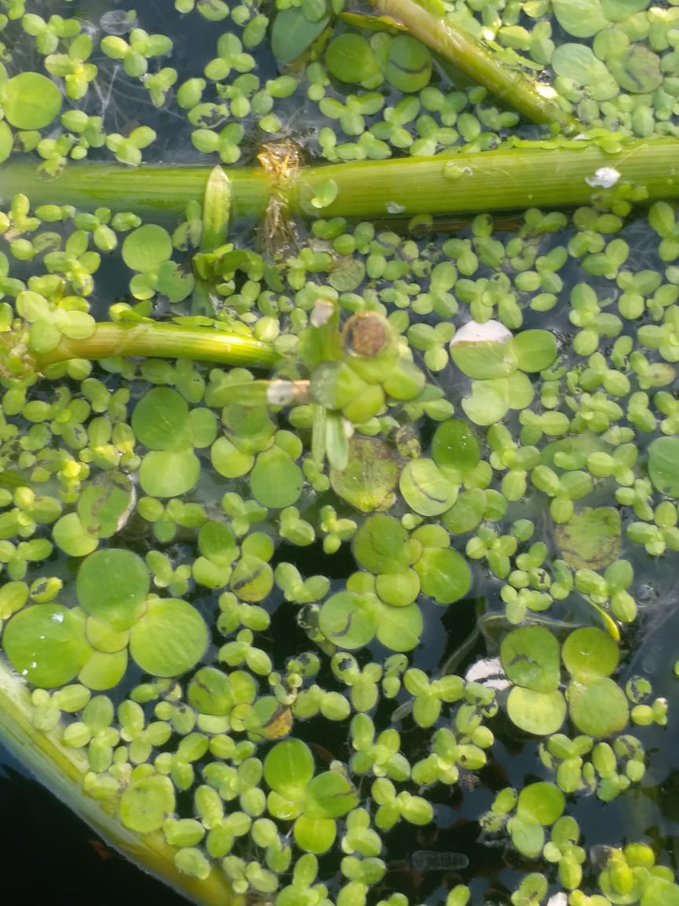
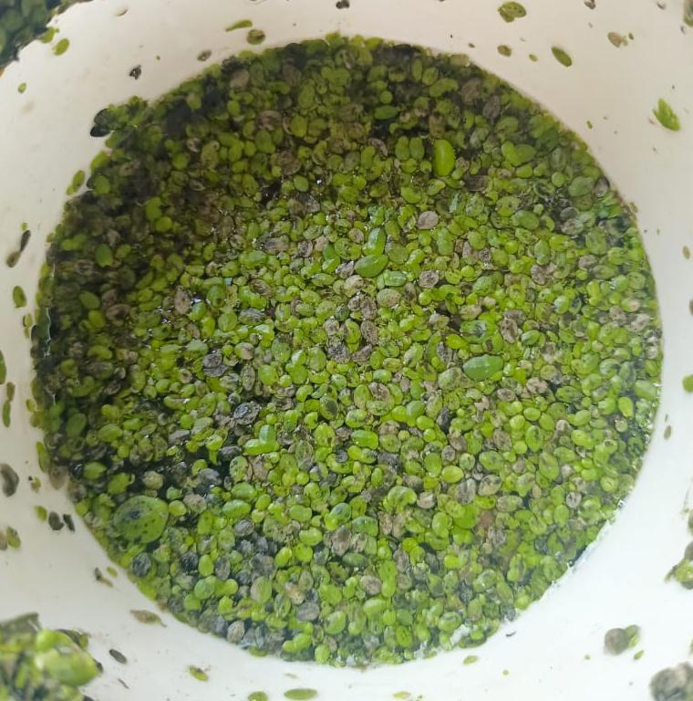
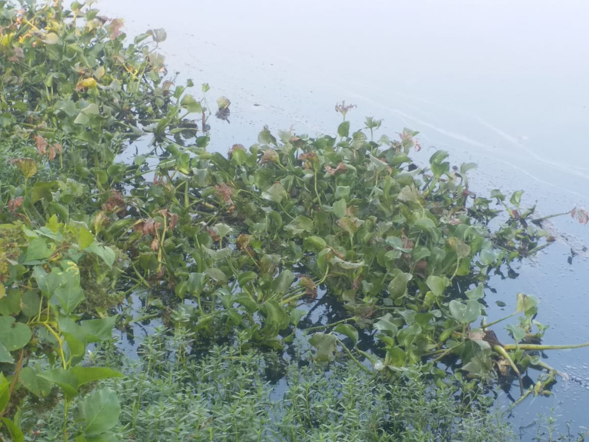
plant species IDENTIFIED :
Alternanthera philoxerodies
(Alligator weed)
Spirodela polyrhiza
Lemna (Duck weed)
Typha angustifolia (Narrowleaf cattail)
Eichhornia
(Water hyacinth)

Slide 20
micro organisms IDENTIFIED:

Slide 21
Conclusion :
Based on the pH value ,the lake water is Basic in nature.
The presence of Chlorine , Magnesium , Calcium is the reason for hardness of the water. Which concludes that water is extremely hard according to the parameters of pollution control board and with respect to the tests done for total hardness, any water with 700ppm and above is very hard.
The plant species which were identified perform different activities in controlling and causing pollution .
Usually in the contaminated water body, microbes should be more and the Dissolved oxygen level should be less, we found the same here , but due to the growth of the plants in the water(weeds), the oxygen level has been quite maintained ,thus helps the water organisms to survive.
On testing the D.O level the result we got 3mg/L , 6mg/L , 3mg/L , 2mg/L which gives a conclusion that the water contamination level is different at different points on the lake and is severely polluted .

Slide 22
As the main reason for the contamination is the direct release of sewage water to the lake without undergoing any sewage treatments.
If the sewage water is properly treated by setting up of STP in near by location of the lake, the pollution rate can be decreased .
By taking up few preventive measures and responsibilities the lake can be brought to its previous state with the help of the local governing bodies as well as the localities.
On the basis of our study we would like to conclude that the lake is at its initial stage of pollution with appropriate steps towards its conservation we can make the lake a better home for much more species.

Slide 23
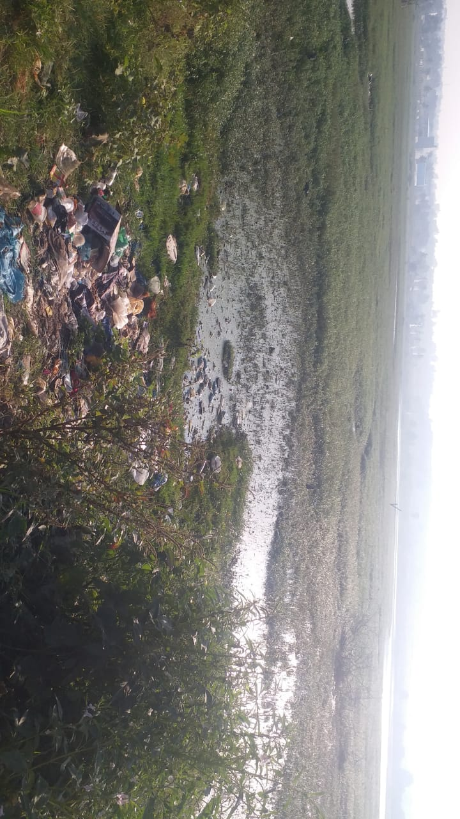
Photo gallery
Wastes thrown into the water body of Kannalli lake
Drone view of the Kannali lake

Slide 24
ACKNOWLEDGMENTS:
We would like to thank our teachers Ms.Meera Ma’am , Ms. Sripoorna Ma’am , Ms. Akshatha Ma’am , Ms. Ashwini Ma’am , Ms. Sarita Ma’am , Ms. Veena Ma’am for the valuable suggestions and guidance .
We would like to convey our gratitude to our school management and IISc for giving us such an enriching opportunity to learn.

Slide 25
References:
Process and methods instructed in the testing kits .
Bio manual for identification of microbes and plant species .
Parameters published by Pollution Control Board .
Local Panchayath.
www.researchgate.com
www.cleanwaterstore.com
Microbiology departments of Bangalore university .

