Slide 1



Sustainability of Peri-Urban Lakes
Lake Symposium 2022
Varun Singoor
Class XI

Slide 2
Introduction
The urban water body – ‘Lake’ – is an integral part of the urban ecosystem with recreational and environmental attributes.
In the context of urban development, lakes are accompanied with parks which also harbor variety of flora and fauna forming a potential ecological network within the city.
They are vulnerable to developments and short-sightedness of the governing bodies in defining these ecological elements for recreational use only.
The values of urban lakes are ecological, economic, social, cultural, political and are the driving force behind the sustainability of lakes.

Slide 3
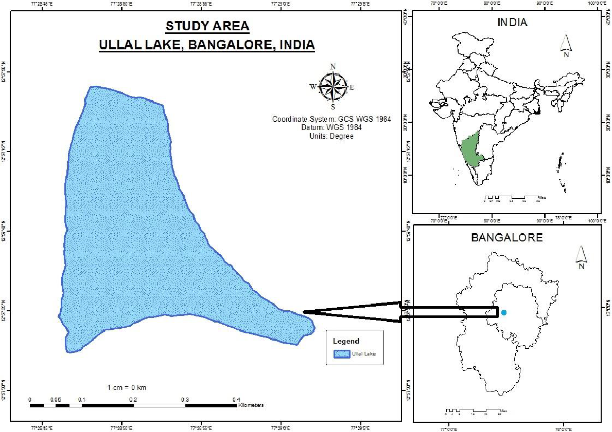
Objectives & Study Area
To study the water quality parameters of peri-urban lake in Ullal, known as Ullal Lake.
To analyze the lake water quality and suggest measures for the sustainability of the lake.
To measure few physical, chemical, biological parameters of Ullal Lake and relate to the key drivers of lake sustainability.
To identify the Water Quality Index with a few parameters.

Slide 4
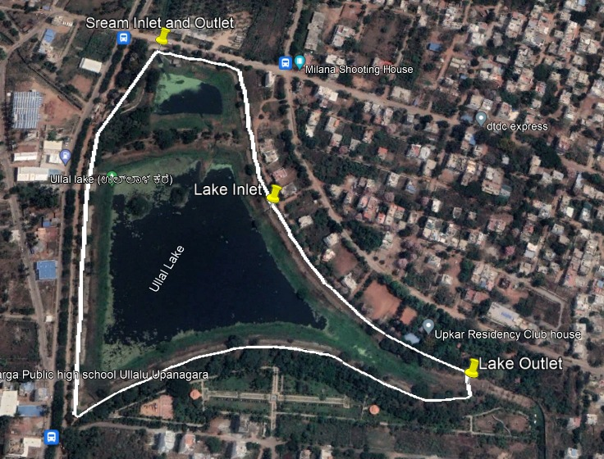
Geospatial Image
Ullal lake is surrounded by peri-urban settlements.
There are two sections, each with an inlet and are interconnected.
Good amount of vegetation in the near-shore areas of the lake.

Slide 5
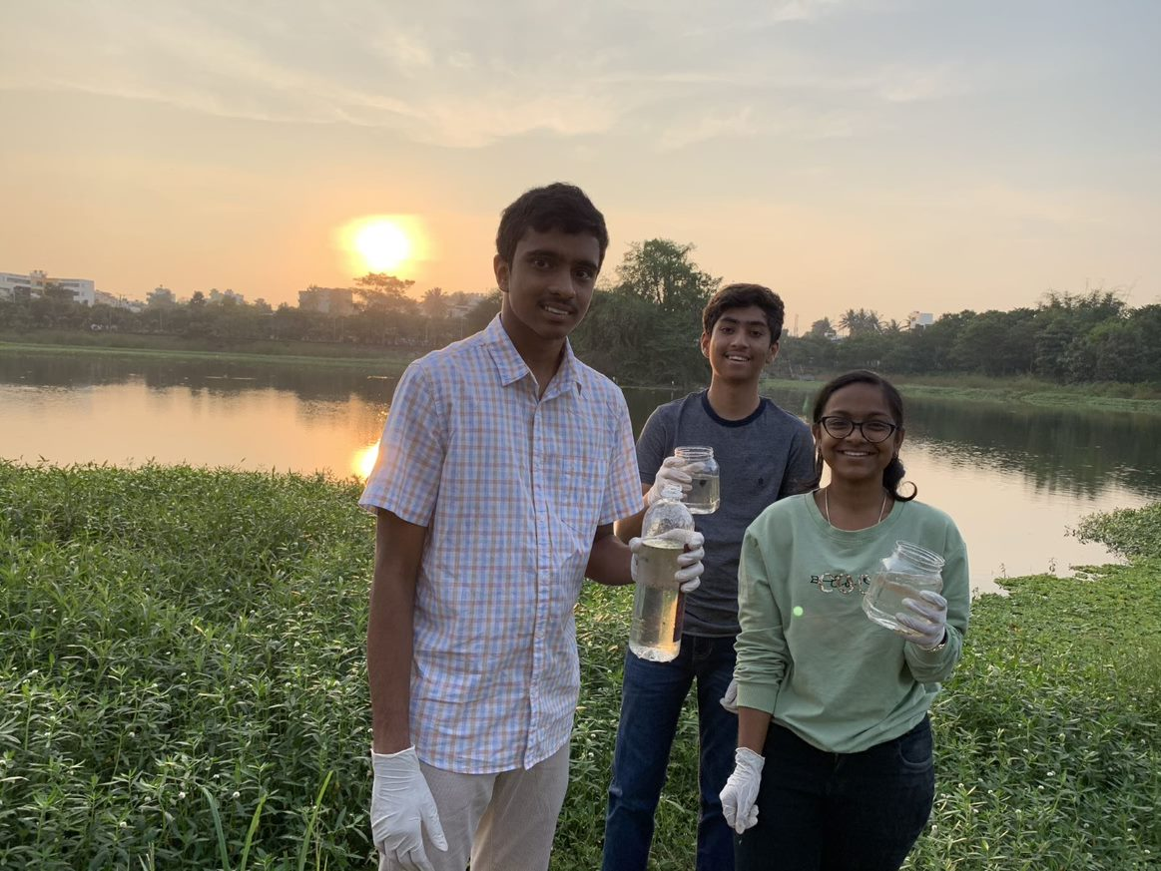
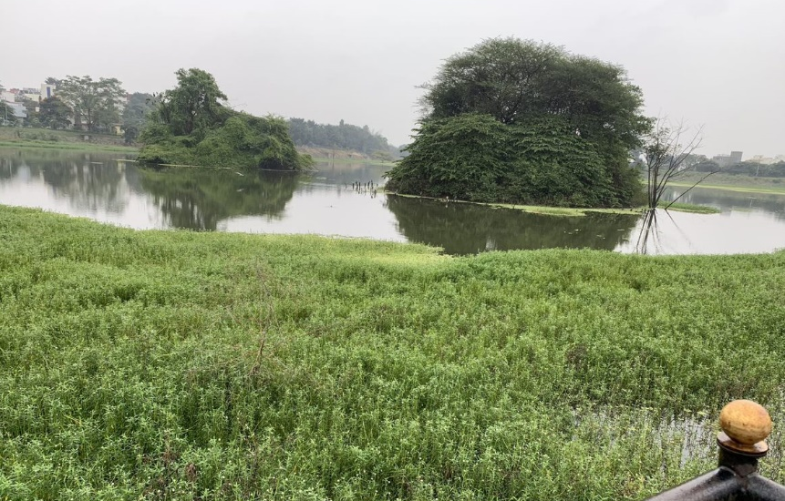
Methods & Material
Collection of water sample in Ullal Lake.
We chose one location not too far from the water inlet to the lake.
The sample was a mix of recent flow as well as existing water in the lake..
The water sample was tested for chemical parameters within 48 hours.
Only one sample was taken as part of the project.

Slide 6
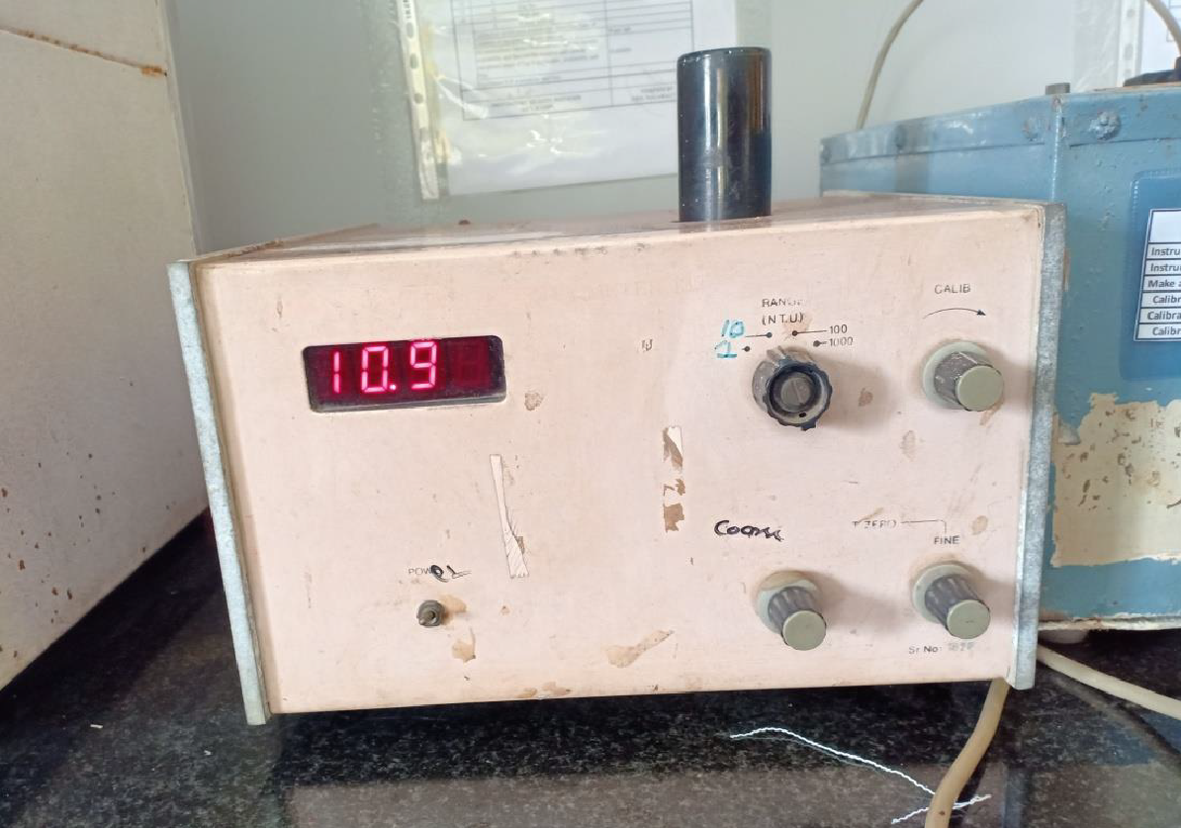
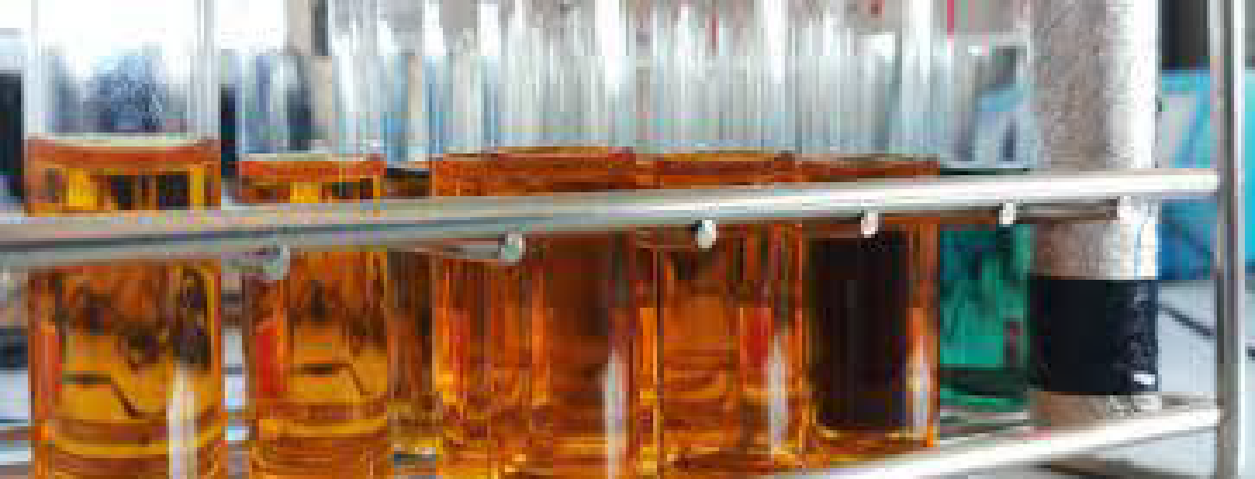
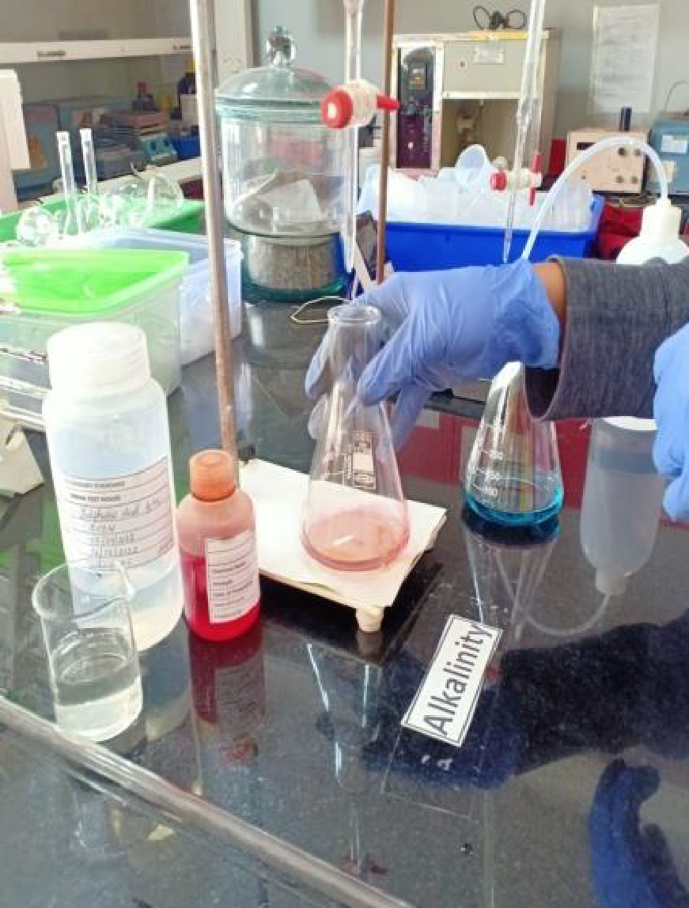
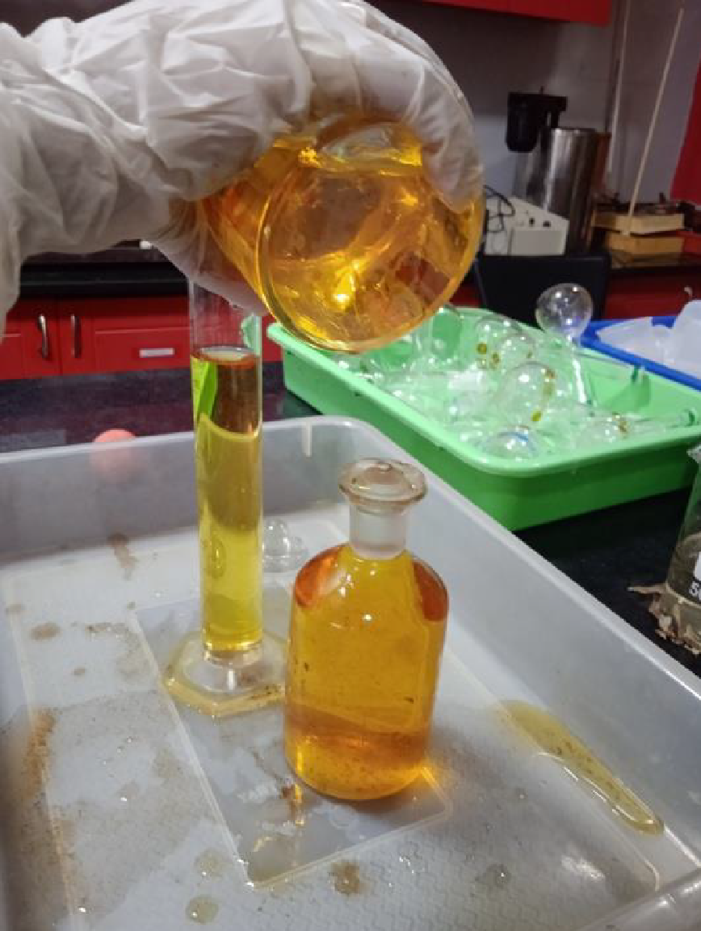
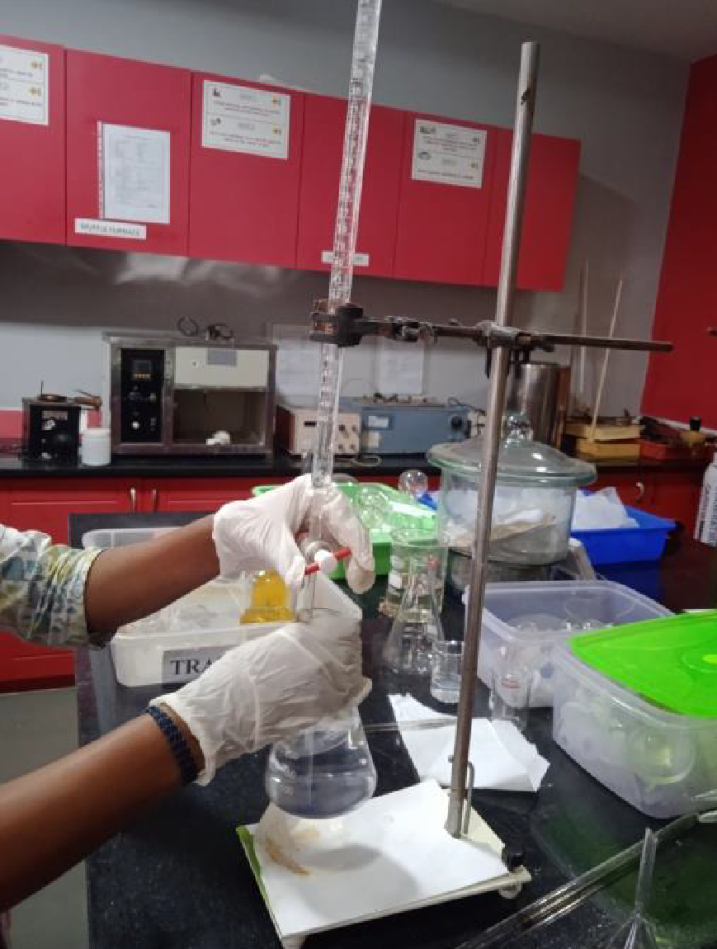
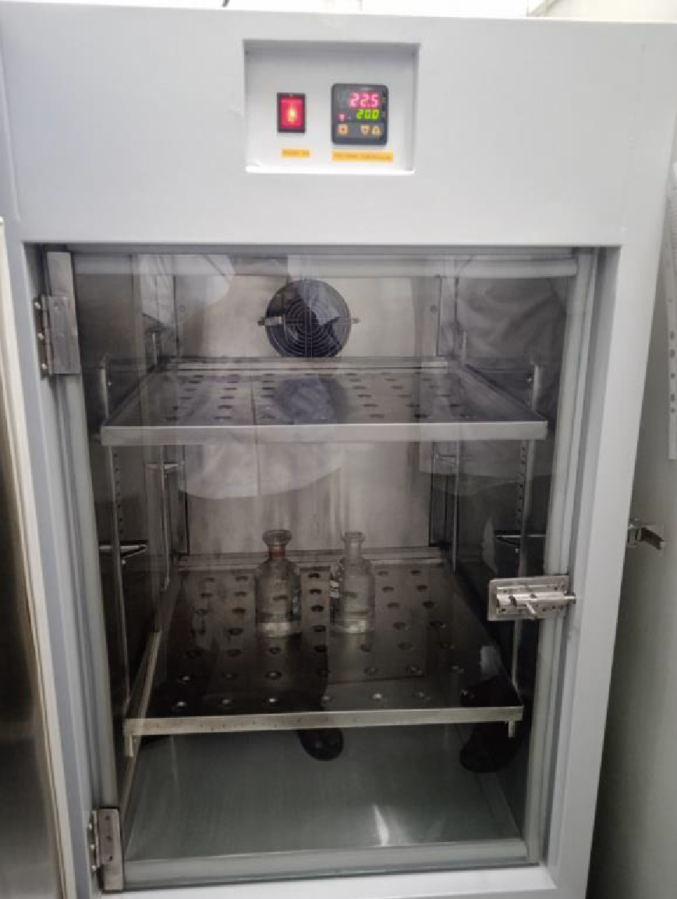
Lab Exercise
COD
Turbidity
Alkalinity
BOD

Slide 7
Test Results
TEST PARAMETER | UNITS | MEASUREMENT
Temperature at 5PM | Centigrade | 22°C
Turbidity | NTU | 10.9
Total Alkalinity as CaCO₃ | mg/L | 260.4
Dissolved Oxygen | mg/L | 4.73
Chemical Oxygen Demand as O₂ | mg/L | 64.89
Free Carbon dioxide | mg/L | Not detected
Biological Oxygen Demand – for 5 days at 20°C | mg/L | 24.1
Total hardness in terms of CaCO₃ | ppm | 225
Fluoride | mg/L | Not detected
Chlorides | mg/L | 180

Slide 8
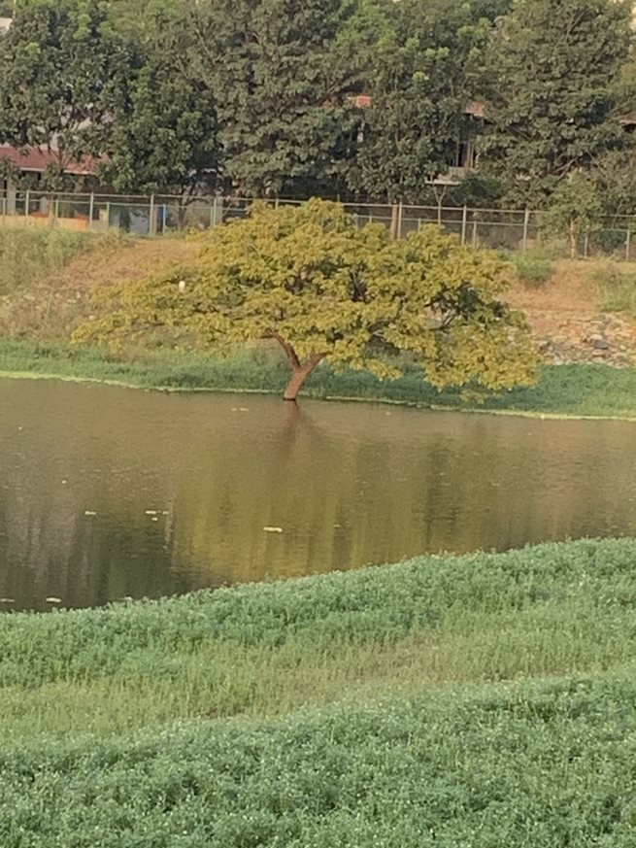
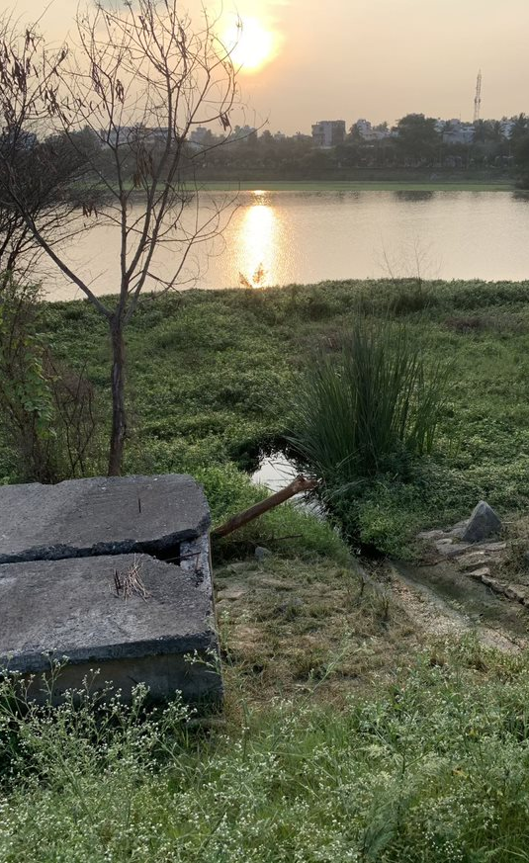
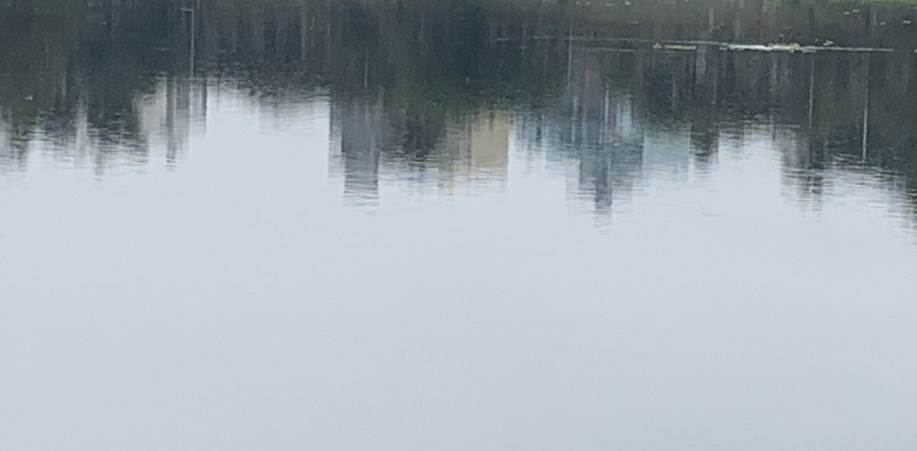
Measurements and Impact
Turbidity: 10.9 NTU
This indicates the characterization of the surface is not all that bad.
Visibility for fish will not be affected by the suspended solids in water.
Alkalinity (CaCO₃): 260.4 mg/L
Well within the permissible limit of 600 mg/L.
This shows the lake has the ability to buffer or neutralize acidity.
It means that lake can overcome the near-shore moss growth.
Notes:
Turbidity through turbidity meter
Alkalinity measured though the following procedure -
Measure a suitable volume of sample in 250 ml conical flask. Add 2-3 drops of phenolphthalein indicator. If the pink colour develops titrate against 0.02 N H2SO4, till the colour disappears, which is the characteristic of pH 8.3.Note down the volume of H2SO4 consumed. Add 2-3 drops of methyl orange and continue titration with H2SO4 till the yellow colour changes to orange, which is the characteristic of pH 4.5. Note down the additional amount of H2SO4 required. In case pink colour does not appear after addition of phenolphthalein, continue with addition of methyl orange.

Slide 9
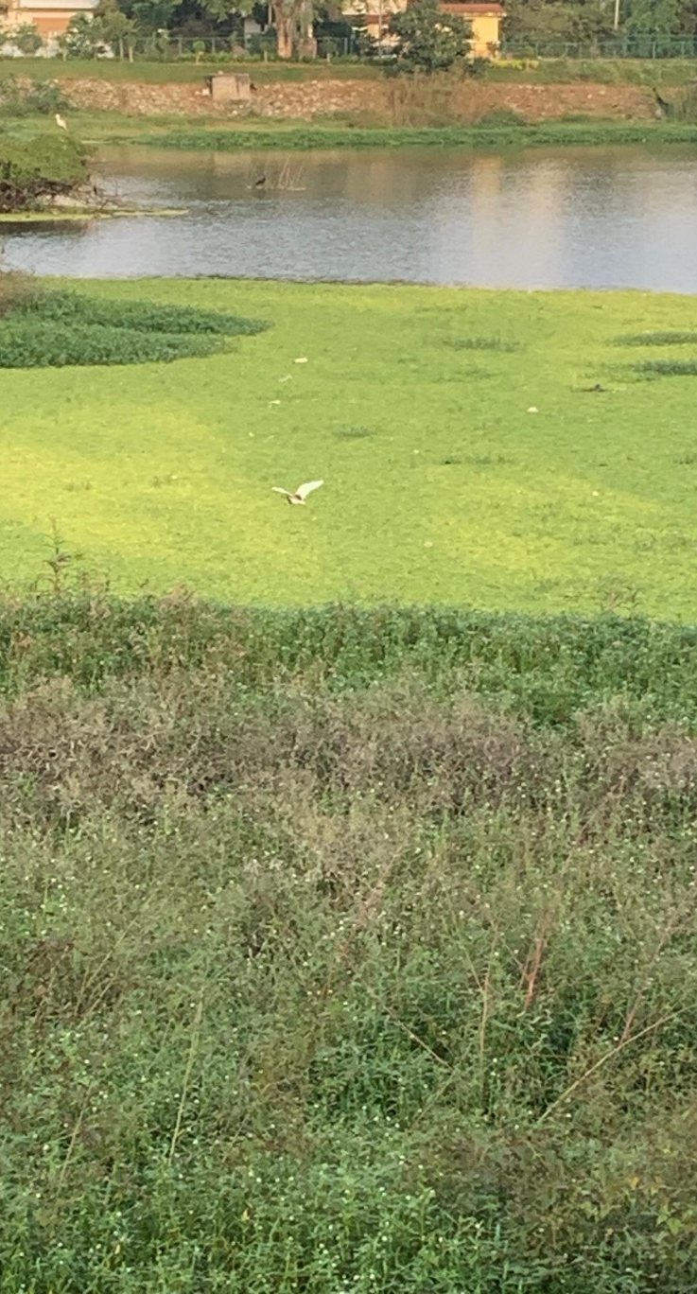
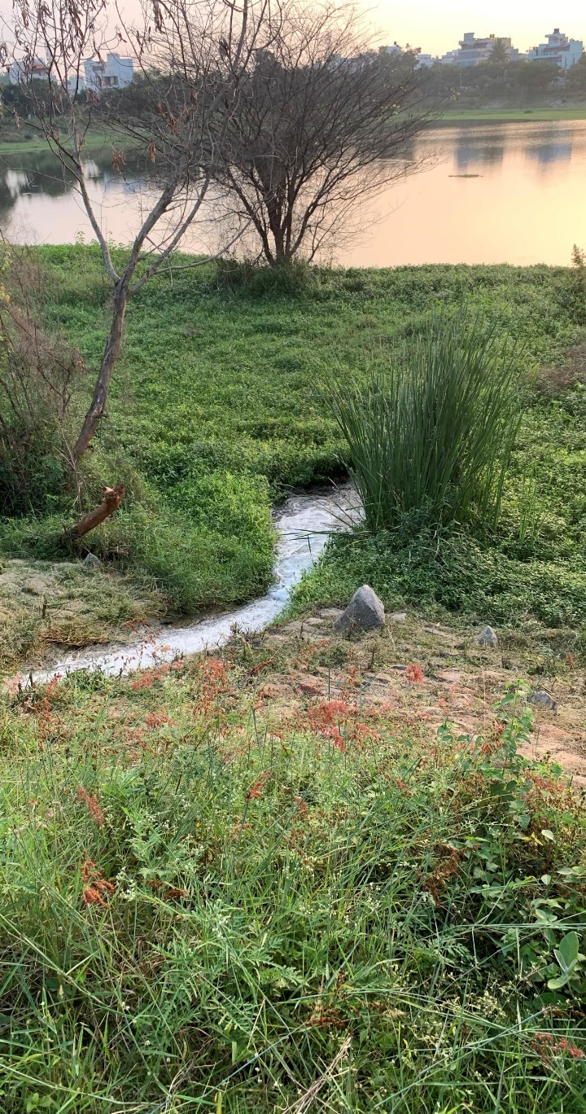
Dissolved Oxygen: 4.73 mg/L
As we know availability of DO is crucial, lower amounts can cause acute stress and hypoxia for fish.
Ullal lake has slightly lower levels of DO than preferred levels of 6.5-8 mg/L.
Presence of aquatic birds, cranes, around the lake indicate availability of some fish.
The fish in this lake will be under a bit of stress but not hypoxia since it is well above 3 mg/L.
Flushing inflow into the lake and vegetation ensures dissolved oxygen in water.
Notes:
Dissolved Oxygen through Winkler’s method

Slide 10
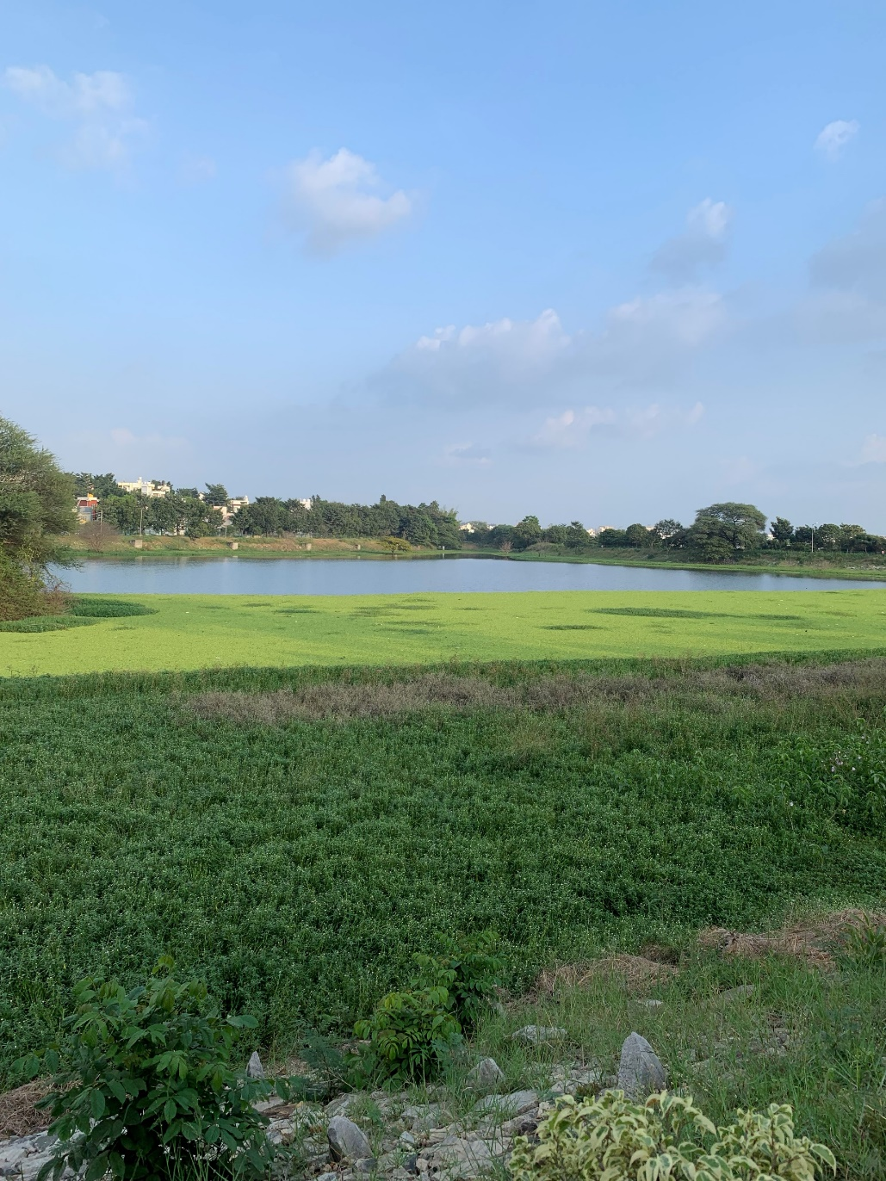
Chemical Oxygen Demand (COD): 64.89 mg/L
Amount of O₂ required to break down the organic matter by chemical oxidation.
There is a bit of sewage inflow into the lake but is treated well and COD is in control in the lake water.
This indicates, there is less amount of oxidizable pollutants found in lake, even though it contains wastewater.
Lab checks did not detect presence of free CO₂ in the sample.
Notes:
Chemical Oxygen Demand through the following Procedure
15ml of conc. sulphuric acid with 0.3g of mercuric sulphate and a pinch of silver sulphate along with 5ml of 0.025M potassium dichromate is taken into a Nessler's tube. 10ml of sample (thoroughly shaken) is pipetted out into this mixture and kept for about 90 minutes on the hot plate for digestion. 40ml of distilled water is added to the cooled mixture (to make up to 50ml) and titrated against 0.25M FAS using ferroin indicator, till the colour turns from blue green to wine red indicating the end point. A reagent blank is also carried out using 10ml of distilled water.
Free Carbondioxide through the following procedure –
A known volume (25ml) of the sample was measured into a conical flask. 2-3 drops of phenolphthalein indicator was added and titrated against 0.22N sodium hydroxide till the pink colour persisted indicating the end point. If the pink colour appears on adding phenolphthalein it indicates the absence of free carbon-dioxide.

Slide 11
Biochemical Oxygen Demand (BOD): 24.1 mg/L
It is the amount of oxygen the microbes require to decompose the organic matter under aerobic conditions.
Conducted at 20°C for 5 days.
Ullal lake has treated disposed wastewater it is high yet acceptable since it is well below 30 mg/L.
Though there is not much of algae, other aquatic weeds have covered the surface, but water is clear.
The lake has typical sources of high BOD such as dead plants, wastewater treatment plants, failing septic systems, urban storm water runoff.
Notes:
Biochemical Oxygen Demand through the following procedure –
The sample having a pH of 7 is determined for first day DO. Various dilutions (at least 3) are prepared to obtain about 50% depletion of D.O. using sample and dilution water. The samples are incubated at 20 oC for 5 days and the 5th day D.O is noted using the Winkler’s method. A reagent blank is also prepared in a similar manner.

Slide 12
Impact of BOD
Since BOD is high it appears that bottom living bacteria consume much of available oxygen, and may have caused stress to fish with reduced DO.
Without oxygen at the bottom at all times, beneficial bacteria and insects cannot biodegrade the organic sediment at bed level of the lake.

Slide 13
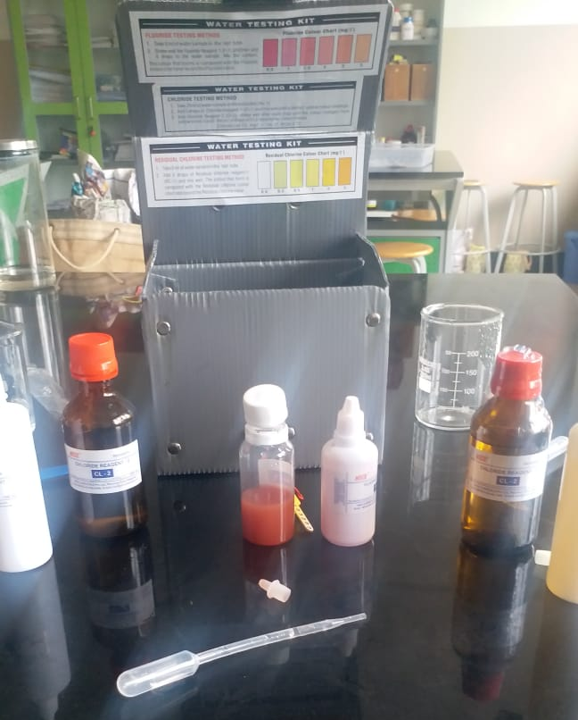
Measurements and Impact – Hardness, Fluoride & Chlorides
Hardness in terms of CaCO₃: 225 ppm
Water hardness is very high in comparison to municipal water supply.
Though it is hard, it also prevents toxicity of other heavy metal ions to aquatic life.
Fish may not be able to thrive, but insoluble precipitates of metals is not harming life.
Fluoride was not detected in the water sample, which means not much impact on groundwater in the surrounding areas.
Chlorides: 180 mg/L
Chlorides is at an acceptable level and may not harm the vegetation.
The plant community structure that of a normal lake we would see.
Notes:
All of them through Water Testing Kit
Fluoride: take 5ml of sample water then add 5 drops of Fluoride reagent – 1 (F – 1). Note the colour.
Chlouride: Take 25ml of sample, then add 5 drops of Chloride reagent – 1 (C – 1), then add Chloride reagent – 2 (C – 2) till yellow colour turns red.
Total Hardness: take 25ml of sample water, then add 10 drops of Total Hardness reagent – 1 (TH – 1), then add Total Hardness reagent – 3 (TH – 3) till pink colour turns blue.

Slide 14
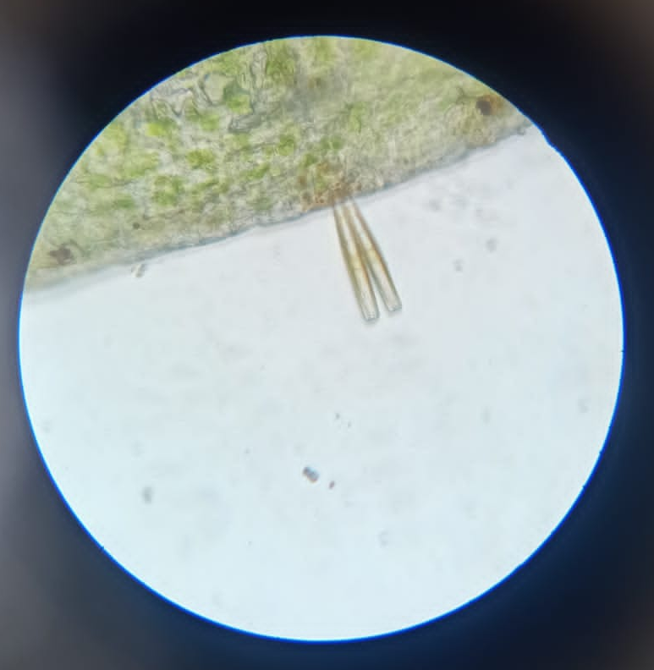
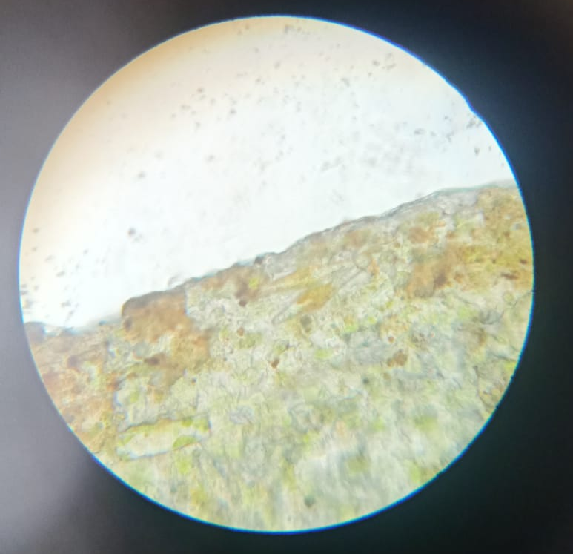
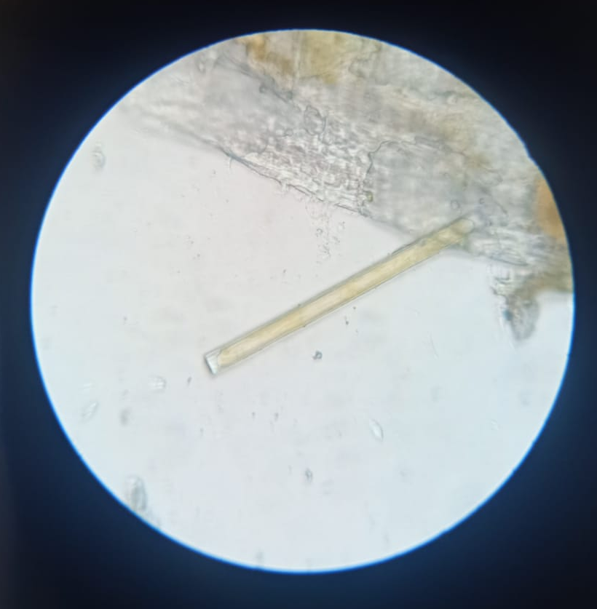
Microbes
Microbes were identified from the sample.
The microscopic pictures indicated the presence of below microbes:
Euglena.(lower left)
Stalked-attached pennate diatoms.(right)

Slide 15
Conclusion
As per researchgate.net 2015 publication, the seasonal values of Water Quality Index (WQI) indicate that during summer season, lake water is more affected than during winter.
Our sample collection is at the start of winter.
Therefore, the Dissolved Oxygen is at an acceptable level, though slightly lower
Based on this simple study, it can be said that health of Ullal Lake is affected but not adverse.
Improvement areas include purification methods from filtration processes that should be carried out before introducing any foreign material into the water body.
Proper bioremediation techniques should also be used to improve the water quality.
Overall, with the current state with simple improvements Ullal Lake can sustain for a few more years.

Slide 16
References
https://www.researchgate.net/
https://www.fondriest.com/environmental-measurements/parameters/water-quality
https://www.sciencedirect.com/
https://www.neptjournal.com/
https://www.watereducation.org/
https://www.hach.com/parameters/
https://www.ijisrt.com

Slide 17
Acknowledgements
I would like to thank the teachers who helped and assessed me continuously throughout the project.
I would also thank Sneha Test House, Chandra Layout, Bengaluru that helped me with the findings of water parameters of the lake water sample.
Special thanks to Indian Institute of Science for the opportunity to present research findings in the Lake Symposium.

Slide 18

Thank You

