Slide 1


SUSTAINABLE DEVELOPMENT AND ENVIRONMENTAL EDUCATION
GOWURI KISHORE, VISHNU CHAITANYA MURARI, YADUNANDAN P
XI
CBSE

Slide 2

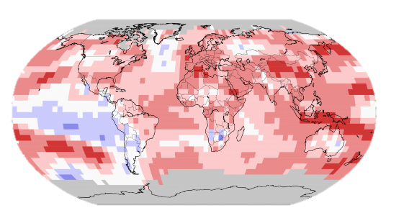
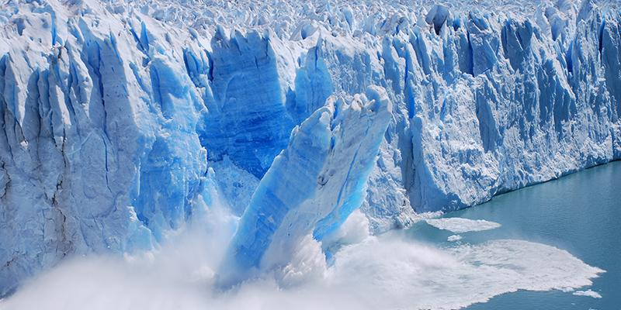

A GLIMPSE THROUGH THE PRESENT SITUATION
The global temperature is increasing by 0.2 $℃$ in one decade.
.
High rise in temp
Moderate rise in temp
Low rise in temp
Sea temp
Notes:
https://timesofindia.indiatimes.com/home/environment/global-warming/how-rise-in-earths-average-global-temperature-is-affecting-our-planet/articleshow/72039042.cms
https://www.ipcc.ch/sr15/chapter/chapter-1/

Slide 3

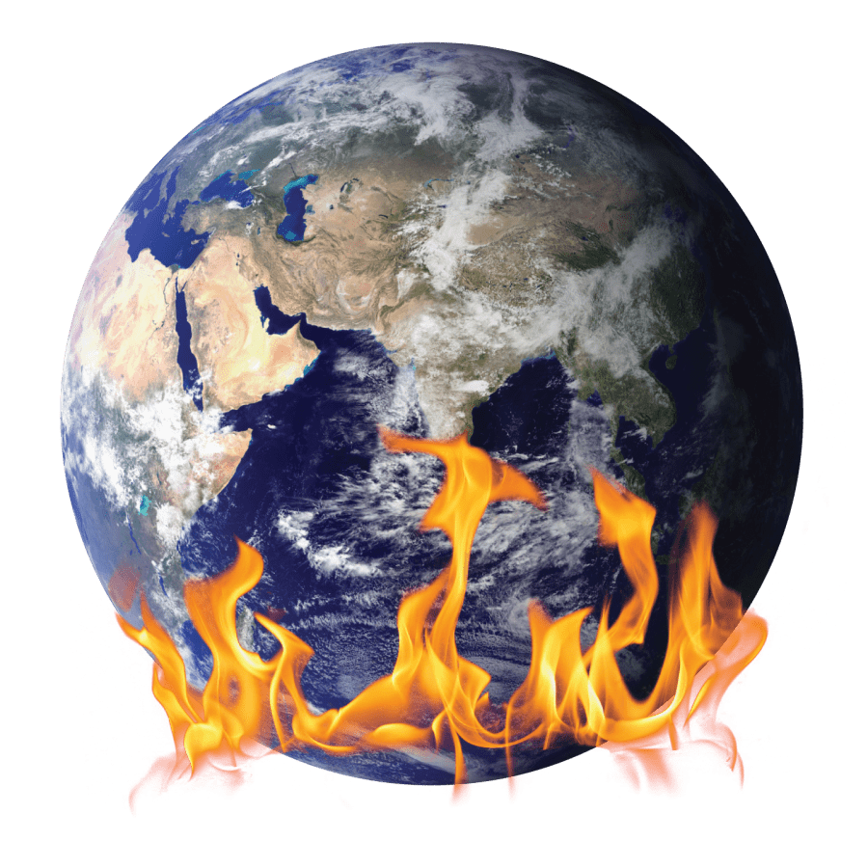
Effects of global warming
Melting glaciers and ice sheets.
Sea level rise.
Generation of more intense heat waves.
Global temperature increases.
Animal geographic ranges are shifting.
Plants and trees are blooming sooner.
Weather damage will also increase and intensify.
Notes:
https://climate.nasa.gov/effects/

Slide 4
OBJECTIVE:
To come up with easily adaptable solutions of sustainable development.
To spread awareness about the importance of environmental education.

Slide 5
PRINCIPLE
Using solar energy as a renewable and sustainable form of energy.
Comparing the carbon emission of an IC engine car and an EV car.
Bringing awareness and educating people about the importance of environment.

Slide 6
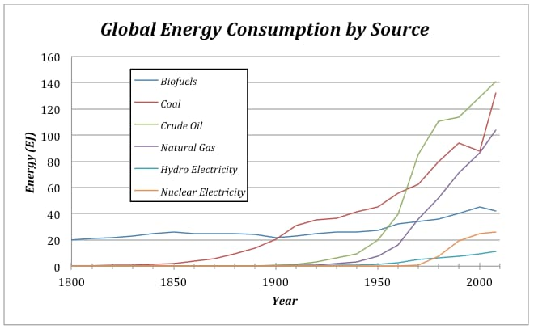
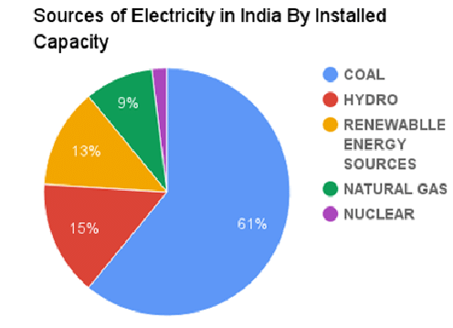
ENERGY GENERATION FROM FEW RESOURCES
Notes:
https://www.researchgate.net/figure/Pie-chart-showing-of-distribution-of-power-sources-The-Government-of-India-has-been_fig1_314110462

Slide 7
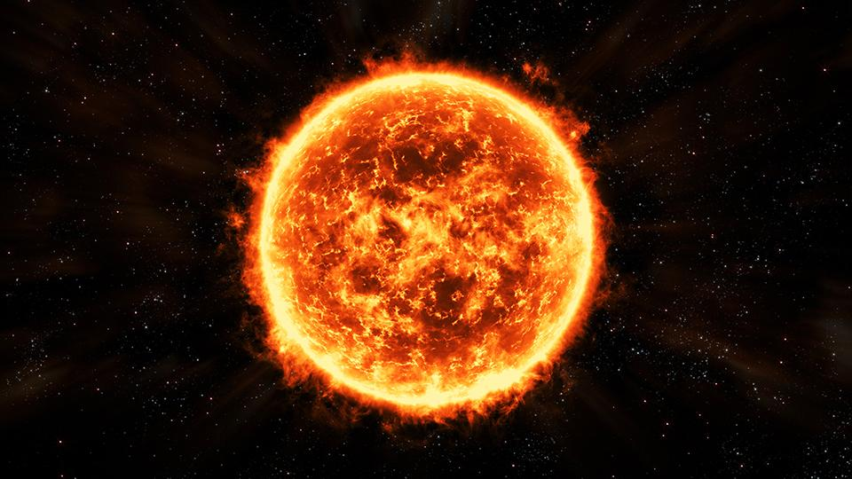
SOLAR ENERGY : BRIGHTENING UP THE FUTURE
Creates thermal and electrical energy.
Photovoltaic (PV) solar panel is used to capture and convert solar radiations to electricity by colliding photons in the conducting tubes.
The photons’ energy is converted into different forms
Inexpensive
Clean energy
Easy to harness
Renewable
Notes:
https://www.thesundaily.my/style-life/feature/solar-energy-for-sustainable-development-DY5809151
https://www.solvingsolar.com/how-solar-panels-work/#:~:text=Solar%20panels%2C%20or%20solar%20photovoltaic%20panels%2C%20transform%20sunlight,can%20then%20be%20used%20to%20power%20a%20property.

Slide 8
Why not these?
Expensive, displaces people and submerges large lands under water, affecting flora and fauna and changes the natural course of rivers.
Alternative uses for the land, which might be more highly valued than electricity generation. Turbines might cause noise and is expensive.
Produces radioactive toxic waste. Nuclear energy has a negative impact on environment
And there is a risk of accident.
Why less of hydro?
Why less of wind?
Why less of nuclear?
Notes:
https://www.internationalrivers.org/news/10-reasons-why-hydropower-dams-are-a-false-climate-solution/#:~:text=Once%20considered%20a%20renewable%20way,methane%20that%20exacerbates%20climate%20change. (hydro)
https://www.japantimes.co.jp/opinion/2022/07/01/commentary/world-commentary/hydropower-problems/ (hydro)
https://www.energysage.com/about-clean-energy/wind/pros-cons-wind-energy/ (wind)
https://www.greenamerica.org/fight-dirty-energy/amazon-build-cleaner-cloud/10-reasons-oppose-nuclear-energy (nuclear)

Slide 9

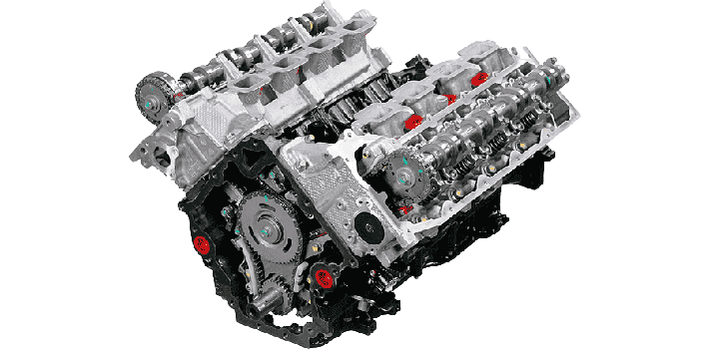
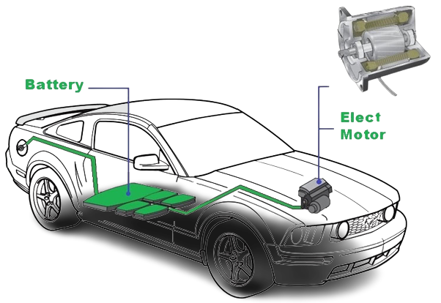
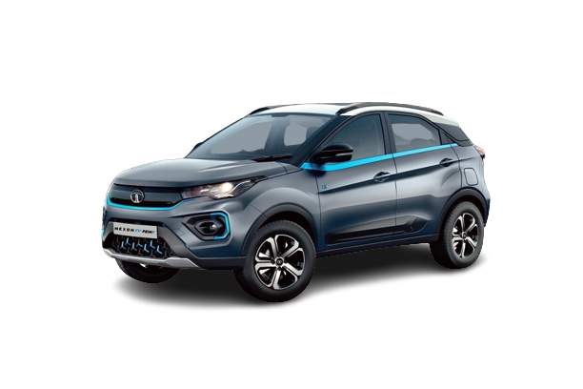
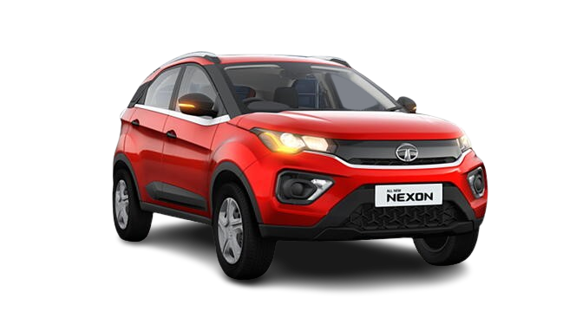
FUEL
⚡ FUEL VS ELECTRIC ⚡
ELECTRIC

Slide 10
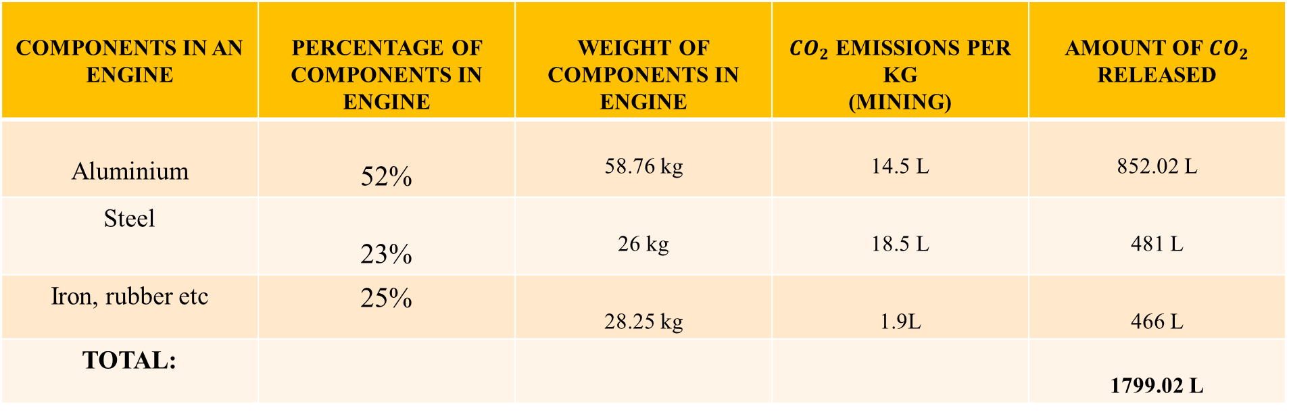
IC ENGINE
IC engine manufacturing process :
Melting Holding Casting Fettling Machining
CARBON FOOTPRINT OF ENGINE MANUFACTURING
COMPONENTS IN AN ENGINE | PERCENTAGE OF COMPONENTS IN ENGINE | WEIGHT OF COMPONENTS IN ENGINE | ${CO}_{2}$ EMISSIONS PER KG (MINING) | AMOUNT OF ${CO}_{2}$ RELEASED
Aluminium | 52% | 58.76 kg | 14.5 L | 852.02 L
Steel | 23% | 26 kg | 18.5 L | 481 L
Iron, rubber etc | 25% | 28.25 kg | 1.9L | 466 L
TOTAL: |  |  |  | 1799.02 L
Notes:
http://newengineeringpractice.blogspot.com/2011/08/engine-block-manufacturing-process.html#:~:text=Manufacturing%20of%20engine%20blocks%20are,surface%20finish%20and%20coolant%20passages. (process)
https://axlewise.com/how-much-does-an-engine-weigh/#:~:text=Many%20factors%20decide%20an%20engine%27s,model%2C%20material%2C%20and%20size. (weight)
Mining :
Aluminium - https://www.researchgate.net/publication/337430874_Aluminum_Production_in_the_Times_of_Climate_Change_The_Global_Challenge_to_Reduce_the_Carbon_Footprint_and_Prevent_Carbon_Leakage#:~:text=From%20bauxite%20mine%20to%20aluminum,various%20estimates%20and%20assumptions%20made.
Steel-
https://www.mckinsey.com/industries/metals-and-mining/our-insights/decarbonization-challenge-for-steel
Iron, runner etc , an avg has been taken since they are evry small quantities.
Pollution stats
https://www.epa.gov/greenvehicles/greenhouse-gas-emissions-typical-passenger-vehicle#:~:text=typical%20passenger%20vehicle%3F-,A%20typical%20passenger%20vehicle%20emits%20about%204.6%20metric%20tons%20of,8%2C887%20grams%20of%20CO2.
https://leasecar.uk/blog/what-percent-of-carbon-emissions-comes-from-cars/

Slide 11
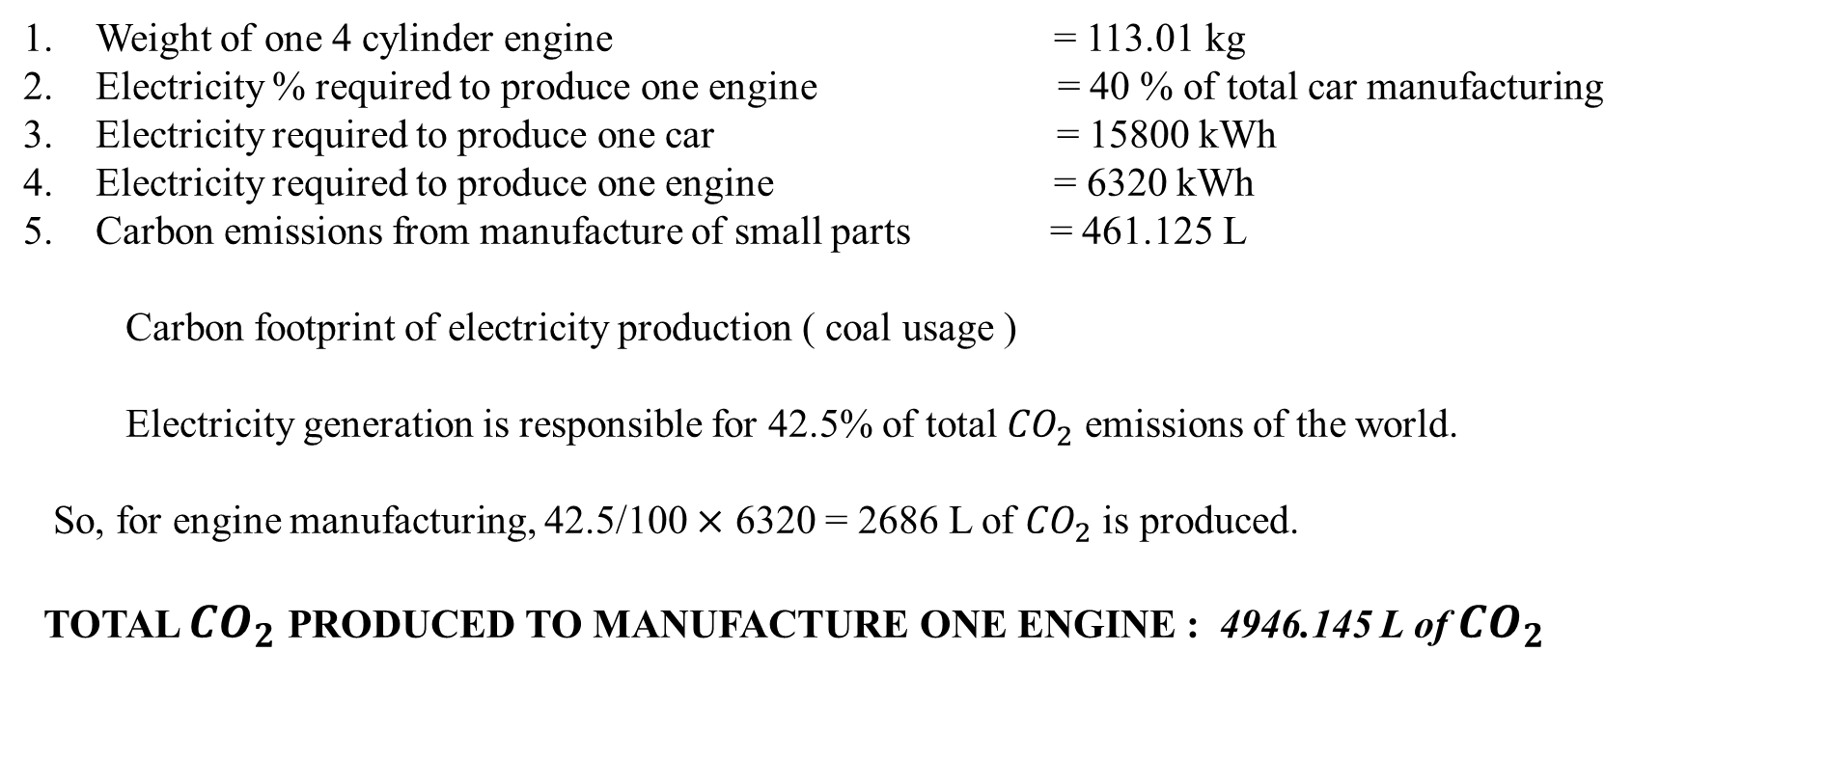
GENERAL REQUIREMENTS TO PRODUCE ONE ENGINE
Weight of one 4 cylinder engine = 113.01 kg
Electricity % required to produce one engine = 40 % of total car manufacturing
Electricity required to produce one car = 15800 kWh
Electricity required to produce one engine = 6320 kWh
Carbon emissions from manufacture of small parts = 461.125 L
Carbon footprint of electricity production ( coal usage )
Electricity generation is responsible for 42.5% of total ${CO}_{2}$ emissions of the world.
So, for engine manufacturing, 42.5/100 $×$ 6320 = 2686 L of ${CO}_{2}$ is produced.
TOTAL ${CO}_{2}$ PRODUCED TO MANUFACTURE ONE ENGINE : 4946.145 L of ${CO}_{2}$
Notes:
Elec-
https://www.motorbiscuit.com/how-much-energy-to-build-a-car/

Slide 13
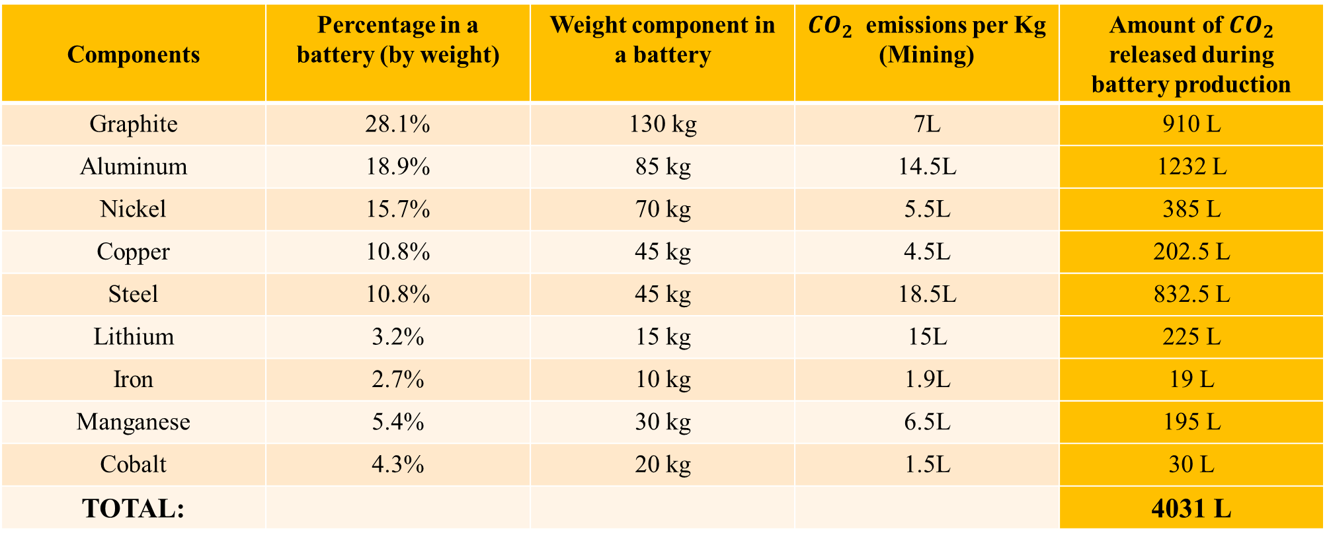
EV SYSTEM
Components | Percentage in a battery (by weight) | Weight component in a battery | ${CO}_{2}$ emissions per Kg (Mining) | Amount of ${CO}_{2}$ released during battery production
Graphite | 28.1% | 130 kg | 7L | 910 L
Aluminum | 18.9% | 85 kg | 14.5L | 1232 L
Nickel | 15.7% | 70 kg | 5.5L | 385 L
Copper | 10.8% | 45 kg | 4.5L | 202.5 L
Steel | 10.8% | 45 kg | 18.5L | 832.5 L
Lithium | 3.2% | 15 kg | 15L | 225 L
Iron | 2.7% | 10 kg | 1.9L | 19 L
Manganese | 5.4% | 30 kg | 6.5L | 195 L
Cobalt | 4.3% | 20 kg | 1.5L | 30 L
TOTAL: |  |  |  | 4031 L
Notes:
Mining :
Aluminium - https://www.researchgate.net/publication/337430874_Aluminum_Production_in_the_Times_of_Climate_Change_The_Global_Challenge_to_Reduce_the_Carbon_Footprint_and_Prevent_Carbon_Leakage#:~:text=From%20bauxite%20mine%20to%20aluminum,various%20estimates%20and%20assumptions%20made.
Steel-
https://www.mckinsey.com/industries/metals-and-mining/our-insights/decarbonization-challenge-for-steel
Iron
https://bellona.org/news/ccs/2019-03-is-steel-stealing-our-future
Nickle
https://nickelinstitute.org/media/4817/lifecycledata-faq-update2020.pdf
Copper
Lithium
https://climate.mit.edu/ask-mit/how-much-co2-emitted-manufacturing-batteries#:~:text=Particularly%20in%20hard%20rock%20mining,are%20emitted%20into%20the%20air.
Manganese
https://www.researchgate.net/publication/311440844_CO2-emissions_from_the_production_of_manganese_and_chromium_alloys_in_Norway#:~:text=The%20total%20CO%202%20equivalent,%5B15%5D.%20...
Cobalt
https://www.miningmagazine.com/plant/news/1398270/first-cobalt-shines-in-emissions-assessment

Slide 14
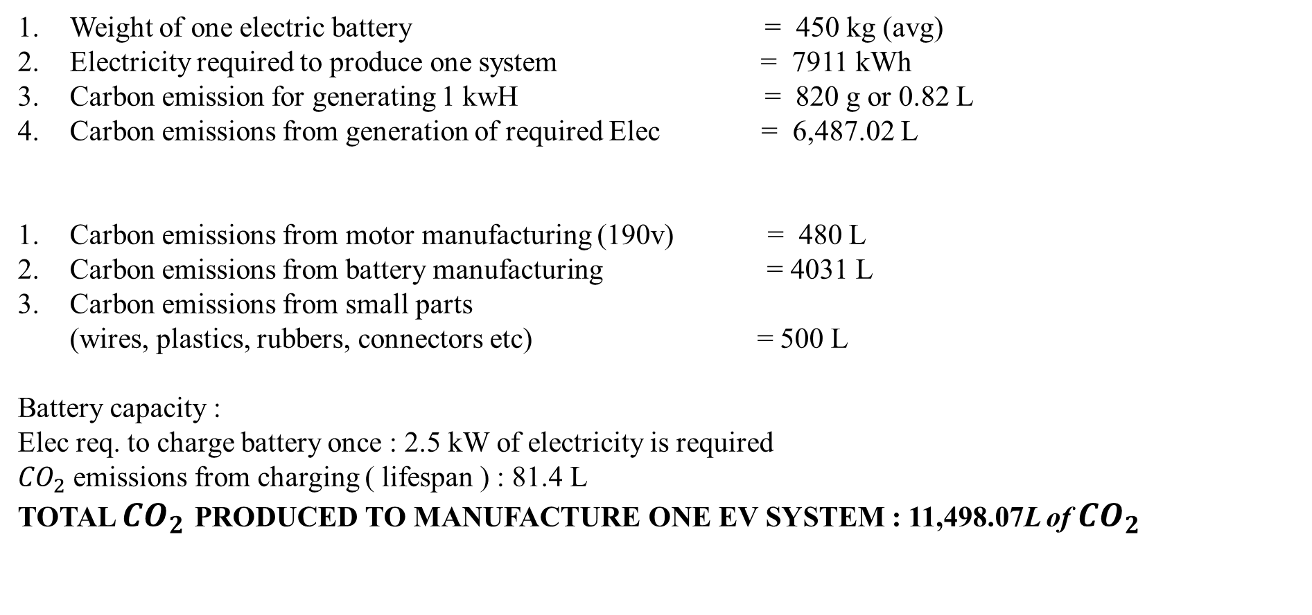
GENERAL REQUIREMENTS TO PRODUCE ONE EV SYSTEM
Weight of one electric battery = 450 kg (avg)
Electricity required to produce one system = 7911 kWh
Carbon emission for generating 1 kwH = 820 g or 0.82 L
Carbon emissions from generation of required Elec = 6,487.02 L
Carbon emissions from motor manufacturing (190v) = 480 L
Carbon emissions from battery manufacturing = 4031 L
Carbon emissions from small parts
(wires, plastics, rubbers, connectors etc) = 500 L
Battery capacity :
Elec req. to charge battery once : 2.5 kW of electricity is required
${CO}_{2}$ emissions from charging ( lifespan ) : 81.4 L
TOTAL ${CO}_{2}$ PRODUCED TO MANUFACTURE ONE EV SYSTEM : 11,498.07L of ${CO}_{2}$

Slide 15
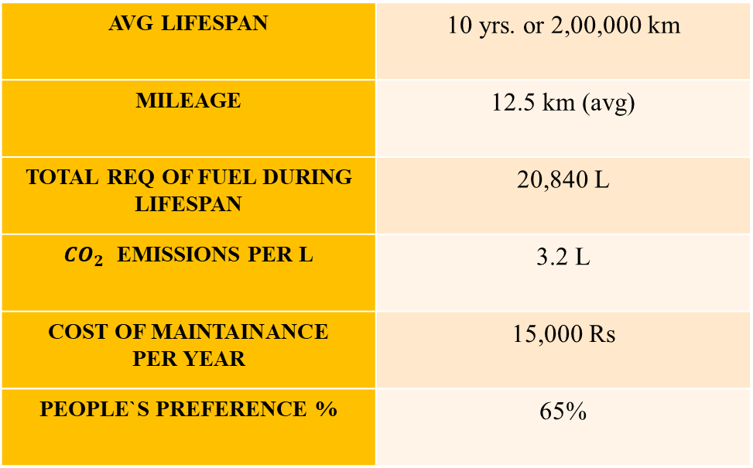
SPECS COMPARISION
IC SYSTEM
EV SYSTEM
AVG LIFESPAN | 10 yrs. or 2,00,000 km
MILEAGE | 12.5 km (avg)
TOTAL REQ OF FUEL DURING LIFESPAN | 20,840 L
${CO}_{2}$ EMISSIONS PER L | 3.2 L
COST OF MAINTAINANCE PER YEAR | 15,000 Rs
PEOPLE`S PREFERENCE % | 65%
AVG LIFESPAN | 15 yrs. or 3,21,000 km
MILEAGE | 400 km per charge
TOTAL CHARGES DURING LIFESPAN | 651 times
ELEC REQ PER CHARGE | 2.5 kW
COST OF MAINTAINENCE PER YEAR | 10,000 Rs
PEOPLE`S PREFERENCE % | 35%
FOR CALCULATIONS, THE AVG OF BOTH THE DISTANCES HAS BEEN TAKEN.
AVG DISTANCE = 2,60,500 km
Notes:
https://www.forbes.com/sites/jimgorzelany/2022/10/06/by-the-numbers-what-it-costs-to-maintain-an-electric-vehicle/?sh=344deb1d64d3
(PRICE COMPARISION FOR MAINTAINENCE )
https://www.91mobiles.com/hub/electric-car-vs-petrol-car/
https://www.team-bhp.com/forum/technical-stuff/256952-typical-annual-maintenance-costs-your-car.html (fuel cars)
https://e-vehicleinfo.com/electric-car-vs-petrol-car-total-cost-of-ownership/ (EV)
Lifespan
IC engine –
https://riverdaleautomotive.com/2017/08/what-is-the-average-lifespan-of-a-vehicle-engine/#:~:text=Average%20engine%20lifespan&text=For%20some%20time%2C%20the%20average,miles%2C%20or%20about%2010%20years.
EV SYSTEM –
https://blog.evbox.com/uk-en/ev-battery-longevity
People`s pereference
https://theprint.in/india/35-indians-want-to-drive-electric-car-lack-of-range-infra-keeps-many-from-buying-survey/611509/

Slide 16
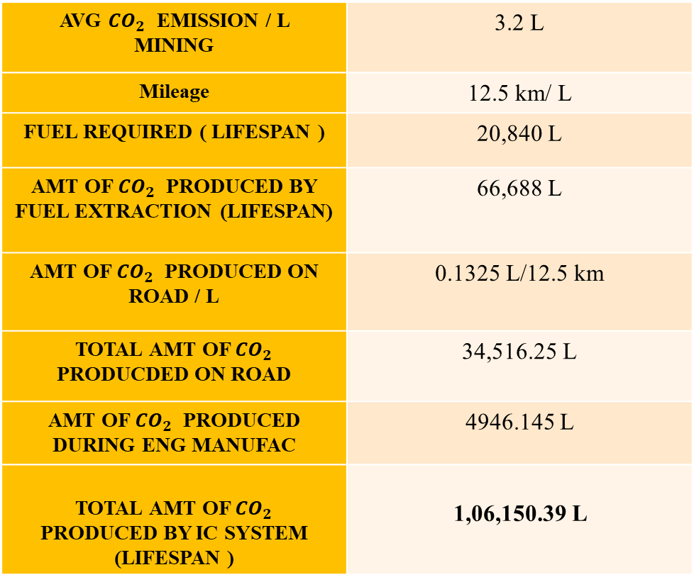
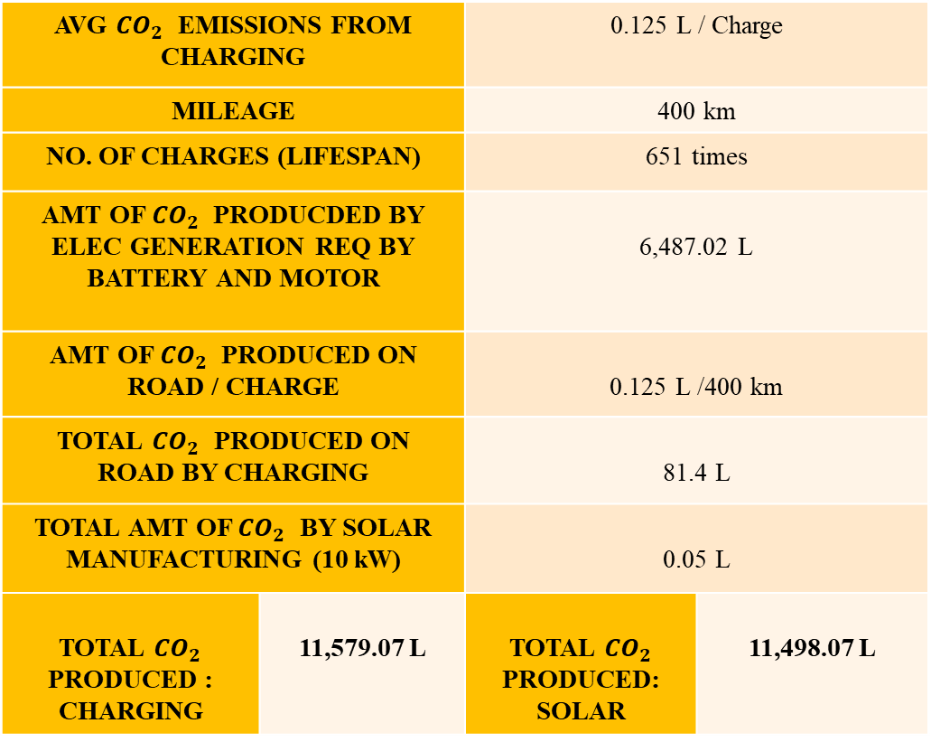
CARBON FOOTPRINT : FUEL VS ELECTRICITY
AVG ${CO}_{2}$ EMISSION / L MINING | 3.2 L
Mileage | 12.5 km/ L
FUEL REQUIRED ( LIFESPAN ) | 20,840 L
AMT OF ${CO}_{2}$ PRODUCED BY FUEL EXTRACTION (LIFESPAN) | 66,688 L
AMT OF ${CO}_{2}$ PRODUCED ON ROAD / L | 0.1325 L/12.5 km
TOTAL AMT OF ${CO}_{2}$ PRODUCDED ON ROAD | 34,516.25 L
AMT OF ${CO}_{2}$ PRODUCED DURING ENG MANUFAC | 4946.145 L
TOTAL AMT OF ${CO}_{2}$ PRODUCED BY IC SYSTEM (LIFESPAN ) | 1,06,150.39 L
AVG ${CO}_{2}$ EMISSIONS FROM CHARGING |  | 0.125 L / Charge
MILEAGE |  | 400 km
NO. OF CHARGES (LIFESPAN) |  | 651 times
AMT OF ${CO}_{2}$ PRODUCDED BY ELEC GENERATION REQ BY BATTERY AND MOTOR |  | 6,487.02 L
AMT OF ${CO}_{2}$ PRODUCED ON ROAD / CHARGE |  | 0.125 L /400 km
TOTAL ${CO}_{2}$ PRODUCED ON ROAD BY CHARGING |  | 81.4 L
TOTAL AMT OF ${CO}_{2}$ BY SOLAR MANUFACTURING (10 kW) |  | 0.05 L
TOTAL ${CO}_{2}$ PRODUCED : CHARGING | 11,579.07 L | TOTAL ${CO}_{2}$ PRODUCED: SOLAR | 11,498.07 L
Notes:
https://massachusetts.revolusun.com/blog/carbon-footprint-of-solar-panel-manufacturing/

Slide 17
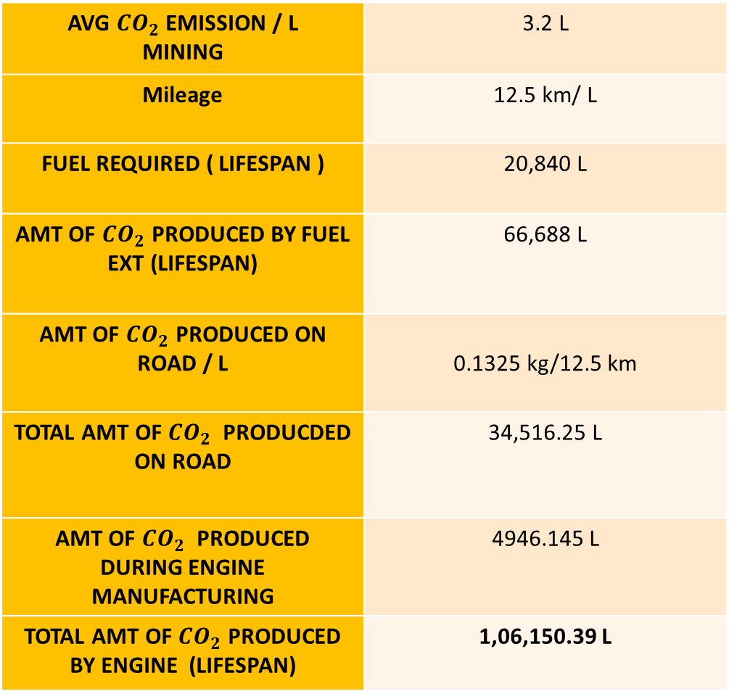
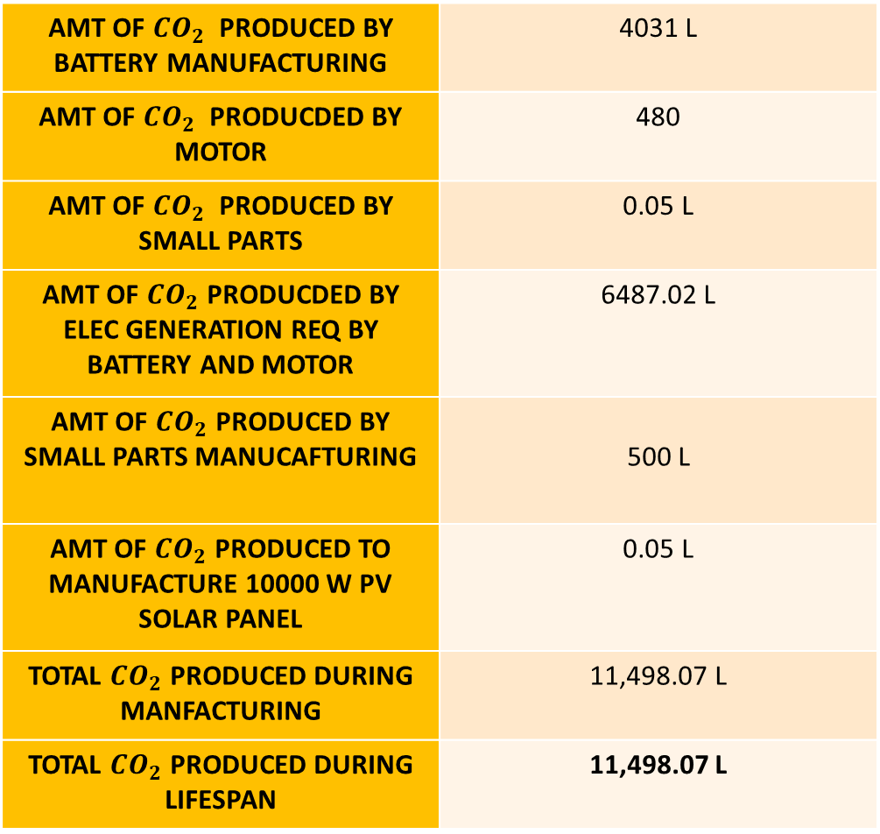
CARBON FOOTPRINT : FUEL VS ELECTRICITY
AVG ${CO}_{2}$ EMISSION / L MINING | 3.2 L
Mileage | 12.5 km/ L
FUEL REQUIRED ( LIFESPAN ) | 20,840 L
AMT OF ${CO}_{2}$ PRODUCED BY FUEL EXT (LIFESPAN) | 66,688 L
AMT OF ${CO}_{2}$ PRODUCED ON ROAD / L | 0.1325 kg/12.5 km
TOTAL AMT OF ${CO}_{2}$ PRODUCDED ON ROAD | 34,516.25 L
AMT OF ${CO}_{2}$ PRODUCED DURING ENGINE MANUFACTURING | 4946.145 L
TOTAL AMT OF ${CO}_{2}$ PRODUCED BY ENGINE (LIFESPAN) | 1,06,150.39 L
AMT OF ${CO}_{2}$ PRODUCED BY BATTERY MANUFACTURING | 4031 L
AMT OF ${CO}_{2}$ PRODUCDED BY MOTOR | 480
AMT OF ${CO}_{2}$ PRODUCED BY SMALL PARTS | 0.05 L
AMT OF ${CO}_{2}$ PRODUCDED BY ELEC GENERATION REQ BY BATTERY AND MOTOR | 6487.02 L
AMT OF ${CO}_{2}$ PRODUCED BY SMALL PARTS MANUCAFTURING | 500 L
AMT OF ${CO}_{2}$ PRODUCED TO MANUFACTURE 10000 W PV SOLAR PANEL | 0.05 L
TOTAL ${CO}_{2}$ PRODUCED DURING MANFACTURING | 11,498.07 L
TOTAL ${CO}_{2}$ PRODUCED DURING LIFESPAN | 11,498.07 L
Notes:
https://massachusetts.revolusun.com/blog/carbon-footprint-of-solar-panel-manufacturing/

Slide 18



Electric car batteries are highly recyclable, with around 90 percent of the cell being recoverable as a commercial activity.
How different auto brands are recycling batteries?
Nissan`s second-life batteries from its Leaf car model for energy storage, with an off shelf home or commercial unit called xStorage as a rival to Tesla’s Powerwall.
Honda is in a collaboration SNAM to collect and recycle batteries for second-life use or the extraction of precious elements.
BMW creates mobile power units.
Renault launched SmartHub project comprising 1,000 second-life electric-car batteries, to provide energy for l housing,, residential homes and local businesses.
Notes:
https://www.azocleantech.com/article.aspx?ArticleID=1597

Slide 19
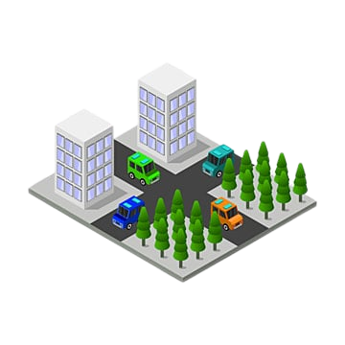



MOBILITY CHALLENGES TO EVs:
The major challenges to electric vehicles today in India are:
1. Limited range.
2. No proper infrastructure.
3. A time consuming endeavor.
4. No universal chargers and fast charging stations.
5. People`s mindset is conservative towards IC engines.
Notes:
https://evehicleshop.in/problems-with-electric-vehicles-in-india-2o22updated/

Slide 20


OUR IDEA !!!
-AN INDEGENIOUS SOLUTION TO EV PROBLEMS!
SWAPBATT
An innovative technology to deal with the time consuming and inconvient way of charging a battery.
Our idea involves the use of a battery vending dock.
The consumer can swap an empty battery with a fully charged battery from the docking station with the addition of the latest technology in the market.

Slide 21


SWAP DOCK
This product, SWAP DOCK, a charging station covers. an area of 10 ft by 10ft with an height of 5 ft.
It houses several battery units which can be swapped by the customer when their battery is down.
This acts like a power bank for the EV's batteries.

Slide 22

CAPITAL : 4-8 cr, Medium scaled
PLACE : Preferable locations – SEZ’s
1. Hosur - 40 lakhs per acre
2. Dharwad – 20 lakhs per acre
KIADB -government allotted land based on the project (recommended)
LABOUR - 50 PEOPLE REQUIRED
COST OF PRODUCTION:
TYPE | NUMBER | SALARIES
SKILLED | 10 | 15,000
UNSKILLED | 15 | 7,000
TECHNICAL LABOURs | 5 | 20,000
Notes:
https://kum.karnataka.gov.in/KUM/PDFS/
https://www.deccanherald.com/state/karnataka-govt-clears-investment-proposals-worth-rs-26000-crore-929967.htmlKEVESPPolicyInsidepagesfinal.pdf

Slide 23

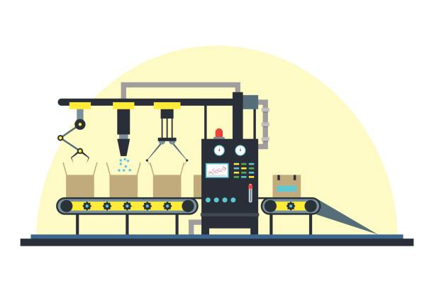
No. of batteries produced per month - 1500
Sl No. | Cost Element | Cost in INR / month
1 | Labour cost | 3,55,000
2 | Assembly Line & Machinery | 38,00,000
3 | Cost per Battery | 22,220
Profits from battery manufacturing unit :
1.Cost of production : 22,220 rupees
2.Selling price : 24,000 rupees
3.Market price : 25,000 rupees
4.Profit per battery : 1780 rupees
5.Total profit earned by selling : 26,70,000 rupees / month
6.ROI : 16 months
Notes:
https://e-vehicleinfo.com/lithium-ion-battery-prices-in-india/

Slide 24
COMPONENTS OF THE SWAP DOCK
Sl# | Components | Cost in INR
1 | External shell – sheet Al | 7,000
2 | Charging modules | 9,000
3 | External monitor | 3,000
4 | Card Scanner | 9,000
5 | COST OF 1 MACHINE | 28,000
6 | COST FOR 10 MACHINES | 2,80,000
7 | SOFTWARE/APP | 1,00,000
8 | HARDWARE CHARGES (10 No.s) | 1,50,000
9 | AREA CHARGES (LEASE) | 3,12,000
10 | PV SOLAR 10000 W | 4,50,000
11 | TOTAL COST | 13,48,000

Slide 25
ARRANGING THE FINANCES (in Rs)
Subsidy from the state on EV’s | 50,00,000
Subsidy from MSME : 50L | 50,00,000
Loan amount in INR | 2,00,00,000
Own investment in capital | 1,01,55,000
Total capital | 4,01,55,000
Notes:
https://e-amrit.niti.gov.in/electric-vehicle-incentives
https://timesofindia.indiatimes.com/city/bengaluru/desp
https://msme.gov.in/sites/default/files/MSME_Schemes_English_0.pdfite-growth-of-evs-karnataka-lags-in-subsidising-consumers/articleshow/88232015.cms

Slide 26

CONTINUED…
Expenses by paying salary - 3,55,000 rupees / month
Total capital required to start the industry – 4,01,55,000 rupees
Profits from battery manufacturing unit :
Cost of production : 22,220 rupees
Selling price : 24,000 rupees
Market price : 25,000 rupees
Profit per battery : 1,780 rupees
no of batteries produced per month - 1500
Total cost of batteries produced - 3,60,00,000 rupees
Machineries cost - 38,00,000 (2 machine *19L)
Total profit earned by selling - 26,70,000 rupees
MAKE PROFITS WHILE SAVING THE EARTH!

Slide 27


ADVANTAGES OF SWAP SYSTEM
Eco friendly and pocket friendly to both the user and the producer, overall, saving money and the world.
Time saving as it is a simple swap and go system.
Addresses the issue of infrastructure and limited range problems of EV`s.
Batteries can be monitored constantly, to prevent mishaps.
One of a kind product that harnesses the renewable resources to lead to a green and clean future.
Notes:
https://www.maglab.ch/products/battery-monitoring-system/#:~:text=The%20Battery%20sensing%20and%20monitoring,and%20(iii)%20temperature%20sensor.
https://www.bosch-mobility-solutions.com/en/solutions/sensors/electronic-battery-sensor/#:~:text=The%20electronic%20battery%20sensor%20(EBS)%20measures%20the%20current%2C%20voltage,acid%20batteries%20with%20great%20precision.

Slide 28
PRINCIPLE
Using solar energy as a renewable and sustainable form of energy.
Comparing the carbon emission of an IC engine car and an EV car.
Thus concluding ,electric vehicles are green and eco friendly when compared to existing IC cars.
Bringing awareness and educating people about the importance of environment. Exploring and understanding the measures taken by the government of Karnataka to protect the environment.

Slide 29

Environmental Education
Environmental education is a process that allows individuals to explore environmental issues, engage in problem solving, and take action to improve the environment.
As a result, individuals develop a deeper understanding of environmental issues and have the skills to make informed and responsible decisions.

Slide 30
IMPORTANCE OF CONSERVATION
FOLLOW THIS
SUSTAINABLE DEVELOPMENT
TO AVOID
GLOBAL WARMING
OPTIMAL USAGE OF RESOURCES
using more renewable sources
switch to efficient methods of pollution control
industries to reduce wastage and opt for efficient energy sources.
combustion of fossil fuels.
endangers an increase in the global temperature.
results in the massive wastage of energy sources.
Appropriate infrastructures
right selection of building materials
Reduction in energy and water usage via green building initiative.
RESULTS IN

Slide 31

What are the steps taken by our government?
The constitution states that:
“It shall be the duty of every citizen of India to protect and improve the natural environment including forests, lakes, rivers and wildlife and to have compassion for living creatures”
Various Schemes like Plantation schemes, Seedling distribution schemes, awareness schemes.
Creating educational parks for promoting awareness and recreation. eg. tree parks, Daivavana.

Slide 32
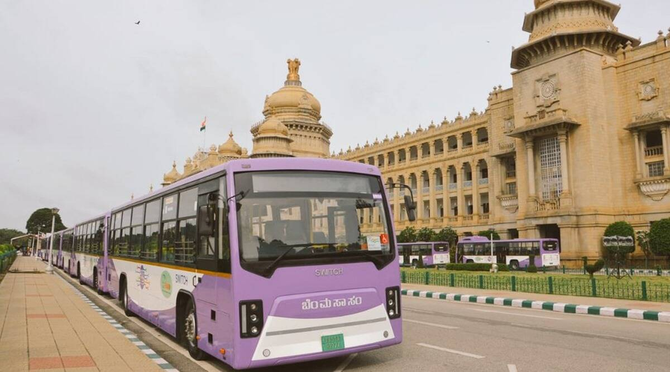
ELECTRIC BUSES
Advantages-
Reduces dependency on fossil fuels.
Reduces noise and air pollution.
Reduces GHG emissions.
Cost efficient.
More durability and efficiency.
More mileage (range).

Slide 33

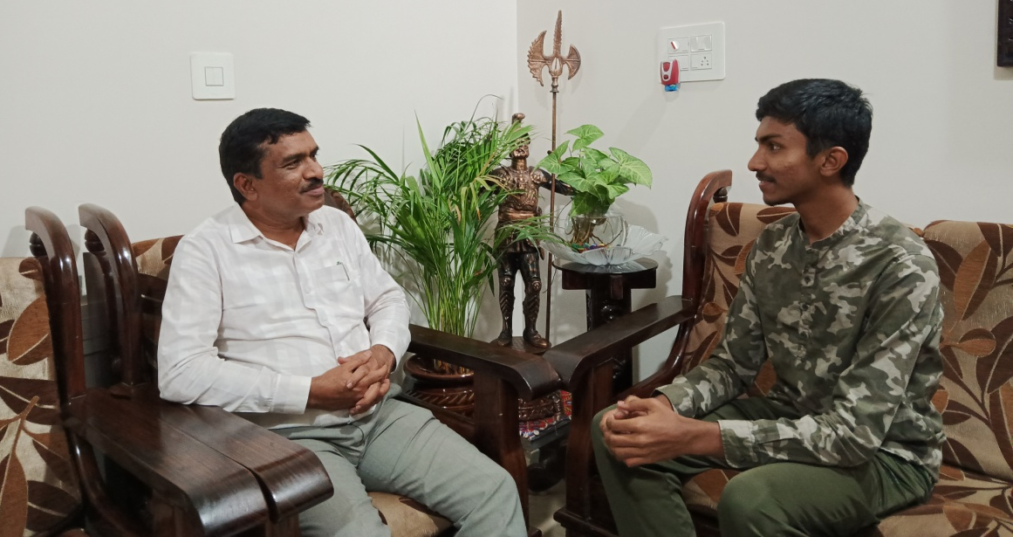
INTERVIEW
We had the privilege of interviewing an official from the Karnataka forest department. We contacted Respected Mr. Prasanna Kumar SR (Deputy conservator of forests, Mysore) and asked a few questions concerning sustainability and carbon emissions.
The drastic increase in population has resulted in over dependence of existing limited resources.
Urbanization has resulted in decrease in the forest cover and increase in pollution.
Human activities have led to the exploitation of the ecosystem.

Slide 34





SOLUTIONS SUGGESTED
Using EVs and eco-friendly alternatives.
Plantation schemes.
Eco-friendly practices.
Implementing and following rules and regulations.
Awareness programmes.
Notes:
Source - DFO

Slide 35
SEMINAR
GRADE SELECTED : 5TH Standard
NO.OF STUDENTS : 39
OPTIONS GIVEN | NO. OF SELECTIONS
 | BEFORE | AFTER
BURSTING CRACKERS | 5 | 2
LISTENING TO LOUD MUSIC | 7 | 7
GARDENING | 15 | 23
CYCLING | 12 | 25
EATING BARBEQUE/SIZZLING FOOD | 5 | 3

Slide 36
RESULT
We found that the carbon emission from IC vehicles is 9 times more when compared to EV throughout its life.
From the survey, we found out that many children have resolved to conserve the nature consciously.

Slide 37

CONCLUSION:
Stocks of natural resources are limited. Resources are being exhausted and are not being replaced by an alternative solution.
Small things like using the resources mindfully, judiciously and conserving the resources by consciously.
Each individual can contribute by taking small steps, starting from their homes, which when followed by a community as a whole, will change the environment as we know it!

Slide 38
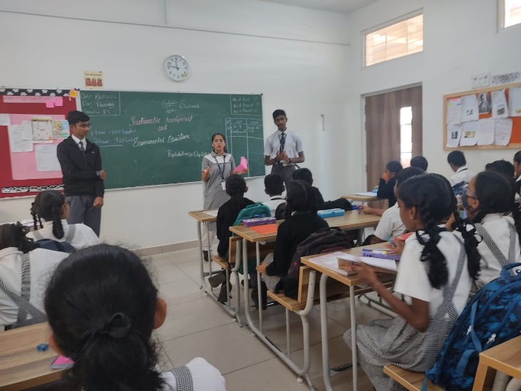
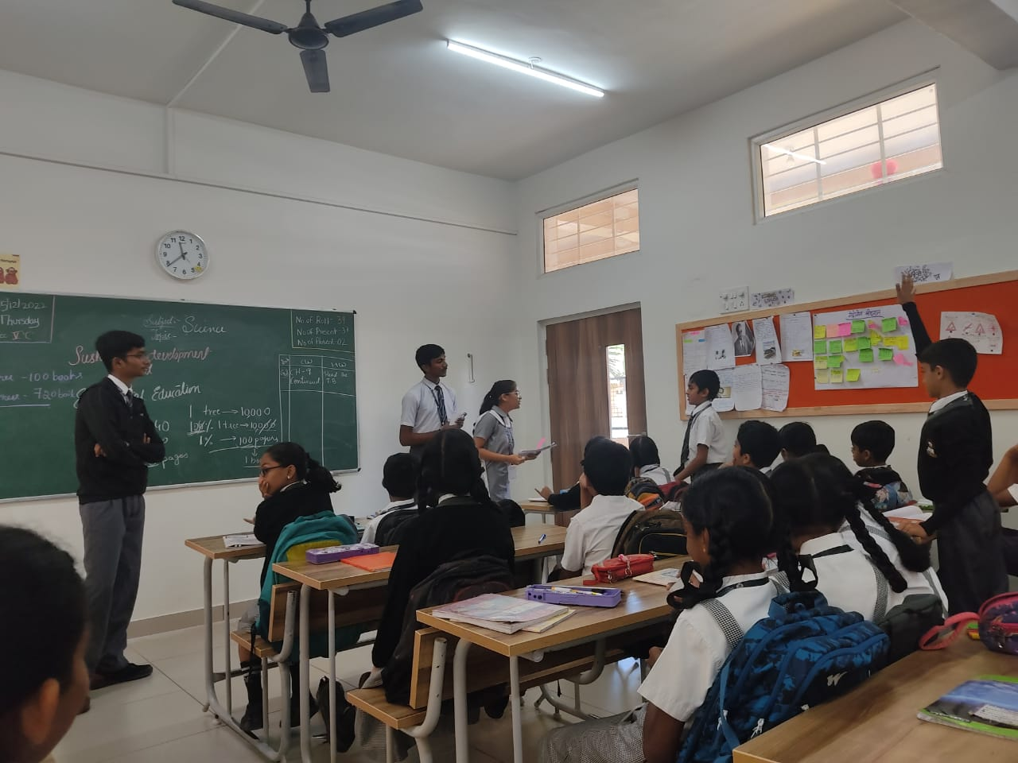
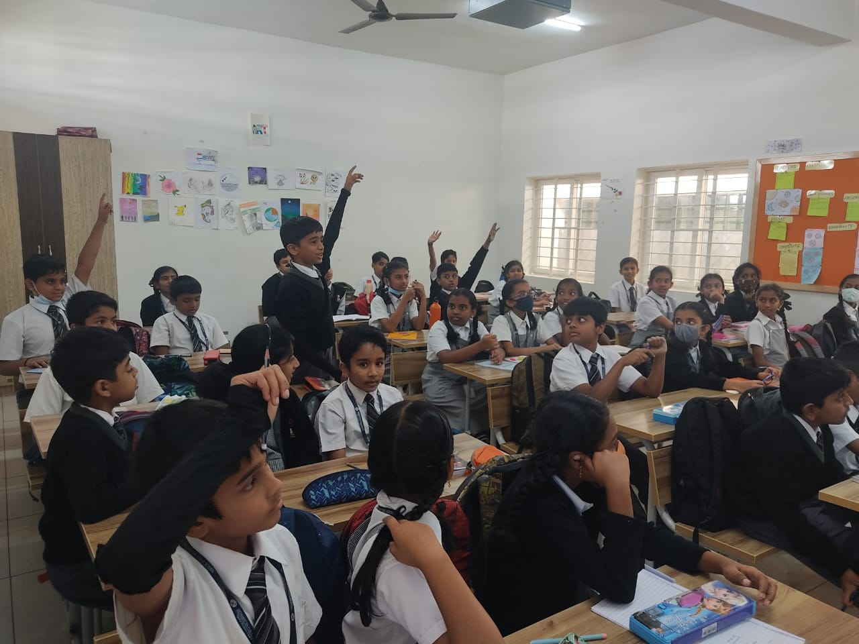
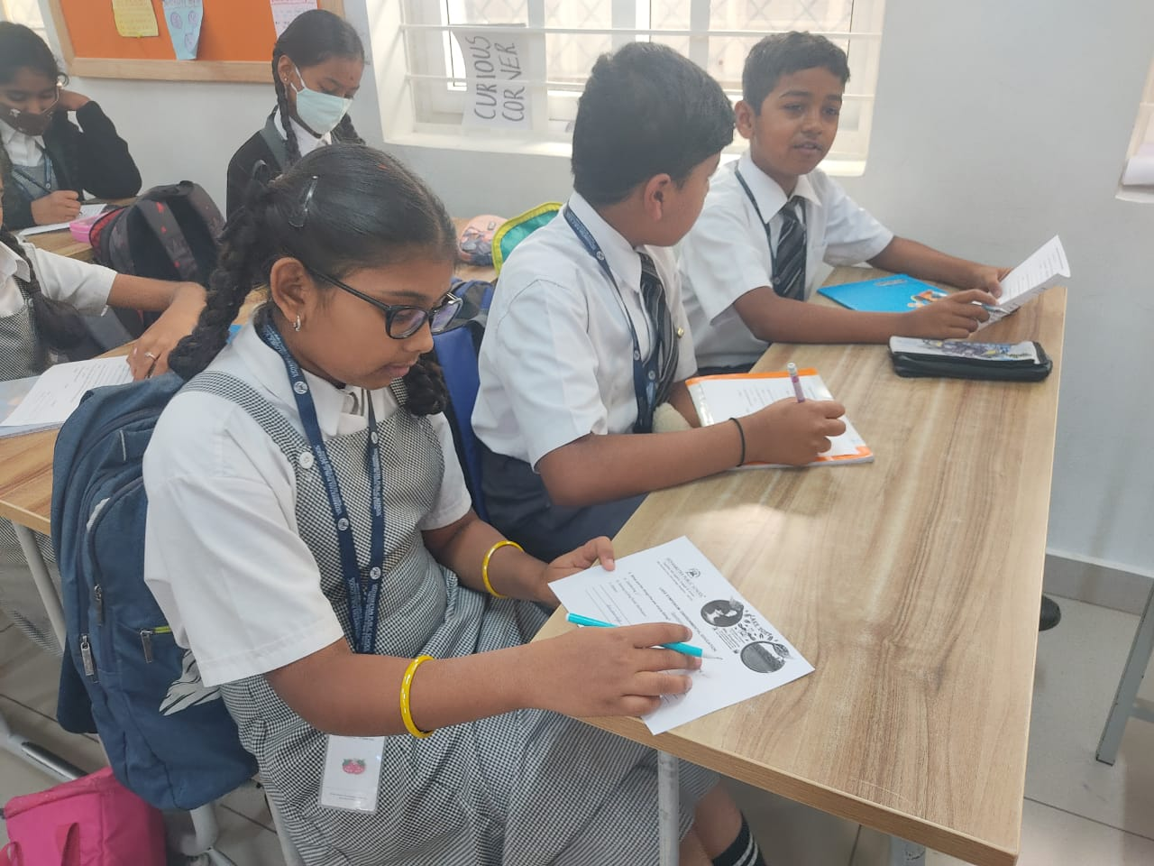
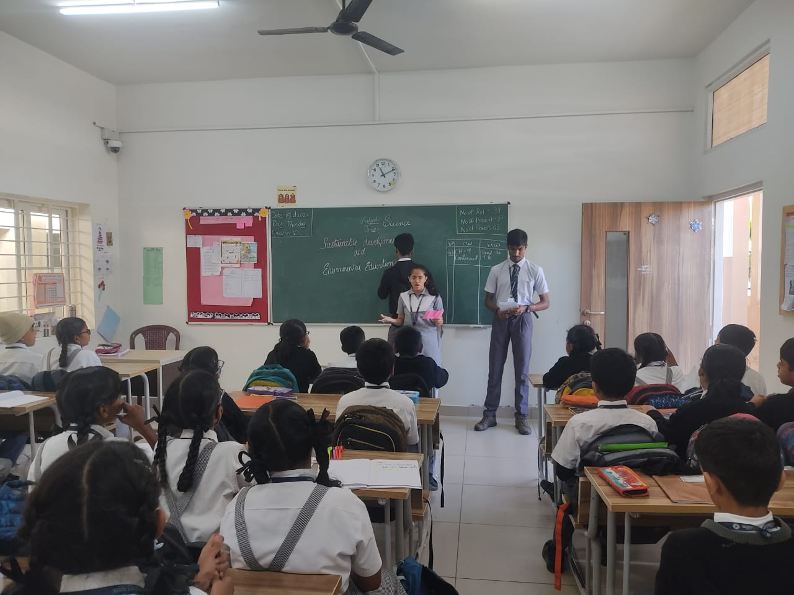
PICTURE GALLERY

Slide 39

INTERVIEW LINK AND VIDEO LINKS
INTERVIEW:
https://drive.google.com/file/d/1xcCifnLmQ7pOMDjBFkQdOGGo7UH1hc5g/view?usp=share_link
Notes:
https://drive.google.com/file/d/1xcCifnLmQ7pOMDjBFkQdOGGo7UH1hc5g/view?usp=share_link

Slide 40
References
https://www.rainforesttrust.org/
https://massachusetts.revolusun.com/blog/carbon-footprint-of-solar-panel-manufacturing/
https://www.thesundaily.my/style-life/feature/solar-energy-for-sustainable-development-DY5809151

Slide 41
ACKNOWLEDGEMENTS
We are very grateful to the IISc team for providing us this platform.
We would also like to thank the VPS management and the teachers for their well coordinated support and for encouraging us.
We would also like to thank Ms H S Gayathri, Ms. Veena, Ms. Vijayalakshmi ,
Ms. Priyanka, Mr. Hemanth and other facilitators, for their overall support in carrying out this project.
We also thank Mr. Prasanna Kumar ( DCF ), for giving his precious and valuable points that contributed towards our project.

Slide 42



