Slide 1

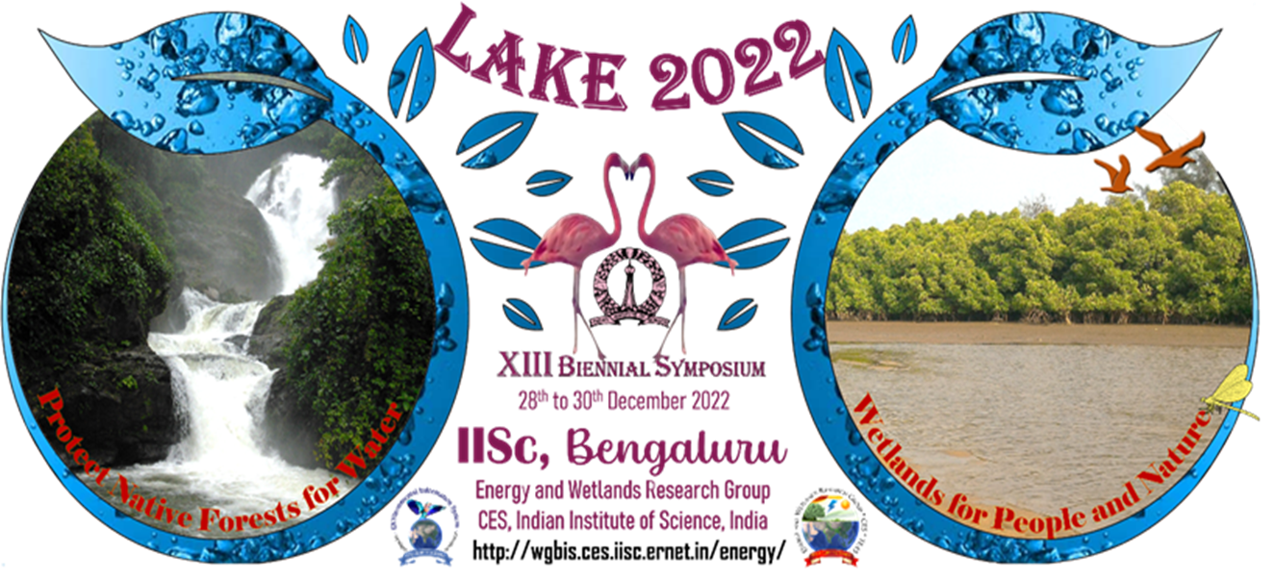
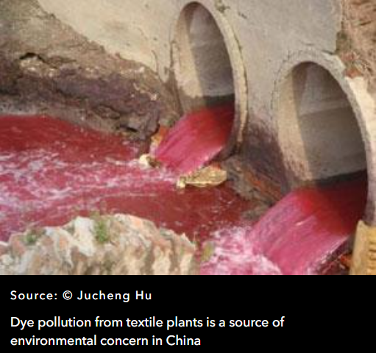
THE 13TH BIENNIAL LAKE SYMPOSIUM
Topic : Bioremediation of Textile Dyes and Heavy Metals
Venkat Charan Sagara J
Shouri A K Bhat
Aishwarya Chidambara
Class 10

Slide 2
Introduction
The presence of the textile dyes and heavy metals in water bodies causes environmental pollution and leads to serious health hazards in living organisms.
Treating the wastewater is very much necessary to avoid the demerits.
The physical and chemical treatment of the wastewater is proven effective but they have their own significant drawbacks like high cost and demand for extensive labour.
The treatment of the wastewater by biological methods has proven effective and they are also cost effective and environment friendly.

Slide 3
Objective
To isolate different fungal organisms to check their efficiency to decolorize textile effluents and remediate heavy metal pollutant, from Vrishabhavathi river.

Slide 4
Materials and Methods
Sample collection:
Vrishabhavathi river water sample was collected in order to isolate potent microorganisms to remediate textile dye and heavy metals from the sample.
Isolation:
The potent fungal organism were isolated by plating the sample on potato dextrose agar medium and incubated at 27 degree celsius for 3-5 days.

Slide 5
Dye decolorization efficiency of the fungal organisms:
The isolates were tested for their dye absorption efficiency by transferring 1 gram of fungal biomass to a 100ml laboratory dye solutions followed by incubation for 24 hours at 27 degree celsius.
Efficiency of heavy metal absorption by fungal biomass:
The isolates were for absorption of heavy metals by adding 1g of fungal biomass (Aspergillus Niger) to the heavy metals solution (chromium) , followed by incubation for 24 hours at 27 degree celsius..

Slide 6
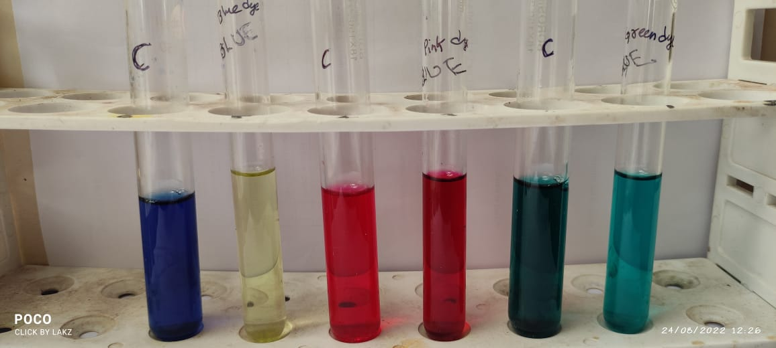
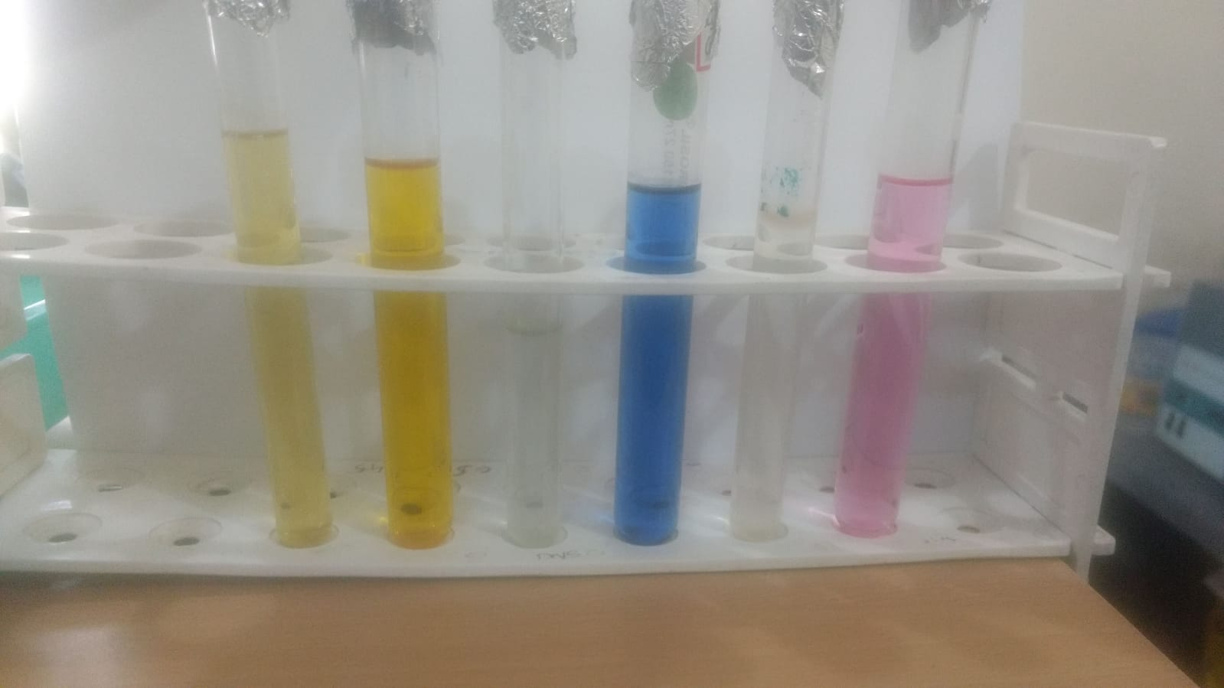
Results and Discussion
BBEFORE
AFAFTER
The Aspergillus niger absorbed 100% of laboratory dye from the solutions, among different isolates Aspergillus niger was proven effective for absorption of textile dyes.
Efficiency of chromium absorption by fungal biomass “results awaited”.

Slide 7
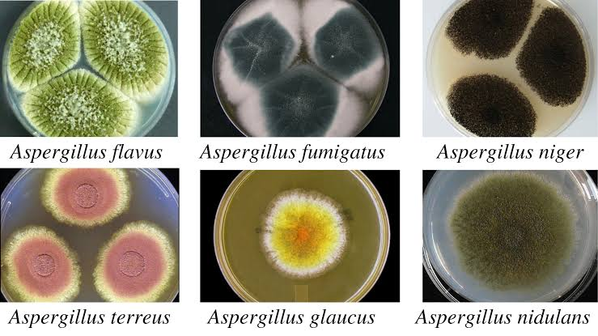
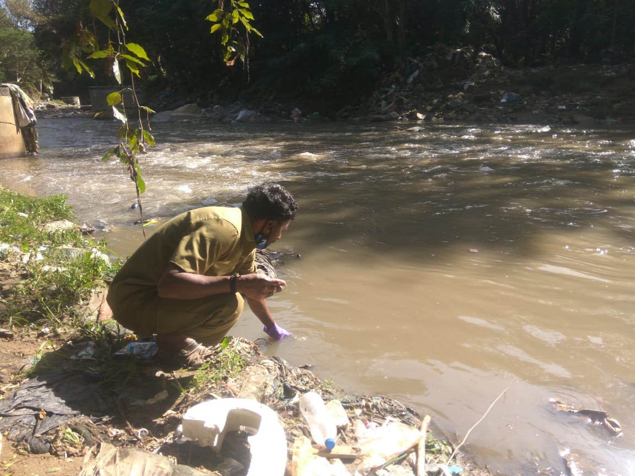
Picture Gallery
Cultured fungal plates
Collection of sample from Vrushabhawathi
river

Slide 8
Concentration of zinc and chromium in Vrushabhawathi river
SI No. | Parameters | Unit | Result | Test
1 | Zinc | Mg/L | 0.048
2 | Cadmium | Mg/L | BDL | APHA 23rd edition (3125B)
3 | Chromium | Mg/L | 0.035

Slide 9
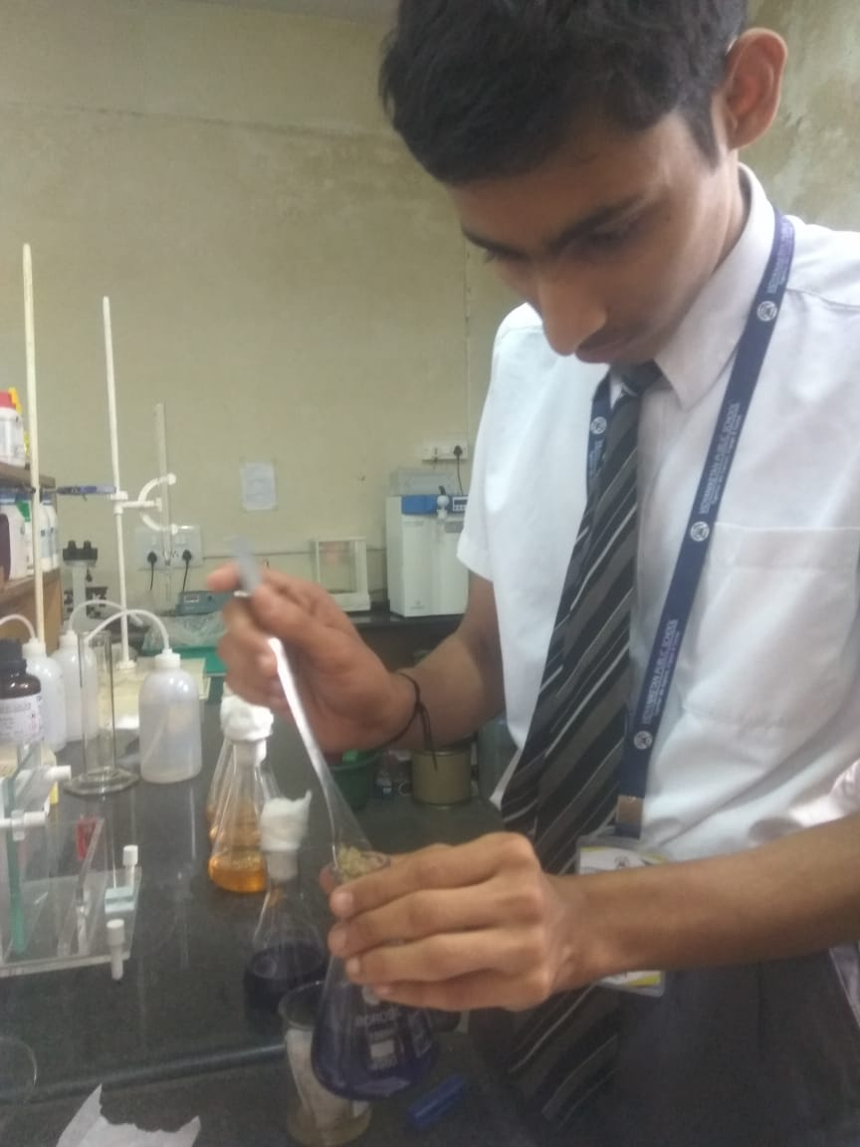
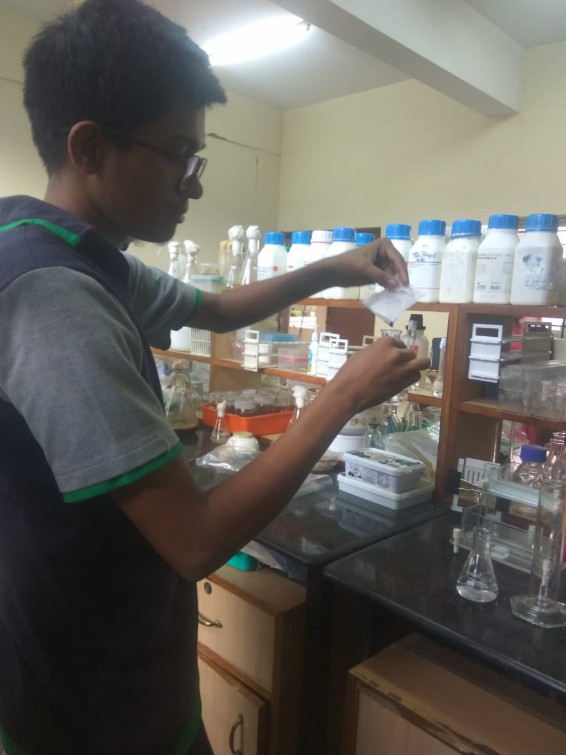
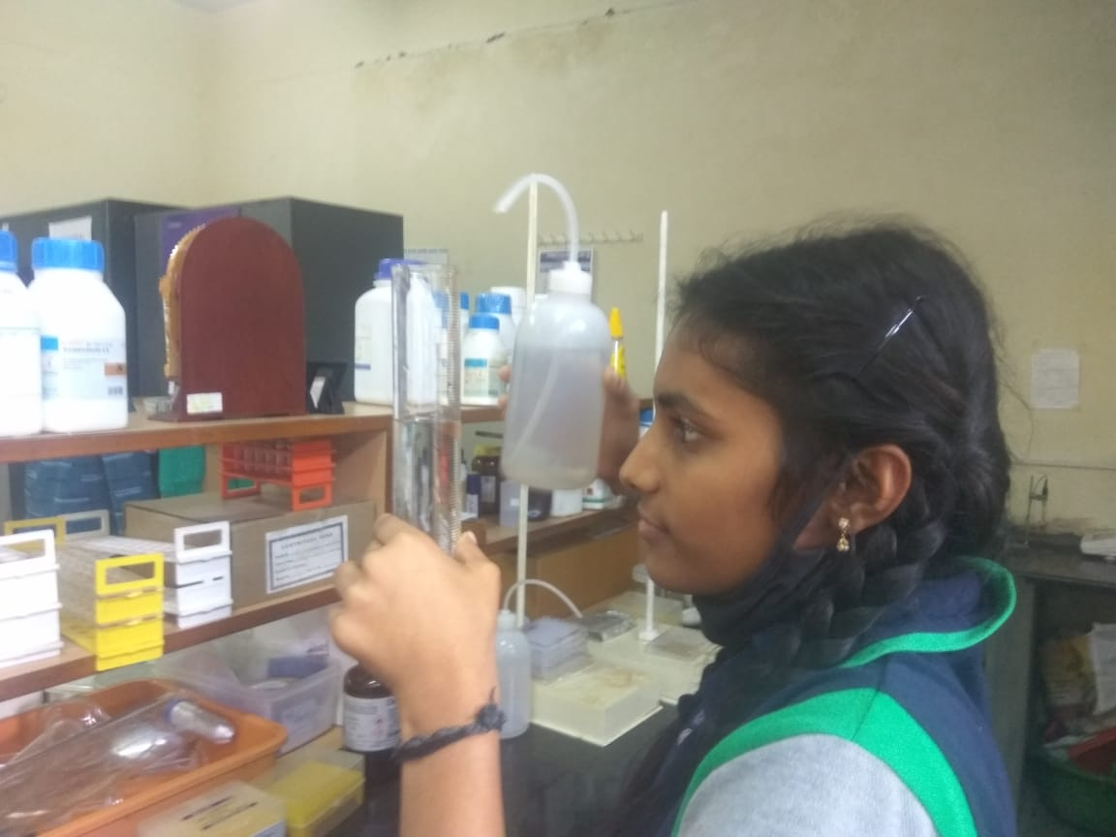
PICTURE GALLERY

Slide 10
Recommendations
We recommend textile industries to use fungal organisms to regulate the dye from the waste water.

Slide 11
Conclusion
The biological methods have been proven effective to remediate laboratory dyes from wastewater.
Among several fungal isolates Aspergillus niger was found to be effective for absorbing the laboratory dyes.
By considering these points in view we can recommend both textile and chrome plating/ paint industries to use biological methods to remediate their effluents.

Slide 12
References
https://link.springer.com/article/10.1007/s11356-019-07137-z
https://www.sciencedirect.com/science/article/pii/S0960852401000281
https://www.researchgate.net/publication/319607450_Immobilized_fungi_on_Luffa_cylindrica_An_effective_biosorbent_for_the_removal_of_lead
https://books.google.co.in/books?hl=en&lr=&id=e5lIh_M70TUC&oi=fnd&pg=PR7&dq=fungi+for+bioremediation&ots=qAgUWrSVgi&sig=3gXhP4_3YhEa-k7R-onpgyQS_hg
https://link.springer.com/article/10.1007/s12088-016-0584-6
https://www.mdpi.com/92112

Slide 13
ACKNOWLEDGEMENT
We are really privileged to be a part of Lake Symposium-2022-2023.
Our sincere thanks, to the Indian Institute of Science,
Department of Microbiology-Bangalore University.
We also extend our sincere thanks to School and all our respected teachers for guiding us through this project.

Slide 14
Thank You

