Slide 1
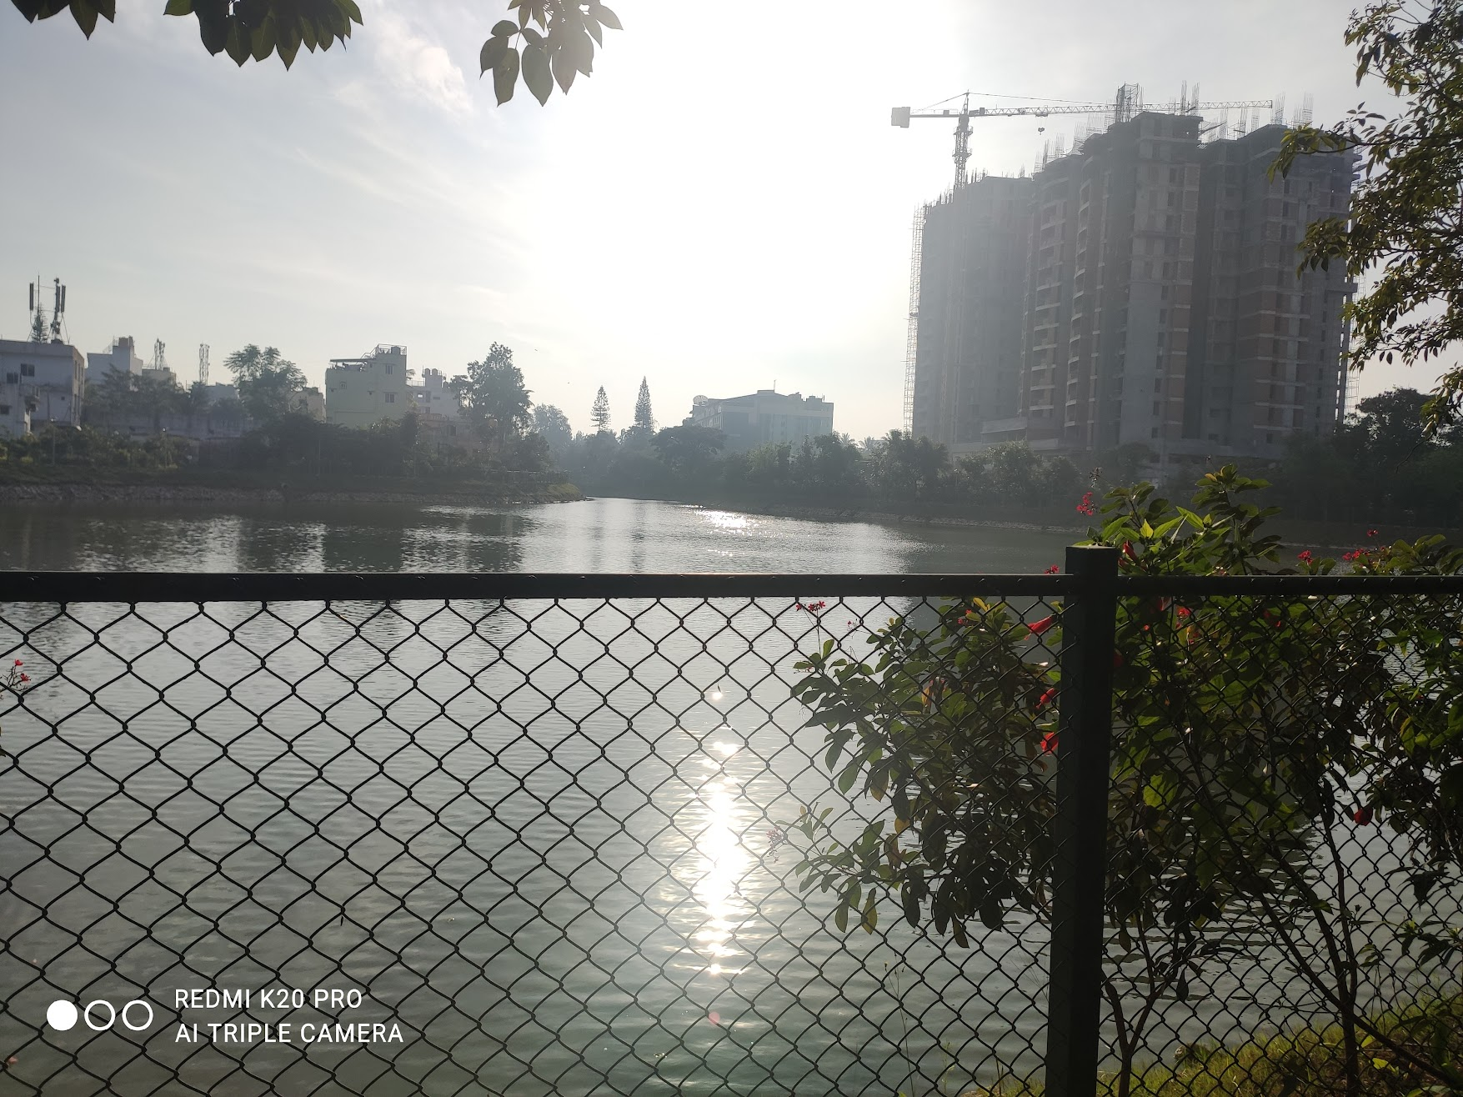



Profiling of Aquatic Ecosystem: A comparison of Soil in Kalena Agrahara Lake and Hulimavu Lake
Ayush Kumar Sahu
Maitreya M. Kataktalware
Grade 9
Presidency School Bengaluru South

Slide 2





LAYOUT OF PRESENTATION
03
Introduction
04
Objectives
05
Study Area
06
Materials & Methods
07
Results
08
Discussion

Slide 3
INTRODUCTION
Soil is the uppermost layer of the earth's crust and is a mixture of organic compounds, minerals, gases, liquid and living (or dead) organisms, that supports life on earth.
A typical soil is about 50% solids (45% mineral and 5% organic matter), and 50% voids (or pores) of which half is occupied by water and half by gas.
The pore space allows for the infiltration and movement of air and water, both of which are critical for life existing in soil.
Soil biodiversity supports and performs many key ecosystem services and functions, from cycling of nutrients and controlling pests and diseases to building and maintaining soil structure.

Slide 4
OBJECTIVES
OBJECTIVE 1
1
To collect soil sample around the lakes and its analysis
OBJECTIVE 2
2
To study the micronutrient profile of soil around both lakes to understand the type of plants suitable for the area

Slide 5
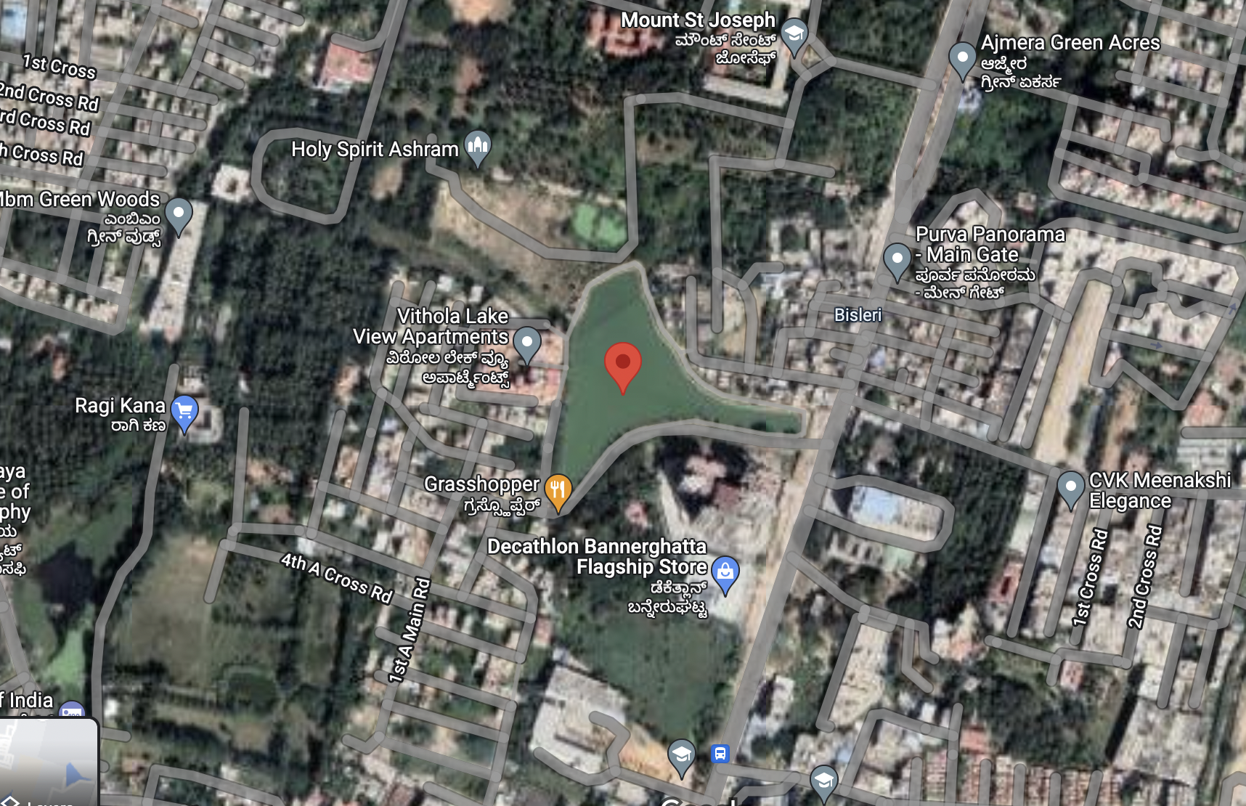
Study Area
Kalena Agrahara Lake
(12°52'18.9"N 77°36'13.1"E)
Kalena Agrahara lake on Bannerghatta Road is a seven-acre lake with fresh water, thick greenery, fish and moving birds is rare in Bengaluru
The Kalena Agrahara lake maintenance association keeps the water body clean and beautiful involving residents of apartment blocks near the lake
The lake, which once spread more than seven sections of land has now contracted to half of its size because of infringement
While the lake association has managed to revive the lake, now faces extreme difficulties, it is currently confronting another issue: infringement. In the course of the most recent couple of months, nearby land sharks have started to dump garbage on the lakebed

Slide 6
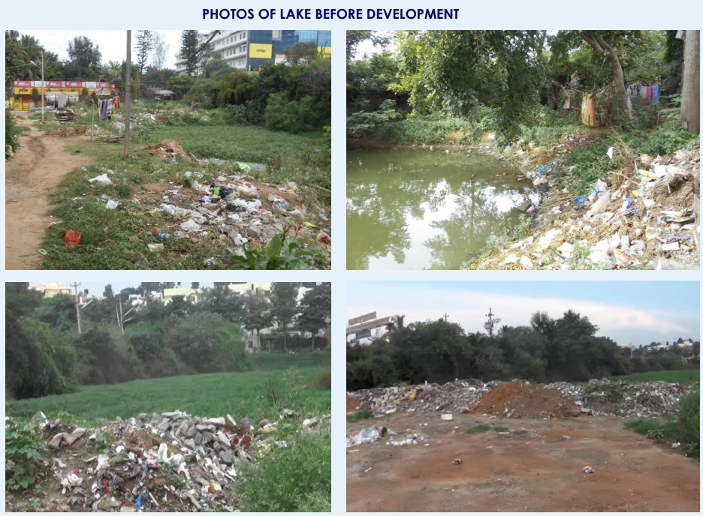
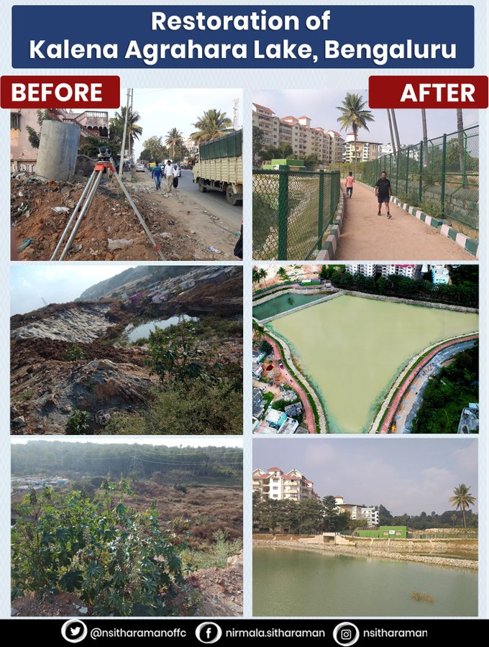
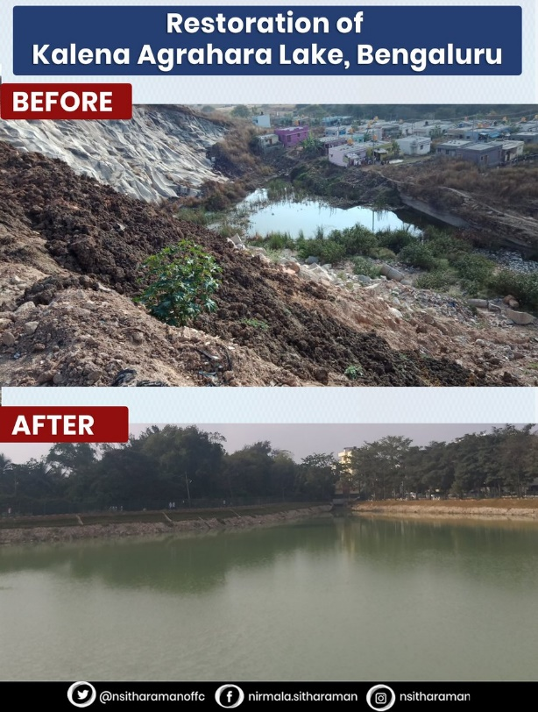

Slide 7
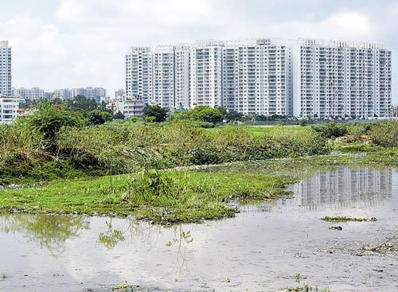
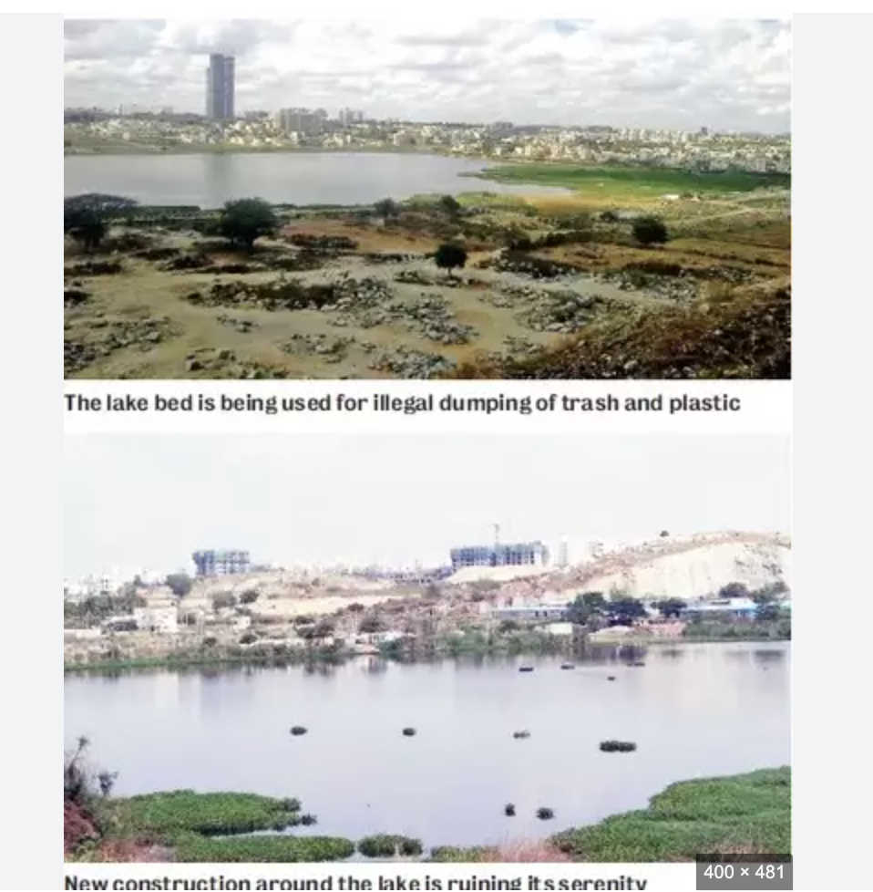
Hulimavu Lake

Slide 8

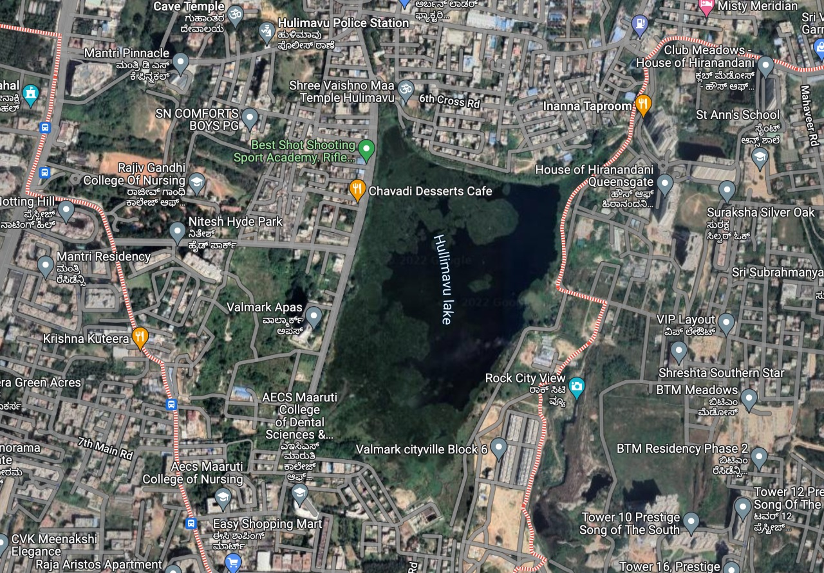










II. Hulimavu Lake
(12°52'18.9"N 77°36'13.1"E)
Hulimavu lake is situated in the Hulimavu area of Bengaluru
Spread over approx. 120 acres with a perimeter of about 3 km
The lake is under the jurisdiction of the Bangalore Development Authority (BDA)
In the last two decades, the Hulimavu lake has been encroached upon by real estate developers, and the current extent of the lake has been estimated to be only approximately 25 acres (0.10 km )
By the end of the first decade of the 21st century the lake had nearly dried up
In October 2012 the lake was breached, and sewage water flowing out of the lake flooded the nearby residential areas
Following the floods, BDA prepared a detailed plan for the development of the lake at a cost of ₹14 crore.

Slide 9

MATERIALS & METHODS
The soil parameters observed include
Physical and Chemical properties (Abiotic components),
Biological properties (Community patterns, and diversity)
pH
Colour
Abiotic components
01
Texture
Temperature
EC
Consistency

Slide 10
Community patterns and diversity
  Local species richness
02
Materials used are as follows:-
Soil Samples
Google Earth
Soil sample testing with the help of Biocentre

Slide 11

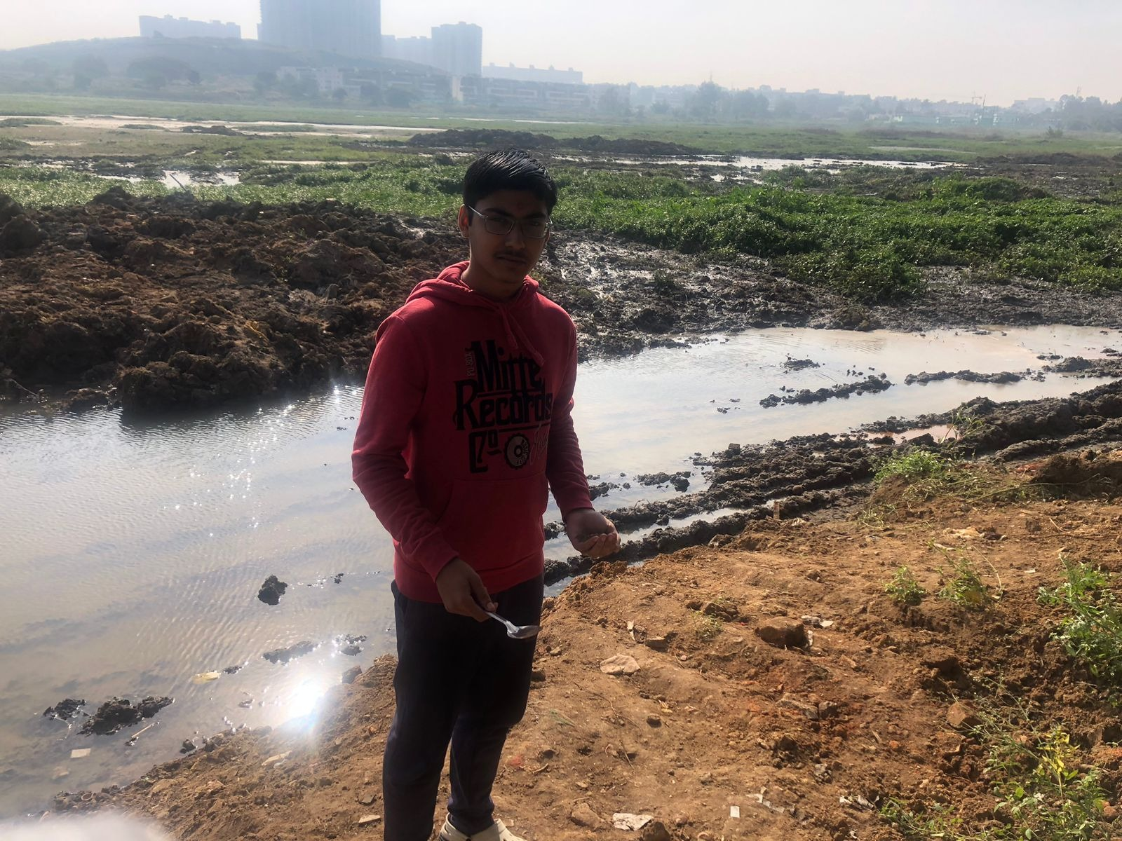
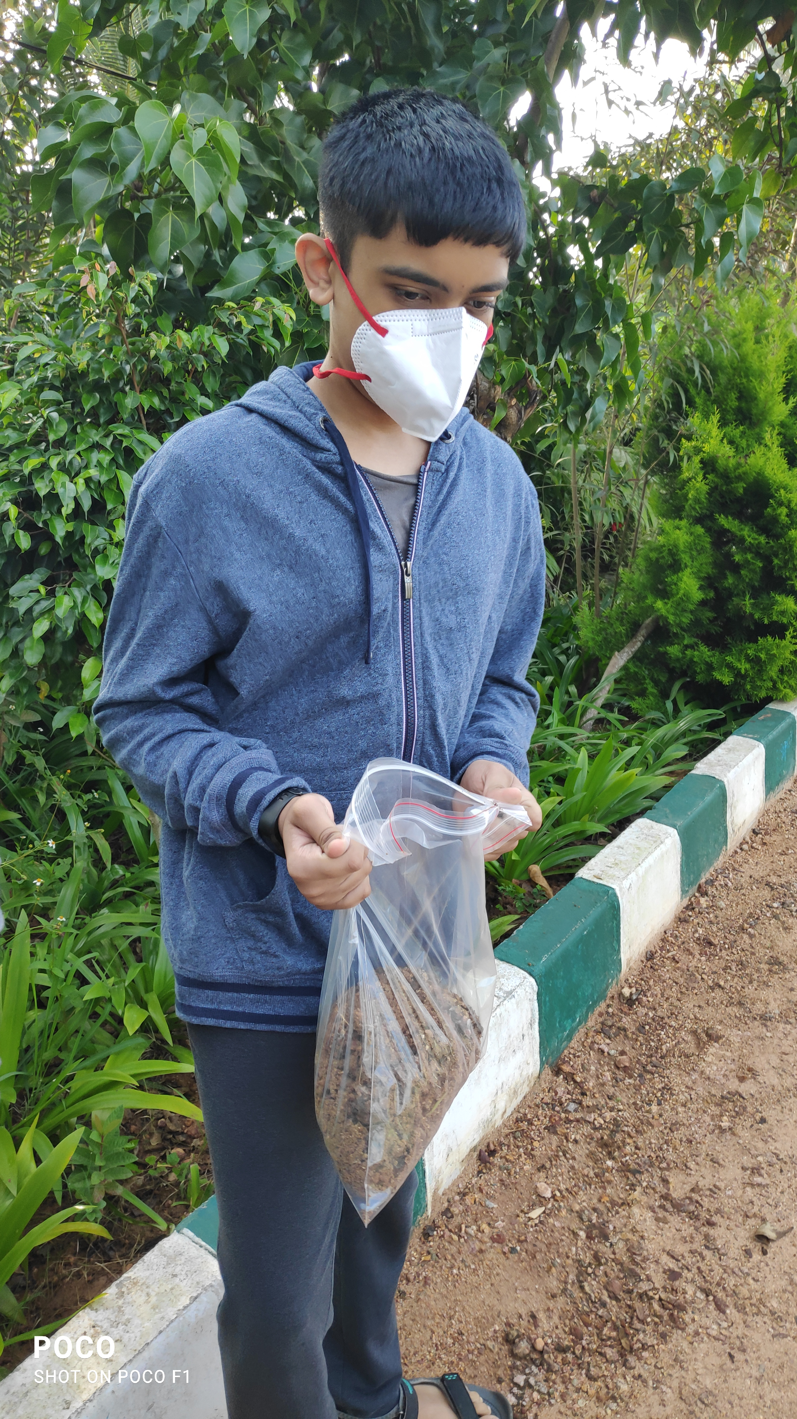
Us at the lakes collecting soil samples

Slide 12


SOIL PROFILE OF LAKES

Slide 13
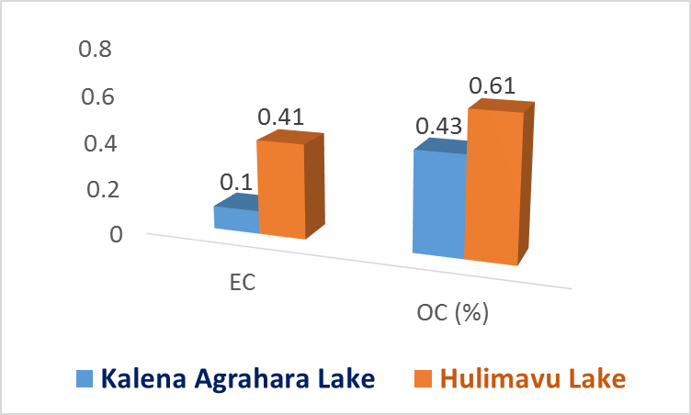
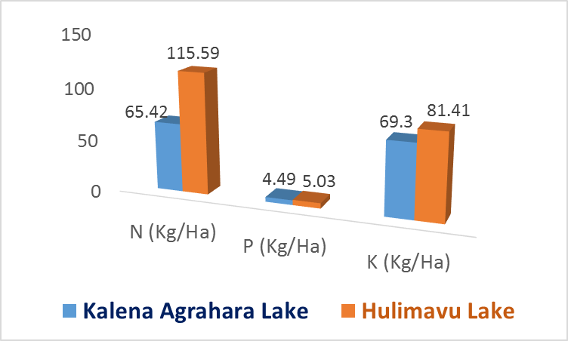

Soil Profile

Slide 14
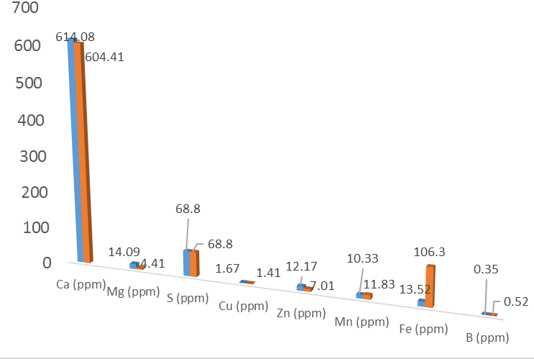
Soil Profile

Slide 15
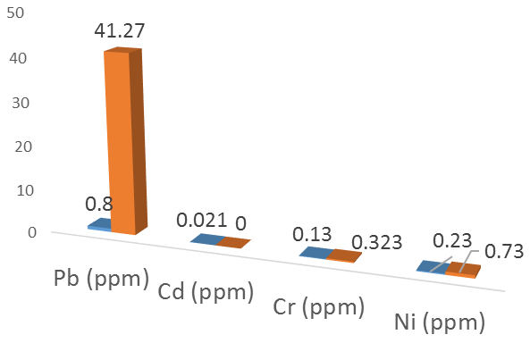
Soil Profile

Slide 16
Interpretation of Soil Profile
S No | Parameter | Interpretation
 |  | Kalena Agrahara | Hulimavu
1 | pH | Alkaline soil | Alkaline soil
2 | EC | Ideal for life forms | Ideal for life forms
3 | OC (%) | Deficient | Ideal for life forms
4 | N (Kg/Ha) | Deficient | Deficient
5 | P (Kg/Ha) | Deficient | Deficient
6 | K (Kg/Ha) | Deficient | Deficient
7 | Ca (ppm) | High | High
8 | Mg (ppm) | High | High
9 | S (ppm) | High | High

Slide 17
Interpretation of Soil Profile
S No | Parameter | Interpretation
 |  | Kalena Agrahara | Hulimavu
10 | Cu (ppm) | Very High | Very High
11 | Zn (ppm) | Very high | High
12 | Mn (ppm) | Very high | Very high
13 | Fe (ppm) | Very high | Very high
14 | B (ppm) | < critical limit | < critical limit
15 | Pb (ppm) | < critical limit | Very High
16 | Cd (ppm) | < critical limit | -
17 | Cr (ppm) | < critical limit | < critical limit
18 | Ni (ppm) | < critical limit | < critical limit

Slide 18
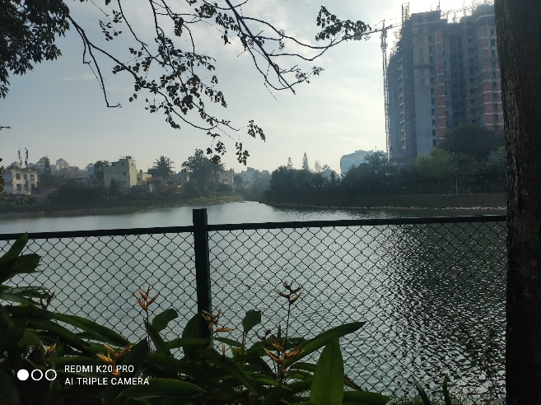
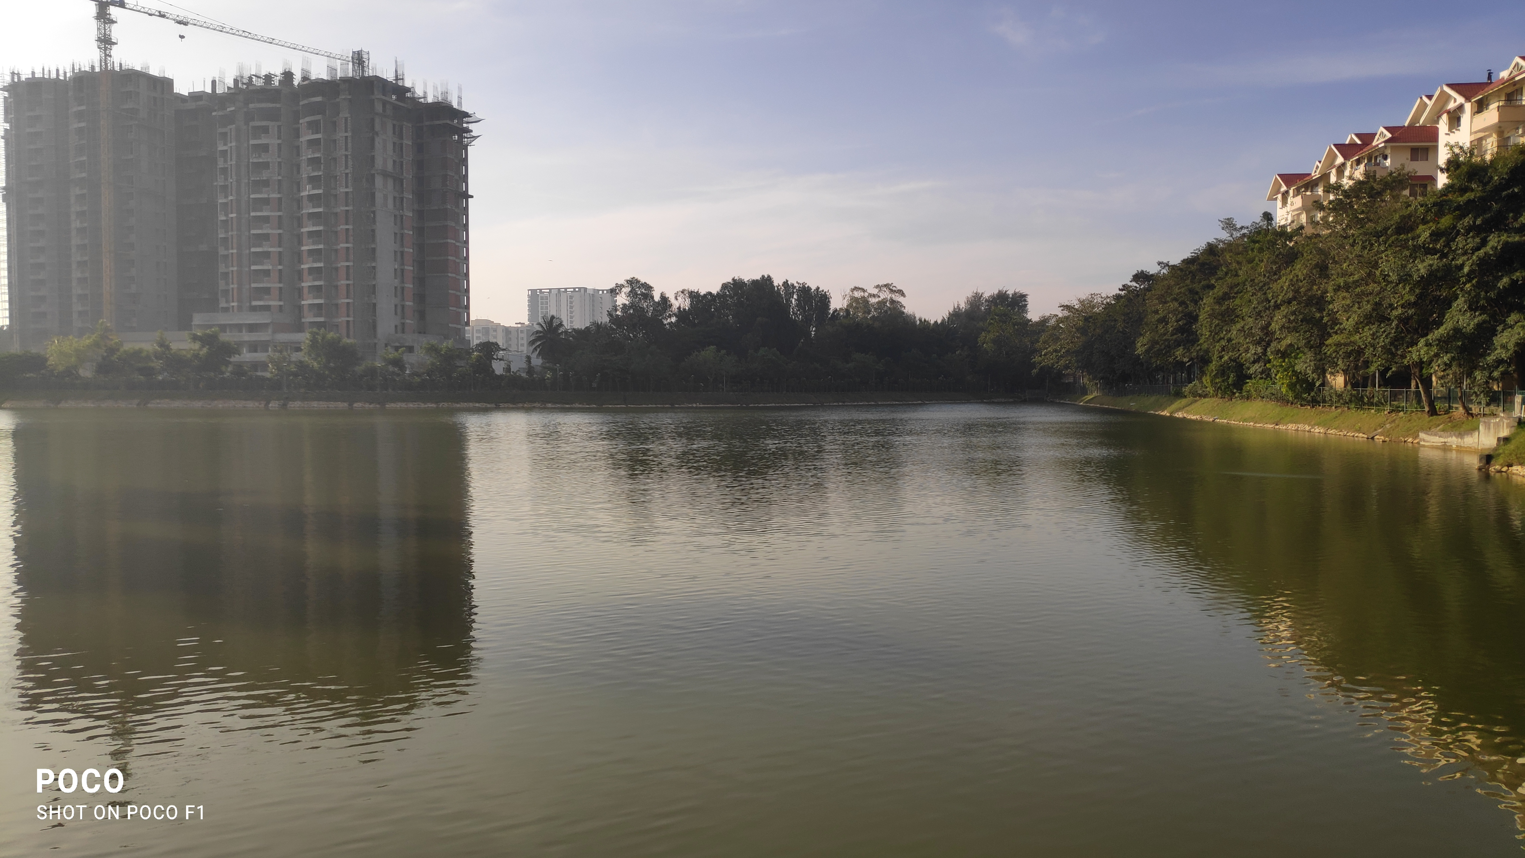
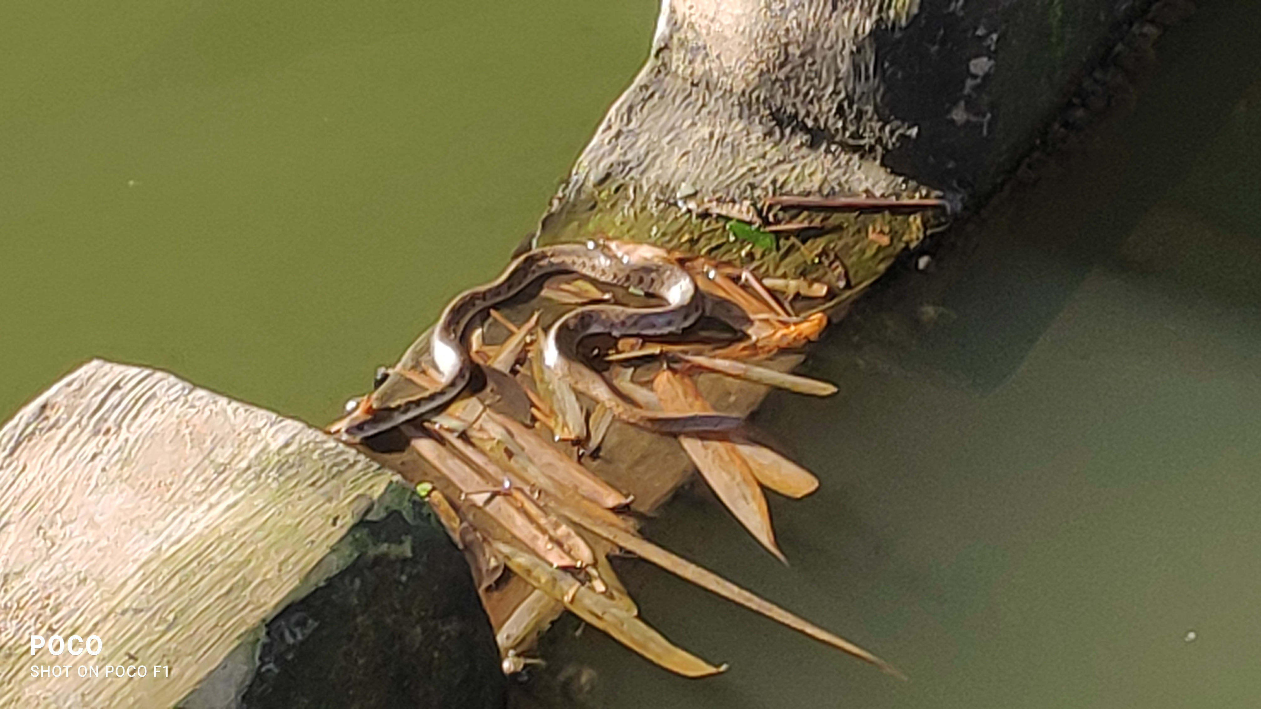
DISCUSSION
Abiotic components
  Soil was light in colour, due to high alkaline and Ca content
  Soil temperature was 26ºC
  Soil was lumpy and rough in texture, with more silt and less Water holding capacity, making it dry
Community patterns and diversity
  Plants/algae/ were present on the periphery of lake and water. But the plant/ aquatic weed growth was sparse in the center of the lake.
  There were frogs/snakes/other insects/fish present in the lake

Slide 19
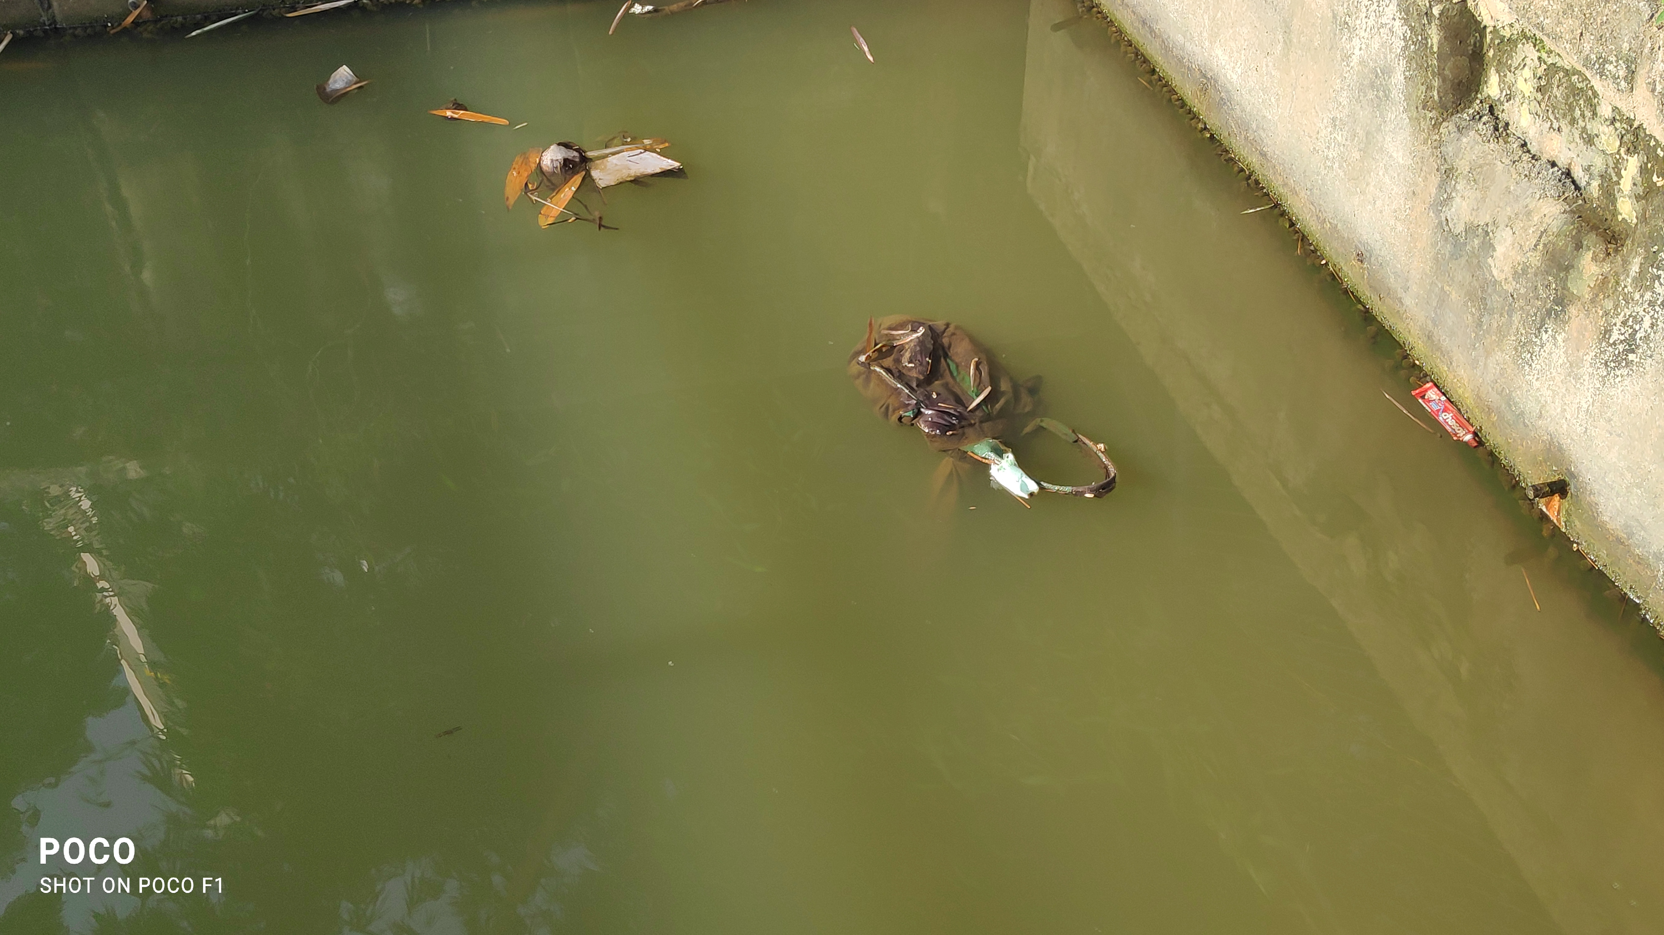
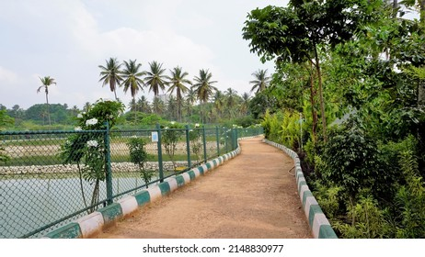
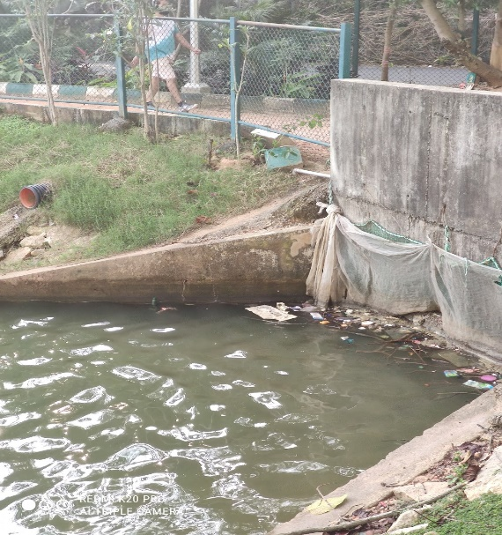
DISCUSSION
Kalena-Agrahara Lake
As the soil is alkaline in nature we have to add more organic matter in the soil to neutralize it.
Although the soil around the lake is found to be deficient in NPK , we find many plants around the lake. This is because the gardener uses fertilizers and manure occasionally (once in 2 months).

Slide 20
DISCUSSION
Hulimavu Lake
Here also the soil is found to be alkaline, hence we should put organic matter in the soil.
The NPK is also deficient here, but there is no addition of fertilizers in the soil.
Certain nutrients like Ca, Mg, S, Cu, Zn, Fe, Mn were high in both the soil samples.

Slide 21
CONCLUSION
Kalena Agrahara lake had clean water, and is well maintained. People use it for recreation and leisure purpose. But the soil around the eco system was deficient in major nutrients and minerals
Fish/ambhibians/insects/ other vertebrates biodiversity in the lake water was better, due to clean water and less garbage dumping and pollution, as compared to many other lakes in the city
Plant biodiversity in and around both the lakes was not rich, which might be due to deficient nutrients in soil, alkalinity in soil making the nutrient absorption restricted by plants and soil had poor texture and poor water holding capacity
Hulimavu lake has a garbage dumping issue, and is not well maintained. The soil around the eco system was deficient in major nutrients and minerals

Slide 22
ACKNOWLEDGEMENT
We would like to thank IISc for hosting LAKE Conference 2022 and giving us this opportunity
Special thanks to Principal Ma'am for allowing us participate in the same
Our heartfelt thanks to Ms. Indumathi Ma'am and Ms. Ashwini Ma'am for guiding us with the project
Special mention about Mr Santhosh, Gardener for helping in soil sample collection
We acknowledge the services provided by Bangalore Bio Centre, Bannerghatta Road, Govt of Karnataka, for soil sample analysis
Our heartfelt thanks to our parents for taking us to the sites for data collection

Slide 23

REFERENCES
www.wikipedia.com
www.climate-policy-watcher.org
https://www.sciencedirect.com/science/article/pii/S116103010400053X
https://www.researchgate.net
https://wgbis.ces.iisc.ernet.in/energy/lake2022
https://www.usda.gov
https://www.ncbi.nlm.nih.gov/pmc/articles/
https://www.agrifarming.in/soil-acidity-soil-alkalinity-effects-on-crop-yield
https://www.thehindu.com/news/cities/bangalore/nirmala-sitharaman-visits-kalena-agrahara-lake/article65416314.ece
https://www.thenewsminute.com/article/unplanned-urbanisation-hulimavu-lake-floodplains-worsened-bluru-floods

Slide 24
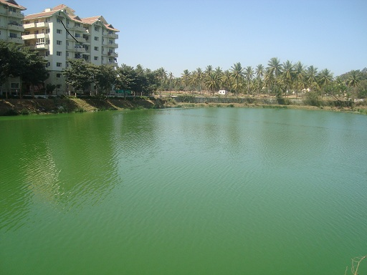
Thank You

