Slide 1
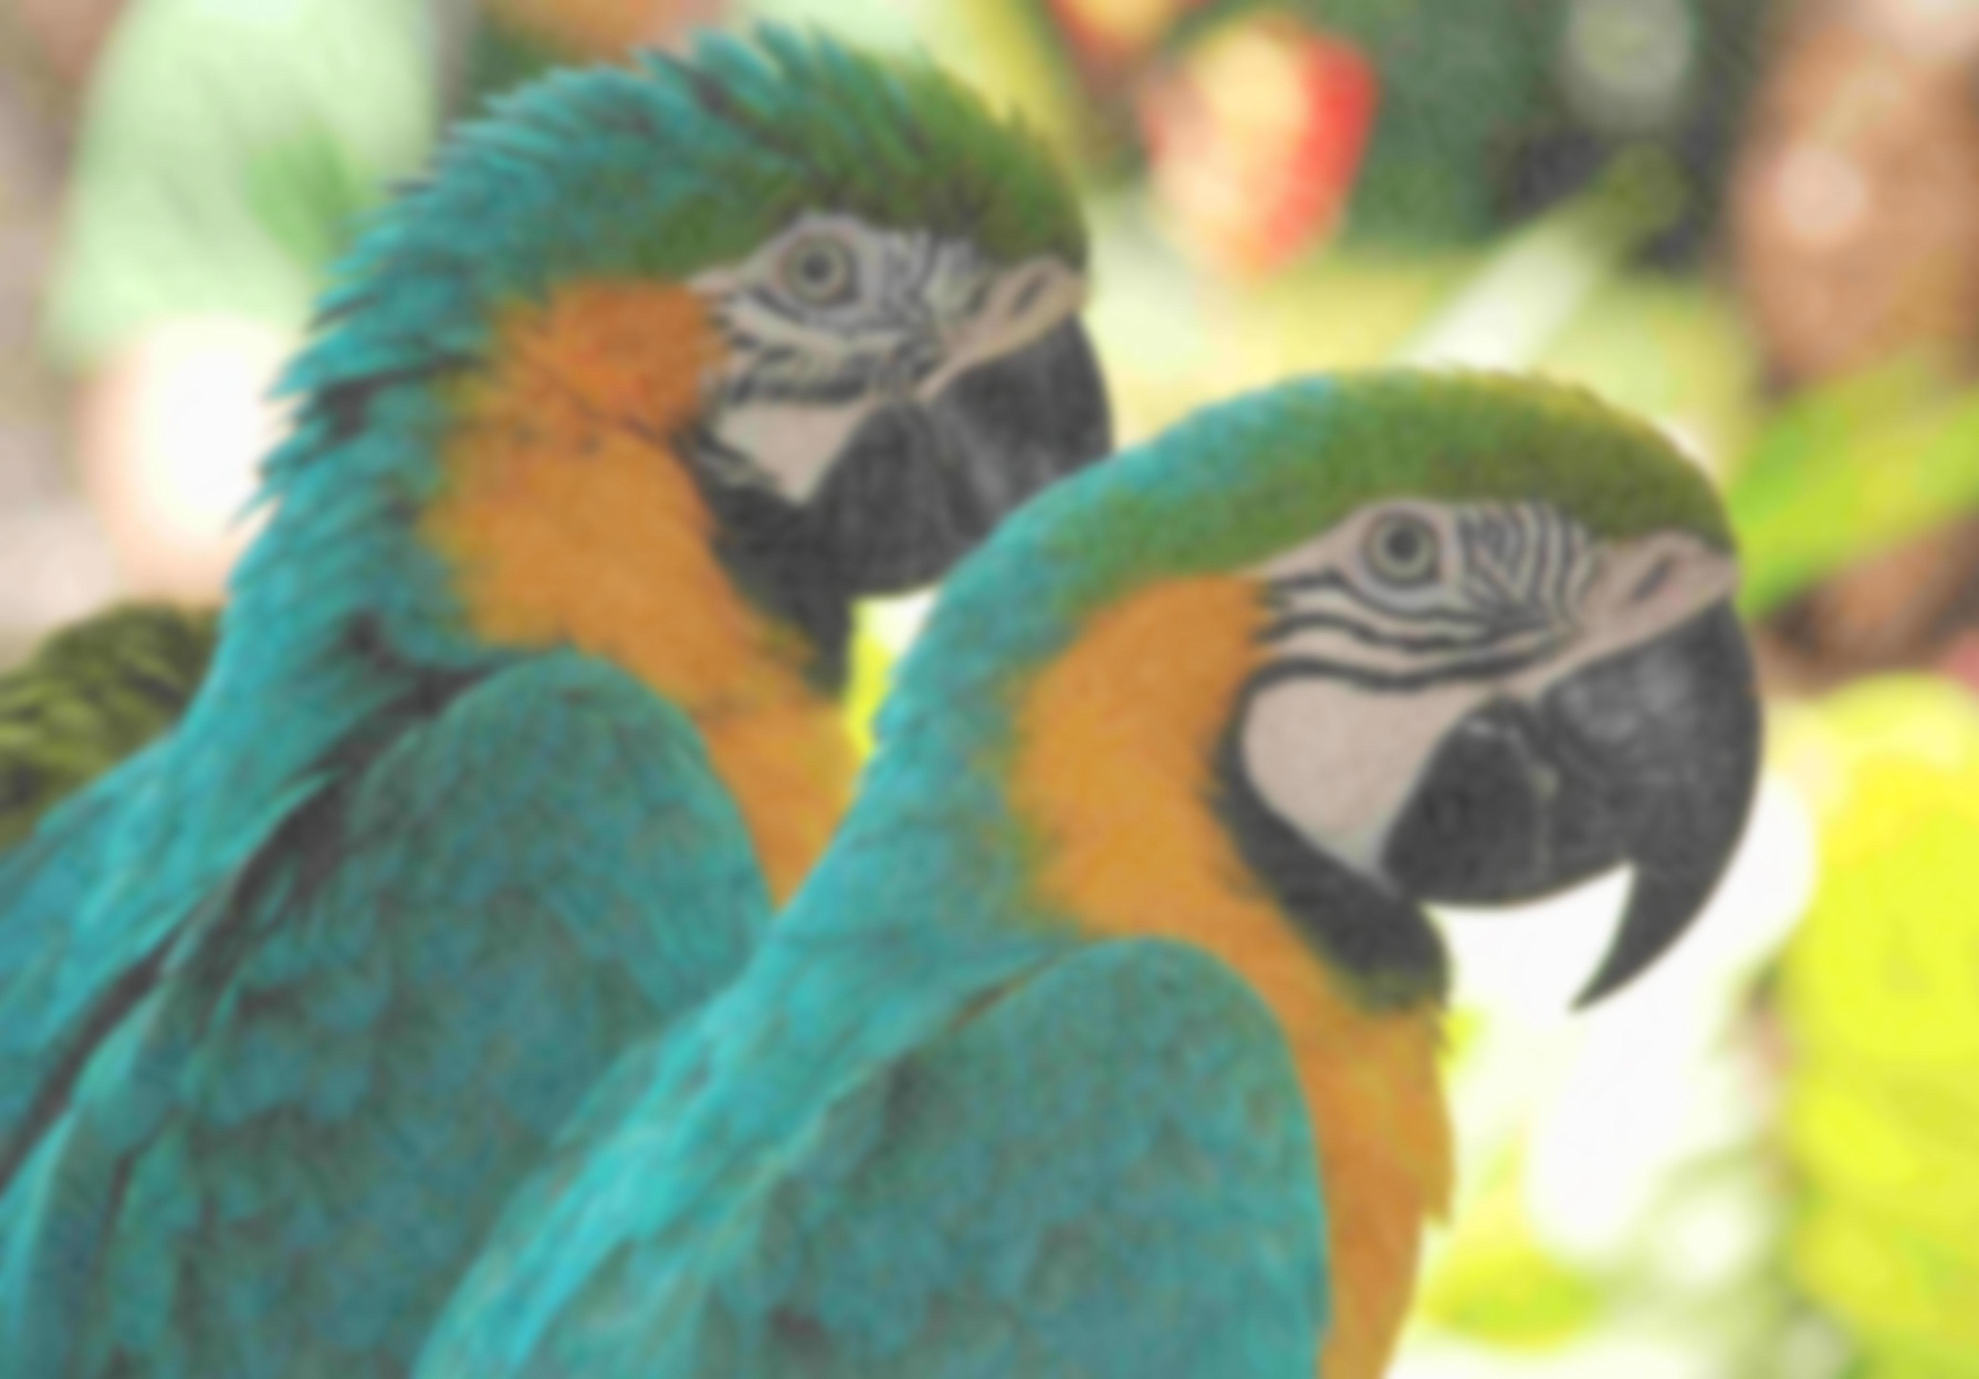
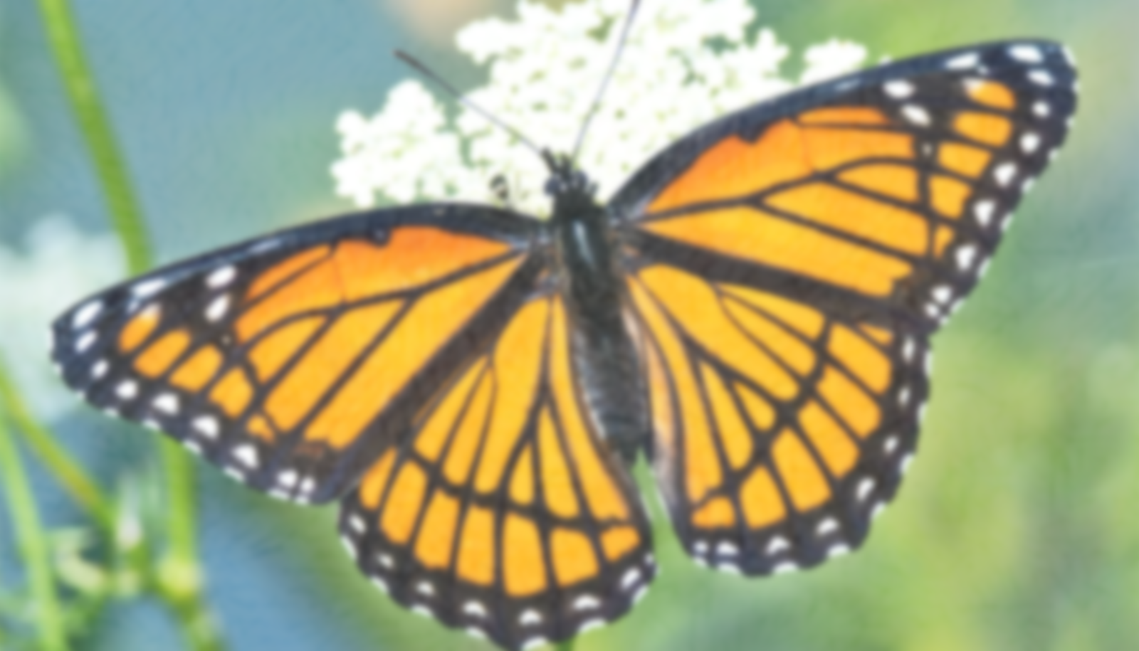
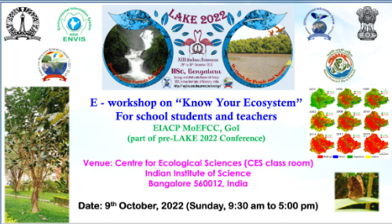
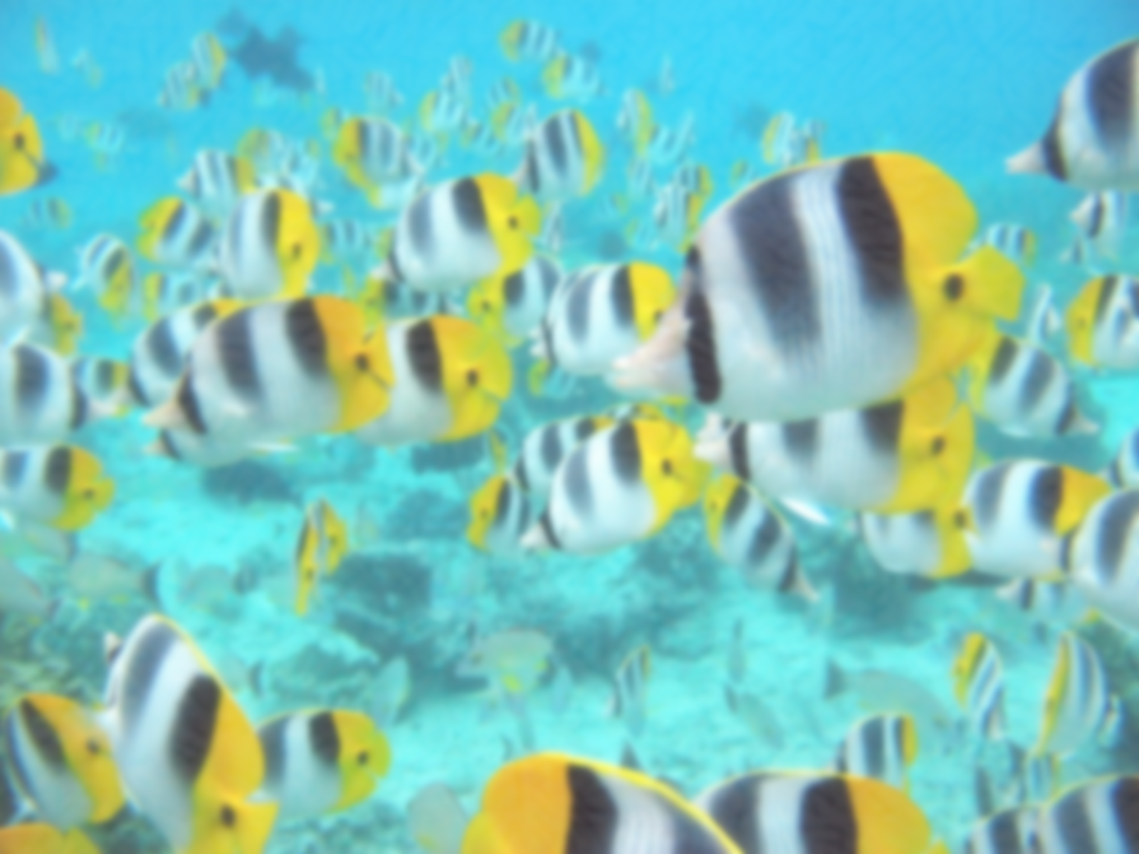

The bio-indicators of kalena Agrahara lake grade 9 by Kaushal
SCHOOL: PRESIDENCY SCHOOL BANGALORE SOUTH

Slide 2
INTRODUCTION
Fluttering butterflies, varieties of migratory and native water birds that swoop down in droves dot down the surroundings of lakes.
Birds and butterflies play an important role in pollination. Thus, they play a major role in ecosystem . These are the bioindicators which indicate the quality of the lake.
This presentation covers about some of the various species of birds, fishes butterflies in Kalena Agrahara lake.

Slide 3
objectives
Record and capture the various species of birds , butterflies and fishes of Kalena Agrahara lake.
Identify the species of the same found there.
Record the frequency of birds with the corresponding weather.

Slide 4

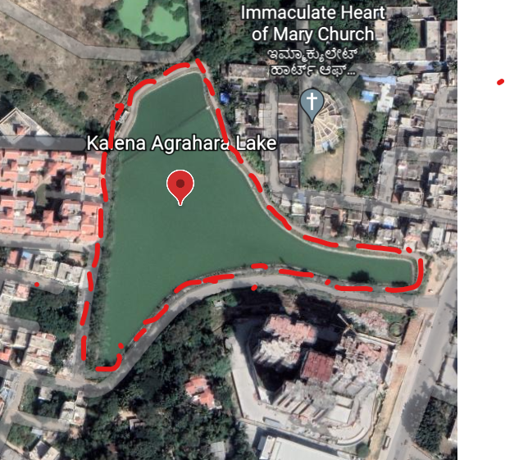
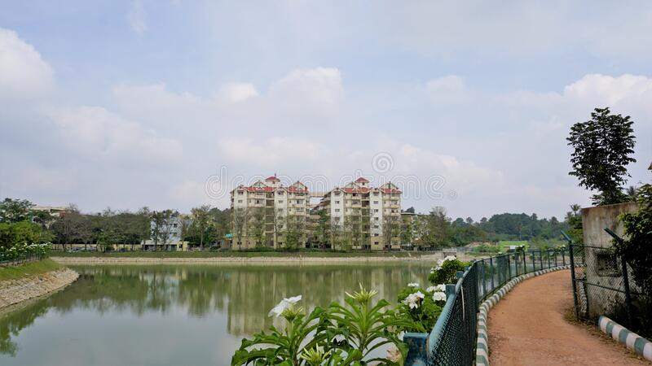
STUDY AREA
Kalena Agrahara Lake : The lake, located in the Bommanahalli zone of Bruhat Bengaluru Mahanagara Palike (BBMP), has been rejuvenated by the civic body by using funds from Members of Parliament Local Area Development Scheme (MPLAD) and State budgetary allocations.
Location: 12°51’55.8"N 77°35'21.9"E
Area :Spread over 7.3 acres,
storage capacity of the lake : 58.50 ML (after the development)

Slide 5

MATERIALS AND METHODS
Materials needed :
  Phone with a camera , Google earth.
Methods:
  Capturing different butterflies and birds seen around the lake in a camera.
  Identify the species of birds butterflies and fishes.

Slide 6
RESULTS AND DISCUSSION
  Kalena Agrahara lake
  Kalena Agrahara lake was filled with diverse species of flora and fauna .It has a variety of plants and trees which is the habitat of fauna such as birds butterflies and fishes .Some of them which we have found there as follows:

Slide 7
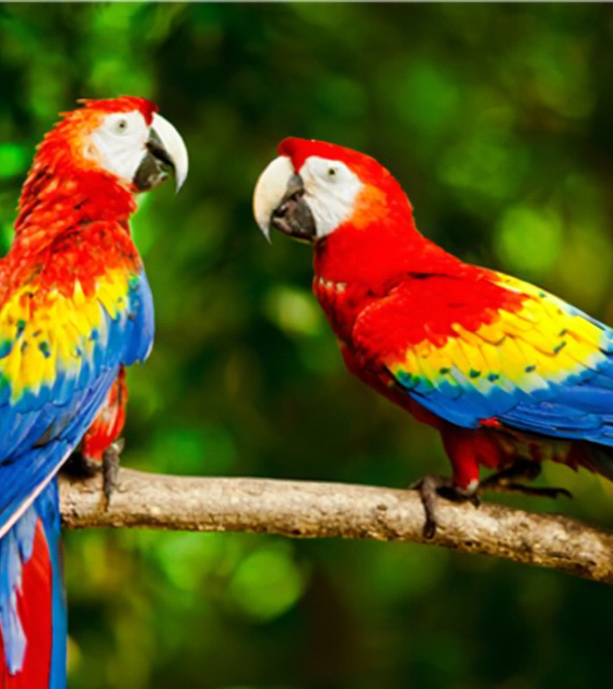
BIRDS

Slide 8
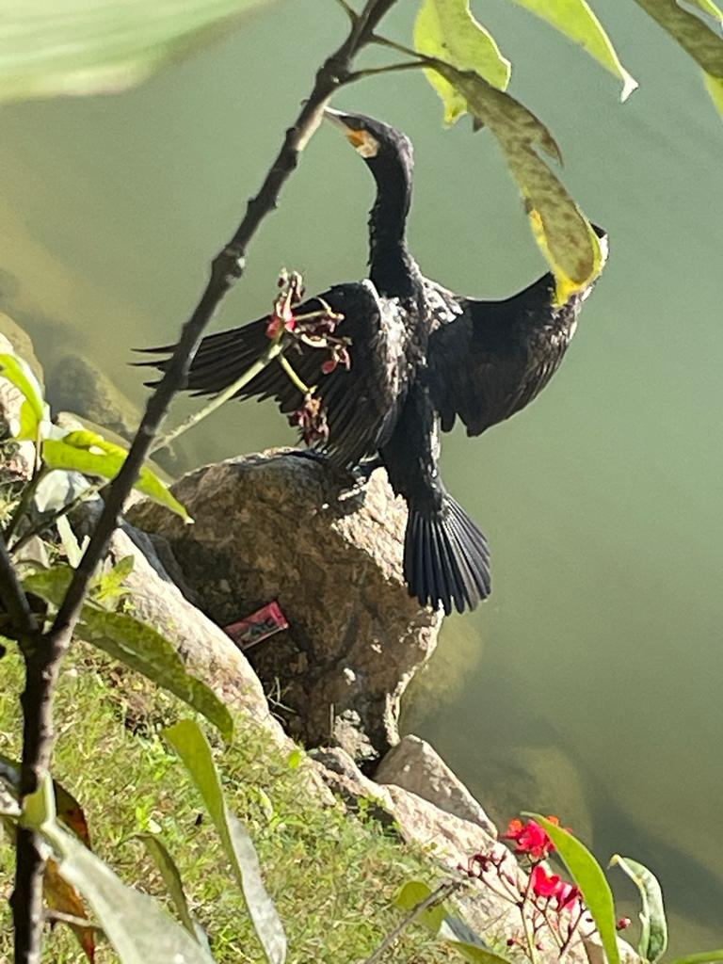
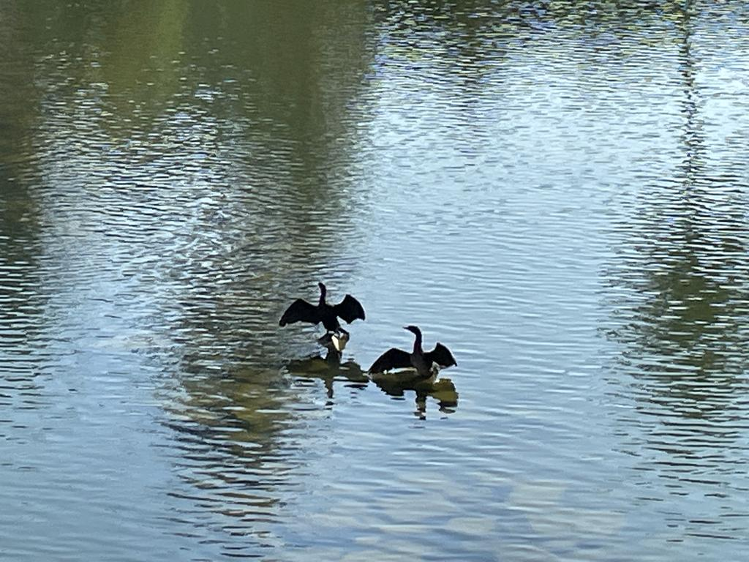
Great cormorant
Common name | Great cormorant
Scientific name | Phalacrocorax carbo
Kannada name | ನೀರು ಕಾಗೆ - Neeru Kaage
Type | Carnivores (Fish-eating )
Class | Aves
Order | Suliformes
Family | Phalacrocoracidae Reichenbach
IUCN status | Least Concern category

Slide 9
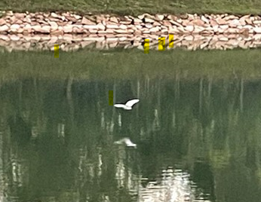
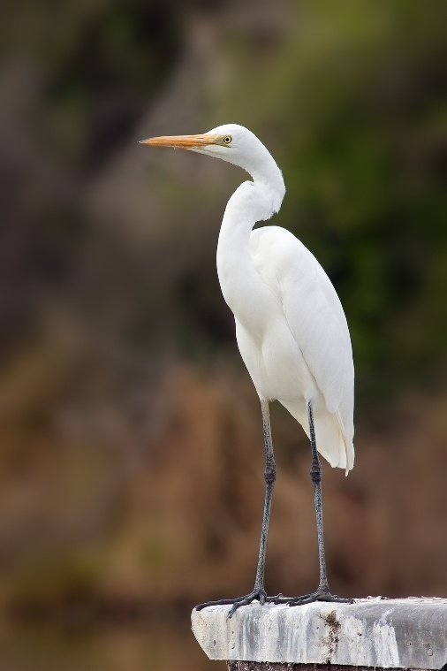
Great egret
Common name | Great egret
Scientific name | Ardea alba
Kannada name | ದೊಡ್ಡ ಬೆಳ್ಳಕ್ಕಿ · Doḍḍa beḷḷakki
Type | Carnivores (Fish-eating )
Class | Aves
Order | Pelecaniformes
Family | Ardeidae Leach
IUCN status | Least Concern category
Source: https://animalia.bio/great-egret
Great Egrets will migrate and move south for the winter in colder regions.
he Great Egret cannot live in the cold weather because it lacks heavy enough feathers to keep warm.

Slide 10
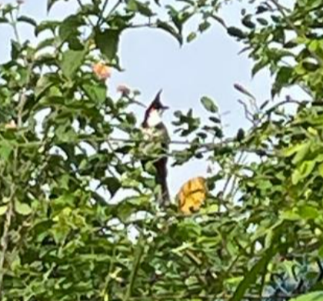
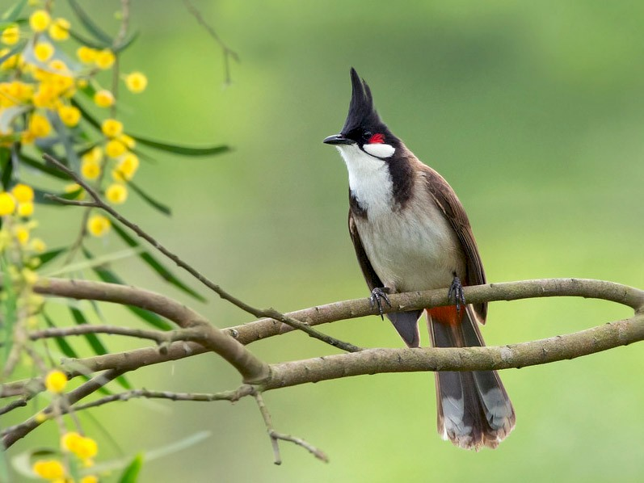

Red whiskered bulbul
Common name | Red whiskered bulbul
Scientific name | Pycnonotus jocosus
Kannada name | ಕೆಮ್ಮೀಸೆ ಪಿಕಳಾರ - Kemmise Pikalara
Type | Omnivores
Class | Aves
Order | Passeriformes
Family | Pycnonotidae
IUCN status | Least Concern category
Source:https://ebird.org/species/rewbul

Slide 11
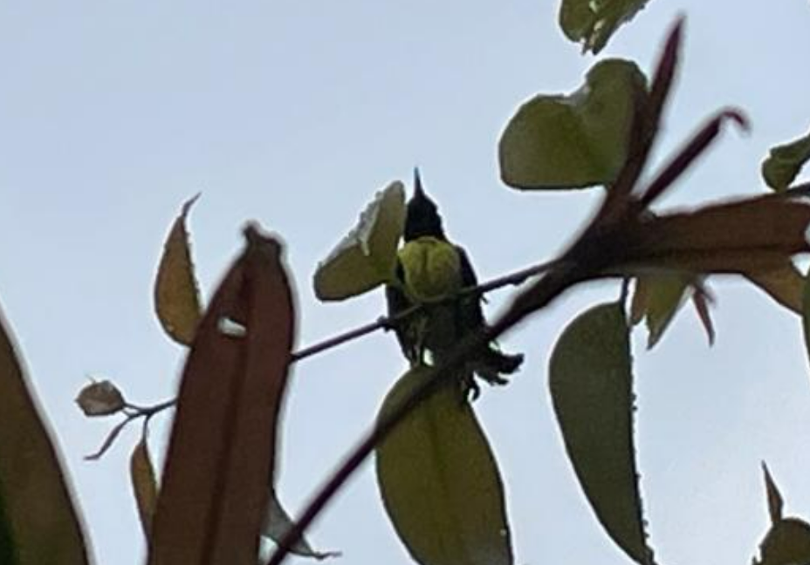
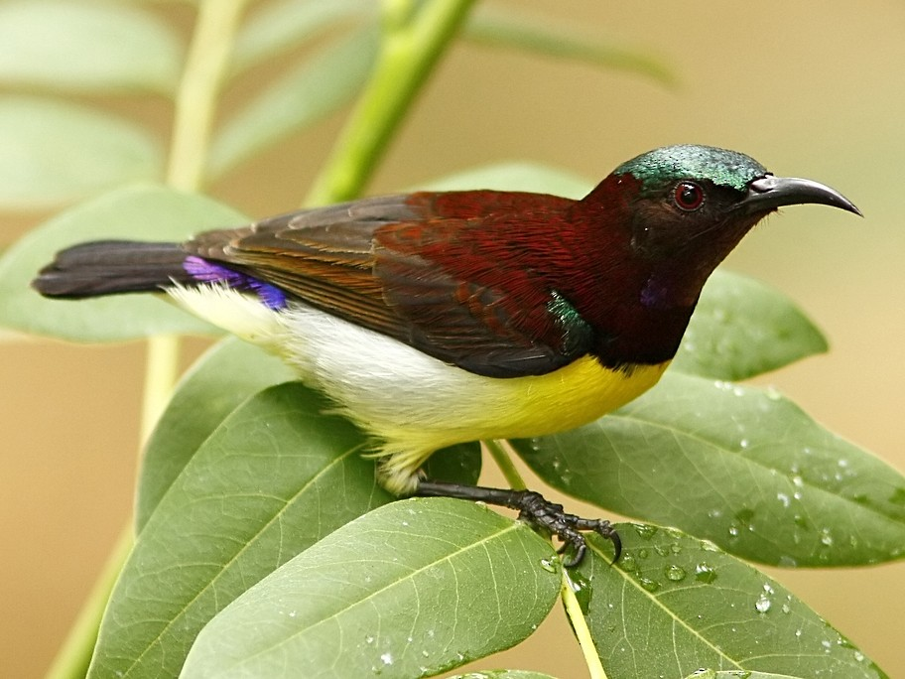
Purple rumpled sun bird
Common name | Purple rumpled sun bird
Scientific name | Leptocoma zeylonica
Kannada name | ನೇರಳೆ ಬೆನ್ನಿನಾ ಸೂರಕ್ಕಿ, ಖಗರತ್ನ - Nerale bennina Soorakk
Type | Omnivores (Mainly nectar)
Class | Aves
Order | Passeriformes
Family | Nectariniidae
IUCN status | Least Concern category
Source:https://ebird.org/species/rewbul
These sunbirds are noisy less active and they spend a lot of time perching on small branches.

Slide 12
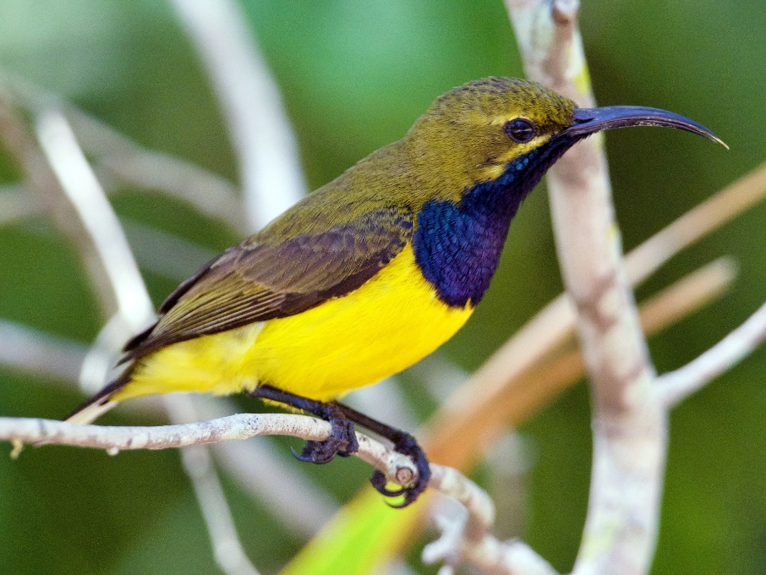
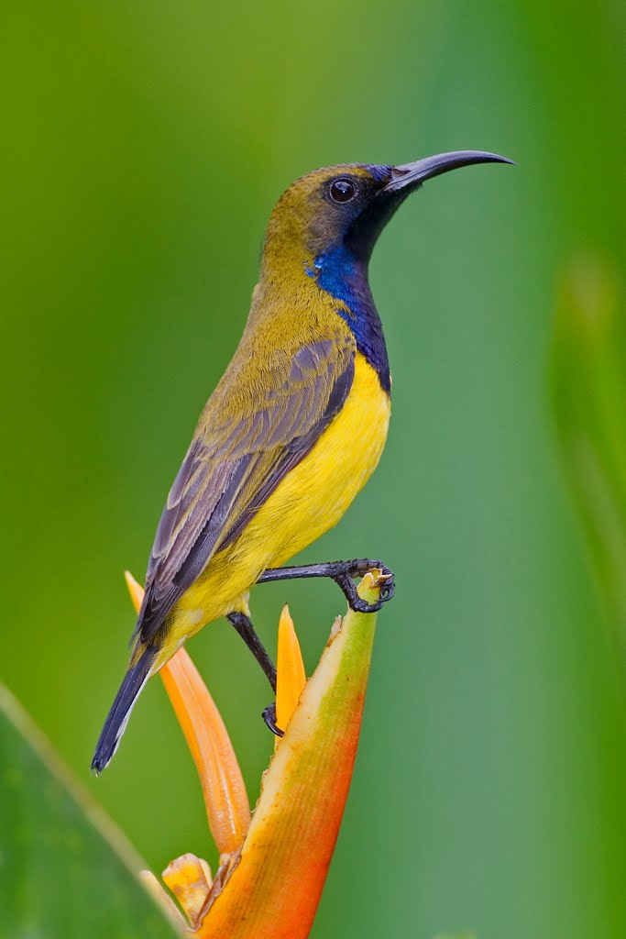
Olive backed sunbird
Common name | Olive backed sunbird
Scientific name | Cinnyris jugularis
Type | Omnivores (Mainly nectar)
Class | Aves
Order | Passeriformes
Family | Nectariniidae
IUCN status | Least Concern category
Source:https://ebird.org/species/rewbul
Source: http://daintreesafari.com
The birds mate between the months of April and August in the Northern Hemisphere, and between August and January in the Southern Hemisphere.

Slide 13
BIRD COUNT
day | weather | No of birds
12/11/22 | Sunny , slow winds | 6-7 captured great cormorant
13/11/22 | Cool , windy | 5 captured great egret
14//11/22 | Cool , light drizzles | 4
16/11/22 | Sunny, | 8-9 captured red whiskered bulbul
17/11/22 | sunny | 5 -6 Captured purple rumpled sun bird, olive backed sun bird
18/11/22 | Cool,windy | 4-5
20/11/22 | Cloudy,windy | 3-4

Slide 14
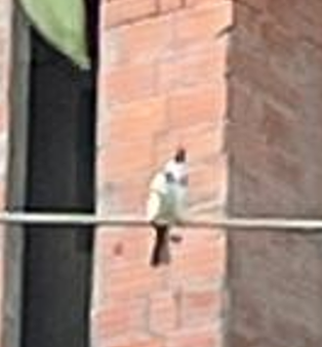
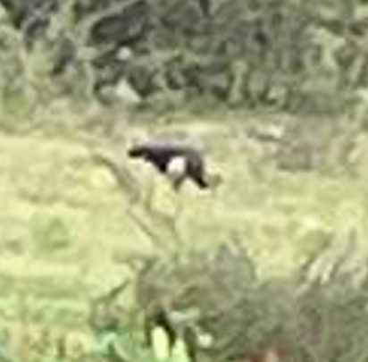
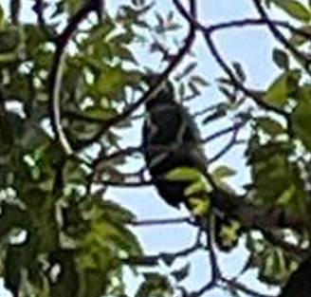
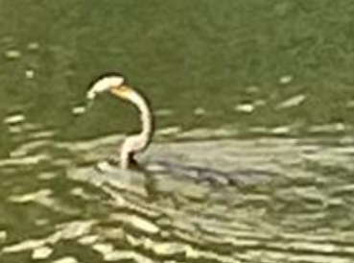
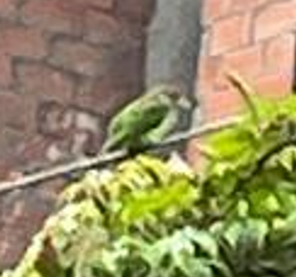
Other birds captured

Slide 15
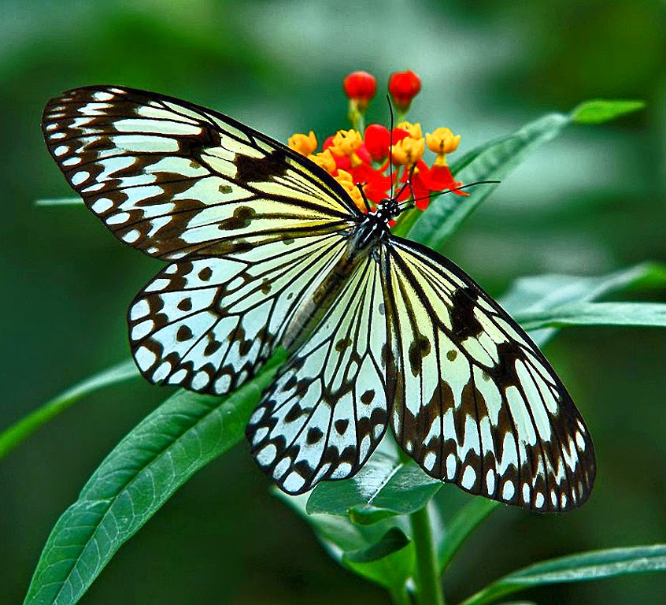
BUTTERFLIES

Slide 16
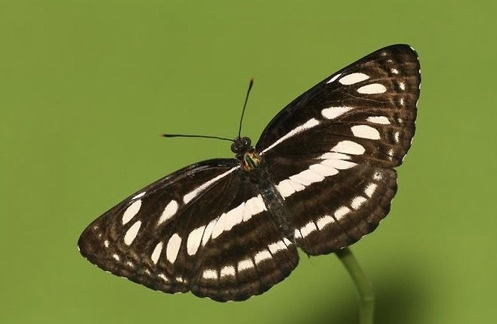
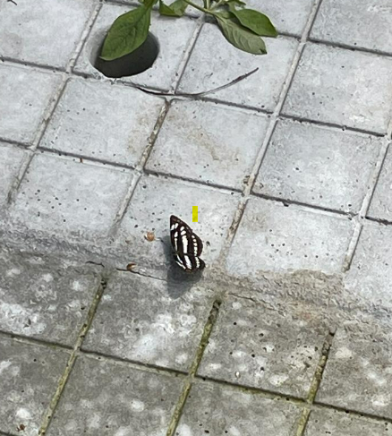
Common sailer
Common name | Common sailer
Scientific name | Neptis hylas
Class | Insecta
Order | Lepidoptera
Family | Nymphalidae
IUCN status | Threatened category
Source: https://www.pinterest.com
DATE CAPUTRED:13/11/22
It is medium sized butterfly with black and white markings on the dorsal side of its wings Upper side of Common Sailor butterfly is having blackish brown base color. The thorax is dusty appearance. Underside markings of Common Sailor butterfly resembles those on upper side but with lighter brown color.

Slide 17
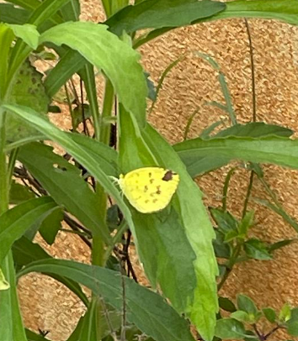
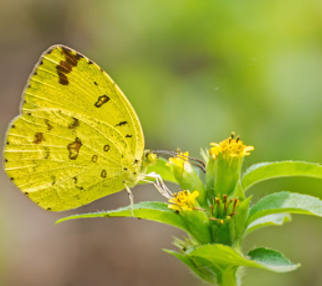
ORIENTAL Common grass yellow
Common name | Oreintal Commong rass yellow
Scientific name | Eurema hecabe
Class | Insecta
Order | Lepidoptera
Family | Pieridae
IUCN status | Threatened Category
Souce: https://www.treknature.com
DATE CAPTURED: 14/11/22
Small in size. They have bright yellow wings, with blackish brown bordering on the upper side and the underside of the wings are paler yellow with brown speckles
The common grass yellow exhibits seasonal polyphenism.

Slide 18
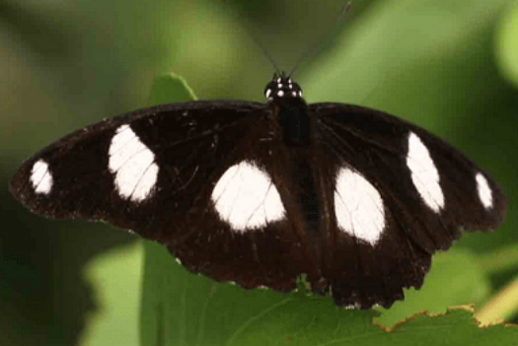
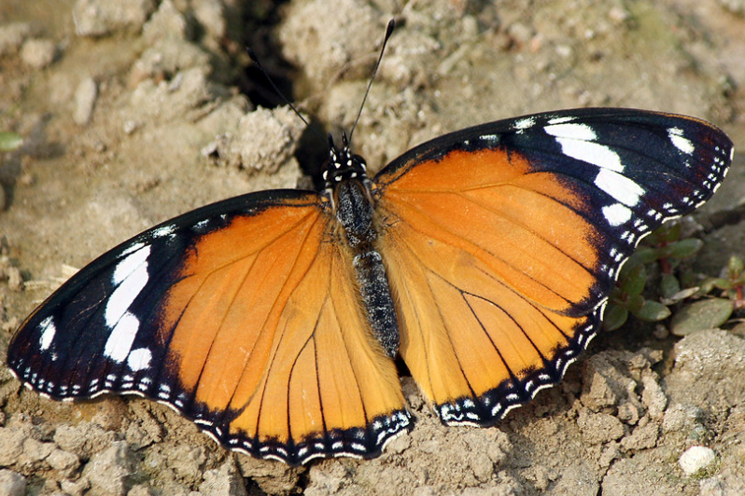
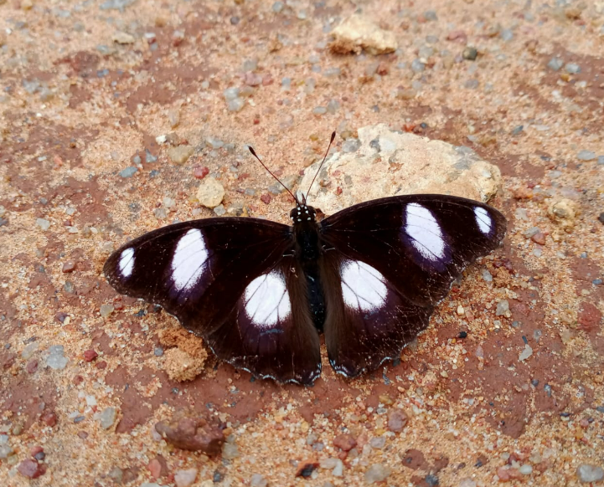
danaid egg fly
Female
Common name | Danaid eggfly
Scientific name | Hypolimnas misippus
Class | Insecta
Order | Lepidoptera
Family | Nymphalidae
IUCN status | Least Concern category
Source: https://observation.org/
Source: https://www.flickr.com
DATE CAPTURED:22/11/22
Hypolimnas misippus, the Danaid egg fly, mimic, or diadem, is a widespread species of nymphalid butterfly. It is well known for polymorphism and mimicry.
The color of antennae, head, thorax and abdomen is dark brown. The adult Danaid Egg flies are dimorphic. The males and females have entirely different colors and patterns.

Slide 19

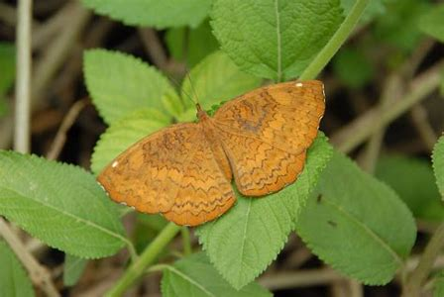
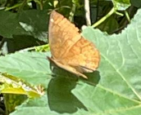
Common castor
Common name | Common castor
Scientific name | Ariadne merione
Class | Insecta
Order | Lepidoptera
Family | Nymphalidae
IUCN status
Source:http://www.sahapedia.org/butterfly-conservatory-ybp
DATER CAPTURED: 17-11-2022
Common castor, is an orange butterfly with brown lines they have smaller appendages are covered with long hairs, giving them the characteristic brush look.

Slide 20
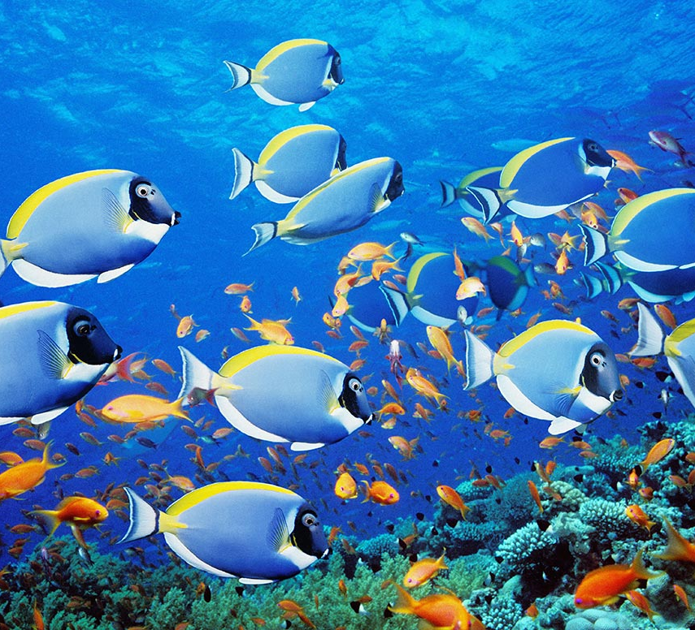
FISHES

Slide 21
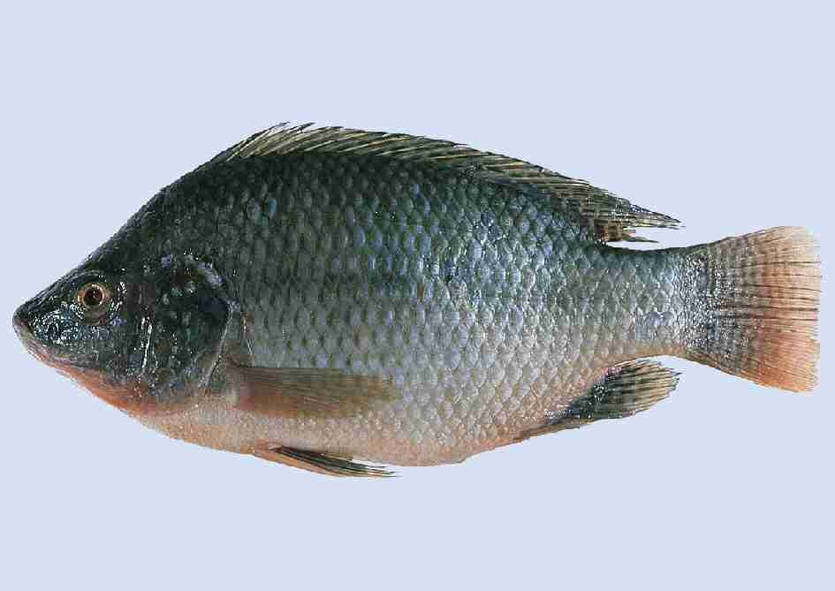
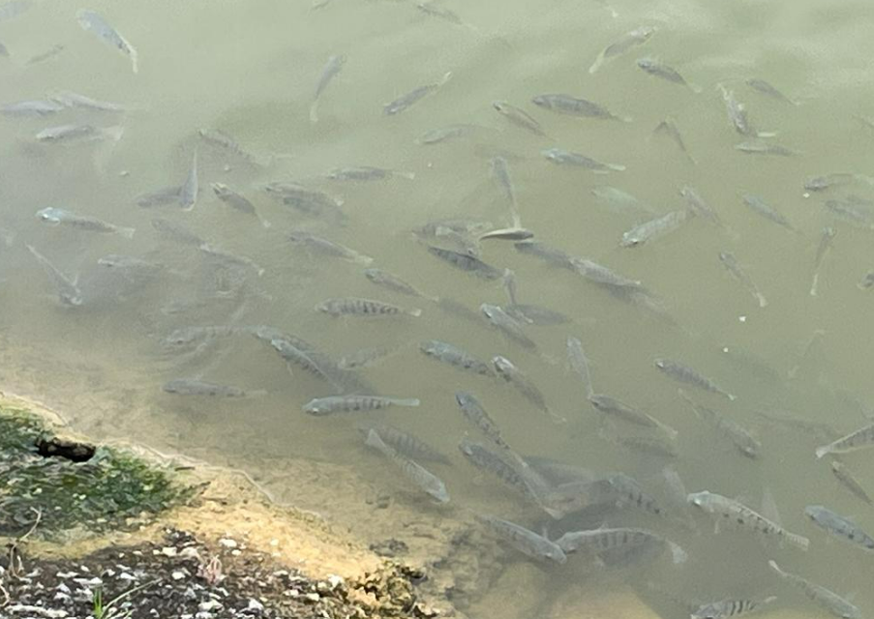
Some of the fishes captured
Mostly there were 2 fishes which could be found in kalena Agrahara lake
1.Tilapia
Common name | Tilapia
Scientific name | Oreochromis niloticus
Kannada name | ಟಿಲಾಪಿಯಾದಲ್ಲಿ
Class | Actinopterygii
Order | Cichliformes
Family | Cichlidae
IUCN status | Least Concern category
Source: http://swittersb.wordpress.com

Slide 22
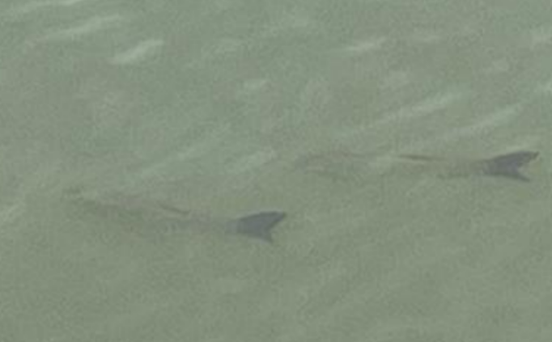
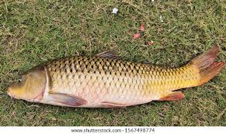
2.Rohu
Common name | : Rohu
Scientific name | Labeo rohita
Kannada name | ರೋಹು
Class | Actinopterygii
Order | Cypriniformes
Family | Cyprinidae
IUCN status | Least Concern
Source: www.shutterstock.com

Slide 23
conclusion
Kalena Agrahara lake is a well-maintained lake.
It is filled with a diverse flora and fauna.
The occurrence of a variety of birds and butterflies around the lake indicates the presence of a variety of trees, bushes and flowers.
The sewage is treated properly and then released .Hence the water is clean
The occurrence of clean water promotes the presence of fishes.
But it must be continued to be maintained to preserve its beauty.

Slide 24
acknowledgement
I would like to thank IISc for hosting LAKE conference 2022 and giving us this opportunity to research about the different fauna of Kalena Agrahara lake.
I would specially thank principal ma'am for allowing us participate in this conference.
I hearty thanks to Indumathi ma'am and Ashwini ma’am ,who helped us in guiding to make this report.
Lastly ,I would also thank our parents who took us to the study area for data collection.

Slide 25
REFERENCES
https://en.wikipedia.org/wiki/Great_egret
https://en.wikipedia.org/wiki/Great_cormorant
www.nationalgeographic.com/animals/birds/facts/great-egret
https://ebird.org/science/status-and-trends/greegr/range-map-breeding
https://butterfly-conservation.org/butterflies/holly-blueZhttps://www.butterflyidentification.com/holly-blue.htm
http://natureconservation.in/description-of-common-grass-yellow-butterfly-eurema-hecabe/
https://www.birdsandnature.in/2021/07/the-common-grass-yellow.html
https://www.birdbaron.com/fun-facts-about-birds/
https://learnbirdwatching.com/fun-facts-about-great-egrets/

