Slide 1
MADIWALA LAKE
By - Dhruv Sharma
Rahul Shinde
GRADE 11
PRESIDENCY SCHOOL
BANGALORE SOUTH

Slide 2
OBJECTIVE
The objectives of our work are to check the Water Quality parameters to gauge the health of Madiwala Lake and to test the water quality to analyze the present status of ecological balance in this particular ecosystem.
To test the Water quality based on Physical and Chemical parameter and compare the result.

Slide 3
INTRODUCTION
Madiwala lake is nearly 300 years old.
The lake lies in BTM layout.
The extent of the lake is 7,36,407 m^2 and the marshland area is 1,85,832 m^2. It comes under the Karnataka Forest Department.
In the olden days, the lake was mainly used by the washer men who lived near it.
At present, the lake has an open butterfly park, herbal garden, island ecosystems, boating facilities and is visited by migratory birds.

Slide 4
MATERIALS AND METHODS USED
Water testing kit
Water sample was collected near the boating area.
Test of water quality was performed from September to November.
Using quality chemicals dedicated specifically for the testing process
Procedure of titration and matching the concentrations with the obtained colour and values provided in the manual (BIS)

Slide 5
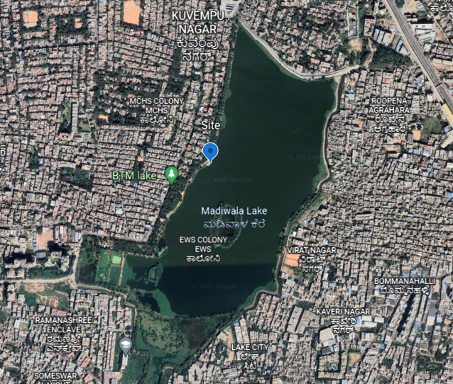
MAP OF AREA OF STUDY

Slide 6
 |  | Procedure | Optimum range (BIS)
Physical parameter | Turbidity | Turbidity Tube set | 1 - 5 NTU
Chemical Parameter | pH | pH paper | 6.5 - 8.5
 | Hardness | Titration : EDTA | 200 - 600 mg/l

Slide 7
Chemical parameters | Dissolved O2 | Titration -Na₂S₂O₃ | 5 mg/l
 | Nitrates | Reaction -Reaction - NO₃ A and NO₃ B | 45 mg/l
 | Ammonia | Reaction - Nessler’s Reagent | 0.5 mg/l
 | Chloride | Titration - AgNO₃ | 250 - 1000 mg/l
 | Residual Cl | Reaction - O-toluidine | 0.2 - 1 mg/l
 | Phosphorus | Estimated by SnCl₂ Method | NA
 | Iron | Reaction - Fe -A And Fe-B | 0.3 mg/l
 | Fluoride | Reaction - Zirconyl solution | 1 - 1.5 mg/l

Slide 8
 | September (27th ) | October (28th ) | November (30th )
pH | 7.7 | 7 | 7
Nitrate | 10 mg/l | > 45 mg/l | <10 mg/l
Iron | <0.3 mg/l | 1 mg/l | 0.5 mg/l
Hardness | 144 | 120 | 136
Chloride | 70.9 mg/l | 460.85 mg/l | 63.81 mg/l
Residual Chlorine | 0.5 mg/l | 0.5 mg/l | 0.2 mg/l
Turbidity | 50 NTU | 100 NTU | 50 NTU
Faecal pollution | positive | positive | positive
Ammonia | 0.3 mg/l | < 0.5 mg/l | <1 mg/l
Phosphorus | 0.1 mg/l | 0.1 mg/l | 0.1 - 0.2 mg/l
Dissolved oxygen | 5.4 mg/l | 6 mg/l | 8 mg/l
Fluoride | 1 mg/l | 1 mg/l | 1 mg/l

Slide 9
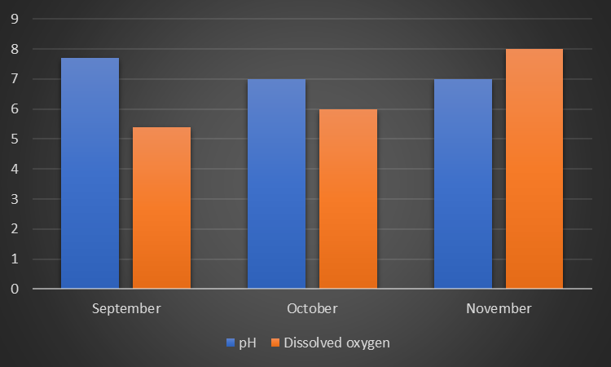

Slide 10
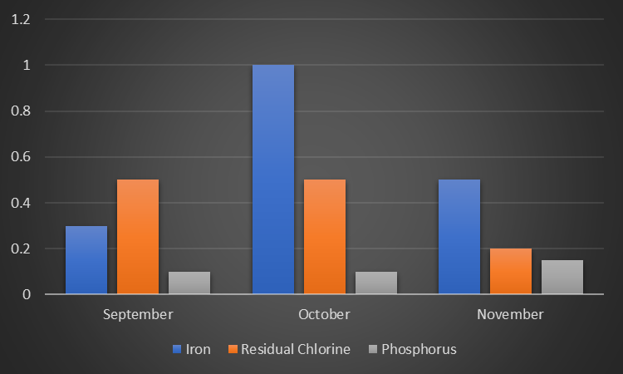

Slide 11
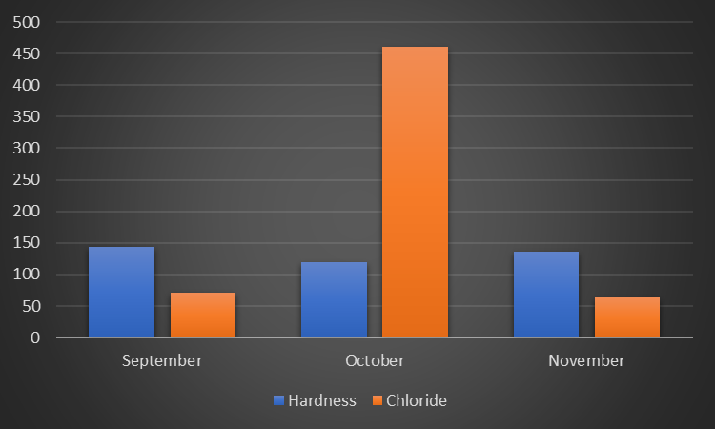

Slide 12
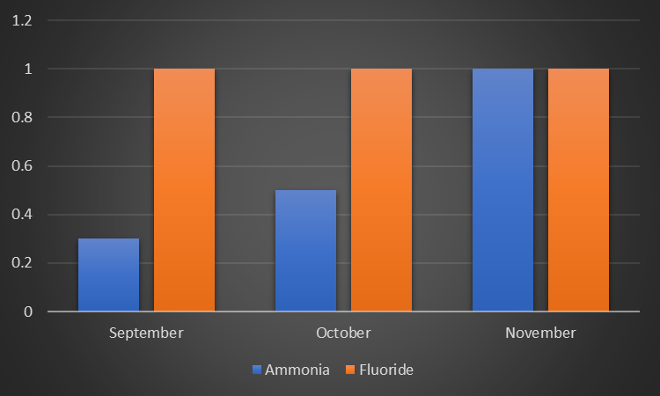

Slide 13
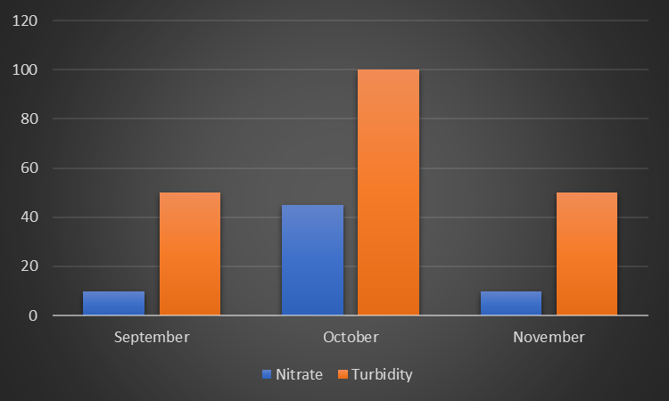

Slide 14
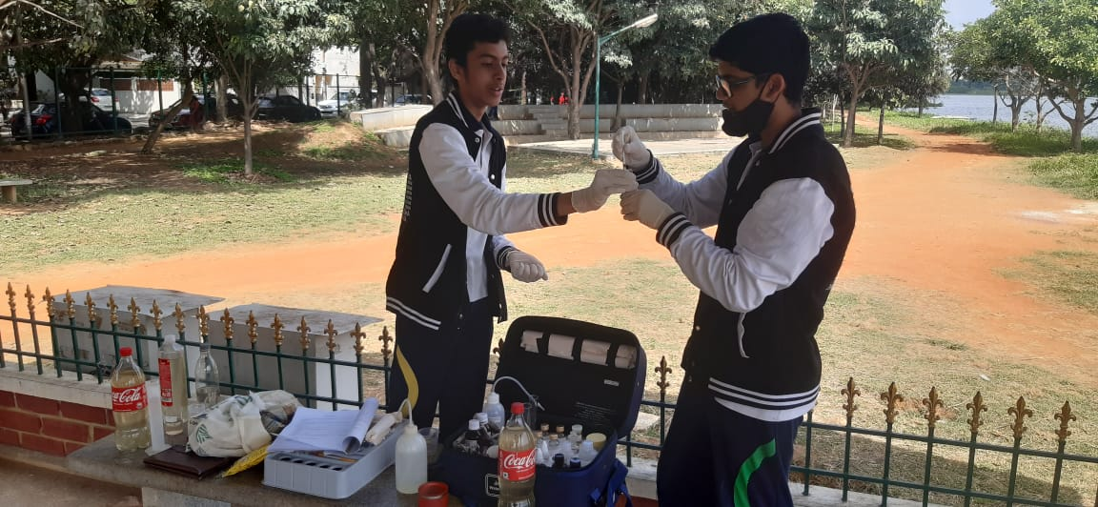
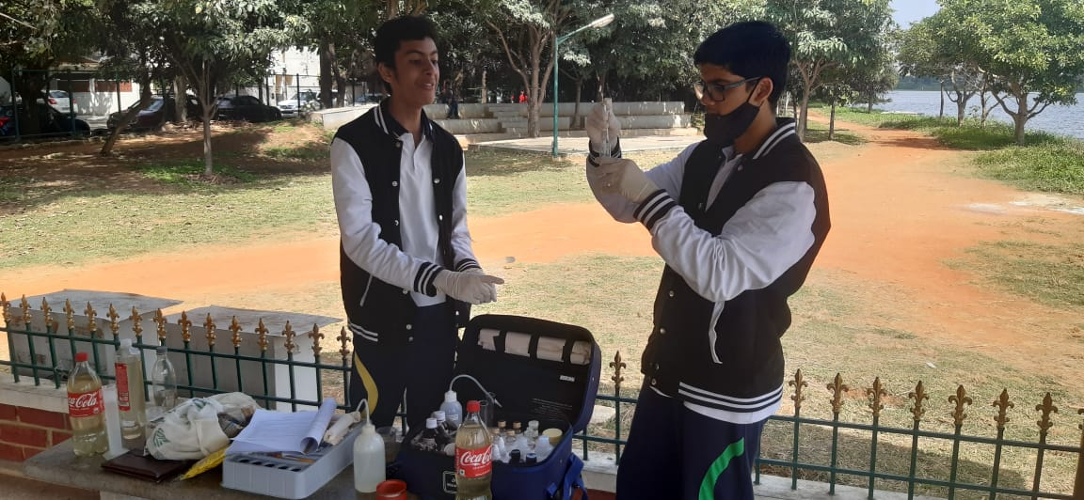

Slide 15
CONCLUSION
From our analysis and studies, we can conclude that the water quality of Madiwala Lake is at the optimal range.
Sewage contaminations supports the growth of macrophytes. Thus, macrophytes need to be regularly cleared.
To improve lake quality, artificial floating island have been created to absorb the nutrients.
Rotating fountains have been placed in different parts of the lake along with manual boating to increase the dissolved oxygen.

Slide 16
ACKNOWLEDGEMENT
• We acknowledge the great help rendered by the forest department and the Officer Mr. Harshavardhan, Mr. Ramesh and Mr Lohith (WWF).
• Our Sincere thanks to our beloved Principal Ma’am Ms. Bhuvaneswari, Presidency School Bangalore South.
• We also thank our teachers, Ms Ashwini and Ms Indumathi to render their guidance and support throughout our work.

Slide 17
REFERENCES
https://wgbis.ces.iisc.ernet.in/biodiversity/pubs/ETR/ETR25/studyarea.htm
https://wgbis.ces.iisc.ac.in/energy/water/paper/ETR72/00_ETR72_Lake-auditing_Final.pdf
Electrical Conductivity of Lake Water as Environmental Monitoring –A Case study of Rudra sagar Lake. Mihir Pal, Nihar Samal, Pankaj Kumar Roy, & Malabika. B. Roy.
https://www.thenewsminute.com/article/several-dead-fish-snails-found-floating-bengaluru-s-madiwala-lake-89476
http://www.sbprojectcleanwater.org/Documents/Water%20Quality%20Reports/Sampling_Report_7-00_text7.pdf
http://ijarcs.info/index.php/Ijarcs/article/viewFile/3859/3750

