Slide 1


The Comparative Study of Soil Samples from Two Lakes
Class 11
Anagha A S
Harini S
Prarthana D R
Shreya H Menon

Slide 2
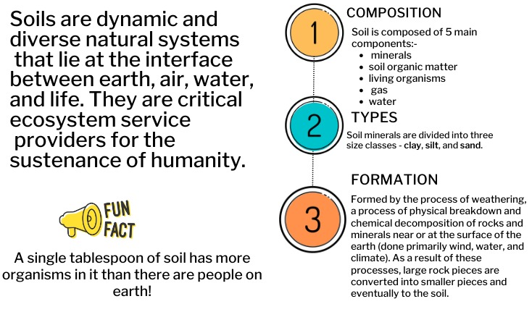
Introduction

Slide 3
Analyzing the soil sample from Gottigere lake and Madiwala lake.
Qualitative and quantitative analysis of macronutrients and micronutrients.
To find out indicator species related to pollution.
OBJECTIVE

Slide 4
Materials and Methods

Slide 5
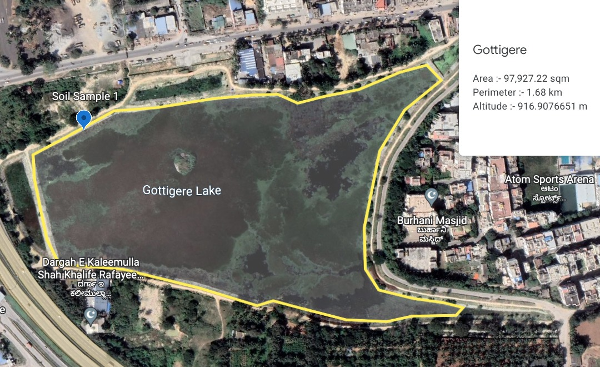
Gottigere Lake
Gottigere lake, with a water spread area of about 14.98 ha, is located in the Bellandur Lake catchment of the South Pennar River basin.

Slide 6
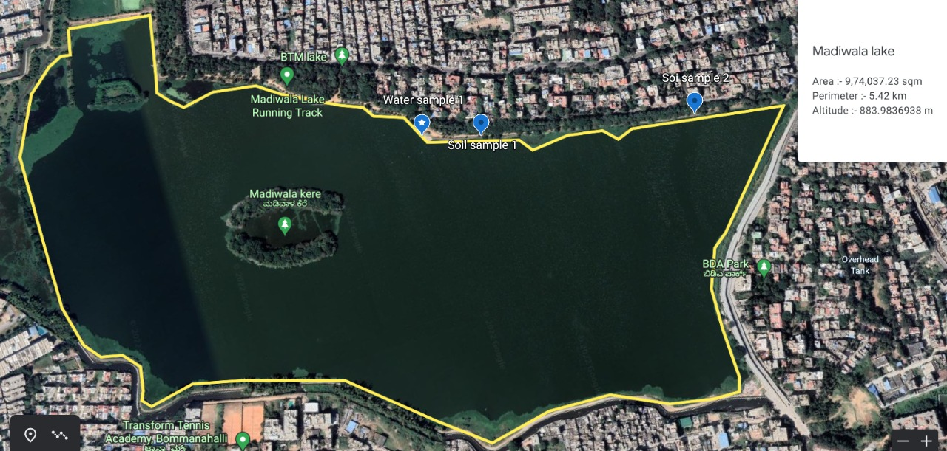
Madiwala Lake
Madiwala lake is one of the biggest lakes in Bangalore, India spread over an area of 114.3 ha. Legend has it that the lake was built by the Cholas in a day. The water in the lake was fit for drinking till the early 1990s.

Slide 7
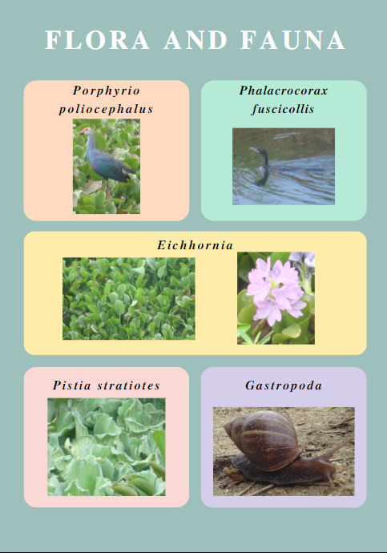
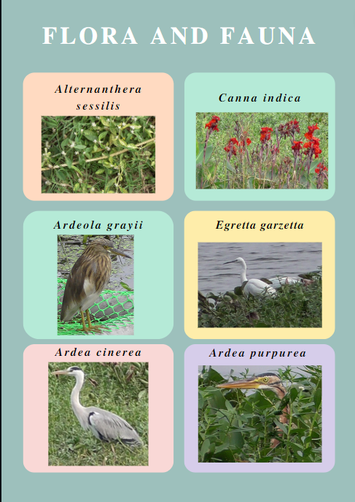
G
O
T
T
I
G
E
R
E
L
A
K
E
M
A
D
I
W
A
L
A
L
A
K
E

Slide 8
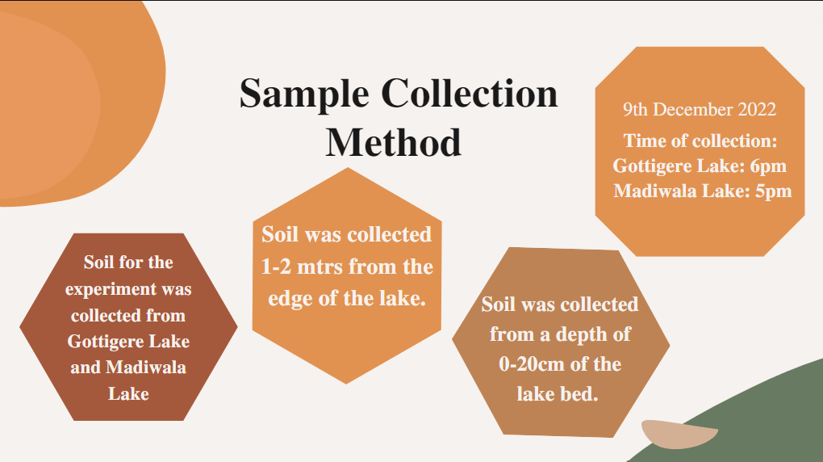

Slide 9
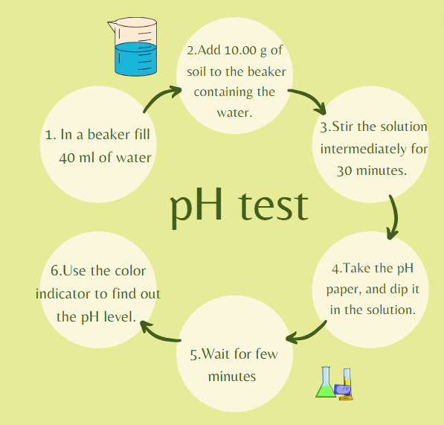
Experimental Method

Slide 10
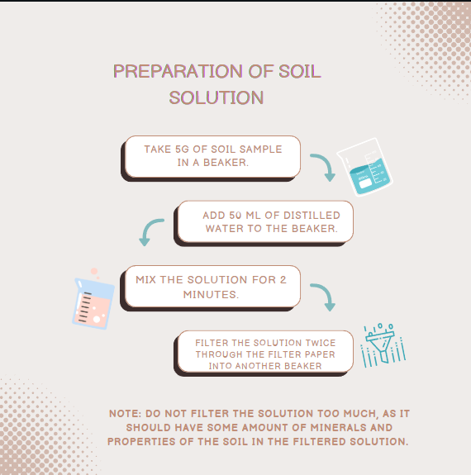

Slide 11
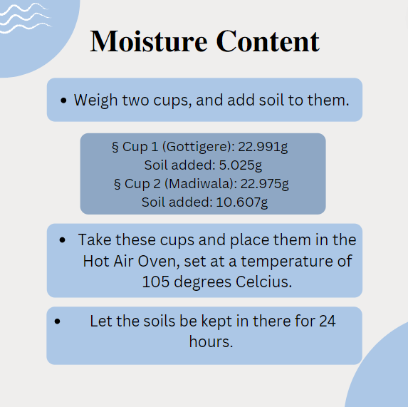

Slide 12
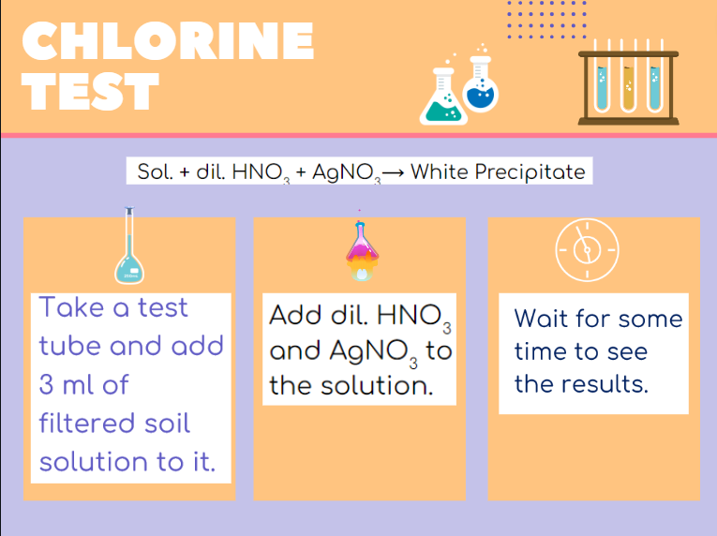

Slide 13
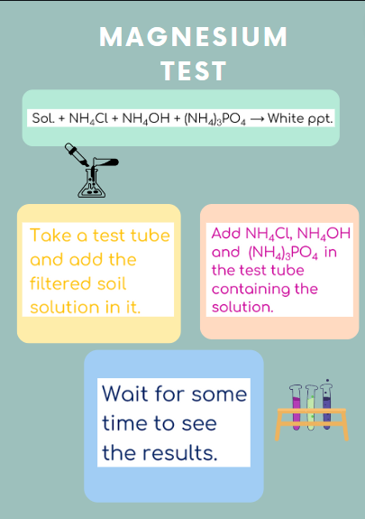

Slide 14
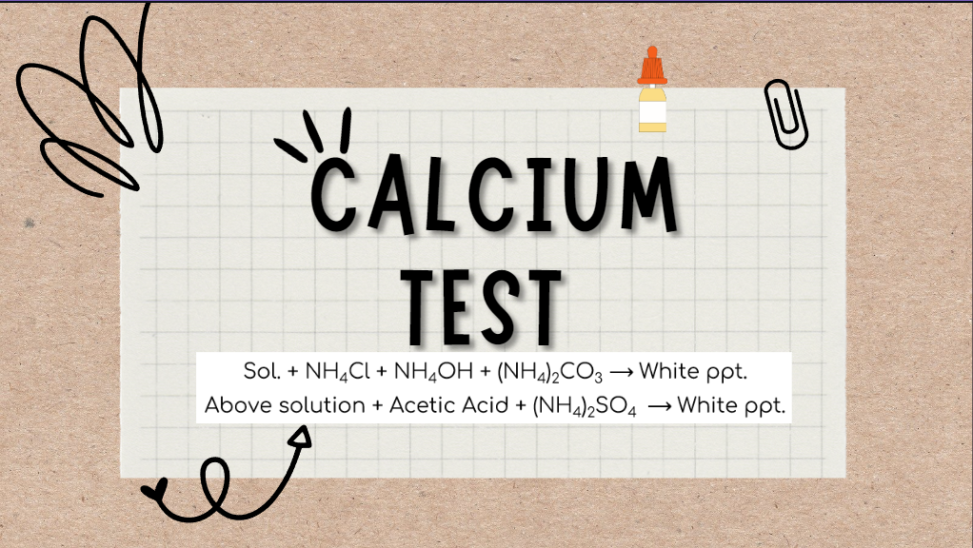

Slide 15
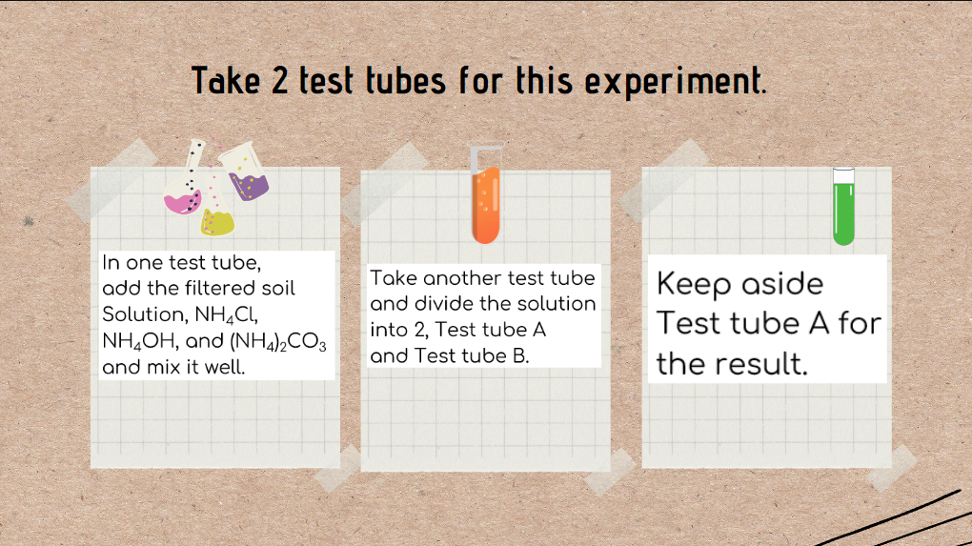

Slide 16
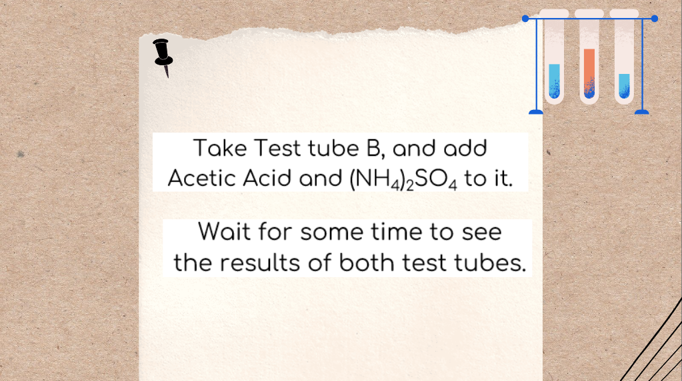

Slide 17
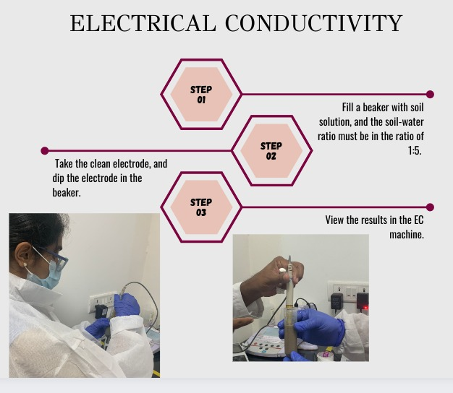

Slide 18

Sieve Analysis
Collect 2kgs of soil from each lake.
Keep the samples for overnight drying in the Hot Air Oven.
Take the dried samples, and put them in the machine for sieving.
Use different sizes of sieve to check the layers of soil present.

Slide 19
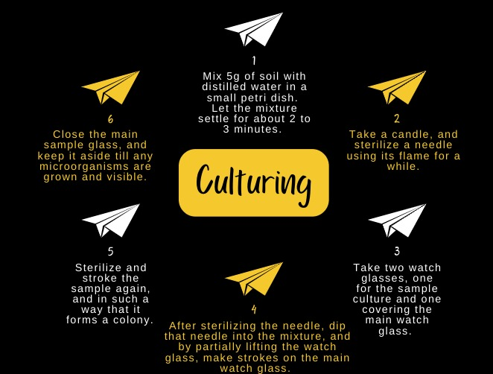

Slide 20
Results and Discussion

Slide 21
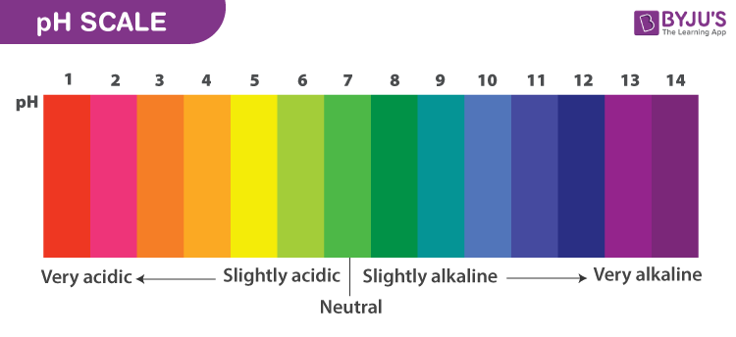
pH Level
Gottigere Lake Neutral/alkaline in nature.
Madiwala Lake weak basic in nature
9
7 to 9

Slide 22
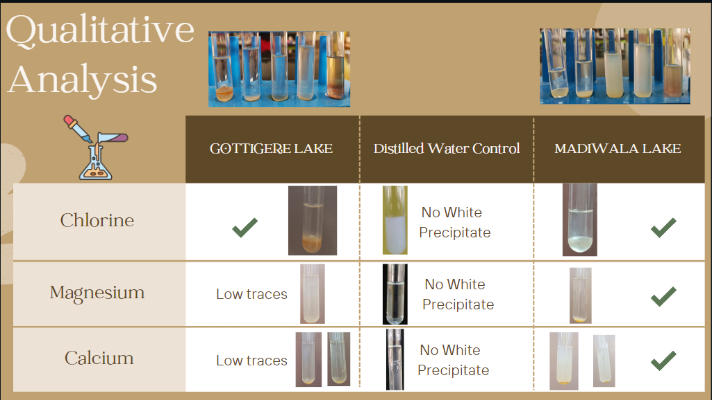

Slide 23
Test Parameter
Chemical: Moisture content Bulk Density
Quantitative Analysis: Electrical Conductivity Chloride Calcium Magnesium
Sieve Analysis: Uniformity Co-efficient Co-efficient of gradation, cc

Slide 24
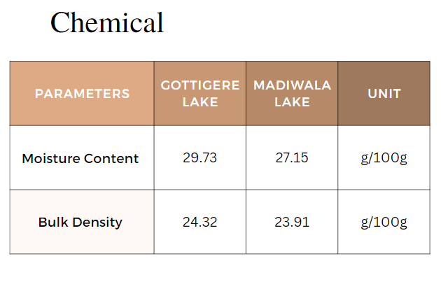

Slide 25
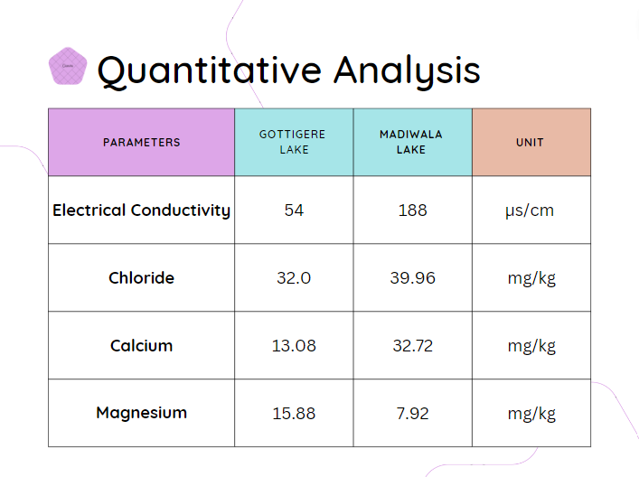

Slide 26
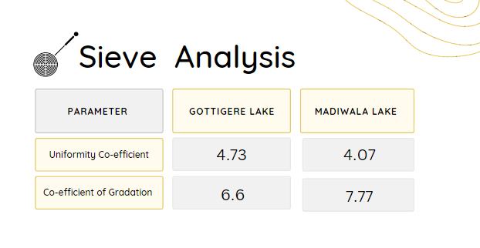

Slide 27
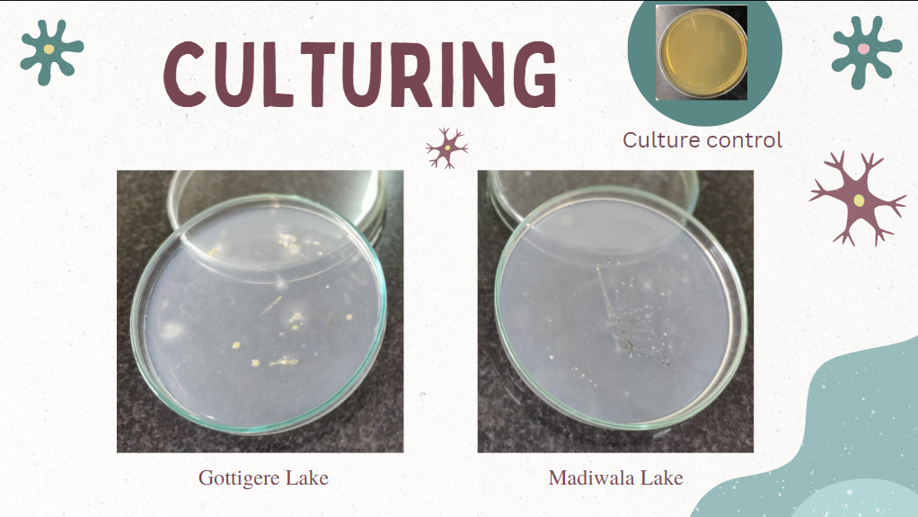

Slide 28
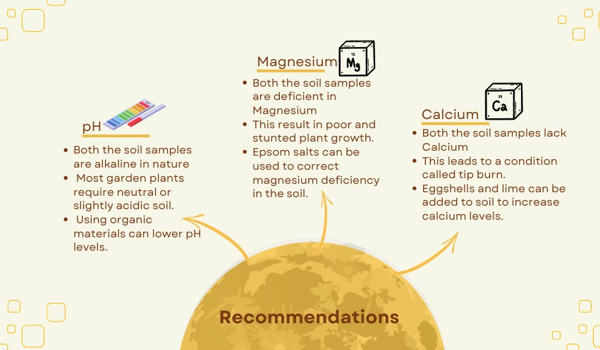
Recommendations

Slide 29
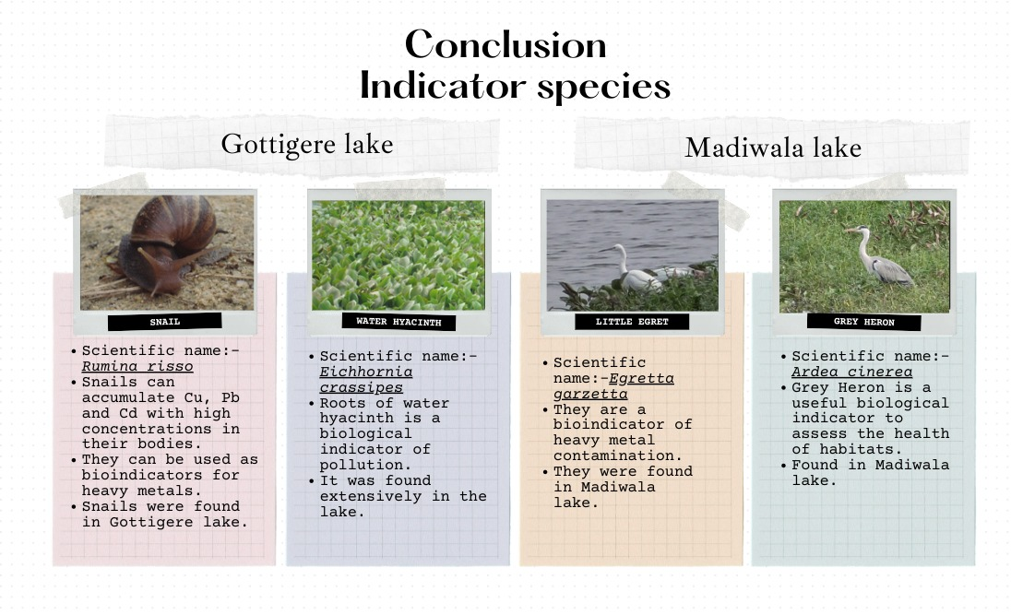

Slide 30
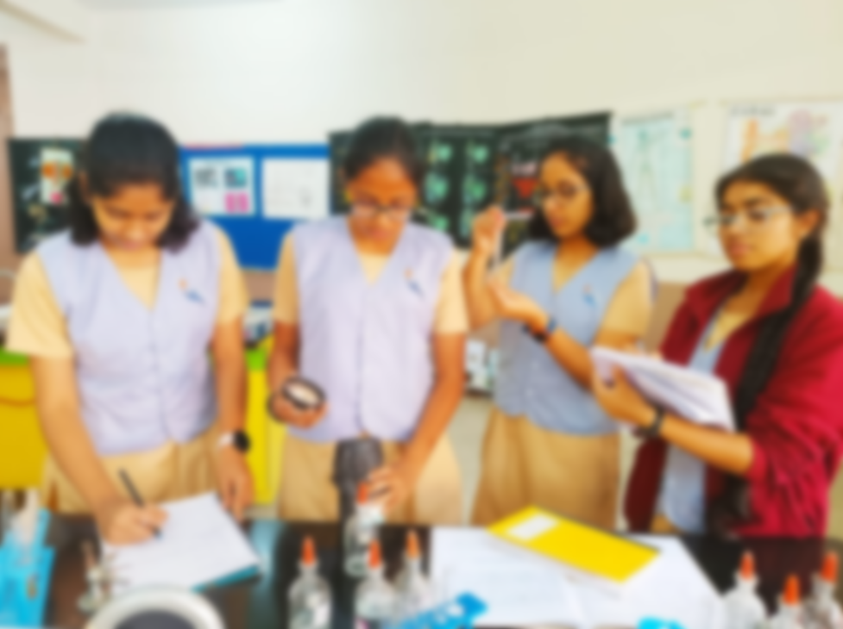




References
https://www.britannica.com/science/soil
https://www.holganix.com/blog/10-inspirational-quotes-on-soil
https://www.canr.msu.edu/uploads/234/68557/rec_chem_soil_test_proce55c.pdf
https://youtu.be/B319MMQ8M84
https://en.wikipedia.org/wiki/Soil
https://byjus.com/chemistry/soil-pollution/
https://www.qld.gov.au/environment/land/management/soil/soil-properties/colour
https://www.masterclass.com/articles/alkaline-soil
https://www.masterclass.com/articles/how-to-add-calcium-to-soil
https://www.researchgate.net/publication/237449722_Present_status_of_Gottigere_Tank_Indicator_of_Decision_maker's_apathy

Slide 31
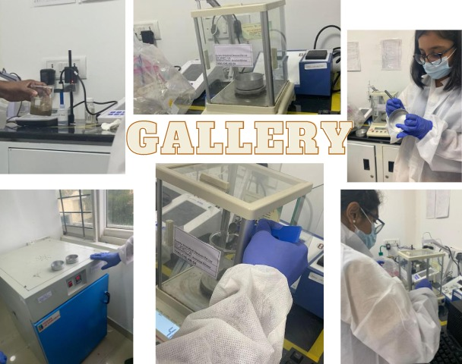

Slide 32
THANK YOU

