Slide 1


COMPARATIVE STUDY OF BIRDS IN TWO DIFFERENT LAKES
School - PSBBLLA
By Poomkuzhimannil Alain Zachariah- Class 11
Avra Jyoti Pal-Class 11
Vaishnavi Viswanathan- Class 11

Slide 2
INTRODUCTION:
Birds are are an essential part of the ecosystem. As the human population and its activities continue to place more significant strain on biodiversity and its associated systems, one way to give back to nature is to understand what is available, how many are available, and where they are located.

Slide 3
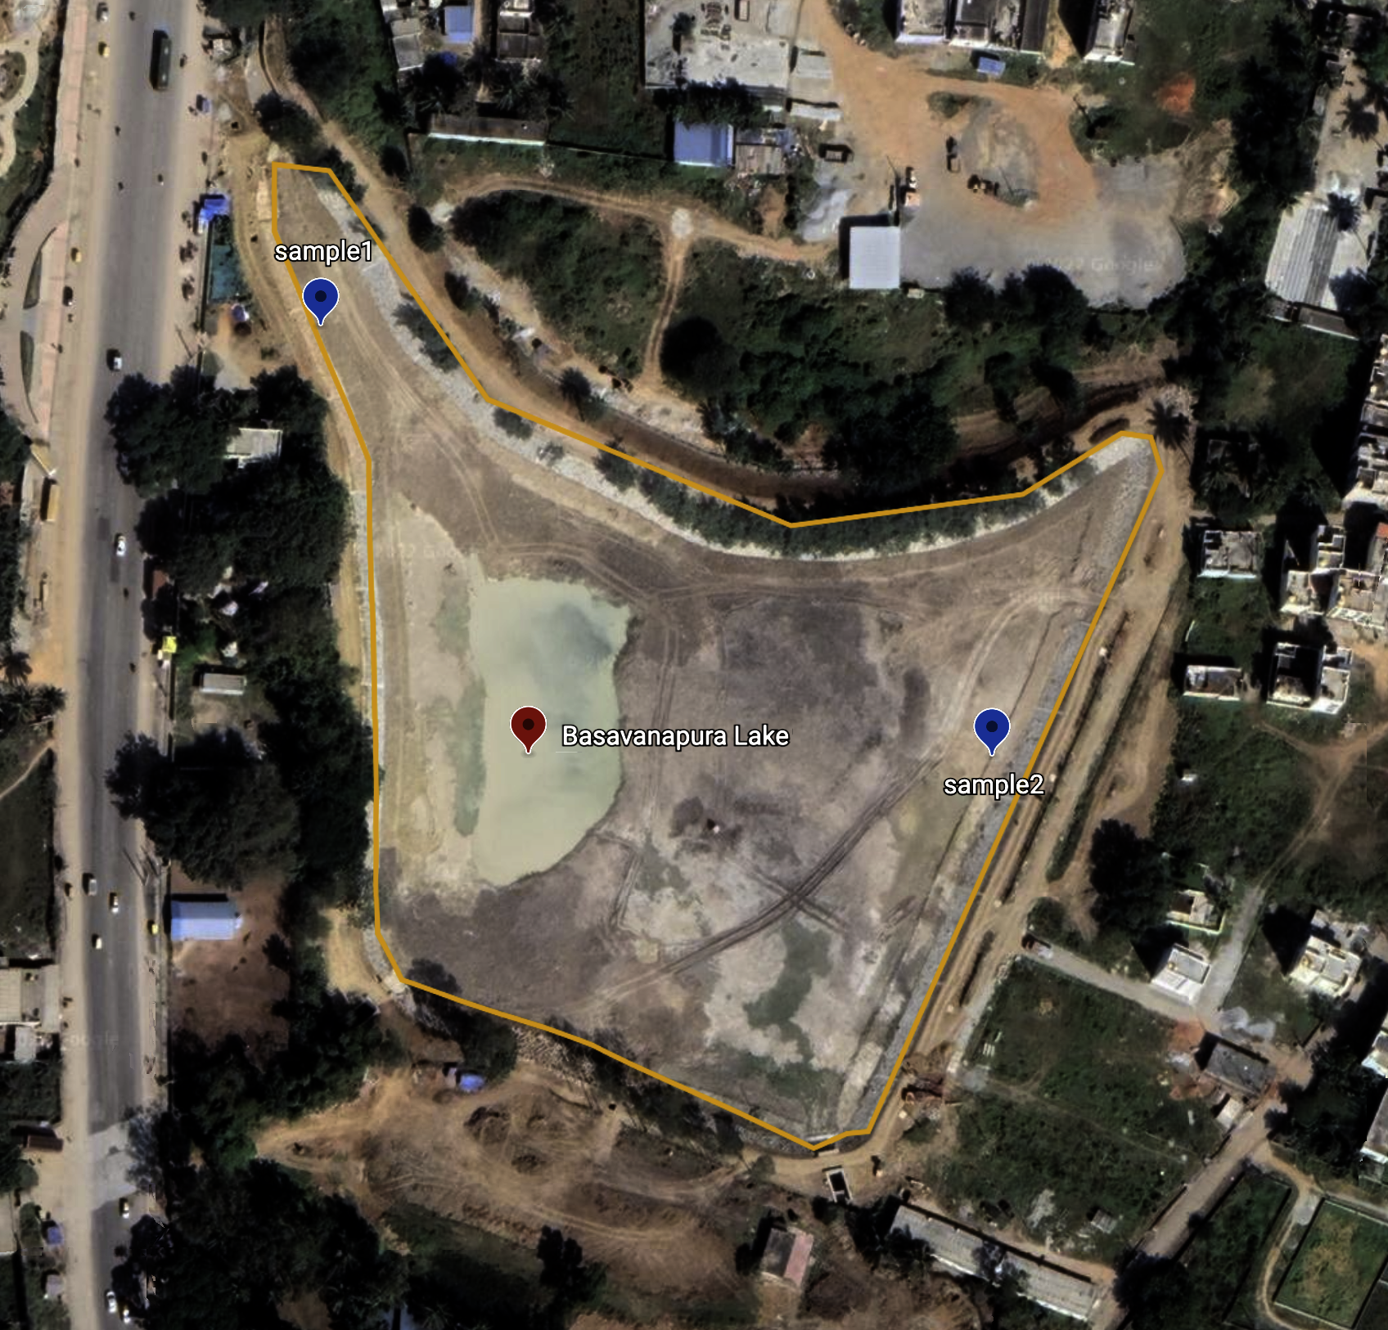
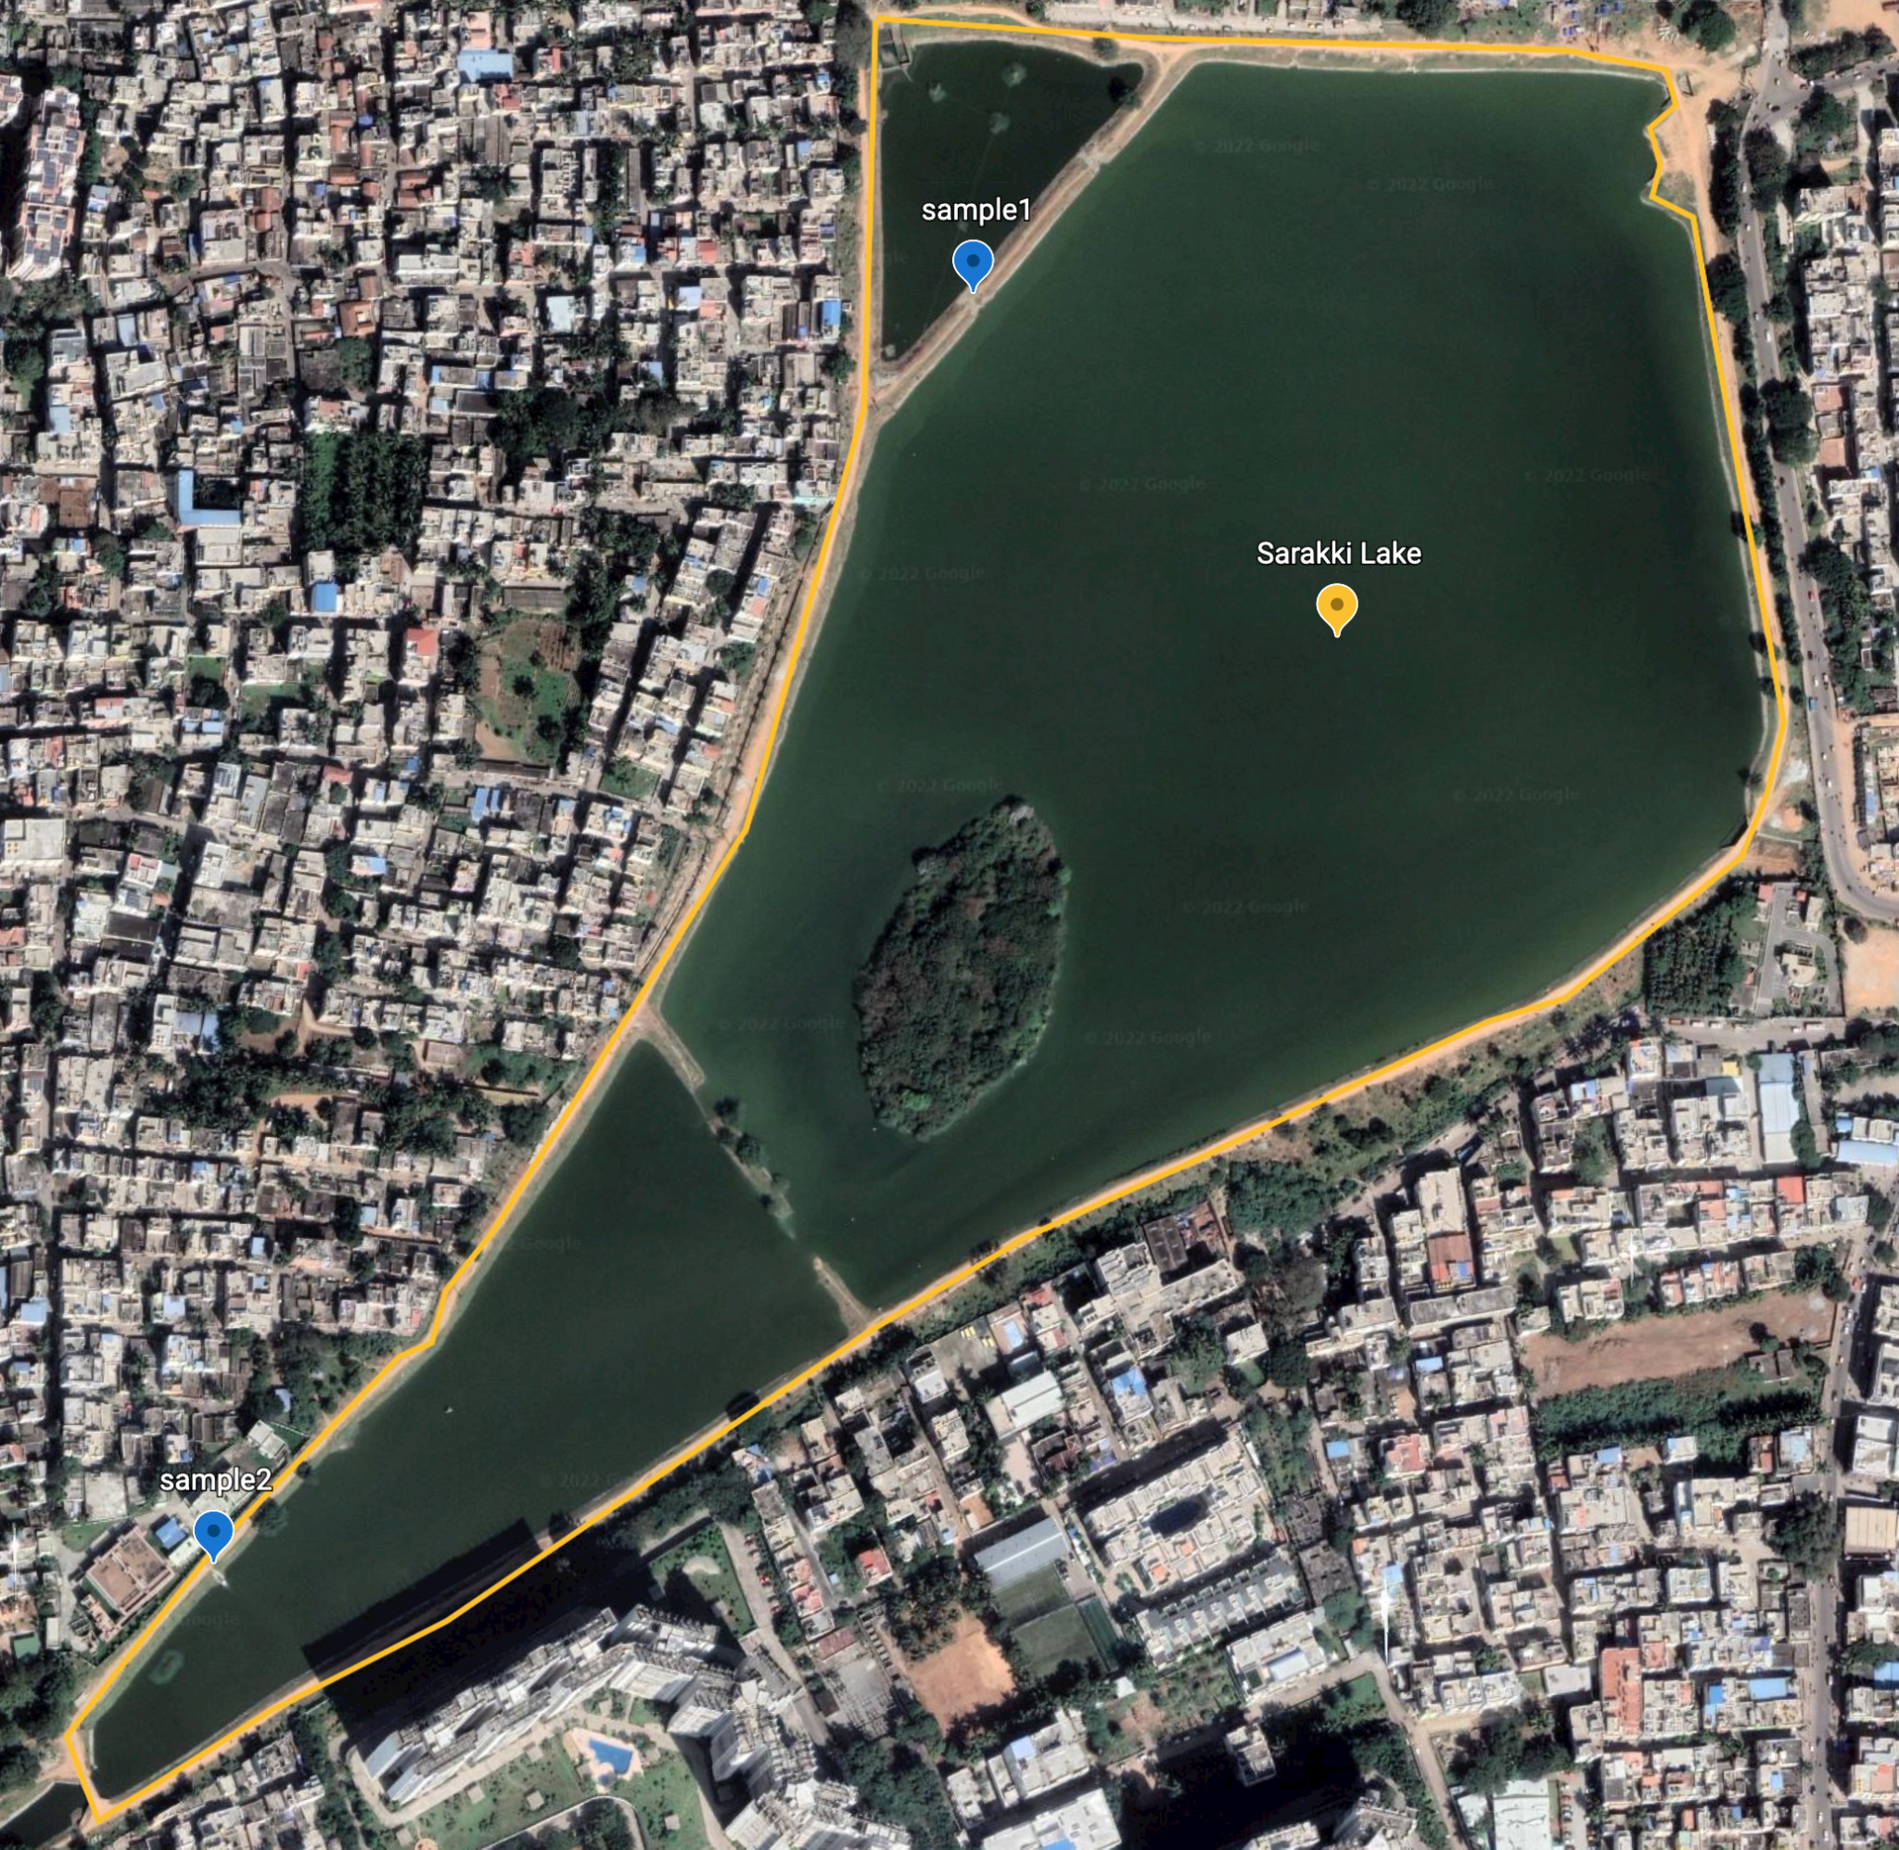

STUDY AREA
BASAVANAPURA LAKE
SARAKKI LAKE
12°50’41”N 77°35’19”E
12°53’55”N 77°34’44”E
Notes:
Sarakki lake 38 acres
Basavanapura 14 acres

Slide 4
OBJECTIVE
Identification of specific & common birds found in the lakes under the study.
Study of their habitat.
Factors affecting the presence of specific birds in each lake.
Notes:
We will b doing a comparative study btw the 2 lakes aka sarakki and basavanapura lake. We weill b focusing of birds that r common and birds which r found only in once lake. Why are they found in both? Or y r they found only in one lake?

Slide 5
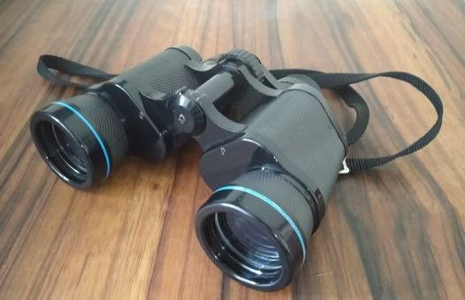
MATERIALS AND METHODS
Binoculars
DSLR camera / phone
Field guides and bird watchers for identification
Study was carried out from 17th oct 2022 to 10th dec 2022
Visual identification method was followed.
Time spent on lakes was about one hour

Slide 6
Table of contents
01
Birds found in Basavanapura Lake
02
Birds found in Sarakki Lake
Result
03
Factors affecting the presence of specific birds in each lake.

Slide 7
01
Birds Found in Basavanapura lake

Slide 8
Birds spotted | Scientific name | Number of birds | IUCN Status
Oriental darter | Anhinga melanogaster | 1 | Near Threatened
Indian pond heron | Ardeola grayii | 3-4 | Least concern
Cattle egret | Bubulcus ibis | 5-6 | Least concern
Little grebe | Egretta garzetta | 5-6 | Least concern
Great cormorants | Phalacrocorax carbo | 1-2 | Least concern
Indian cormorants | Phalacrocorax fuscicollis | 2-3 | Least concern
Little cormorants | Microcarbo niger | 3-4 | Least concern
Black kite | Milvus migrans | 3-2 | Least concern
Grey wagtail | Ardea cinerea | 1 | Least concern
Bulbul | Pycnonotus | 1-2 | Least concern
Common mynah | Acridotheres tristis | 1-2 | Least concern

Slide 9
DATE | TIME SPENT | TYPES OF BIRDS | NUMBER
1st November 2022 | 45 mins | Cormorants,Oriental darters, Indian pond heron, common mynah egret | 3,1,4,1,6 respectively
15 November 2022 | 1 hour | Cormorants,grey wagtail,little grebe Indian Pond Heron, egret | 14,1,3, 3, 6 respectively
28th November 2022 | 45 mins | Cormorants, pond heron,black kite, oriental dater, egret | 2, 3, 3,1,6 respectively
7th December 2022 | 1 hour | Cormorants, Indian Pond heron, egret, Black kite, Grey wagtail, bulbul, little grebe | 4, 3, 7, 3, 2, 2, 5 respectively

Slide 10
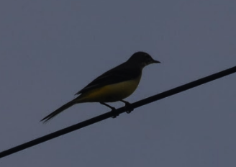
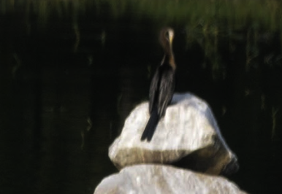
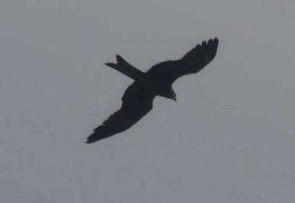
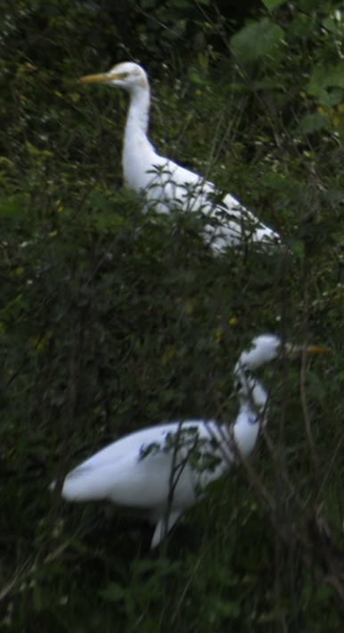
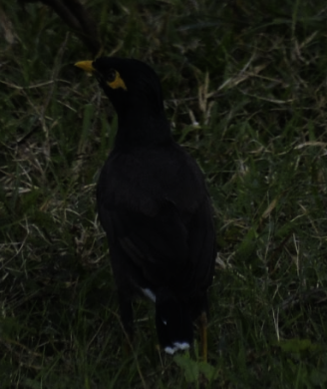
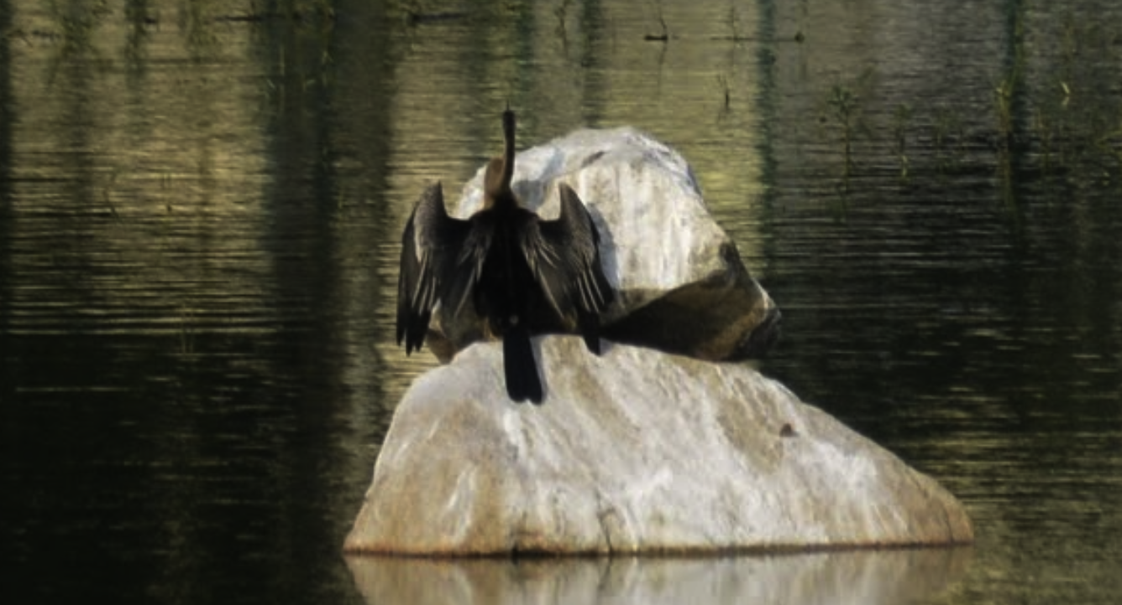
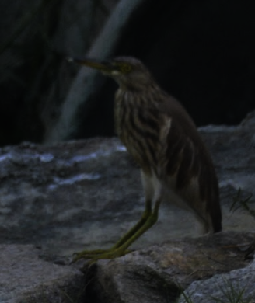
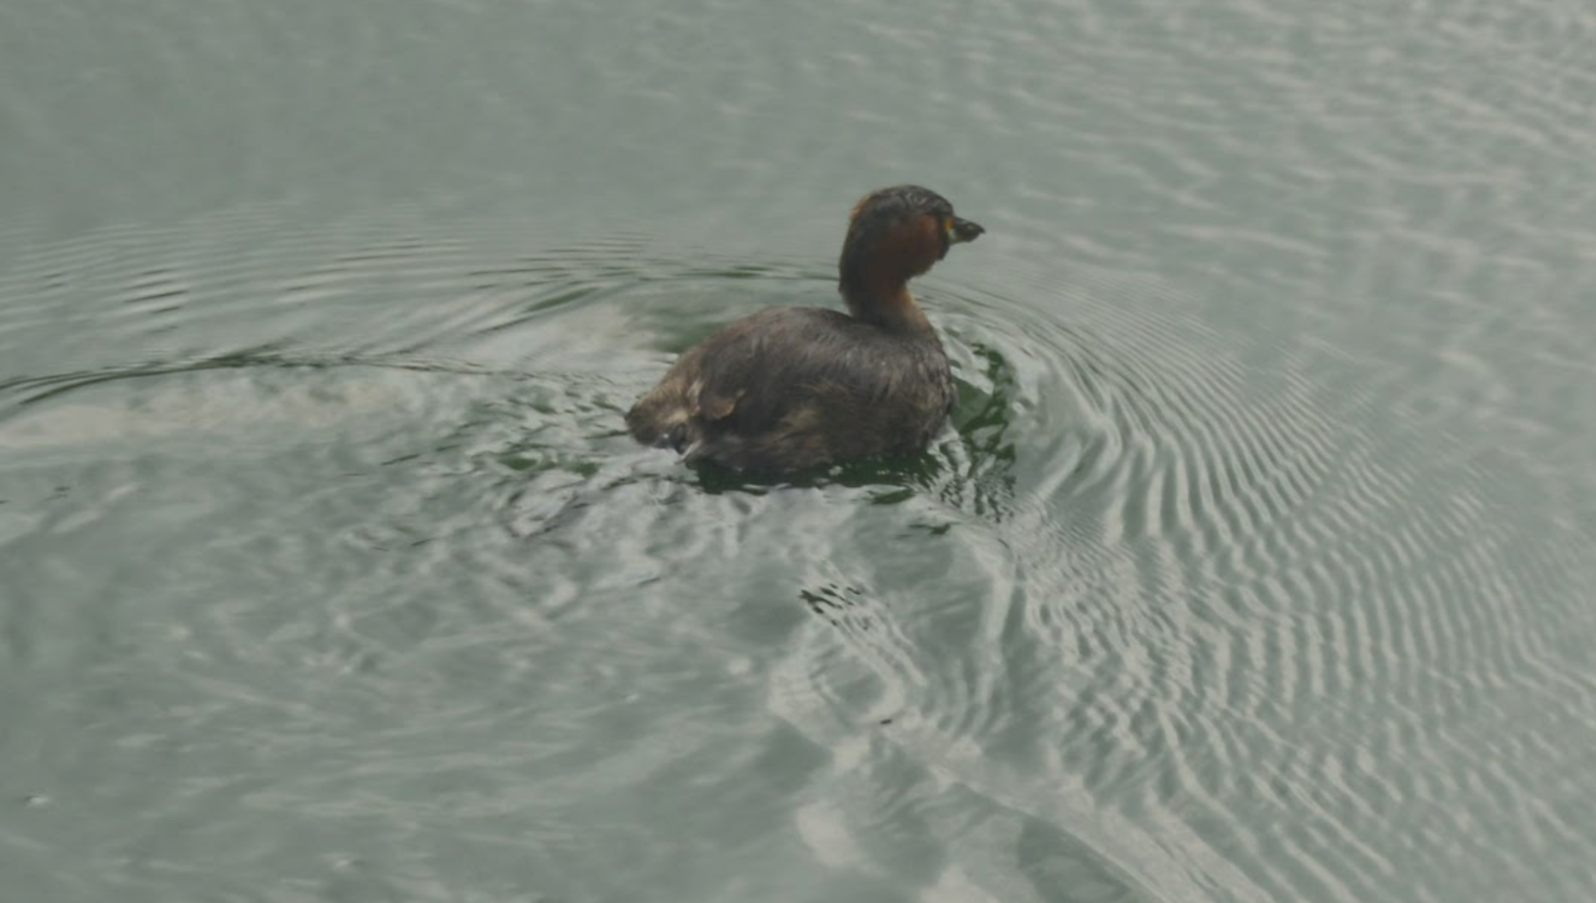
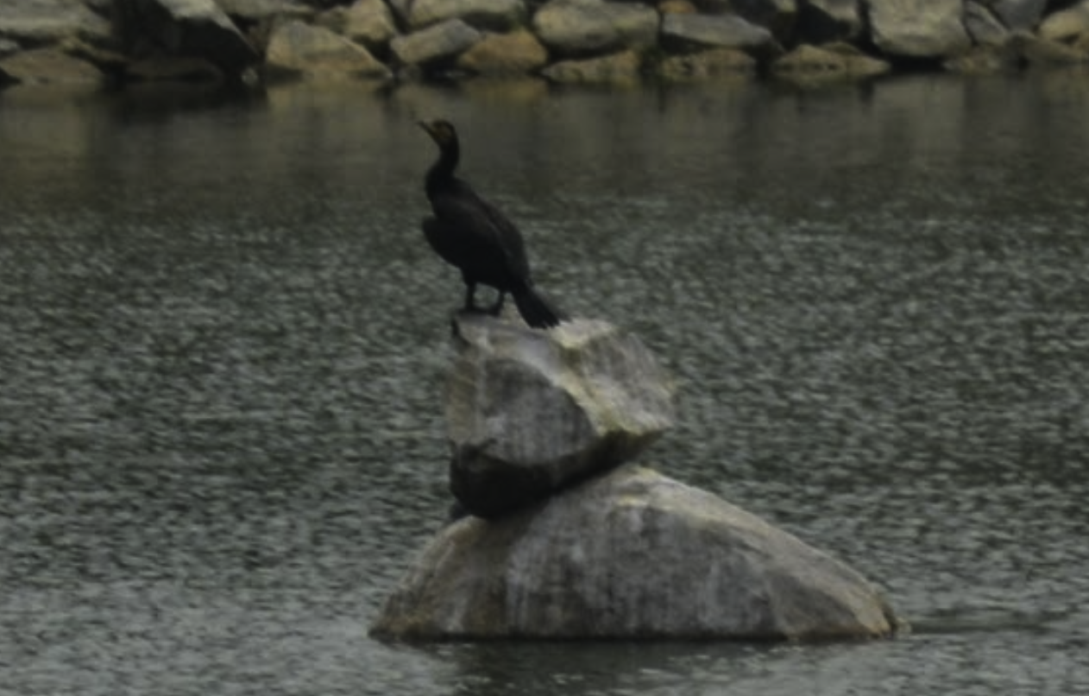
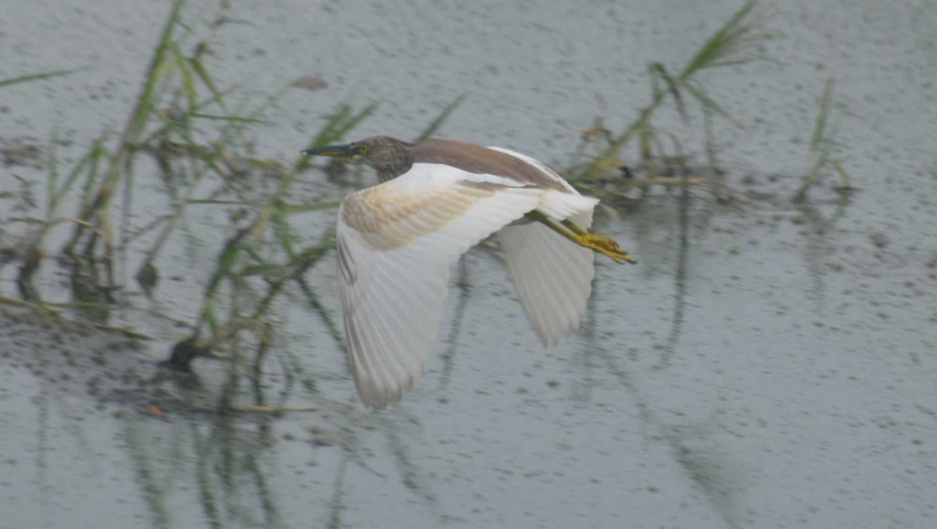
Greywagtail
Black kite
Egrets
Common mynah
Indian pond heron
Oriental darter
Little grebe
Cormorant

Slide 11
02
Birds Found in Sarakki lake
Least concern

Slide 12
Birds spotted | Scientific name | Total No. of birds found | IUCN Status
Painted stork | Mycteria leucocephala | 7 | Near Threatened
Indian pond heron | Ardeola grayii | 7-9 | Least concern
Cattle egret | Bubulcus ibis | 1-2 | Least concern
Little egret | Egretta garzetta | 2-3 | Least concern
Great cormorants | Phalacrocorax carbo | 15 - 18 | Least concern
Indian cormorants | Phalacrocorax fuscicollis | 2-4 | Least concern
Little cormorants | Microcarbo niger | 4-5 | Least concern
Black kite | Milvus migrans | 5-6 | Least concern
Grey heron | Ardea cinerea | 3 | Least concern
Spot billed ducks | Anas poecilorhyncha | 12 | Least concern
Spot billed pelicans | Pelecanus philippensis | 5 | Near Threatened

Slide 13
SARAKKI LAKE
DATE | TIME SPENT | TYPES OF BIRDS | NUMBER
6th November 2022 | 45 mins | Cormorants, Painted stork, Indian pond heron, egret | 15, 9, 2, 2 respectively
26th November 2022 | 1 hour | Cormorants, Painted stork, Indian Pond Heron, Spot billed ducks | 14, 3, 3, 6 respectively
28th November 2022 | 45 mins | Cormorants, Painted stork, egret | 20, 3, 1 respectively
4th December 2022 | 2 hours | Cormorants, Painted stork, Indian Pond heron, egret, Black kite, Grey heron, Spot billed Ducks, Spot Billed Pelicans | 20, 3, 7, 3, 2, 2, 2, 5 respectively

Slide 14
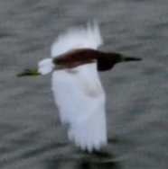
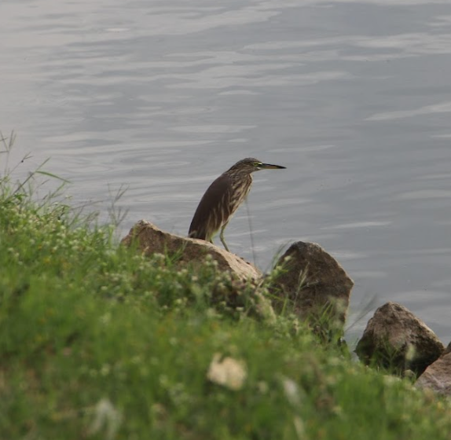
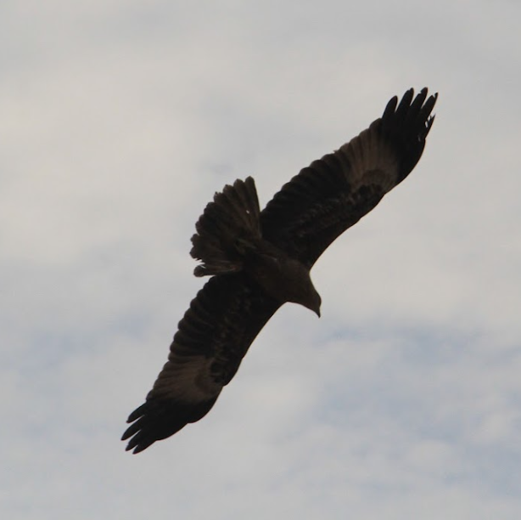
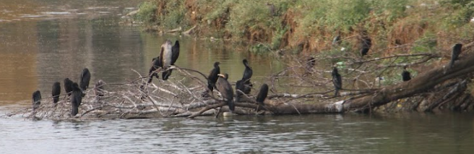
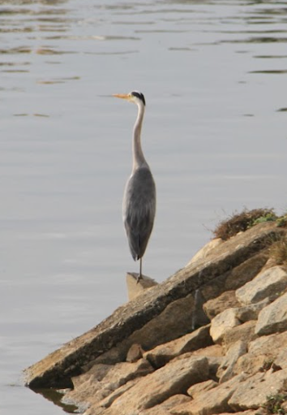
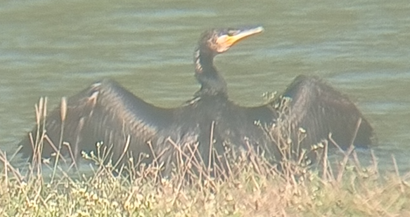
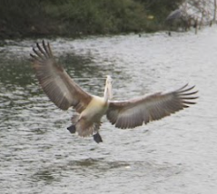
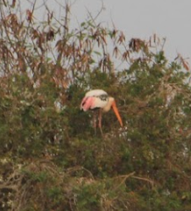
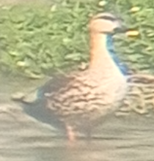
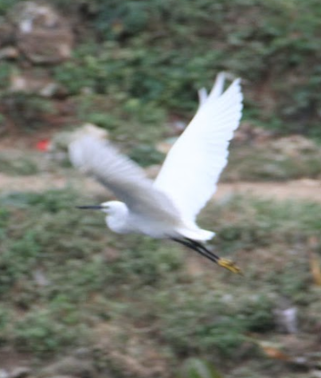
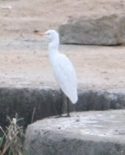
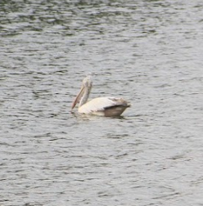
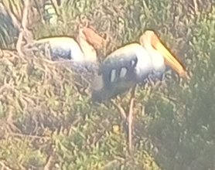
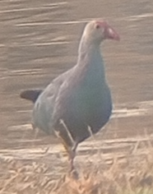
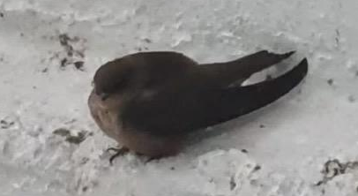
Cormorants
Indian Pond heron
Black kite
Grey Heron
Spot billed duck
Little Egret
Cattle Egret
Spot Billed Pelicans
Painted stork
{Unidentified}
{Unidentified}

Slide 15
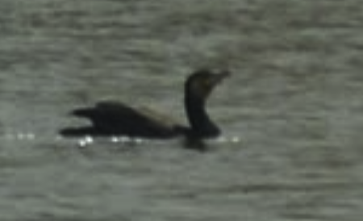
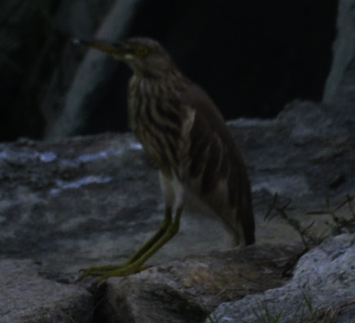
Common birds
Common in both lakes
Sarakki lake
Basavanapura lake
Painted stork
Grey heron
Spot billed pelicans
Spot billed ducks
Little egret
Indian pond heron
Cattle egret
Great cormorants
Little cormorants
Black kite
Indian cormorants
Oriental daters
Little grebe
Grey wagtail
Common mynah bulbul

Slide 16
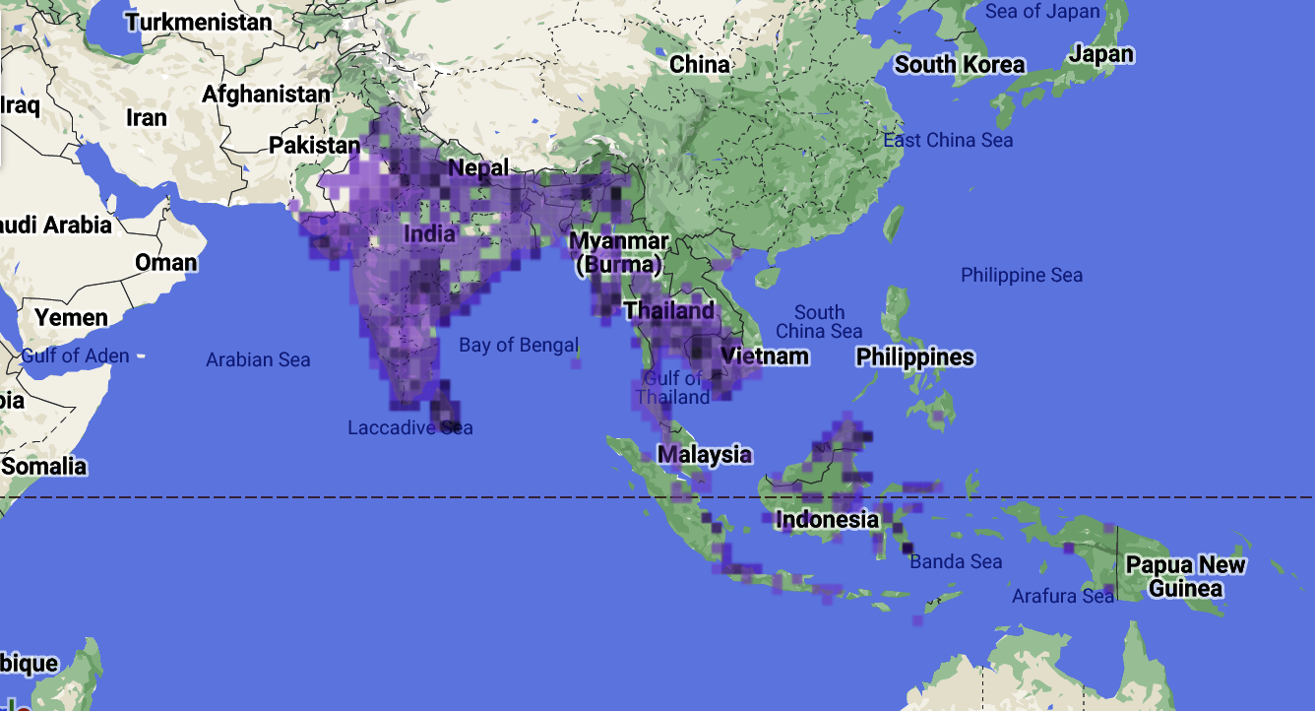
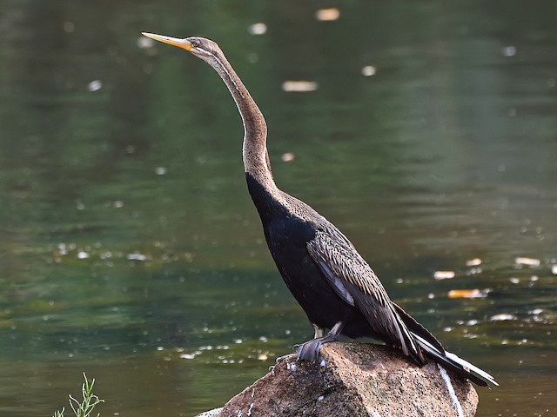
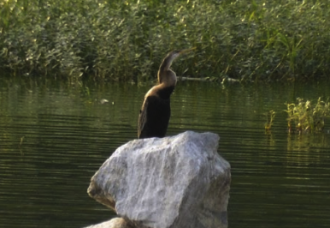
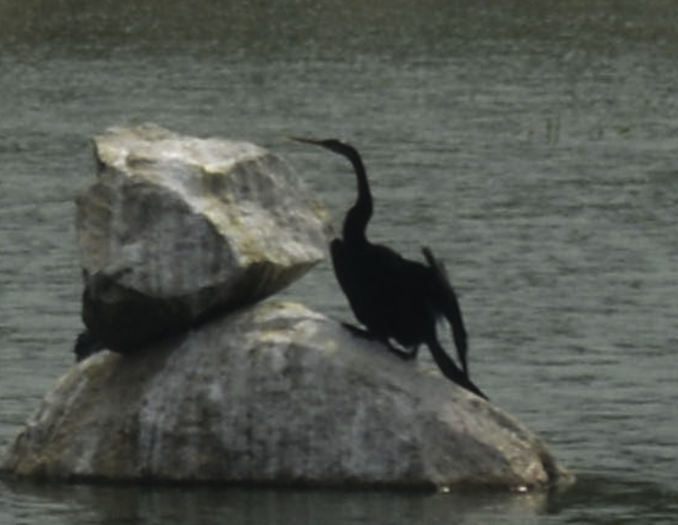
Oriental darters (Anhinga melanogaster)
Kingdom: Animalia
Phylum:Chordata
Class:Aves
Order:Suliformes
Family:Anhingidae
Genus:Anhinga
Species:Anhinga melanogaster
Wikipedia
ebird
Notes:
The oriental darters or the anhinga melanogaster is native to the indian subcontinent. Water bird of south and southeast asia. Long slender neck pointed bill and is very similar to the cormorants. They have 4 digits on each leg and have webbed feet. Endothermic and show bilateral symmetry. Show sexul dimorphism the male is larger and females tend to have shorter bills. The adults have black next and the ung ones have pale brown ones. The immature bird’s neck is lighter than that of a mature one.

Slide 17
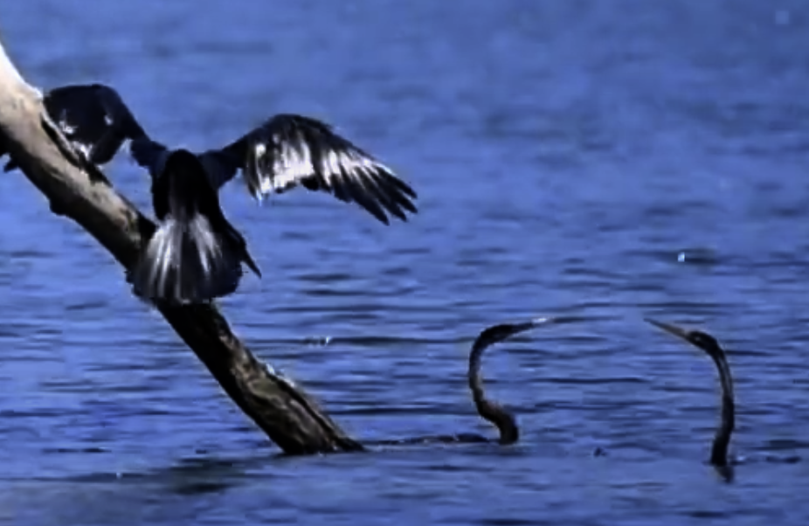
Oriental darters (Anhinga melanogaster)
Feeding habits
mostly fish but also amphibians, mollusks, reptiles, echinoderms, insects, crustaceans, turtles, snakes, newts, frogs, shrimp, sponges, leaves, grains, seeds, and nuts.
Habitat
lakes, marshes and large rivers, including deep estuaries. It usually occurs in trees or bamboos’ thickets near these wet areas, in forested margins or on densely vegetated islets. This species can be seen up to 1200 metres of elevation.
What Were Their Main Threats?
Humans, Habitat Loss, Pollution, Deforestation, Hunting, Degradation
There are only 22,000 individuals of the Oriental darter (Anhinga melanogaster) species left in the world.
The Oriental darter (Anhinga melanogaster) is a water bird of tropical South and Southeast Asia.
found all year long
also known as Plotus melanogaster and snakebird.
Notes:
They are monogamous one mate at a time and breed in colonies
Mates communicate thru calls and wing flapping breeding depends on region and weather. 2 to 6 eggs per season 25 to 30 days to hatch
Nest in mixed species heronaries - breeding ground for herons
Spend time swimming
Feather not completely waterproof they absorb water and r less buoyant helps in faster swimming and diving
Chicks are preyed by raptors esp; palla’s fish eagle
They often live alongside of herons and cormorants hunt in eachothers company
Human shy birds
Known fr fishing strategies
Listed as nt by the iucn. Due to habit loss pollution egg collecting hunting etc

Slide 18
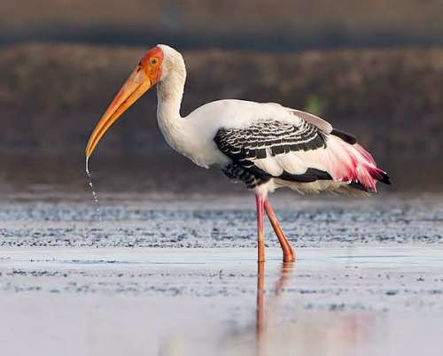
PAINTED STORK
indianbirds.thedynamicnature.com

Slide 19
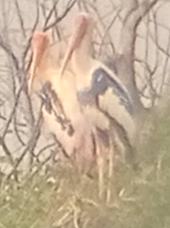
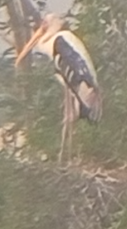
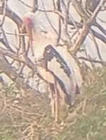
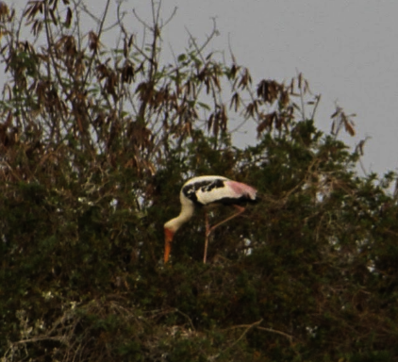
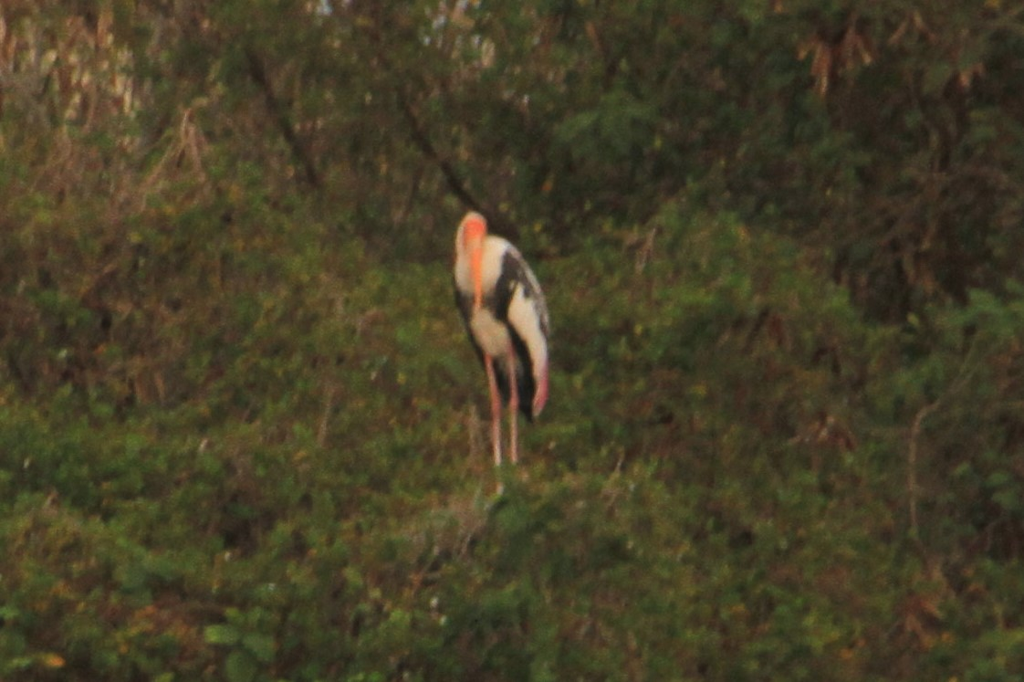
PAINTED STORK
Scientific name: Mycteria leucocephala
Rank: Species
Higher classification: Mycteria
Family: Ciconiidae
Mass: 3.2 kg (Adult)
Length: 93 – 100 cm (Adult)
Wingspan: 150–160 cm (59–63 in)
Lifespan : 28 years
predominately non-migratory birds.

Slide 20
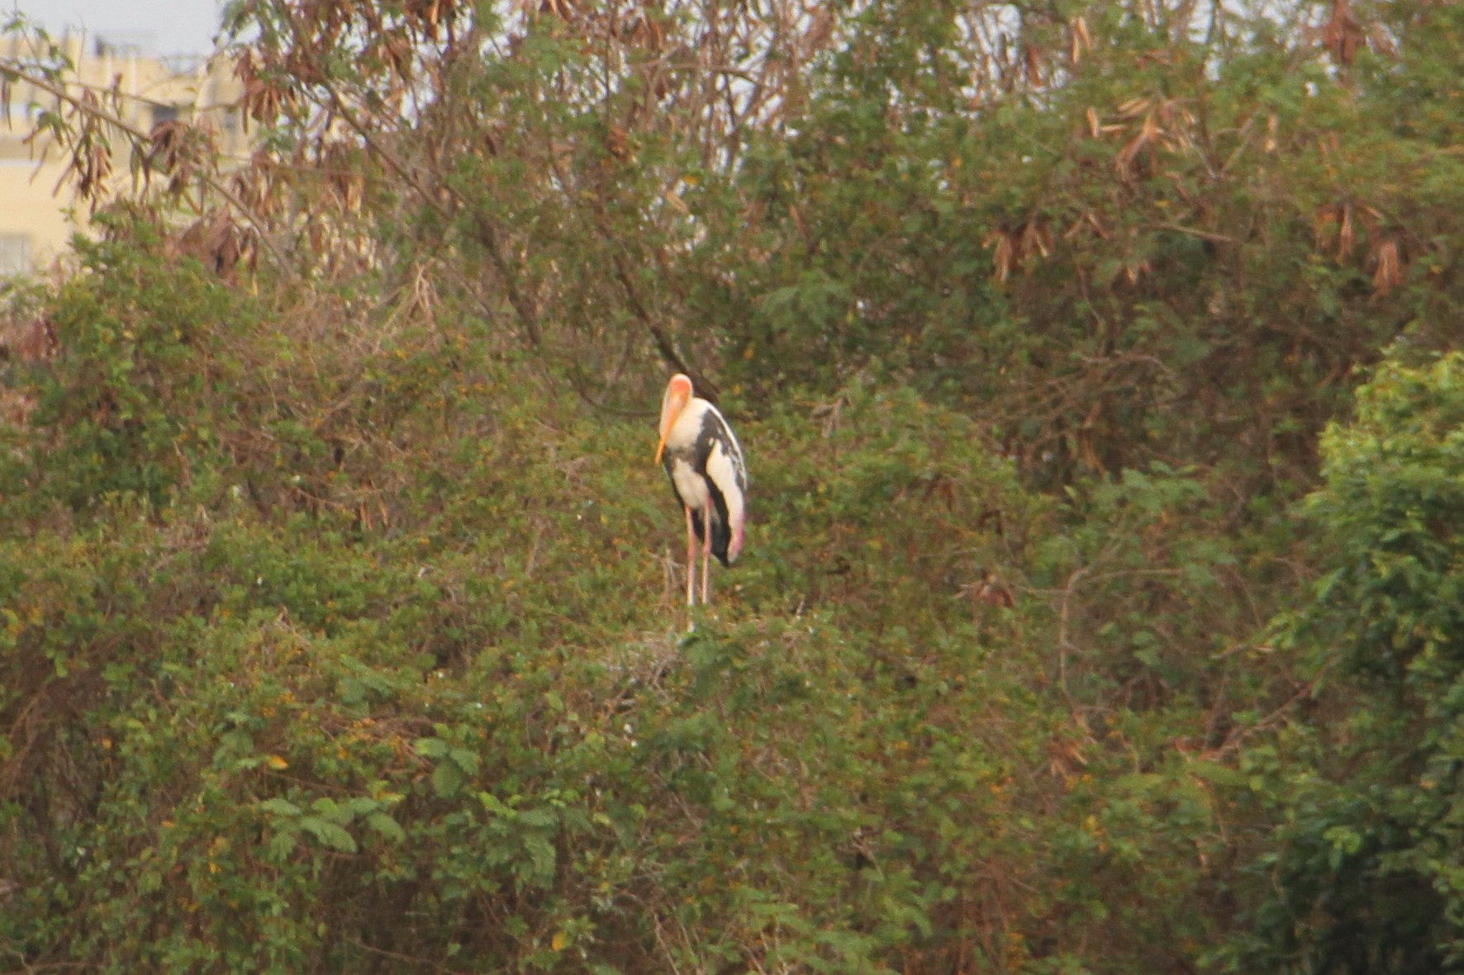
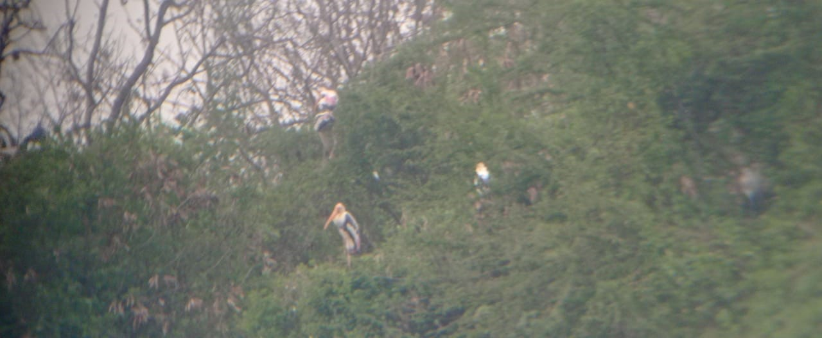
Painted Stork
Breeding
Habitat
They are colonial tree nesting birds ( mixed colonies with other water birds also )
The New World mesquite trees (Prosopis juliflora) are chiefly utilized by painted storks as colonial nesting trees.
The platform nests are typically placed in a tree on an island or in an otherwise undisturbed area.
They are often restricted to :
shallow freshwater wetlands
Marshes
flooded agricultural fields ( during monsoons )
seepage ponds etc
Habitat Regions :Tropica, terrestrial, saltwater/marine, freshwater
Food Habits
Painted storks feed on:
Fish, Insects, Crustaceans, Amphibians, Reptiles etc

Slide 21
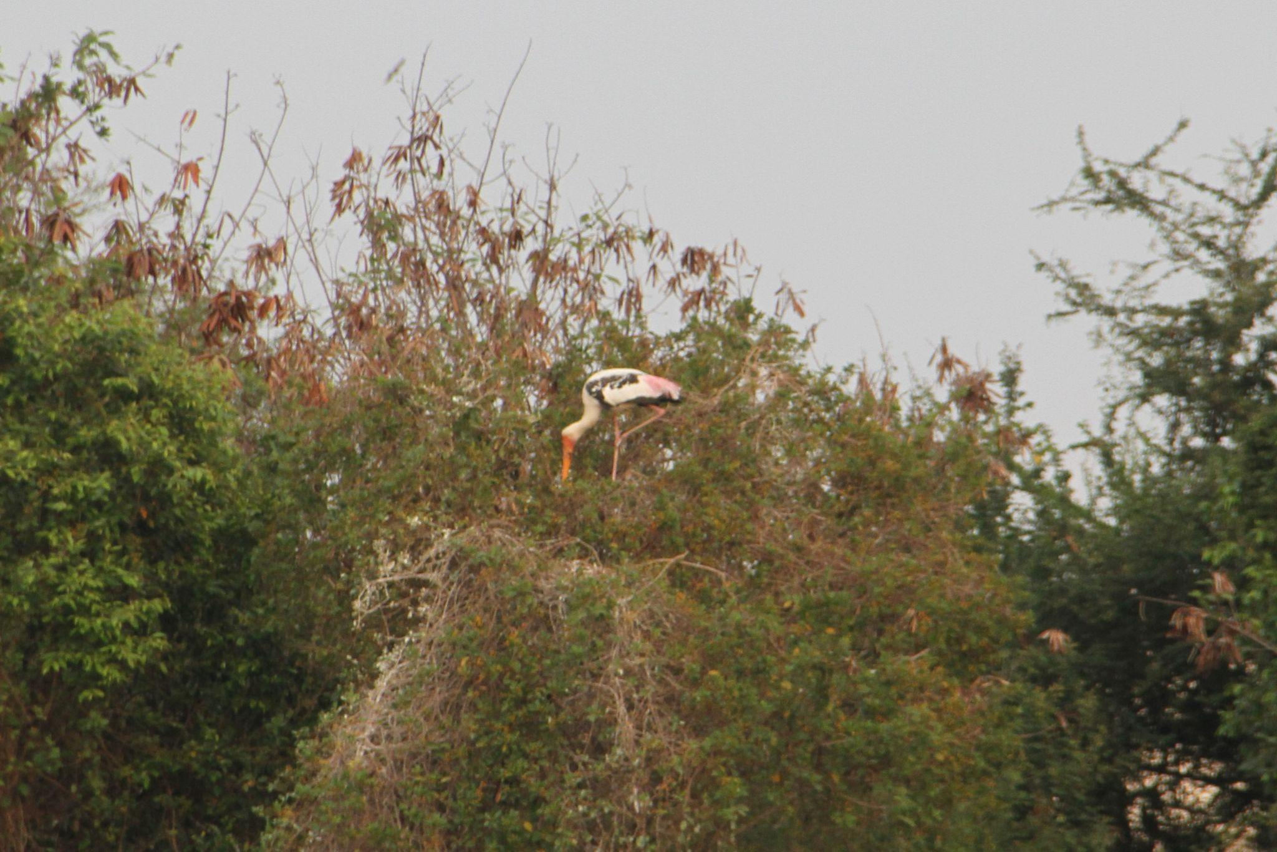
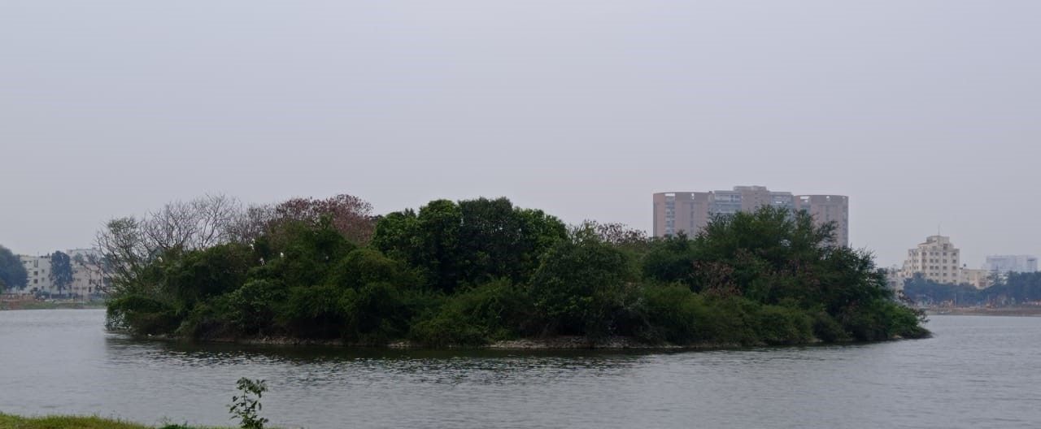
OBSERVATION:
Pink tertial feathers and bright orange face identified.
Found in colonies
Habitat : -
They were always found on the larger island present in the lake.
Found on top of trees ( on nests mostly ).
Behaviour : -
They weren’t found actively flying around. Found on top of trees of the island most of the time.

Slide 22
Result and Conclusion
03

Slide 23
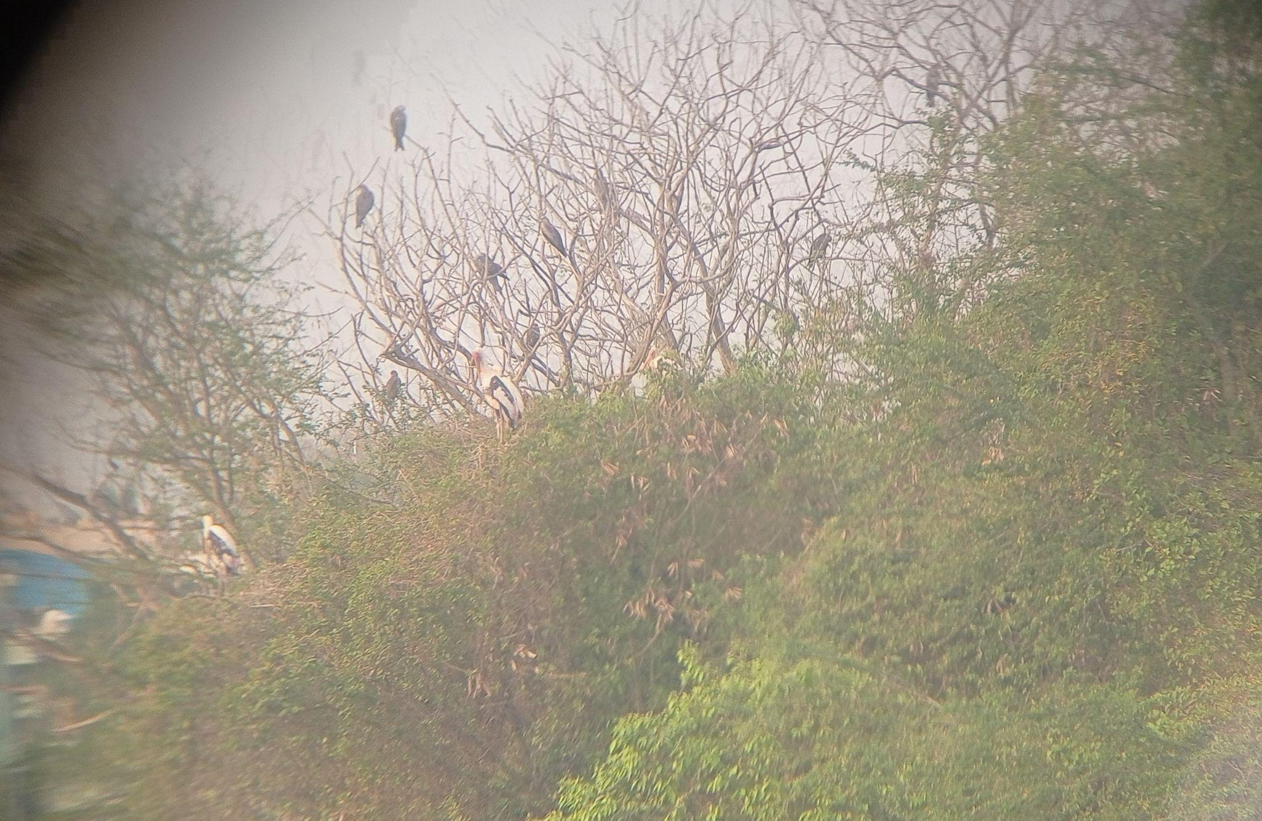
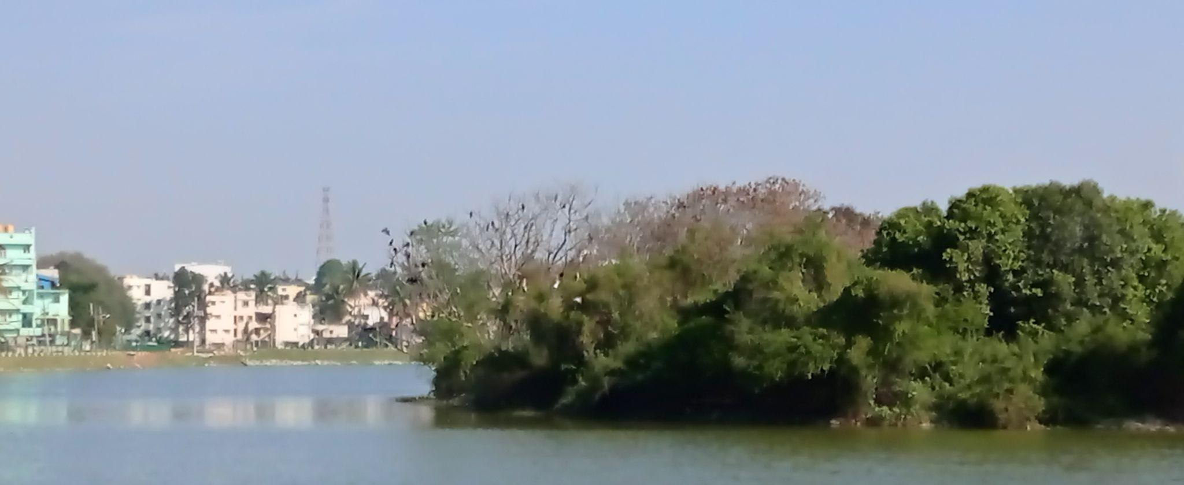
Why are Painted storks not found in basavanapura lake
Probable presence of Prosopis juliflora
Island present
Rich vegetation in island. Prosopis juliflora tree present probably
An undisturbed area, perfect for the protection of young ones

Slide 24
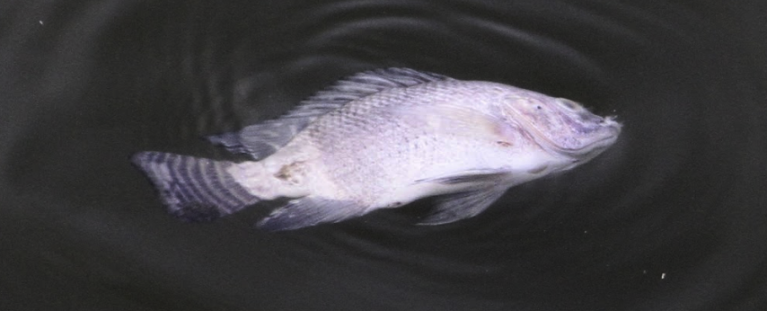
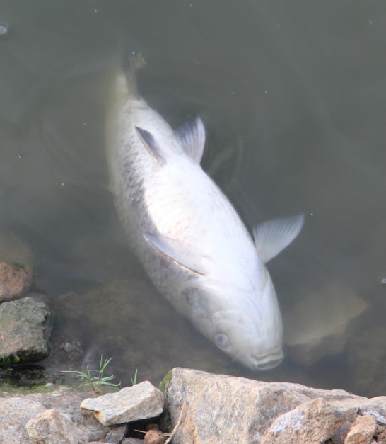
Why are the Oriental darters not found in Sarakki lake ?
Relatively big fishes found in the lake
Fish kill found
Comparatively more presence of humans

Slide 25
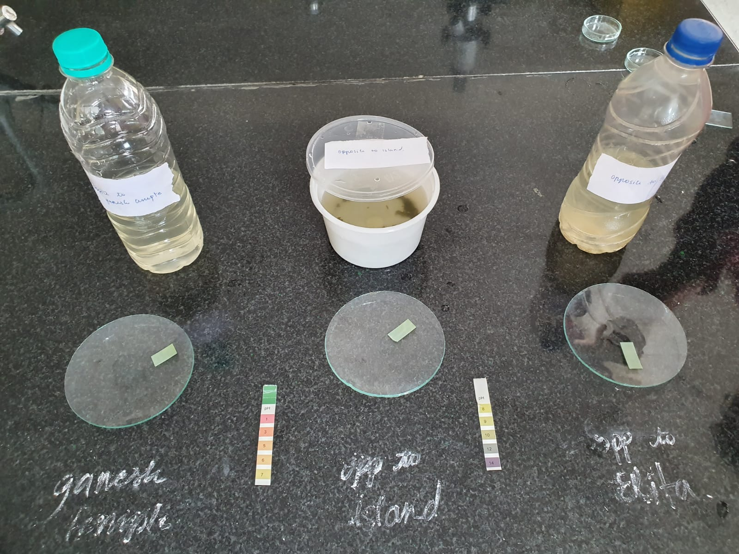

Other Parameters Compared
PARAMETERS | SARAKKI LAKE | BASAVANAPURA LAKE
PERIMETER | 2.47 km | 0.68 km
AREA | 24.79 ha | 1.93 ha
NO OF IDENTIFIED SPECIES | 13 species | 11 species
pH OF LAKE (avg of sample) | 9 | 8
ALKALINITY (avg of samples) | 130 mg/l | 150 mg/l
DISSOLVED OXYGEN (avg of sample) | 5.85 mg/l | 5.5 mg/l

Slide 26

Acknowledgements
We wish to express our gratitude to IISc for providing us with this wonderful opportunity to do this project. We would like to thank our teachers for guiding us, supporting us and encouraging us to give our best for this project. Special thanks to Usha ma’am and Madhurima ma’am for helping us with the project. We express our gratitude towards Dr. Antony and Professor K S Bhat for guiding us in our research. We would like to thank our school’s principal, Mahalakshmi ma’am and Vice Principal, Jayashree ma’am for providing us this opportunity. Thank you, audience for listening.

Slide 27
Sources
Wikipedia.org
Ebird.org
Slidesgo
Inaturalists
Animaldiversity.org
Adityasbirdingblog.com
Wildlife-animal-pedia.fandom.com
Site.bbmp.gov.in
https://kspcb.karnataka.gov.in
Mutagens.co.in

Slide 28
Thank You

