Slide 1


Analysis of Nitrogen dioxide (NO₂) on Artocarpus heterophyllus and Syngonium podophyllum
By:
Avyay Vijay, Jahnavi Prasad, Sanjeev Raman S Iyer, Pranav K

Slide 2



Introduction

Slide 3
Introduction
Analysis of one of the pollutants released by exhausts of automobiles and its effects on flora and fauna.
A case study of its effects on Jackfruit (Artocarpus heterophyllus) and Arrowhead vine (Syngonium podophyllum).
The study was conducted in 3 different locations in the school campus with varying levels of pollution.

Slide 4
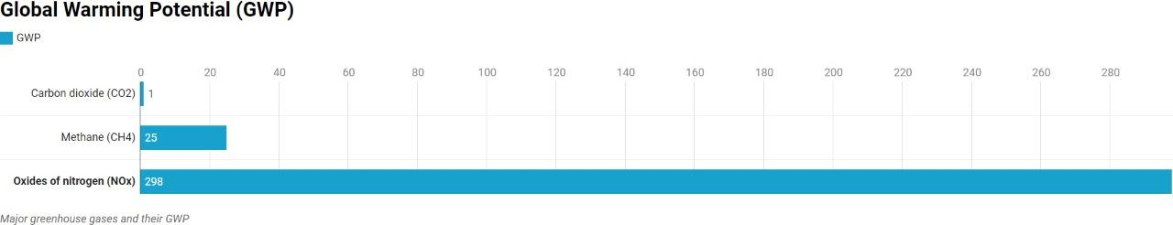
As seen in the graph below, NOx has 298 times more Global Warming Potential than CO₂. We shall be analysing oxides of nitrogen and focusing on NO₂ and its effect on plants.
The measure of how much energy 1 ton of a gas will absorb over a period of time is global warming potential.

Slide 5
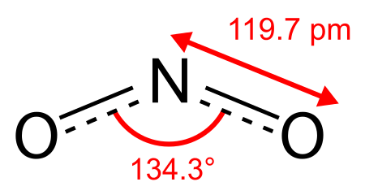
Information about NO₂
Highly reactive gas
Enters air from burning of fossil fuels
Oxidises easily
It has a bond angle of 134.3degrees.
It has bent type of molecular geometry.
NO₂ fumes are brown in colour with a pungent smell.

Slide 6
Objective
Hypothesis: Pollutants from exhausts like NO_{x} have detrimental effects on jackfruit and arrowhead vine.
To see the effects of NO_{x} on starch levels, physiological features and stomatal structure of Artocarpus heterophyllus.
To see the effects of NO_{x} on starch levels, physiological features and stomatal structure of Syngonium podophyllum.

Slide 7
Case Study-
Artocarpus heterophyllus

Slide 8
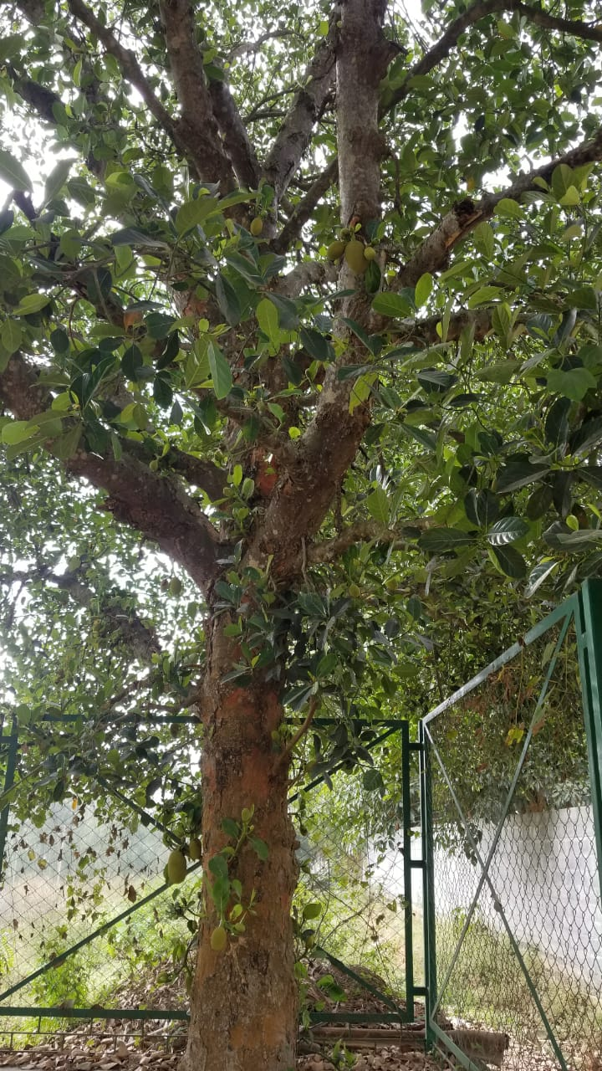
Artocarpus heterophyllus
Artocarpus heterophyllus is the scientific name of Jackfruit.
Jackfruit belongs to the Moraceae family.
Relatively short trunk
Dense treetop
Heights from 10 to upto 20 metres
Phyllotaxy is alternate and spirally arranged

Slide 9
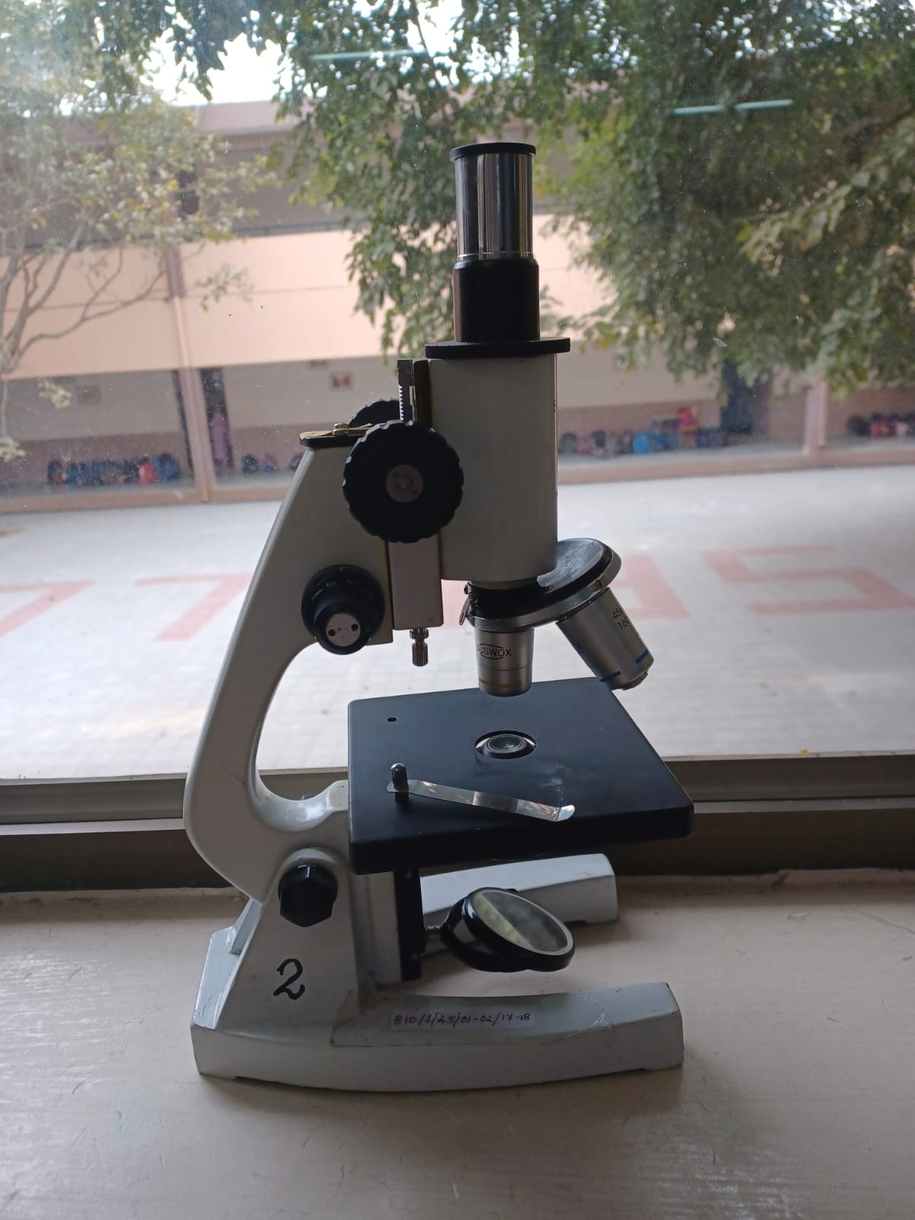
Materials Used for Analysis of Artocarpus heterophyllus
Leaf and stem samples from three different locations.
Microscope
Iodine solution
Soil from site of sample
Ph paper

Slide 10
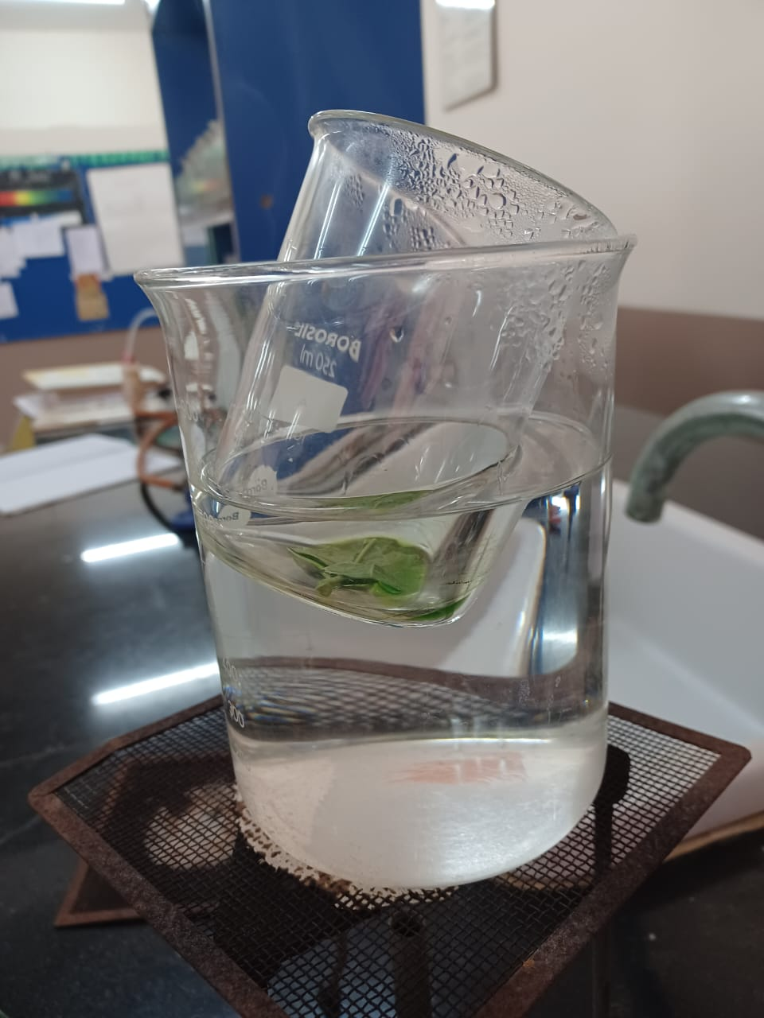
Methods for Analysis of Artocarpus heterophyllus
Preparation of slide on stomatal index
Starch test
Soil pH test
Physiological differences

Slide 11
Geography and Location

Slide 12
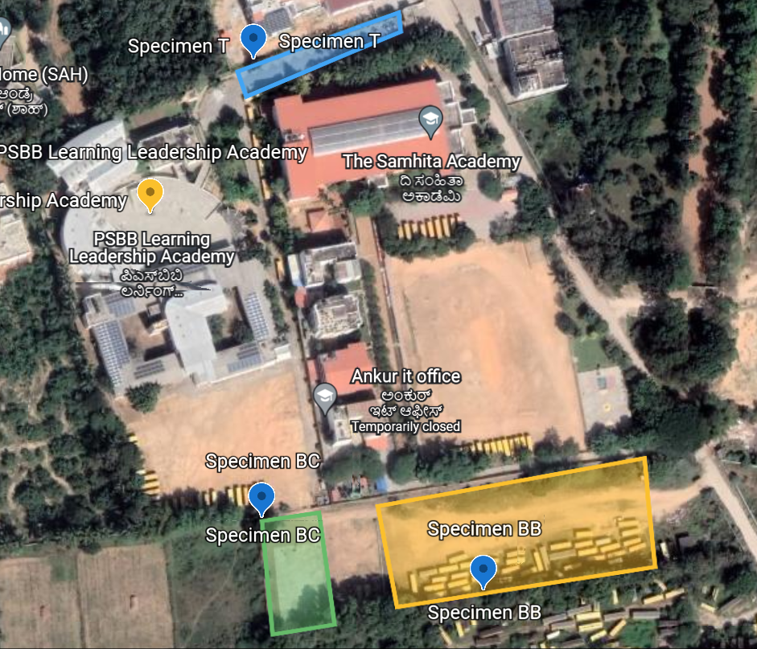
Map of
School Campus

Slide 13
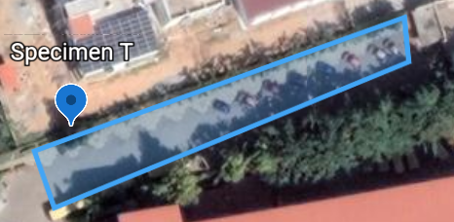
Specimen T
Situated along temple route
Buses are parked near Specimen T with exhaust pipes facing it
Located near multiple warehouses and construction sites

Slide 14
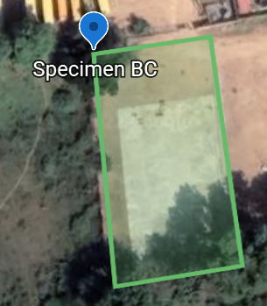
Specimen BC
Situated adjacent to basketball court
Located near the school ground and multiple trees
Surrounded by farms

Slide 15
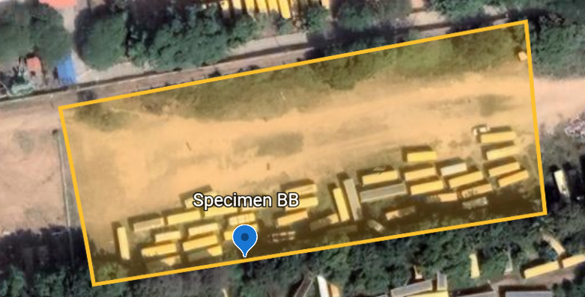
Specimen BB
Situated on boundary of bus bay
Surrounded by multiple trees
Located near many buses

Slide 16
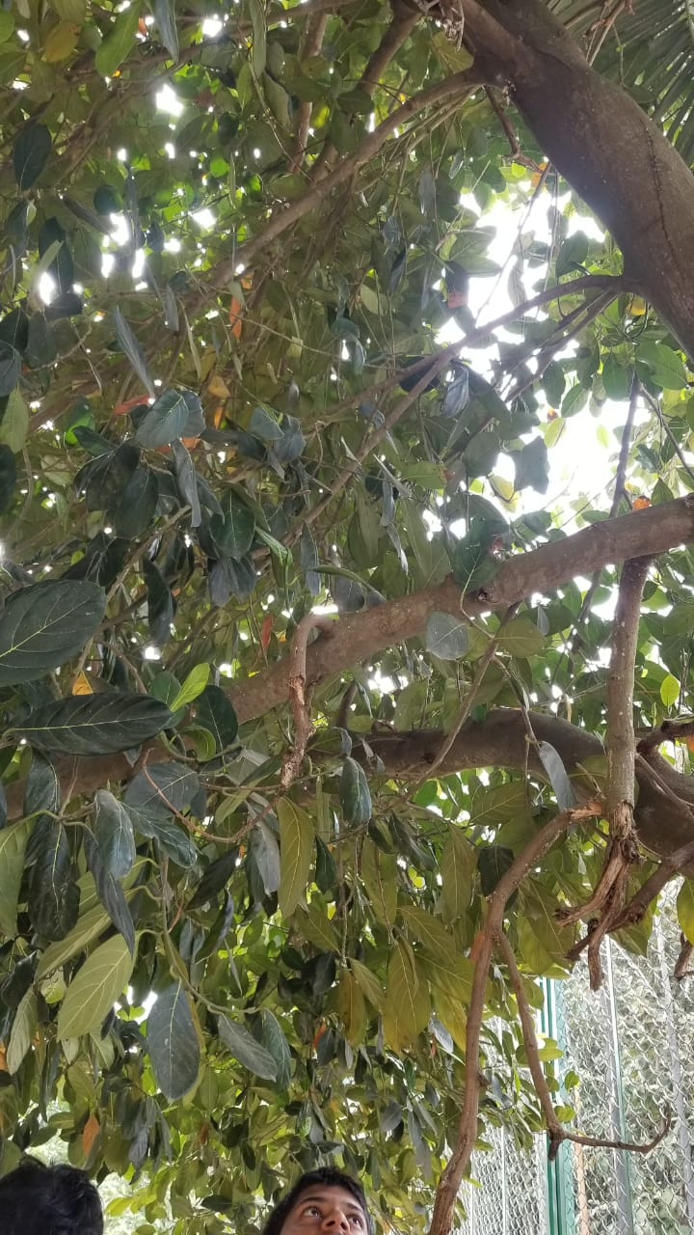
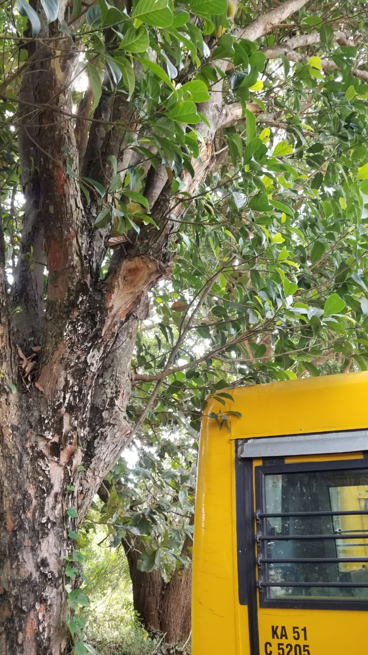
T
BC
BB

Slide 17
Physical Description

Slide 18
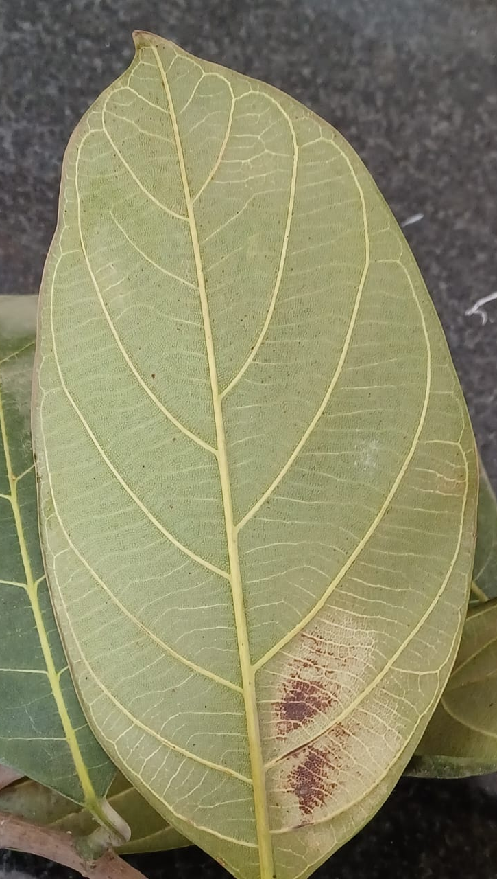
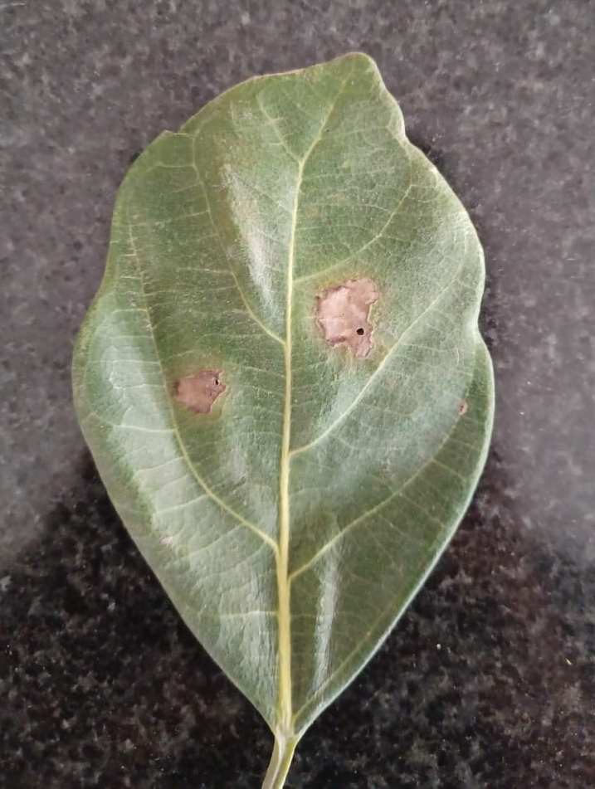
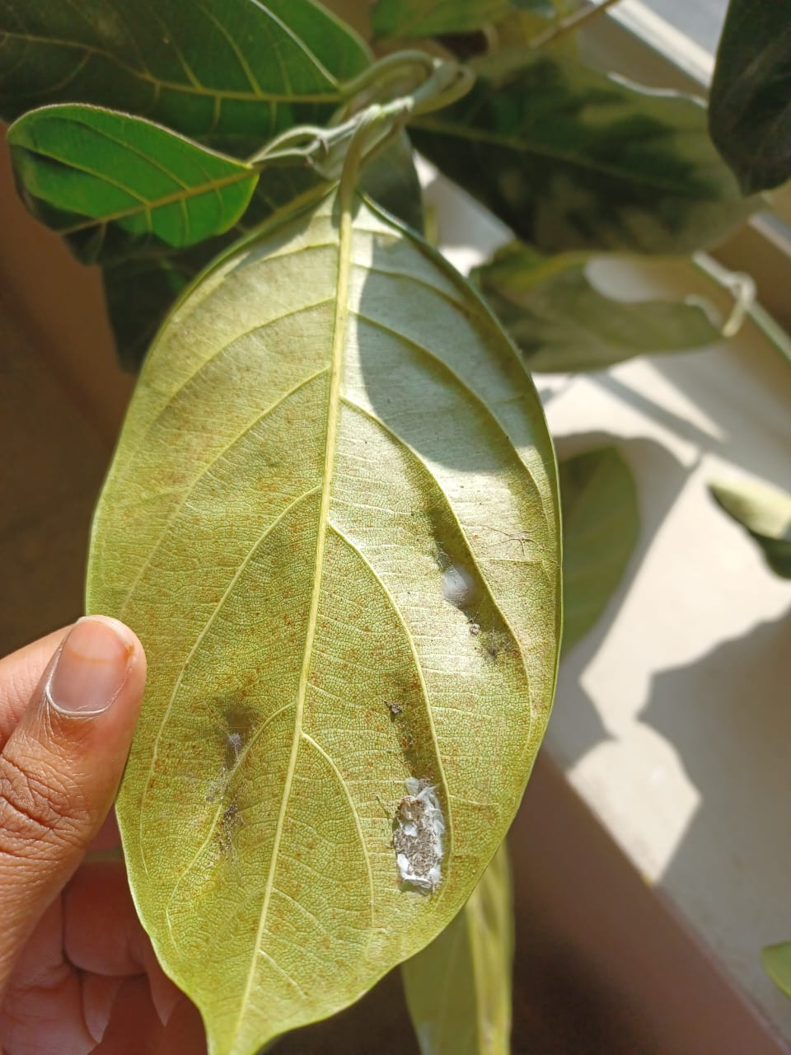
Pictures of specimen T

Slide 19
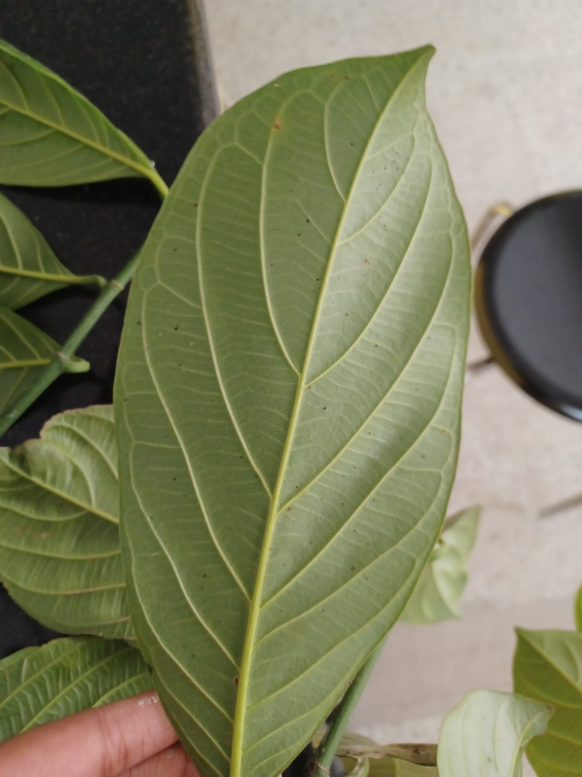
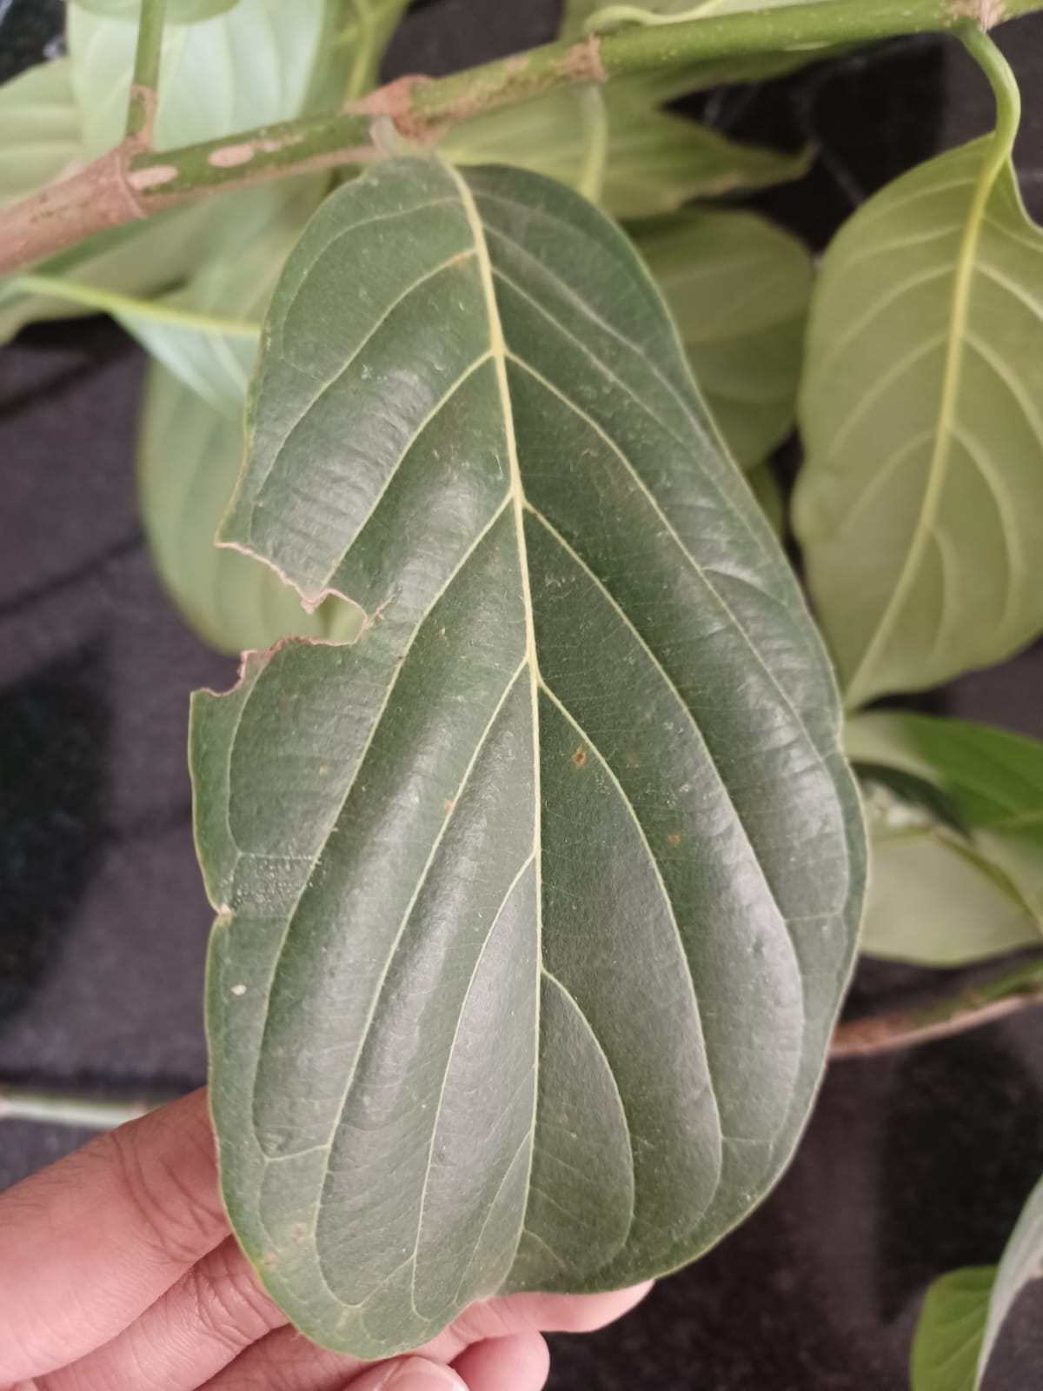
Pictures of specimen BB

Slide 20
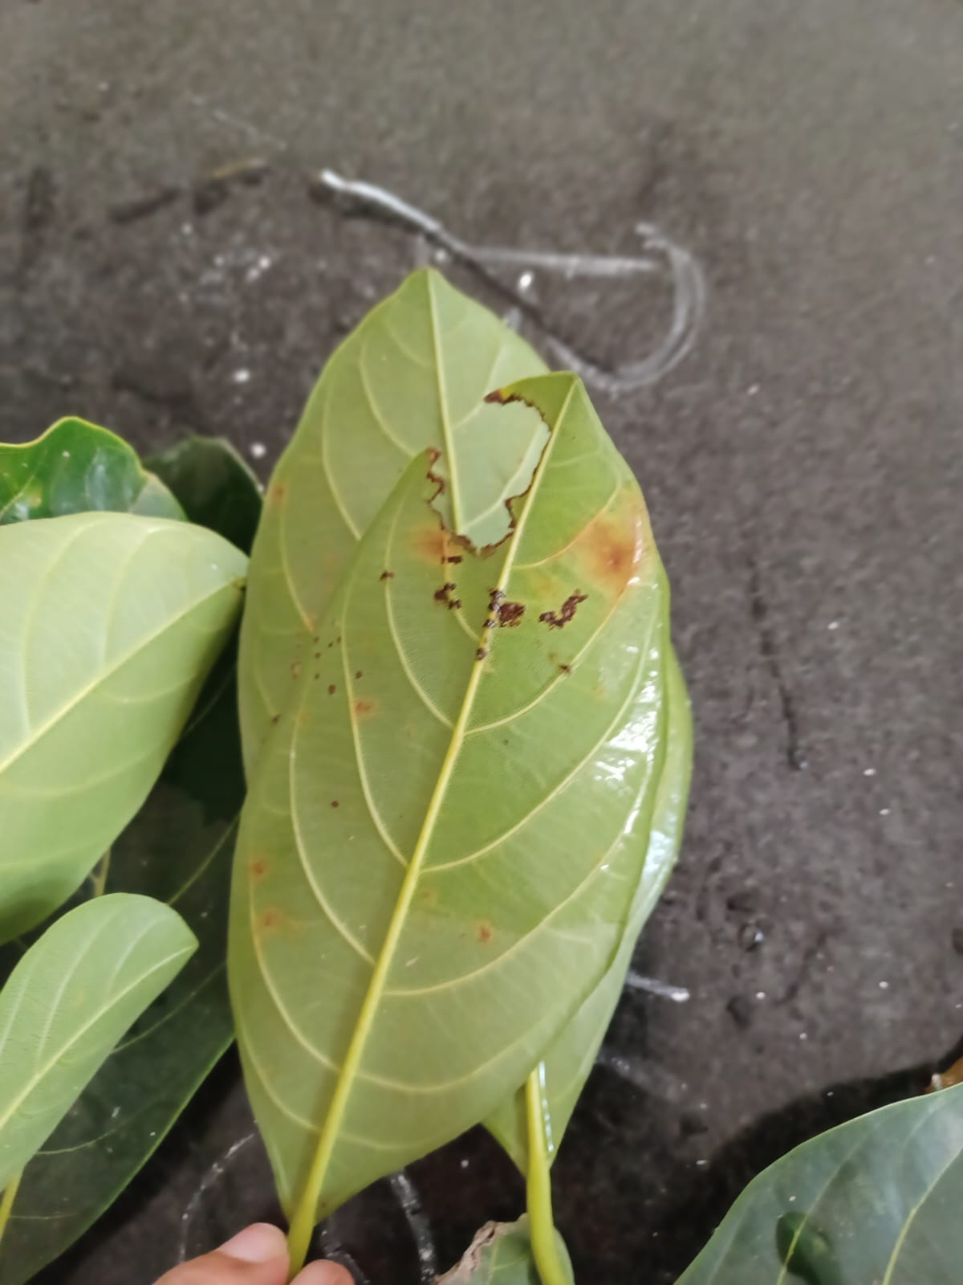
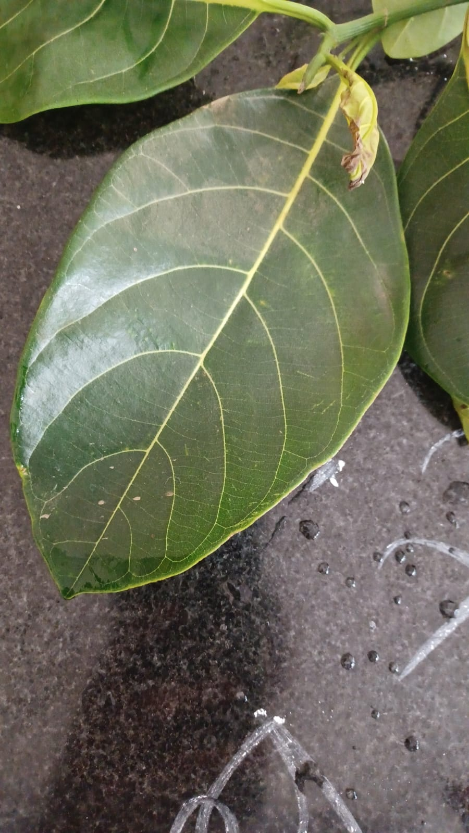
Pictures of specimen BC

Slide 21
Stomata

Slide 22
Method used to observe stomata:
A fresh leaf was taken from each specimen
The leaf was slit and a section was taken from the lower section
This section was set on a glass slide and a drop of glycerine was added
The slide was placed under the microscope and observed

Slide 23
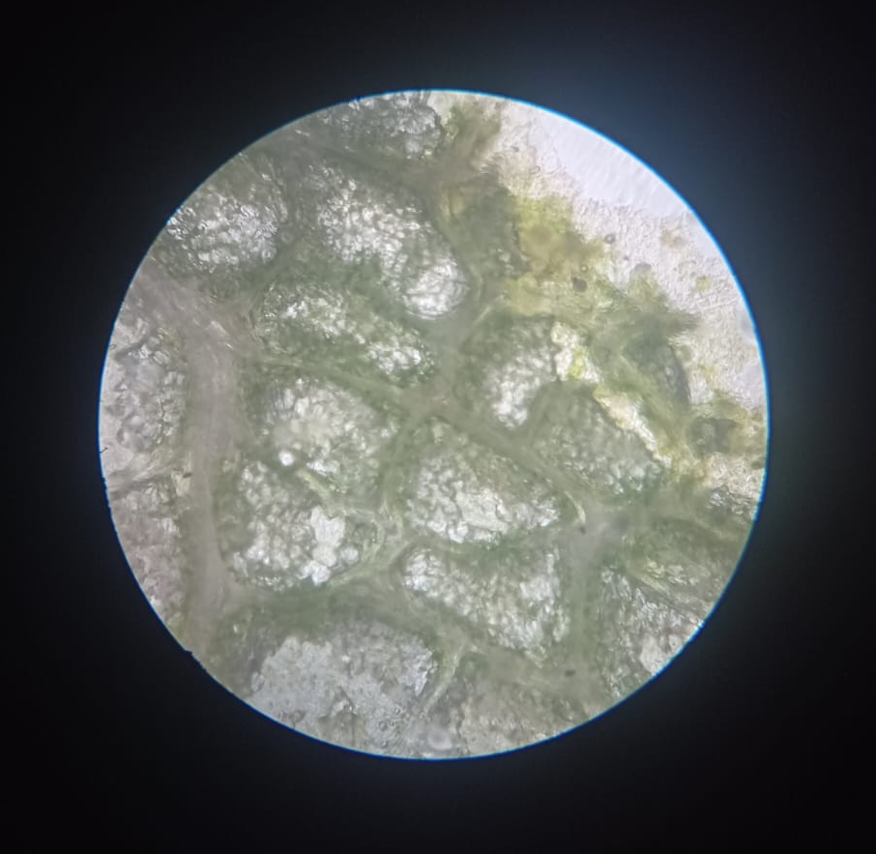
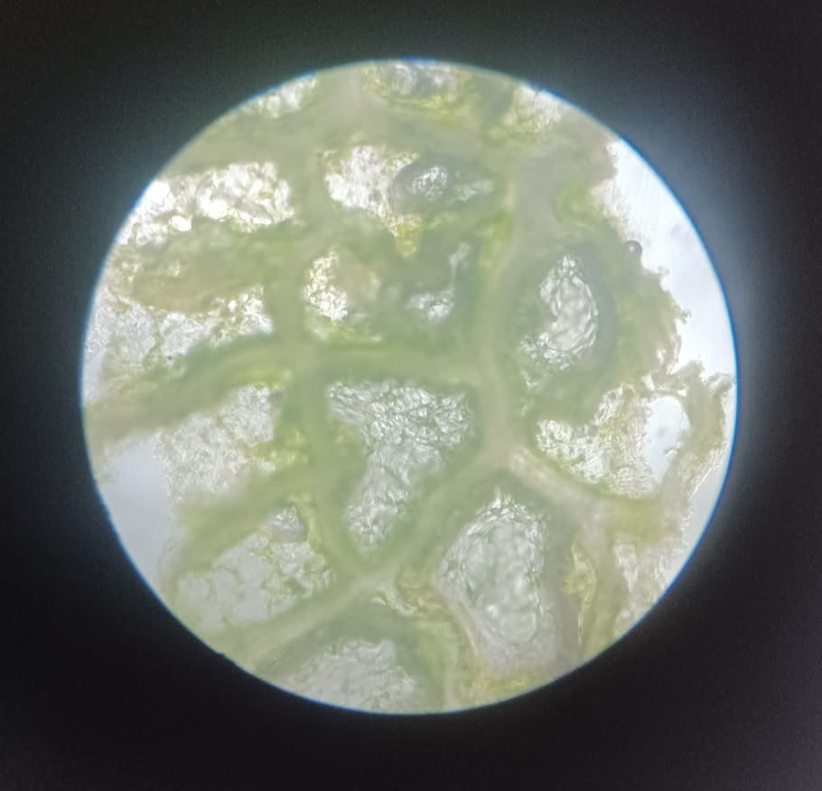
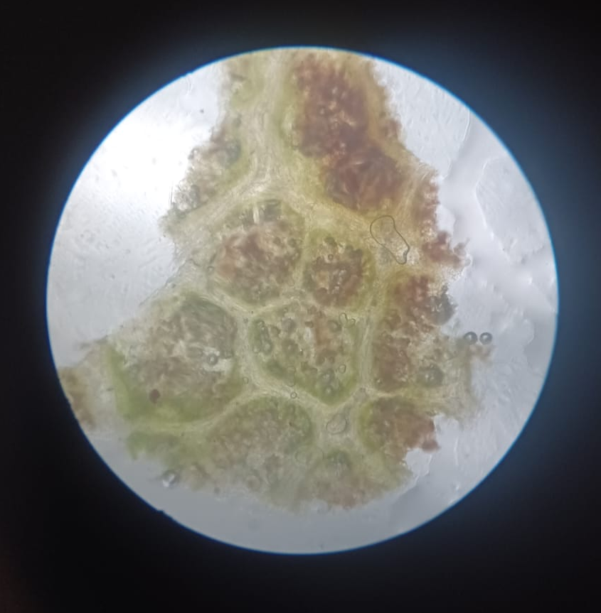
Results
Specimen BB | Specimen BC | Specimen T
No discolouration and no pollution seen in stomata | No discolouration and no pollution seen in stomata | Brown spots are present and stomata is polluted

Slide 24
pH test

Slide 25
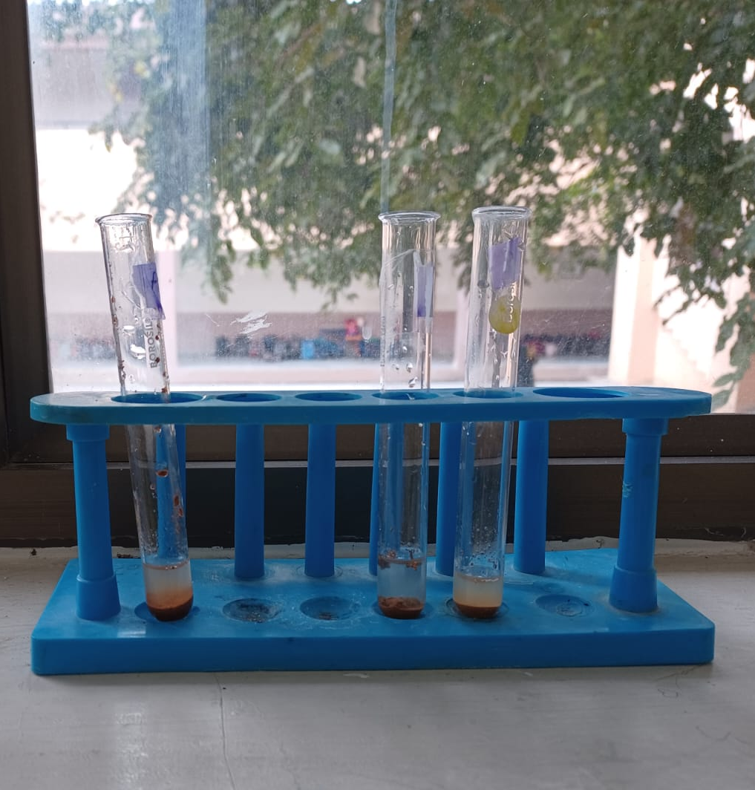
Method used to check pH
Soil samples were collected from all 3 sites of the specimens
The soil samples were mixed with equal amounts of water and left to sediment
A drop of the standing water was taken and tested with pH paper

Slide 26
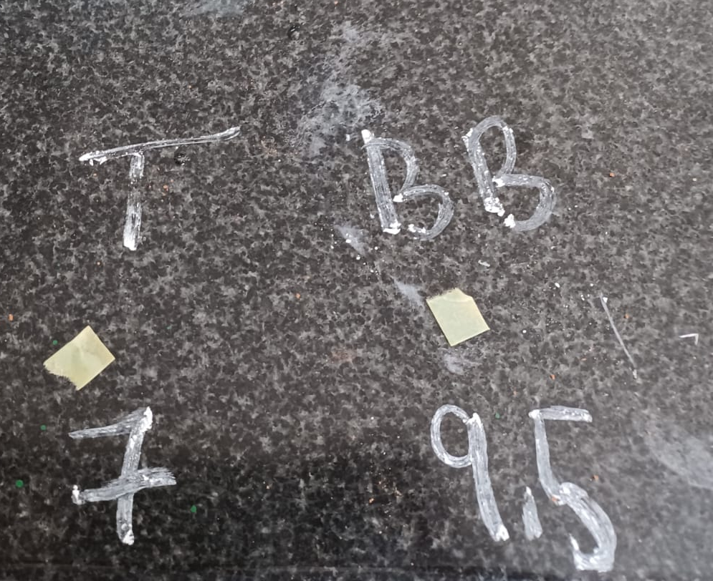
Results
Note: Specimen BB and BC have same soil pH
 | Specimen BB/BC | Specimen T
pH | 9.5 | 7
Remarks | Normal pH of soil in this area | Slightly more acidic than normal pH of soil

Slide 27
Starch Test

Slide 28
Method for starch test
Fresh leaf samples were collected from the 3 sites
The leaves were cleaned and boiled in water to ensure that the cell processes would cease
The samples were then put in boiling ethanol which was in a water bath to dissolve the chlorophyll
The leaves were then washed and rehydrated
Iodine solution was added to the leaves to check for starch

Slide 29

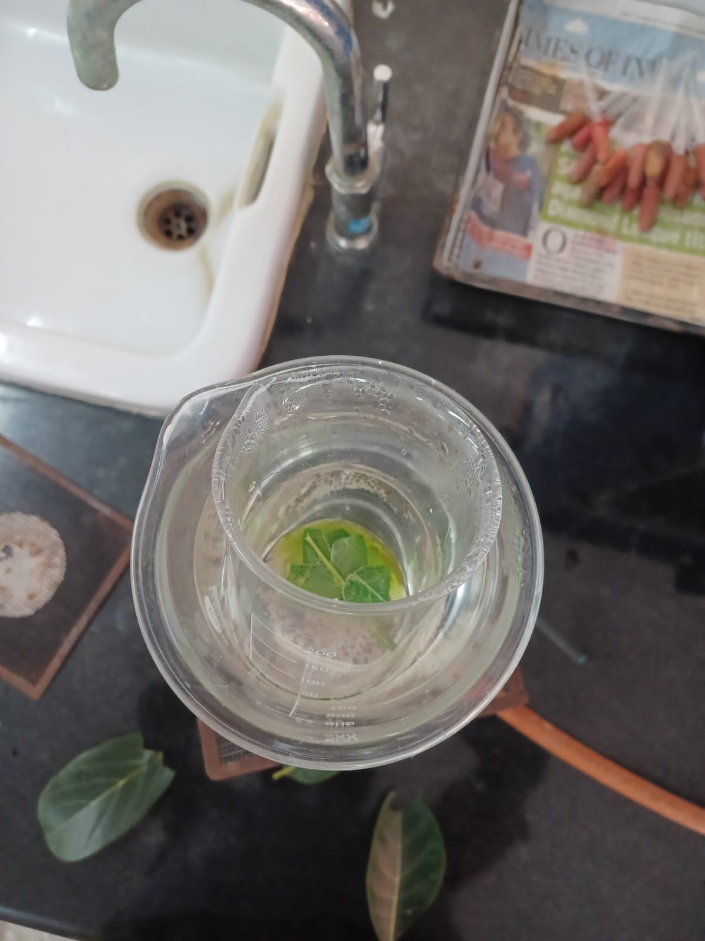
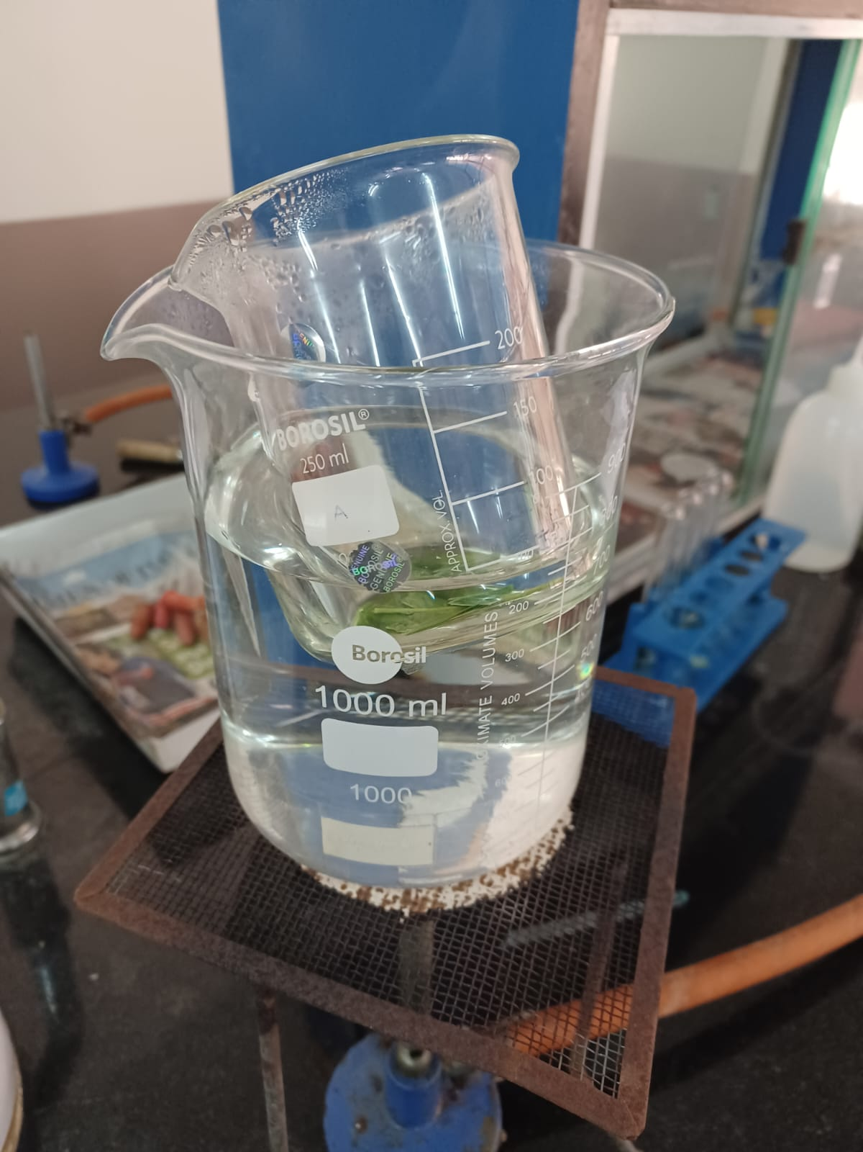
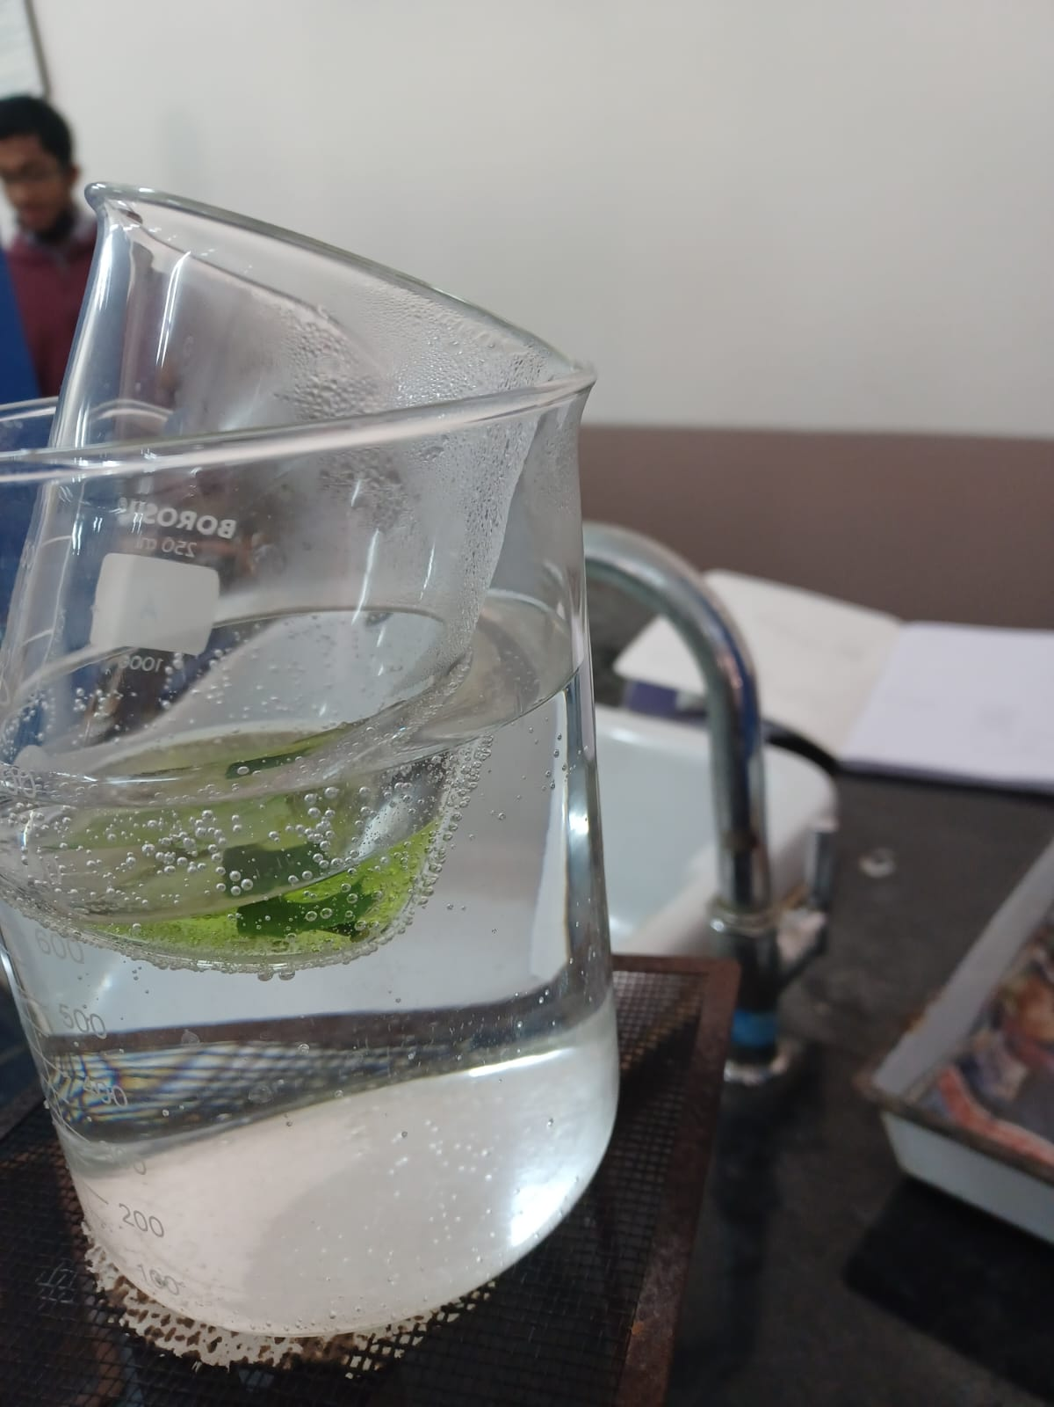
Starch Test

Slide 30
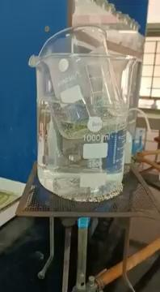
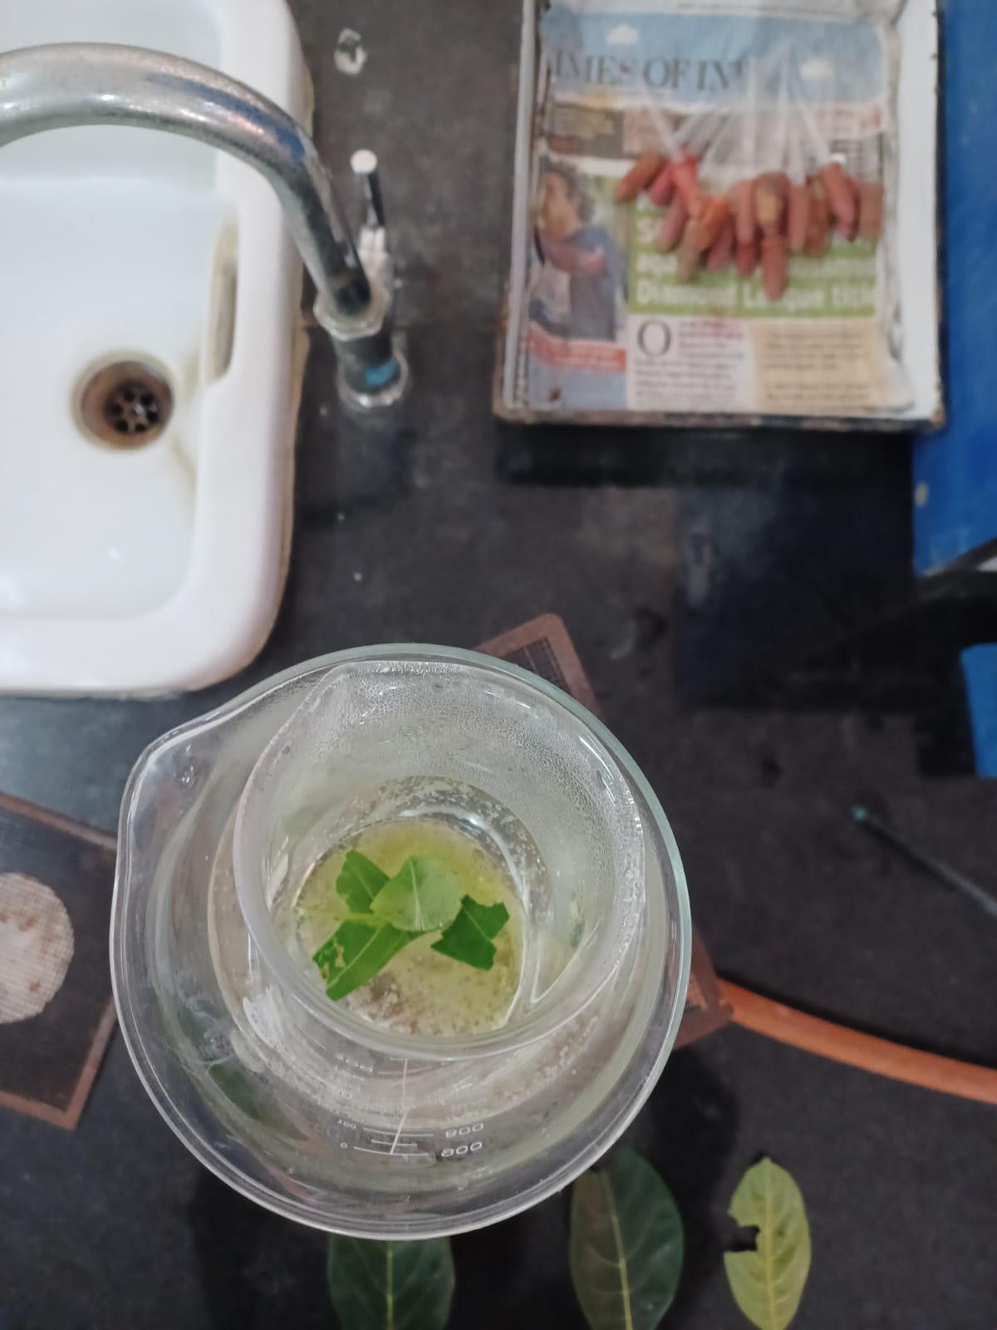
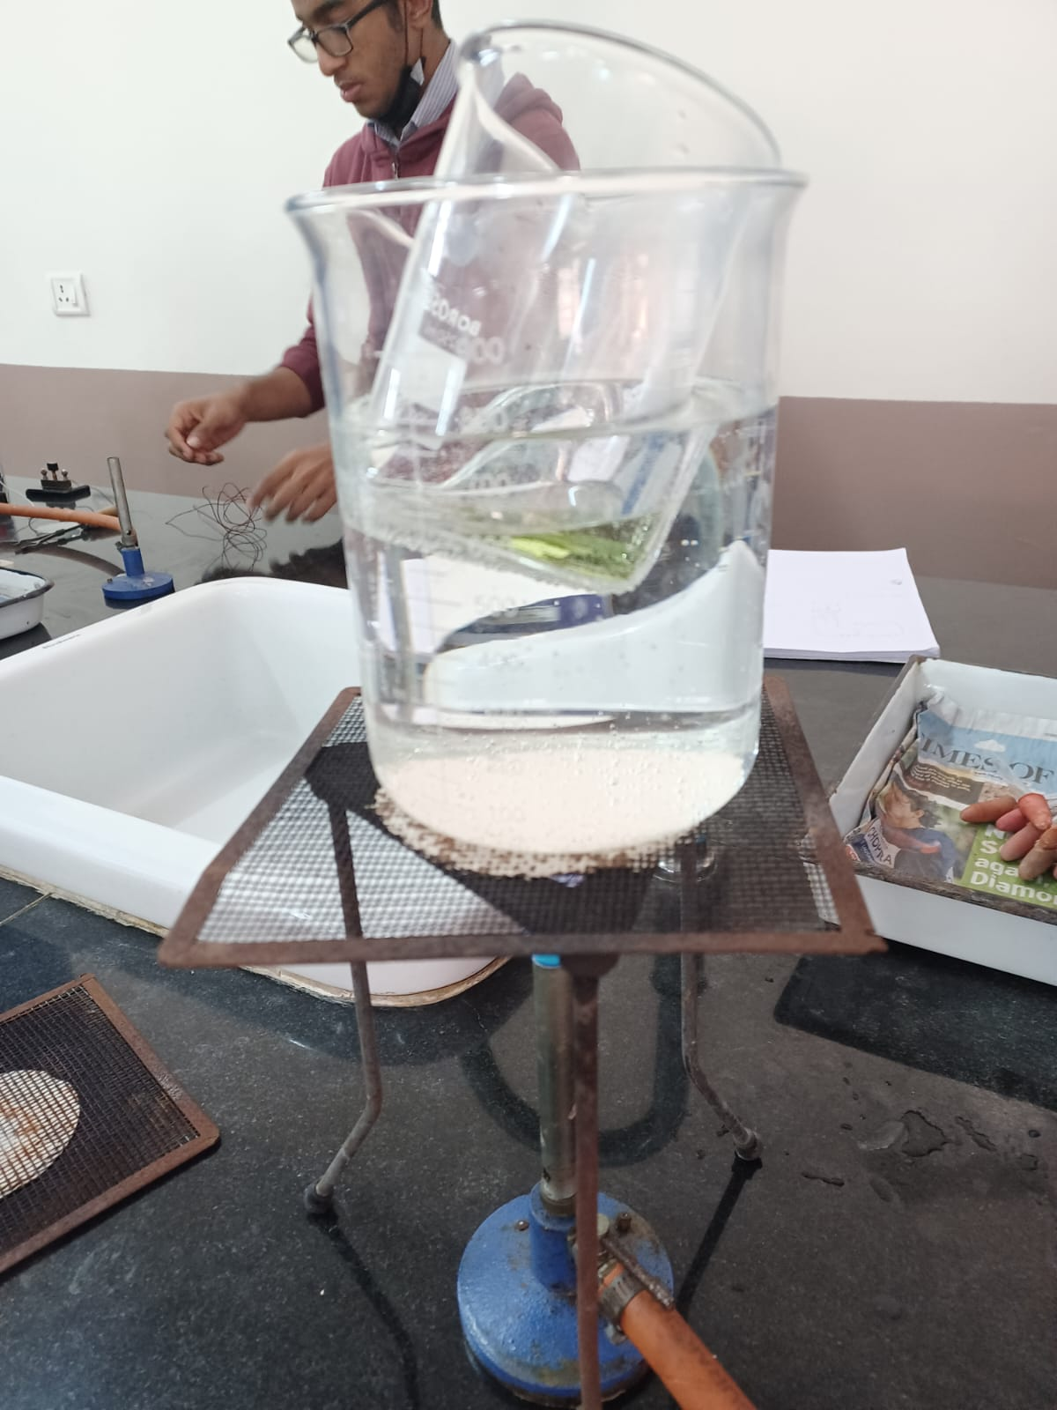
Starch Test

Slide 31
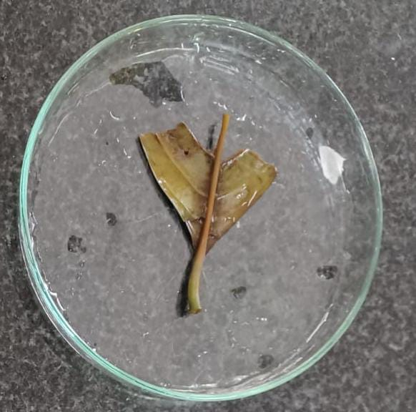
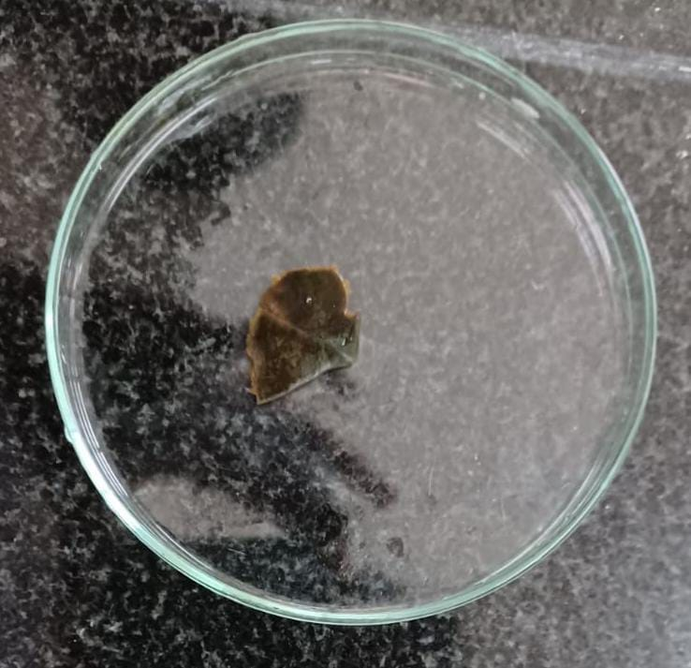
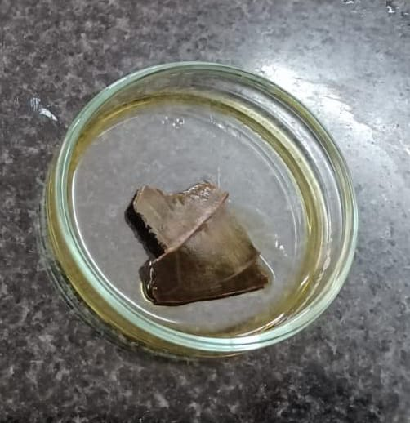
Results
Specimen BB | Specimen BC | Specimen T
Shows least amount of starch | Shows equal amount of starch as specimen T | Shows equal amount of starch as specimen BC

Slide 32
Comparison of the 3 samples

Slide 33
Comparison of results
 | Specimen BC | Specimen BB | Specimen T
Physical description | No discolouration No cement dust | Some discolouration No cement dust | Severe discolouration Coated with cement dust
Site | Well ventilated Not exposed to bus exhaust fumes | Well ventilated Exposed to some bus exhaust fumes | Near construction sites Exposed to large amount of bus exhaust fumes
Stomata | Healthiest Clean | Clean | Showed brown spots Clearly polluted & damaged
Starch | Equal amount of starch as specimen T | Least amount of starch | Equal amount of starch as specimen BC
pH | Around 9.5 | Around 9.5 | Around 7 More acidic than other specimens

Slide 34
Case Study-
Syngonium podophyllum

Slide 35
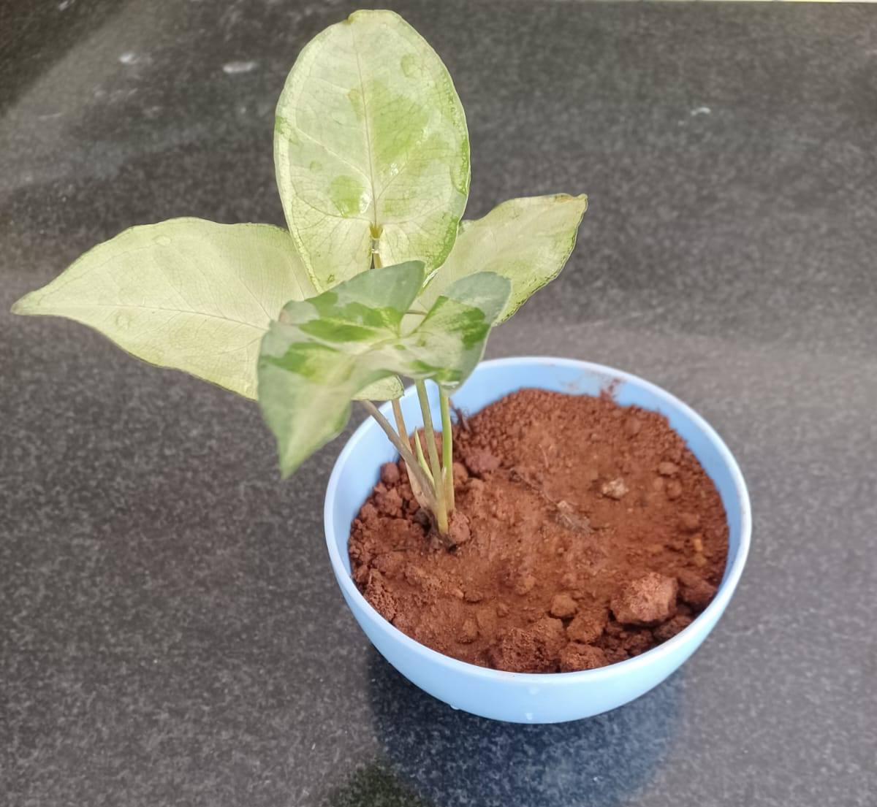
Syngonium podophyllum
Syngonium podophyllum is the scientific name of arrowhead vine.
It climbs a few metres tall over trees of tropical jungles.
Cultivated indoors, reaches about 1.5 metres.
Leaves are arrow-shaped and upto 30 centimeters long.
Its flowers are small, whitish or greenish on spadices within light-yellow through green spathes.

Slide 36
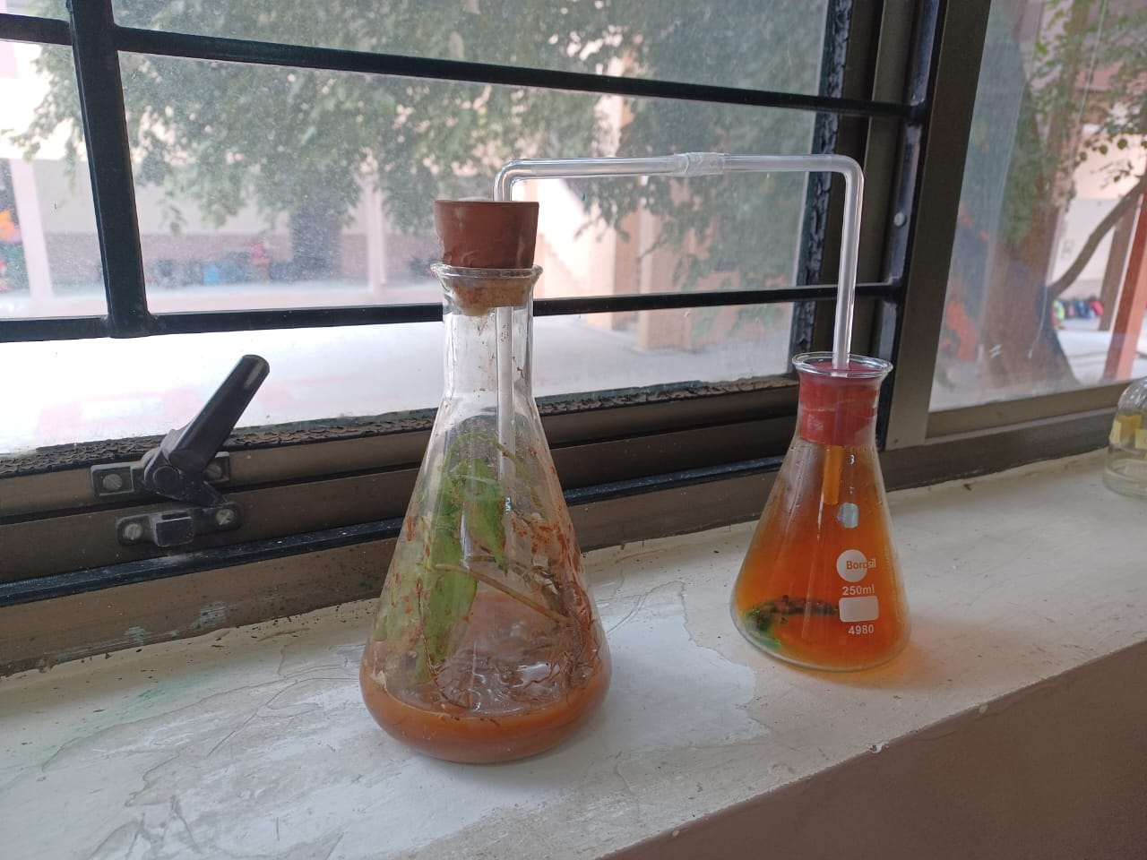
Materials Used for Analysis of Syngonium podophyllum
Two specimens of Syngonium podophyllum of similar physiological features.
Conical flask
Copper strips
Concentrated nitric acid
U-tube
Bell jar

Slide 37
Method for Analysis of Syngonium podophyllum
Done by preparation of nitrogen dioxide in a container, transferring NO₂ to an another container with the plant inside it through an U- tube.
NO₂ was prepared by adding nitric acid(HNO₃) to copper metal turnings in the first container. Brown fumes of nitrogen dioxide evolved which was transferred by the U tube.
The plant was kept in container 2 for a few days to study the effects of nitrogen dioxide on the plant’s behaviour.

Slide 38
Tests done on Syngonium podophyllum
Serial Number | Tests done after subjecting plant to NO₂ | Results
1 | Physical appearance | Discolouration
2 | Appearance of leaf under microscope | Dark veins in plant leaf
3 | Appearance of Stomata | Dark, black spots

Slide 39
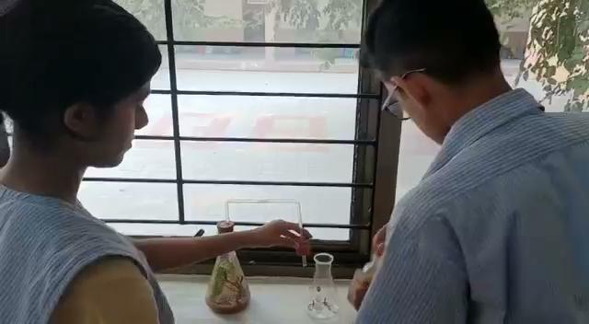
Subjecting Syngonium podophyllum to NO₂

Slide 40
Comparison of Leaves

Slide 41
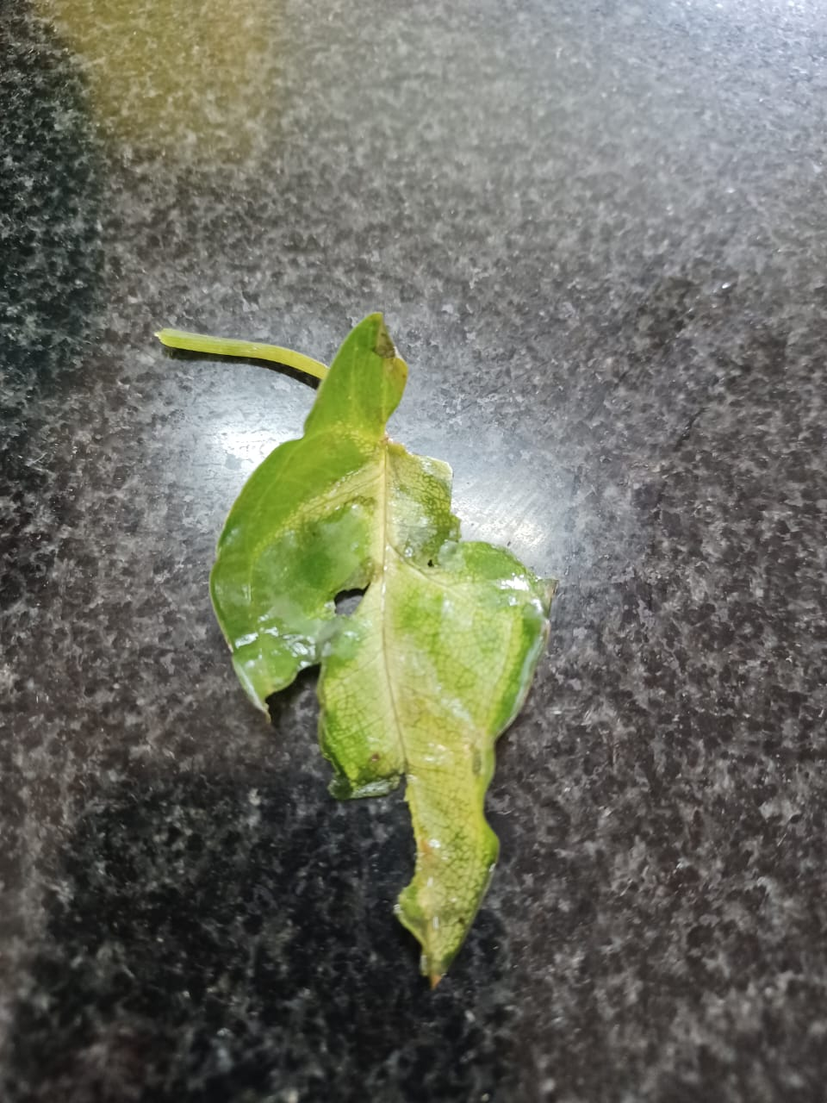
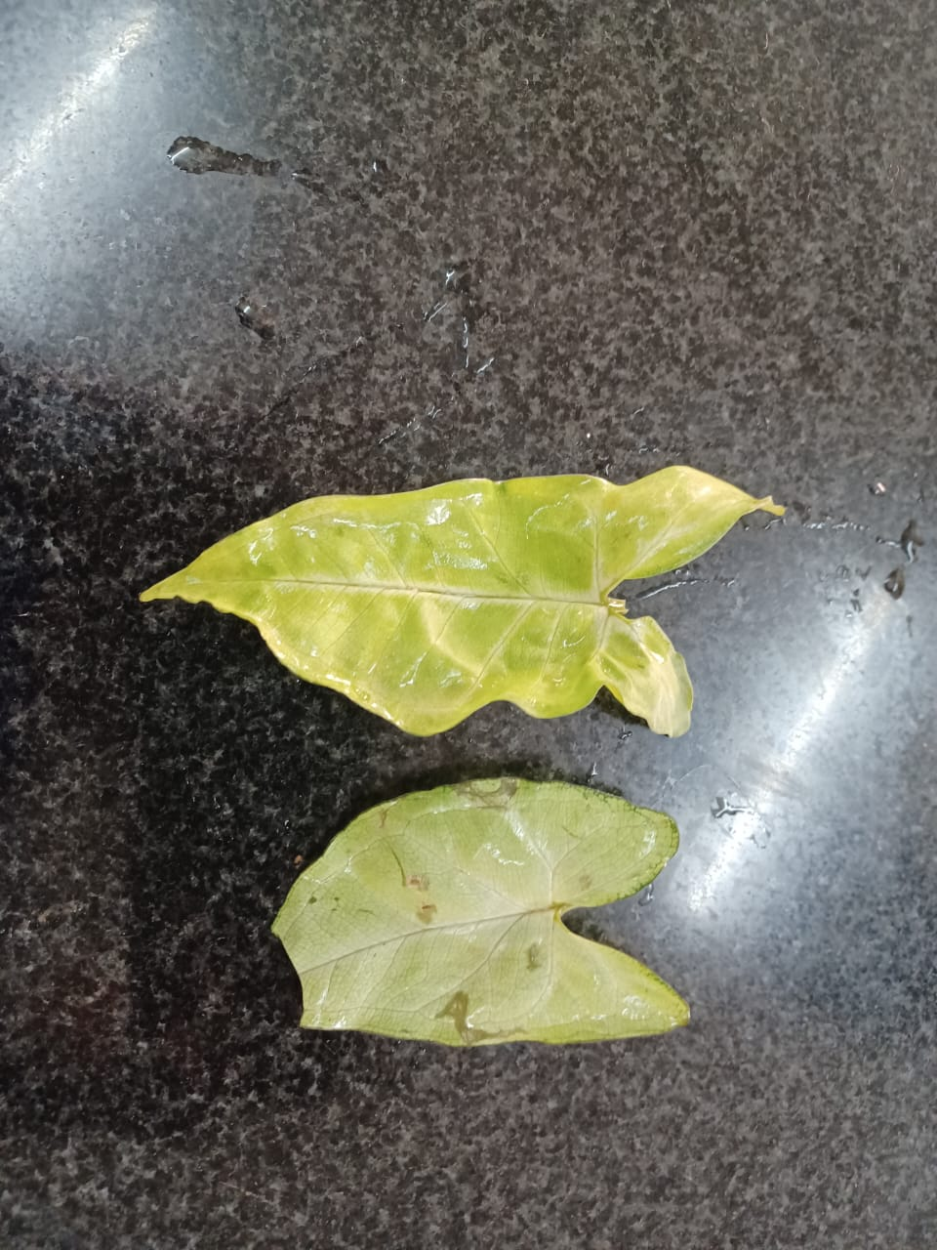
Comparison of Leaves
Normal Environment | Subjected to NO₂
No discolouration No lesions | Spots visible on leaf Stomata are clogged by NO₂ Slight discolouration

Slide 42
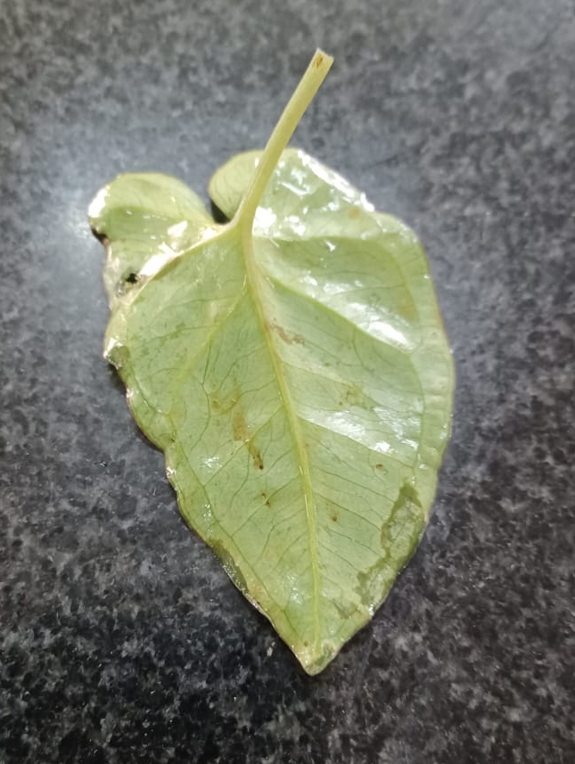
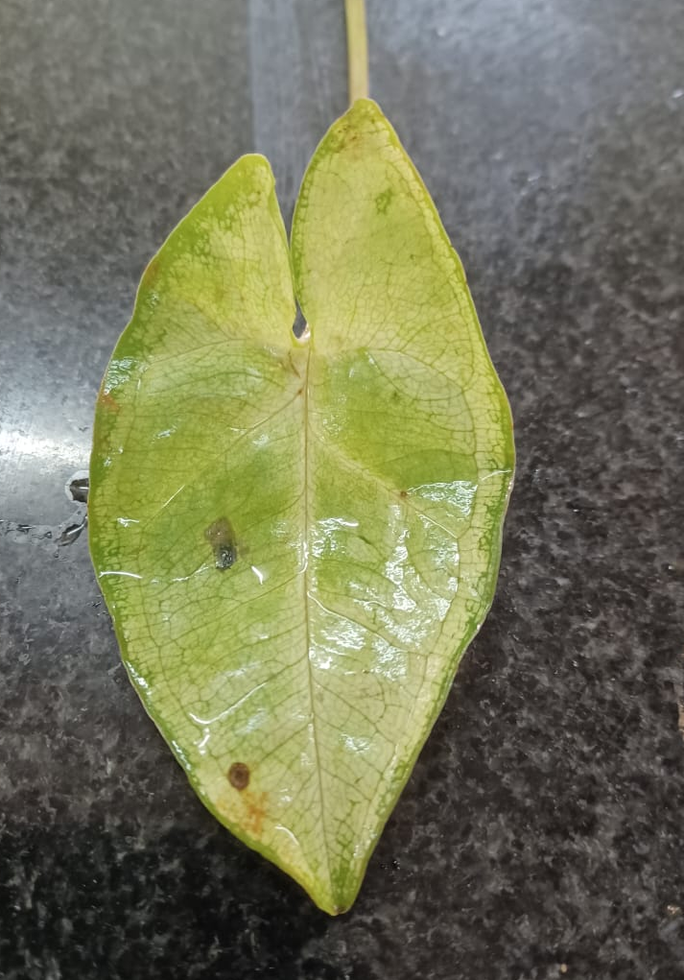
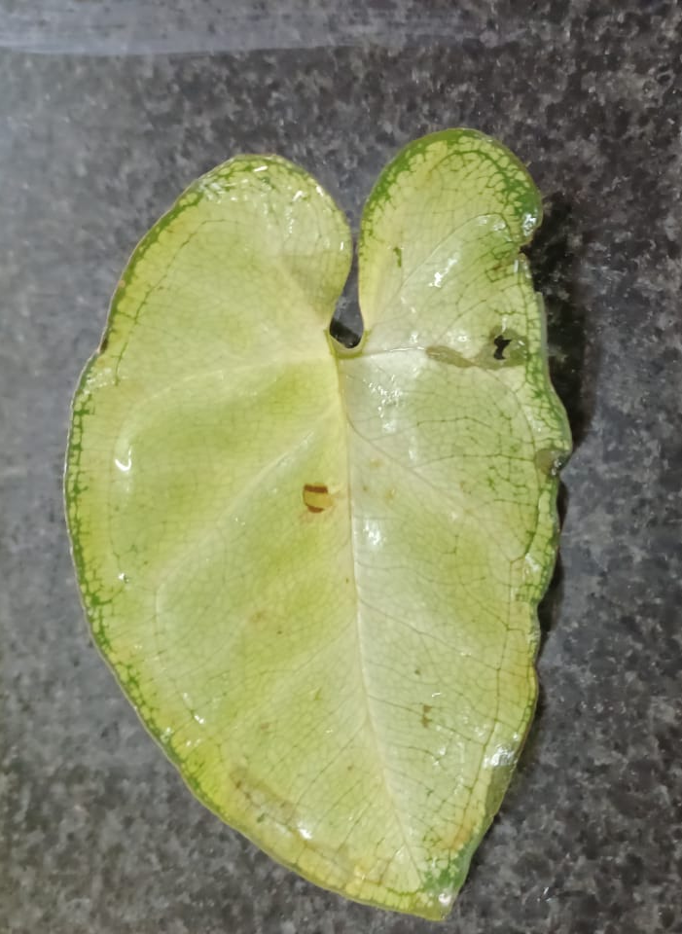
Discolouration seen on leaves of plant subjected to NO₂

Slide 43
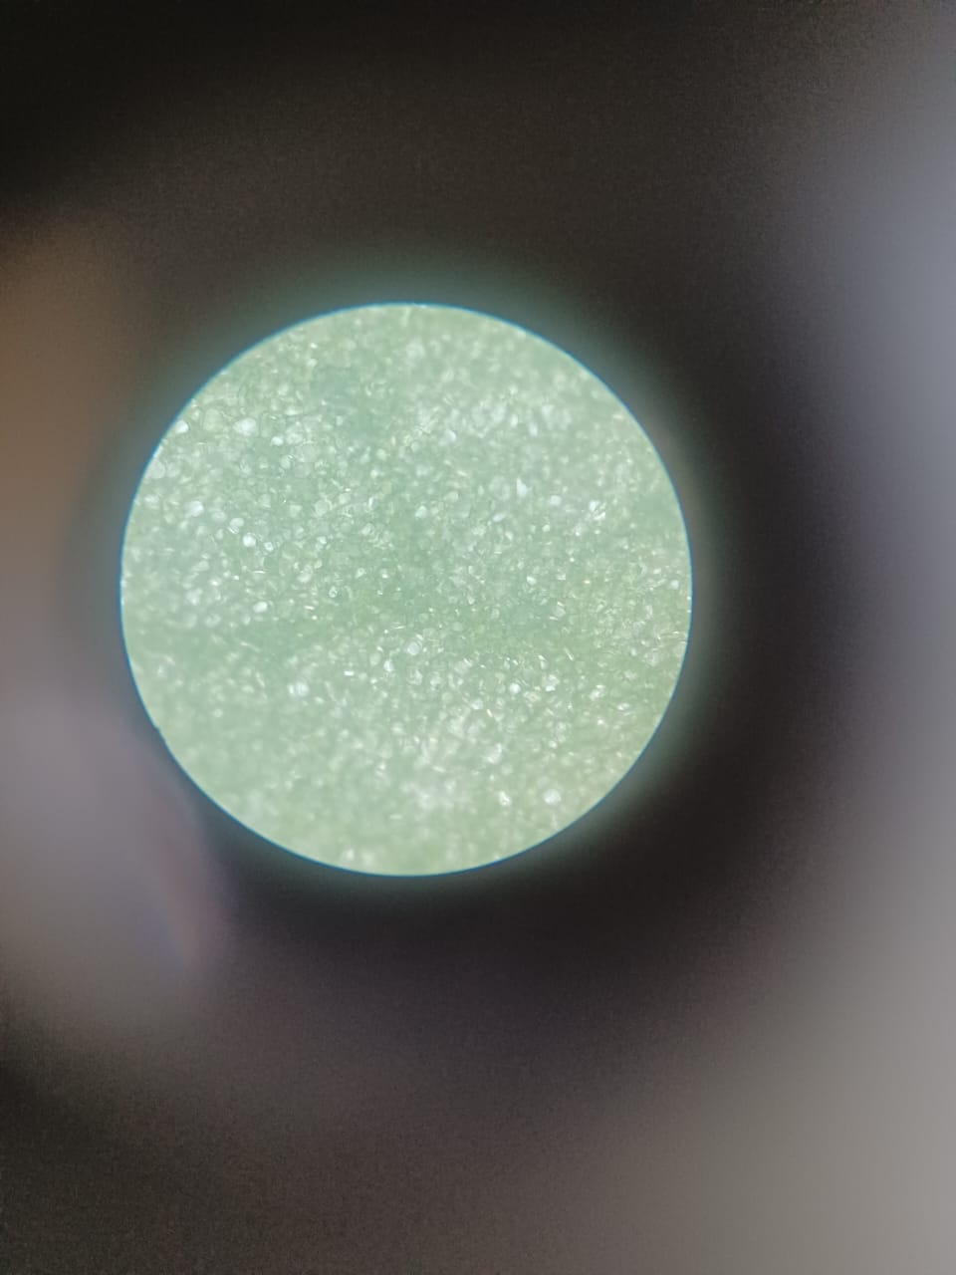
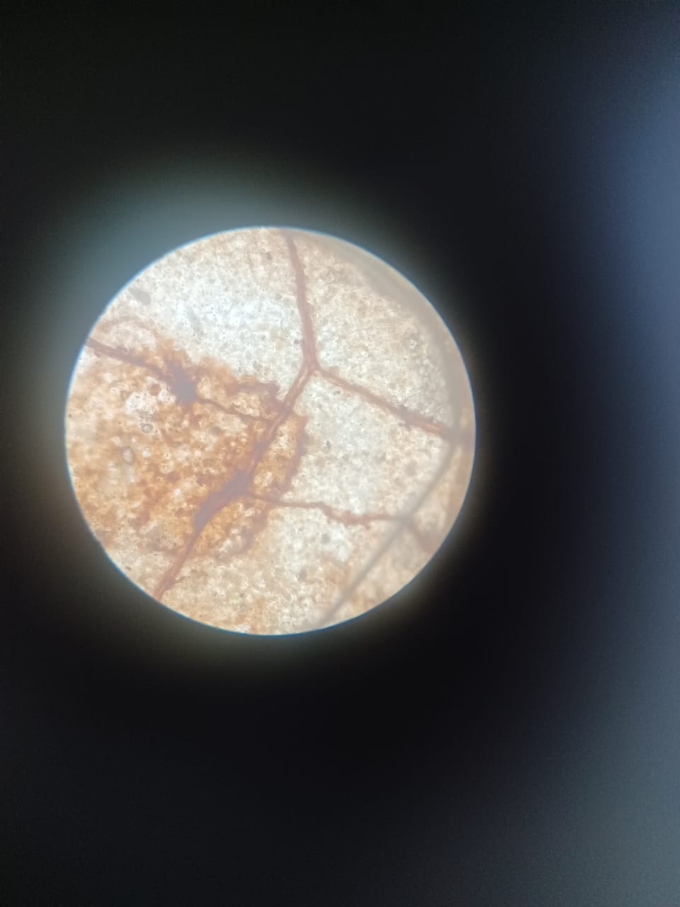
Comparison of Leaves under Microscope
Normal Environment | Subjected to NO₂
No pollution seen No brown spots No dark lines | Covered by dark brown spots Dark brown lines visible

Slide 44
Stomata

Slide 45
Method of observing stomata
A fresh leaf was taken from each specimen
The leaf was slit and a section was taken from the lower section
This section was set on a glass slide and a drop of glycerine was added
The slide was placed under the microscope and observed

Slide 46
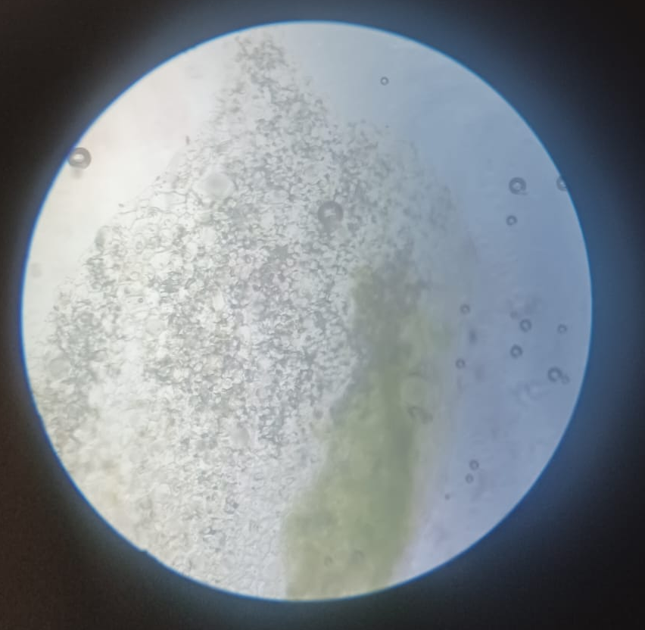
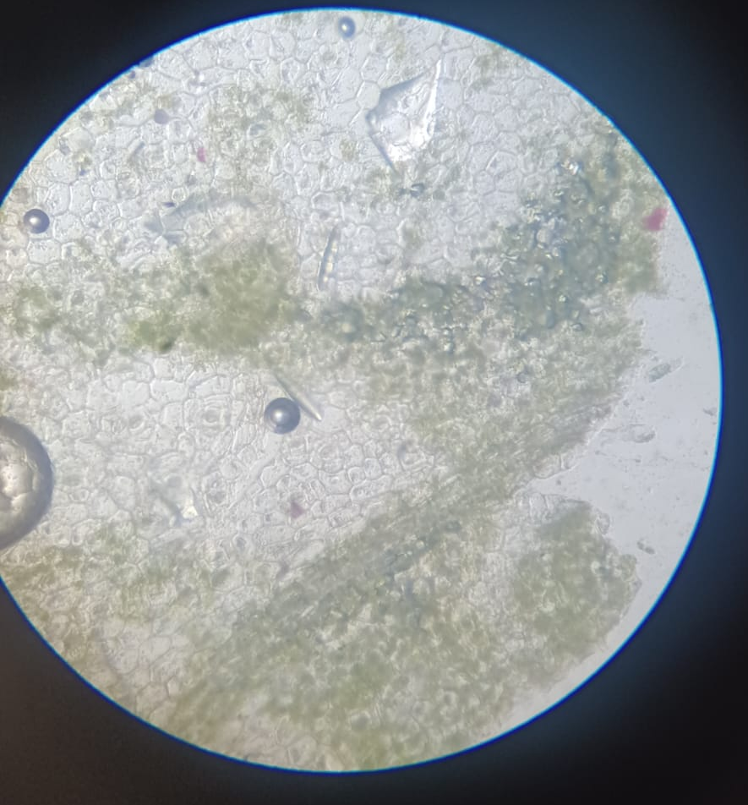
Results
Normal Environment | Subjected to NO₂
Black spots and lines are observed | Stomata are cleaner and appear greener

Slide 47
Conclusion

Slide 48
Results and Discussion
We can conclude that NO₂ does have detrimental effects on plants as we have observed consistent leaf injury, discolouration and stomatal damage in our experiments
In our case study of Artocarpus heterophyllus, specimen BC appeared the healthiest and it was the farthest away from exhaust fumes and pollution
In our case study of Syngonium podophyllum, the specimen subjected to NO₂ had clear damage even though it was exposed to NO₂ for a short period of time

Slide 49
Effects of NO₂ on Plants
Leaf Injury
Stomatal damage
Discolouration of leaves
Affects photosynthesis

Slide 50
Recommendations
Main cause of NO₂ emissions is burning of fossil fuels in vehicles.
Use of public transport by majority of the population can reduce the emission of NO₂
Shifting to electricity powered vehicles will also help in stopping the emission of NO₂

Slide 51
Bibliography
Effects of nitrogen dioxide on human health: Systematic review of experimental and epidemiological studies conducted between 2002 and 2006
Sensitivity study of plant species due to traffic emitted air pollutants (NO2 and PM2.5) during different seasons in Dhaka, Bangladesh

Slide 52
The Effects of Air Pollutants on Vegetation and the Role of Vegetation in Reducing Atmospheric Pollution
Disturbances in stomatal behaviour caused by air pollutants
Gaseous NO2 effects on stomatal behavior, photosynthesis and respiration of hybrid poplar leaves

Slide 53
Acknowledgements
We would like to thank our school, PSBB LLA and our esteemed principal for giving us an opportunity to participate in this conference as well as providing us with the necessary lab facilities.
In particular, we would like to thank the teachers-in-charge for their valuable input and guidance. We would like to thank our classmate Avaneesh for his significant contributions to this project.
Last but not the least, we would like to thank IISc for all that we learnt, and all the fun we had while working on this project.

Slide 54
Thank You

