Slide 1
A comparative study on sarakki lake , begur lake and konnankunte lake: water quality and bird population
Samiksha Jain VIIA
Shrimayee Kashyap VIIA

Slide 2
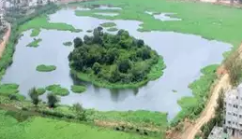
SARAKKI LAKE INTRODUCTION
Situated in the J.P nagar ,puttenhalli main road.
In kannada language the meaning turns out to be ‘A THOUSAND BIRDS’.
According to BBMP, the lake has a perimeter of 3.5 kms’
Area of the lake is around 84 acres.
34 acres were encroached by private builders and other establishments in 2013.in august 2014 the case filed by people for “right to water” ordered the clearing of encroachment.

Slide 3
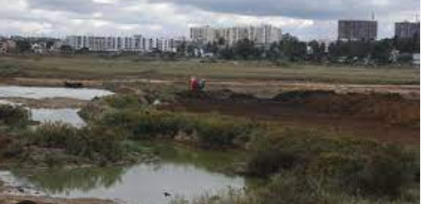
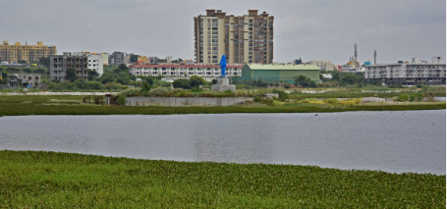
BEGUR LAKE INTRODUCTION
Situated on begur road , karnataka.
There is a statue at the centre of the lake.
The perimeter of this lake is 4.4 kilometres.
The area of the lake is 113.66 acres.
The lake is covered by 50 -60% of algal and other organism growth

Slide 4
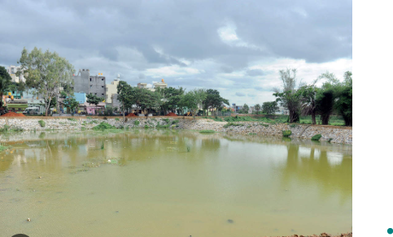
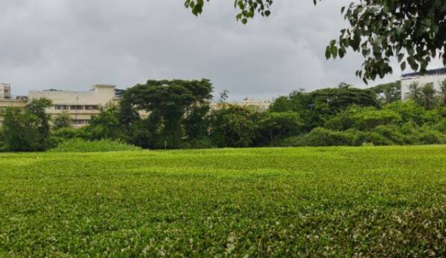
KONNANKUNTE LAKE INTRODUCTION
This lake is unknown to most people .
It is present on the konnankunte area.
It has a perimeter of 1.14 kilometres.
Area of 15.13 acres
Most of the land has been encroached by roads , a school and a graveyard.

Slide 5
OBJECTIVES:
To study the water quality of three different lakes.
To compare the water quality with bird population.
To increase the species diversity especially birds.

Slide 6
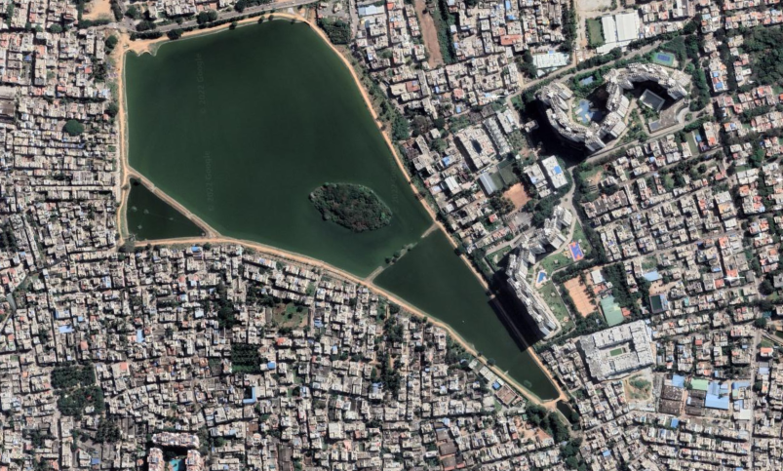
Study area: sarakki lake (mapping)
E
12.8994° N, 77.5799° E
N
S
W

Slide 7
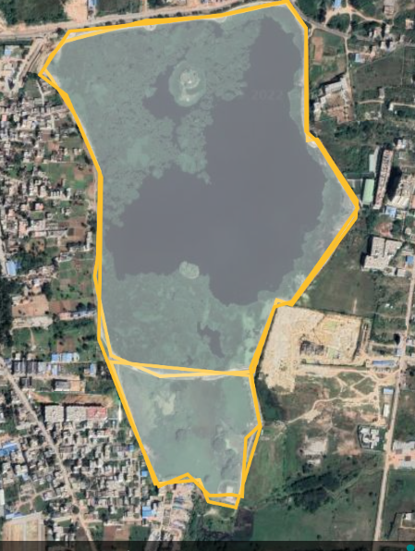
Study area: begur lake (mapping)
N
76° 40' 15.6468'' E
W
E
S

Slide 8
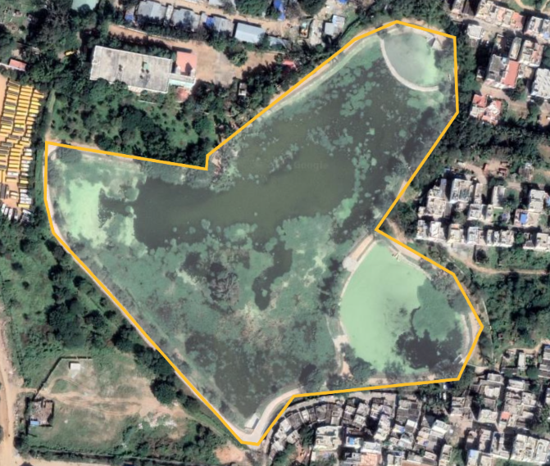
Study area: konnankunte lake (mapping)
N
12.8819° N, 77.5616° E
W
E
S

Slide 9
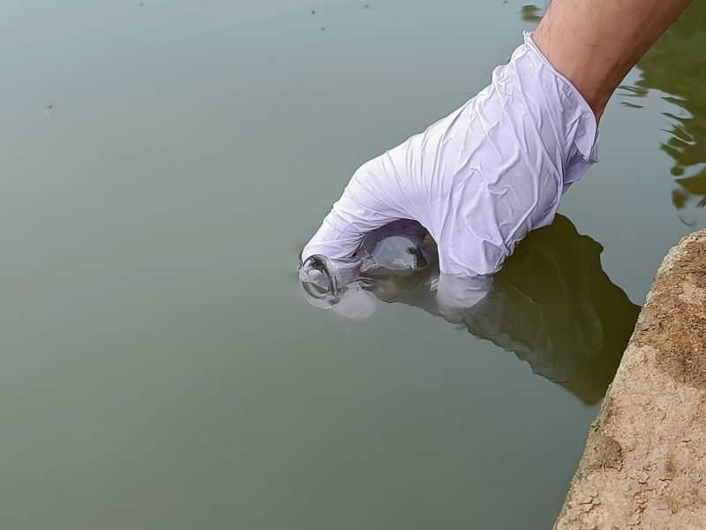
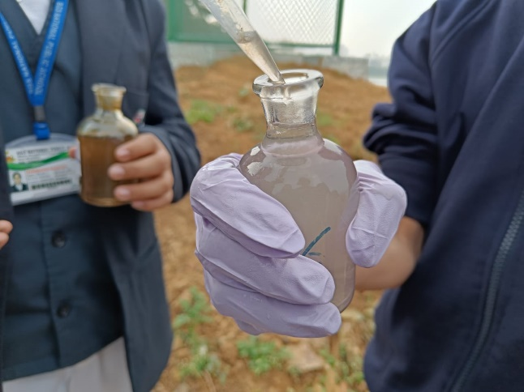
SAMPLE COLLECTION:

Slide 10
MATERIALS AND METHODS
MATERIALS | METHODS
MnSO4 solution, alkaline potassium iodide solution, starch indicator,Na2S2O2, | Checking dissolved oxygen of the lake water(Winkler’s Method)
BOD bottles, pipette | Water sample collection
pH paper | For checking pH of water
Thermometer | For checking temperature
NH4Cl,NH4OH,EDTA,MgSO4,EBT,NaCl | For checking total hardness
NaOH,murexide,NaCl,EDTA | For checking calcium hardness
H2SO4,Phenolphthalien,Methyl orange | For checking alkalinity

Slide 11
Water analysis
parameters | Sarakki lake | Begur lake | Konnankunte lake
TEMPERATURE | 24º C | 25º C | 23º C
pH | 7[NEUTRAL] | 7[NEUTRAL] | 7[NEUTRAL]
DISSOLVED OXYGEN | 9.5 mg/L [good water] | 4.3mg/L[heavily polluted water] | Not tested
ALKALINITY | 12mg/L | 8mg/L | 8mg/L
TOTAL HARDNESS | 136mg/L | 212mg/L | 104mg/L
CALCIUM HARDNESS | 48mg/L | 49.6mg/L | 33.66mg/L
MAGNESIUM HARDNESS | 124mg/L | 199mg/L | 95.8mg/L

Slide 12
BIRD SPECIES OF SARAKKI LAKE
Sl.no | Common name | Number | Scientific name | Activity of the bird | Eating habit
1 . | Great cormorant | 36 | Phalacrocorax carbo | Flying/swimming | Piscivorous
2. | Wire-tailed swallow | 15 | Hirundo smithii | flying | Insectivores
3. | Barn swallow | 15 | Hirundo rustica | flying | insectivores
4. | Spot-billed pelican | 4 | Pelecanus philippensis | Floating on water | Piscivoures
5. | Indian pond hero | 11 | Ardeola grayii | Waiting for fish near the outlet | Piscivoures
6. | Brahminy kite | 6 | Haliastur indus | flying | Avivoures
7. | Black kite | 8 | Milvus migrans | flying | avivoures

Slide 13
BIRD SPECIES OF SARAKKI LAKE
8. | Grey heron | 3 | Ardea cinerea | flying | Piscivoures
9. | Little egret | 7 | Egretta garzetta | flying | carnivoures
10. | White-throated kingfisher | 1 | Halcyon smyrnensis | flying | Avivoures
11. | White-browed wagtail | 1 | Motacilla maderaspatensis | flying | Insectivoures
12. | Great tit | 1 | Parus major | flying | Insectivoures
13. | Pale-billed flowerpecker (India's smallest bird) | 1 | Dicaeum erythrorhynchos | flying | Nectivoures
14 | Rock dove(pigeon) | 12 | Columba livia | flying | frugivoures

Slide 14
BIRD SPECIES OF SARAKKI LAKE
Sl.no | Common name | count | Scientific name | Action of the bird | Type of birds
15. | House crow | 5 | Corvus splendens | flying | Omnivorous
16. | Rose-ringed parakeet | 1 | Psittacula krameri | Flying | frugivorous
17. | Purple sunbird | 1 | Cinnyris asiaticus | Flying | Nectarivous
18. | Common sandpiper | 1 | Actitis hypoleucos | Flying | insectivores
19. | Greenish warbler | 1 | Phylloscopus trochiloides | Flying | Insectivores
20. | Indian spot-billed duck | 4 | Anas poecilorhyncha | floating | Omnivorous
21. | Grey-headed swamphen | 10 | Porphyrio porphyrio | sitting | Omnivorous

Slide 15
BIRD SPECIES OF SARAKKI LAKE
22. | Indian peafowl | 2 | Pavo cristatus | flying | frugivorous
23. | Common myna | 3 | Acridotheres tristis | Flying | Molluscivores
24. | Red-whiskered bulbul | 4 | Pycnonotus jocosus | Flying | Frugivorous
25. | Short-toed snake eagle | 1 | Circaetus gallicus | flying | avivoures

Slide 16
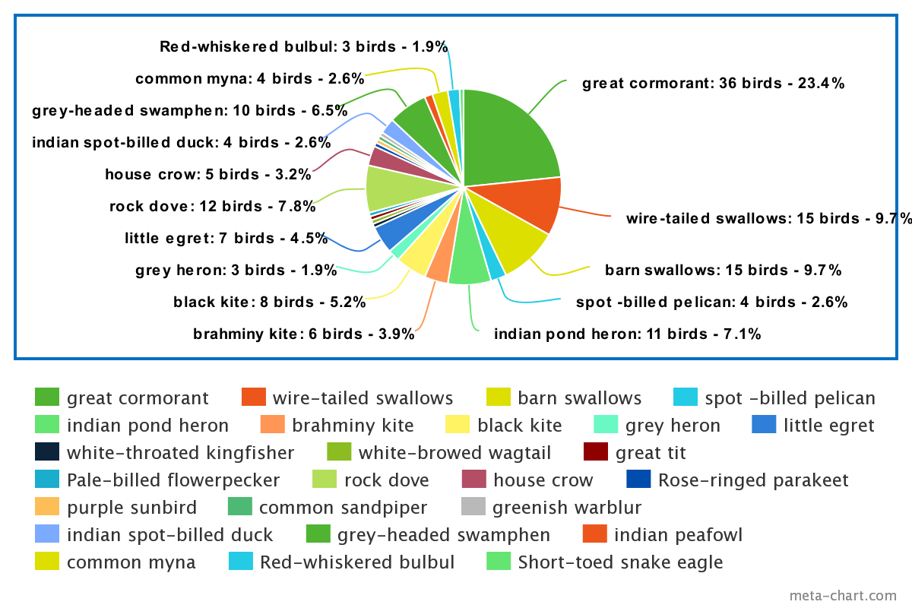

Slide 17
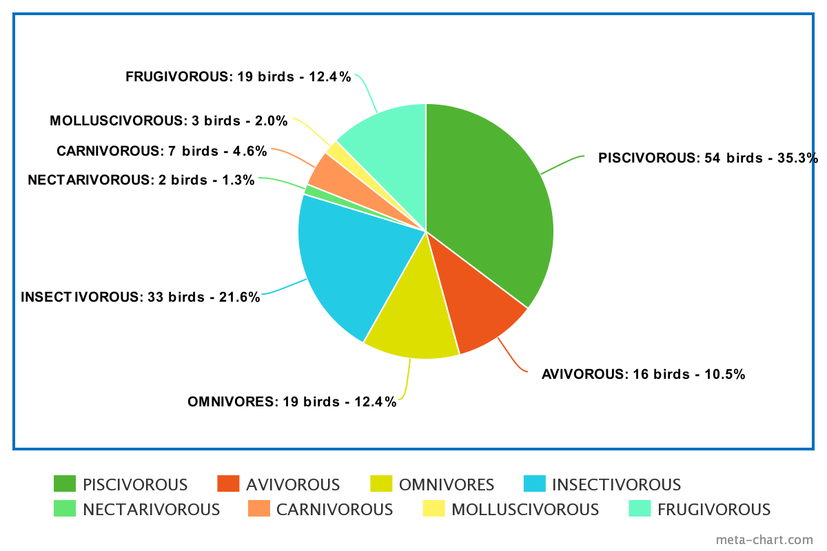
Bird eating habits based on their number

Slide 18
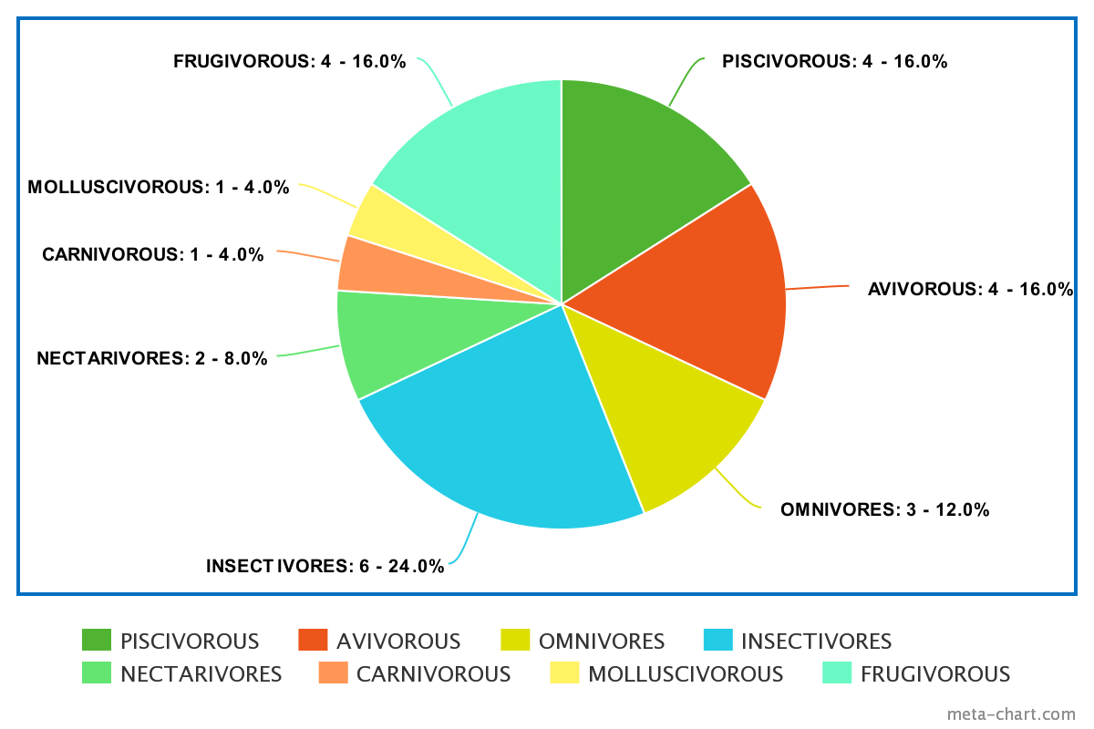
Bird eating habits based on their species

Slide 19
Few fish species found at sarakki lake:-
Catla
Rohu
Mrigal

Slide 20
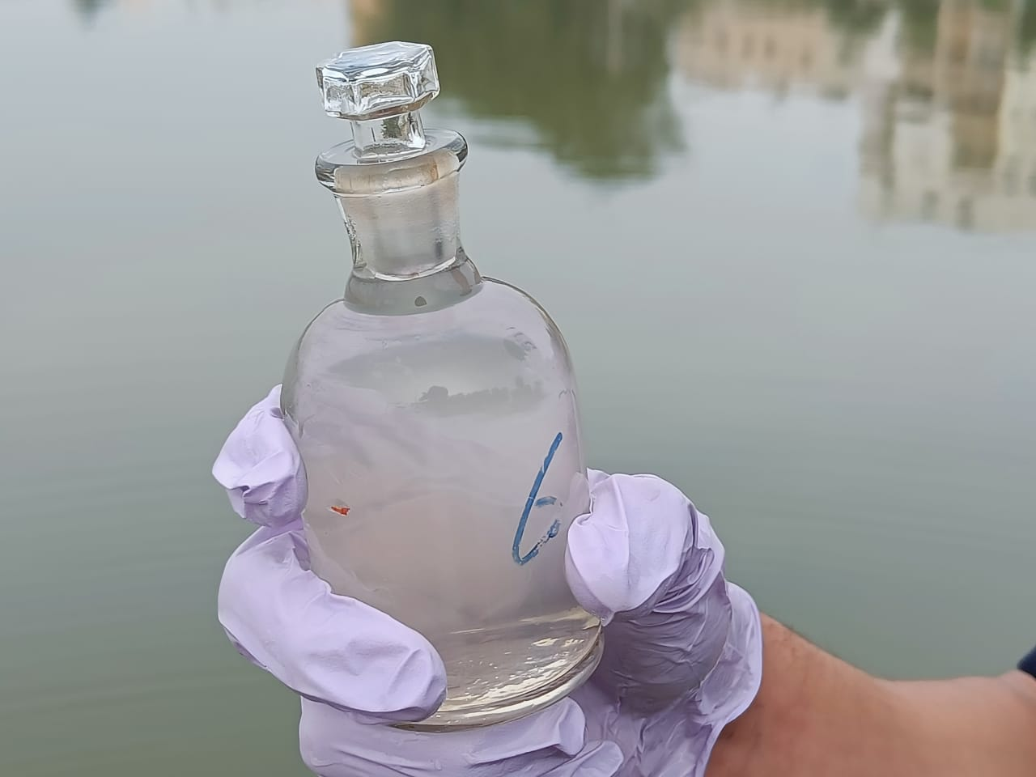
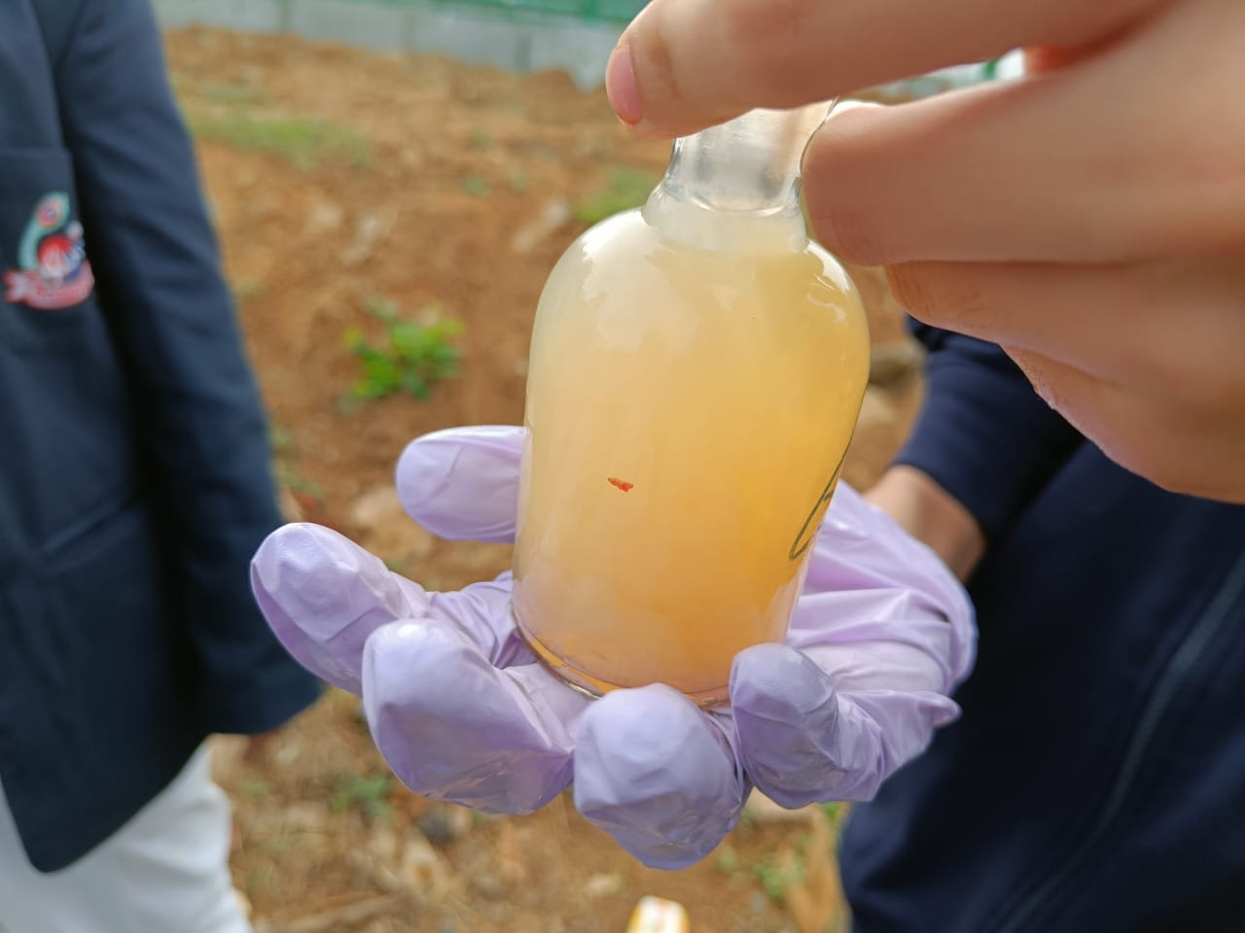
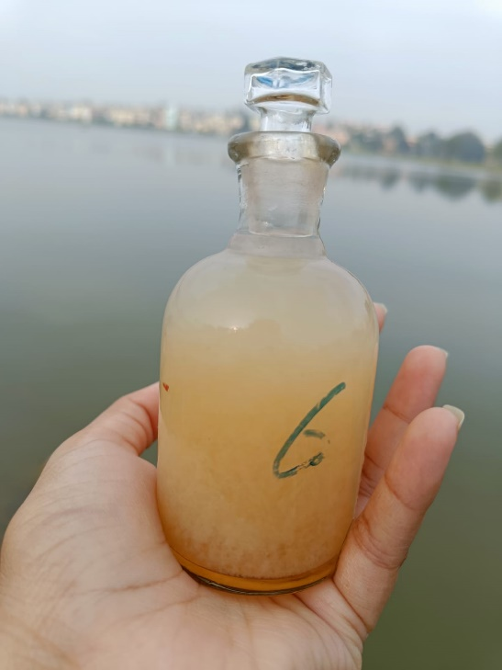
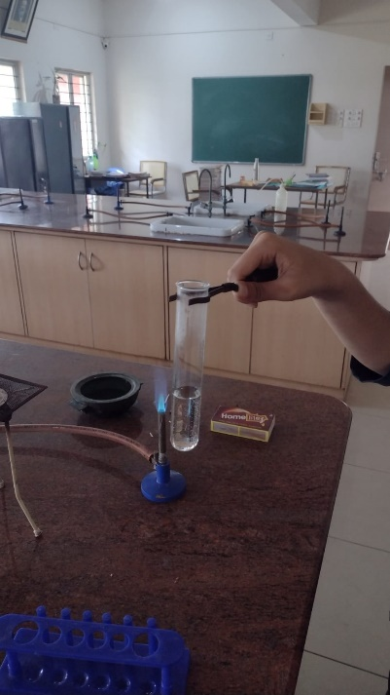
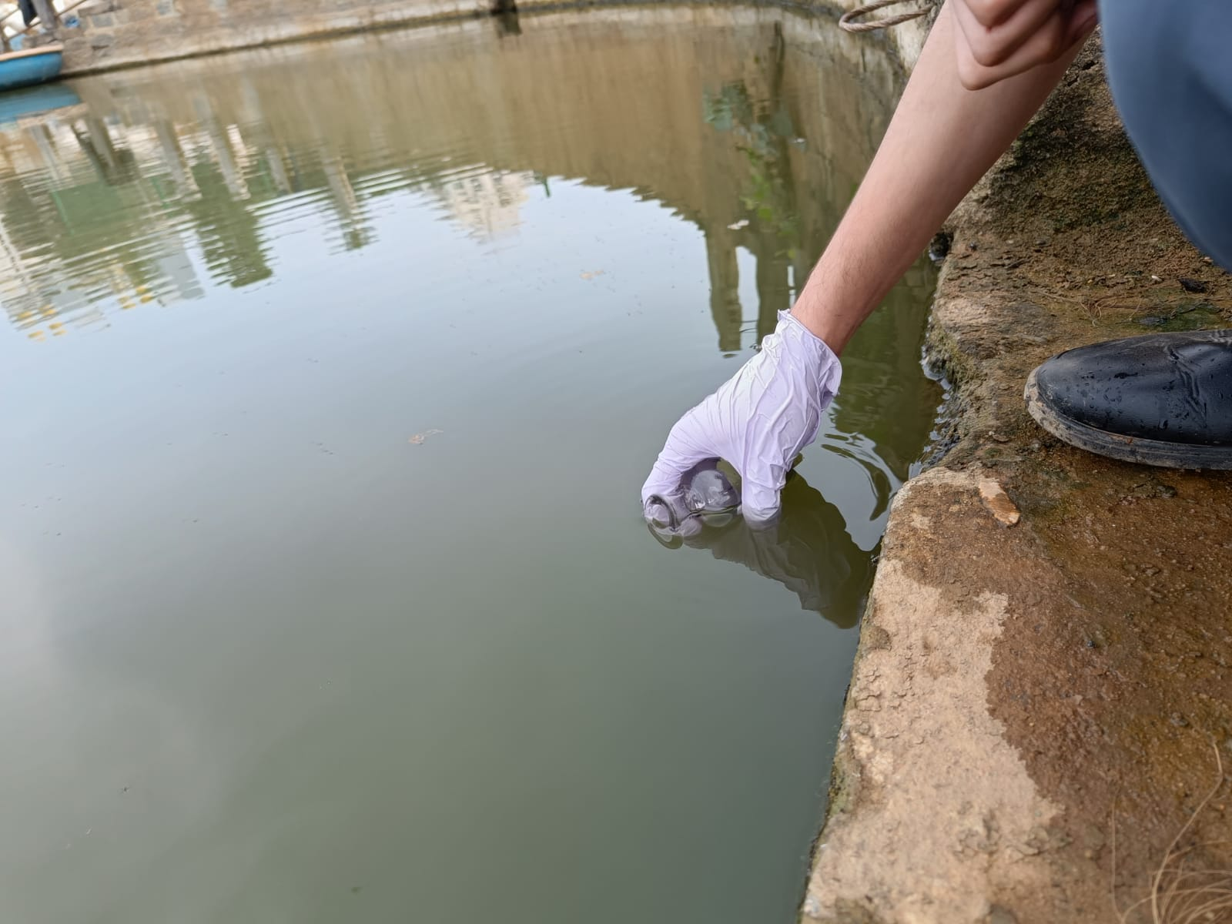
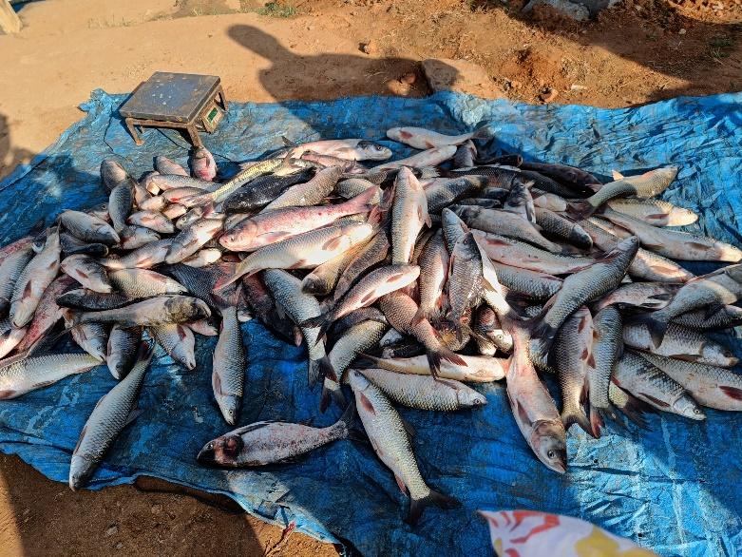
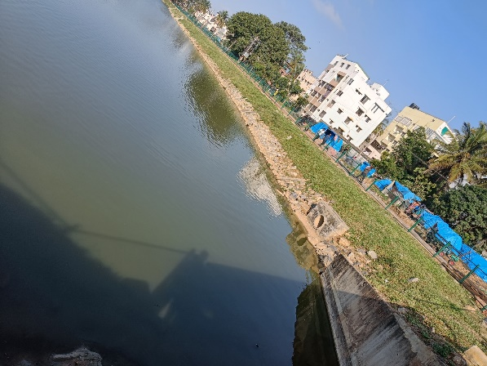
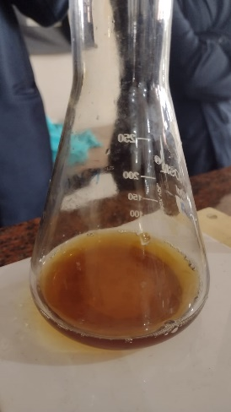
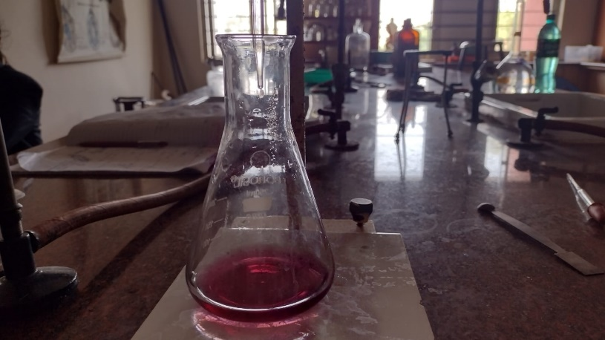

Slide 21
CONCLUSION:-
From the study undertaken by us we understand that the water of sarakki lake has more dissolved oxygen as there are less macrophages present in the water but all other parameters are seen to be more than the permitted levels in the water.
Marine life is present in sarakki lake but it is controlled marine life.

Slide 22
There are a lot of fishes dying here as we could see a number of fishes floating on water but the reason is unknown.
The begur lake water is more polluted compare to sarakki lake water because the magnesium hardness, calcium hardness and the total hardness are more in this lake.
The dissolved oxygen is less in begur lake as there are a lot of macrophytes present on water.

Slide 23
The konanakunte lake water is better compared to the water of sarakki lake and begur lake as the magnesium hardness, calcium hardness and the total hardness are the least in this lake.
Our follow up plan is:-
Testing more lakes with reference to water quality and bird population of the lakes.
Observe bird diversity of begur lake and konanakunte lake.

Slide 24
References :-
https://www.wikipedia.org/
https://earth.google.com/
https://ebird.org/species/rewbul?siteLanguage=en_IN
https://wgbis.ces.iisc.ac.in/
https://merlinbirdid.app&hl=en_IN&gl=US&pli=1
Eyes on nature –book[IISc]
https://www.meta-chart.com/

Slide 25
THANK YOU
S SAMIKSHA JAIN
SHRIMAYEE KASHYAP
BGS NATIONAL PUBLIC SCHOOL

