Slide 1


STUDY OF BUTTERFLY POPULATION IN SCHOOL GARDEN
By: Manasa & Nivedita
Class: 12

Slide 2
INTRODUCTION
Butterflies are a popular motif in the visual and literary arts. They are certainly one of the most appealing creatures in nature.
Butterflies are insects that belong to the order Lepidoptera.
They play an important role in the ecosystem, i.e. they act as a keystone species. They are valuable pollinators, induce natural genetic variations, and act as natural pest control. They are an indicator of a healthy environment.
The life cycle has four stages: egg, caterpillar, pupa and adult.
Each butterfly species sticks to their host plant or plants to lay their eggs. The larvae from the eggs will only eat the leaves from the host plant.

Slide 3
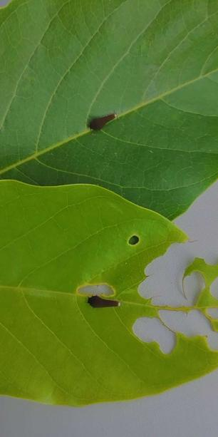
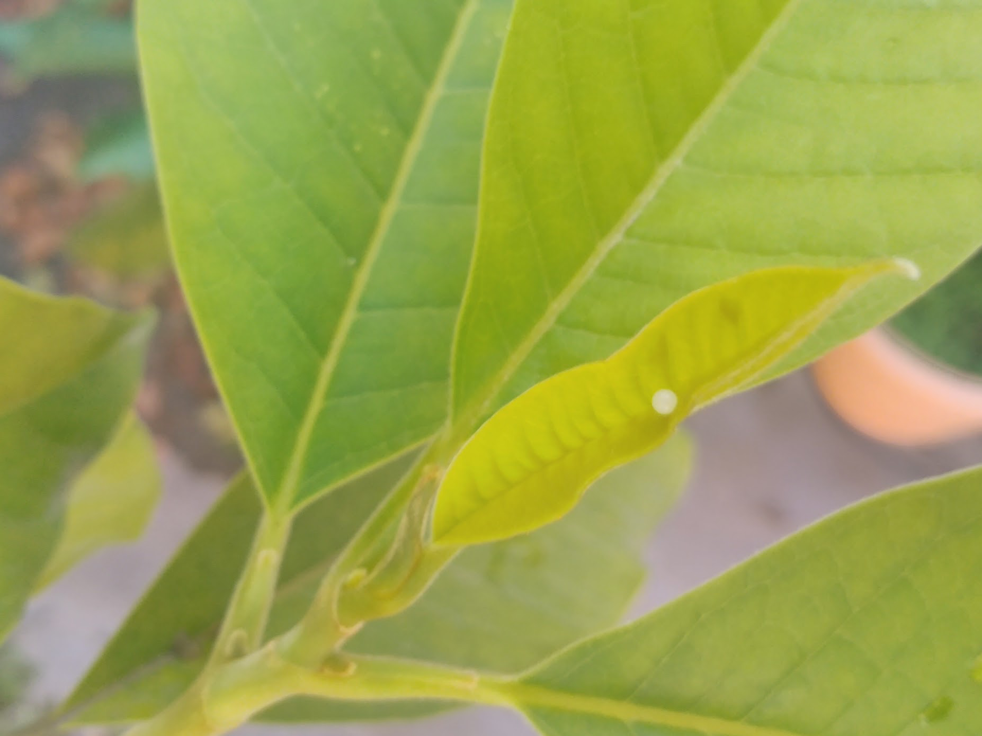
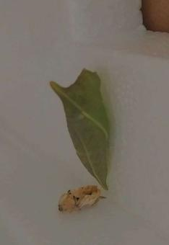
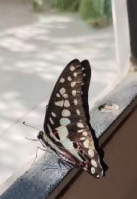
Life Cycle Of Common Jay

Slide 4
OBJECTIVES
To study the habits and life cycle of butterflies.
To study the host plants in school garden.
Study of population and species of butterflies in the school garden.
To increase population of butterflies in the school garden.

Slide 5
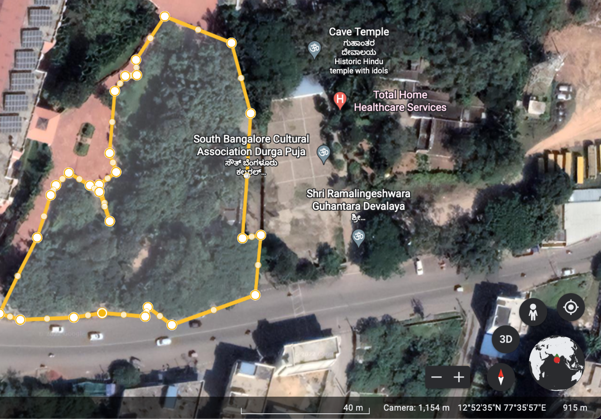
MATERIALS & METHODS
Study Area 1
BGS NPS - Garden
Latitude : 12.8767868
Longitude : 77.5989384
Perimeter : 314.64 m
Area : 4,512.72 m²

Slide 6
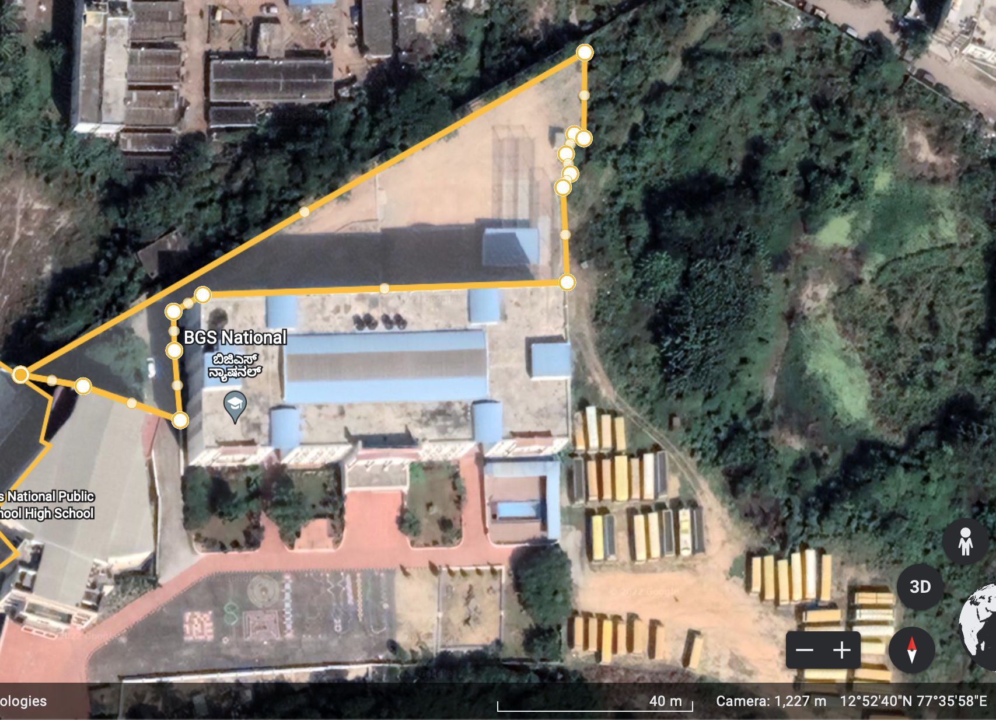
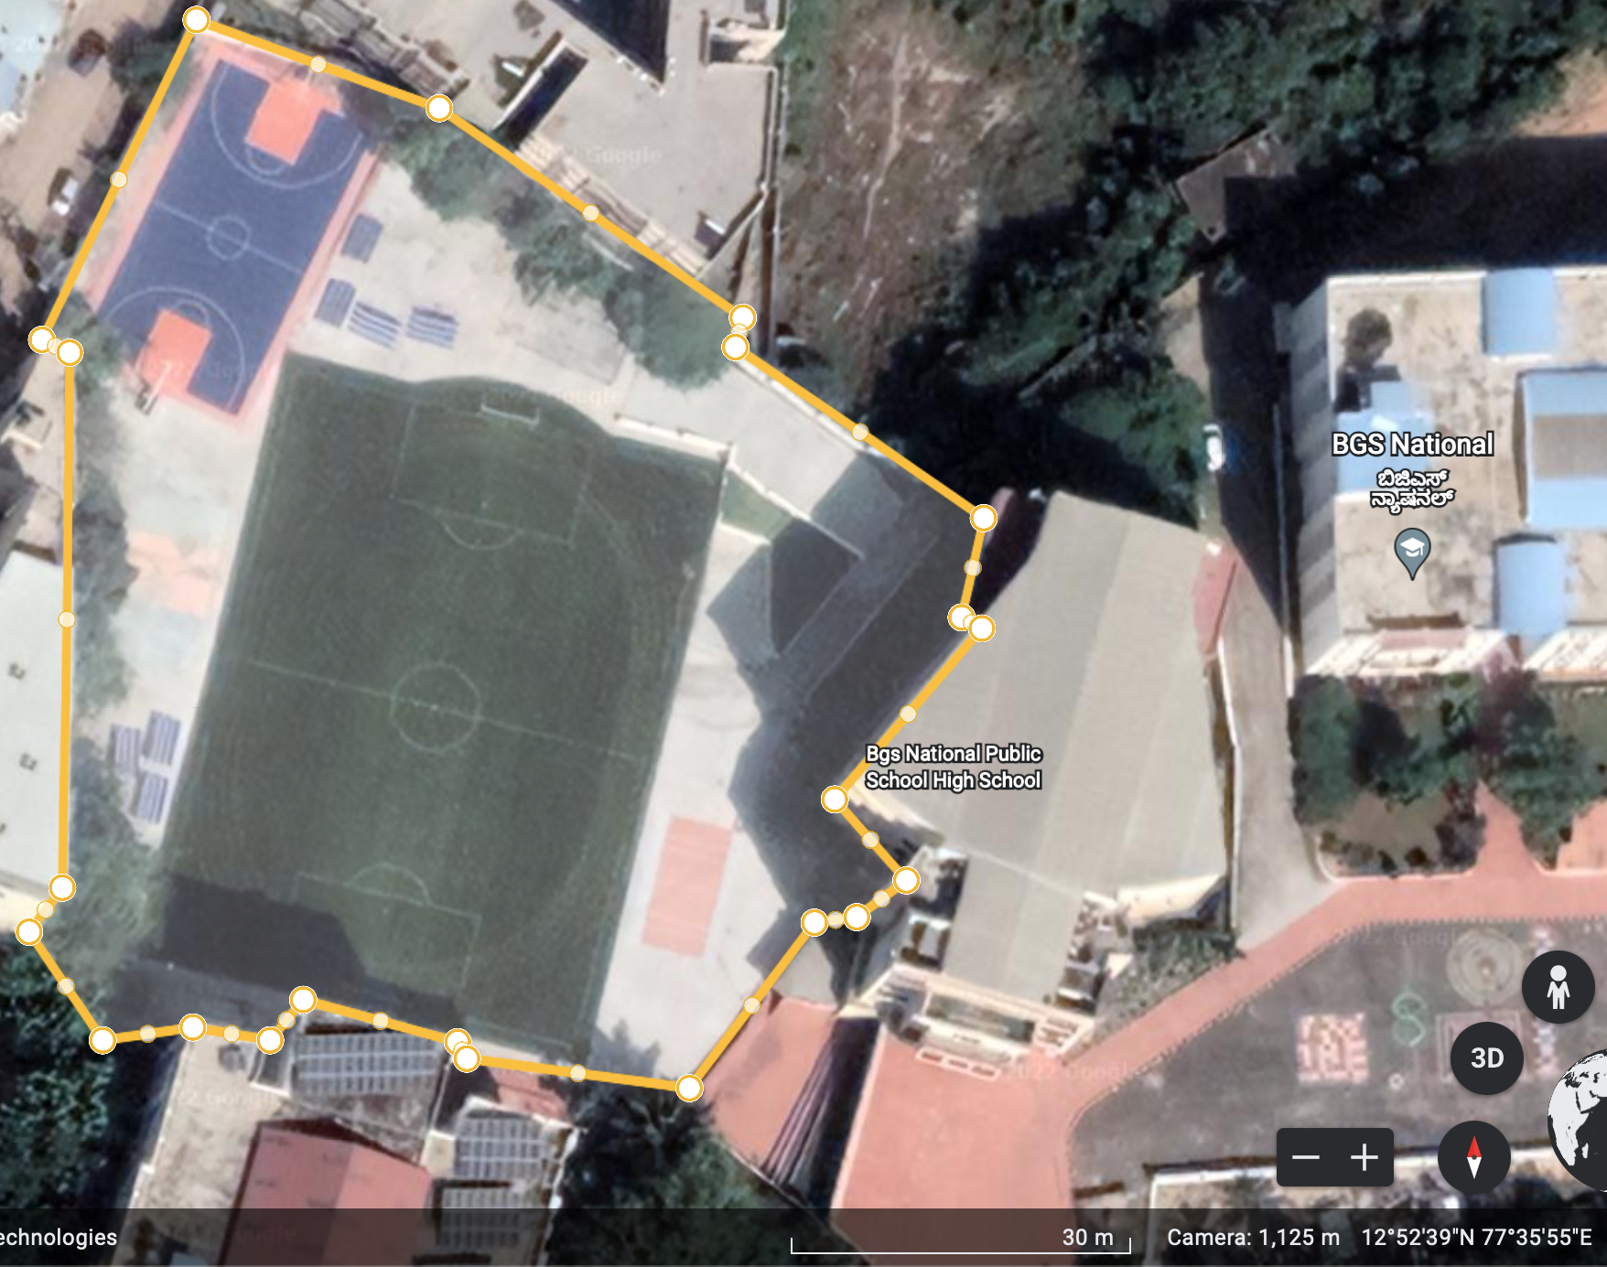
Study Area 2
Study Area 3
BGS NPS - Behind PP Block
Latitude : 12.8780155
Longitude : 77.5996409
Perimeter : 326.15 m
Area : 2,444.24 m²
BGS NPS - School Ground
Latitude : 12.8777542
Longitude : 77.5986892
Perimeter : 306.73 m
Area : 5,507.2 m²

Slide 7
MATERIALS
https://commons.wikimedia.org/wiki/Butterflies_of_Bangalore
https://www.ifoundbutterflies.org
Camera - Canon SX160 IS

Slide 8
METHODS
Method of counting host plants and caterpillars: Walking
Method of counting butterflies: Walking and photography

Slide 9
Butterfly Species Found In Our School Garden
Common Mormon, Papilio polytes
Blue Mormon, Papilio polymnestor
Common Baron, Euthalia aconthea
Tailed Jay, Graphium doson
Common Jay, Graphium agamemnon
Dark-Brand Bushbrown, Mycalesis mineus
Danaid Eggfly, Hypolimnas misippus
Great Eggfly, Hypolimnas bolina
Tailed Palmfly, Elymnias caudata
Three-Spot Grass Yellow, Eurema blanda
Apefly, Spalgis epius
Common Fourring, Ypthima huebneri
Common Sailor, Neptis hylas
Common Cerulean, Jamides celeno
Common Castor, Ariadne merione
Mottled Emigrant, Catopsilia pyranthe
Grass Demon, Udaspes folus

Slide 10
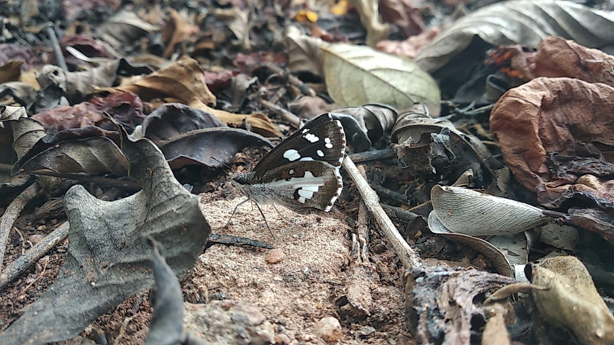
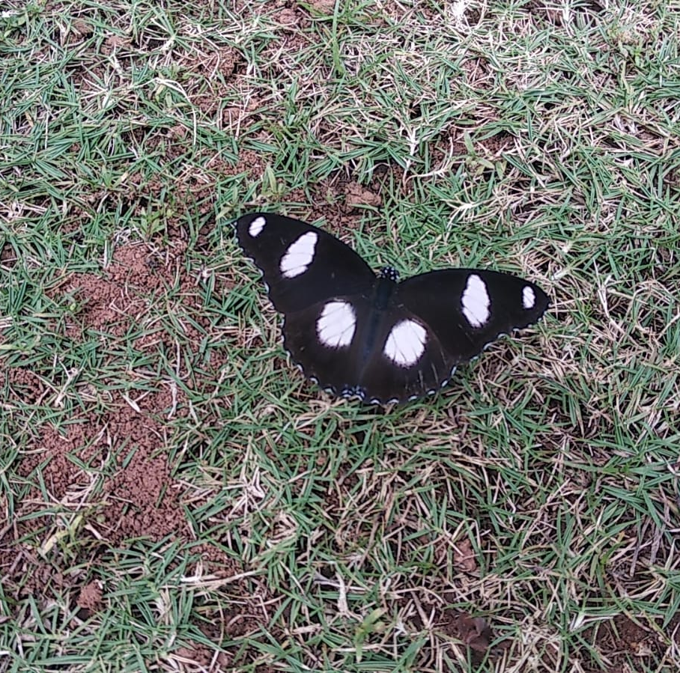
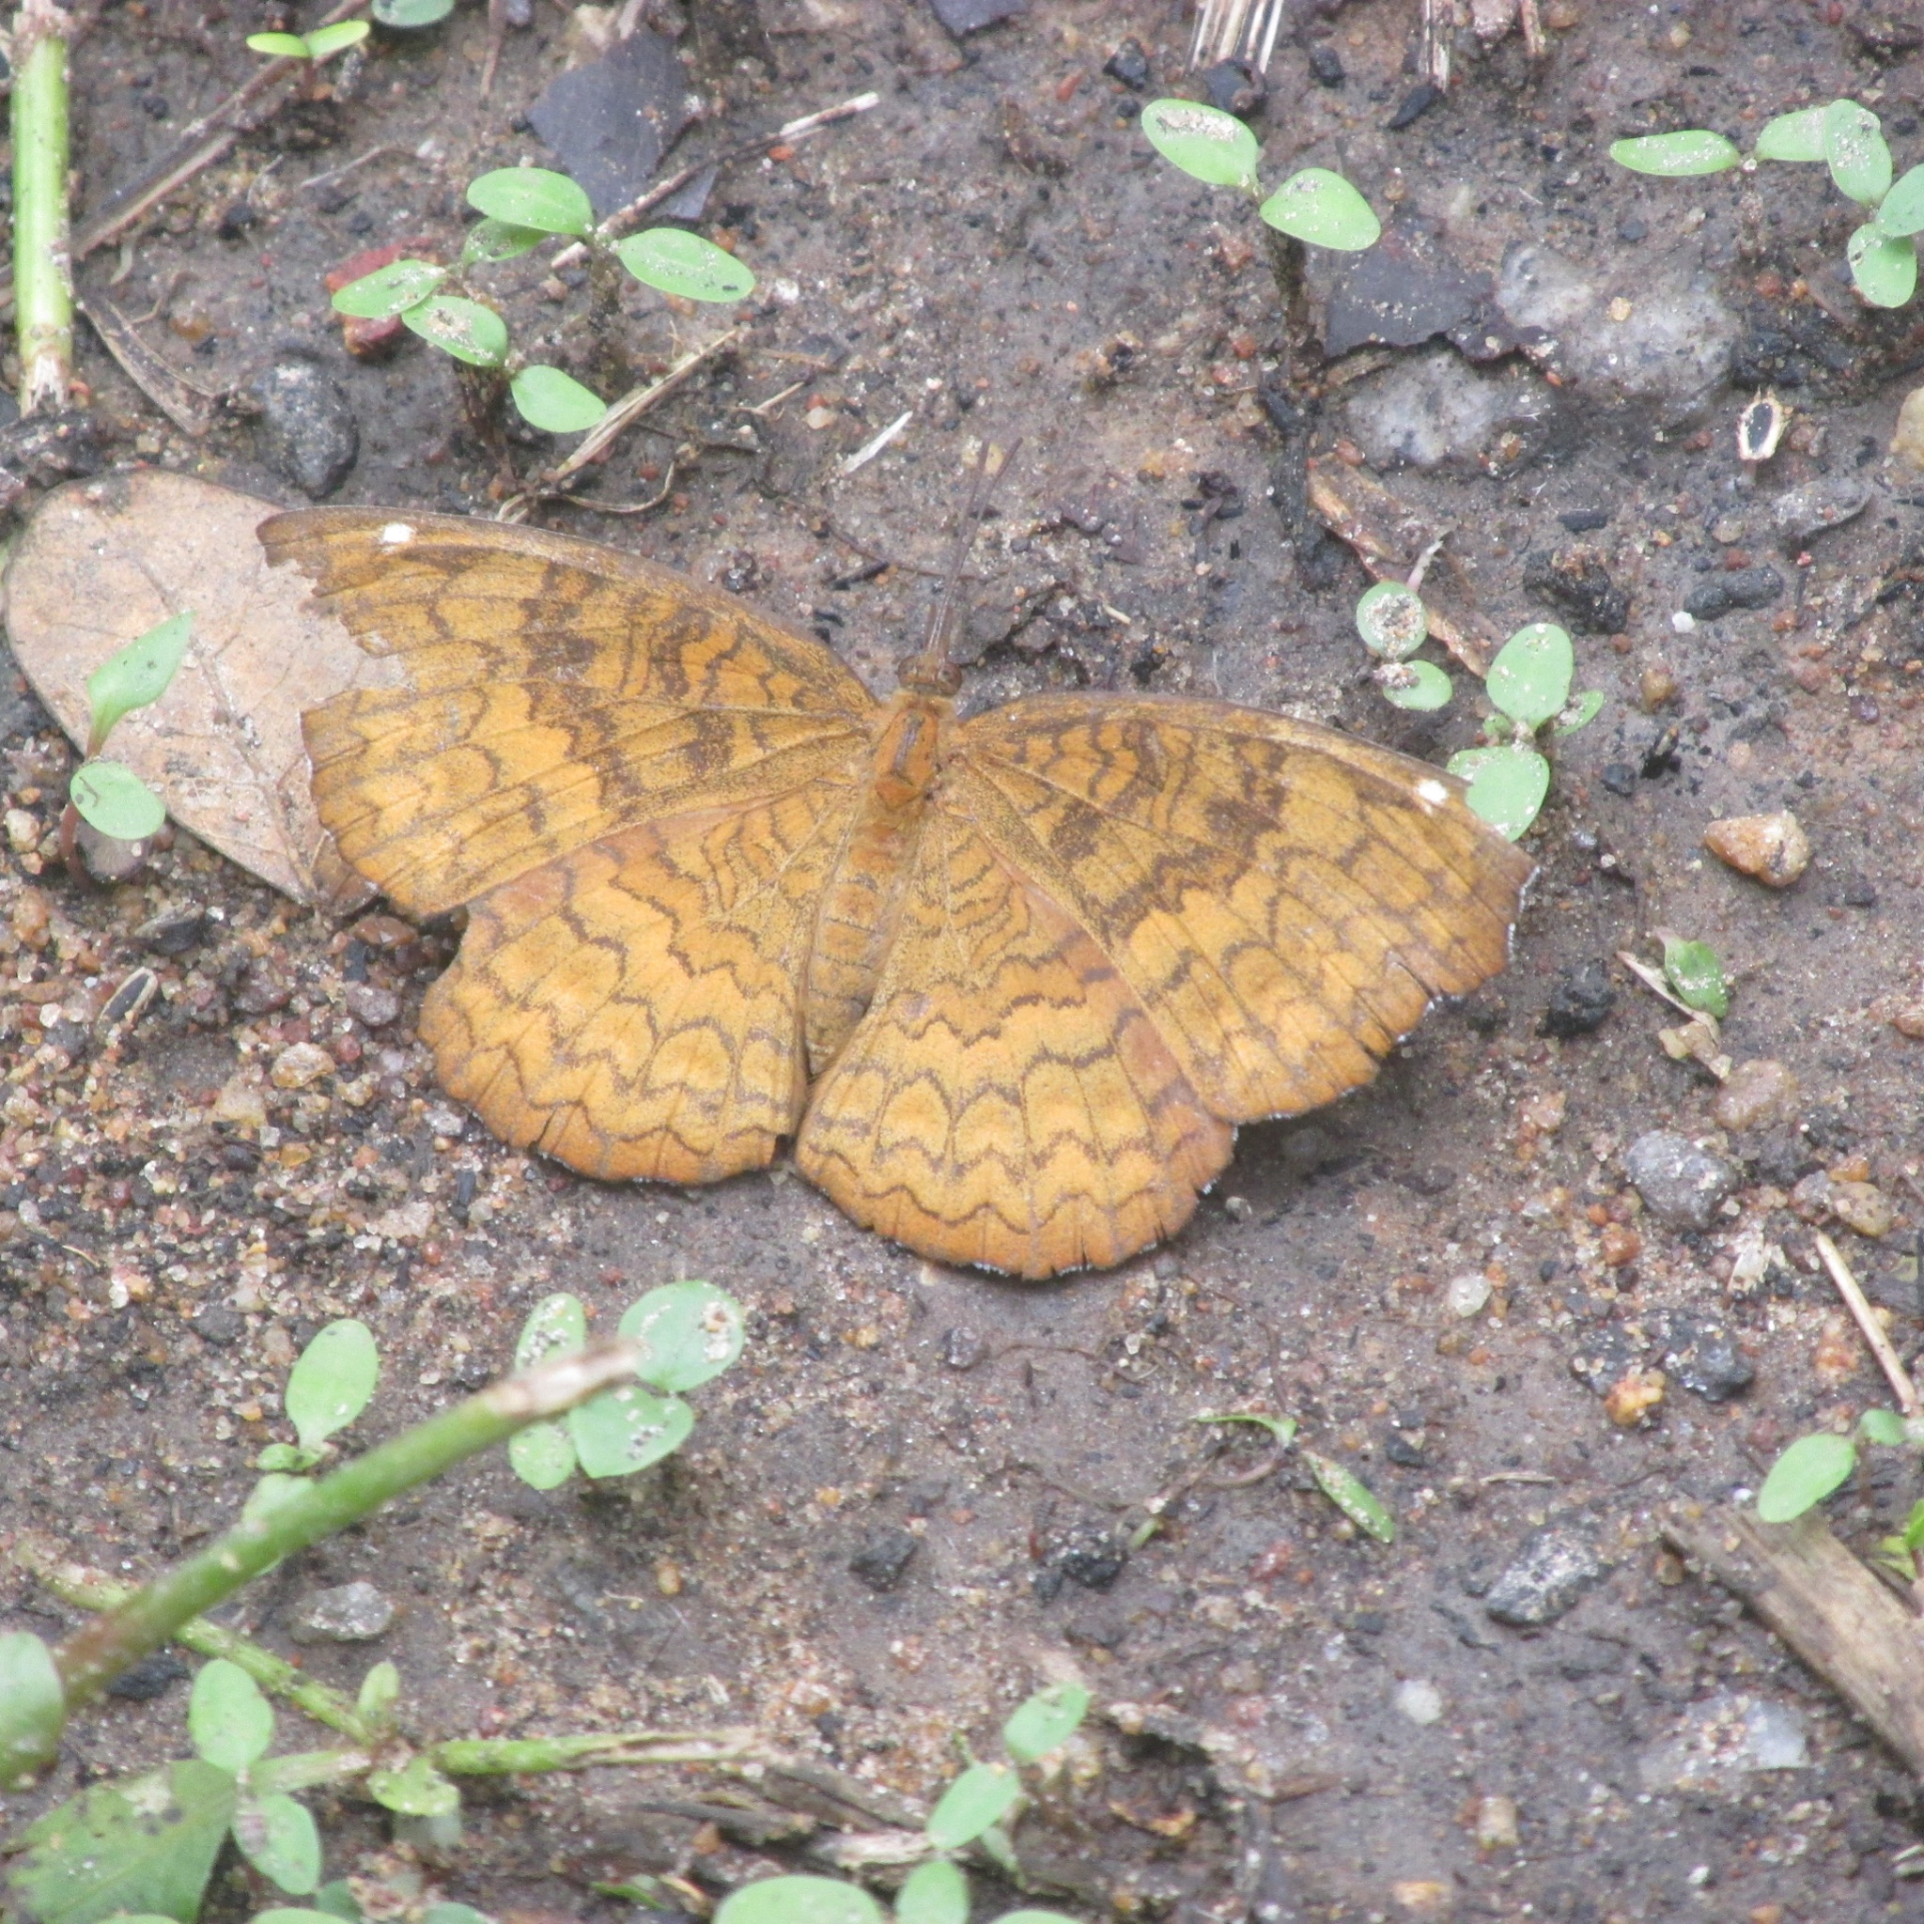
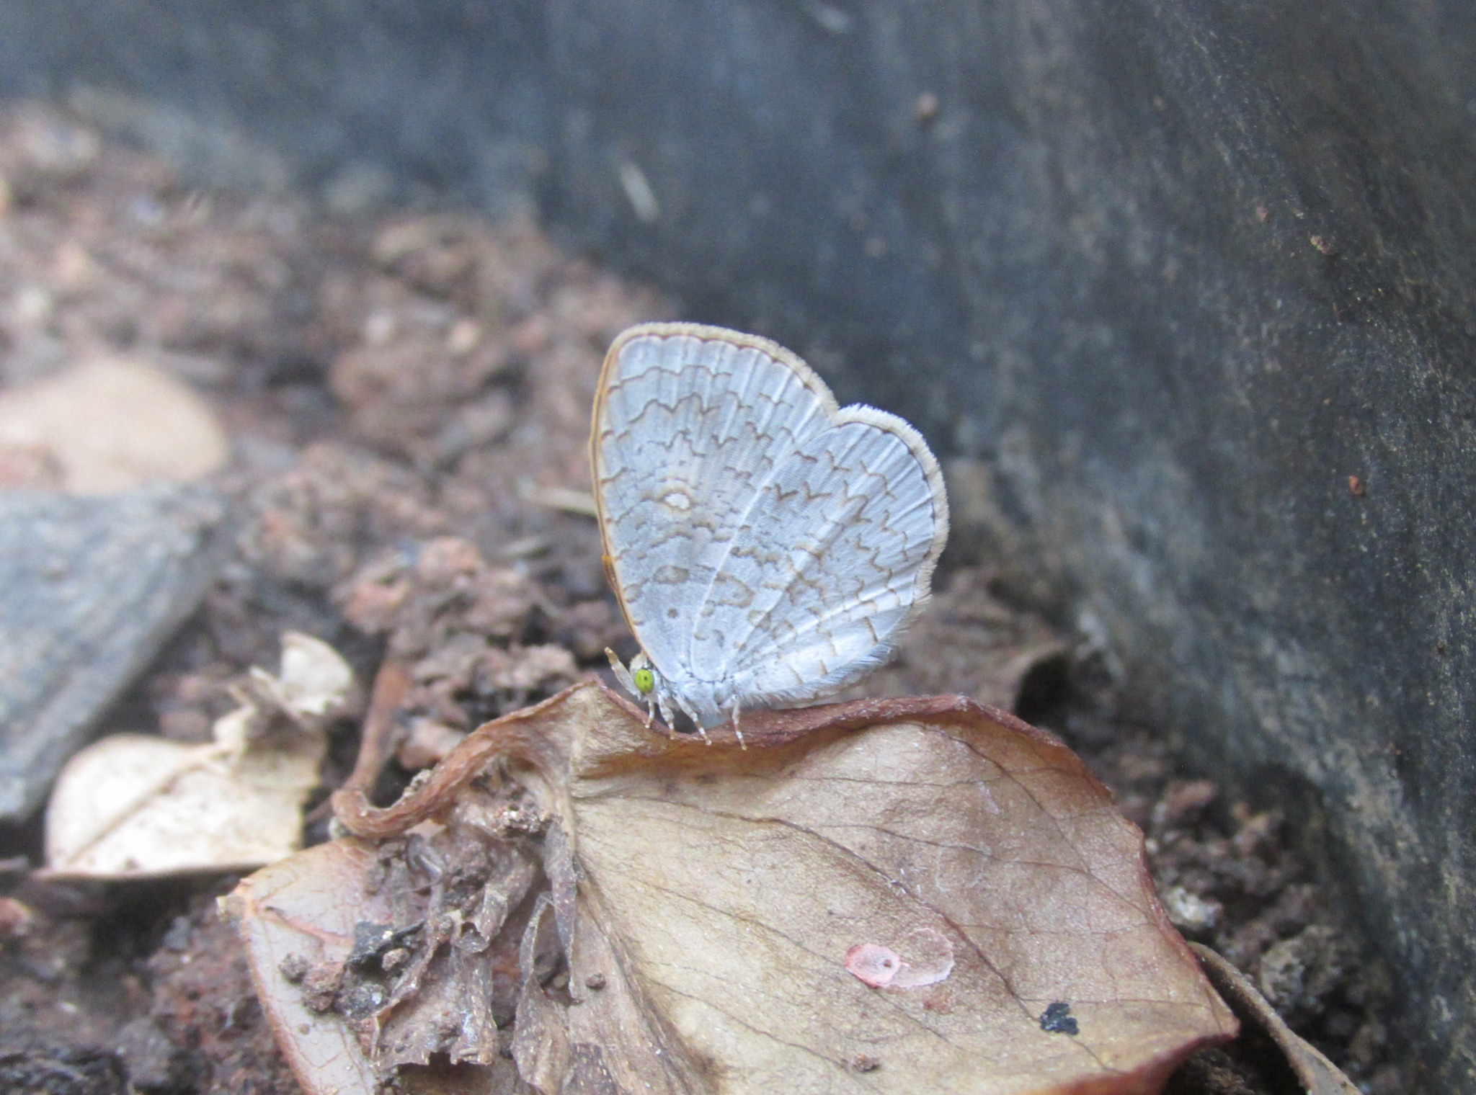
Danaid Eggfly (Male)
Grass Demon
Common Castor
Apefly

Slide 11
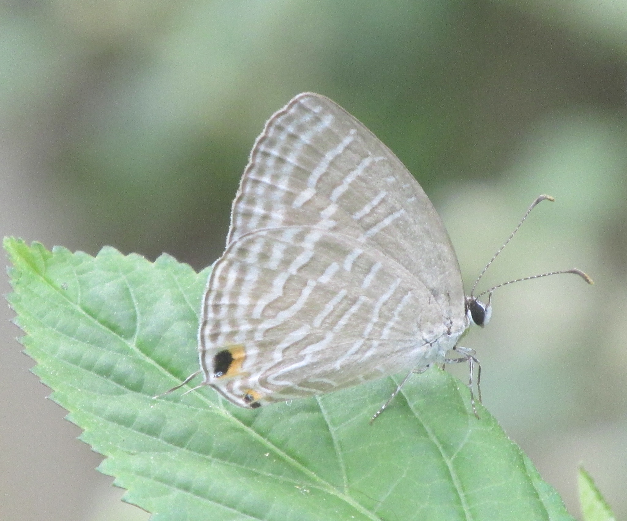
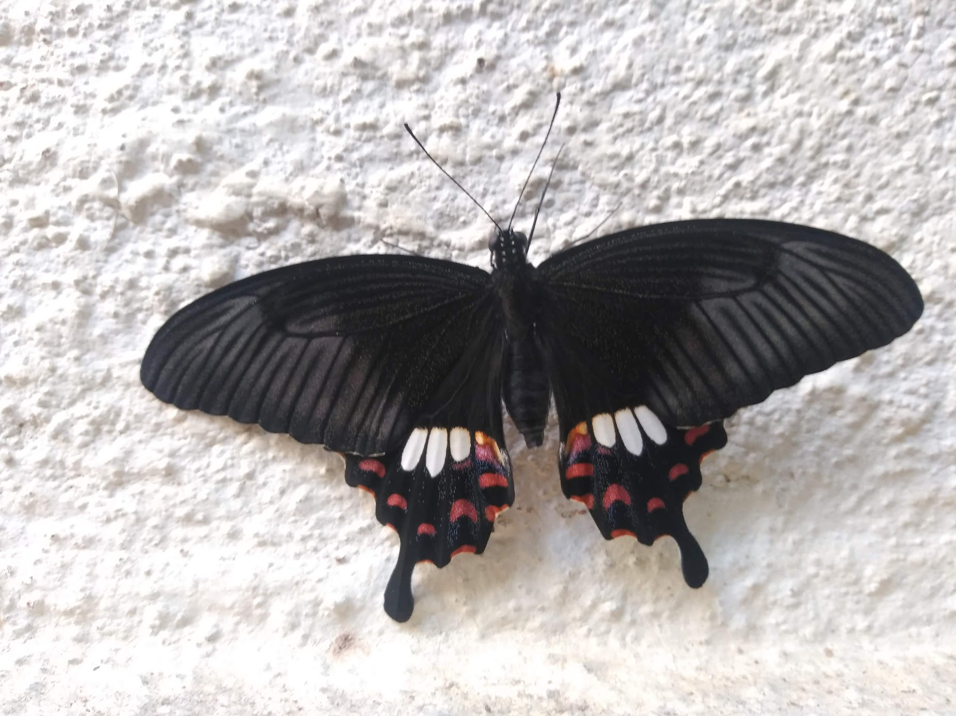
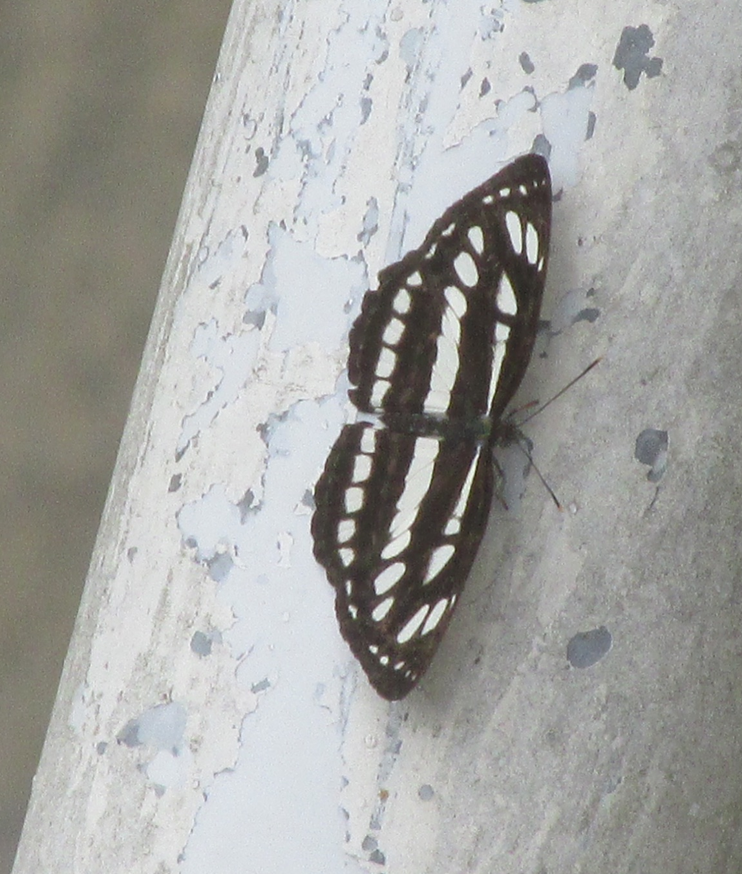
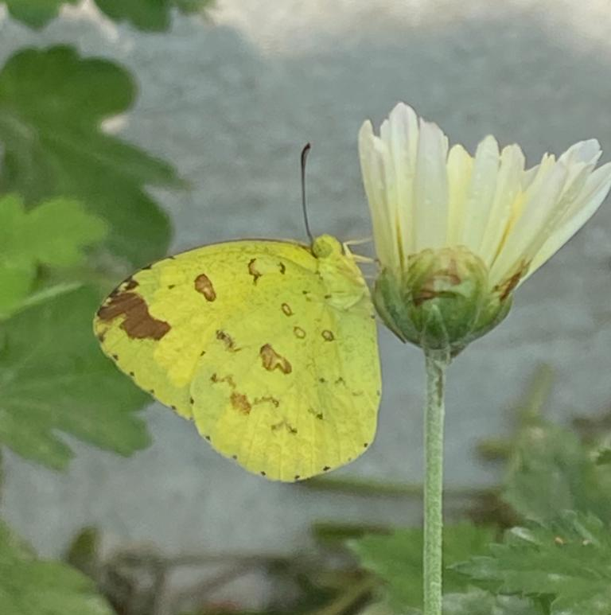
Common Cerulean
Common Mormon (Female)
Common Sailor
Three-Spot Grass Yellow

Slide 12
Butterflies Found - Area 1
Date | Time | Species | Number Found
03/12/2022 | 9 am - 10:20 am | Common Castor | 3
 |  | Common Cerulean | 3
 |  | Dark-Brand Bushbrown | 1
 |  | Tailed Palmfly | 4
 |  | Common Baron | 1
 |  | Three-Spot Grass Yellow | 1
 |  | Common Jay | 2

Slide 13
Date | Time | Species | Number Found
03/12/2022 | 12:45 pm - 1 pm | Common Fourring | 2
 |  | Common Cerulean | 1
 |  | Common Mormon | 1
 |  | Tailed Palmfly | 3
 |  | Apefly | 1
 |  | Three - Spot Grass Yellow | 1
 |  | Danaid Eggfly | 1 (Male)
 |  | Great Eggfly | 1 (Male)
 |  | Common Sailor | 1
 |  | Mottled Emigrant | 1
 |  | Tailed Jay | 2

Slide 14
Date | Time | Species | Number Found
05/12/2022 | 1:50 pm - 2:40 pm | Danaid Eggfly | 1 (Male)
 |  | Three-Spot Grass Yellow | 2
 |  | Mottled Emigrant | 1
 |  | Blue Mormon | 3
 |  | Common Cerulean | 2
 |  | Tailed Palmfly | 2
 |  | Common Mormon | 2
 |  | Grass Demon | 1
 |  | Common Castor | 2
 |  | Common Jay | 1
 |  | Tailed Jay | 1

Slide 15
Date | Time | Species | Number
6/12/2022 | 2:35 PM - 3 PM | Common Cerulean | 4
 |  | Common Castor | 3
 |  | Tailed Palmfly | 8
 |  | Common Jay | 3
 |  | Common Mormon | 2
 |  | Common Fourring | 1
 |  | Great Eggfly | 1
 |  | Blue Mormon | 1
 |  | Tailed Jay | 2

Slide 16
Date | Time | Species | Number
7/12/2022 | 11:20 am - 11:50 am | Common Castor | 4
 |  | Tailed Palmfly | 7 (1 Female, 6 Male)
 |  | Common Fourring | 2
 |  | Common Jay | 2
 |  | Danaid Eggfly | 1
 |  | Common Cerulean | 3
 |  | Common Mormon | 1
 |  | Common Sailor | 1

Slide 17
Rearing Caterpillars
Common Jay and Tailed Jay caterpillars were reared to study life cycle and habits of them and increasing their population. We chose these because of the large number of Champak trees available.
Collected the caterpillars for rearing from 06/10/2022 to 15/11/2022.
Reared 28 caterpillars, out of which 16 survived.
14 Common Jay, 14 Tailed Jay
Sample 1: 14 Caterpillars - 7 Tailed Jay, 7 Common Jay
Survived: 7 Caterpillars
Sample 2: 14 Caterpillars - 7 Tailed Jay, 7 Common Jay
Survived: 9 Caterpillars

Slide 18
Sample 1
Sl. No. | Species | Pupation | Eclosion
1 | Common Jay | 14/10/2022 | 26/10/2022
2 | Tailed Jay | 22/10/2022 | 05/11/2022
3 | Common Jay | 23/10/2022 | 05/11/2022
4 | Common Jay | 25/10/2022 | 06/11/2022
5 | Common Jay | 26/10/2022 | 06/11/2022
6 | Common Jay | 27/10/2022 | 07/11/2022
7 | Common Jay | 24/11/2022 | 04/12/2022

Slide 19
Sample 2
Sl. No. | Species | Pupation | Eclosion
1 | Common Jay | 13/10/2022 | 28/10/2022
2 | Common Jay | 14/10/2022 | 30/10/2022
3 | Common Jay | 22/10/2022 | 08/11/2022
4 | Common Jay | 23/10/2022 | 09/11/2022
5 | Tailed Jay | 07/11/2022 | 24/11/2022
6 | Tailed Jay | 18/11/2022 | 07/12/2022
7 | Tailed Jay | 01/12/2022 | -
8 | Tailed Jay | 05/12/2022 | -
9 | Tailed Jay | 16/12/2022 | -

Slide 20
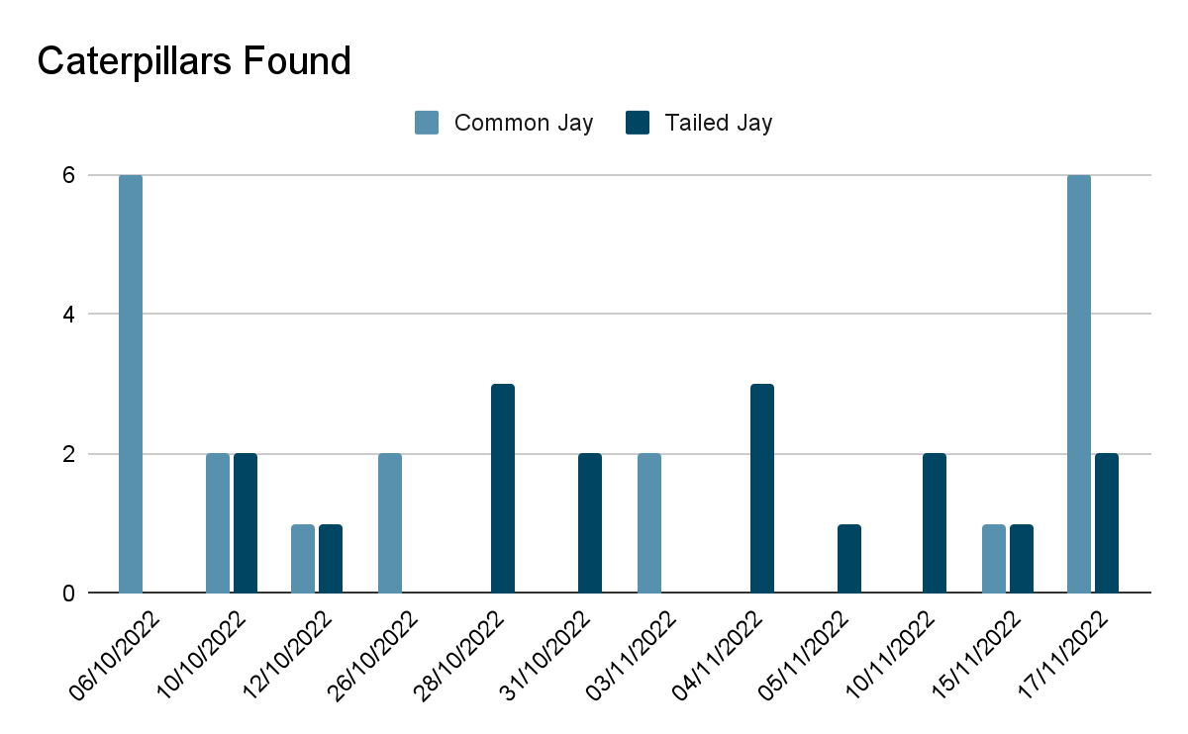

Slide 21
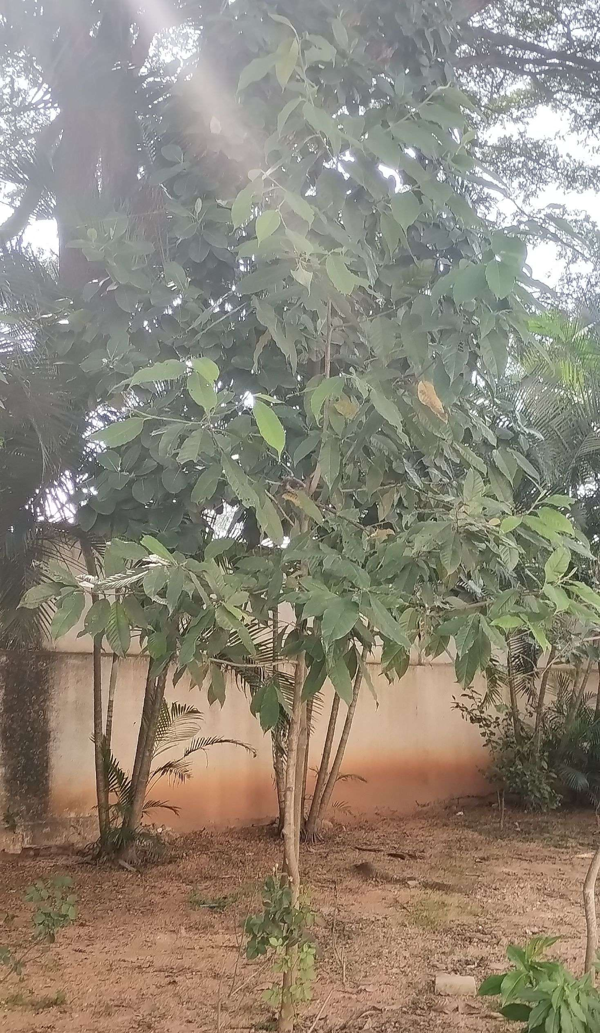
Reviewing Host Plants In School
Champak, Michelia champaca
Guava, Psidium guajava
Oleander, Nerium oleander
Mango, Mangifera indica
Lemon, Citrus limon
Curry Leaves, Murraya koenigii
False Ashoka, Polyalthia longifolia
Flame Of The Forest, Butea monosperma
Champak

Slide 22
Study Area 1
Sl.No. | Plant Species |  | Butterfly species |  | Reason
 | Name | Number | Supposed To Be On It | Found
1. | Champak | 17 | Common Jay Tailed Jay | Common Jay Tailed Jay | Mostly healthy host plants.
2. | Mango | 30 | Common Baron | None | Unknown.
3. | Flame Of The Forest | 4 | Common Cerulean | None | Not feasible for study.

Slide 23
4. | Lemon | 6 | Common Mormon Blue Mormon | Common Mormon | Found only on fresh leaves.
5. | Curry Leaves | 3 | Common Mormon | None | Dead plants.
6. | Guava | 3 | Common Guava Blue Large Guava Blue | None | Dry leaves.

Slide 24
Study Area 2
Sl. no | Plant Species |  | Butterfly Species |  | Reason
 | Name | Number | Supposed To Be On It | Found
1. | Oleander | 2 | Common Crow | None | Unknown.
2. | False Ashoka | 20 | Common Jay Tailed Jay | None | Some healthy. Some dry, dead.
3. | Mango | 12 | Common Baron | None | Some dead, some unknown.
4. | Guava | 4 | Common Guava Blue Large Guava Blue | None | Dry leaves.

Slide 25
Study Area 3
Sl. no | Plant Species |  | Butterfly Species |  | Reason
 | Name | Number | Supposed To Be On It | Found
 | Oleander | 3 | Common Crow | Eggs | Noisy area.
2. | Champak | 2 | Common Jay Tailed Jay | Tailed Jay | Noisy area.
3. | Guava | 2 | Common Guava Blue Large Guava Blue | None | Parasite infested.
4. | Lemon | 1 | Common Mormon Blue Mormon | None | Parasite infested.
5. | False Ashoka | 1 | Common Jay Tailed Jay | None | Dead plant.

Slide 26
Comparative Study Of Champak In Study Areas 1 & 3
Area 1 is more ideal for butterflies that area 3 due to lower noise levels.
Date | Study Area | Caterpillars Found
23/11/2022 | 1 | 3
 | 3 | 0
30/11/2022 | 1 | 3
 | 3 | 2
07/12/2022 | 1 | 5
 | 3 | 2

Slide 27
Introducing Host Plants In School
Bryophyllum was introduced on 22/11/22.

Slide 28
CONCLUSION
Population of butterflies increased successfully.
Low population of butterflies is usually due to inadequate number or unhealthy host plants.
Noise levels of an area affects population of butterflies (as seen in Area 3).

Slide 29
RECOMMENDATIONS
What we did was only the beginning. We plan to do much more to increase the population and species of butterflies.
Introduce new host plants.
Introduce a few caterpillars to the school garden.
Introduce more nectar plants.

Slide 30
ACKNOWLEDGEMENT
First of all, we would like to thank IISc, Bangalore and Adamya Chetana for taking such initiatives for the betterment of our surroundings by scientifically finding out solutions to these problems and also for giving the students such a wonderful platform to contribute towards this.
We warmly acknowledge the continuous encouragement and support offered by our dear Academic Director Shri S.A. Nair and Principal Smt. Sreekala G. Kumar. We extend our hearty thanks for giving the opportunity to make use of the facilities available in the campus to carry out the project successfully.
We are highly indebted to our pillar of support Smt. Rajasree her constant guidance and constant supervision, without whom carrying out this wouldn’t have been possible. We would like to express our gratitude towards them for their encouragement and the kind of motivation we were provided with. We would also like to thank Chathurved Sir, who has guided and helped us.
Finally, we extend our gratitude to one and all who are directly or indirectly involved in this noble initiative.

Slide 31
REFERENCES
Wikipedia
Butterflies Of Singapore
https://www.ifoundbutterflies.org
https://www.environment.sa.gov.au/goodliving/posts/2018/12/benefits-of-butterflies
https://commons.wikimedia.org/wiki/Butterflies_of_Bangalore
https://www.joyfulbutterfly.com/life-cycle-of-a-butterfly/
https://www.britannica.com/animal/butterfly-insect

Slide 32
THANK YOU

