Slide 1
Our Surroundings: In our school
By Nidhi and Navelli Class XG, BGSNPS

Slide 2
Introduction
Welcome to one and all present here!
Our project is centered in and around our school area . We have made an observation of the different plants and trees in our school garden . Noting down their names, favourable conditions to grow in and characteristics . Our main aim is to know the vegetation in our school garden and spreading awareness about local species and what can be grown in our area

Slide 3
Objective
To create awareness and be aware of our surrounding vegetation
To know which plants and trees are suitable for growing in our school

Slide 4
Area

Slide 5
Materials and Methods
Materials: Google lens, camera
Methods: Random Participant observation

Slide 6
Polyalthia longifolia
Scientific name: Polyalthia longifolia
Common Name : monoon longifuliun, The Buddha tree,False Ashoka, Mast tree
Family : Annonaceae
Classification: Evergreen Tree
Charachterisitics: 15-20m
Flowering : Yes, 2 weeks , spring, green star-like petals
Uses: Pencils,boxes, decoration, mast for ships, matchsticks
Life span : 23-61 years
Native To: India ,Srilanka (also found all over Asia)

Slide 7
Rudbeckia laciniata
Scientific name:Rudbeckia laciniata
Common Name : cutleaf coneflower.Golden glow
Family : Asteraceae
Classification: Flowering Plant
Charachterisitics: 1-3m, Moist soil, flood plains
Flowering : Yes, late summer –autumn, disc shaped yellowish green
Uses: Herbs,salads,
Life span : perennial
Native To: North America( USA and Canada)

Slide 8
Vitis davidii
Scientific name:Vitis davidii
Common Name : Chinese Bramble Grape
Family : Decidious Climber
Classification: Grapevines
Charachterisitics: Upto 25m, well drained soil
Flowering : Yes, Black Grapes
Uses: Fruit, ground cover
Life span : perennial
Native To: Asia

Slide 9
Peepal tree
scientific name:Ficus religiosa
Family: Moraceae
Classification: Fig tree
Characteristics: longest living tree, resistant to drought and frost
Uses: medicinal, ayurveda
Life span: 900-2500 years
Native to: Indian native

Slide 10
Guava tree
Common name: Guava tree
Scientific name:Psidium guajava
Family: Myrtle
Classification: Shrubby plant
Characteristics: Pivoting root with secondary roots, scented flowers around 8 cm in length
Uses: Source of fruit, bark helps with skin conditions like acne
Life span: 30-40 years
Native to: Mexico, Central America and regions surrounding

Slide 11
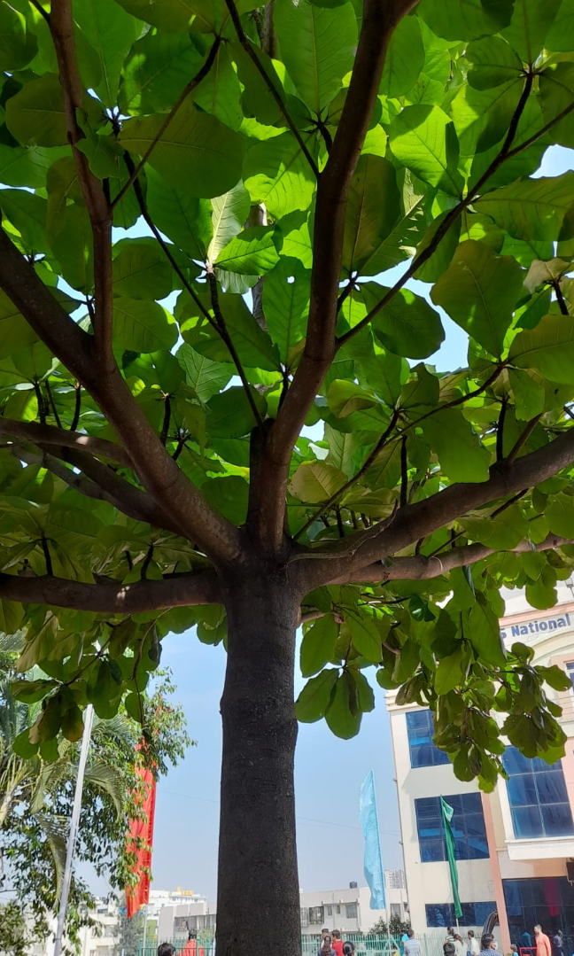
Almond Tree
Common name: almond tree
scientific name: Prunus dulcis
family: Rosaceae
Classification: Tree
Characteristics: tree is hardy and grows in places with mild winters, prefers full sun and grows well in drained soil
Uses: Ornamental tree, Food source
Life span: 20-25 years
Native: Iran and surrounding countries

Slide 12
Grevillea robusta
Scientific name:Grevillea robusta
Common Name : southern silky oak, silk oak or silky oak, silver oak or Australian silver oak
Family : Proteaceae
Classification: Spider Flower, Evergreen Tree
Charachterisitics: 5-40m
Flowering : Yes, Sept-Nov, yellowish orange, fruit (glabrous follicle)
Uses: manufacture of Furniture, fences, and cabinets
Life span : 60 years
Native To: eastern coastal Australia,

Slide 13
Philodendron rugosum
Scientific name:Philodendron rugosum
Common Name : Rare Sow’s Ear Plant
Family : Araceae
Classification: Philodendron, climbing, evergreen plant
Charachterisitics: well drained aerated soil, humidity
Flowering :
Uses:
Life span : 20-40 years or 100 years
Native To: Ecuador
threatened by habitat loss
Toxic to cats and dogs (calcium oxalate crystals,)

Slide 14
Cissus quadrangularis
Scientific name:Cissus quadrangularis
Common Name : Veld Grape,
Family : Vitaceae
Classification: Treebrine
Charachterisitics: 1-3m,creeper, well-drained soil , sunshine
Flowering : Yes, small white, yellowish, or greenish flowers; globular berries are red when ripe.
Uses: Fruit, heal broken bones(medicine)
Life span :30 years
Native To: tropical Asia, the Arabian Peninsula and much of Africa

Slide 15
CONCLUSION
Species | Exotic or Native
Cissus Quadrangularis | Native
Philodendron Rugosum | Exotic
Grevillea Robusta | Exotic
Almond tree | Indian almond is native to India. But originally native to Iran
Guava tree | Exotic
Peepal tree | Native
Vitis Davidii | Native
Rudbeckia Lasiniata | Exotic
Polyalthia longifolia | Native

Slide 16
Uses
Species | Medicinal uses
Polyiathia Longifolia | Helps to prevent Bacillus subtilis, Staphylococcus aureus, Escherichia coli, Pseudomonas aeruginosa, and Salmonella typhi.
Rudbeckia laciniata | The green coneflower is used to prevent menstrual pain
Vitis Davidii | No medicinal uses really, just a source of food.
Peepal tree | the leaf juice of the peepal tree may be helpful for cough, asthma, diarrhoea, ear pain, toothache, haematuria (blood in urine), migraine, scabies, eye troubles, and gastric problems.
Guava tree | People use guava leaf for stomach and intestinal conditions, pain, diabetes, and wound healing. The fruit is used for high blood pressure.

Slide 17
Uses
Species | Medicinal uses
Almond tree | Almonds help in preventing cholesterol, regulate blood sugar levels etc.
Grevillia Robusta | Grevillia Robusta bark leaves used for headaches and dizziness, sore throats, earache, chest problems, flu.
Philodendron rugosum | No medicinal uses found, decorative plant
Cissus quadrangularis | Used to heal broken bones, treat asthma, allergies etc.

Slide 18
Acknowledgement
We would like thank our school and IISC for this wonderful opportunity to present our project. Firstly we would like to thank Academic Director sir Dr. S.A Nair, Principal Ma’am Smt. Sreekala G Kumar, Vice Principal Ma’am Smt. Savitha Suverna for Hosting Eco Club . Special thanks to all our science teachers for guiding us throughout this project. Thank you IISC for giving us a chance to present our work and last but not the least thank you all for being here

Slide 19
References
www.Wikipedia.com
www.bimbima.com
www.healthline.com

