Slide 1
SURVEY ON A TERRACE GARDEN

Slide 2
Team Details
Students
Ahana Kainth [IX 'G']
Siddhi Dudgikar [X 'H']
Aabhirup Samanta [IX 'F']

Slide 3
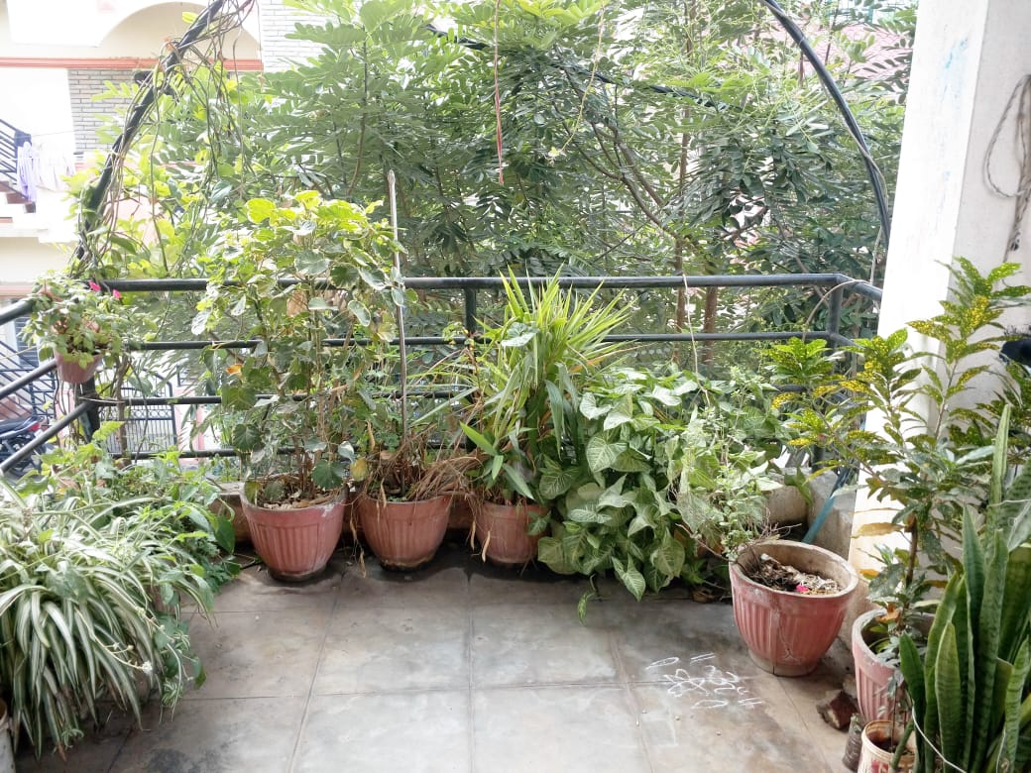
STUDY SPACE

Slide 4
Home : situated in Hulimavu, and is spread across 1200 sq.ft. As there is not much space, all the planting is done on either the balcony or the terrace.

Slide 5
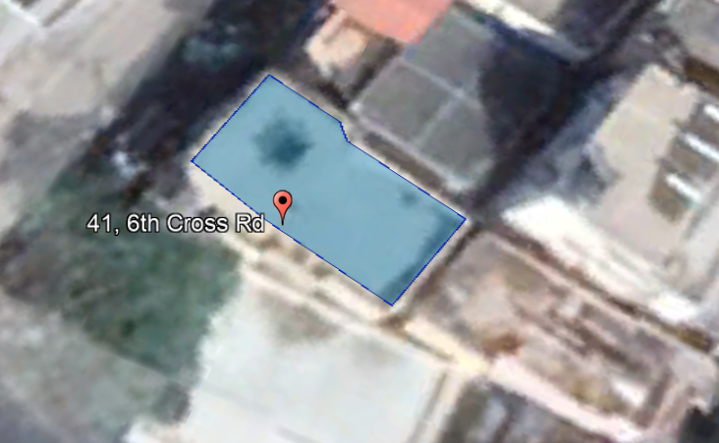
Location
CO-ORDINATES:
12.880307894591033, 77.59814325114766

Slide 6
OBJECTIVE: Motivating everyone here to start a small terrace garden of your own.

Slide 7
Plant species
Common Name | Local Name | Scientific Name | Values | Native to -
Shankpushpi | - | Convolvulus prostratus | Medicine | Madhya Pradesh
Lemon Grass | Gavati Chaha [Marathi ] | Cymbopogon | Aroma | Sri Lanka
Taro | Alu [Marathi] | Colocasia | Food | Bay of Bengal
Rose | - | Rosa | Perfume industry | Asia
Button Rose | - | Rosa | - | Asia
Nerium | Kanagle [Kannada] | Nerium Oleander | - | Northwest Africa
Chrysanths | Shawantige [Kannada] | Chysanthemum | - | East Asia

Slide 8
Plant species
Common Name | Local Name | Scientific Name | Values | Native
Betel Leaves | Viledele [Kannada] | Piper Betle | Food industry/religion | Southeast Asia
Hibiscus | Dasvaala | Hibiscus | Cosmetic and selfcare industry | North America
Stevia | - | Stevia rebaudiana | Natural Sweetner | Brazil
Devil's ivy | - | Epipremnum aureum | - | Mo'orea Island
Snake Plant | - | Dracaena trifasciata | - | West Africa
Spider plant | - | Chlorophytum comosum | - | South Africa
Aloe Vera | - | Aloe barbadensis miller | Cosmetic and selfcare industry | South-East Arabian Peninsula

Slide 9
Plant species
Common Name | Local Name | Scientific Name | Values | Native
Sour Cherry | - | Prunus cerasus | Food industry | Europe
Passion Fruit | - | Passiflora edulis | Food Industry | Brazil
Globe Amaranth | Adike Hoovu | Gomphrena globosa | - | Brazil
Lemon | - | Citrus limon | Food Industry | Asia
Jasmine | Mallige Hoovu | Jasminum | Perfume industry | Europe
Periwinkle | - | Vinca | - | Madagascar
Tulsi | - | Ocimum tenuiflorum | Medicine | Asia

Slide 10
Plant species
Common Name | Local Name | Scientific Name | Values | Native
Lakshmi Taru | - | Simarouba glauca | - | Florida, USA
Bramhakamala | - | Saussurea obvallata | - | India
Turmeric | Haldi | Curcuma | Food industry | Asia
Curry Leaves | Karibevu | Murraya koenigii | Food industry | India
Tomato | - | Solanum lycopersicum | Food industry | South America
Green Chillies | - | Capsicum annuum | Food industry | South America
Bitter Gourd | - | Momordica charantia | Food industry | Tropical Asia

Slide 11
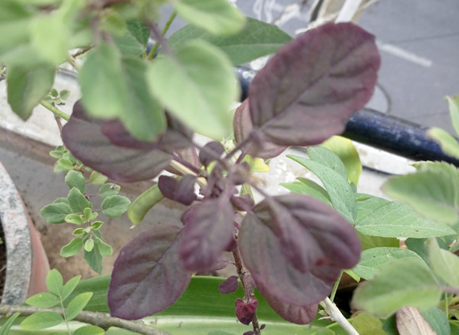
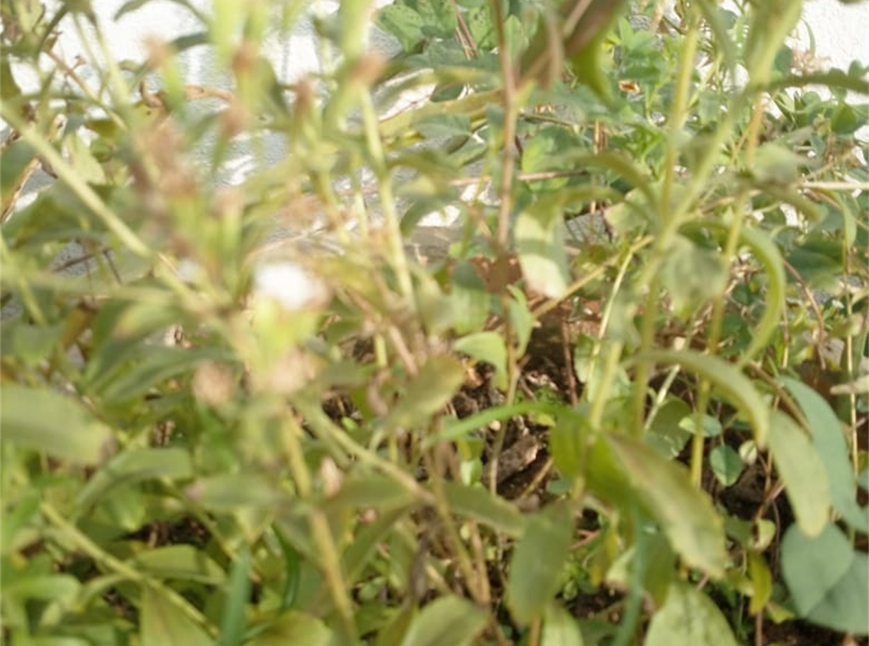
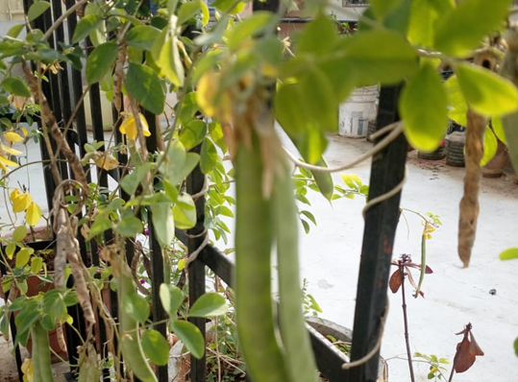
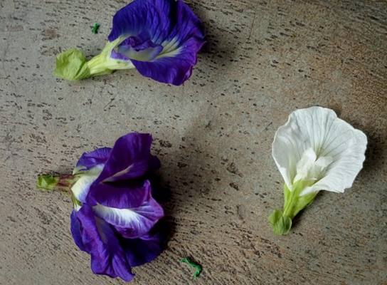
Picture Gallery

Slide 12
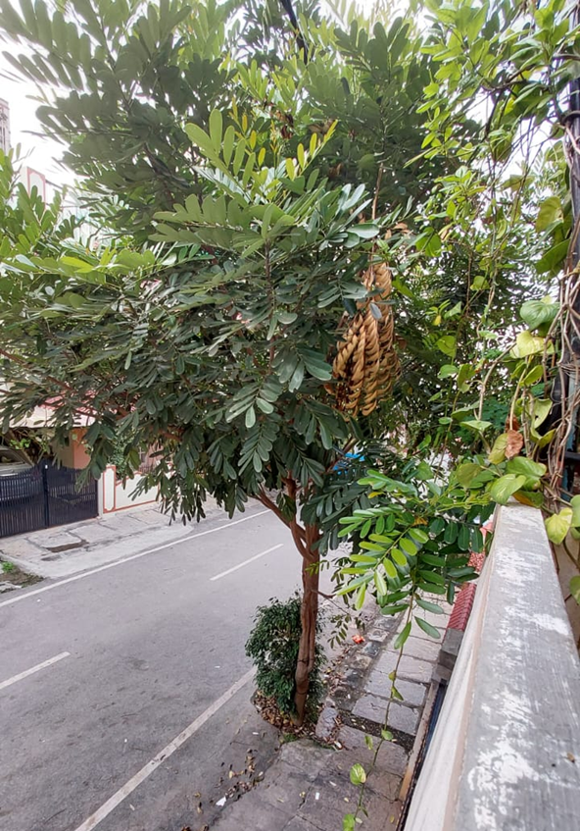
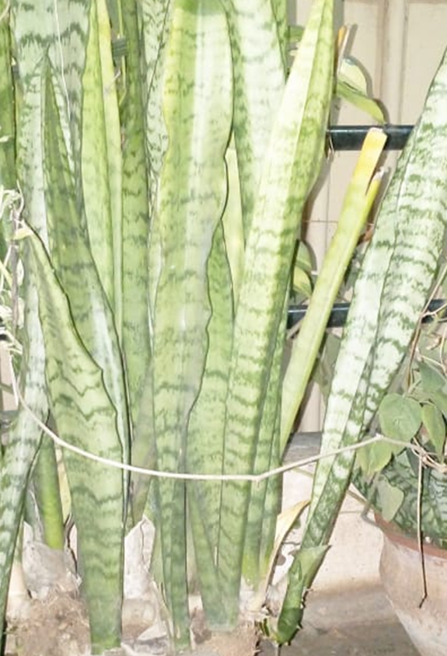
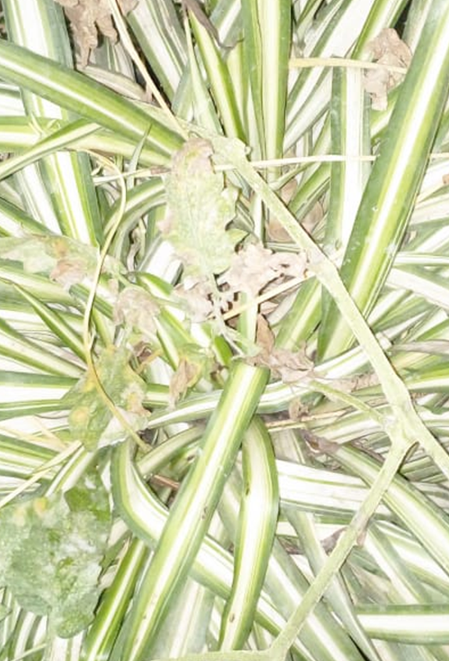
Picture Gallery

Slide 13
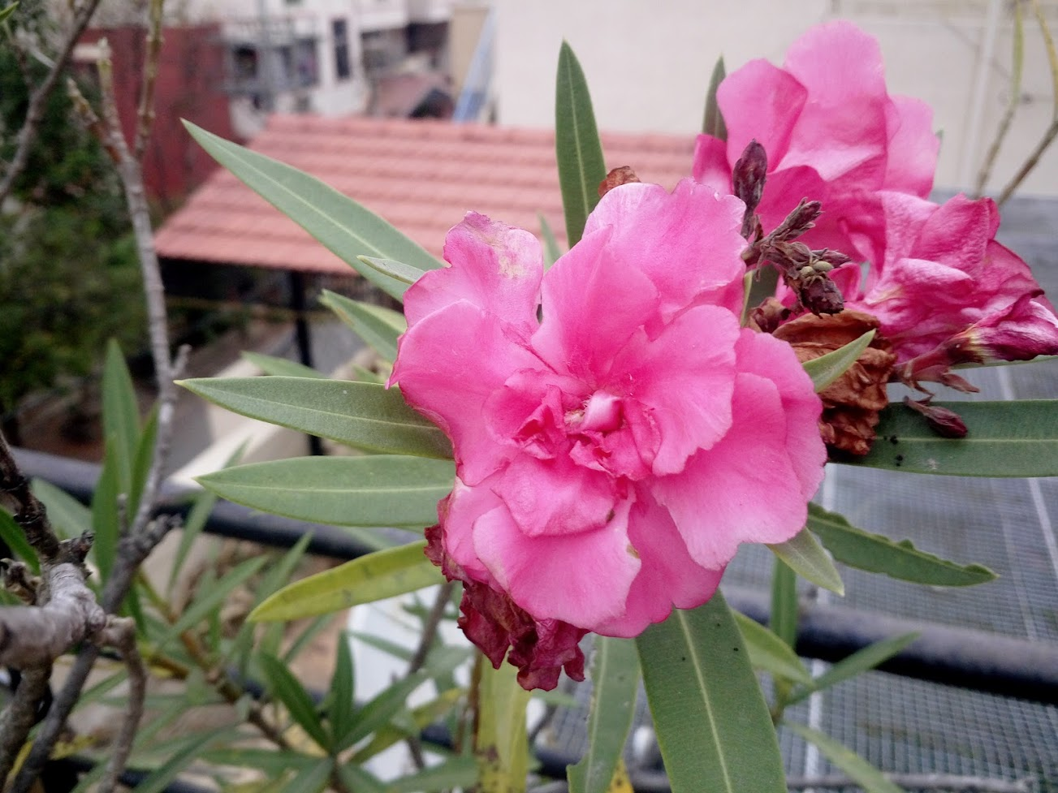
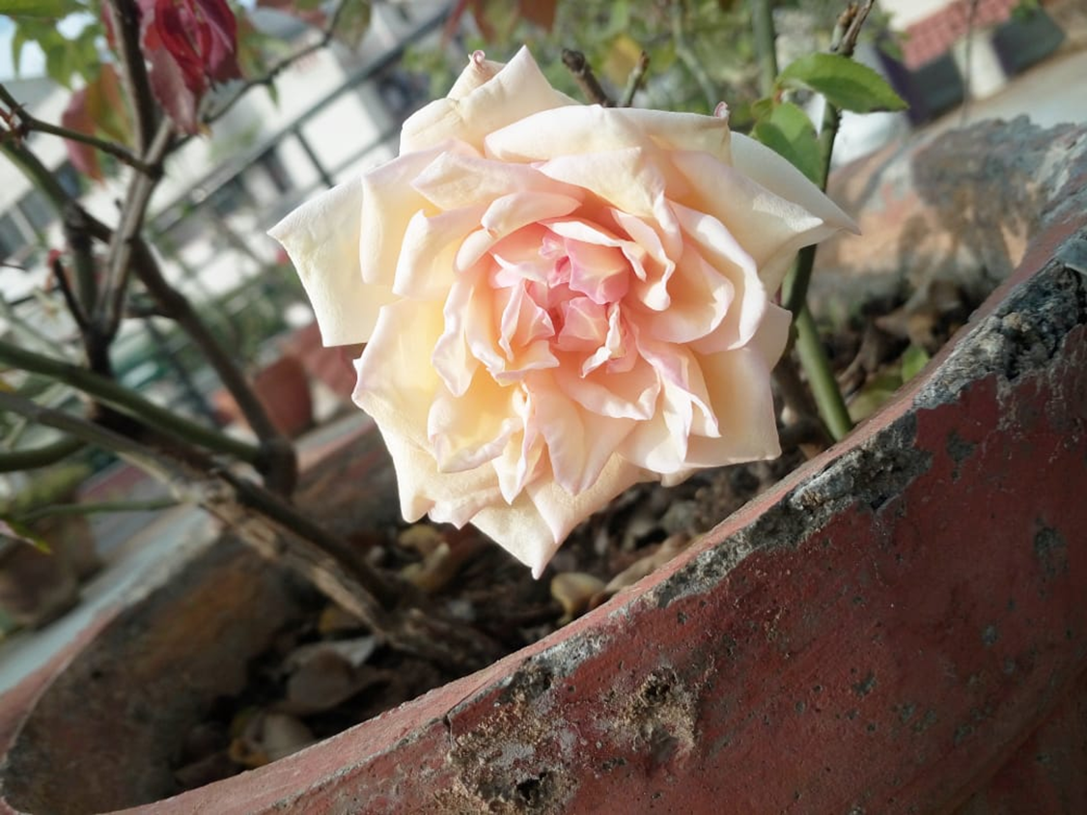
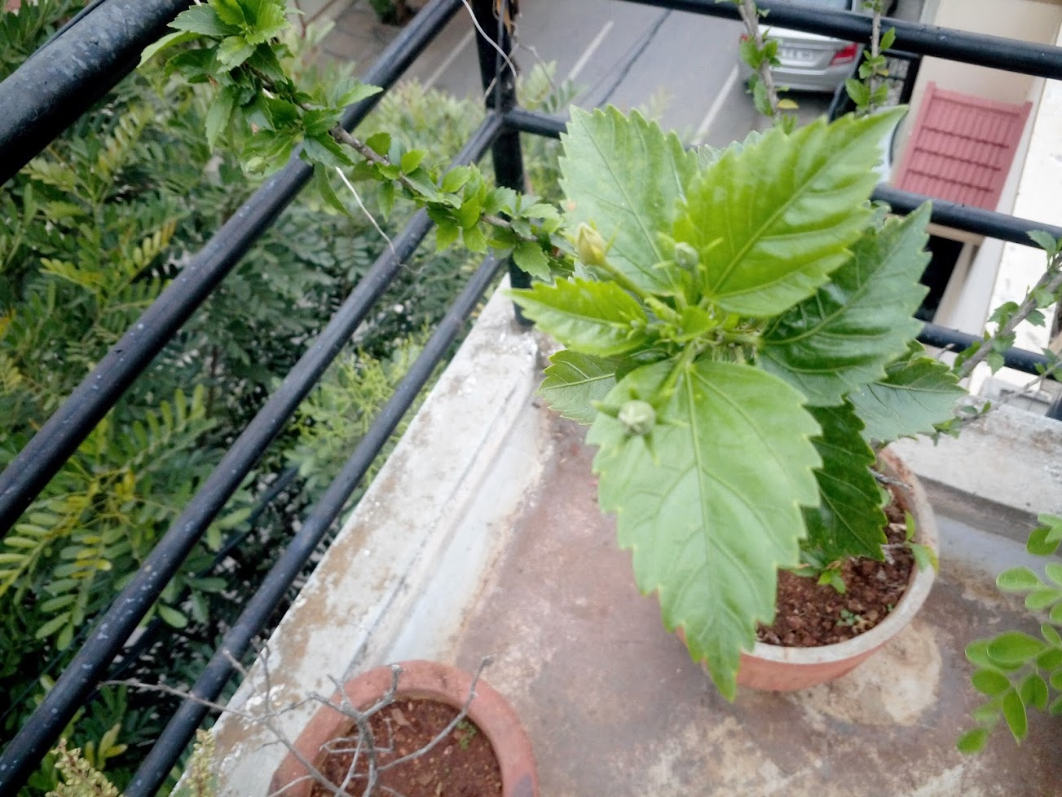
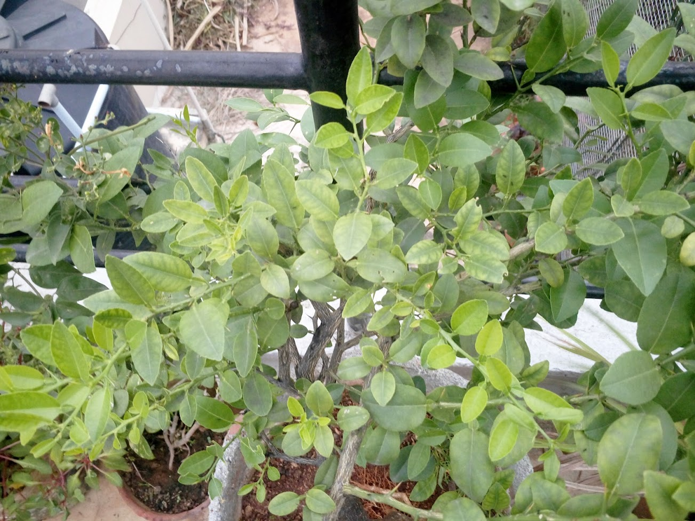
Picture Gallery

Slide 14
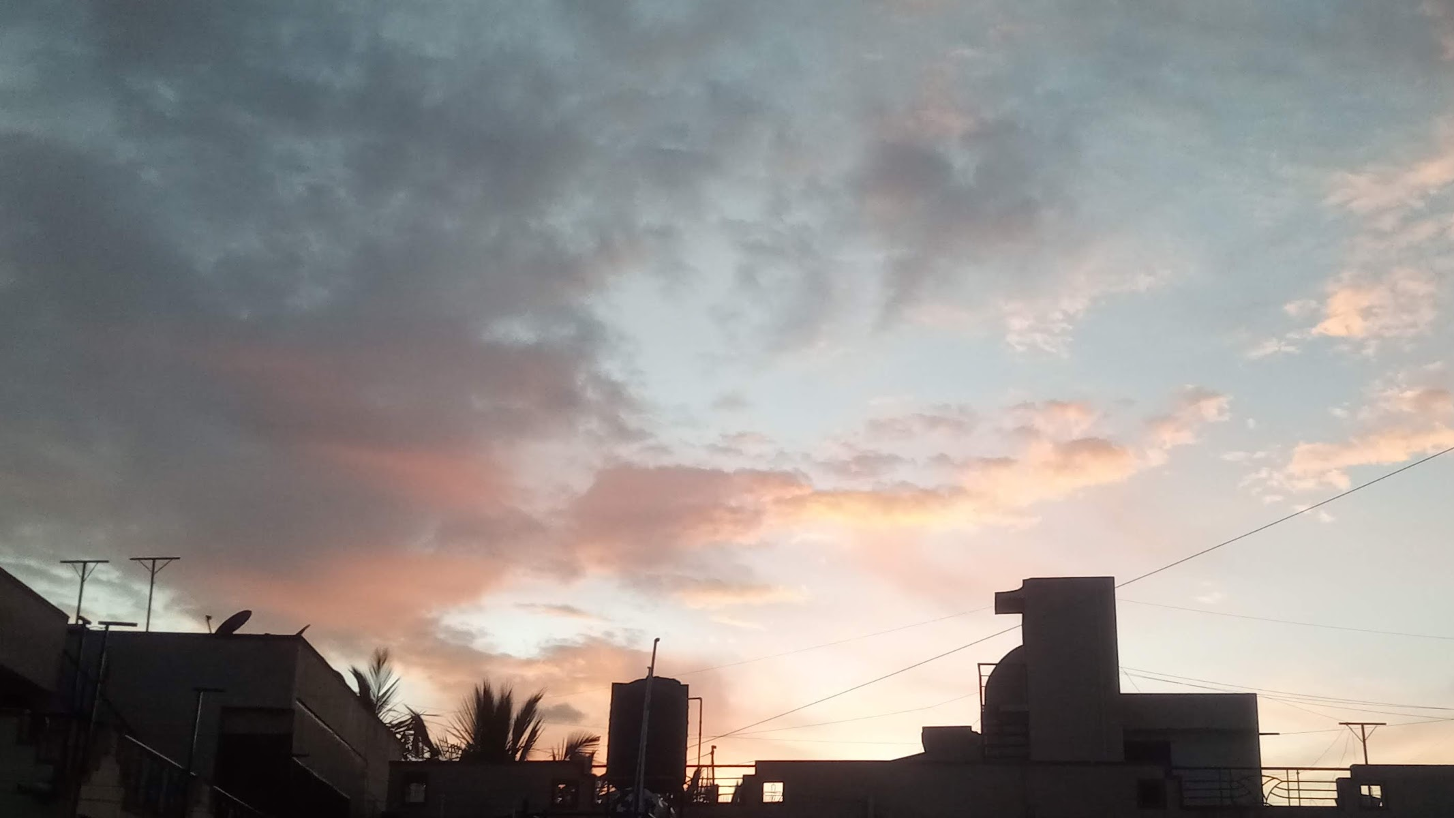
CREATURES THAT VISIT US

Slide 15
Butterflies and Moths
​Common Name | Scientific Name​
​Grass Yellow | ​Eurema hecabe
​Swallow Tail | ​Papilionidae
​Common Mormon | ​Papilio polytes
​Common Jay | ​Graphium doson
​Common Castor | ​Ariadne merione
​Hubner's Wasp Moth | ​Amata huebneri

Slide 16
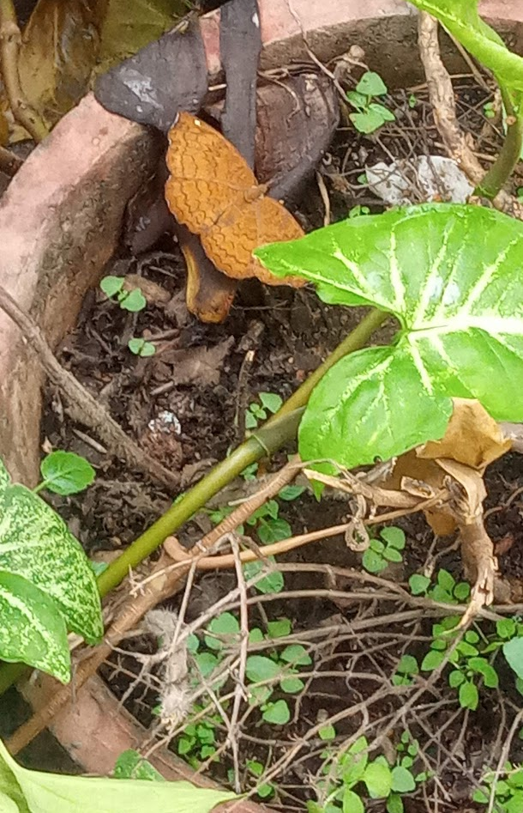
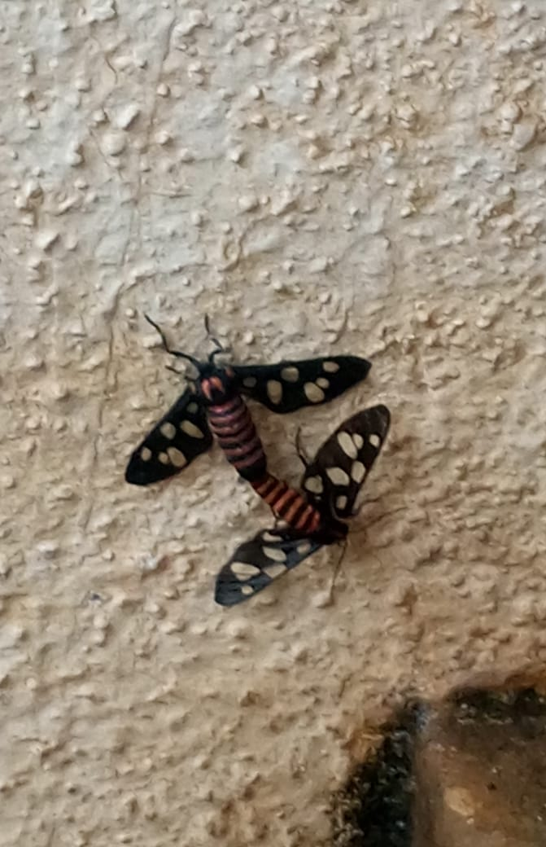
Captured Butterfly and Moth

Slide 17
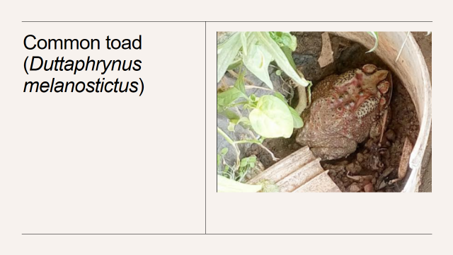
Frog seen

Slide 18
Birds spotted
Common Name | Scientific Name
House Crow | Corvus splendens
Eagle | Aquila
Feral Pigeon | Columba livia domestica
Red-whiskered Bulbul | Pycnonotus jocosus

Slide 19
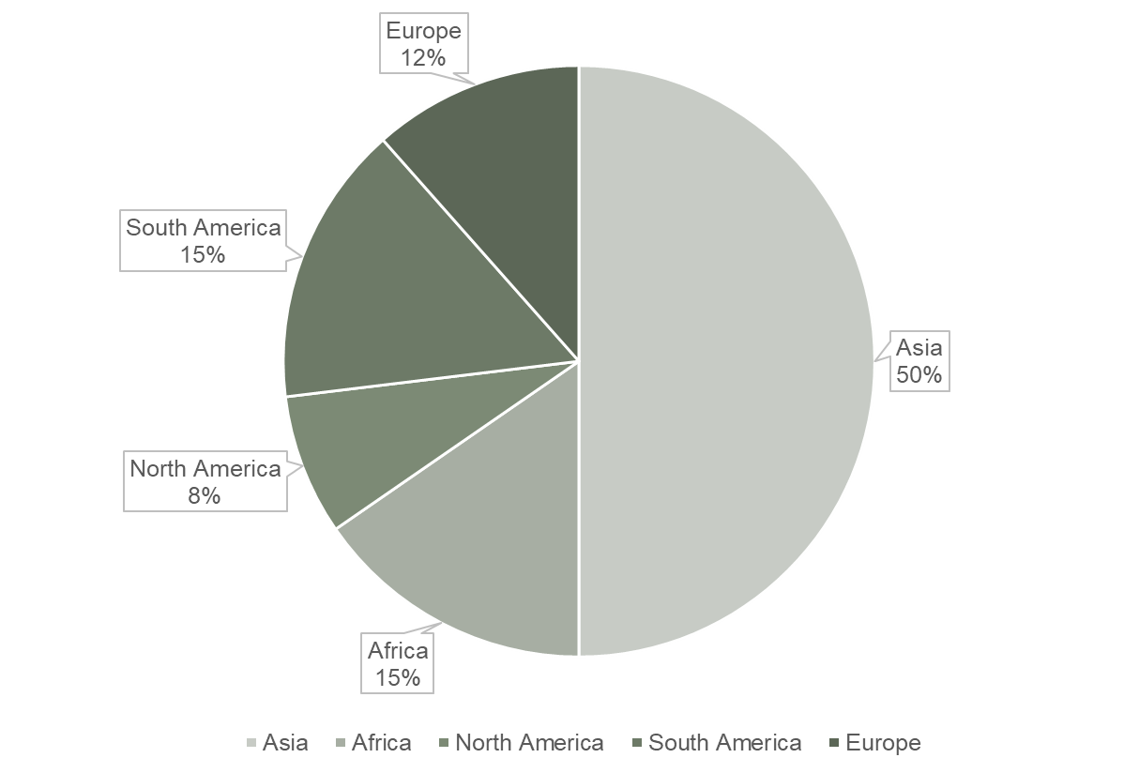
Ratio of the Native of the Plants [Continents]

Slide 20
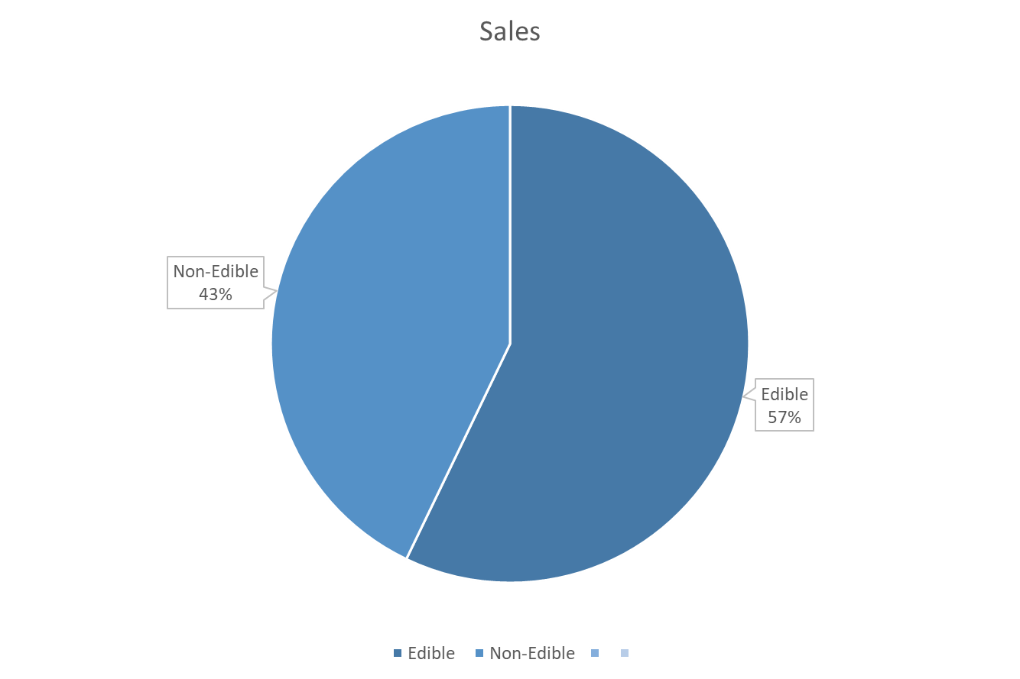
Ratio of the plants whose parts are edible to plants whose parts are inedible

Slide 21
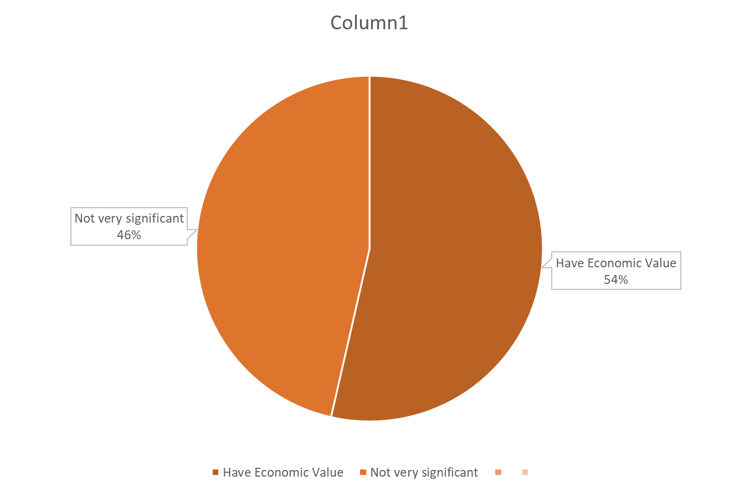
Ratio of the plants that have economic value

Slide 22
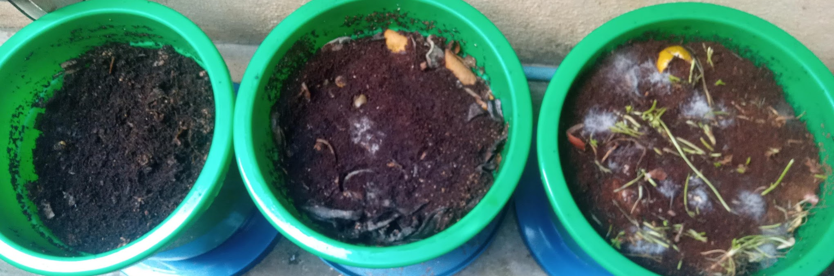
Composting in process

Slide 23
we would want to express our gratitude to Vrijulal Sir for always supporting and mentoring us, as well as to IISc Bangalore for providing this chance. We also want to express our gratitude to the Academic Director Sir and Principal Ma'am for letting us know about these possibilities and inspiring us to take part. We also wish to express our gratitude to Vijaya Ma, Rajasree Ma'am, and Chitralekha Ma'am for always being there to lend a hand and support us.

Slide 24
Thank you

