Slide 1


LAKE CONFERENCE 2022
Birds of Weavers colony
Team
Preetham S – Class 8

Slide 2
INTRODUCTION:
Birds are best indicators of wetland function.
Birds are the key species in an agricultural ecosystem for maintaining the ecological balance.
Birds add life sound and colour to our lives
Watching birds is a often diversion from the pressure to our daily life
Weather ecosystems , agriculture production , wildlife, water or tourism success can be measured by the health of birds.
A decline in birds numbers tells us are damaging the environment through habitat fragmentation and destruction, pollution and pesticides, introduced species and many other impacts.

Slide 3
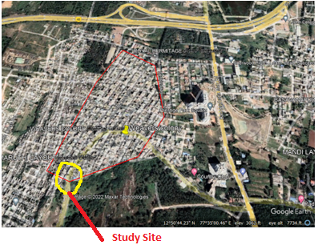
Objective:
To Document Birds of Weavers colony.
MAP
N
Study Area:
Weavers colony is located in
Gottigere ward,
Bangalore south
12º84’30”N
77º58’07”E
Weavers colony

Slide 4
Methods and materials:
We visited weekly once from July to October
In-between 6.30 am to 7-30am and Evening 5.30 pm to 6.30 pm.
Identification of the birds was made by visual method and by hearing the calls of the birds.
We used Pakshi app for identifying the sounds of the birds.
iNaturlist for identifying the birds name.

Slide 5
Results and Discussion
Totally 35 species of birds were found in the selected site.
Birds found month wise
SL NO | MONTH | SPECIES
1 | July | 24
2 | August | 23
3 | September | 24
4 | October | 19

Slide 6
Checklist of birds which are documented at Weavers colony
Sl No | Common name | Scientific name | Genus | July | Aug | Sept | Oct
1 | House sparrow | Passer domesticus | Passer | 1 | 4 | 2 | 4
2 | Jungle myna | Acridotheres fuscus | Acidotheres | 2 | 5 | 12 | 3
3 | Peacock | Pavo cristatus | Pavo | 0 | 1 | 0 | 1
4 | Jungle prinia | Prinia sylvatica | Prinia | 1 | 0 | 0 | 2
5 | Ashy prinia | Prinia socialis | Prinia | 2 | 0 | 3 | 1
6 | Dove | Columbidae Sp. | Columba | 3 | 3 | 13 | 7
7 | Red whiskerd bulbul | Pycnonotus jocosus | Pycnonotus | 2 | 13 | 1 | 2
8 | Eagle | Aquilinae Sp. | Aquila | 3 | 1 | 0 | 0
9 | Brewer blackbird | Euphagus cyanoncephalus | Euphagus | 1 | 0 | 3 | 0
10 | Laughing dove | Spilopelia senegalensis | Spilopelia | 1 | 3 | 7 | 0
11 | Swallow | Ardea alba | Typical Swallow | 0 | 7 | 0 | 2
12 | Great egret | Hirundinidae Sp. | Egretta | 1 | 0 | 2 | 1
13 | Tailor bird | Orthotomus Sp. | Orthotomus | 0 | 2 | 3 | 1
14 | Helmated guinea fowl | Numida meleagris | Numida | 0 | 3 | 0 | 0
15 | Domestic turkey | Meleagris gallopavo | Meleagris | 0 | 0 | 4 | 7

Slide 7
16 | Green bee eater | Meropidae Sp. | Merops | 1 | 4 | 1 | 0
17 | Greater coucal | Centropus sinensis | Centropus | 0 | 1 | 0 | 0
18 | Wagtail | Motacilla Sp. | Motacilla | 0 | 0 | 9 | 3
19 | Domestic muscovy duck | Cairina maschata | Cairina | 0 | 9 | 11 | 1
20 | Rooster | Gallus domesticus | Gallus | 5 | 11 | 0 | 3
21 | Mouring dove | Zenaida macroura | Zenaida | 0 | 0 | 1 | 0
22 | Black kite | Milvus migrans | Milvus | 1 | 1 | 17 | 0
23 | Little greebe | Tachybaptus ruficollis | Tachybaptus | 7 | 17 | 0 | 3
24 | Light vented bulbul | Pycnonotus Sp. | Pycnonotus | 0 | 3 | 1 | 0
25 | Rose ringed parkeet | Psittacula krameri | Psittacula | 0 | 0 | 0 | 0
26 | White throated kingfisher | Halcyon merulla | Halcyon | 4 | 3 | 0 | 1
27 | Common blackbird | Turdus merula | Turdus | 1 | 2 | 0 | 0
28 | Leaden flycatcher | Myiagra rubecula | Myiagra | 0 | 1 | 1 | 0
29 | House crow | Corvus splendens | Corvus | 0 | 0 | 1 | 0
30 | Asian koel | Eudynamys Sp. | Eudynamys | 1 | 3 | 0 | 0
31 | Oriental magpie Robin | Copsychus saularis | Copsychus | 1 | 3 | 0 | 3
32 | White cheeked barbet | Megalima viridis | Psilopogon | 1 | 3 | 5 | 5
33 | Indian jungle crow | Corvus cuminatus | Corvus | 5 | 6 | 6 | 5
34 | Scissor tailed flycatcher | Tyrannus forficatus | Tyrannus | 0 | 0 | 1 | 0
35 | Unidentified |  |  | 0 | 1 | 0 | 0

Slide 8
Conclusion
Birds are a part of the balanced nature
Birds play a critical role in reducing and maintaining populations of
insects in natural system.
Totally 35 species of birds were found in the selected site.
Wag Tail, Rooster, House Crow, Red Whiskered Bulbul, Indian
jungle crow, Jungle Myna and others were found in all the four
months of the study.
Tailor Bird, Common black bird and Scissor tailed flycatcher were
found only once in the study.

Slide 9
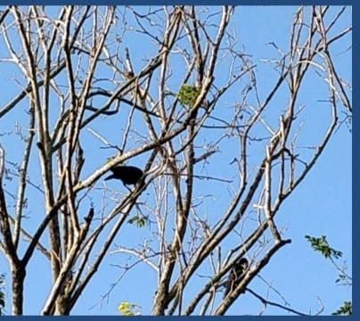
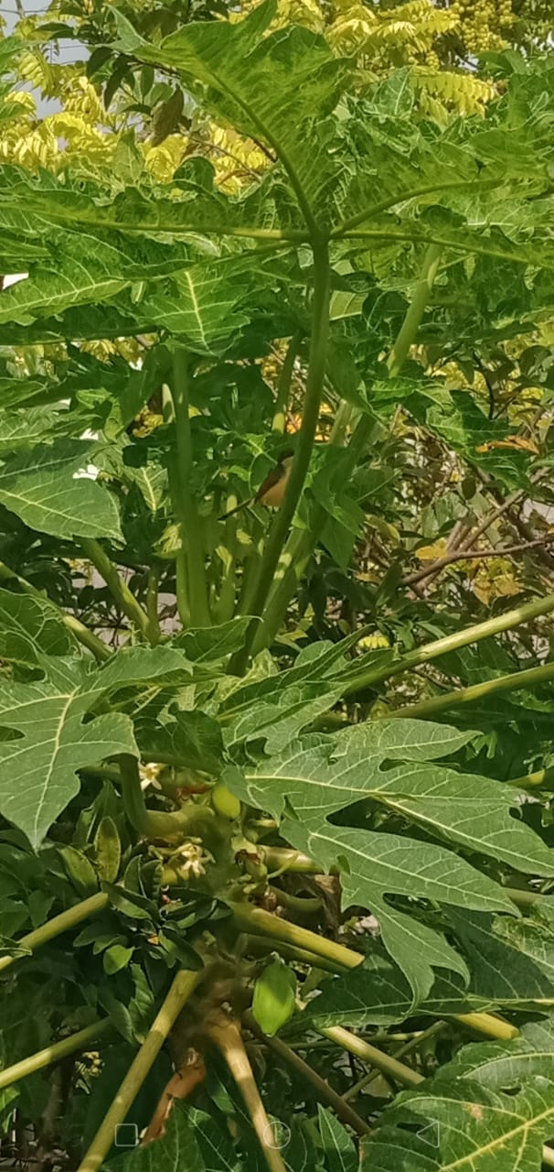
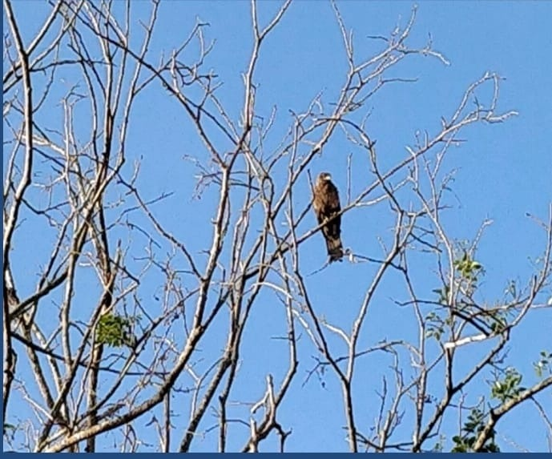
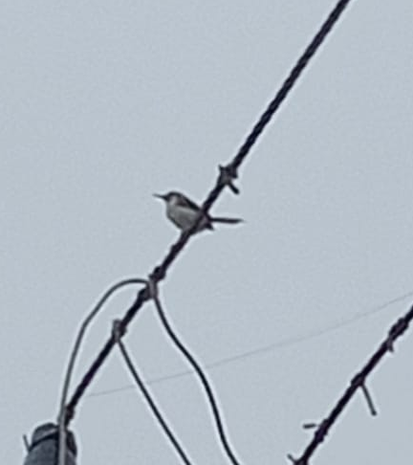
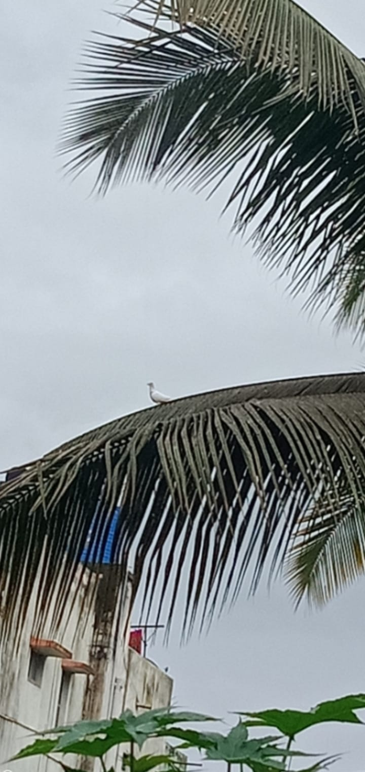
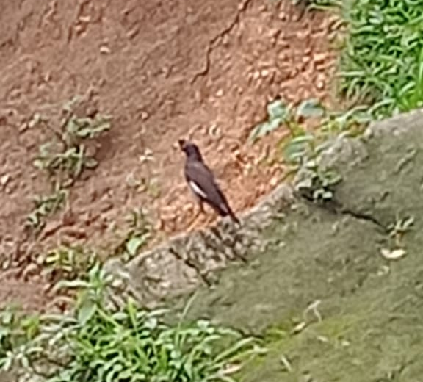
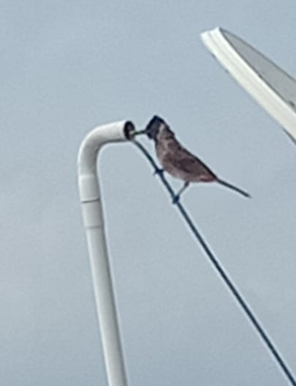
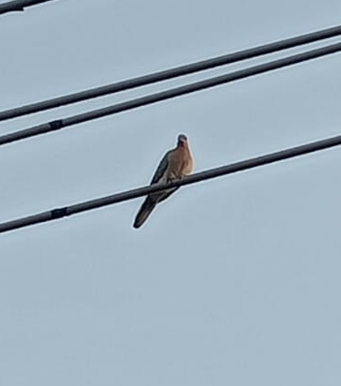
Identified birds:
House Crow
Ashy Prinia
Black Kite
Jungle Prinia
Dove
Jungle Myna
Red Whiskered Bulbul
Laughing Dove

Slide 10
ACKNOWLEDGEMENT
We thank our H.M, Guide Teacher for allowing us to conduct the Study.
We thank Energy and Wetland Research Group, Center for Ecology Sciences, Indian Institute of Science. Bangalore.
Shri Vriju lal of CEE and Shri Chaturved Shet R for guiding.
We thank one and all here for giving us opportunity to present the Study.

Slide 11
REFERENCE:
Harish Bhat et all (2015) A Brochure of Eyes on Nature published by Karnataka State Council for Science and Technology.
Pakshi app for identifying the bird sounds.
For scientific name Wikipedia.
iNaturlist for identifying the birds name.
100 birds of Bangalore city by Karnataka forest department 2005.

Slide 12
THANK YOU

