Slide 1


LAKE CONFERENCE 2022
Trees of Weavers colony
Team
Tejas U, Darshan S – Class 9

Slide 2
INTRODUCTION
TREES CREATE AN ECOSYSTEM BY PROVIDING SHELTER AND FOOD FOR BIRDS AND ANIMALS.
THEY ABSORB CARBON DIOXIDE FROM THE AIR AND RELEASE OXYGEN.
THEY PLAY A SIGNIFICANT ROLE IN REDUCING EROSION AND MODERATING THE CLIMATE.
THEY ARE WIDELY APPRECIATED FOR THEIR PRODUCTS AND THE BEAUTY THEY CONTRIBUTE TO OUR ENVIRONMENT.

Slide 3
Objective
To document Trees in Weavers Colony
To measure height and girth of identified trees

Slide 4
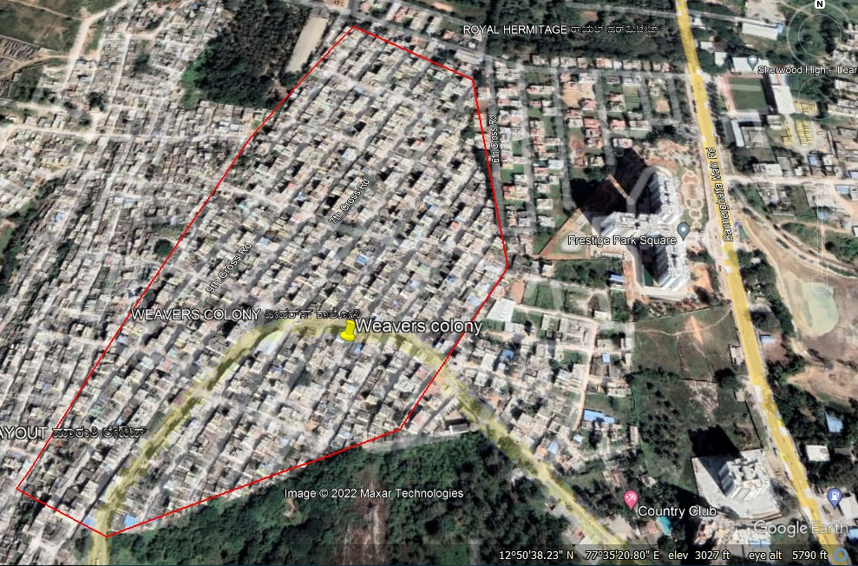
TREES
Study area:
12 ͦ 84’40”N, 77 ͦ 58’49’’E
to
12 ͦ 84’50’’ N , 77 ͦ 58’23’’E
Weavers colony, Gottigere,
B G Road, Bangalore South, Bangalore -83
N
Study area selected was around 2 sq km

Slide 5
Methods & Materials
Covered 10 crosses from East to West
Counted each tree and recorded Girth as per standard GBH [Girth at breast height] and Height of trees using Shadow method
Used materials : Measurement Tape, set square, Field Data Book, Smart Phones to Capture Picture.
Google lens for identification of trees and scientific name Wikipedia

Slide 6
Checklist of Trees in Weavers colony from 1st cross to 10th cross
Sl No | Common name | Scientific name | Family | Order | Medicinal value | No of trees
1 | Guava tree | Psidium guajava | Myrtle | Myrtales | Stomach pain, diabetes | 4
2 | Pongamia pinnata tree | Millettia pinnata | Fabaceae | Fabales | Piles, skin diseases | 115
3 | Lazy tree | Mimosa pigra | Sloth | Pilosa | Dysentry, microbial infections | 1
4 | Neem tree | Azadirachta indica | Mahogany | Sapindales | Antiinflammatory, anticelular | 20
5 | Parijatha tree | Nyctanthus arbor | Oleaceae | Lamiales | Fever, malaria, dengue | 2
6 | Cashew tree | Anacardium occidentale | Anacardiaceae | Sapindales | High cholesterol, heart disease | 4
7 | Purple fruit tree | Sterculia foetida | Clusiaceae | Malpighiales | Stroke, cancer | 10
8 | Turpentine tree | Bursera simaruba | Burseraceae | Sapindales | Lower blood sugar, lower cholesterol | 1
9 | Unchi tree | Alstonia scholaris | Moraceae | Gentianeles | Diarrhea, ayurvedic | 1
10 | Hatti fruit tree | Ficus carica | Mulberry | Rosales | Diabetes, skin diseases | 2

Slide 7
11 | Coconut tree | Cocos nucifera | Arecaceae | Arecales | Antibacterial, antifungal | 42
12 | Indian mulberry tree | Morinda citrifolia | Madder | Gentianeles | Lower blood sugar, lower cholesterol | 1
13 | Gooseberry tree | Phyllanthus acidus | Phyllanthaceae | Malpighiales | Pain and swelling of pancreas | 4
14 | Neelgiri tree | Eucalyptus globules | Myraceae | Myrtales | Muscle pain, heals wounds | 1
15 | Curry leaves tree | Murraya koenigil | Rutaceae | Sapindales | Dysentery, diarrhea | 1
16 | Cilantro tree | Coriandrum sativum | Apiaceae | Apiales | Against infections | 1
17 | Horsepass tree | Aesculus hippoastanum | Equidae | Perissodactyla | Cough remedy, reduce fever | 11
18 | Areca palm tree | Dypsis lutescens | Palmae | Arecales | Antibacterial, hypoglycemic | 7
19 | Almond tree | Prunus dulcis | Rose | Rosales | Blood pressure | 6
20 | Champak tree | Magnolia champaca | Magnolia | Magnoliales | Quick wound, healing | 6

Slide 8
21 | Singapore cherry tree | Muntingia calabura | Muntingiaceae | Malvales | Antiseptic | 1
22 | The Silver Oak Tree | Grevillea robusta | Proteaceae | Proteales | Used in the manufacture of furniture, cabinetry, and fences | 14
23 | Peepal tree | Ficus religiosa | Mulberry | Rosales | Cough, asthma, ear pain | 6
24 | Mango tree | Mangifera indica | Anacardiaceae | Sapindales | Stomachic, bronchitis | 2
25 | Star fruit tree | Averrhoe carambola | Oxalidaceae | Oxalidales | Ayurvedic, skin disorders | 1
26 | Soursop tree | Amona puricata | Dipterpcarpaceae | Malvales | Wounds, ear ache, headache | 1
27 | Paneer fruit tree | Syzgium jambos | Myrtaceae | Myrtales | Diabetes | 1
28 | Butter fruit tree | Bunchoria glandifera | Lauraceae | Laurales | Sperm quality | 1
29 | Ebathi tree | Ficus racemosa | Moraceae | Rosales | Various skin diseases | 1
30 | Gulmohar tree | Delonix regia | Fabaceae | Fabales | Gum used as a binding agent and in manufacturing tablets | 6
31 | Yellow flametree | Peltophorum pterocarpum | Fabaceae | Fabales | Used for fodder and used as dyes | 8

Slide 9
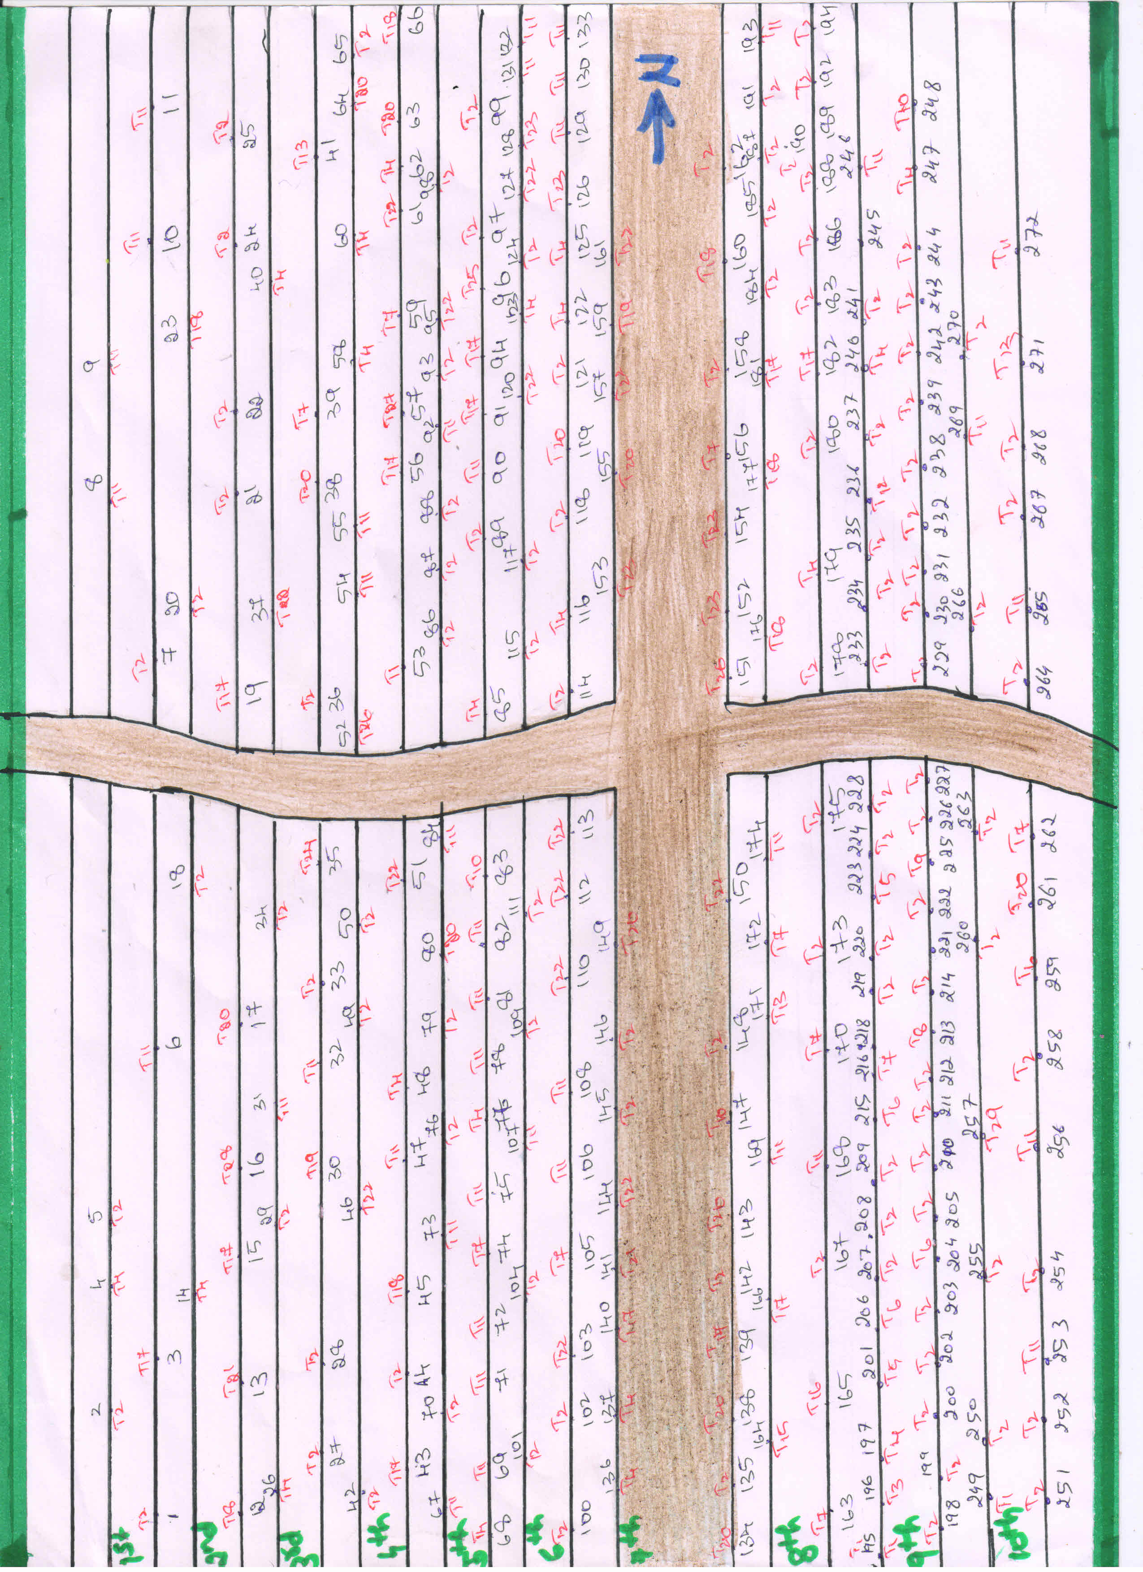
Location of Trees in weavers colony

Slide 10
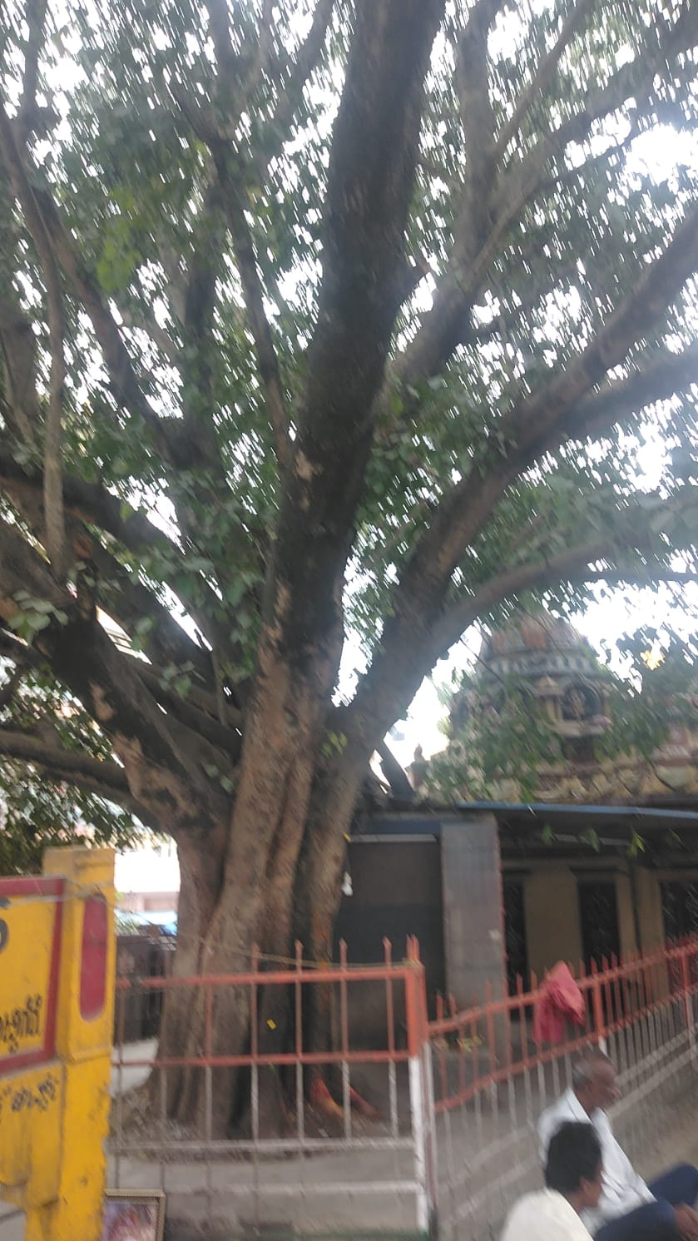
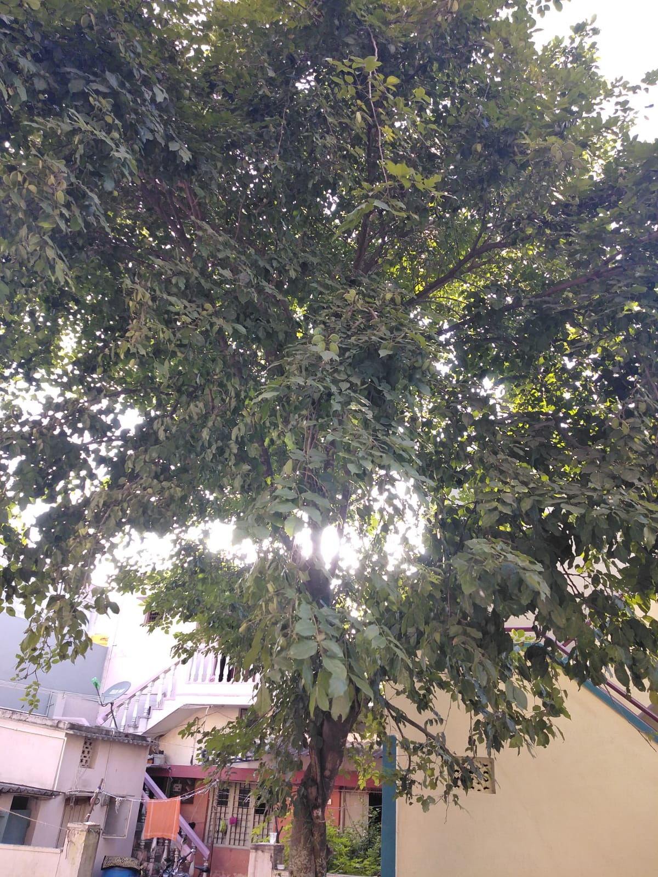
Field Work
Tallest tree in study
Peppal tree
100 inches girth and height 145 feet
Shortest tree in study
Pongamia Pinnata
10 inches girth and height 19 feet

Slide 11
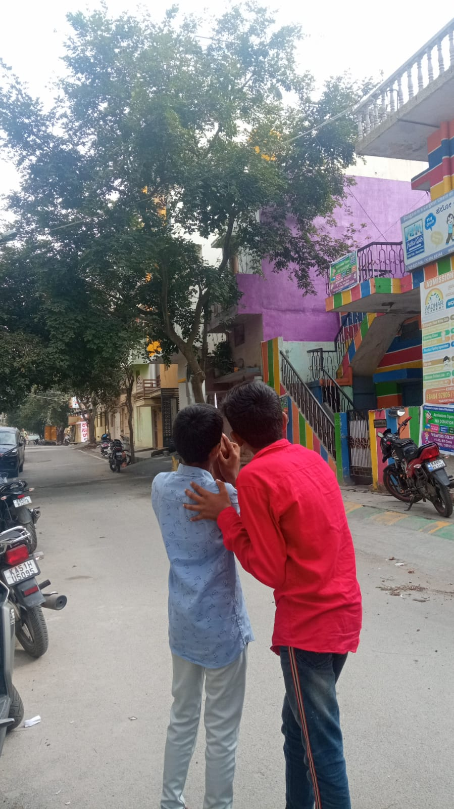
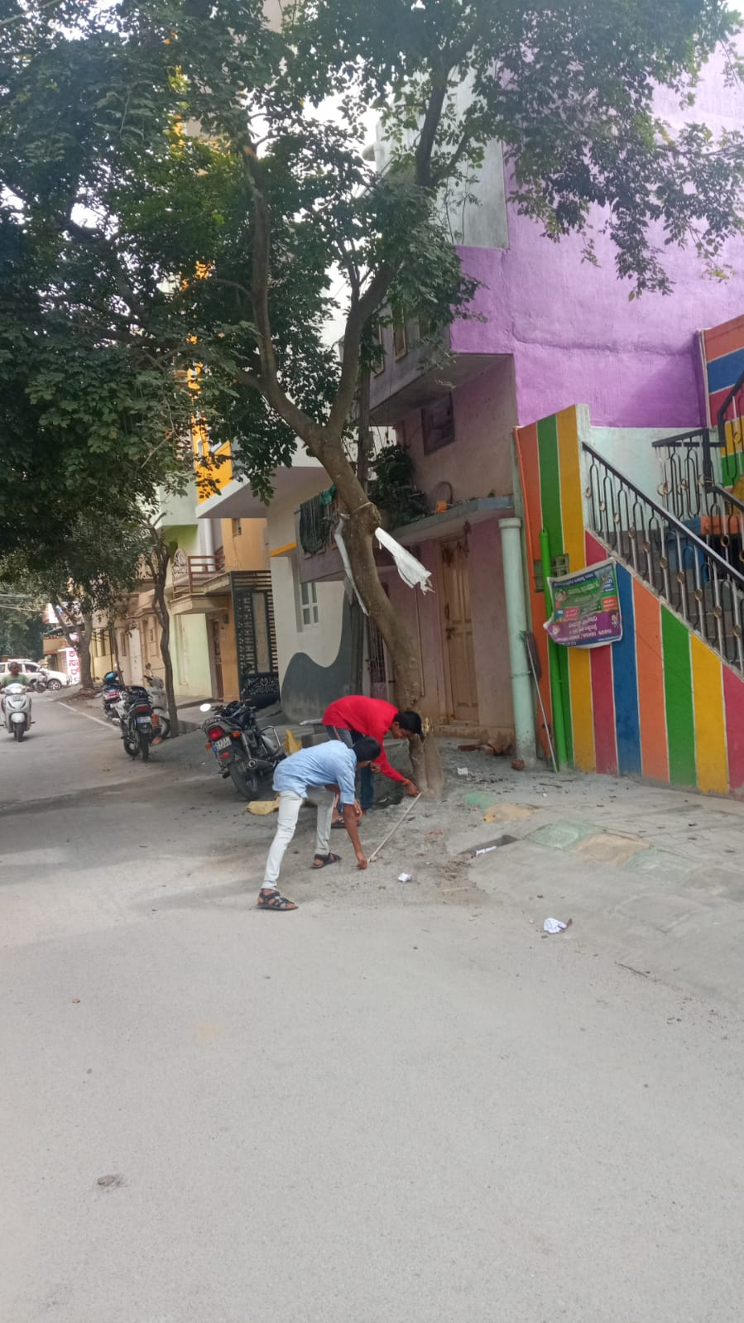
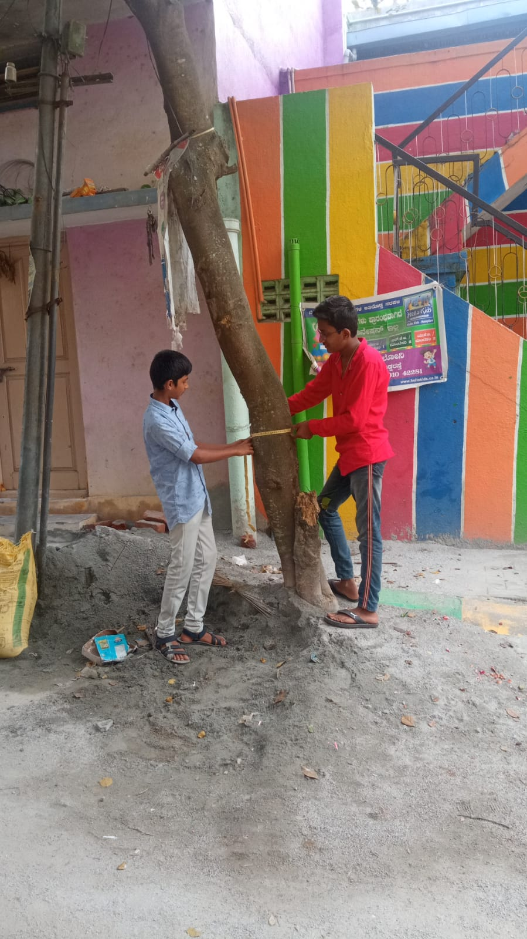
Field Work

Slide 12
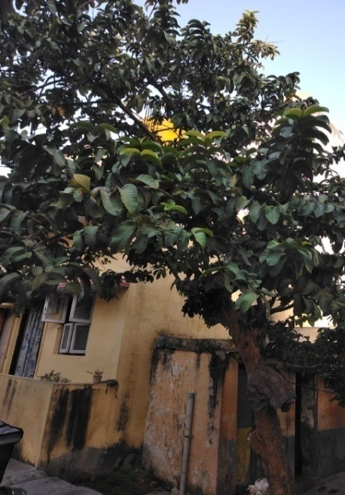

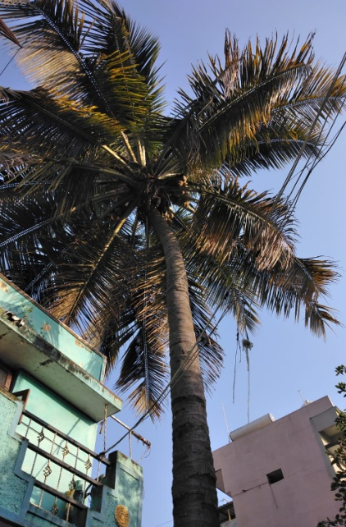
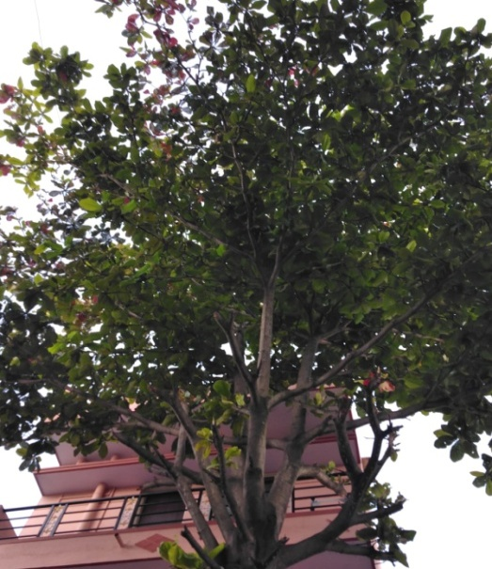
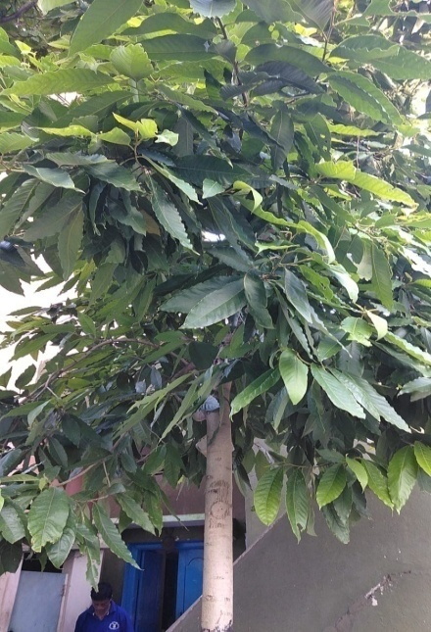
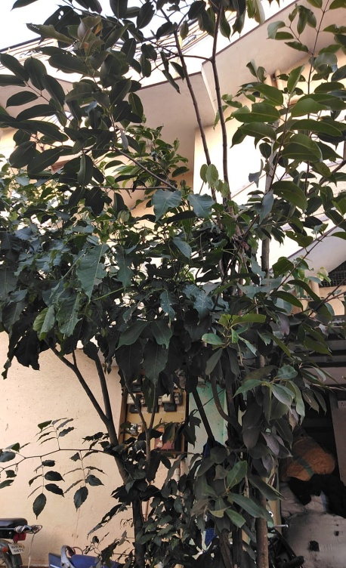
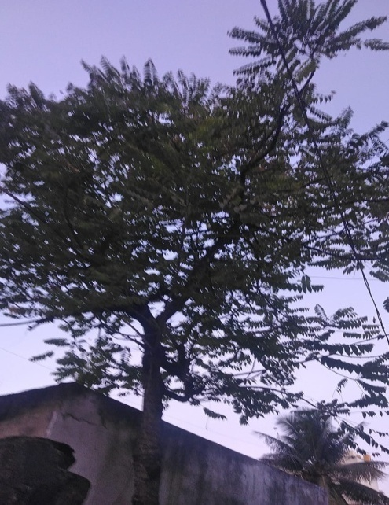
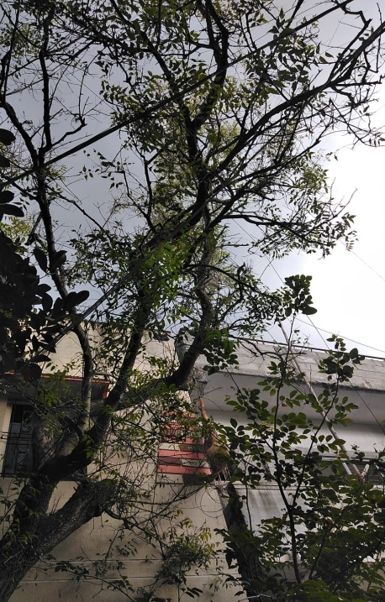
Psidium guajava
Millettia pinnata
Cocos nucifera
Anacardium occidentale
Magnolia champaca
Sterculia foetida
Phyllanthus acidus
Azadirachta indica

Slide 13
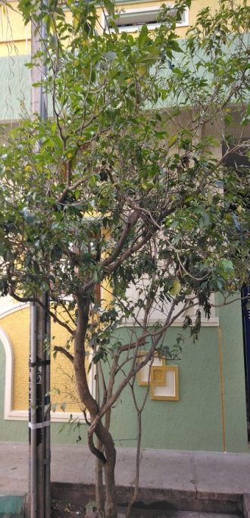
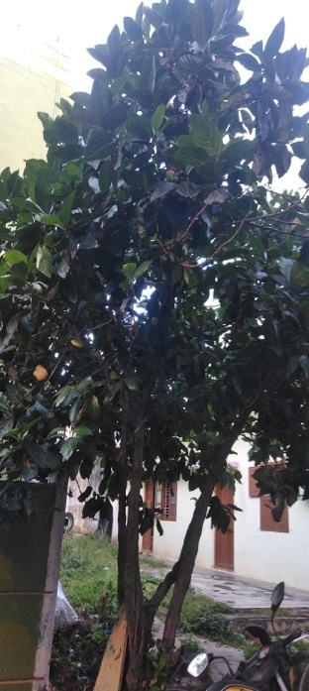
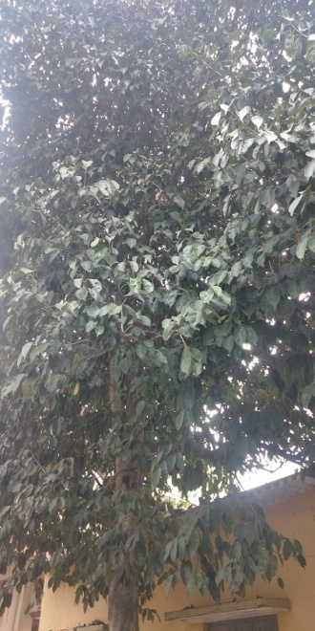

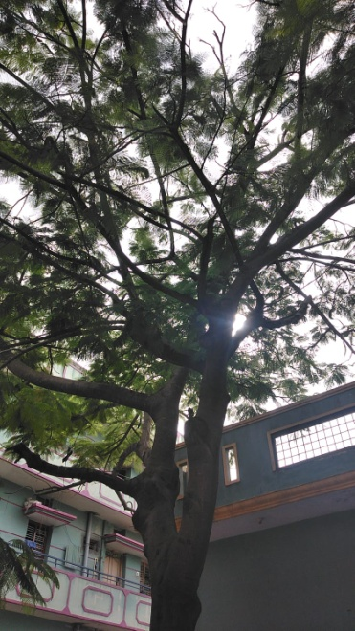
Nyctanthus arbor
Morinda citrifolia
Sterculia foetida
Ficus religiosa
Delonix regia

Slide 14
Important Data collected
Total Trees counted : 286
Tallest tree: peppal tree was 100 inches girth and height was 145 feet
Shortest tree : Pongamia Pinnata tree was 10 inches girth and height was 19 feet
Max 54 trees were in 9th cross and least 11 trees were in 1st cross
Educated people to plant a sapling in front their houses and collected their phone number for follow up to plant.

Slide 15
RESULT and DISCUSSION
In Weavers Colony there are 286 Trees.
Most trees were found in 9th cross [54 trees] and the least count was in 1st Cross [11 trees].
Dr. TVR sir words, “that a person needs oxygen of 7 trees for his life time”.
In our study area there are 286 trees.
There is space for another 263 trees to grow.
We conveyed people in Weavers colony and took permission to plant 130 saplings out of 263, which will be followed.

Slide 16
Conclusion
The temperature was 2º less below the trees as compared the place with out tree.
In weavers colony there are 286 trees
Space available for another 263 trees to plant in study area.
We all should educate the people regarding plantation and encourage them to plant and take care of trees.
Trees should be planted in and around weavers colony to save the mankind and the animal world.

Slide 17
ACKNOWLEDGEMENT
We thank
Our H.M, Guide Teacher for giving us opportunity to conduct the study.
We thank Energy and Wetlands Research Group, Center for Ecological Sciences, Indian Institute of Science. Bangalore, and Lake 2020 for giving us opportunity.
Shri Vriju lal of CEE and Shri Chaturved Shet R for guiding.
We thank one and all here for giving us opportunity to present the Study.

Slide 18
References
Google lens for identification of trees and scientific name Wikipedia

Slide 19
THANK YOU

