Slide 1
LAKE CONFERENCE 2022
Observation and documentation of Spiders in Weavers colony
Team
Nandini M, Lekhana S - Class 7

Slide 2
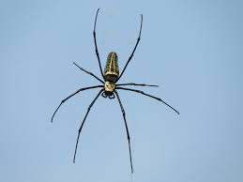
INTRODUCTION
Spiders are placed under phylum arthropod, class Arachinda, order Araneae.
They are air-breathing arthropod.
They have eight legs and they are not insects.
They feed on insects worms and of there own kind.
They are generally harmful to humans and live stocks.
They have poisonous glands present in there mouth parts and they use it to kill the victims

Slide 3
Objective
Observation and
Documentation of
Spiders in Weavers Colony

Slide 4
MAP
Study Area: Weavers Colony, Bengaluru south,
Gottigere Post, Bannerughatta Road, Bengaluru - 560083
N

Slide 5
Study Site:
Sl No | Area | Longitude | Latitude | Place
1 | Maruthi layout | 12°84'19"N | 77°58'02"E | House of Harsha S
2 | Byrappa layout | 12°84'37"N | 77°58'59"E | House of Jeevan M
3 | 5th Cross | 12°84'52"N | 77°58'42"E | House of Ekanth G P
4 | 5th Cross | 12°84'30"N | 77°58'30"E | House of Likhith S H
5 | 8th Cross | 12°84'67"N | 77°58'42"E | House of Jai Veer Prathap H
6 | 10th Cross | 12°84'69"N | 77°58'36"E | House of Mithrashree A
7 | 2nd Cross | 12°84'51"N | 77°58'53"E | House of Deepashree S
8 | 12th Cross | 12°84'66"N | 77°58'14"E | House of Mukthashree S
9 | Pillaganahalli | 12°84'64"N | 77°58'93"E | House of Nandini M

Slide 6
Methods & Materials
Selected study area is around 2 sq Km
Visited Study area every day, from July to October.
In-between 6am to 7-30am.
randomly inspecting the area each and every corner of the house and the garden area

Slide 7
Results and Discussion:
The total of 22 Species of spiders was identified during the study period.
We started our observation in the month of July we found 8 different species of spiders mainly wall jumping spider, daddy long leg spider, funnel spider, etc.
We found more number of species as we started identifying each and every corner of the house and surrounding.
We could find 17 different species In the month of September we could find 16 different species of spiders.
In the month of October we could find only 10 species of spiders

Slide 8
Spiders found month wise in Weavers colony
SL NO | MONTH | SPECIES
1 | July | 9
2 | August | 17
3 | September | 16
4 | October | 10

Slide 10
Checklist of Spiders which are documented at Weavers Colony
Sl no | Common name | Scientific name | Family name | July | Aug | Sept | Oct
1 | Hobo spider | Eratigena agrestis | Agelenidae | 0 | 2 | 0 | 0
2 | Tick spider | Ixodoidea Sp. | Arachnid | 0 | 1 | 2 | 0
3 | European garden spider | Araneus diadematus | Araneidae | 4 | 2 | 1 | 4
4 | Stall orb weaver | Araneuse Sp. | Araneidae | 0 | 4 | 5 | 0
5 | Giant cross | Araneus diadematus | Araneidae | 0 | 2 | 3 | 0
6 | Marbled orbweaver | Araneus marmoreus | Araneidae | 4 | 12 | 8 | 0
7 | Araneomorph spiders | Nephila inaurata | Araneidae | 0 | 3 | 10 | 4
8 | Silver garden orb weaver | Argiope argentata | Araneidae | 0 | 0 | 0 | 1
9 | Argiope spider | Argiope Sp. | Araneidae | 0 | 1 | 4 | 0
10 | Yellow sac spider | Cheirscacanthium includum | Cheiracanthiidae | 3 | 2 | 1 | 0

Slide 11
11 | The tropical tent web spider | Cyrtophora citricola | Cyrtaphora | 4 | 5 | 0 | 0
12 | Giant golden orb weaver | Nephila pilipes | Draneidae | 0 | 0 | 2 | 4
13 | Rose hair tarantula | Chileanrose tarantula | Mygalomorphae | 3 | 0 | 0 | 2
14 | Wall jumping spider | Menemerus bivittatus | oecobiidoe | 2 | 6 | 11 | 0
15 | White spatted green spider | Epeus indicus | Oxyopidae | 4 | 2 | 0 | 0
16 | Cellar spider | Pholcidae Sp. | Pholcidae; C. L. Koch, 1850 | 0 | 5 | 1 | 2
17 | Daddy long leg spider | Pholcidae Sp. | Pholcidos | 4 | 5 | 6 | 0
18 | Small wall jumping spider | Menemerus bivittatus | Salticidae | 0 | 9 | 0 | 1
19 | The brown recluse spider | Loxosceles reclusa | Sicariidae | 0 | 0 | 1 | 0
20 | Australian gaint house spider | Heteropodidae Sp. | Sparassidae | 0 | 0 | 2 | 3
21 | Chilean tiger spider | Scytodes globula | Sytodidae | 1 | 8 | 9 | 2
22 | Red house spider | Neslicodes rufipes | Theridiidae | 0 | 3 | 4 | 0

Slide 13
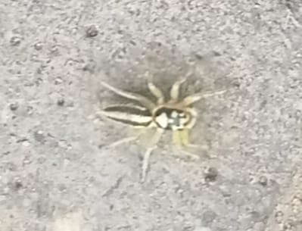
Identified Spiders
Wall jumping Spider
daddy long leg spider
Garden Orb Weaver
spider
Cellular spider

Slide 14
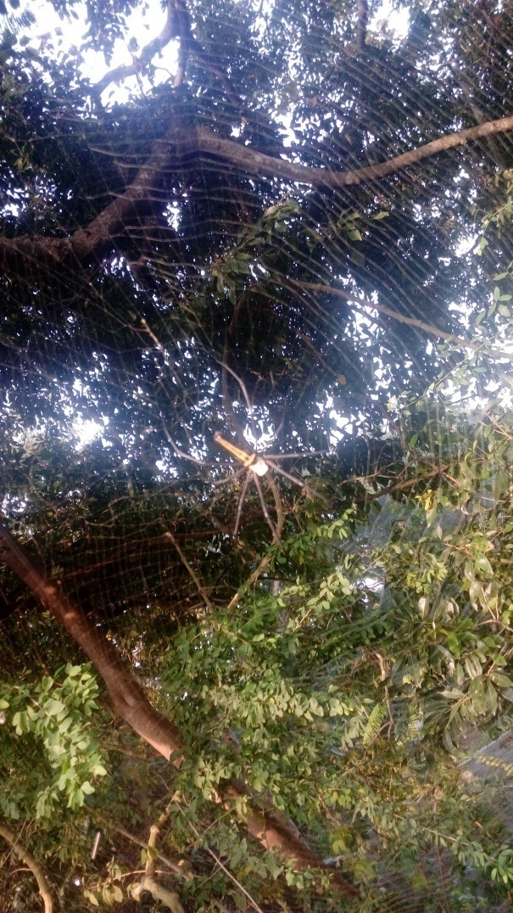
Yellow Sac Spider
European Graden Spdier
Red House Spider
Giant Wood Spider

Slide 15
Conclusion
In the present study we could indentify 22 species of spiders in our 4 month study
as there was variation in every visit due to the human activities and weather change,
this study would be useful in the future assessment of environmental conditions as well to create awareness for their conservation.
From above observation we conclude that there is an urgent need to understand more about their diversity in weavers colony as they are important bio indicators of environmental changes.

Slide 16
ACKNOWLEDGEMENT
We thank our H.M, Guide Teacher for allowing us to conduct the Study.
We thank all 9 members, who documented the spiders in different location of weavers colony.
We thank Energy and Wetland Research Group, Center for Ecology Sciences, Indian Institute of Science. Bangalore,
Shri Vriju lal of CEE and Shri Chaturved Shet R for guiding.
We thank one and all here for giving us opportunity to present the Study.

Slide 17
Reference
Team Saliga – Backyard Spiders.
World Spider catalogue
For Scientific name Wikipedia.
Spiders of Karnataka by Environmental Management and Policy Research Institute.

Slide 18
THANK YOU

