Slide 1
LAKE CONFERENCE 2022
Observation and documentation of Medicinal Plants grown in houses of Weavers colony
Team : Deepashree S, Hemashree V Class - 7

Slide 2
INTRODUCTION
A medicinal plant is a plant that is used with the intention of maintaining health, to be administered for a specific condition, or both, whether in modern medicine or in traditional medicine
Medicinal plants, also called medicinal herbs, have been discovered and used in traditional medicine practices since pre-historic times.
The use of medicinal plants is found in all cultures of the world. Approximately 90% of ayurvedic preparations are plant based.

Slide 3
Objective
Observation and documentation of Medicinal plants grown In households
of Weavers colony.

Slide 4
MAP
N
Study Area: Weavers Colony, Bengaluru south,
Gottigere Post, Bannerughatta Road,
Bengaluru – 560083

Slide 5
Study Site :
1 | 2nd Cross | 12°84'52"N | 77°58'53"E | Site of Deepashree
2 | 3rd Cross | 12°84'53"N | 77°58'51"E | Site of Prema
3 | 7th Cross | 12°84'51"N | 77°58'35"E | Site of Deepthi
4 | 9th Cross | 12°84'52"N | 77°58'25"E | Site of Jayalakshmi

Slide 6
Methods & Materials
Selected study area is around 1 km
Visited Sunday and Wednesday weekly Twice, from August to October-2022.
In between 6 pm to 7.30pm.
Randomly inspecting houses of the road and identified the medicinal plants

Slide 7
Results and Discussion:
Totally 16 species of medicinal plants we were found in the selected site.
Identified 16 species were seen in all the 3 months of our study, as there were protected by the household.
Medicinal values of all species were known in the household.
These values were known from their elders.
Leaves of Tulsi and Betel leaves were used for throat infection.
Hibiscus, Mehandi, Curry leaves and Aloe vera are used for hair care.
Thumbai is used to cure wounds and Yakka for bathing
Coriander, Mint, Curry leaves are used in cooking.
Fruit of Pomegranate is consumed orally and Leaves of Yakka is used for bathing.

Slide 8
Checklist of medicinal plants documented at Houses of
Weavers colony and Used parts of plants
Sl No | Common Name | Scientific Name | Only Food | Only Health | Food and Health | Used parts of plants
1 | Tulsi | Ocimum sanctum | - | √ | - | Leaf
2 | Hibiscus | Rasa Sinensis | - | √ | - | Leaf and Flower
3 | Mehandi | Sonia Inermis | - | √ | - | Stem and Leaf
4 | Coriander | Sativum | √ | - | - | Leaf and Stem
5 | Pomegranate | Punic Granatum | - | - | √ | Leaf and Fruit
6 | Mint | Mentha | √ | - | - | Leaf
7 | Thumbai | Leucas aspera | - | √ | - | Leaf and Flower
8 | Betel Leaf | Piperbetal | √ | - | - | Leaf
9 | Curry Leaves | Murraya Koengii | √ | - | - | Leaf and Stem
10 | Cuban Oregano | Coleus Amboinicus | √ | - | - | Leaf
11 | Aloe Vera | Aloe Barbadensis | - | - | √ | Leaf
12 | Miracle Leaves | Kalanchoe Pinnata | √ | - | - | Leaf
13 | Agathi Leaf | Sesbaniagrandi Flora | √ | - | - | Leaf
14 | Touch-me-not | Mimisa pudica | - | √ | - | Leaf
15 | Lemo grass | Gymbo pogon | - | √ | - | Leaf
16 | Yakka | Calotropis giganta | - | √ | - | Leaf

Slide 9
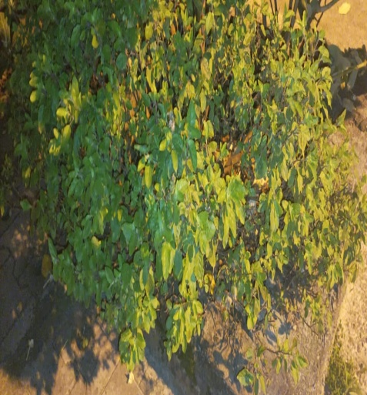
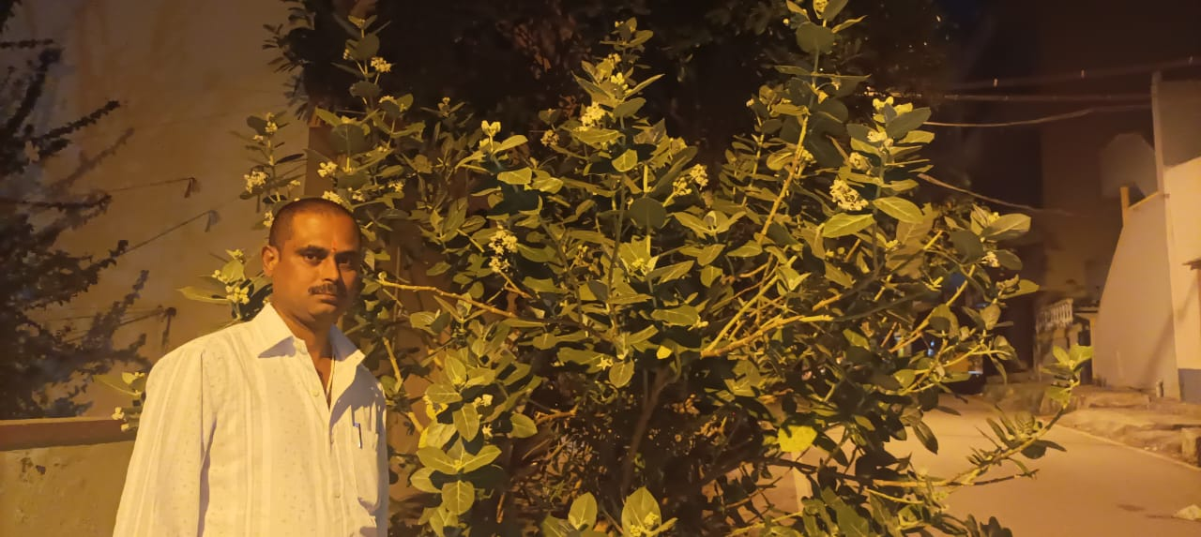
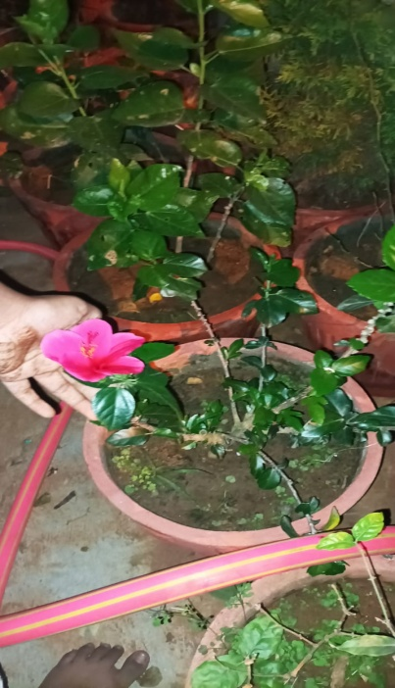
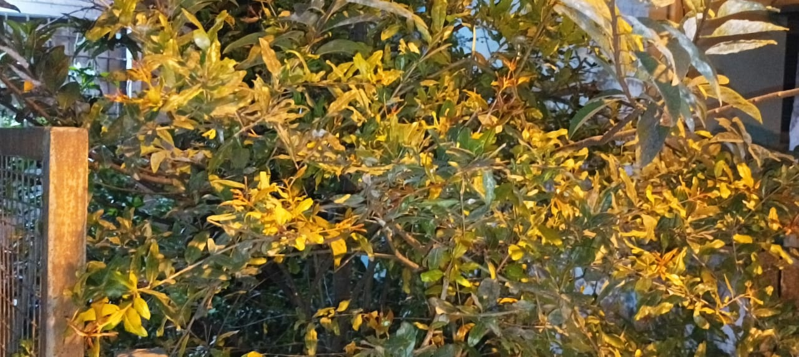
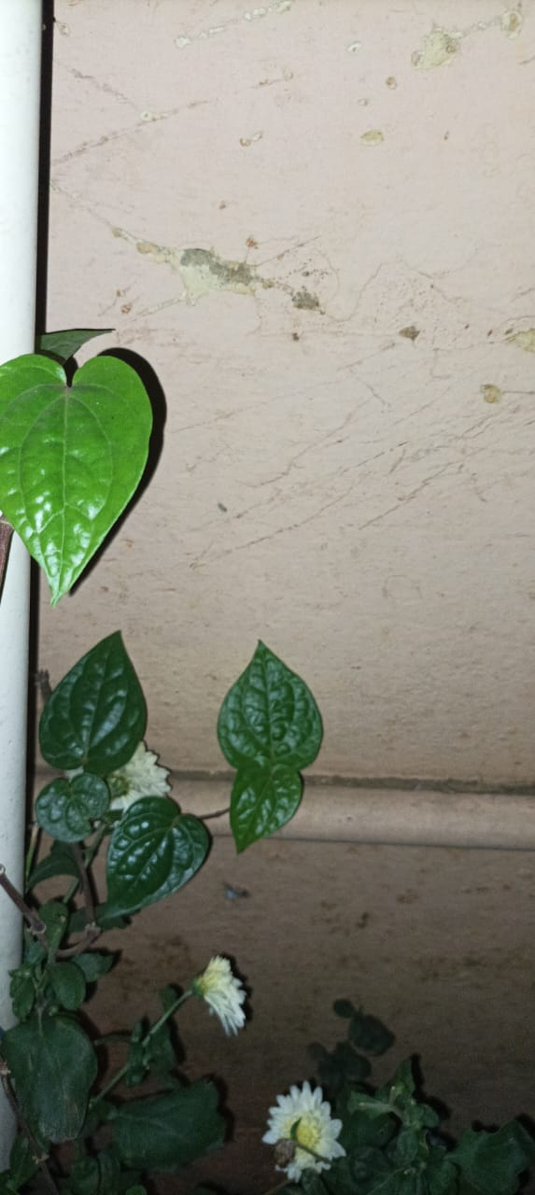
Tulsi (Brown)
Tulsi (Green)
Yakka
Hibiscus
Curry
Mehandi
Pomegranate
Betel

Slide 10
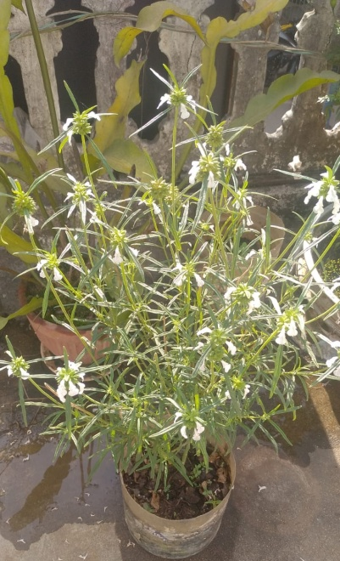
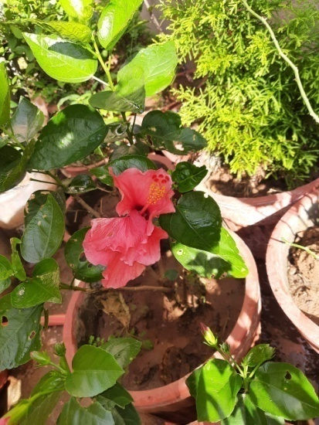
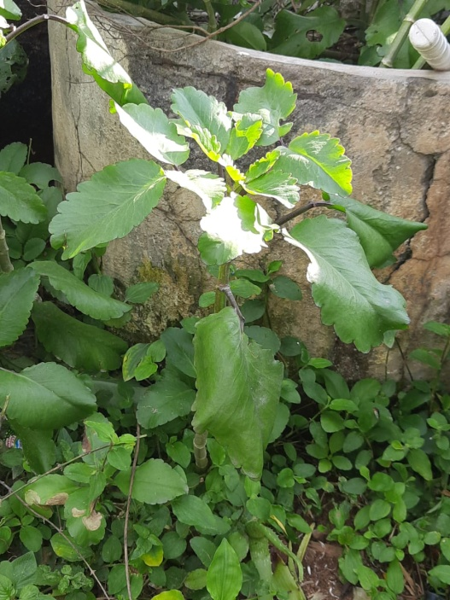
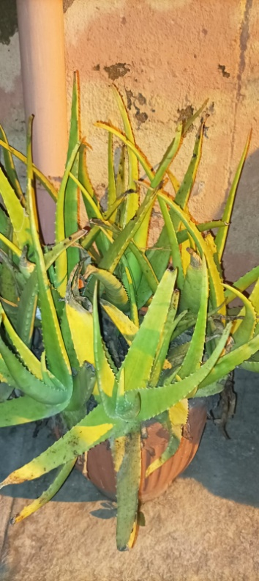
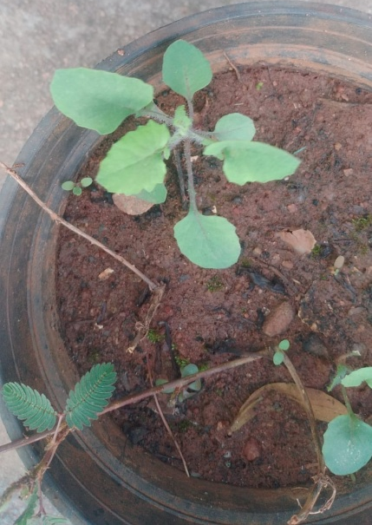
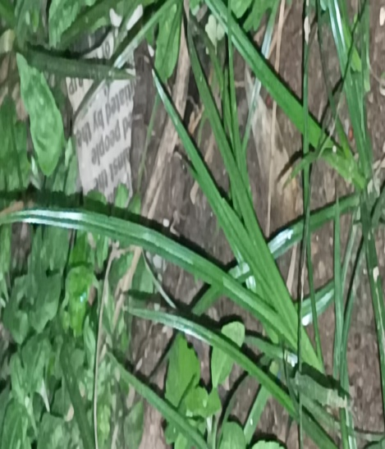
Aloe Vera
Thumbai
Hibiscus
Miracle leaves
Lemo grass
Plants grown in household
of Weavers colony
Cuban Oregano

Slide 11
Conclusion
The present study has explored interesting data on the medicinal plants that are grown in households of Weavers Colony.
Many of the plants were grown as knowledge was passed from their elders.
Medicinal plants grown in household were consumed in various forms such as preparing kashaya, eaten as raw leaves, cooking, cosmetic, treating wounds and while bathing.
This area provides further scope for the study to know household remedies followed by the people, as it was transferred from their elders. This may be useful to know the traditional way of using medicinal plants.

Slide 12
ACKNOWLEDGEMENT
We thank our H.M, Guide Teacher for allowing us to conduct the Study.
We thank Energy and Wetland Research Group, Center for Ecology Sciences, Indian Institute of Science. Bangalore.
Shri Vriju lal of CEE and Shri Cheturved Seit for guiding.
We thank one and all here for giving us opportunity to present the Study.

Slide 13
Reference
For scientific name and information Wikipedia.
iNaturalist for names
Identified plants using Google lens.

Slide 14
THANK YOU

