Slide 1
LAKE CONFERENCE 2022
Insects of Weaver’s colony
Team
Pavithra V, Devika R – Class 7

Slide 2
INTRODUCTION
Insects are important because of their diversity, ecological role, and influence on agriculture, human health, and natural resources. Insects create the biological foundation for all terrestrial ecosystems.
They cycle nutrients, pollinate plants, disperse seeds, maintain soil structure and fertility, control populations of other organisms
Insects are most numerous life form on the planet. Insects are more helpful to environment were they live. Most insects have three stages : egg , immature and adult .
Insects helps crops and flower to pollinate and help to control pest insects population

Slide 3
OBJECTIVES
To identify Insects of
weaver’s colony

Slide 4
MAP
N
Study area: Weavers Colony, Bengaluru south,
Gottigere Post, Bannerughatta Road,
Bengaluru - 560083

Slide 5
Study Site:
Sl No | Study Site | Longitude | Latitude | Location
1 | 5th cross Weavers colony | 12°84'56" N | 77°58'46"E | Hill Place
2 | 8th cross Weavers colony | 12°84'76" N | 77°58'47"E | Open place
3 | 11th cross Weavers colony | 12°84'78" N | 77°58'35"E | Near Gayathri Chowtry
4 | 12th cross Weavers colony | 12°84'60" N | 77°58'12"E | Near Monisha house
5 | 13th cross Weavers colony | 12°84'45" N | 77°58'08"E | Near Sampangi office
6 | Gate park | 12°84'08" N | 77°58'84"E | BNP office
7 | Shiva Temple | 12°84'30" N | 77°58'06"E | Shiva temple surrounding

Slide 6
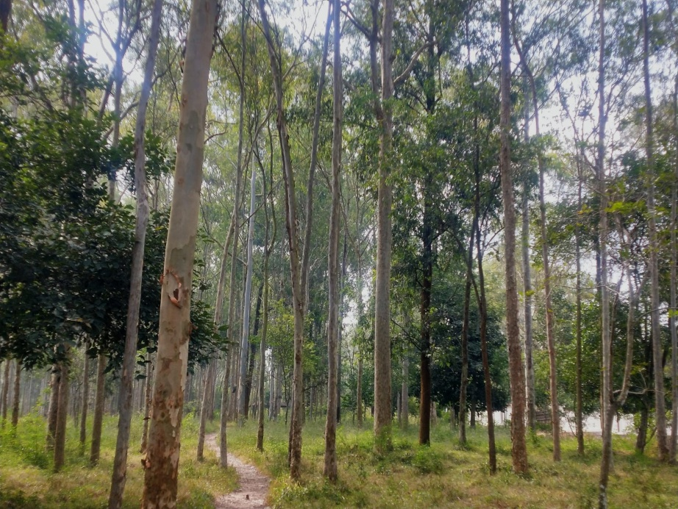
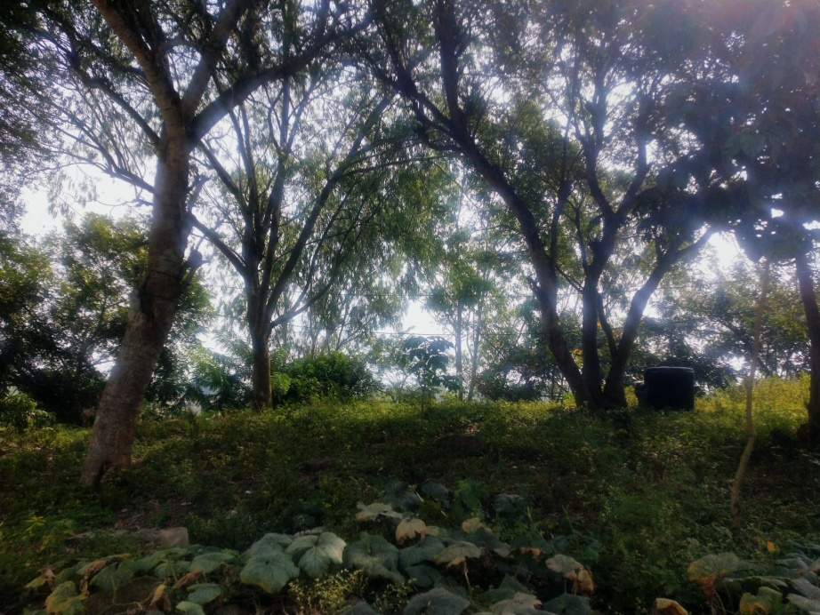
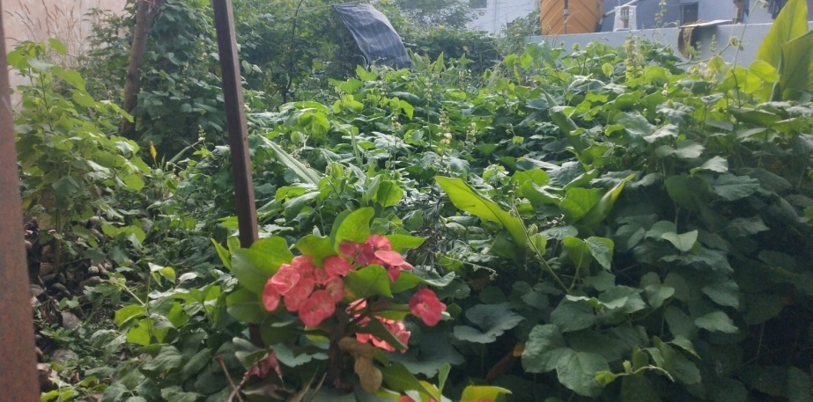
Study Site:
Gate park
BNP office
8th cross Weavers colony - Open place
11th cross Weavers colony - Near Gayathri Chowtry

Slide 7
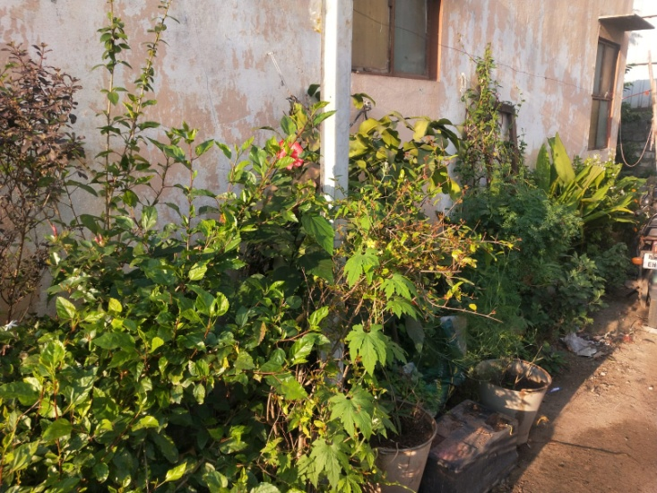
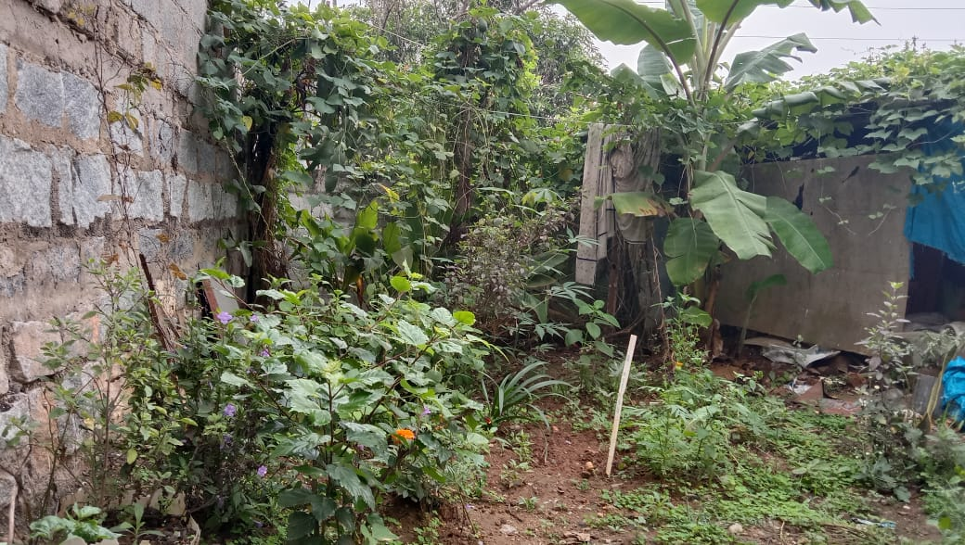
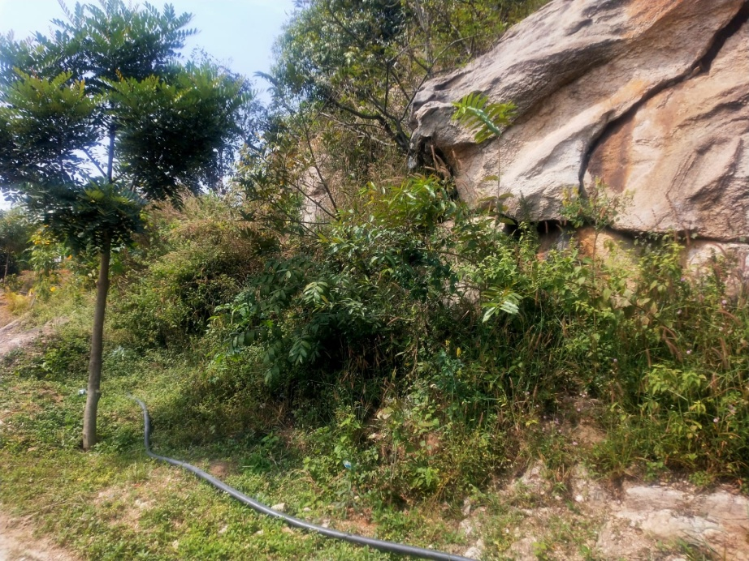
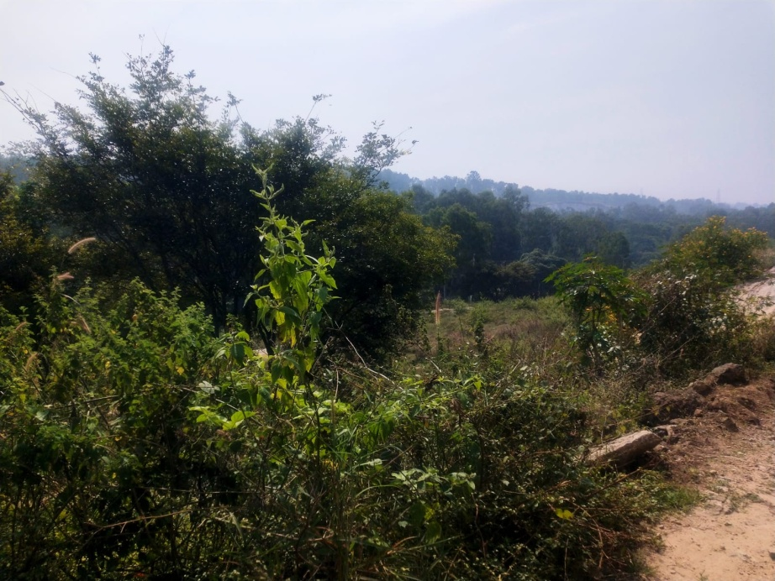
13th cross Weavers colony
Near Sampangi office
12th cross Weavers colony
Near Monisha house
5th cross Weavers colony – Hill place
Shiva Temple – Shiva temple surrounding

Slide 8
Methods & Materials
Selected study area is around 2 Km square
we visited weekly twice Wednesday and Sunday from July to October.
In-between 6am to 7-30am and evening 5pm to 6pm
Randomly inspecting and identifying the insects

Slide 9
Results and Discussion:
Totally 202 species of insects we were found in the selected sites.
Mosquitoes, cockroach, wasp, housefly, dragon fly caterpillar,
cluster fly, red pierrot butterfly were most common in all the visits.
Migratory locust, common emigrant, spotless lady bug, termite,
short winged green grass hopper, cricket, marsh blue tail
were the few which we could see only twice.
Blue moon fly, Bumble bee, Western Honey bee, Big blue bee,
European ear wing, Steel blue lady bird, Spice bush swallow tail
Milkweed Asian bug were found only once in our study period.

Slide 10
Insects found month wise
SL NO | MONTH | SPECIES
1 | JULY | 74
2 | AUGUST | 153
3 | SEPTEMBER | 107
4 | OCTOBER | 85

Slide 12
Checklist of Insects species found in the study sites
Sl No | Study Site | July | Aug | Sept | Oct
1 | 5th cross Weavers colony | 8 | 31 | 38 | 18
2 | 8th cross Weavers colony | 6 | 46 | 52 | 25
3 | 11th cross Weavers colony | 9 | 54 | 55 | 32
4 | 12th cross Weavers colony | 10 | 32 | 59 | 23
5 | 13th cross Weavers colony | 5 | 26 | 42 | 11
6 | Gate park | 13 | 85 | 72 | 42
7 | Shiva Temple | 16 | 76 | 68 | 37

Slide 13
Checklist of Insects which are documented in weavers colony
Sl no | Common name | Scientific name | Family | July | Aug | Sept | Oct
1 | Rice grasshopper | Oxya sp. | Acrididae | 1 | 1 | 0 | 0
2 | Locust | Schistocera gregaria | Acrididae | 1 | 1 | 0 | 0
3 | Grasshopper | Caelifera sp. | Acrididae | 2 | 5 | 3 | 5
4 | Gray bird grasshopper | Schistocerca nitens | Acrididae | 1 | 0 | 0 | 1
5 | Short winged green grasshopper | Dichromorpha viridis | Acrididae | 2 | 5 | 8 | 3
6 | Chinese grasshopper | Acrida cinerea | Acrididae | 0 | 0 | 0 | 1
7 | Migratory locust | Migratory locust | Acrididae | 1 | 0 | 0 | 1
8 | Chinese grasshopper | Acrida cinerea | Acrididae | 1 | 2 | 0 | 3
9 | Vegetable leaf miner | Liriomya sativae | Agromyzidae | 0 | 2 | 0 | 0
10 | Leaf miner flies | Agromyeidae sp. | Agromyzidae; fallén, 1823 | 6 | 15 | 18 | 10
11 | Emerald cockroach wasp | Ampulex compressa | Ampulicidae | 10 | 25 | 36 | 15
12 | White flies | Aleyrodoidae sp. | Animalia | 0 | 3 | 0 | 1
13 | Butterfly | Rhopolocera sp. | Animalia | 4 | 10 | 12 | 6
14 | Moth | Lepidoptera sp. | Animalia | 2 | 5 | 2 | 5
15 | Ring legged earwing | Euborellaia annulipes | Anisolabididae | 0 | 2 | 0 | 1

Slide 14
16 | Green fly | Aphidoidea sp. | Aphididae | 0 | 2 | 1 | 0
17 | Oleander aphid | Aphis nerii | Aphididae | 2 | 9 | 5 | 2
18 | Black fly | Aphid sp. | Aphididae | 1 | 5 | 2 | 0
19 | Wheat aphid | Aphid sp. | Aphididae | 1 | 15 | 0 | 12
20 | Greenfly | Aphid sp. | Aphidoidae | 4 | 15 | 10 | 7
21 | Red draf bee | Apis florea | Apidae | 0 | 0 | 2 | 0
22 | Big blue bee | Xylocopa vialacea | Apidae | 0 | 1 | 0 | 0
23 | Western honey bee | Apis mellifera | Apidae | 0 | 1 | 0 | 0
24 | Bumblebee | Bombus sp. | Apidae | 0 | 1 | 0 | 1
25 | Honey bee | Apis sp. | Apidae | 3 | 15 | 32 | 18
26 | Watry leaf beetle | Neochlamisus sp. | Arcididae | 0 | 2 | 0 | 0
27 | Tiger moth | Arctia caja | Arctiidae | 0 | 2 | 0 | 1
28 | Oriental cockroach | Blatta orientalis | Blattidae | 0 | 2 | 0 | 1
29 | Australian sheep blow flies | Luculla cuprina | Callipharidae | 1 | 2 | 3 | 0
30 | Green bottle fly | Lucilia symrnesis | Calliphoridae | 0 | 2 | 0 | 0
31 | Oriental blue fly | Chrysomya megacephala | Calliphoridae | 0 | 1 | 0 | 1
32 | Blue bottle fly | Calliphra vomitoria | Calliphoridae | 3 | 12 | 8 | 5
33 | Latrine fly | Chrysomya megacephala | Calliphoridae | 0 | 3 | 0 | 0
34 | Asian beetle | Pheroposh sp. | Carabidae | 0 | 1 | 0 | 1
35 | Dasyhelea | Diptera sp. | Ceratopoganidae | 0 | 0 | 0 | 1

Slide 15
36 | Pumpkin beetles | Aulacophora femoralis | Chrysomelidae | 2 | 5 | 0 | 6
37 | Tea jassid | Jacobiasca formosan | Cicadellidae | 0 | 1 | 0 | 0
38 | Bed bug | Cimex lectularius | Cimicidae | 3 | 5 | 1 | 2
39 | Pine lady bird | Chilocrinae sp. | Coccinellidae | 0 | 2 | 0 | 0
40 | Mexican been beetle | Epilachna varivertis | Coccinellidae | 1 | 3 | 2 | 0
41 | Steel blue lady bird | Halmus chalybeus | Coccinellidae | 0 | 1 | 0 | 0
42 | Convergent lady beetle | Hippadamia convergens | Coccinellidae | 0 | 1 | 0 | 1
43 | Heather lady bird | Chilocorus bipustulatuse | Coccinellidae | 0 | 3 | 1 | 0
44 | Hadda beetle | Henosepilachra vigintiozctopuncata | Coccinellidae | 0 | 0 | 1 | 0
45 | Yellow spotless lady bug | Coccinellidae sp. | Coccinellidae | 0 | 2 | 0 | 1
46 | Damsel fly | Zypgoptera sp. | Coenagrionidae | 0 | 0 | 1 | 0
47 | Ischnura senegaleneis | Zygoptera sp. | Coenagrionidae | 0 | 0 | 1 | 0
48 | Citrine forktail | Ischnura hastata | Coenagrionidae | 0 | 0 | 0 | 1
49 | Orange bluet | Enallagma signatum | Coenagrionidae | 0 | 0 | 1 | 0
50 | Mealy bug | Cryptolae montrouzieri | Coinellidae | 0 | 1 | 0 | 0
51 | Beetle | Coleoptera sp. | Coleoptera | 0 | 6 | 2 | 0
52 | Red damselfly | Pyrrhosoma nymphula | Conenagrionidae | 0 | 0 | 0 | 1
53 | Squash bug | Anasa tristis | Coreidae | 0 | 0 | 1 | 0
54 | Cosmet moths | Hypasmocama sp. | Cosmoptetigidae | 0 | 1 | 1 | 1
55 | Aphide wasps | Pemphredoninae sp. | Crabronielae | 0 | 5 | 0 | 3
56 | Beet webworm moth | Spoladea recurvalis | Crambidae | 0 | 2 | 1 | 0
57 | Southern house mosquito | Culex quinquefastus | Culicidae | 3 | 10 | 6 | 3
58 | Asian tiger moth | Aedes albopictus | Culicidae | 0 | 0 | 1 | 0
59 | Mosquito | Culicidae sp. | Culicidae | 25 | 46 | 52 | 34
60 | Yellow fever mosquito | Aedes aegypti | Culicidae | 0 | 0 | 0 | 1

Slide 16
61 | Girdle beetle | Obereopsis brevis swed | Curculionidae | 0 | 2 | 0 | 0
62 | Cabbage shot weevil | Ceutorhyn assimilis | Curculionidae | 1 | 0 | 2 | 0
63 | Lady beetle | Coleoptera sp. | Curuculionidae | 1 | 3 | 0 | 0
64 | Large green long legged fly | Chrysosoma sp. | Dalichopodidae | 1 | 4 | 1 | 0
65 | Carpet beetle | Anthrenus sp. | Dermestidae | 0 | 1 | 1 | 0
66 | Long legged flies | Condylostylus sp. | Dolichopodidae | 1 | 4 | 1 | 0
67 | Long legged flies | Chrysosoma sp. | Dolichopodidae | 1 | 4 | 1 | 9
68 | Fruit fly | Orosophila melangaster | Drosophilidae | 2 | 3 | 5 | 5
69 | Cockroach | Blattodae sp. | Ectobiidae | 12 | 25 | 37 | 26
70 | Brown banded cockroach | Blattodae sp. | Ectobiidae | 5 | 12 | 25 | 26
71 | Philphedra | Fillipinas sp. | Ephedra | 0 | 0 | 1 | 0
72 | Brine flies | Zetterstedted sp. | Ephydridae | 0 | 0 | 1 | 0
73 | Lichen moth | Lithasiina sp. | Erebidae | 0 | 1 | 0 | 0
74 | Cocoa tussock moth | Orgyia sp. | Erebidae | 0 | 2 | 0 | 0
75 | Gaint leapord moth | Hypercompe scriboa | Erebidae | 0 | 1 | 0 | 2
76 | Black witch moth | Ascalapha odorata | Erebidae | 0 | 2 | 0 | 3
77 | Black arches | Lymantria monacha | Erebidae | 0 | 0 | 2 | 0
78 | Tape worm | Parascotia sp. | Erebidae | 0 | 1 | 0 | 1
79 | Clouded tiger moth | Creatonotos transeiens | Erebidae | 0 | 0 | 2 | 0
80 | Hairy caterpillar | Spilarctia sp. | Erebidae | 1 | 5 | 0 | 0
81 | Tiger moth | Arctiidae sp. | Erebidae | 0 | 2 | 0 | 0
82 | Moss foot men | Nepita conferta | Erebidoe | 5 | 57 | 46 | 32
83 | Diglyphus isaea | Parasitic eulophid wasp | Eulophidae | 0 | 1 | 0 | 0
84 | Monkey moth | Eupterotidae sp. | Eupterotidae | 0 | 1 | 0 | 0
85 | Stilt bugs | Berytidae sp. | Fieber | 0 | 1 | 0 | 1

Slide 17
86 | European earwing | Forficula auricularia | Forficulidae | 1 | 0 | 0 | 0
87 | Erratic ant | Tapinoma erraticm | Formicidae | 15 | 42 | 32 | 19
88 | Smaller yellow ant | Lasius claviger | Formicidae | 24 | 38 | 52 | 47
89 | Garden ant | Lasius sp. | Formicidae | 2 | 6 | 3 | 0
90 | Weaver ant | Oecophyll samaragdnia | Formicidae | 3 | 8 | 6 | 2
91 | Carpenter ant | Componotus vagus | Formicidae | 3 | 5 | 1 | 2
92 | Gaint ant | Dinopenera giganeta | Formicidae | 5 | 2 | 2 | 4
93 | Black household ant | Ochetellus glaber | Formicidae | 0 | 4 | 1 | 0
94 | Yellow crazy ant | Anoplolepis gracilipes | Formicidae | 12 | 45 | 58 | 34
95 | Cone ant | Dorymyrmex bicolor | Formicidae | 15 | 46 | 57 | 38
96 | Little black ant | Monomoriu minimumum | Formicidae | 24 | 65 | 54 | 42
97 | Red ant | Fire ant | Formicidae | 26 | 42 | 35 | 28
98 | Florida carpenter ant | Camponotus atriceps | Formicidae | 3 | 12 | 9 | 5
99 | Ants | Formicide sp. | Formicidae | 12 | 25 | 37 | 26
100 | Rover ant | Brachymyrmex sp. | Formicideae | 1 | 3 | 1 | 0
101 | Slug | Gastropods sp. | Gastropoda | 1 | 1 | 0 | 0
102 | Japanese pine | Xenogryllus marmoratus | Gryllidae | 0 | 3 | 0 | 0
103 | Japanese burrowing cricket | Velarificatorus micado | Gryllidae | 0 | 3 | 0 | 0
104 | Cricket | Grylloidea sp. | Gryllidae | 0 | 0 | 1 | 0
105 | Emma field | Teleogryllus commodus | Gryllidae | 0 | 0 | 0 | 1
106 | cricket | Tropical house cricket | Grylloidae | 2 | 5 | 12 | 3
107 | Mole cricket | Neocurtilla hexadactyla | Gryllotalpidae | 0 | 0 | 0 | 1
108 | Alkali bee | Nomia melanderi | Halictidae | 0 | 3 | 1 | 0
109 | Hawks | Hemipepsis sp. | Hemipepsis ustulata | 0 | 1 | 0 | 0
110 | Grass demon | Undaspes folus | Hesperiidae | 0 | 0 | 1 | 0

Slide 18
111 | Bush cricket | Megopoda niponensis | Katydis | 0 | 1 | 0 | 0
112 | Crane fly | Tipulidae sp. | Latreille | 1 | 3 | 0 | 0
113 | Lantern flies | Fulgoridar sp. | Latreille | 0 | 0 | 3 | 0
114 | Asian bug | Reduviidae sp. | Latreille | 0 | 4 | 2 | 0
115 | Cicadas | Cicadoidea sp. | Latreille | 0 | 0 | 2 | 0
116 | Lady bug | Coccinellidae sp. | Latreille | 2 | 5 | 3 | 2
117 | Silver fish | Lepisma sancharina | Lepismatidae | 0 | 2 | 1 | 0
118 | Dragon fly | Anisoptera sp. | Libellulidae | 0 | 15 | 9 | 4
119 | Chalky percher | Diplacodes trivialis | Libellulidae | 0 | 3 | 0 | 0
120 | Caterpillar | Nympha sp. | Limacodidae | 32 | 72 | 52 | 46
121 | Mayfly | Caddisflies sp. | Limnephilidae | 0 | 3 | 0 | 0
122 | Red pierrot | Talicada nyseus | Lycaenidae | 0 | 2 | 3 | 0
123 | Common cerulean | Jamides celeno | Lycaenidae | 0 | 0 | 1 | 0
124 | Western tailed blue | Cupido amyatula | Lycaenidae | 0 | 0 | 3 | 1
125 | Ceraynus blue | Hemiargus ceraunus | Lycaenidae | 0 | 0 | 1 | 0
126 | Flesh fly | Sarcophogidoe sp. | Macquart | 0 | 2 | 0 | 0
127 | Shield mantis | Rhombodera extensicollis | Mantidae | 0 | 1 | 0 | 0
128 | Preying mantis | Mantodea sp. | Mantidae | 0 | 2 | 0 | 0
129 | House fly | Musea domestica | Muscidae | 9 | 20 | 17 | 14
130 | Common house fly | Musca domestica | Muscidae | 18 | 12 | 26 | 35
131 | House fly | Musca domestica | Muscide | 15 | 21 | 28 | 32
132 | Hoplomutilla | Hoplomutilla ashmead | Mutillidae | 0 | 1 | 0 | 0
133 | Cabbage moth | Mamestra brassicae | Noctuidae | 0 | 1 | 0 | 0
134 | Pine processionary | Thoumetopea sp. | Notodantidae | 0 | 2 | 3 | 0
135 | Common crow | Euploea core | Nymphalidae | 3 | 12 | 26 | 0

Slide 19
136 | Carclina satyr | Hermeuptychia sosybius | Nymphalidae | 0 | 0 | 0 | 1
137 | Lemon pansy | Junonia lemonias | Nymphalidae | 0 | 2 | 1 | 2
138 | Common crow | Euploea core | Nymphalidae | 0 | 1 | 0 | 0
139 | Common evening brown | Melanitis leda | Nymphalidae | 0 | 3 | 0 | 2
140 | Blue moon fly | Hypolinnar bolina | Nymphalidae | 0 | 0 | 0 | 1
141 | Minois dryas | Dryas sp. | Nymphalidae | 0 | 0 | 0 | 3
142 | Bugs | Insecta sp. | Orthoptera | 0 | 3 | 1 | 0
143 | Little bug | Insecta sp. | Orthoptera | 2 | 5 | 0 | 0
144 | True bugs | Hemiptera sp. | Orthoptera | 1 | 5 | 0 | 6
145 | Common Mormon | Papilio potytes | Papilionidae | 2 | 5 | 2 | 0
146 | Green clouded butterfly | Spice bush swallowtail | Papilionidae | 0 | 1 | 1 | 0
147 | Pear tree swallowtail | Iphiclides sp. | Papilionidae | 1 | 0 | 0 | 2
148 | Lime butterfly | Papilio demoleus | Papilionidae | 0 | 0 | 1 | 0
149 | Green stink bug | Chinavia hilaris | Pentatomidae | 1 | 1 | 0 | 0
150 | Shield bug | Halyomorpha halyas | Pentatomidae | 0 | 0 | 2 | 0
151 | Brown marmorated stink bug | Halyomorpha halys | Pentatomidae | 0 | 2 | 0 | 1
152 | Myth | Halyomorpha halys | Pentatomidae | 0 | 3 | 0 | 0
153 | Bell cricket | Meloimorpha japonica | Phalangopsidae | 0 | 3 | 0 | 0
154 | Common grass yellow | Eurema hecabe | Pieridae | 2 | 6 | 2 | 0
155 | Common emigrant | Catopsilia pomona | Pieridae | 0 | 0 | 0 | 1
156 | Kudzu bug | Megopta cibraria | Plastaspida | 0 | 0 | 3 | 0
157 | Stone flies | Plecoptera sp. | Plecoptera | 1 | 1 | 2 | 2
158 | Diamondblack moth | Plutella xylostella | Plutellidae | 0 | 1 | 0 | 0
159 | Cluster fly | Pollenia sp. | Pollenidae | 5 | 18 | 4 | 2
160 | Tube worm moths | Acrolophs sp. | Popeanela | 0 | 0 | 1 | 0

Slide 20
161 | Olive moth | Prays oleae | Praydidae | 0 | 1 | 0 | 0
162 | Drain fly | Diptera psychodidae | Prychodidae | 0 | 2 | 0 | 0
163 | Drone flies | Psychoda cinerea | Psychodidae | 0 | 0 | 1 | 0
164 | Cigarette beetle | Lasioderma serricornee | Ptinidae | 0 | 1 | 0 | 0
165 | Indian meal moth | Plodia interpuntella | Pyralidae | 0 | 2 | 1 | 0
166 | Lesser cornstalk borer | Elasmopalpus lignosellus | Pyralidae | 0 | 2 | 0 | 0
167 | European fire bug | Pyrrhocoris apterus | Pyrrhocoridae | 0 | 1 | 0 | 0
168 | Leafhopper Asian bug | Zelus renardii sp. | Reduviidae | 0 | 3 | 2 | 0
169 | Milkweed assassin bug | Zelus longipes | Reduviidae | 0 | 1 | 0 | 0
170 | Soapberry bugs | Serinethinae sp. | Rhopalidae | 0 | 2 | 0 | 0
171 | Caddis flies | Trichoptera sp. | Rhyacophilidae | 0 | 3 | 0 | 0
172 | Passionvine hopper | Seolypopa asstralis | Riconiidae | 0 | 1 | 0 | 1
173 | Tumble bug | Scarabaeidae sp. | Scarabaeidae | 0 | 2 | 0 | 0
174 | Dung beetle | Tumble bug | Scarabaeidae | 0 | 3 | 1 | 0
175 | Dung beetle | Scarobs sp. | Scarabaeidae | 0 | 2 | 0 | 0
176 | Black bug | Macropes excavatus | Scarabaeidae | 0 | 2 | 0 | 0
177 | Micans flower beetle | Dicronorshina micans | Scarabaeidae | 0 | 2 | 0 | 0
178 | Garden fruit chafer | Pachnoda sinuata | Scarabaeidae | 1 | 0 | 3 | 2
179 | Green jwell bug | Scutelleridae sp. | Scutelleridae | 0 | 1 | 0 | 0
180 | Green jewell bug | Chrysocoris stollii | Scutelleridae | 0 | 2 | 0 | 0
181 | Black fly | Simuliidae sp. | Simuliidae | 1 | 5 | 1 | 2
182 | Brachythemis | Brachythemis contaminata | Libellulidae | 0 | 0 | 3 | 1
183 | Crimson marsh glider | Trithemis ourora | Libellulidae | 0 | 0 | 1 | 1
184 | Black horned gem | Microchrysa sp. | Stratiomyidae | 1 | 2 | 0 | 0
185 | Hawk moth | Theretra oldenlondiae | Sphingidae | 0 | 3 | 0 | 0

Slide 21
186 | Pandora sphinx | Eumorpha pandorus | Sphingidae | 0 | 0 | 1 | 0
187 | Convolvulus hawk | Agrius convolvuli | Sphingidae | 0 | 0 | 1 | 0
188 | White banded hunter | Theretra oldeolondiae | Sphingidae | 0 | 0 | 1 | 0
189 | Black soldier fly | Hermetia illucenus | Starotiomyidae | 2 | 3 | 2 | 1
190 | Band eyed drone fly | Eristalinus taeninps | Syrphidae | 0 | 1 | 0 | 0
191 | Leaf mimic katydid | Eurycorypha sp. | Teltigoniidae | 0 | 1 | 0 | 1
192 | Mediterranean fruit fly | Ceratitis capitata | Tephritidae | 2 | 2 | 5 | 3
193 | Bush cricket | Hexacentrus japonicus | Tettigoniidae | 1 | 3 | 1 | 2
194 | Black kneed cone head | Conocephalus mealaenus | Tettigoniidae | 0 | 0 | 2 | 0
195 | Thrips | Thysanoptera sp. | Thripidae | 0 | 5 | 1 | 0
196 | Clothes moth | Tineola bisselliella | Tineidae | 8 | 22 | 16 | 9
197 | Mosquito hawks | Crane fly | Tipulidae | 1 | 3 | 0 | 0
198 | Chionea soita | Limoniinae sp. | Tipulidae | 0 | 0 | 1 | 0
199 | Wasp | Ammophilinae sp. | Trigondiidae | 1 | 0 | 3 | 1
200 | Handsome trig | Phyllopalus pulchellus | Trigonidiidae | 0 | 0 | 2 | 0
201 | Yellow paper wasp | Polistes versicolor | Vespidae | 0 | 2 | 0 | 0
202 | Wasp | Vespids sp. | Vespidae | 0 | 3 | 5 | 0

Slide 24
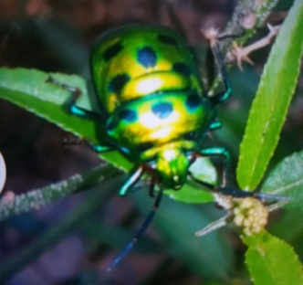
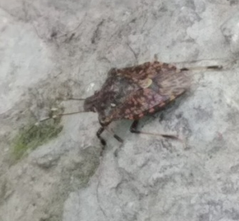
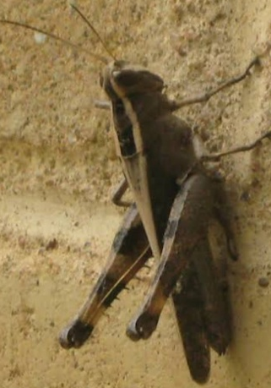
Identified Insects
Cricket
Jewel Bug
Pink stink
Bug
Dragon fly
cricket
European
earwing
Alkali bee
Long leged fly
Daddy long
legs
Rice
Grass hopper

Slide 25
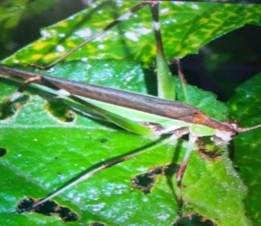
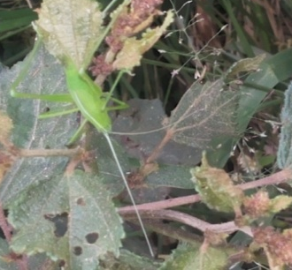
Jewel Bug
Indian
Bush Cricket
Lady Bird
House Fly
Bush Cricket
cockroach
Yellow
Paper
wasp
Seven spot
Lady bug
Red pierrot
Big blue
bee
Insects of Weavers Colony

Slide 26
Preying mantis
Carpenter ant
Black
solider fly
Grasshopper
Crane fly
Tiger moth
Black
preying
mantis
Common
Grass
yellow
Slug
Green
Sting
bug
Handsome
trig
Insects of Weavers Colony

Slide 27
Conclusion
Observation of insects in weaver’s colony has made us to think that
the diversity of insects that is found is highest possible in an urban area.
Insects create the biological foundation for all terrestrial ecosystems.
They cycle nutrients, pollinate plants, disperse seeds, maintain soil structure and fertility, control populations of other organisms,
and provide a major food source.
Due to the presence of different species of insects
we will have pollination of flowers, dispersal of seeds
and this results a beautiful environment.

Slide 28
ACKNOWLEDGEMENT
We thank our H.M, Guide Teacher for allowing us to conduct the Study.
We thank all our group members who helped to collect the data.
We thank Energy and Wetland Research Group, Center for Ecology Sciences, Indian Institute of Science. Bangalore,
Shri Vriju lal of CEE and Shri Chaturved Shet R for guiding.
We thank one and all here for giving us opportunity to present the Study.

Slide 29
Reference
Harish Bhat et all (2015) A Brochure of Eyes on Nature published by Karnataka State Council for Science and Technology.
For scientific name Wikipedia

Slide 30
THANK YOU

