Slide 1


LAKE CONFERENCE 2022
Observation and Documentation of Butterflies in Weavers Colony
Team
Hemashree K, Yashaswini P - Class 9

Slide 2
INTRODUCTION:
The development of butterflies is linked to the
evolution of flowering plants .
Butterflies also indicate the climate and environment change.
Butterflies are depended on specific plants for food.
Thus, the diversity of butterflies reflects the plant diversity in the area.
So the conservation of plants will help in conservation of Butterflies.

Slide 3
OBJECTIVES
Observation and Documentation of Butterflies in Weavers Colony.
Study Site:
Selected study area is around 2 Km
Sl No | Study Site | Latitude | Longitude | Area description
1 | Gate Park | 12°84'09"N | 77°58'83"E | Forest office
2 | 1st Cross | 12°84'49"N | 77°58'55"E | Vegetable market
3 | 2nd Cross | 12°84'44"N | 77°58'49"E | In front of Medical store
4 | 4th Cross | 12°84'55"N | 77°58'48"E | Madhurya Montessori
5 | 5th Cross | 12°84'69"N | 77°58'55"E | Hill place
6 | 9th Cross (N) | 12°84'67"N | 77°58'39"E | Angala parameshwari Temple
7 | 9th Cross (S) | 12°84'15"N | 77°58'11"E | Shiva Temple
8 | 10th Cross | 12°84'64"N | 77°58'33"E | Chowdeshwari Temple
9 | Maruthi badavane | 12°84'07"N | 77°57'87"E | Banashankari Temple
10 | 13th Cross | 12°84'36"N | 77°57'96"E | Ramalingeshwara Temple

Slide 4
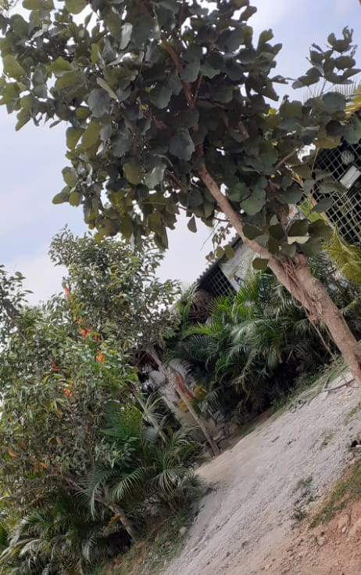
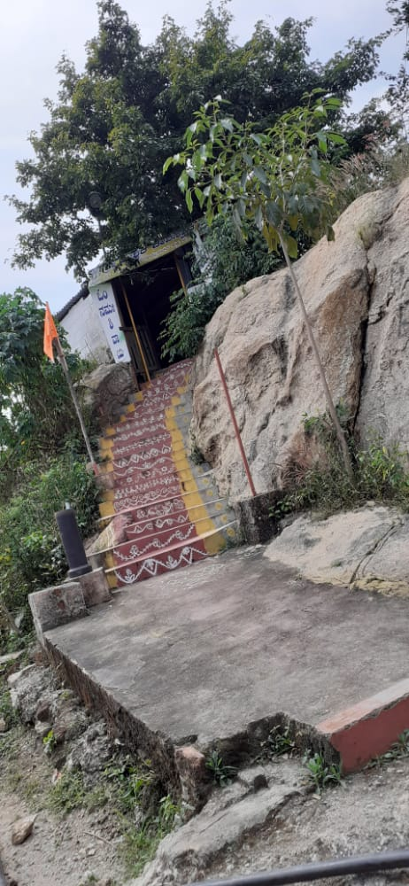
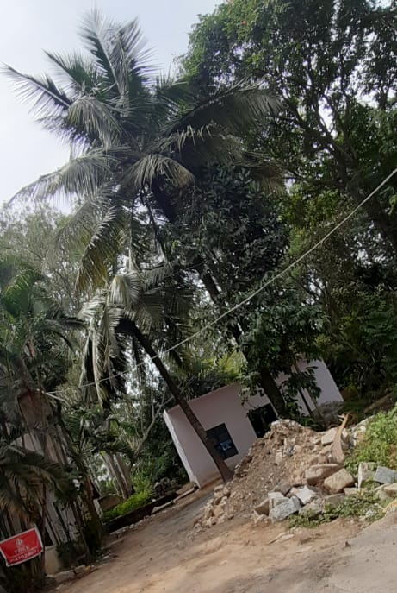
9th Cross
Angala parameshwari
Temple
9th Cross
Shiva Temple
Maruthi Badavane
Banashankari
Temple

Slide 5
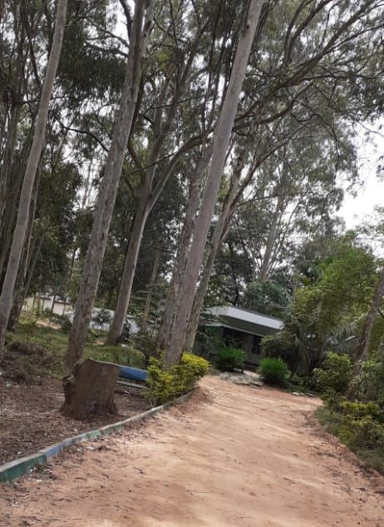
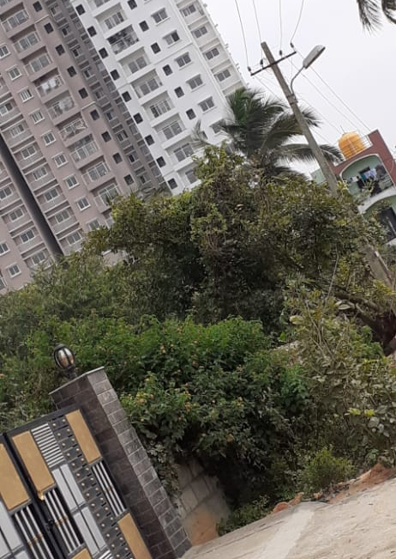
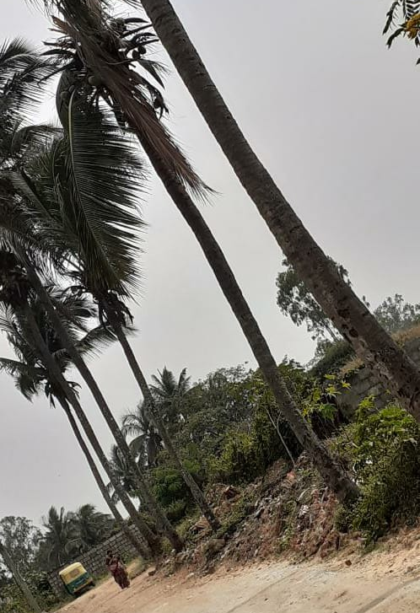
Gate Park
BNP office
1 st Cross
Market place
10th Cross
Chowdeshwari
Temple

Slide 6
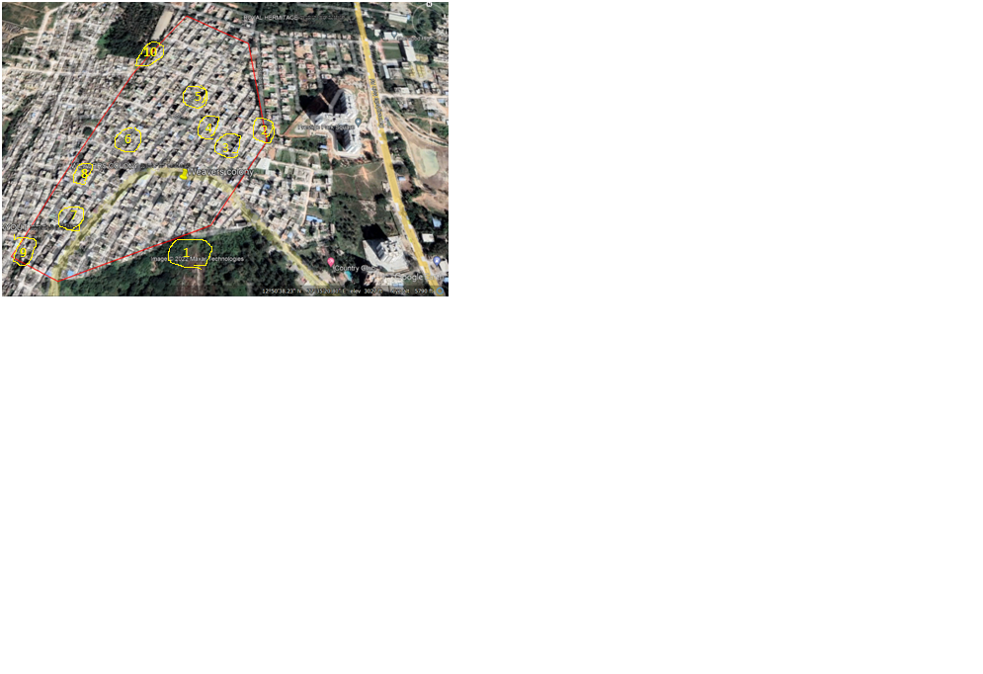
Study Area: Weavers Colony, Bengaluru south, Gottigere Post,
Bannerughatta Road, Bengaluru - 560083
N
MAP:

Slide 7
MATERIALS AND METHODS:
Visited the Study area every Saturday between 2.00pm to 4.00pm and Sunday 9.00 am to 11.00 am of the month August to November 2022,
Randomly sampling method was followed.

Slide 8
RESULTS AND DISCUSSION
Butterflies found month wise
SL NO | MONTH | No of spices
1 | August | 55
2 | September | 55
3 | October | 55
4 | November | 55

Slide 9
Totally 55 species of butterflies were observed
in the study site.
Brush footed family were the highest number
Blues family is lowest in number.
In Brush footed family common five ring ypthima baladus
butterfly was more
We understood that butterflies are very well
attracted to plants.

Slide 10
Number of species found in month wise
Sl No | Study Site | August | September | October | November
1 | Gate Park | 10 | 10 | 8 | 9
2 | 1st Cross | 6 | 3 | 4 | 5
3 | 2nd Cross | 4 | 3 | 4 | 5
4 | 4th Cross | 3 | 2 | 3 | 3
5 | 5th Cross | 5 | 6 | 3 | 3
6 | 9th Cross (N) | 3 | 5 | 6 | 4
7 | 9th Cross (S) | 17 | 12 | 14 | 15
8 | 10th Cross | 6 | 5 | 6 | 7
9 | Maruthi badavane | 4 | 6 | 7 | 5
10 | 13th Cross | 4 | 6 | 6 | 4

Slide 11
Checklist of Butterflies documented in Weavers colony
Sl No | COMMON NAME | SCIENTIFIC NAME | FAMILY | Aug | Sep | Oct | Nov
1 | Common cerulean | Jamides celeno | Blues | 5 | 4 | 3 | 2
2 | Dull babul blue | Azanus Uranus | Blues | 9 | 7 | 5 | 4
3 | Pea blue | Lampides boeticus | Blues | 2 | 2 | 4 | 3
4 | Pale grass blue | Pseudozizeeria maha | Blues | 7 | 6 | 3 | 4
5 | Common grass blue | Zizina labradus | Blues | 11 | 6 | 9 | 5
6 | Lime blue | Chilades lajus | Blues | 9 | 5 | 7 | 3
7 | Red pierrot | Talicada nyseus | Blues | 1 | 1 | 2 | 2
8 | Common four ring | Ypthima huebneri | Brush footed | 5 | 4 | 2 | 3
9 | Angled castor | Ariadne ariadne | Brush footed | 6 | 5 | 4 | 3
10 | Chocolate pansy | Junonia iphita | Brush footed | 9 | 8 | 5 | 3
11 | Common evening brown | melanitis leda | Brush footed | 8 | 7 | 6 | 4
12 | Common five ring | Ypthima baladus | Brush footed | 15 | 14 | 12 | 8
13 | Dark blue tiger | Tirumala septentrionis | Brushfooted | 2 | 3 | 7 | 4
14 | Pecock pansy | Junonia almana | Brushfooted | 4 | 3 | 2 | 3
15 | Striped tiger | Danaus genutia | Brushfooted | 10 | 7 | 8 | 7

Slide 12
16 | Great egg fly | Hypolimnas bolina | Brushfooted | 6 | 7 | 4 | 3
17 | Common three ring | Ypthima asterope | Brushfooted | 9 | 7 | 9 | 6
18 | Common leapord | Phalanta phalantha | Brushfooted | 3 | 3 | 4 | 5
19 | Blue tiger | Tirumala limniace | Brushfooted | 3 | 7 | 5 | 2
20 | Lemon pansy | Junonia lemonias | Brushfooted | 2 | 4 | 6 | 3
21 | Painted Jezebel | Delias hyperete | Brushfooted | 8 | 7 | 9 | 6
22 | Crimson tip | Colotis danae | Brushfooted | 6 | 4 | 5 | 3
23 | Common jay | Graphium dosen | Brushfooted | 4 | 4 | 2 | 3
24 | Common castor | Ariadene merione | Brushfooted | 10 | 13 | 15 | 11
25 | Danid egg fly | Hypolimnas misippus | Brushfooted | 4 | 4 | 5 | 6
26 | Common snow flat | Tagides japetus | Brushfooted | 2 | 5 | 3 | 3
27 | Tawny coster | Acraea terpsicore | Brushfooted | 4 | 8 | 9 | 10
28 | Malabar tree nymph | Idea malabarica | Brushfooted | 3 | 3 | 4 | 2
29 | Speckled wood | Pararge aegeria | Brushfooted | 3 | 4 | 2 | 3
30 | Common crow | Euploea core | Brushfooted | 5 | 4 | 7 | 3
31 | Common three brown | Letherohria | Brushfooted | 6 | 5 | 4 | 3
32 | Common palm fly | Elymnias hypermnestre | Brushfooted | 4 | 5 | 6 | 3
33 | Plain tiger | Danaus chrysippus | Brushfooted | 2 | 2 | 3 | 2
34 | Common sailor | Neptis hylas | Brushfooted | 5 | 4 | 5 | 6
35 | Indian sun beam | Curetis thetis | lycaenidae | 2 | 1 | 4 | 1
36 | Common mormon | Papilo polytes | Swallowtail | 8 | 6 | 3 | 5

Slide 13
37 | Lime butterfly | Papilo demoleus | Swallowtail | 9 | 2 | 7 | 5
38 | Blue mormon | papilio polymnestor | Swallowtail | 5 | 8 | 9 | 10
39 | Lime swallowtail | papili demoleus | Swallowtail | 2 | 5 | 4 | 2
40 | Common rose | pachliopta aristolochiae | Swallowtail | 6 | 3 | 5 | 3
41 | Common windmill | Atrophaneura polyeuctes | Swallowtail | 1 | 1 | 2 | 1
42 | Small grass yellow | Euerema brigitta | yellow and white | 9 | 10 | 8 | 11
43 | Mottled emrigrant | catopsilia pyranthe | yellow and white | 10 | 9 | 11 | 12
44 | Common grass yellow | Eurema hecabe | Yellow and white | 5 | 4 | 3 | 4
45 | Pioneer | Belenois aurota | Yellow and white | 6 | 7 | 3 | 4
46 | Common emgriant | Catopsilia pomona | Yellow and white | 8 | 6 | 5 | 4
47 | Great orange tip | Hebomoia glaucippe | Yellow and white | 6 | 7 | 3 | 5
48 | Common bush brown | Mycalesis perseus | Yellow and white | 3 | 3 | 4 | 2
49 | Indian cabbage white | Pieris canidia | Yellow and white | 6 | 6 | 3 | 4
50 | Small salmon arab | Colotis amata | Yellow and white | 6 | 5 | 10 | 7
51 | Common gull | Cepora nerissa | Yellow and white | 8 | 3 | 4 | 5
52 | Psyche | leptosia nina | Yellow and white | 9 | 7 | 5 | 4
53 | Indian Jezebel | delias eucharis | Yellow and white | 5 | 4 | 6 | 5
54 | spotless grass yellow | Euerema laeta | Yellow and white | 5 | 4 | 7 | 5
55 | Mimic white | Enantia enantia | Yellow and white | 7 | 4 | 3 | 5

Slide 15
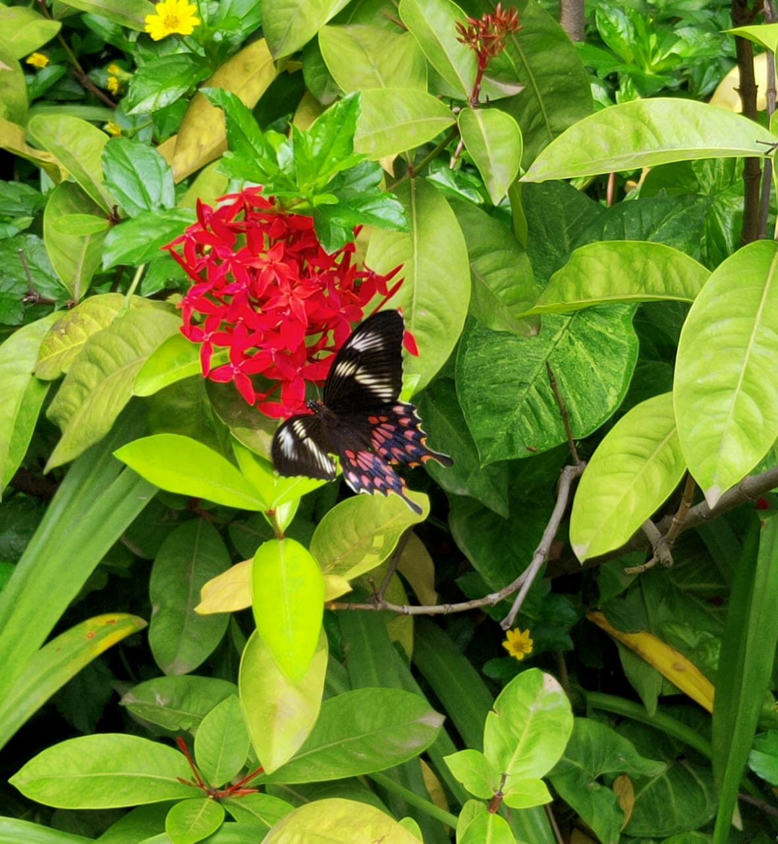
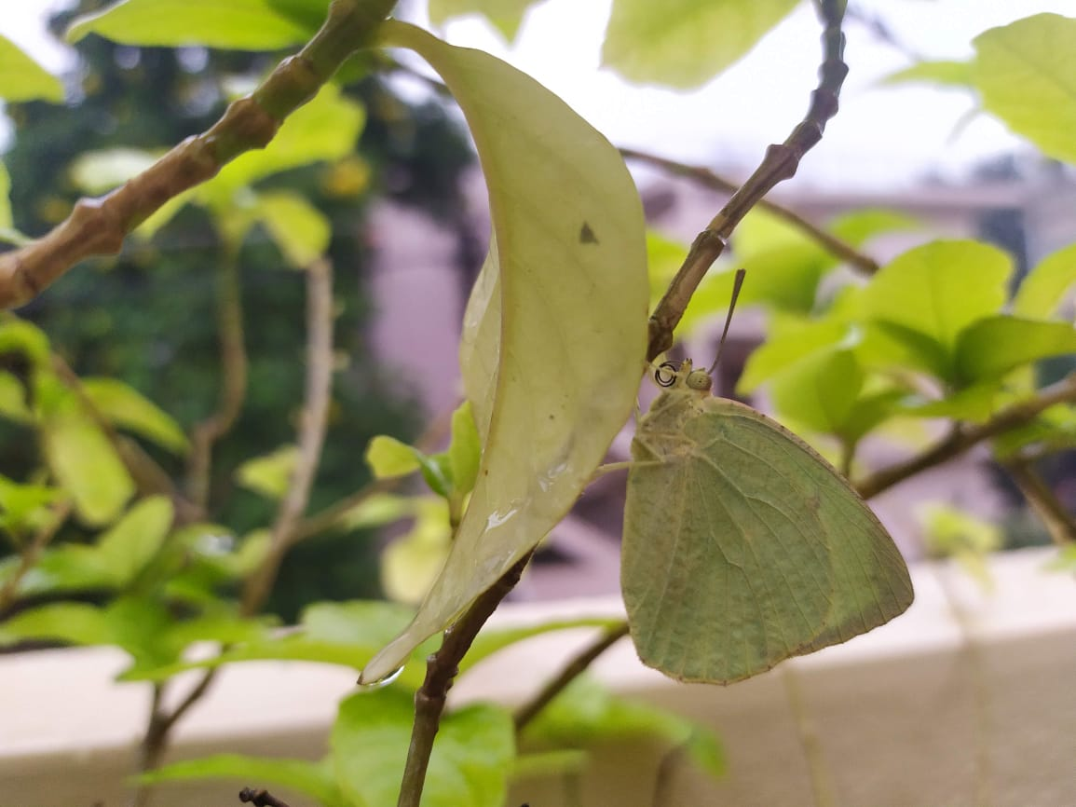
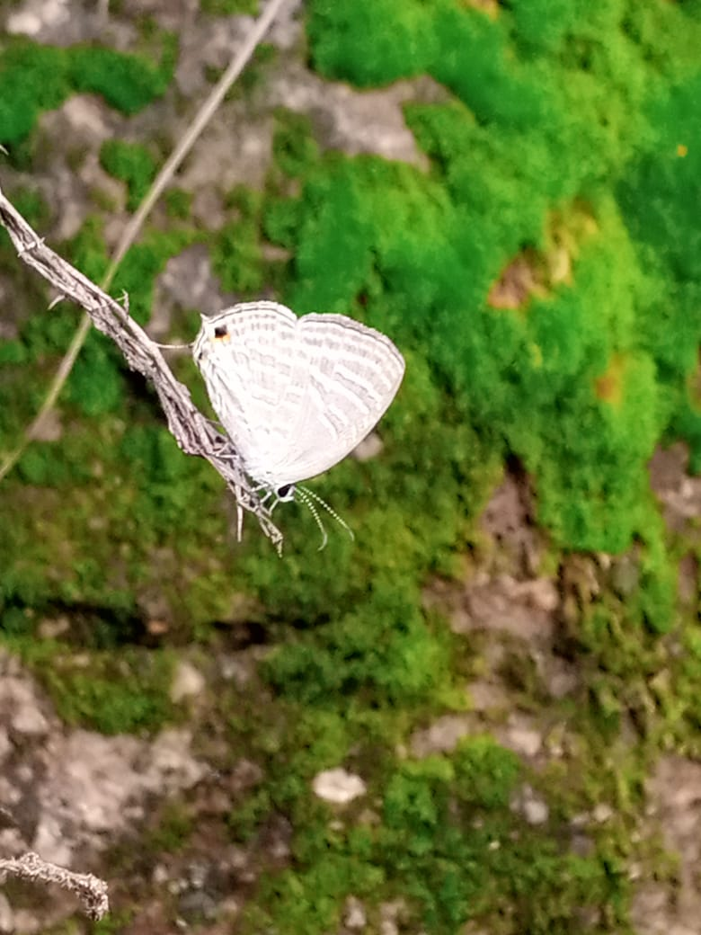
Some of the butterflies as documented:
Crimson Rose butterfly
Order: Lepidoptera.
Photo by Pruthvi H K
Common Emigrant butterfly
Order: Lepidoptera.
Photo by Kishor Kumar A
Jamides celeno butterfly
Order: Lepidoptera
Photo by Kruthika bai

Slide 16
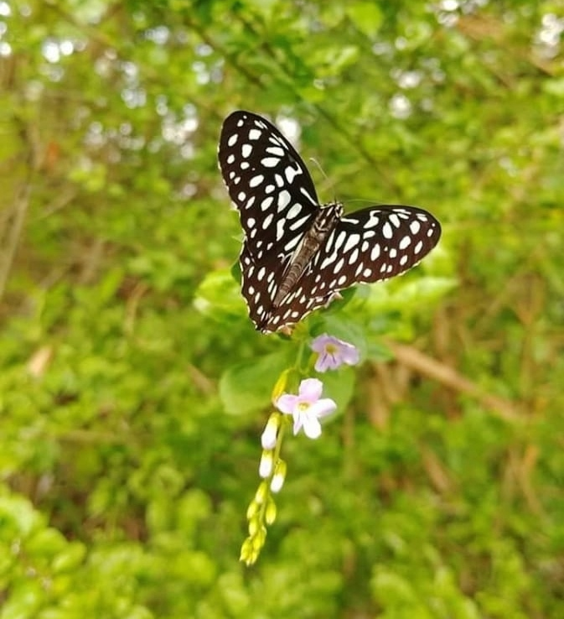
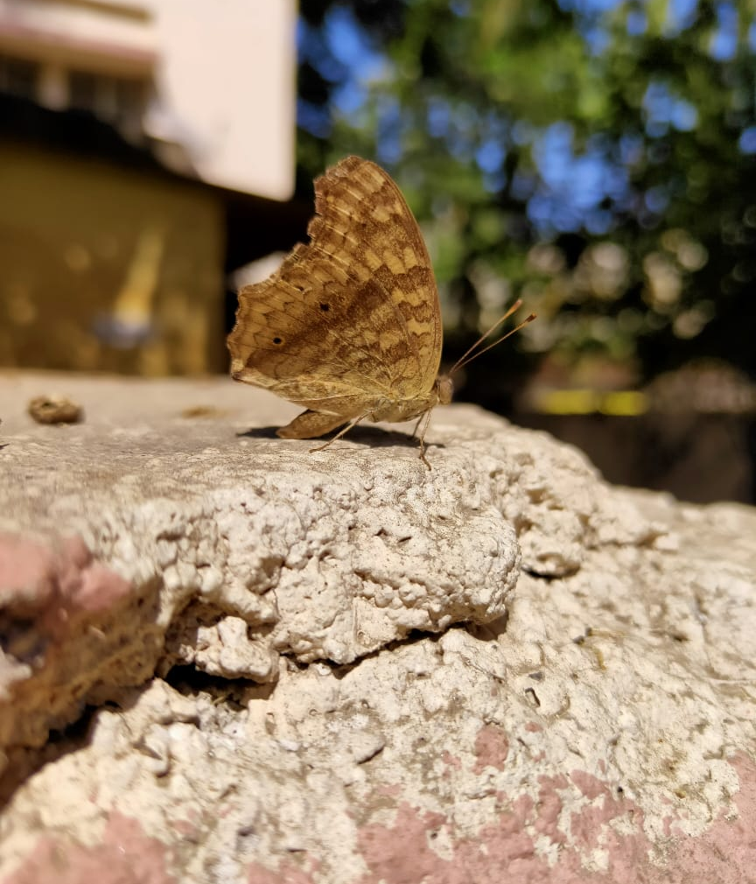
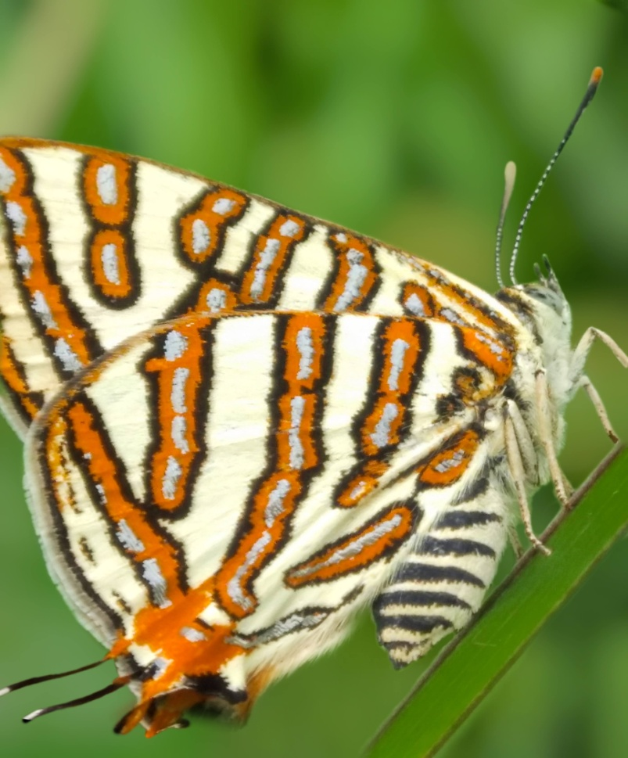
Common palmfly butterfly.
Order: Lepidoptera
Photo by: Jyothi D K
Common silverline butterfly
Order: Lepidoptera
Photo by: Bhoomika M
Dark Blue tiger butterfly.
Order: Lepidoptera
Photo by: Yashwanth H

Slide 17
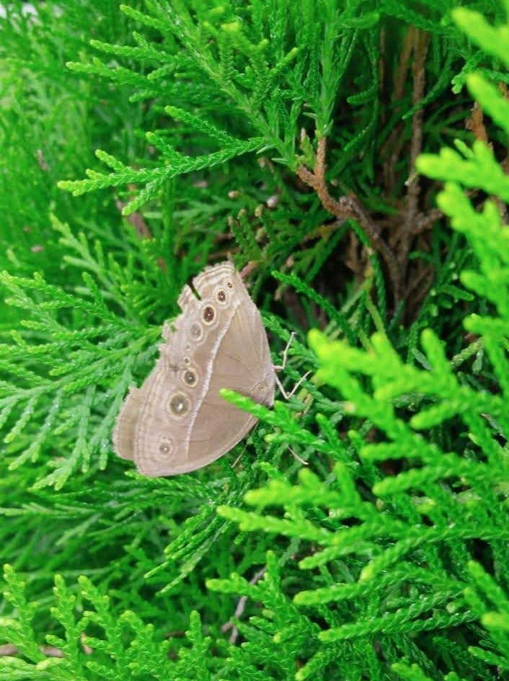
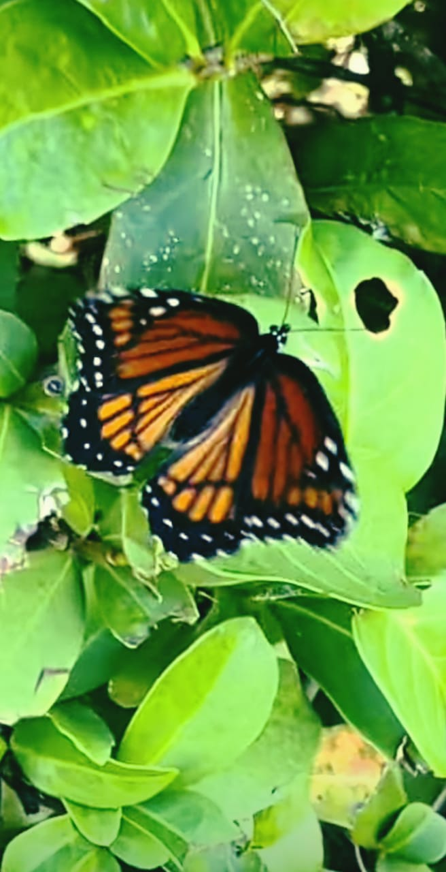
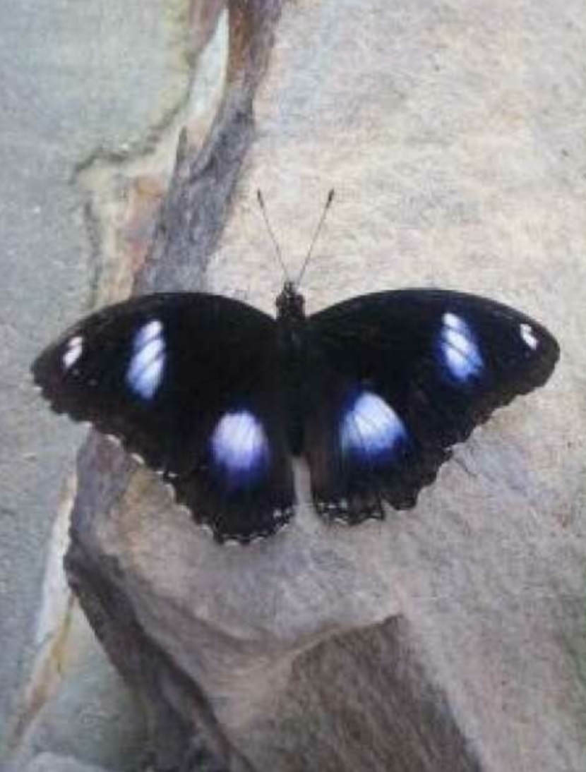
Common jezebel
Order: Lepidoptera
Photo by Hemashree K
Danaid eggfly
Order: Lepidoptera
Photo by Yashaswini P
Common bush brown butterfly
Order: Lepidoptera
Photo by Sandhya G

Slide 18
Conclusion
The present study reveals that the diversity of ypthima baladus butterfly is the largest with 49 number
We identified 55 species of butterflies and mainly butterflies attract to plants like milk weed, curry leaves, hibiscus leaves, neem leaves, lemon leaves.
So conservation of plants will help conservation of butterflies. This study area has a wide scope for further study.

Slide 19
ACKNOWLEDGEMENT.
We thank our H.M, Guide Teacher for allowing us
to conduct the Study.
We thank all 10 members of our group who helped
in collecting the data,
We thank Energy and Wetland Research Group, Center for
Ecology Sciences, Indian Institute of Science. Bangalore, and
Shri Vriju lal of CEE and Shri Chaturved Shet R for guiding and
Thank one and all here for giving us opportunity to
present the Study.

Slide 20
REFERENCE:
Harish Bhat et all (2015) A Brochure of Eyes on Nature published by KSCST.(Karnataka State Council for Science and Technology).
Butterfly Diversity of Bangalore Urban District by Chaturved Shet R.
iNaturalist app for identifying name.
For scientific name Wikipedia.

Slide 21
Thank you

