Slide 1


Biodiversity of Our School
Srinivasan L (Grade IX), Vijet Bhat (Grade IX)
Central Board of Secondary Education (CBSE)

Slide 2
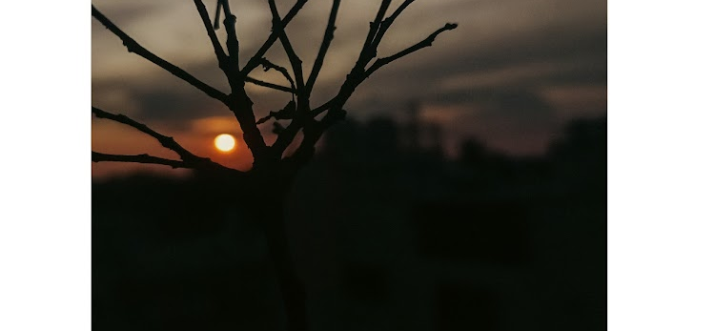
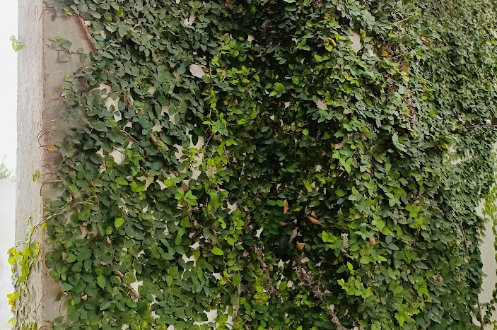
Introduction
We have chosen this project under the theme of "Plants Identification" for the IISc Lake 2022 Conference.
Till date, it is seen that plants in India have significantly decreased, both quantitatively and qualitatively.
Thus, we have taken up this project to bring to light the decline as well as the increment in agriculture of our school.
Previously, the land had lain barren. But now, due to initiation from our institutions, the land is flourished.

Slide 3
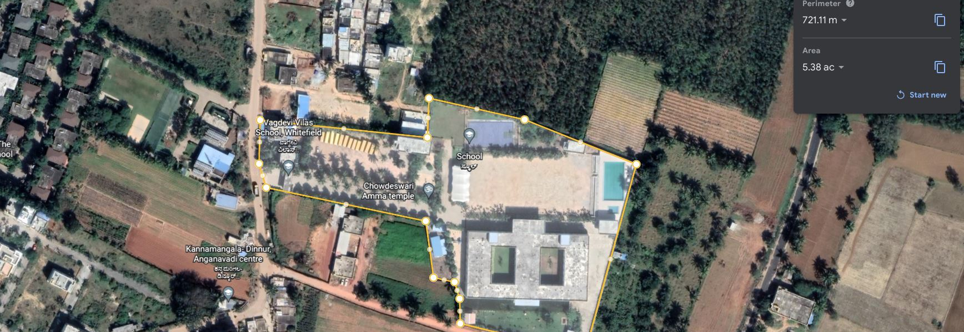
Area of Study
Coordinates (Latitude, Longitude)
(13.02 N, 77.77 E)
Area => 5.38 acres

Slide 4
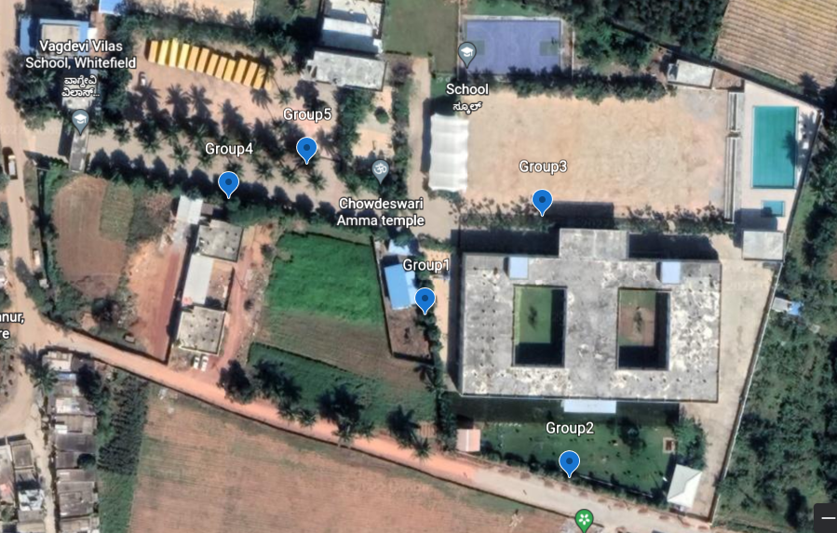
Area of Study
Location of the trees:-
Group One – 7 trees...
Group Two – 12 trees...
Group Three – 24 trees...
Group Four - 11 trees...
Group Five – 13 trees...

Slide 5
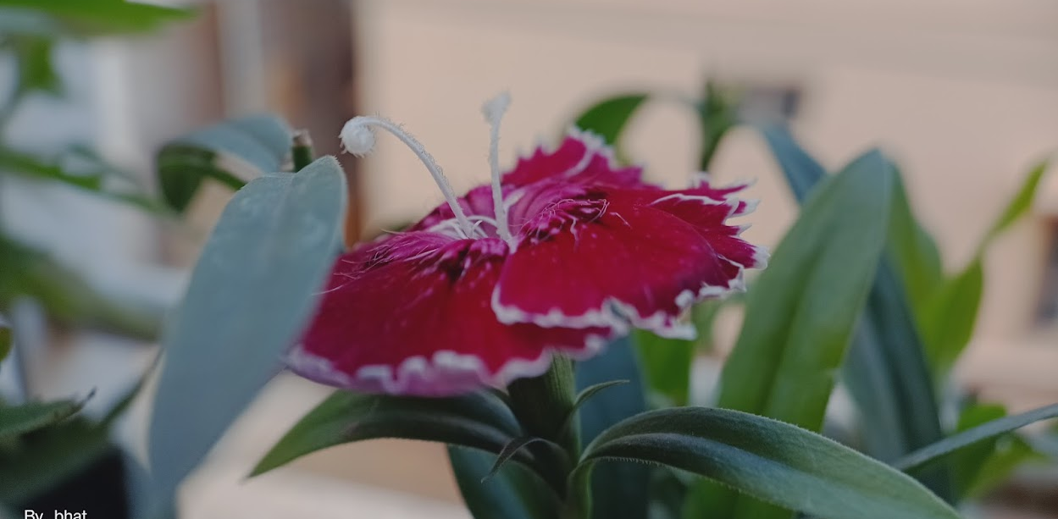
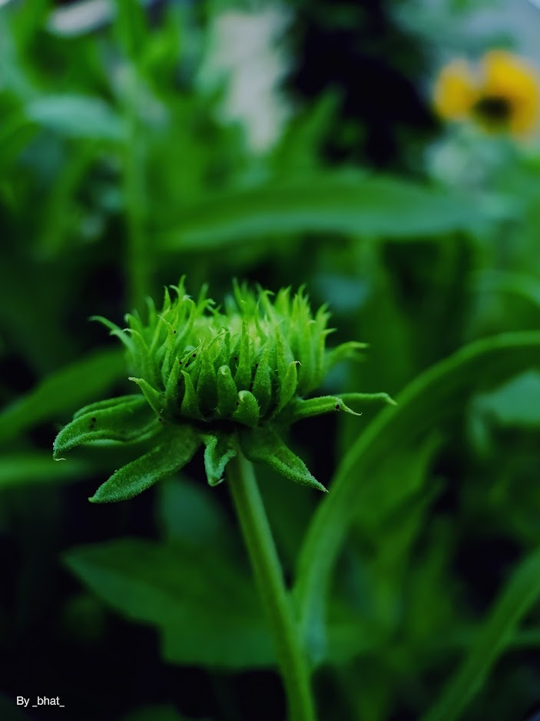
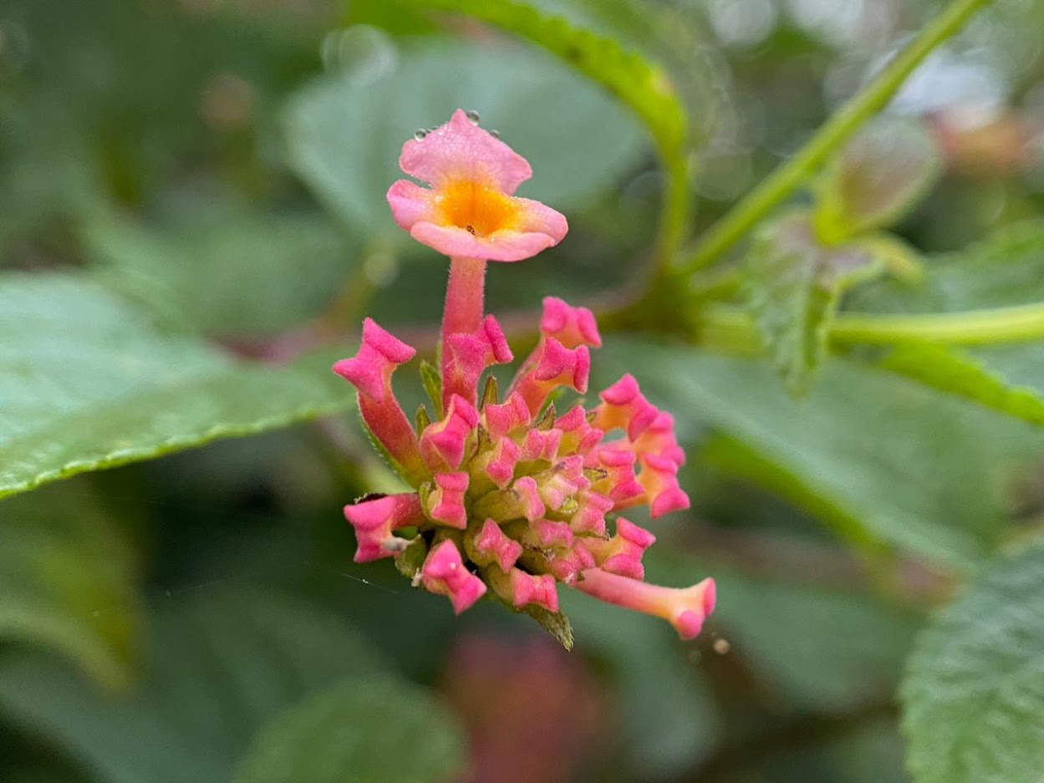

Objectives:-
To perform a comparative study of different plants and animals at a region in Whitefield.
Comparison of their leaf types, growth, suitable climate and ecosystem they offer to symbiotic species (insects, butterflies, spiders, etc.) and to discover rare species and perform their taxonomy.
To identify plant health and deficiency concern.
Sweet William

Slide 6
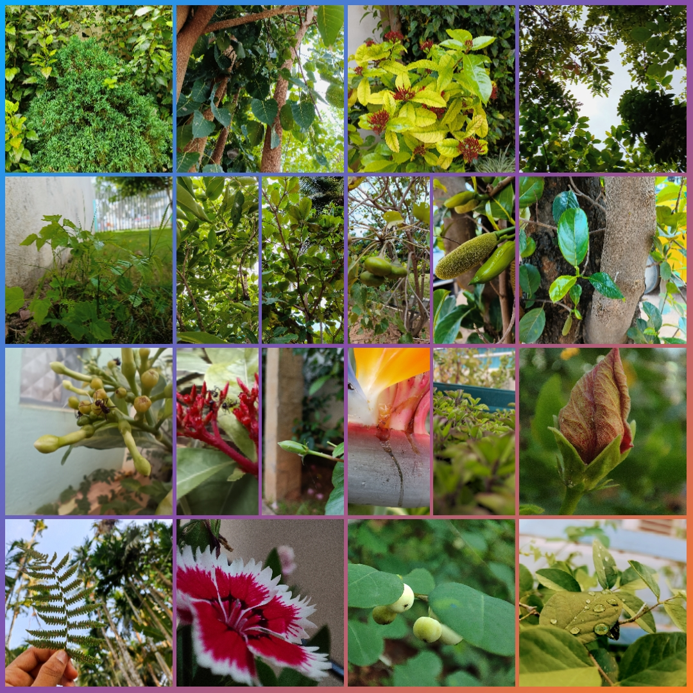
Observations:
As seen in the below pictures, we can notice that few flowers have been infested with insects and spiders such as the Anasuja Argiope. These plants act as a shelter for the organisms while these species act as a pollination agents for few flowers.
In few plants, colours of different leaves are different; this depicts deficiencies, such as Magnesium (Mg) and Iron (Fe) deficiencies.
The leaf shape and structure indicates the best suitable climate, wherein thick leaf shows that the plant requires less water.

Slide 7
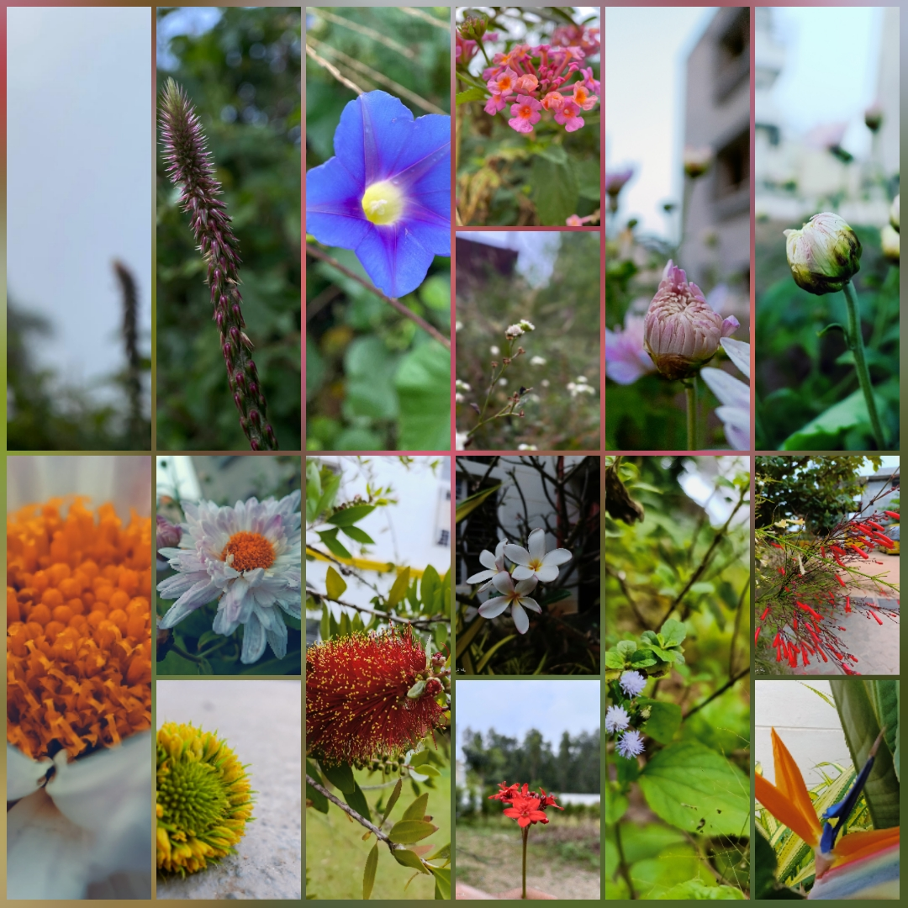
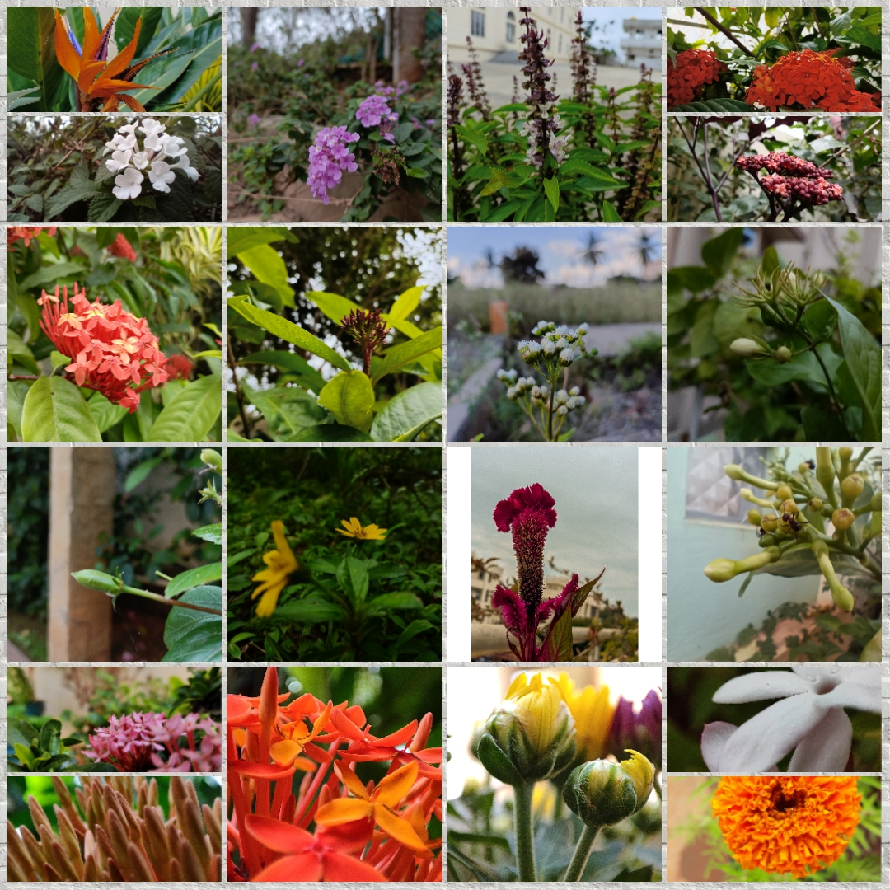
Observations:

Slide 8
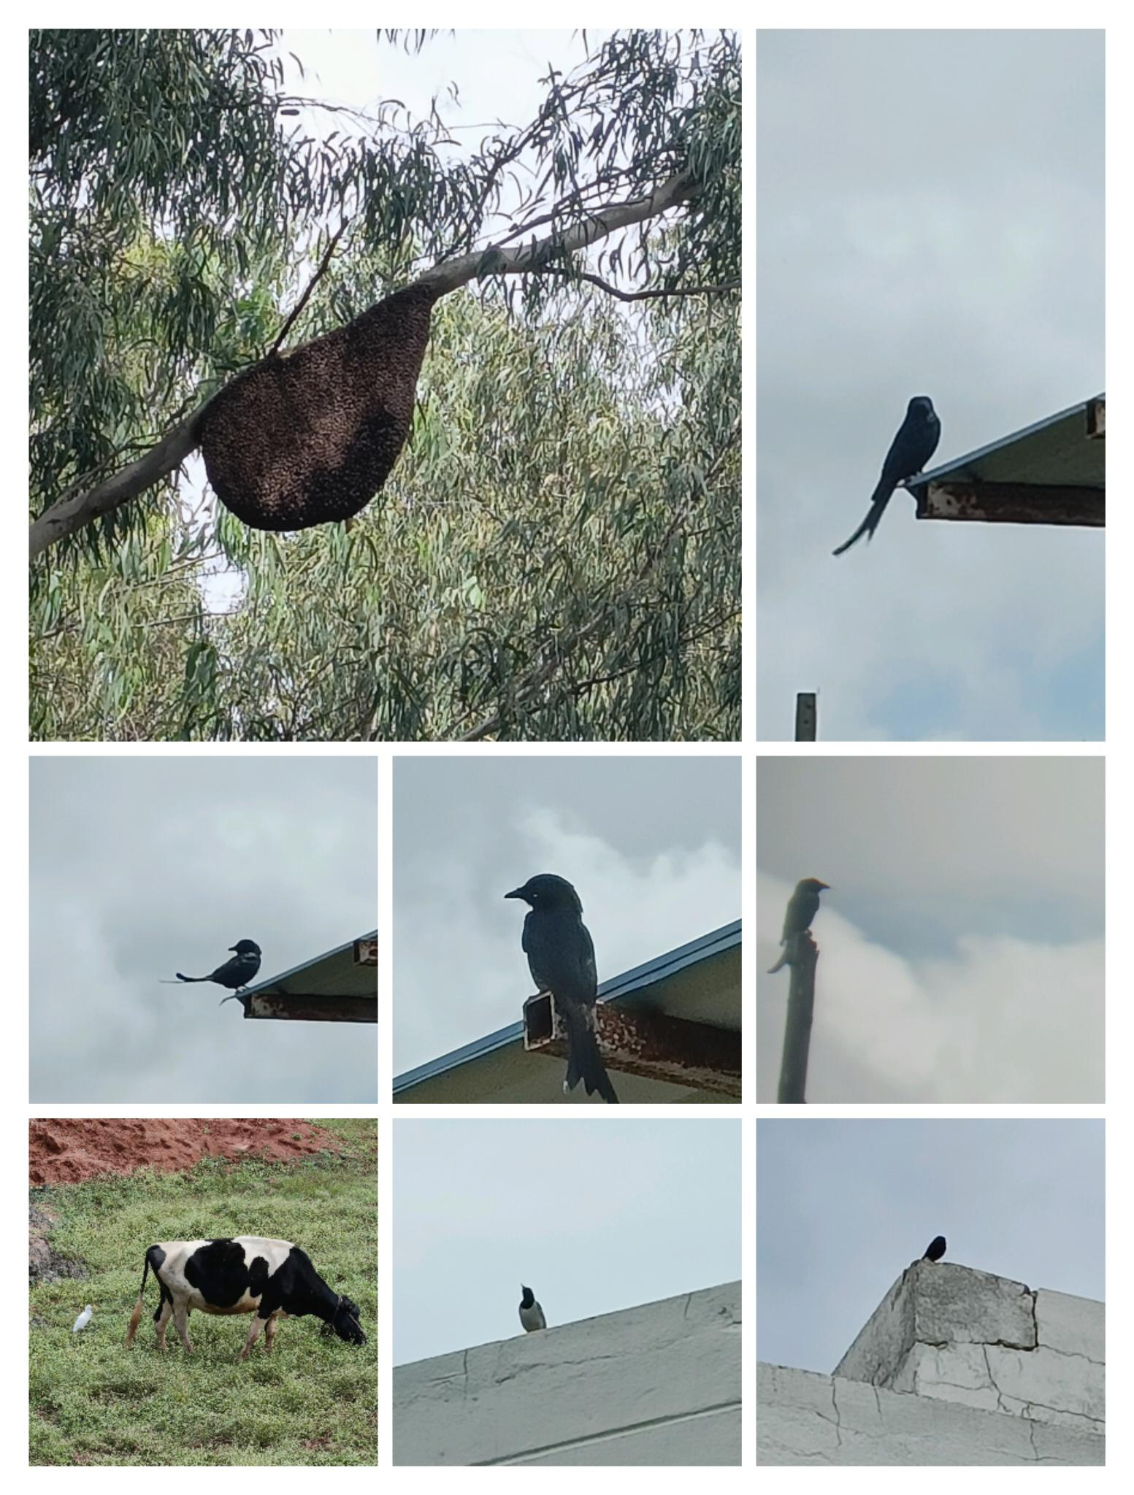
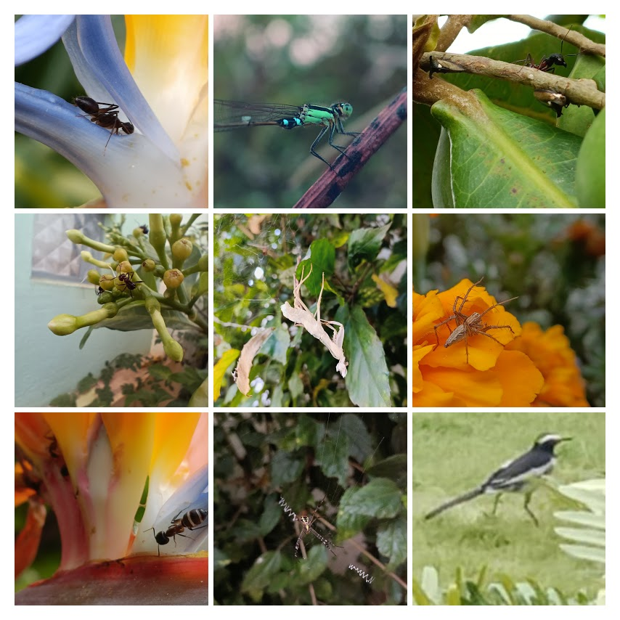
Observations:

Slide 9
Results
Species | Kingdom | Phylum | Class | Order | Family | Genus
Sweet William​​ | Plantae​​ | Angiospermae​​ | Magnoliopsida​​ | Caryophyllales​​ | Caryophyllaceae​​ | Dianthus L.​​
West Indian Lantana | Plantae | Angiospermae | Magnoliopsida | Lamiales | Verbenaceae | Lantana L.
Bird of Paradise Flower | Plantae | Angiospermae | Magnoliopsida | Zingiberales | Strelitziaceae | Strelitzia Aiton
Caesalpinia | Plantae | Angiospermae | Magnoliopsida | Fabales | Fabaceae | Caesalpinia L.
Solanum Lycocarpum | Plantae | Angiospermae | Magnoliopsida | Solanales | Solanaceae | Solanum L.
Billygoat Weed | Plantae | Angiospermae | Magnoliopsida | Asterales | Asteraceae | Ageratum L.
Syzygium | Plantae | Angiospermae | Magnoliopsida | Myrtales | Myrtaceae | Syzygium P. Br.
Thistle​ | Plantae​ | Angiospermae​ | Magnoliopsida​ | Asterales​ | Asteraceae​ | Cirsium Mill.​
Notes:
We have performed taxonomy for few rare species in our school. Taxonomy means to find the kingdom, phylum....genus of the species. For example: Chinese ixora with the kingdom.........rubiaceae and genus ixora. We have performed it for 24 more species.

Slide 10
Leaf Shape
Billygoat weed - Ovate
Syzygium - Elliptic
Peregrina - Oblong
Callistemon Speciosus - Linear
Cyanthillium - Ovate
Wedelia - Oblong
Securinega - Elliptic
Sweet William - Elliptic
Pluchea Indica - Ovate
Thistle - Lanceolate
Gazania Linearis - Ovate
Gazania Rigens - Spatulate
Tagetes Erecta - Lanceolate
Cockscomb - Ovate
Ficus Microcarpa - Elliptic
Chinese Ixora – Oblong
Leea – Elliptic
Combretum Indicum – Elliptic
West Indian Lantana – Ovate
Baby Sunrose - Cordate
Bird of Paradise – Oblong
Firecracker plant – Elliptical
Caesalpinia - Lyrate
Leucus Aspera - Linear
Solanum Lycocarpum - Sagittate
During the analysis, we have noticed that different plants have different leaf shapes. They are classified on the right:-

Slide 11
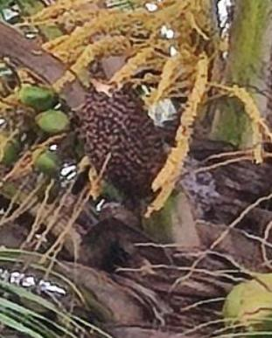
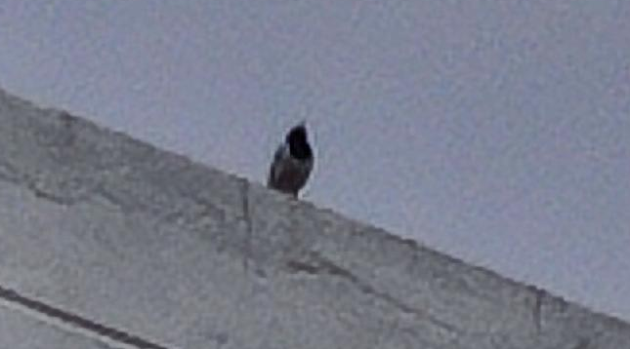
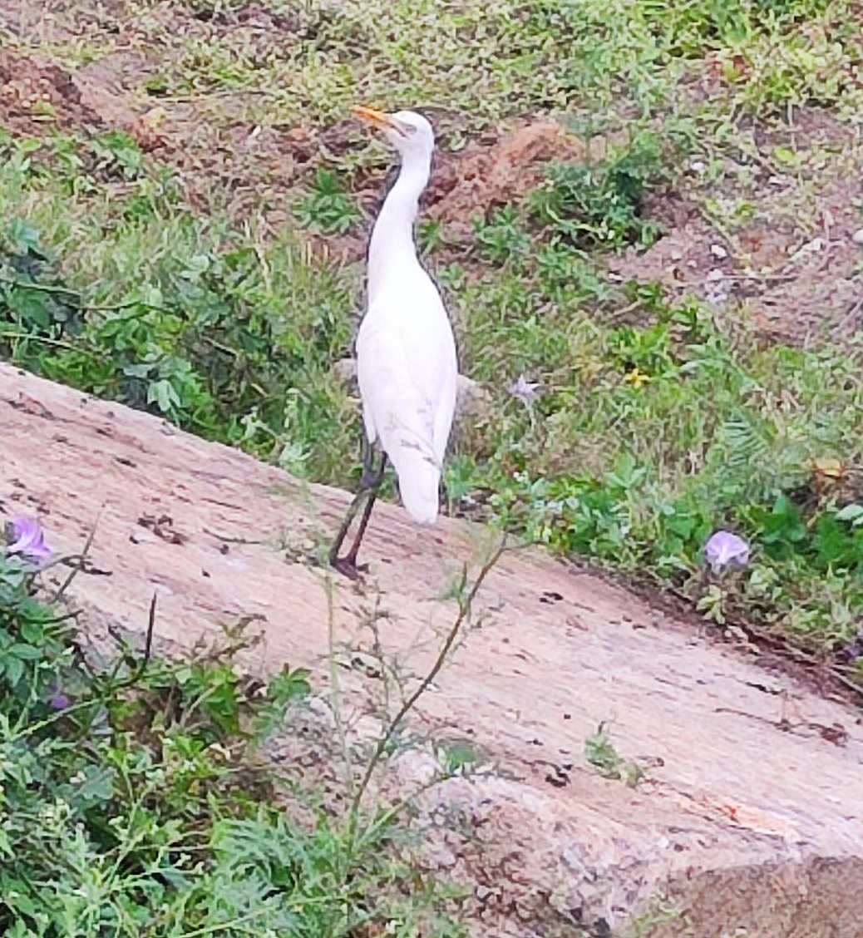
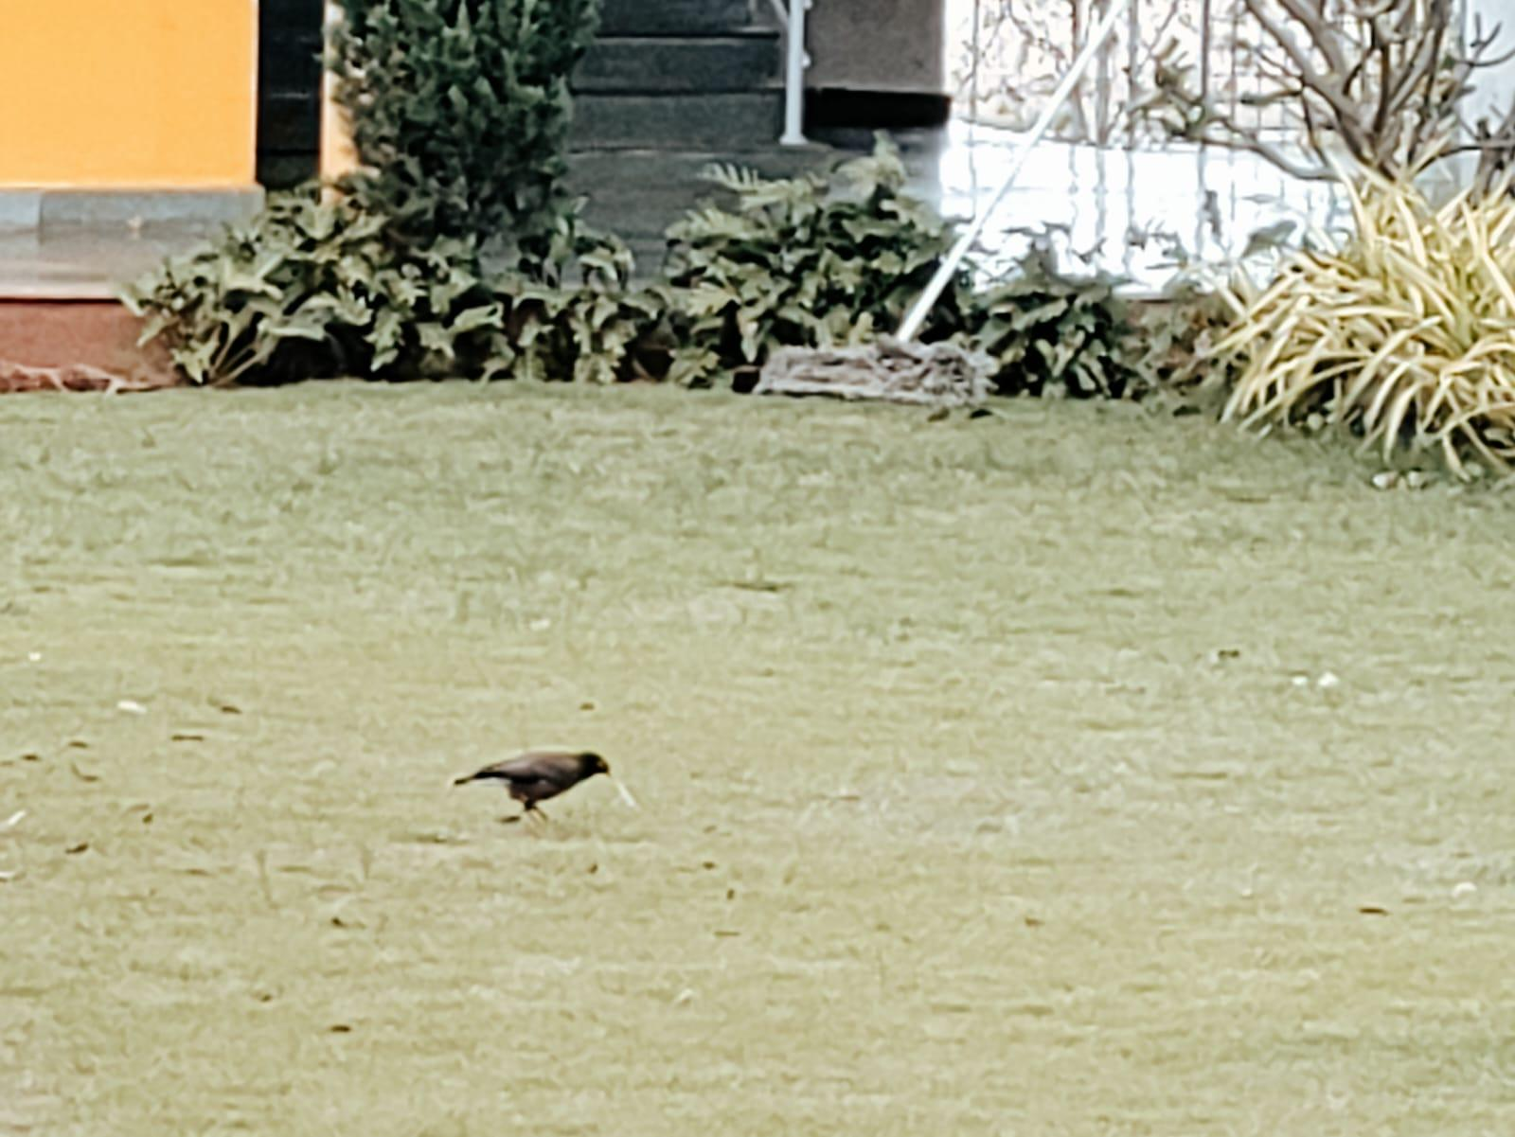
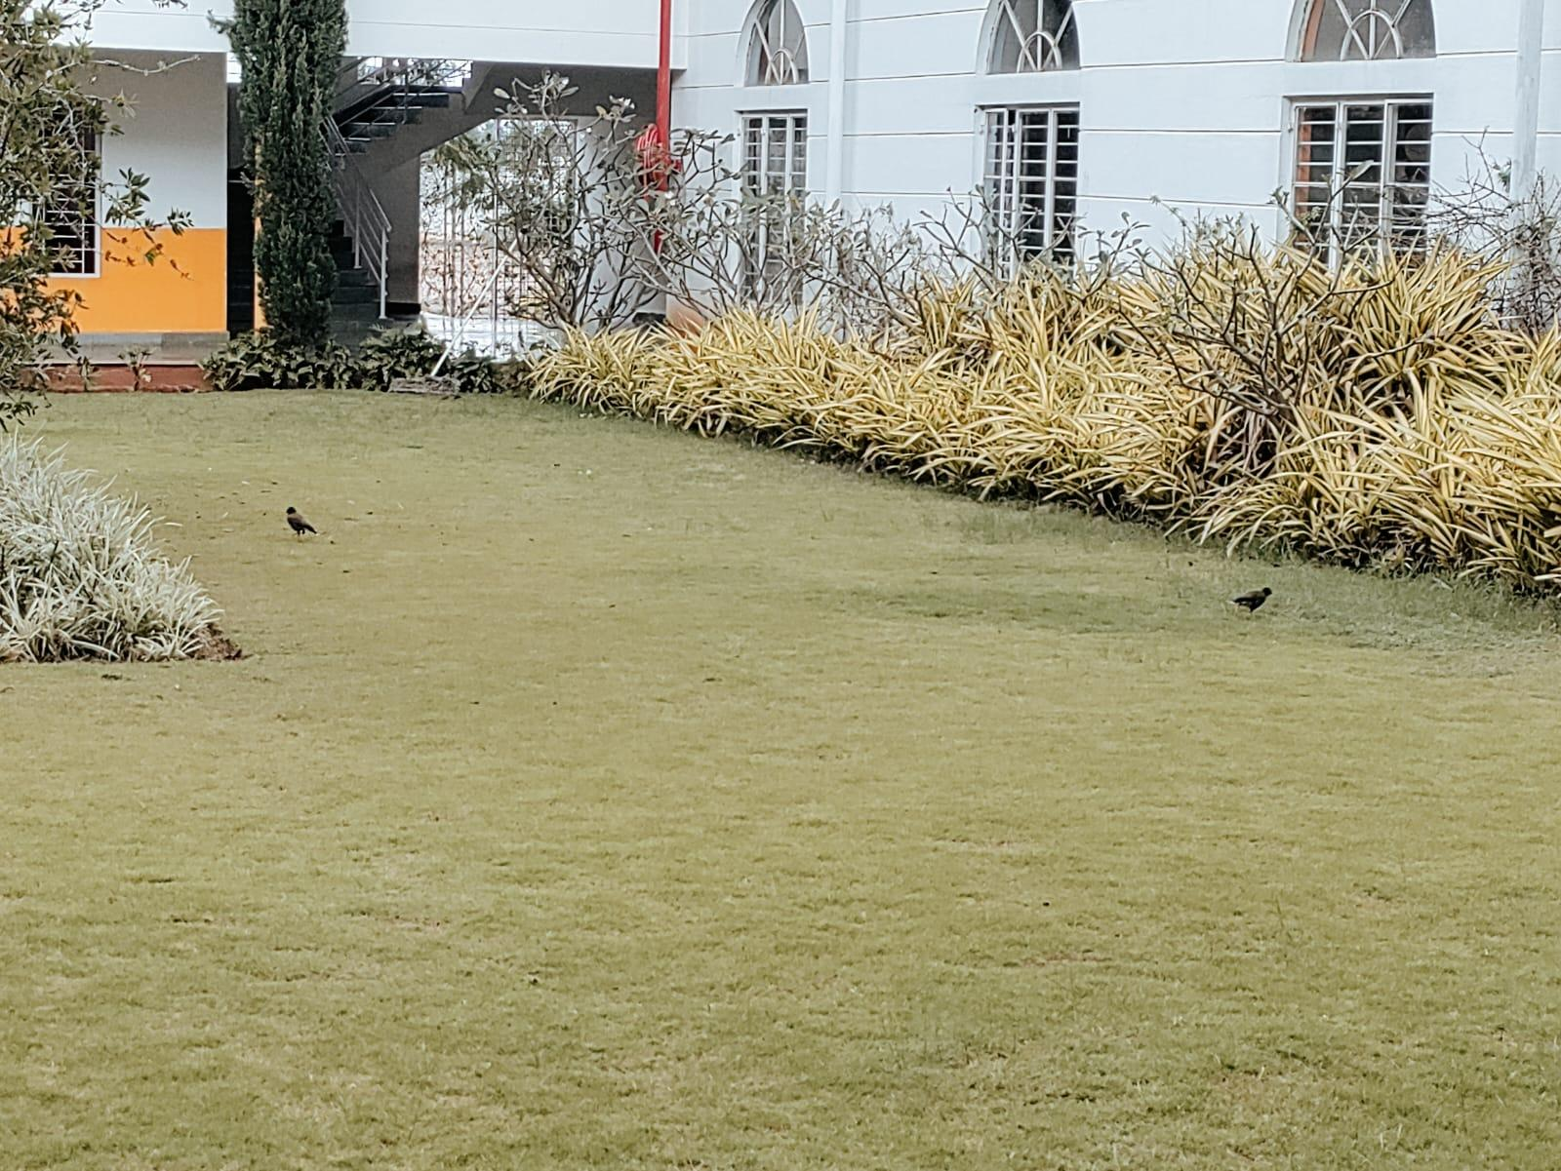
Fauna

Slide 12
Species​ | Kingdom​ | Phylum​ | Class​ | Order​ | Family​ | Genus​
Camponotus herculeanus​ | Animalia​ | Arthropoda​ | Insecta​ | Hymenoptera​ | Formicidae​ | Camponotus​
Argiope Anasuja​ | Animalia​ | Arthropoda​ | Euchelicerata​ | Araneae​ | Araneidae​ | Argiope​
Striped lynx spider​ | Animalia​ | Arthropoda​ | Euchelicerata​ | Araneae​ | Oxyopidae​ | Oxyopes​
Carpenter ant​ | Animalia​ | Arthropoda​ | Insecta​ | Hymenoptera​ | Formicidae​ | Camponotus​
Orchid mantis​ | Animalia​ | Arthropoda​ | Insecta​ | Mantodea​ | Hymenopodidae​ | Hymenopus​
Great Egret​ | Animalia​ | Chordata​ | Aves​ | Pelecaniformes​ | Ardeidae​ | Ardea​
Oriental Magpie Robin​ | Animalia​ | Chordata​ | Aves​ | Passeriformes​ | Muscicapidae​ | Copsychus​
Black Drongo​ | Animalia​ | Chordata​ | Aves​ | Passeriformes​ | Dicruridae​ | Dicrurus​

Slide 13
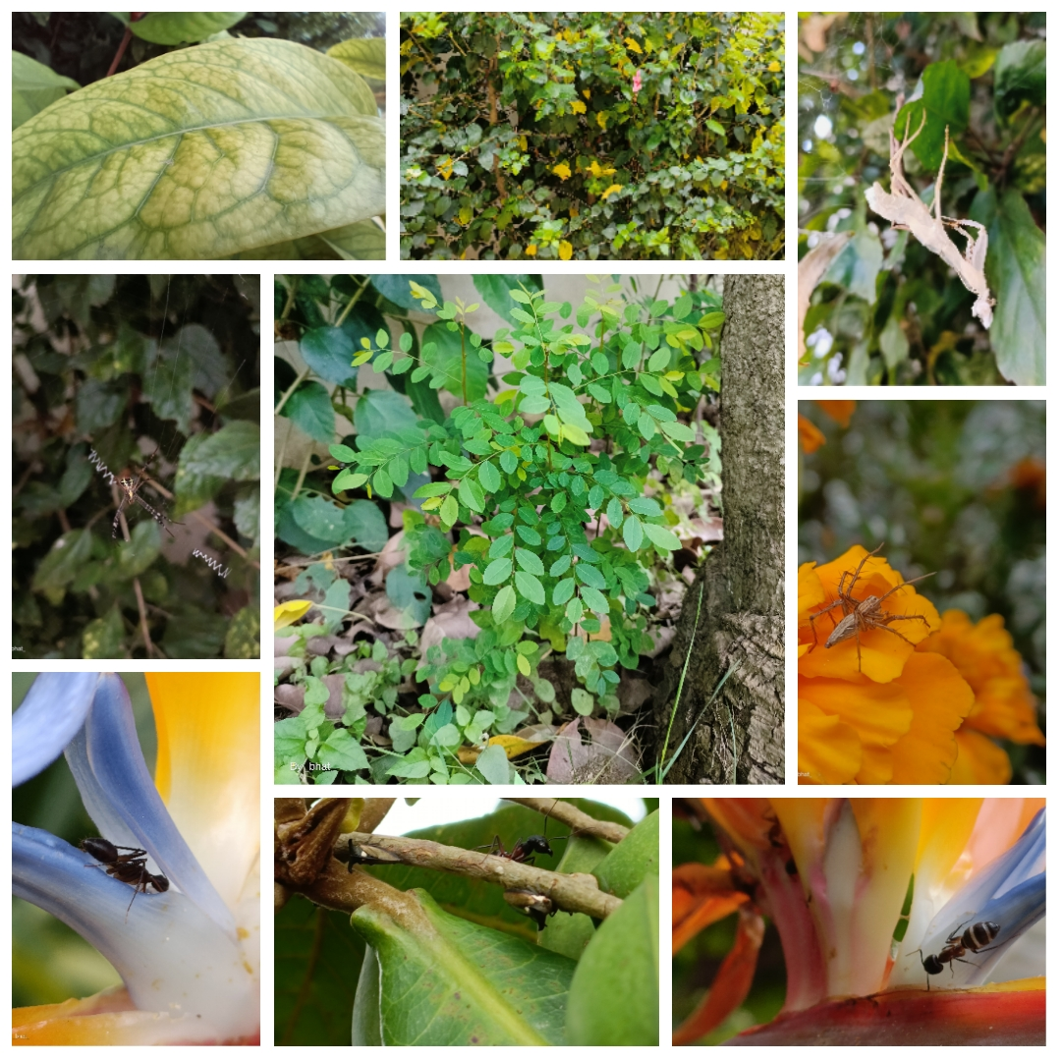
Discussion
We have also noticed a few organisms (insects) on the plant. Therefore, there is a developing eco-system in the plants.
Few plants have deficiencies (Magnesium, Iron, etc.) as can be seen in distinction of leaf colours.

Slide 14
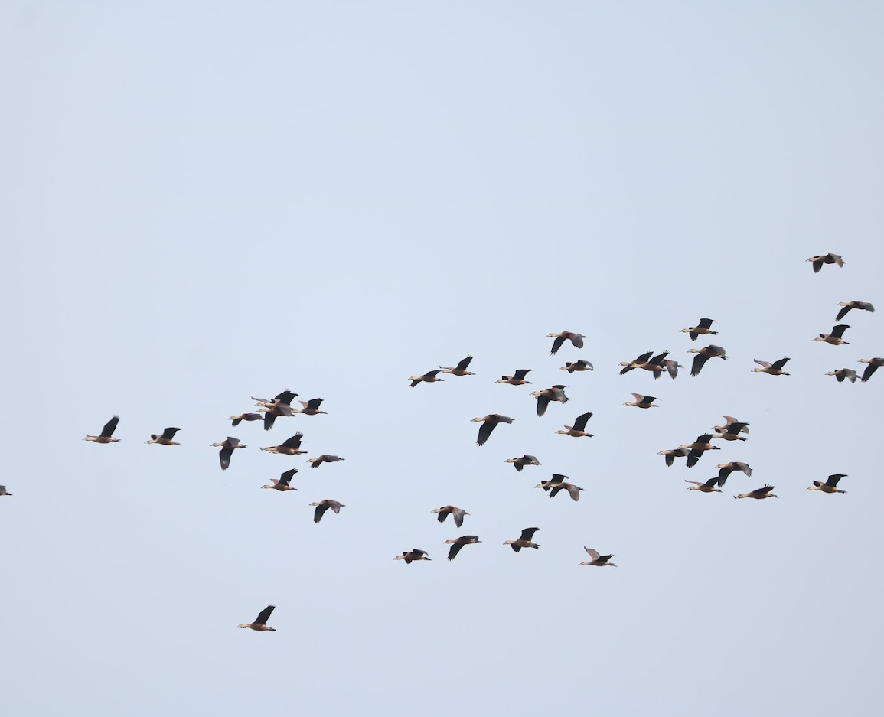

Discussion
Many birds could not be seen in the school campus, probably due to the disturbances during the school hours. But around the school campus, a lot of birds have been spotted as the area is rural and a plethora of farms are present.

Slide 15
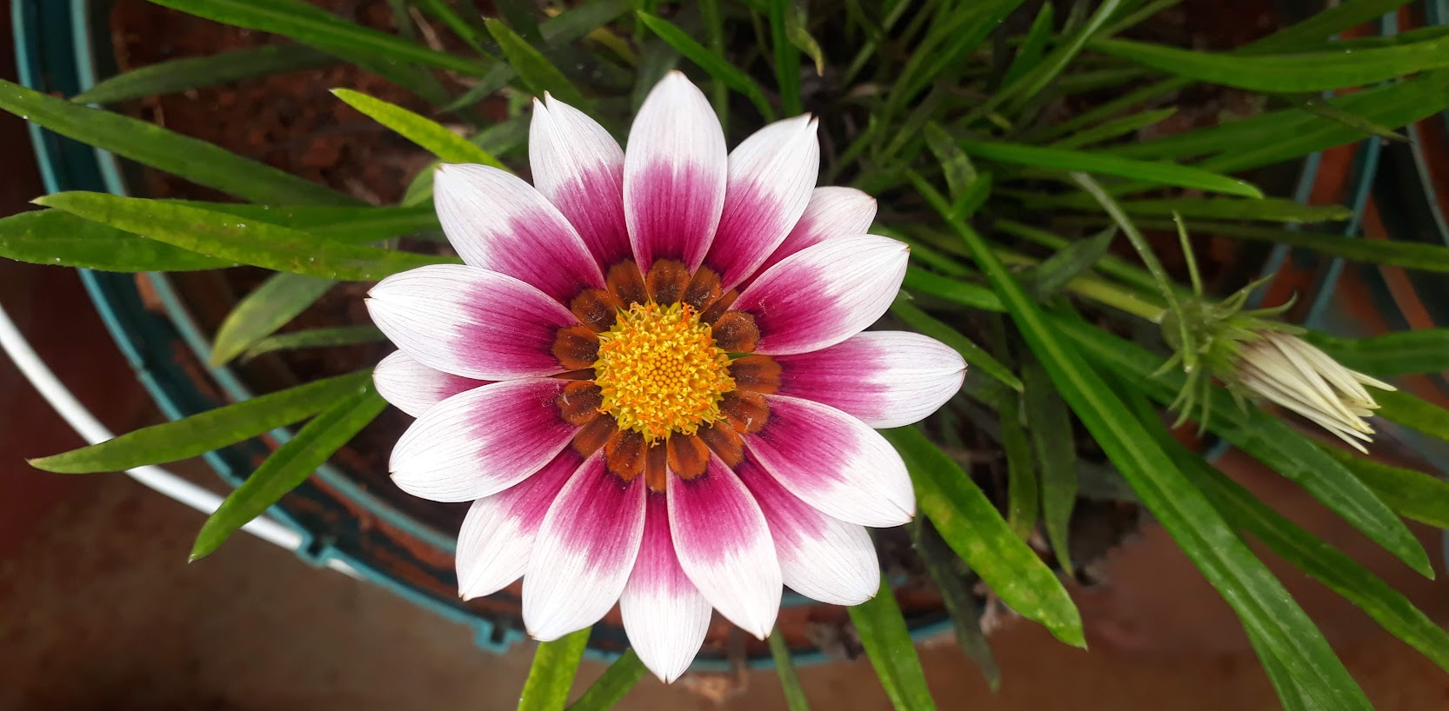
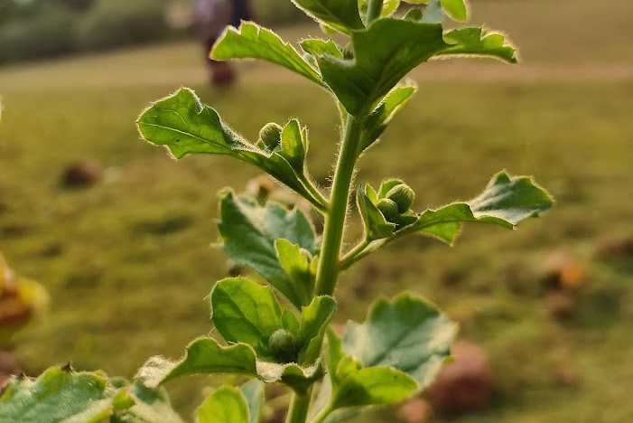
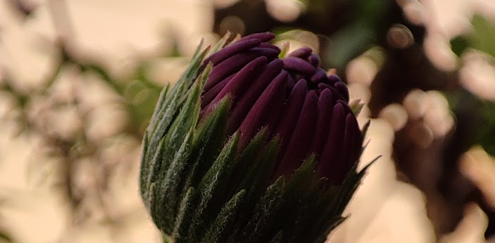
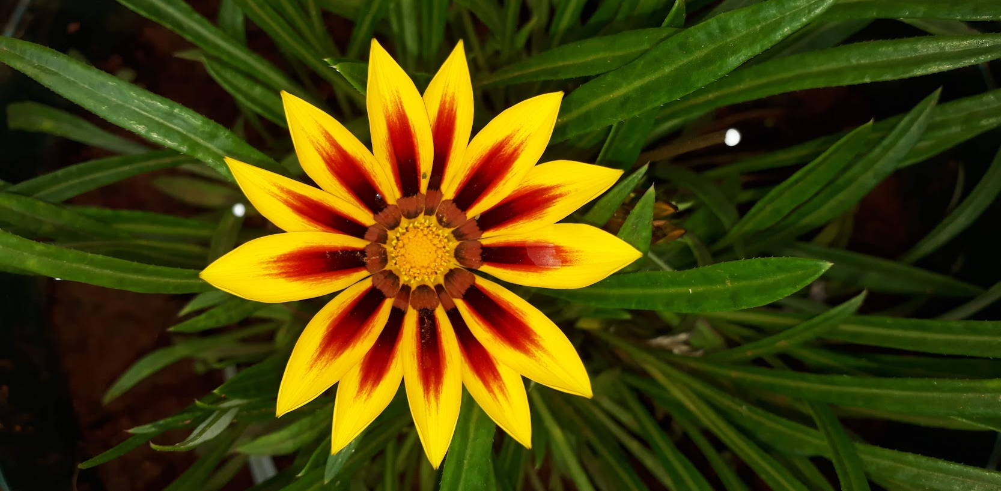
Acknowledgement
We are very grateful to the Indian Institute of Science (IISc) for providing this glorious opportunity to learn and to represent.
We also owe a special thanks to Vagdevi Vilas Institutions (VVI), Whitefield, for entertaining us and to encourage us into this exposure.
Notes:
We thank the Indian Institute of Science for this opportunity they gave us for learning as well as to proudly represent our school. We also thank our Vagdevi Vilas Institutions for encouraging us at all stages.

Slide 16

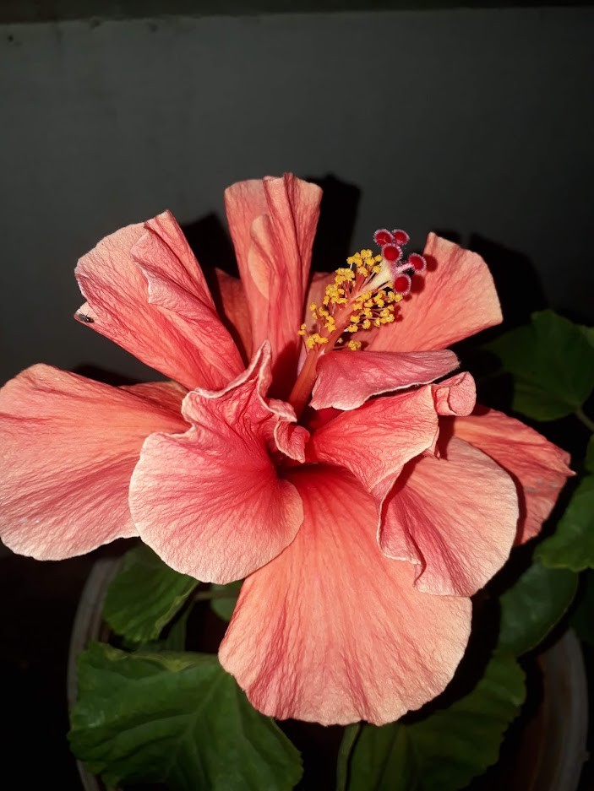
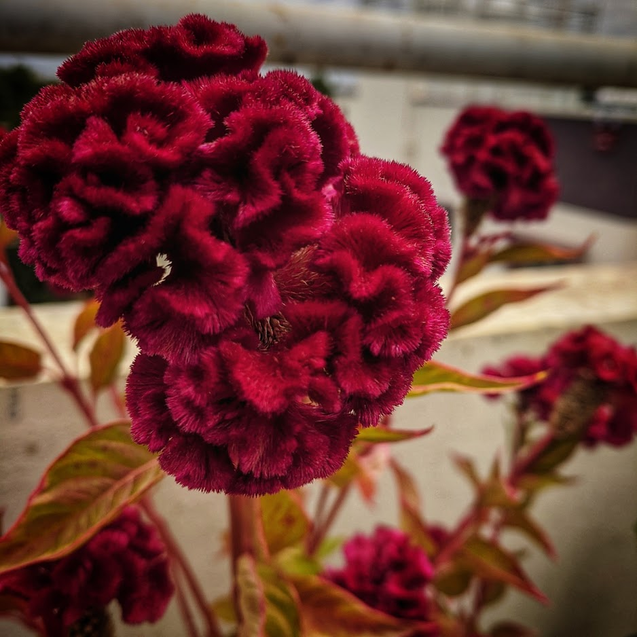
References
Anonymous, https://www.itis.gov/servlet/SingleRpt/SingleRpt?search_topic=TSN&search_value=35199#null , ITIS – Report: Ixora.
Anonymous, https://www.itis.gov/servlet/SingleRpt/SingleRpt?search_topic=TSN&search_value=524618#null, ITIS – Report: Rhinanthus minor ssp. Minor.
Anonymous, https://www.itis.gov/servlet/SingleRpt/SingleRpt?search_topic=TSN&search_value=500418#null, ITIS – Report: Mesembryanthemum.
Anonymous, PlantNet (App).
Anonymous, https://www.nparks.gov.sg/nparksbuzz/oct-issue-2020/gardening/identifying-nutrient-deficiency-in-plants#:~:text=Deficiency%20symptoms%3A%20New%20foliage%2C%20buds,Roots%20become%20short%20and%20stubby., Identifying Nutrient Deficiency in Plants.

Slide 17
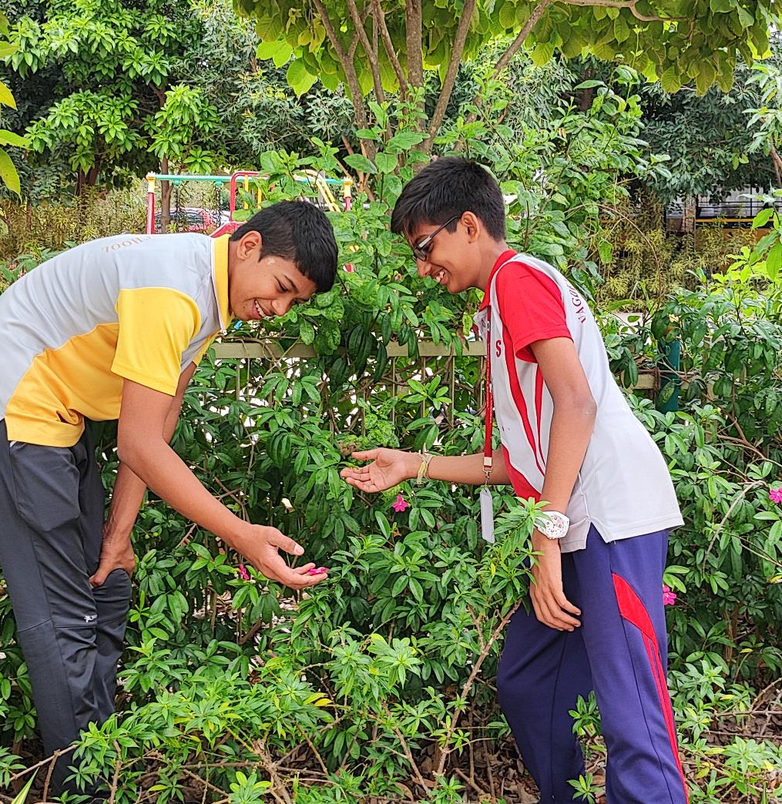
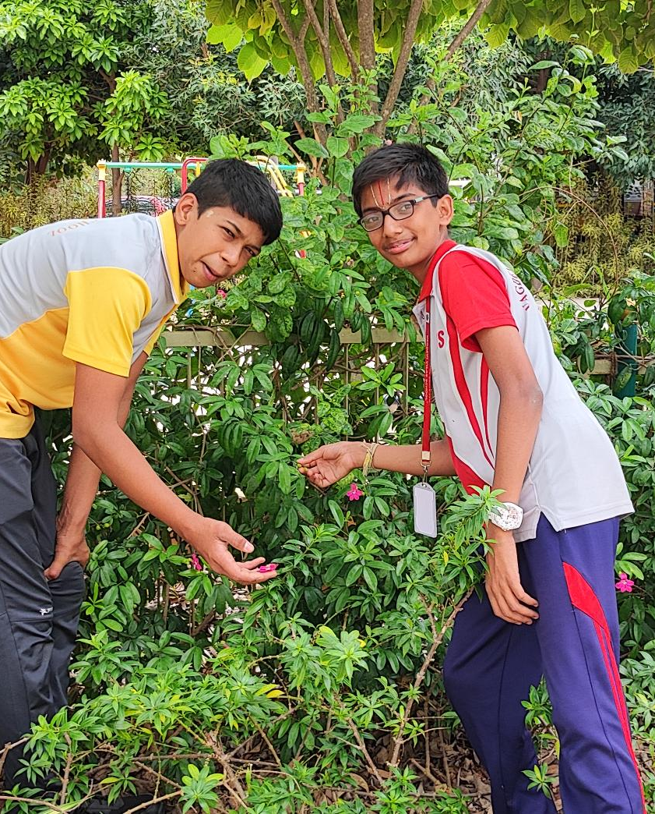
THANK
YOU!

