Slide 1
Study Of Bird At Hoskote Lake
Tanav M Sai , Tejas Vishwakarma
Standard VIII
Affiliations CBSE

Slide 2
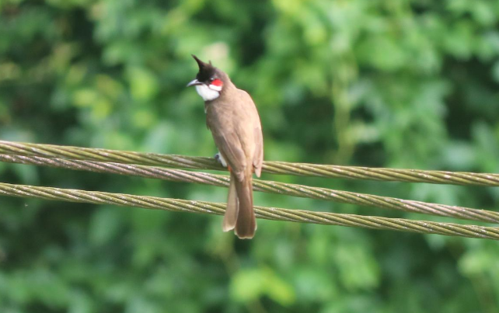
Introduction
Birds are the important part of ecosystem. Large green spaces and lakes support a greater diversity of birds.
They protect important habitat like wetlands .
They are good pollinator.
However, migratory bird numbers are declining in Bengaluru, and many lake-dependent resident bird numbers seem to be increasing in the past five years.
Thus, we wanted to study about the present status of the birds present in Hoskote area.

Slide 3
Objectives
.
Different species of birds found in that specific area.
Present condition of birds in Hoskote lake area.
Finding the endangered birds.

Slide 4
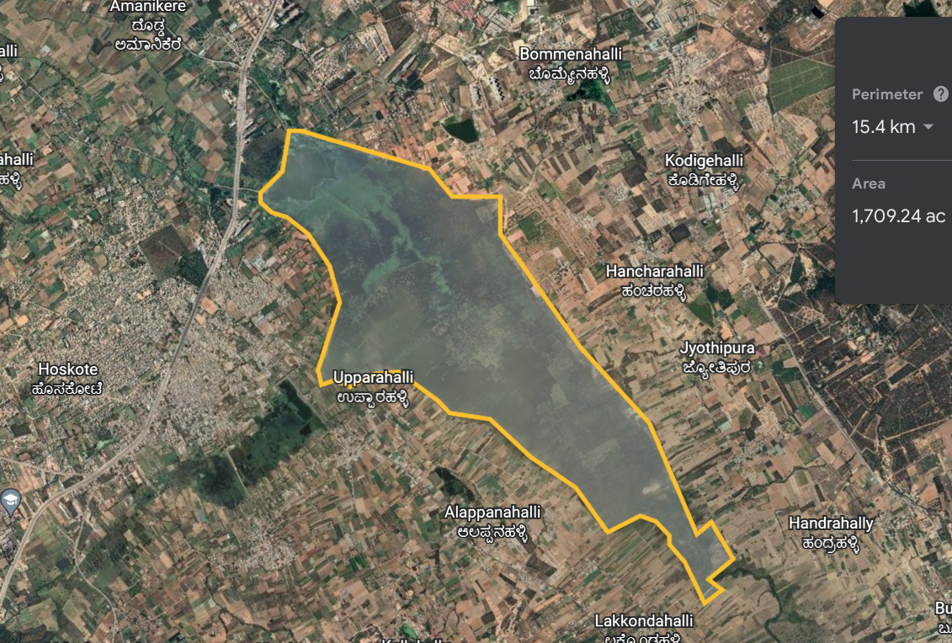
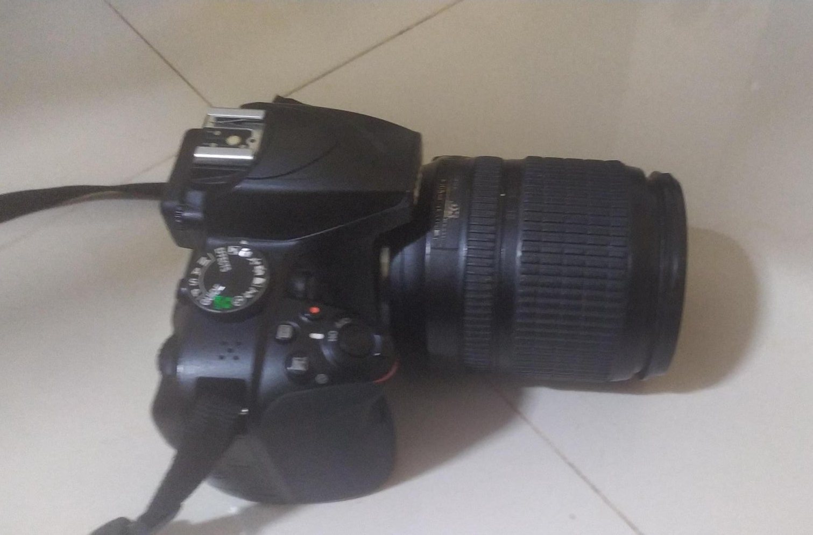
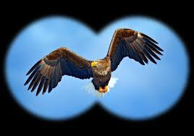
We visited this place five times at the morning and evening hours with 2 hours per visit.
STUDY AREA :
Longitude- 77.7695°E
Latitude-13.0703° N,
Materials Used: Binoculars Camera

Slide 5
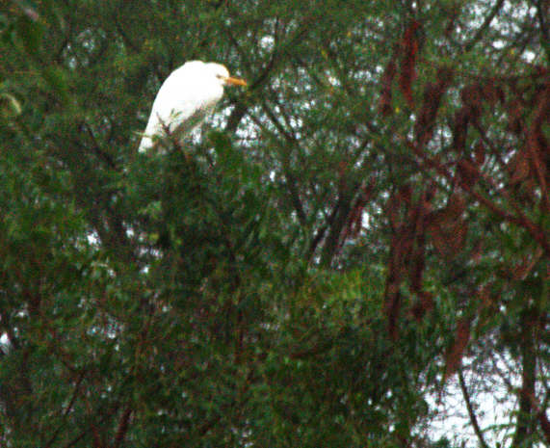
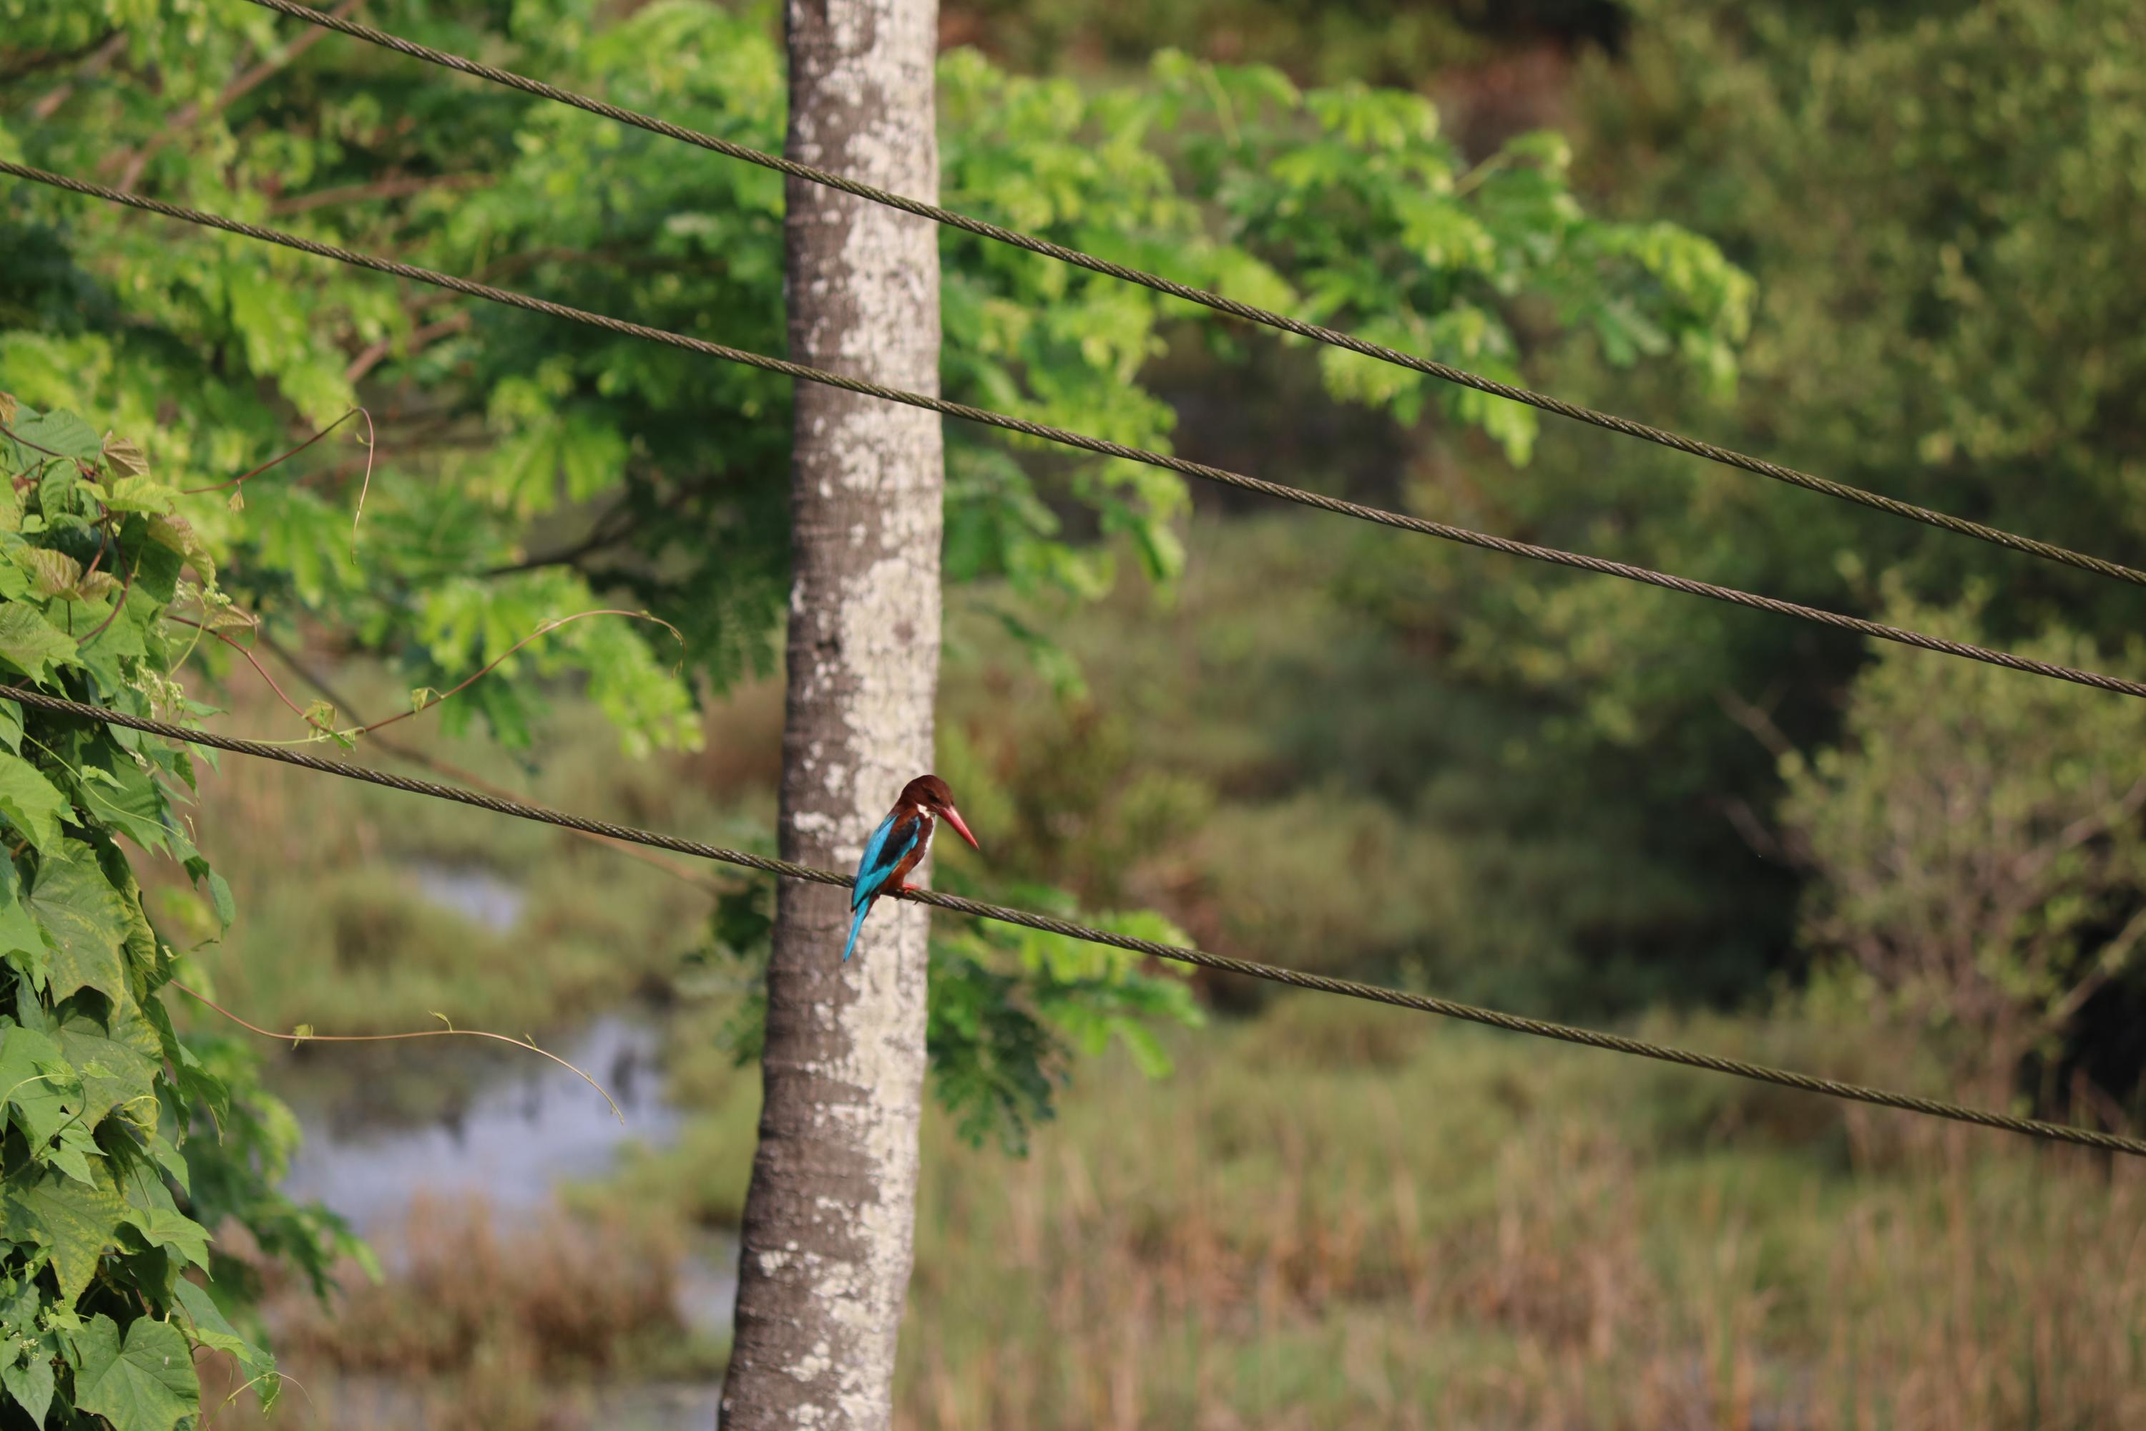
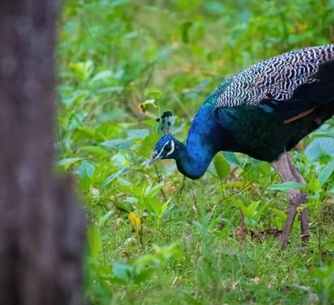
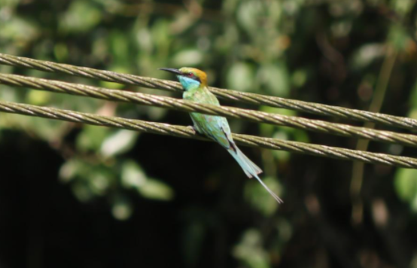
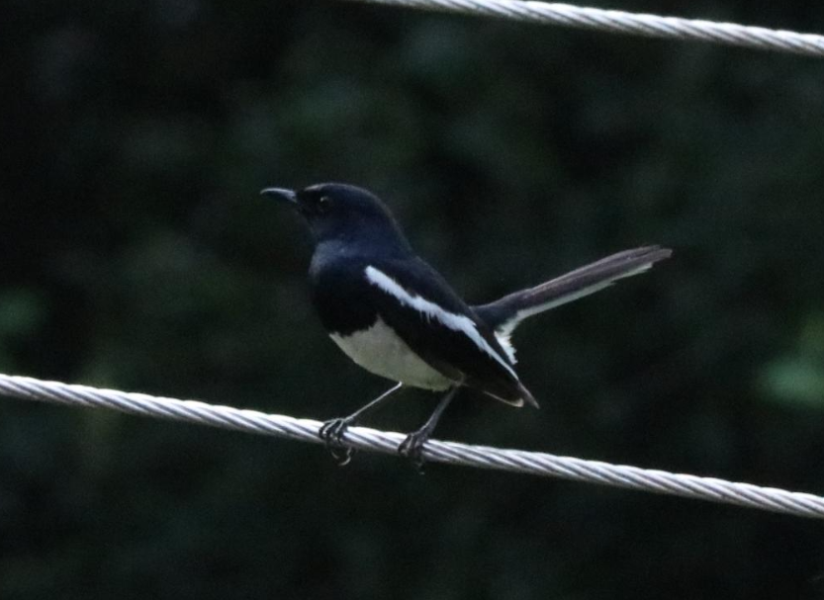
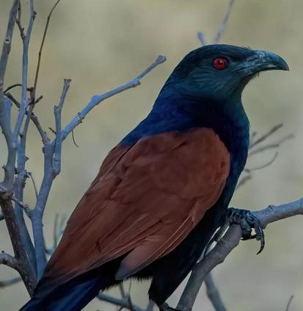
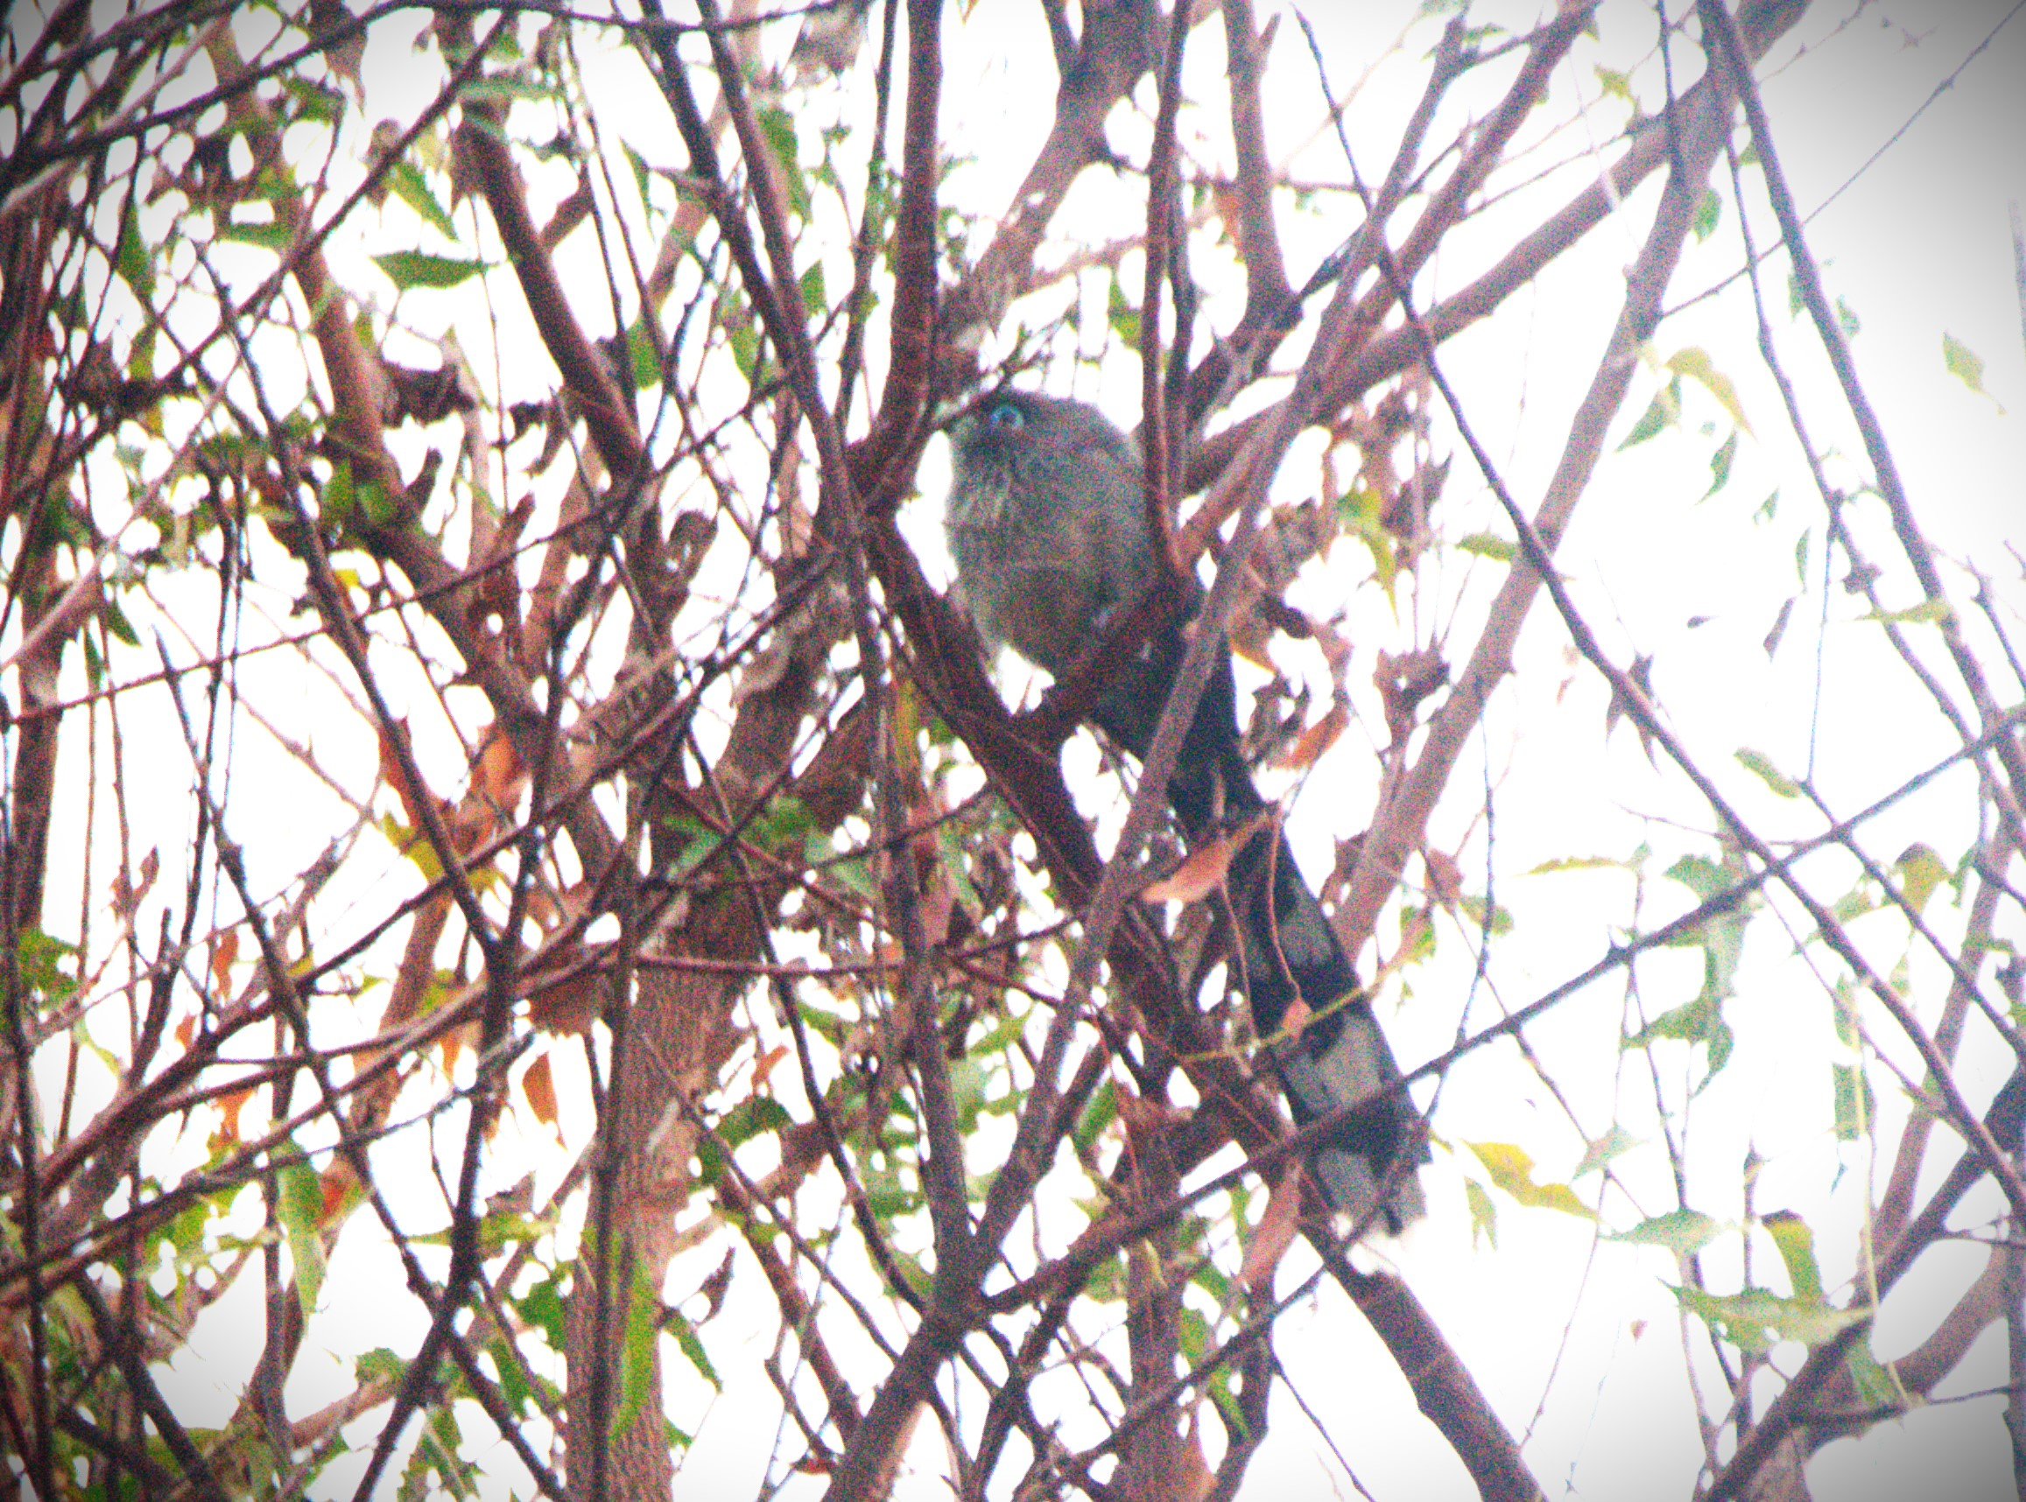
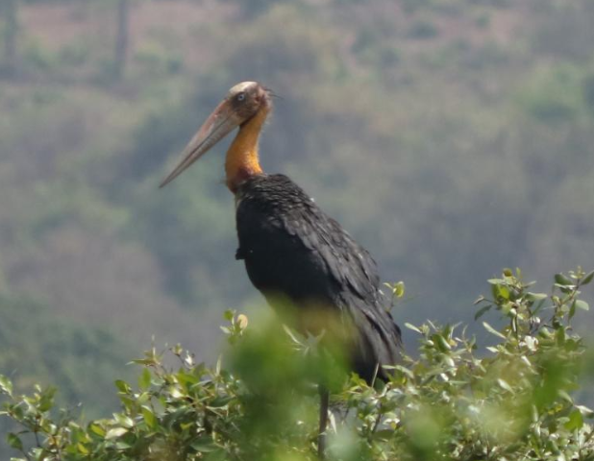
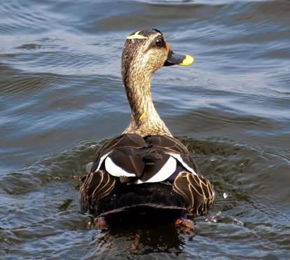
Results:
White-Throated Kingfisher
Great egret
Peacock
Asian green bee-eater
Blue-faced Malkoha
Great couca
Oriental magpie-robin
Lesser Adjutant
Indian spot billed duck

Slide 6
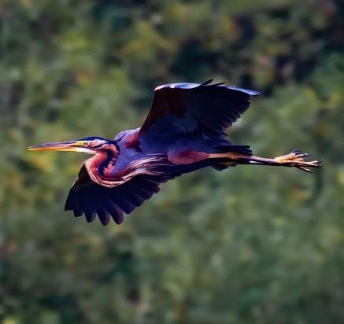
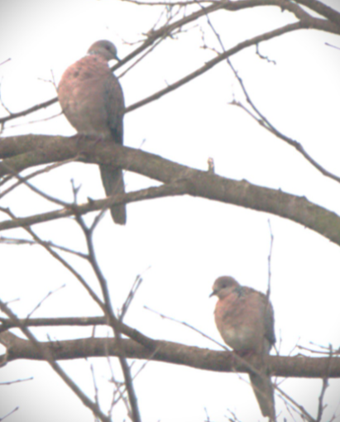
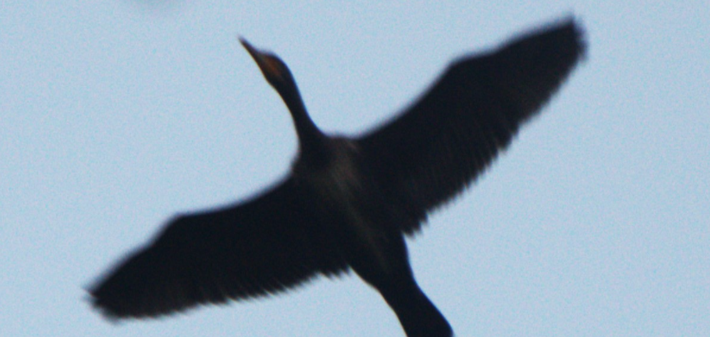
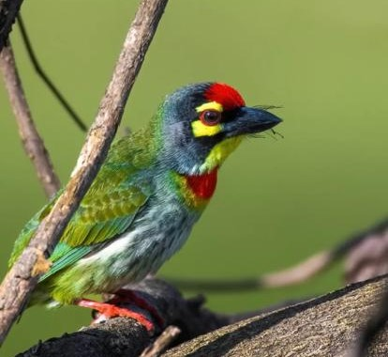
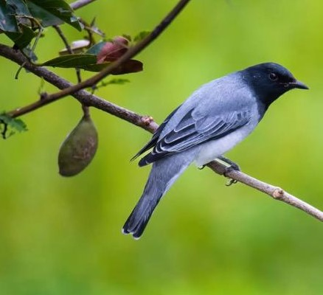
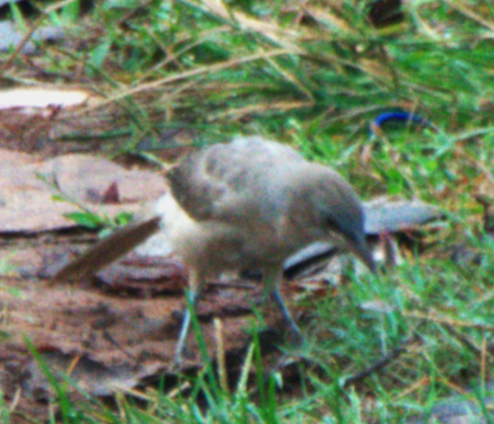
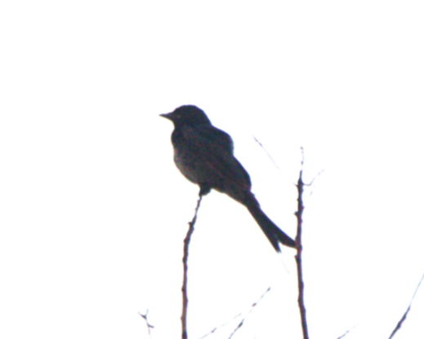
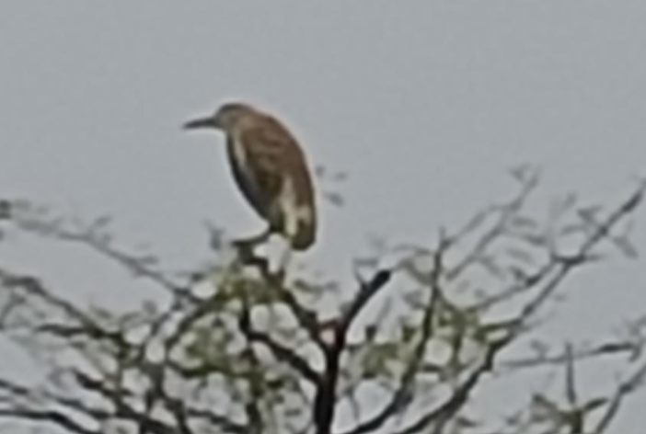
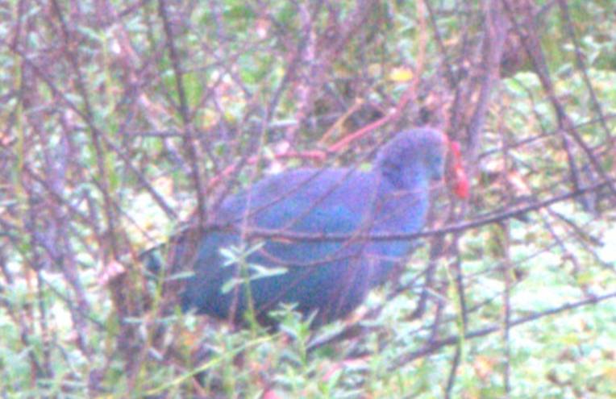
Red whiskered Bulbul
Spotted dove
Purple heron
Great Cormorant
Coppersmith barbet
Black headed cuckoo shrike
Grey Babbler
Black Drongo
Indian pond heron
Grey-headed Swamphen

Slide 7
BIRDS NAME | FAMILY NAME | SCIENTIFIC NAME | BEAK/BILL | GUILD
1)white throated kingfisher | Alcedinidae | Halcyon smyrnensis | long, heavy, and pointed | large crustaceans, insects, earthworms, snakes
2)Asian green bee-eater | Bee eater | Merops Orentails | long, sharp and narrow black | eat insects, especially bees, ants
3)Great cormorate | Cormorants | Phalacrocorax carbo | long but thicker and larger bill. | mostly feed on fish
4)The Indian pond heron | Heron | Aredeola grayii | yellow beak with a black tip. | rustaceans, aquatic insects, fishes
5)Red whiskered bulbul | Pycnonotidae | Pycnonotus jocosus | Brownish-black | frugivorous / animal matter

Slide 8
BIRDS NAME | FAMILY NAME | SCIENTIFIC NAME | BEAK/BILL | GUILD
6)Spotted Dove​ | Dove​ ​ | Spilopelia ​ chinensis​ ​ | Short and black​ ​ | grass seeds, grains​
7)Blue faced malkoha​ | cuckoos​ | Phaenicophaeus viridirostris​ | bill is apple green​ | insects​
8)Great egret​ | Ardeidae​ | Ardea alba​ | Yellow coloured ​ | Mostly fish​
9)Greyy headed swamphen​ | Rail​ | Porphyrio​ | triangle-shaped​ | vegetable-like matter​
10)Black Drongo​ | Drongos​ | Dicrurus macrocercus​ | slightly down curved, black​ | grasshoppers, cicadas, termites, wasps​

Slide 9
BIRDS NAME | Family name | SCIENTIFIC NAME | BEAK/BILL | GUILD
11)grey babbler | Laughingthrushes | Turdoides malcolmi | brownish grey with a yellow-bill | insects small lizards
12)Orential magpi-robbin | Corvidae | Copsychus Saularis | Black coloured beak | insects and other invertebrates
13)Intermediate egret | Ardeidae | Ardea intermedia | thickish yellow bill. | fish, frogs, crustaceans and insects
14)lesser adjutant | Stork | Leptoptilos javanicus | Light red coloured bill | mainly on fish, frogs, reptiles and large invertebrates
15)Purple heron | Heron | Ardea purpurea | Yellow | fish, small mammals and amphibians

Slide 10
BIRDS NAME | FAMILY NAME | SCIENTIFIC NAME | BEAK/BILL | GUILD
16)Peacock​ | Pheasant​ | Pavo cristatus​ | short, thick and conical​ | plant and animal matter​
17)Great coucal​ | Cuculidae​ | Centropus sinensis​ | ​Elaborated and pointed | insects, caterpillars, snails​
18)Indian spot billed duck​ ​ | Anatidae​ | Anas poecilorhyncha​ | elongated, flat​ | Rice,snails​
19)Coppersmith barbet​ | Megalaimidae​ | Megalaima haemacephala​ | large heavy​ | fruit​
20)Black headed cuckoo shrike​ | Ampephagidae​ | Lalage melanoptera​ ​ ​ ​ | downward-curving beaks​ | ​Insects, caterpillars, beetles, grasshoppers

Slide 11
Discussion:
The number of birds found as piscivores(fish eating birds) were great egret, Indian pond heron etc which clearly indicates the different number of fishes present in the lake.
Insectivore birds like Asian green bee eater, Oriental magpie robin were also present in the lake.
This indicates the presence of many insects in that area which makes the bird migrate there in search of food.
Thus, bird species responded differently to habitats in terms of choice of their food.
Assessing the responses of various guilds showed that each bird guild can be affected very differently.

Slide 12
Problems
Birds consuming plastic
Deforestation
Fishermans killing birds accidently
Climate change

Slide 13
Endangered species we found at Hoskote lake :
The lesser adjutant:
The lesser adjutant is a large wading bird in the stork family. The conservation status of the bird is vulnerable(decreasing).The Lesser Adjutant feeds mainly on aquatic preys such as fish, amphibians(piscivores). The mass of the bird is about 5.5kg.

Slide 14
Conclusion
The solutions mentioned can be used for other areas too so that the birds can be restored in their particular habitats.
Parks, wildlife refuges, and other open space should be protected near your community. Open space also provides us with great places to visit and enjoy. Support wildlife habitat and open space protection in your community.
Save Birds save nature not only for mankind but for ecological balance

Slide 15
References
IUCN Red List of Threatened Species
Bird Comparison | Ask A Biologist (asu.edu)
eBird - Discover a new world of birding...
WELCOME TO THE BIRDS OF INDIA WEBSITE!
https://sashikantdash.com/2018/12/16/bangalore-birding-at-hoskote-lake/
https://avibase.bsc-eoc.org/checklist.jsp?lang=EN&p2=1&list=clements&synlang=&region=INswkabr&version=text&lifelist=&highlight=0

Slide 16
ACKNOWLEDGEMENT
We would like to express our deepest gratitude to IISc for giving us chance to participate in this event .
We would like to extend our thanks to VVI for giving us an opportunity to be a part of this event .

Slide 17
THANK YOU

