Slide 1


SOIL ANALYSIS
By Sucheth Bhat and Japleen Kaur
Grade VIII
Central Board Of Secondary Education (CBSE)

Slide 2
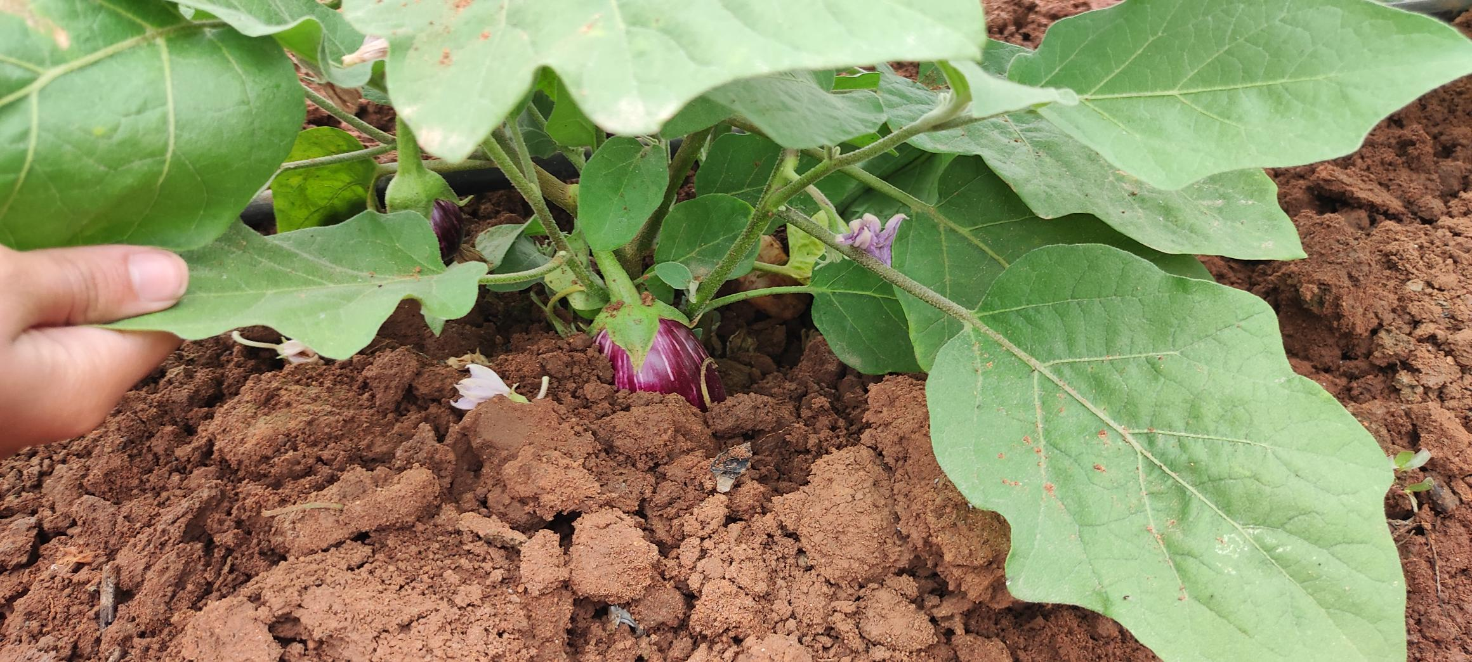

Introduction
Why ‘Soil’ ?
Formerly, soil has been harmed because of poor management, deforestation and excessive agriculture.
Soil is essential for the growth of healthy plants thus its degradation becomes a major concern for us.

Slide 3
Objectives
This project is a provisional study of unique soil from various places.
Comparison of soil from different areas and studying different parameters such as a) nutrient content, b) pH value, c) moisture content, d) water holding capacity, e) soil color.
Strives to recognize the quality of the soil and to discover a convincing solution.

Slide 4
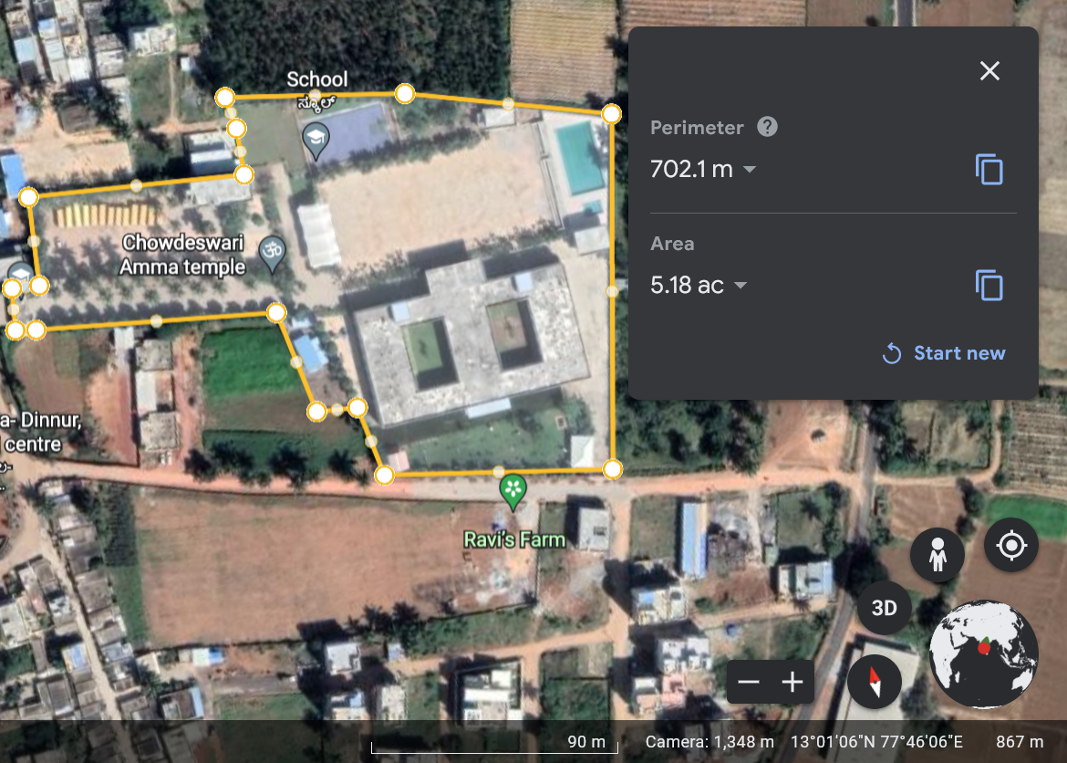
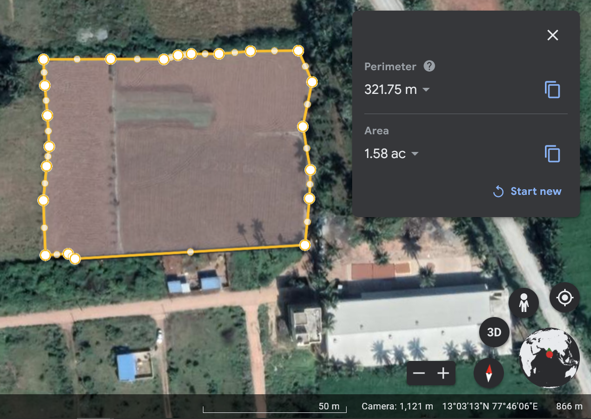
Study Area
Materials and methods
Vagdevi Whitefield:
Coordinates;
13°01'05°N, 77°46'12"E
AREA: 5.18 ACRES
Eggplant Soil:
Coordinates;
13°03'13°N 77°46'10"E
AREA: 1.58 ACRES

Slide 5
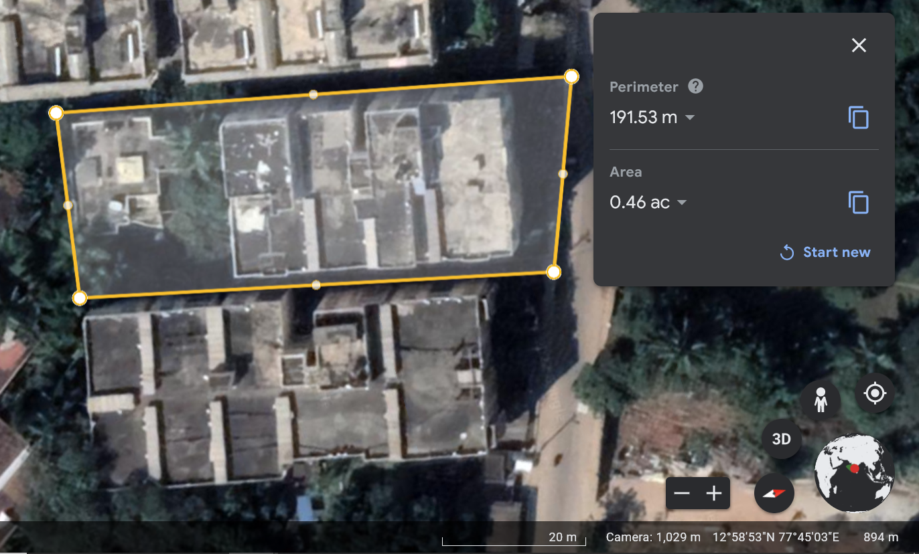
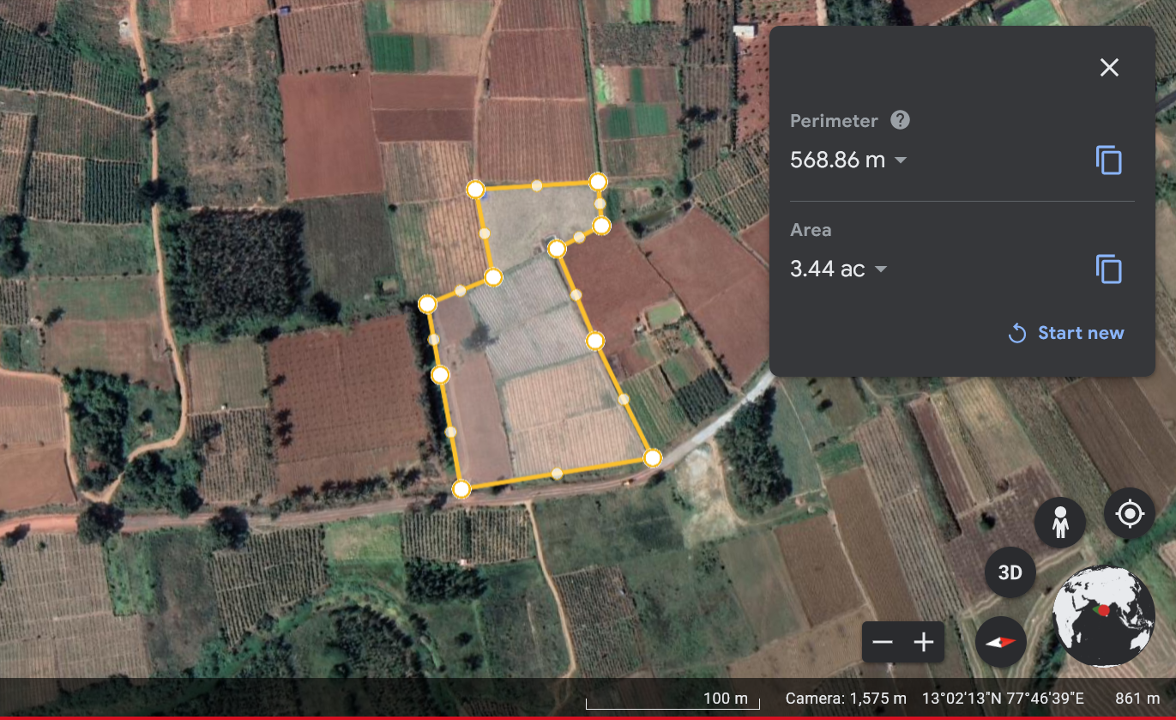
Study Area
Urban area soil
Coordinates;
12°58'54"N, 77°45'03"E
AREA: 0.46 acres
Rose Plant Soil:
Coordinates;
13°02'24"N 77°46'39"E

Slide 6
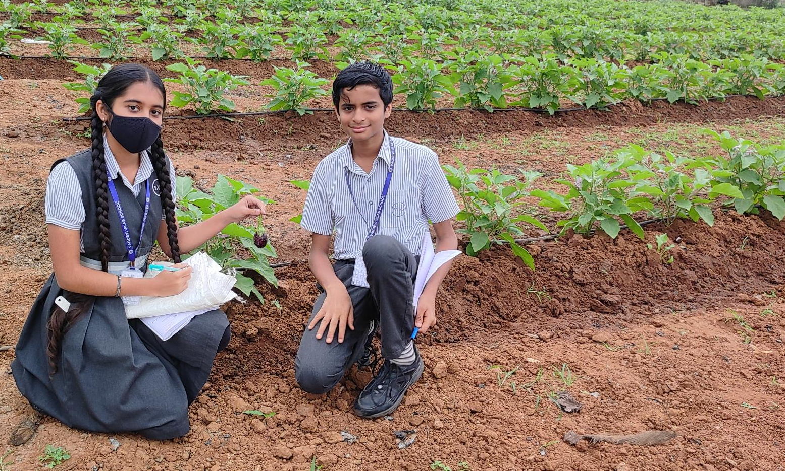
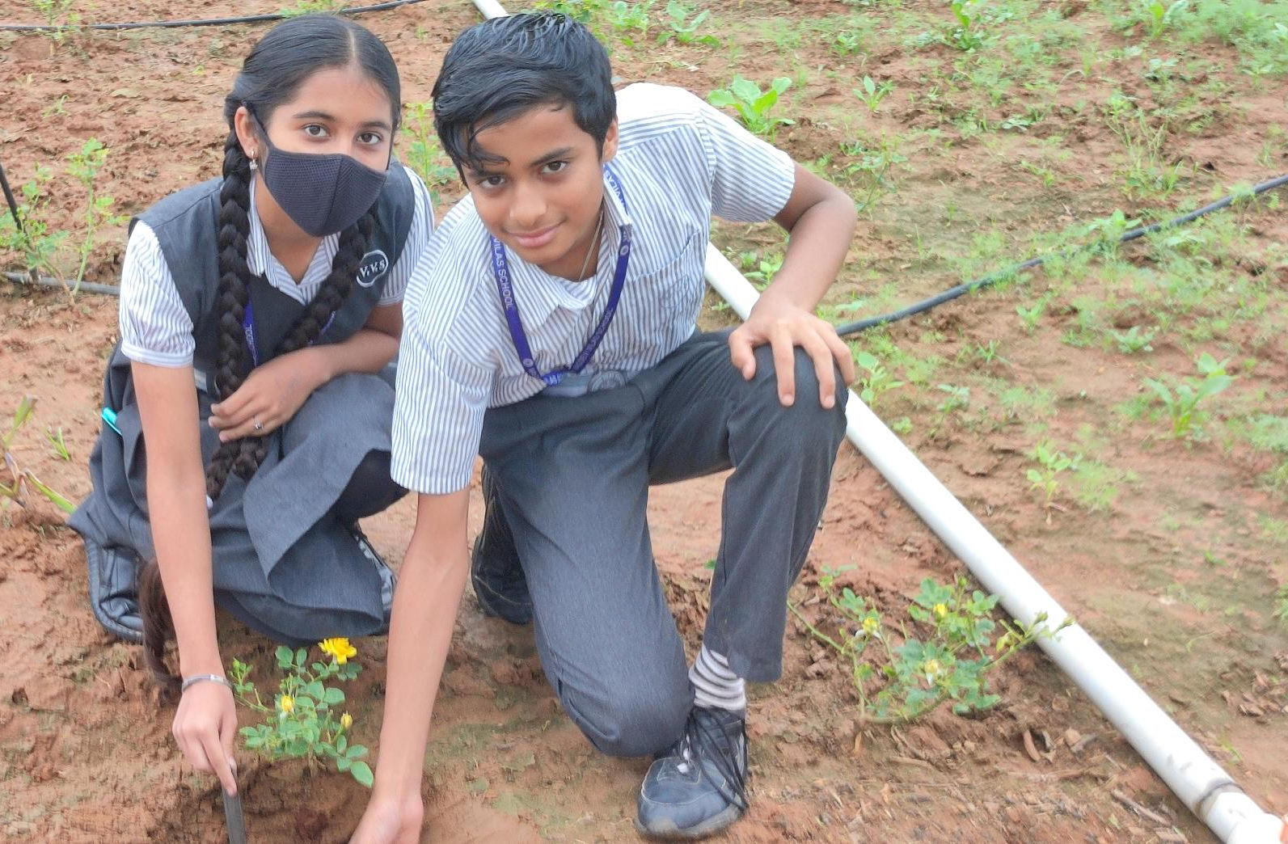
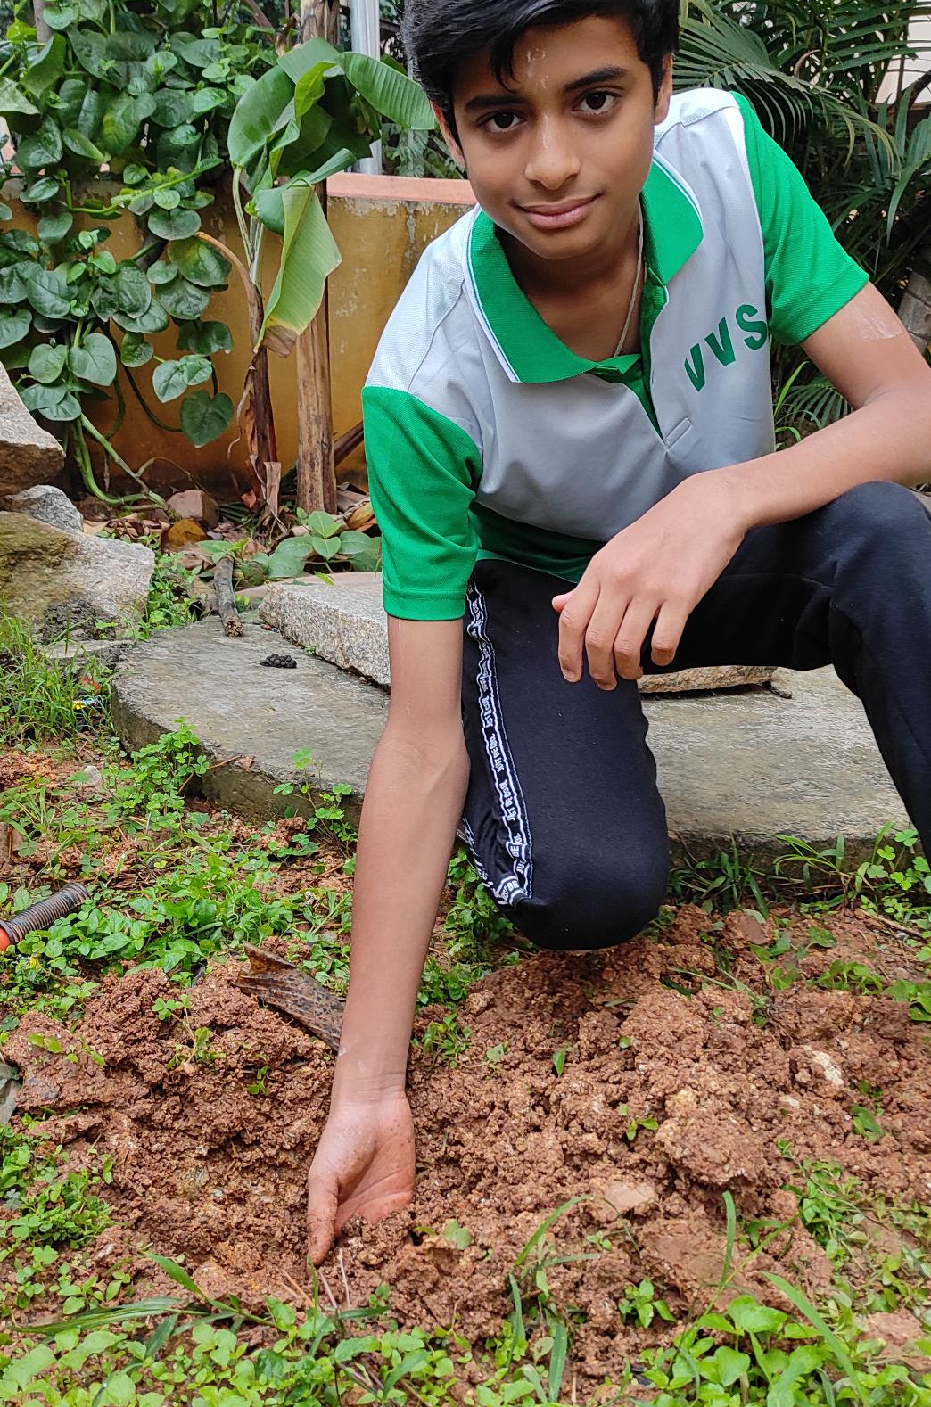
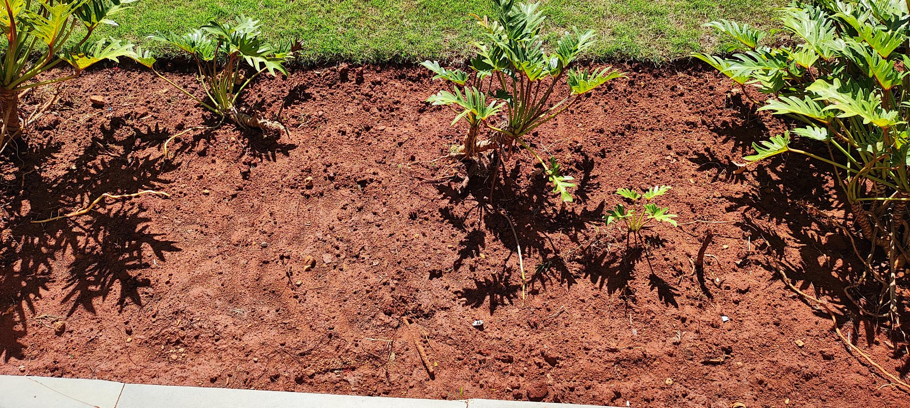
Eggplant soil Collection
Rose Soil Collection
Urban Soil Collection
School Soil Collection

Slide 7
Materials Required:
Soil from different places, distilled water, pH strips, microscope, microscopic slides, electronic compact scale, beakers, droppers, test tubes.
Methods:
Moisture content
We took the difference of the dry and wet weights of the soil and
concluded.
Soil pH
We made solutions of the soil samples and tested them with pH
strips.
Soil Color
We analyzed the soil thoroughly and concluded about the color.
Water holding capacity
We weighed 50g of soil and added water to it until the water started
to drip. We measured the amount of water added and drew a conclusion.
Nutrient tests
Through the soil testing kit, we did the tests of nutrients present in the soil.
Microorganisms
We took some soil samples and viewed them with a microscope to know about the micro-organisms.
LAKE 2022: Conservation of wetlands: ecosystem-based adaptation of climate change, December 28-30, 2022

Slide 8
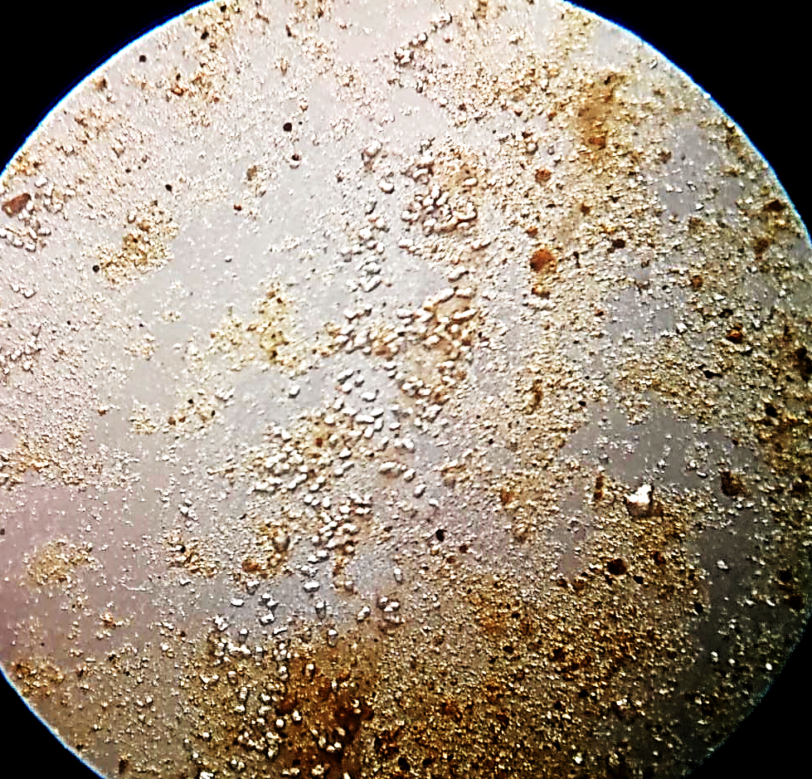
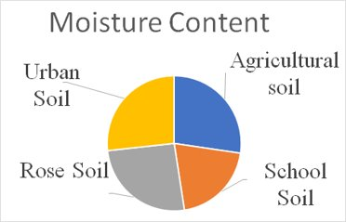
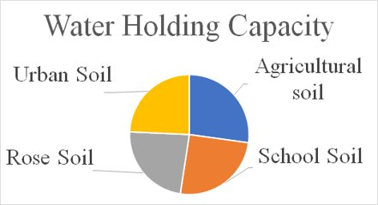
Results
 | Urban Soil | School Soil | Rose Soil | Eggplant Soil (Agricultural soil)
Moisture Content | 6.70ml/20g 33.5% | 5.07ml/20g 25.35% | 6.45ml/20g 32.25% | 6.85ml/20g 34.25%
Soil pH | 6 | 6 | 6 | 7
Soil Color | Dark-brown | Brown | Brown | Brown
Micro organisms | - | - | - | Bacillus
Water Holding Capacity | 6.25ml/50g 12.5% | 6.50ml/50g 13% | 6.00ml/50g 12% | 7.00ml/50g 14%
Bacillus
Bacillus is a rod-shaped bacteria.
The moisture content and water holding capacity is highest in eggplant soil since it is an agricultural soil.
7

Slide 9
Beneficial Micro-organisms
Micro-organisms | Uses
Rhizobium | Replenishes the nitrogen in soil by converting atmospheric nitrogen to water-soluble nitrogen.
Nitrobacter and Nitrosomonas | Nitrobacter and Nitrosomonas convert the ammonia in the soil to nitrite and finally nitrates and helps the plant to grow optimally.
Azotobacter | Converts atmospheric nitrogen to ammonia and helps plant growth.
Nutrient content in Soil
Macronutrients | Micronutrients
Nitrogen | Iron
Phosphorus | Fluoride
Potassium
LAKE 2022: Conservation of wetlands: ecosystem-based adaptation of climate change, December 28-30, 2022

Slide 10
Results
 | Urban soil | School soil | Rose soil | Eggplant soil
Nitrogen | L1 | L1 | L1 | L2
Phosphorus | M1 | M1 | H1 | H1
Potassium | L1 | L2 | M1 | M1
Iron | 0.6 | 0.3 | 3.0 | 2.0
Fluoride | Absent | Absent | Absent | Absent

Slide 11
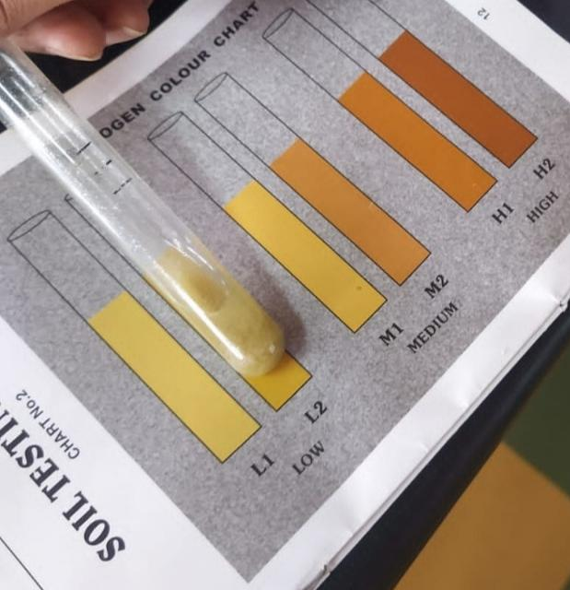
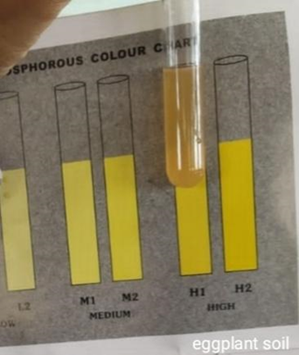
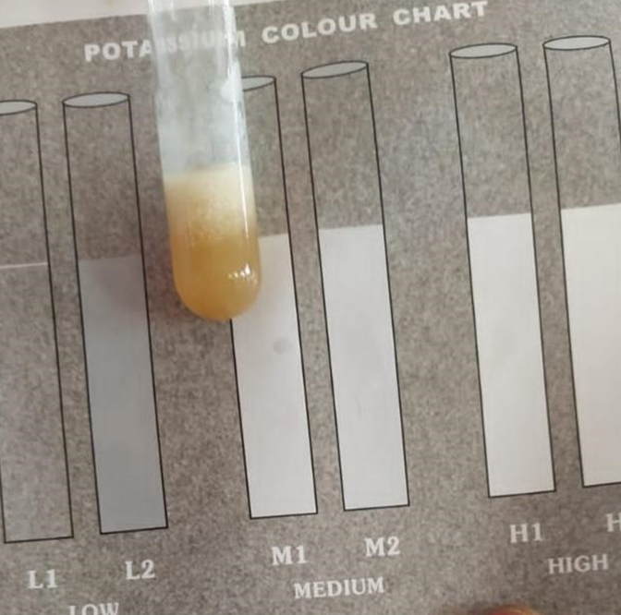
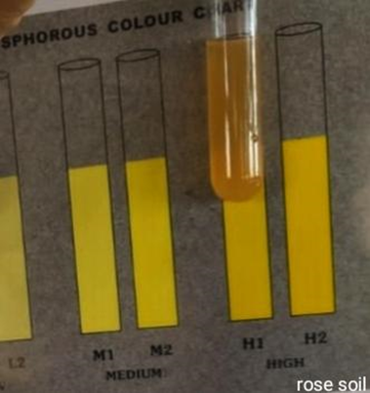
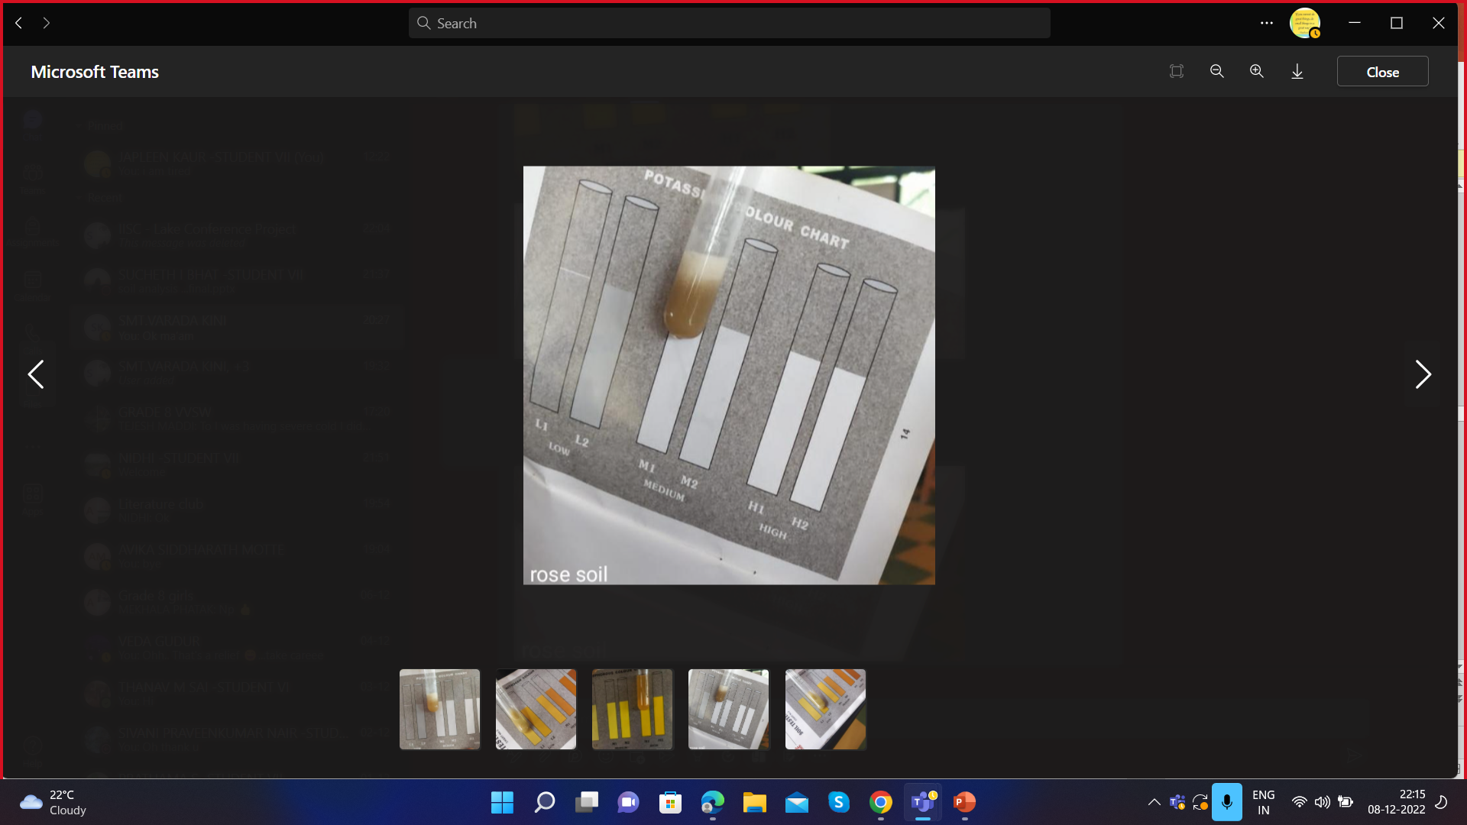
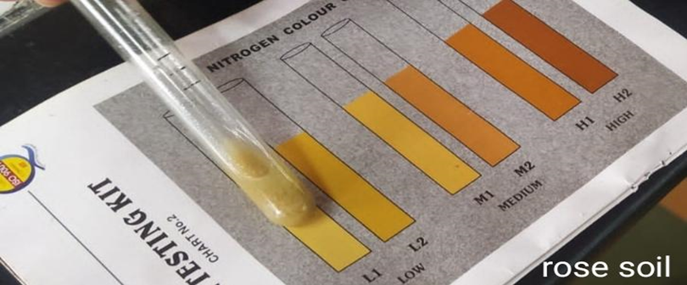
Observations
Nitrogen Content
Phosphorus content
Potassium content
Eggplant soil
Eggplant soil
Eggplant soil
Rose plant soil
Rose plant soil
Rose plant soil

Slide 12
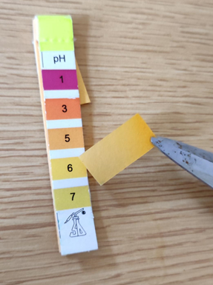
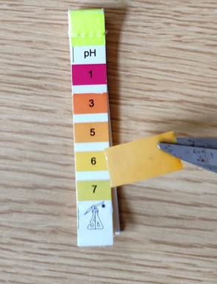

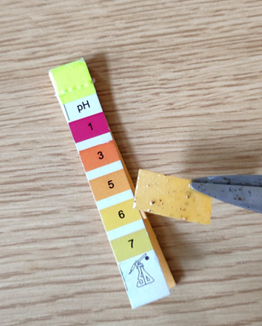
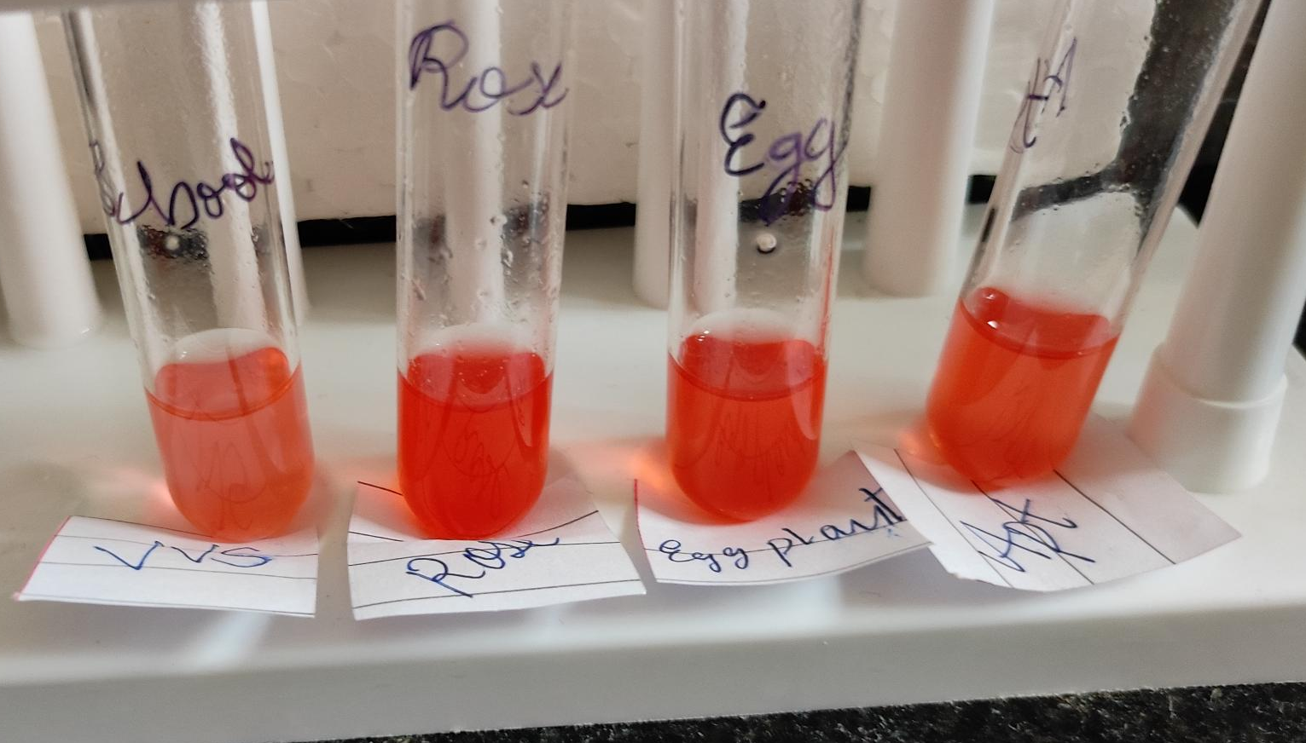
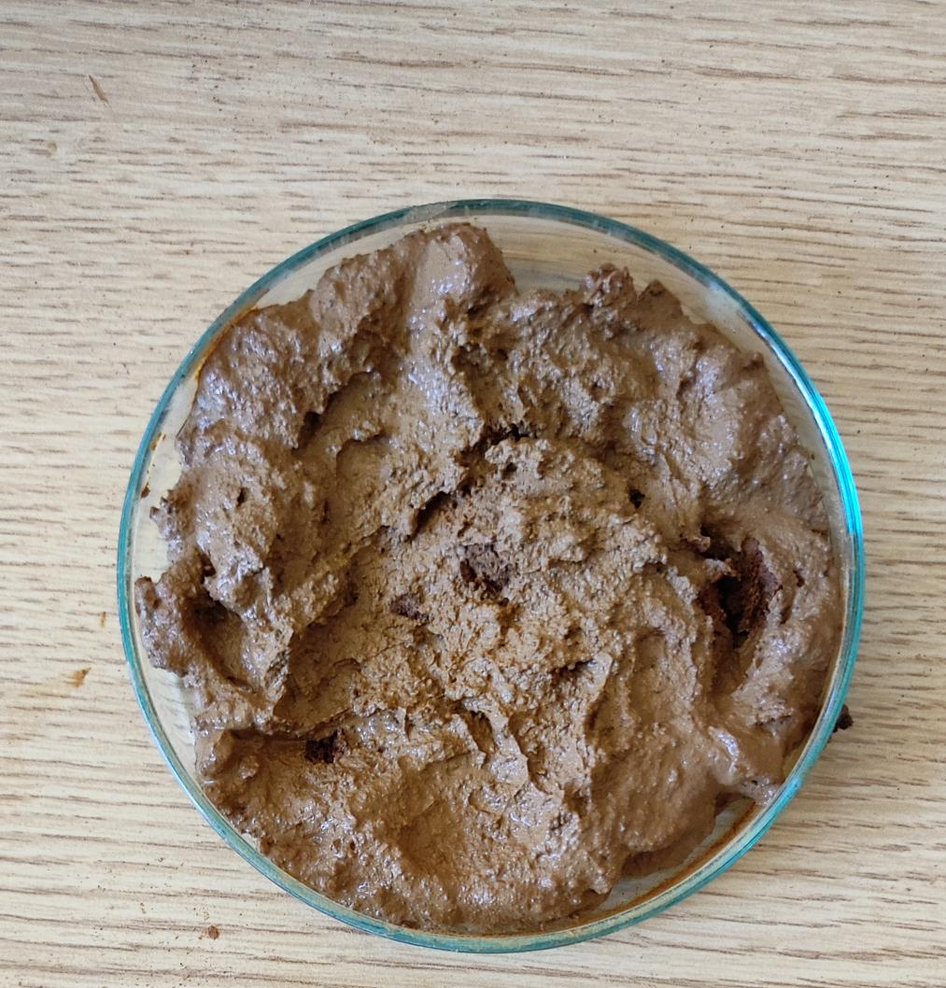
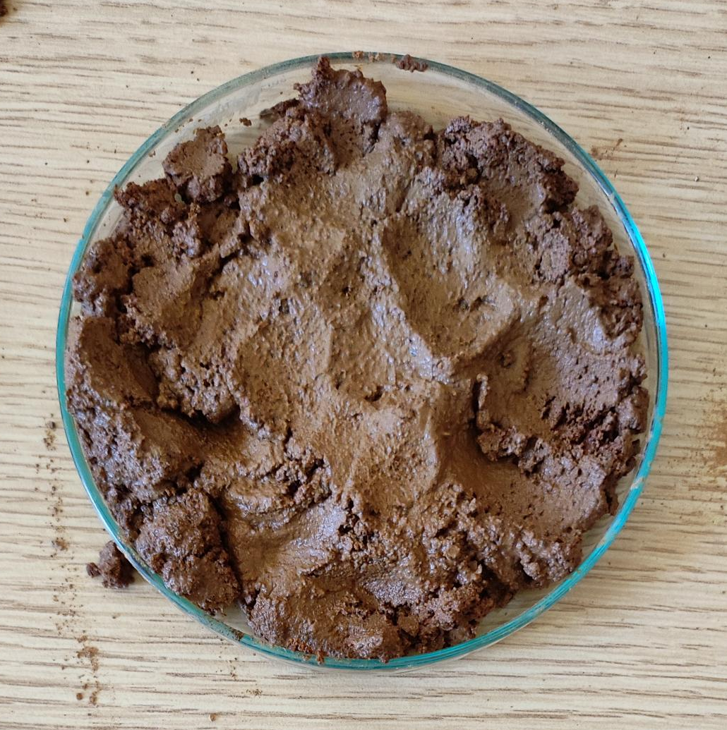

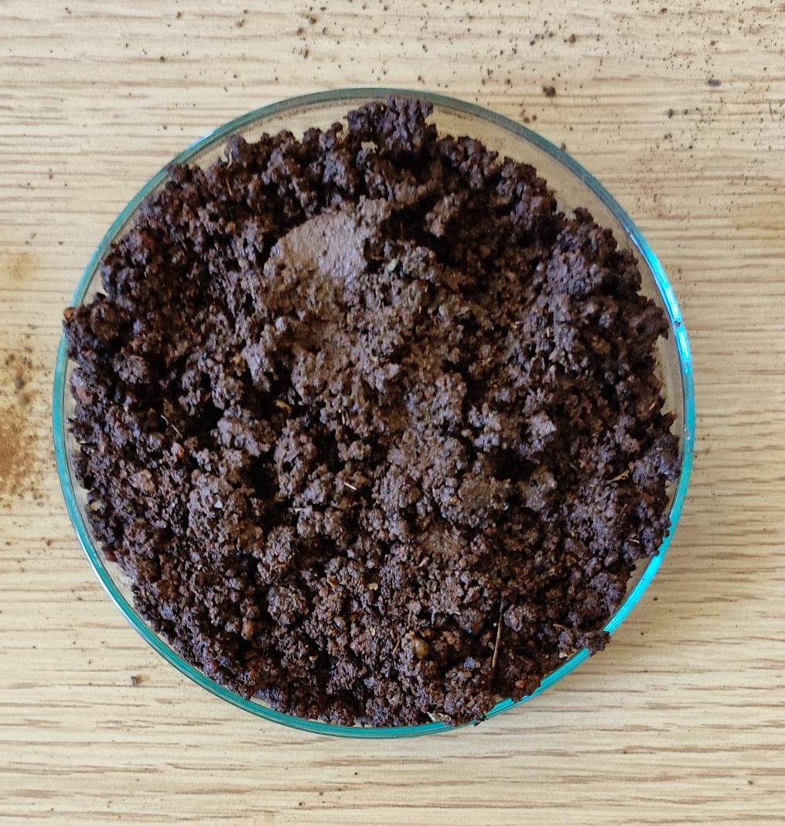
Observation – continuation
School soil
Rose soil
Agricultural soil
Urban soil
pH value
Soil color
Iron test

Slide 13
Discussion
Agricultural soil has the highest moisture content and water-holding capacity due to the presence of manure and micro-organisms.
School Soil and Urban Soil has less moisture content due to lack of rainfall, manure and microbes.
The check of soil based on different parameters were being done regularly to get accurate results.
The deficiency of nutrients in the soil stunts the plant growth.
Nitrogen is a main component of chlorophyll and deficiency of it in the soil causes chlorosis.
The plant growth gets stunted, and the leaves become dark-green in case of phosphorous deficiency.
Browning of the edges of the leaves and purple spots below the leaf can be observed in case of potassium deficiency.

Slide 14
Solutions
Loosening the soil & adding optimal water & vegetable-fruit peels or organic matter helps grow microorganisms and worms of the soil.
Proper irrigation and constant agriculture on the land strengthens the soil and increases moisture content.
Adding organic manure to the soil accumulates the water holding capacity of soil.
Routine check of the different parameters of the soil should be done.
Nitrosomonas, Nitrobacter and Rhizobium are the different ways where the nitrogen content can be enriched in the soil.
Spreading organic mulch beneath plants and applying potassium fertilizer can enrich potassium content in the soil.
Applying sources of phosphorus such as bone meal, manure, and phosphate-fertilizers help replenish phosphorous in the soil.

Slide 15
Conclusion
Depletion in the soil nutrients of school soil and Urban soil is due to the absence of micro-organisms such as rhizobium, Nitrobacter, etc. lack of manure, and insufficient fertilizer use.
Hence, the conservation of soil is very important to produce food and satisfy the needs of people.
Thus, the measures that can be taken are, adding manure and nutrient-rich fertilizers to the soil so that the soil fertility and ecological balance can be restored for future generations.

Slide 16
Acknowledgement
We sincerely thank the IISc team for giving us a glorious opportunity to present our research, thus helping us grow our capacity of bestowing to the people of society.
We also thank team VVI for providing the space and materials necessary for the welfare of our project.

Slide 17
References
https://agriculture.vic.gov.au/farm-management/soil
https://www.dpi.nsw.gov.au/agriculture
https://nrcca.cals.cornell.edu
https://www.cropquest.com
https://www.ahernseeds.com
https://plantscience.psu.edu

Slide 18

Thank You

Slide 19
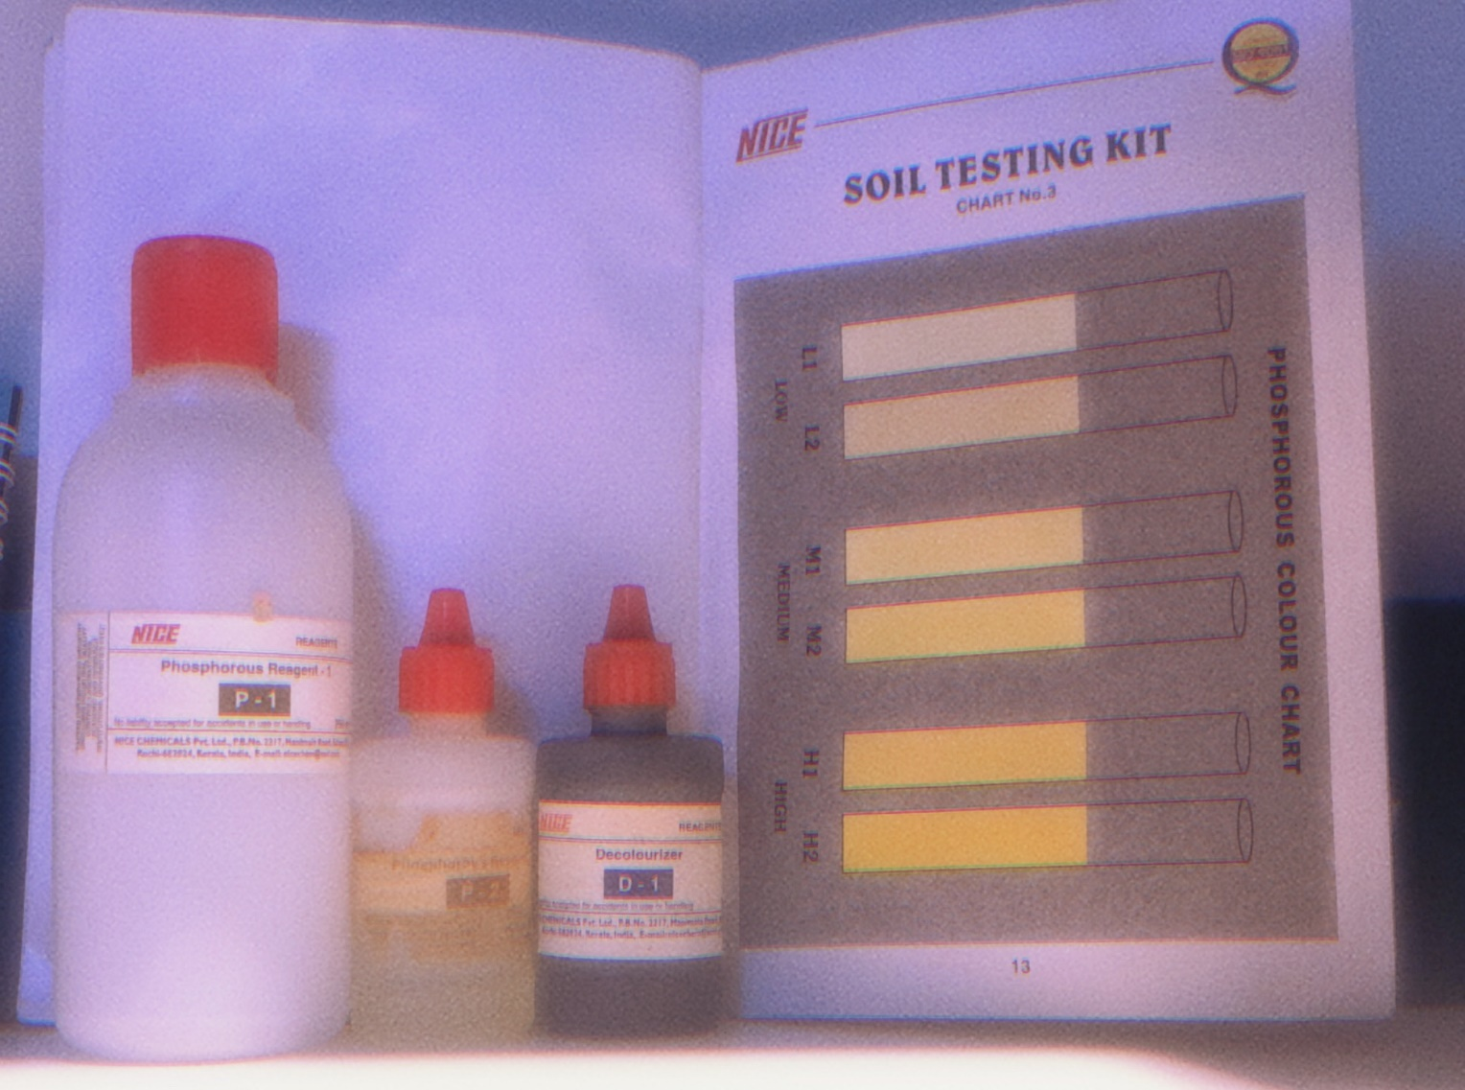
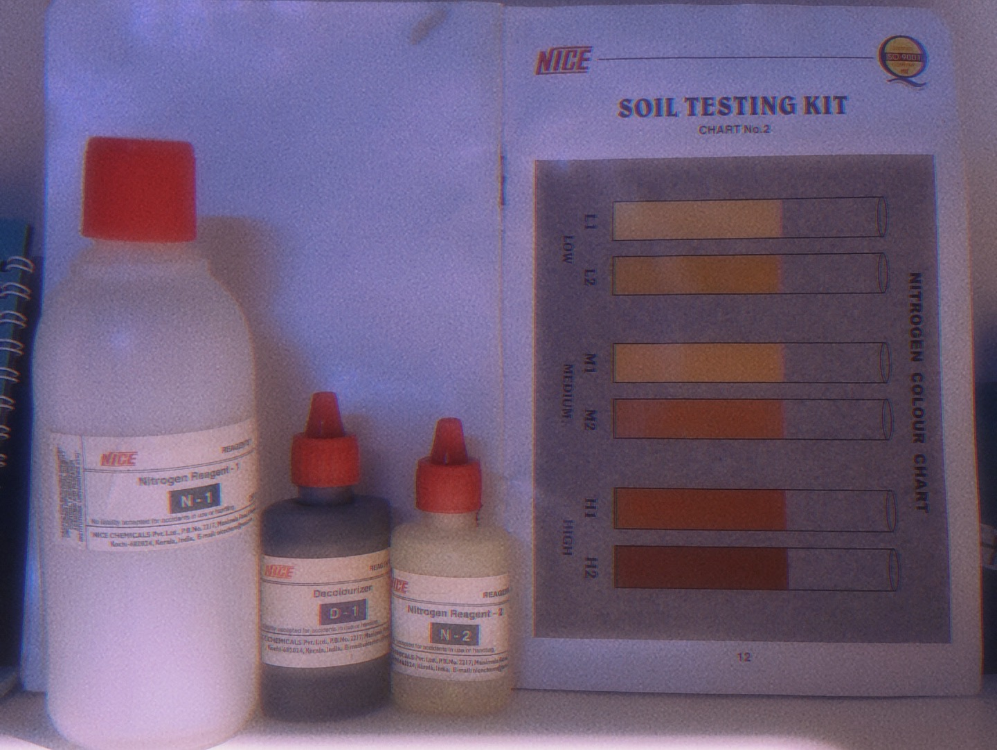
Test for Nitrogen
Test for Phosphorous

