Slide 1

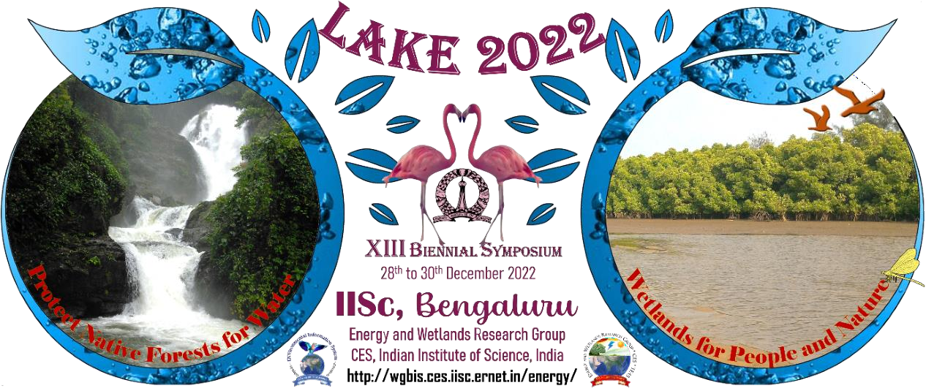
A comparative study on the environmental impactof industrial projects in Bidadi
Yogitha N.K , Manasvi H.S , Chithra shree .N.
Grade : 8 th
Affiliated to CBSE ,New Delhi
Put here
School Logo
12/1/2022
LAKE 2022: Conservation of wetlands: ecosystem-based adaptation of climate change, December 28-30, 2022
1

Slide 2
INTRODUCTION
Since the ages of industrial and technological revolutions, economic growth has been regard as the major fundamental of the world's growth.
The issue of Industrial pollution has taken grave importance for agencies trying to fight against environmental degradation.
Countries facing such sudden and rapid growth of such industries are finding it to be a serious problem which has to be brought under control immediately
It contaminates many sources of drinking water, releases unwanted toxins
Major environmental disasters have been caused due to industrial mishaps, which have yet to be brought under control

Slide 3
Objective
To study the impact of industrialization on environment
To review the studies on impact of industrialization of ground water and rain water
To suggest measures to control the effect of industrialization on environment
To analyze problems with current system
Feasibility of pollution control and recommendation
To provide information on the physio-chemical characteristics of ground water and rain water of Bidadi

Slide 4
Materials and Methods
Study area –
In both the studies, Bidadi industrial area was selected.
Latitude12o .58’N.58’N and longitude of 77o .35’E at an altitude of 921 m above mean sea level.
Sampling and analysis ----
Rain-water sampling- Collection of wet fallout from the atmosphere using a rain water collector- Reference- Vidhya. B.R et.al – assessment of rain water and storm water 2017)
Ground water sampling- Water samples were collected from nine open wells and three bore wells- REFERENCE- Ground water quality analysis- Inayathulla et.al -2018

Slide 5
METHODOLOGY
Ground water analyses- pH, electrical conductivity, dissolved oxygen were monitored at the sample sites and other parameters were analyzed in the laboratory
WQI- calculated by using the standards of drinking water quality- Weighted arithmetic index method- Brown et.al) was used in the study- M. Inayuthulla et.al)
Rain water analyses-
Determination of ph- electrometric method
Determination of turbidity- electrometric method
Determination of alkalinity, hardness- titration
Determination of electrical conductivity- electrometric method

Slide 6
Result and Discussion
GROUND WATER ANALYSIS
Sl.NO | PARAMETERS | PERMISSIBLE VALUE | AVERAGE VALUE
01 | pH | 8.5 | 7.3
02 | TDS | 500 | 1100
03 | Total alkalinity mg/lt | 200 | 300
04 | Total hardness mg/lt | 300 | 600
05 | Sulphate mg/lt | 200 | 120
06 | Ca mg/lt | 75 | 120
07 | Iron mg/lt | 0.3 | 0.1
REFERENCE- Ground water quality analysis- Inayathulla et.al -2018

Slide 7
Result and Discussion
RAIN WATER ANALYSIS
Sl.NO | PARAMETERS | PERMISSIBLE VALUE | AVERAGE VALUE
01 | pH | 5.6 | 6.5
02 | TDS mg/lt | 500 | 430
03 | Total alkalinity mg/lt | 200 | 100
04 | Total hardness mg/lt | 300 | 125
05 | Acidity | 2.5 | 2.3
06 | Electrical conductivity | 300 | 240
07 | ALKALINITY mg/lt | 20-200 | 18
Reference- Vidhya. B.R et.al – assessment of rain water and storm water 2017)

Slide 8
Result and Discussion
CALCULATION OF WATER QUALITY INDEX OF GROUND WATER
Sl.NO | PARAMETERS | PERMISSIBLE VALUE | AVERAGE VALUE
01 | pH | 8.5 | 7.35
02 | TDS mg/lt | 500 | 1120
03 | Total alkalinity mg/lt | 200 | 371
04 | Total hardness mg/lt | 300 | 200
05 | CHLORIDE | 250 | 354.5
06 | SODIUM | 200 | 60
07 | CALCIUM | 75 | 144
REFERENCE- Ground water quality analysis- Inayathulla et.al -2018

Slide 9
Results and Discussion
Ground water analysis
Application of WQI in this study has been found using in assessing the overall quality of water
Analysis of ground water samples from 12 sampling points in the surrounding of an Industrial Area showed the significant spatial variation in the parameters analyzed
The analysis shows that the value of Total Hardness, Fe, Total alkalinity, Total Dissolved Solids exceeds the permissible limits.
Rain water analysis
The mean pH of the wet precipitation is around 6.5 which is more than the neutral value 5.6.
The impact of anthropogenic sources and industrial emission in the neighbor hood can be attributed for change the concentration in harvested rain water

Slide 10
Recommendations
Construction of waste water treatment plant
Portable activated carbon filters
Green bridge
Mechanical aerator

Slide 11
Recommendations
AIR pollution-
Use modified automobile engines where complete combustion of fuel takes place instead of normal battery engines.
Use alternative sources of energy like solar energy, tidal energy, nuclear energy etc. instead of fossil fuels .
Afforestation is very important to keep the air clean and suitable for breathing.
Water pollution-
Proper sewage treatment must be followed.
Avoid disposing waste material or chemicals to water , it may effect the aquatic animals and plants.
Use phosphate-free detergent and dish cleaner.

Slide 12
Recommendations
Land pollution - Toxic chemicals compounds , salts, radioactive agents, toxins and other waste the depletes the soil nutrients.
Avoid usage of fertilizers and pesticides in the agricultural fields, using fertilizers and pesticides harms the soils fertility .
Avoid usage of plastics, it takes years together to get decomposed

Slide 13
Conclusion
The method employed in the studies is found to be suitable to study the water quality analysis around an industrial area
The analysis showed the significant variation of the parameters analysed
Parameters like Total hardness, Fe , Mg, Ca, Total alkalinity, Total dissolved solids with exceedance in permissible limits
According WQI calculated, the water is found to be good for drinking and domestic purposes after implementing certain degree of treatments REFERENCE- Ground water quality analysis- Inayathulla et.al -2018)
The harvested rain water concentration is within the acceptable limit of drinking water quality standards
Harvested rain water can be utilized for ground water recharge by providing the pre-treatment Reference- Vidhya. B.R et.al – assessment of rain water and storm water 2017)

Slide 14
References
Vidya B. R, Arpitha. B Assessment of rain water and storm water quality in Bidadi Industrial Area.
M. Innanyuthalla. Ground water quality analysis in and around Bidadi industrial area. International journal of research in engineering and technology
Water quality analysis: A case study in Byramangala lake water and surrounding ground water. International journal of research granthaalayah

Slide 15
Thank You

