Slide 1
PRODUCTION OF BIO-PESTICIDES FOR ENVIRONMENTAL- FRIENDLY DISEASE MANAGMENT
Achyuth M.R, Pranav G.A , Darshini.T.
Grade : 8 th
Affiliated to CBSE ,New Delhi
Put here
School Logo
12/1/2022
LAKE 2022: Conservation of wetlands: ecosystem-based adaptation of climate change, December 28-30, 2022
1

Slide 2
INTRODUCTION
The chemical pesticides pose many long term threats and risks to living beings due to this harmful side effects.
Bio pesticides are naturally occurring compounds or agents that are obtained from animals and plants
Enhanced agriculture productivity can be achieved in many ways such as through increasing crop yield by providing manure and organic based treatment including bio pesticides .
They are eco-friendly and host specific
Uses of bio pesticides
they pose less threat to the environment and human health
they are less toxic than chemical pesticides

Slide 3
OBJECTIVES
To produce bio-pesticides at the school level
To develop the protocol for the production of biopesticides using native plant species
To demonstrate the use of bio-pesticides
To educate the farmers – to create awareness on biopesticides use and in eco-friendly disease management
To bring about sustainable practices in the school

Slide 4
STUDY AREA
Vagdevi Vilas School Bidadi
Coordinates- 12.7421° N, 77.4302° E

Slide 5
MATERIALS AND METHODS
SAMPLE COLLECTION AND PROCESSING
Fresh leaves of neem ,guava ,custard apple and papaya were collected
The leaves were rinsed gently with distilled water
The leaves were shade dried
The leaves were powdered using a blender
The powder was passed through sieve to get uniform size
Crush 300g neem leaves in 100 ml cow urine.
Paste of ginger and garlic was mixed with the extract
Crush 200g custard apple leaf, 200g papaya leaf, 200g guava leaves in water
Mix the two and boil 5 times at some interval till it become half
Keep for 24 hours, then filter squeeze the extract.
This can be stored in bottles for 6 months

Slide 6
SPEICIES IDENTIFICATION
SPECIES NAME | COMPONENTS | INSECTICIDAL PROPERTY
Guava leaves (Psidium guajava) | Saponins tannins | Anti – microbial Protects from insects
Neem leaves (Azadirachta indica ) | Triterpenoids steroids | Induces sterility in insets Acts as repellent

Slide 7
SPECIES NAME | COMPONENTS | INSECTICIDAL PROPERTY
Custard apple leaves (Annona squamosa) | Acetogenins | Toxic to insects
Ginger (Zingiber officinale) | Monoterpenoids sesquiterpenoids | Anti bacterial Antifungal properties
Garlic ( Allium sativum ) | Diallyl disulphide | Good repellent of insects

Slide 8
SPECIES NAME | COMPONENTS AND PROPERTIES | INSECTICIDAL PROPERTY
Papaya leaves (Carica papaya) | Alkaloids papain cyanogenic glycosides | Acts against mosquito, Aphids, Caterpillar and Worms
Cow urine | Urea | Natural insecticides Kills varieties of germs
Water

Slide 9
PHYTOCHEMICALS SCREENING
TEST | OBSERVATION | INFERENCE
A mixture containing glacial acetic acid [2ml] , 2 drops of $Fecl$_{3 ,} 2ml of concentrated H₂SO₄ was mixed with leaf extract | A brown ring at the interface | Presence of glycosides
Extract was diluted with distilled water and was shaken vigorously for the formation of foam | Foam formation | Presence of saponin
1ml extract + 2ml of Fecl₃ | Formation of blue –green \ black color | Presence of tannins

Slide 10
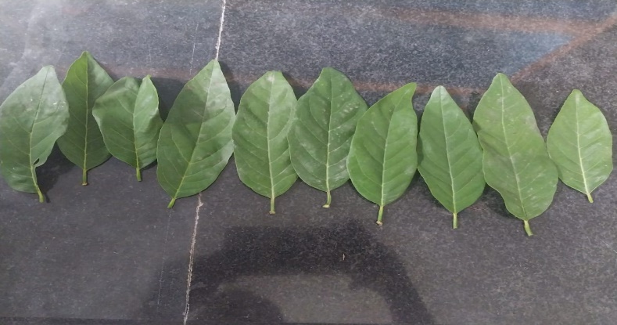
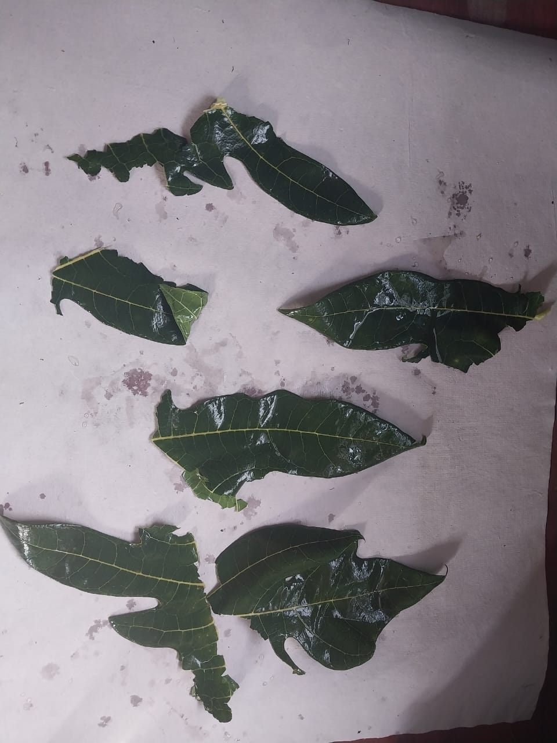
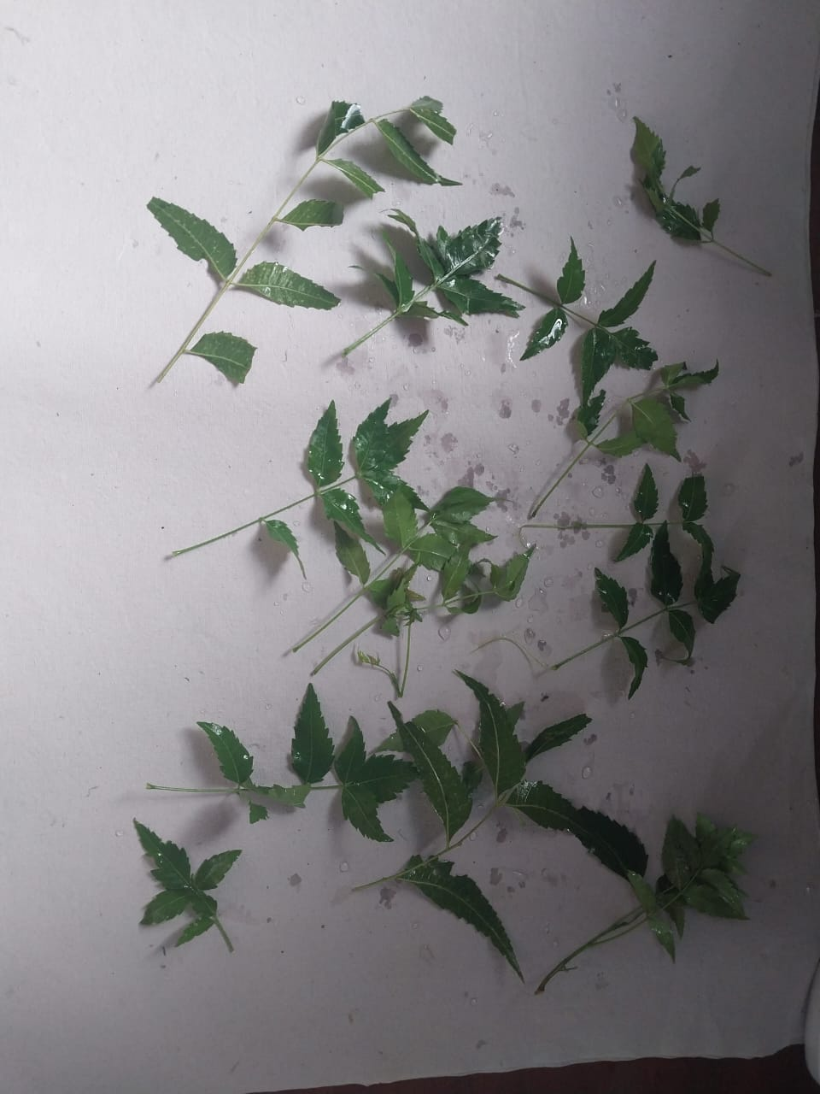
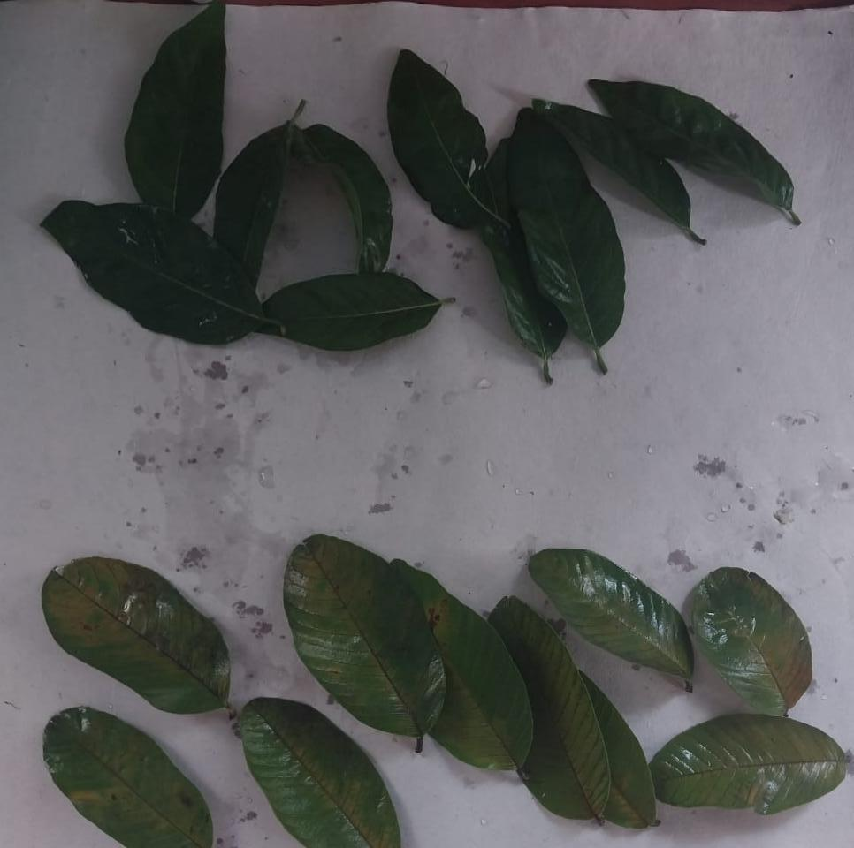
EXPERIMENTAL METHOD
COLLECTION OF LEAVES

Slide 11
EXPERIMENTAL METHOD
RINSING OF LEAVES

Slide 12
DRYING OF LEAVES

Slide 13
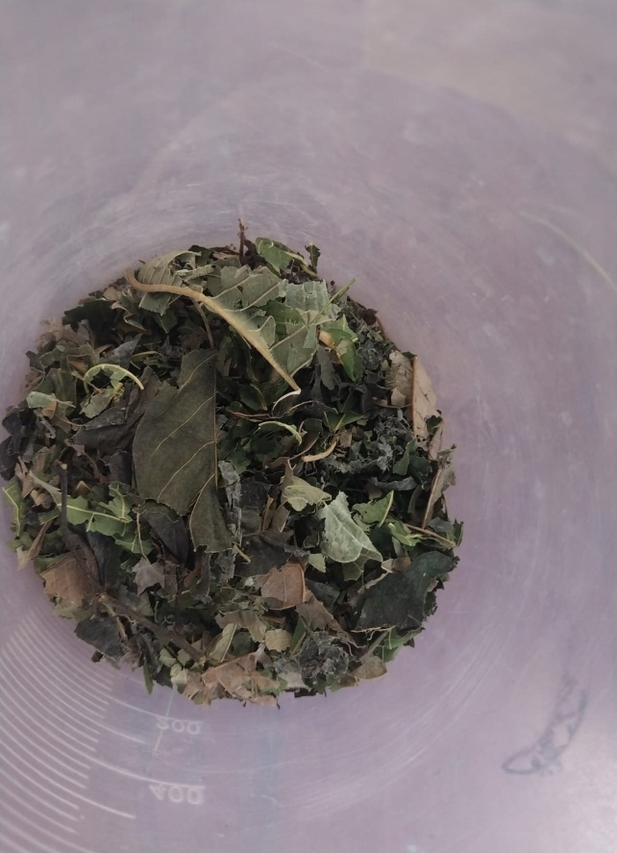
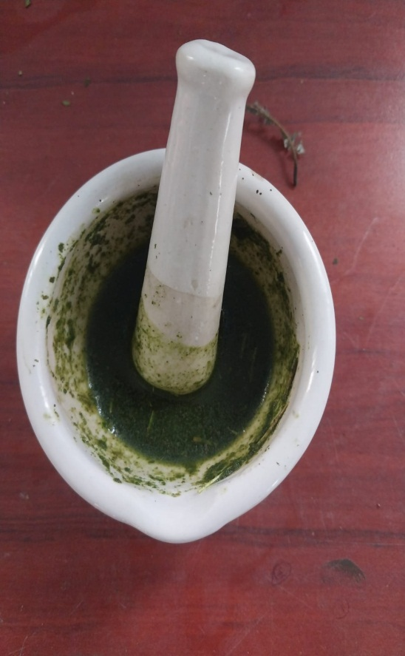
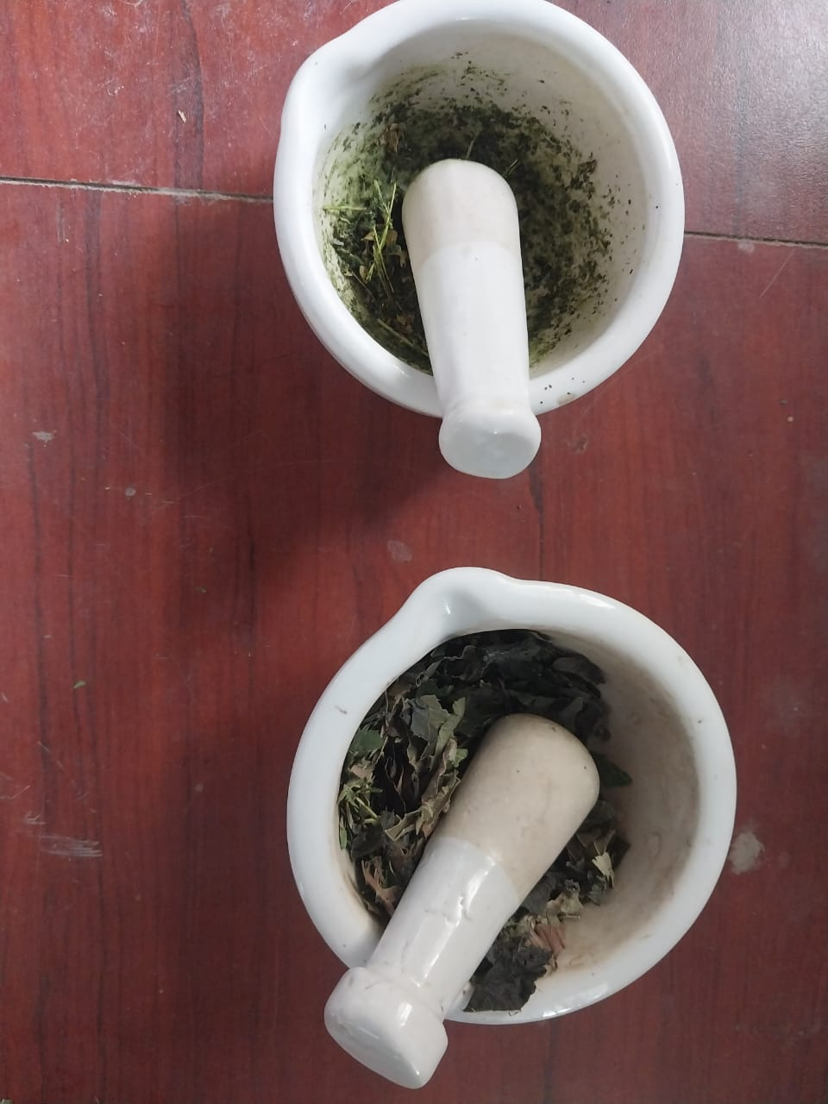
GRINDING OF LEAVES AND EXTRACTION WITH COW'S URINE AND WATER

Slide 14
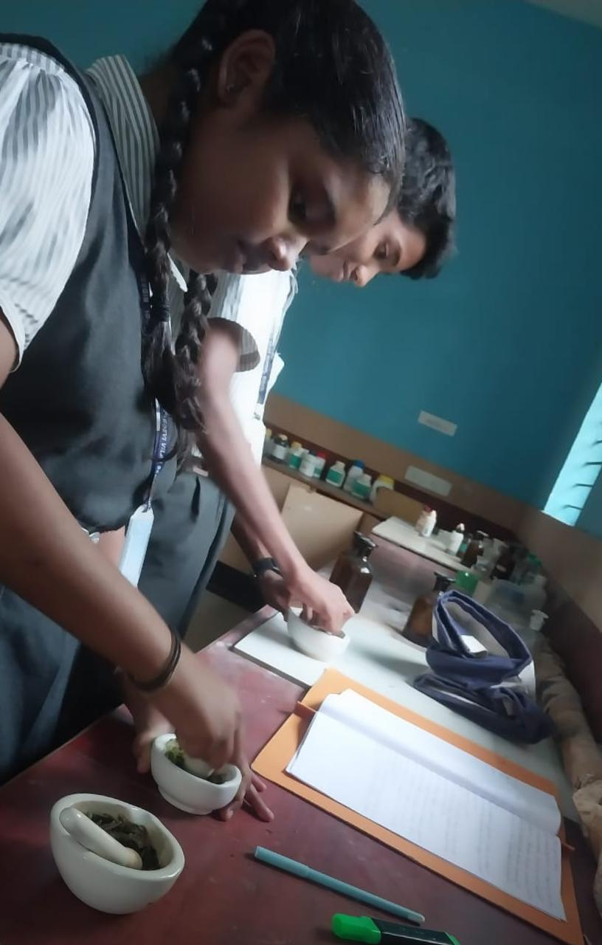
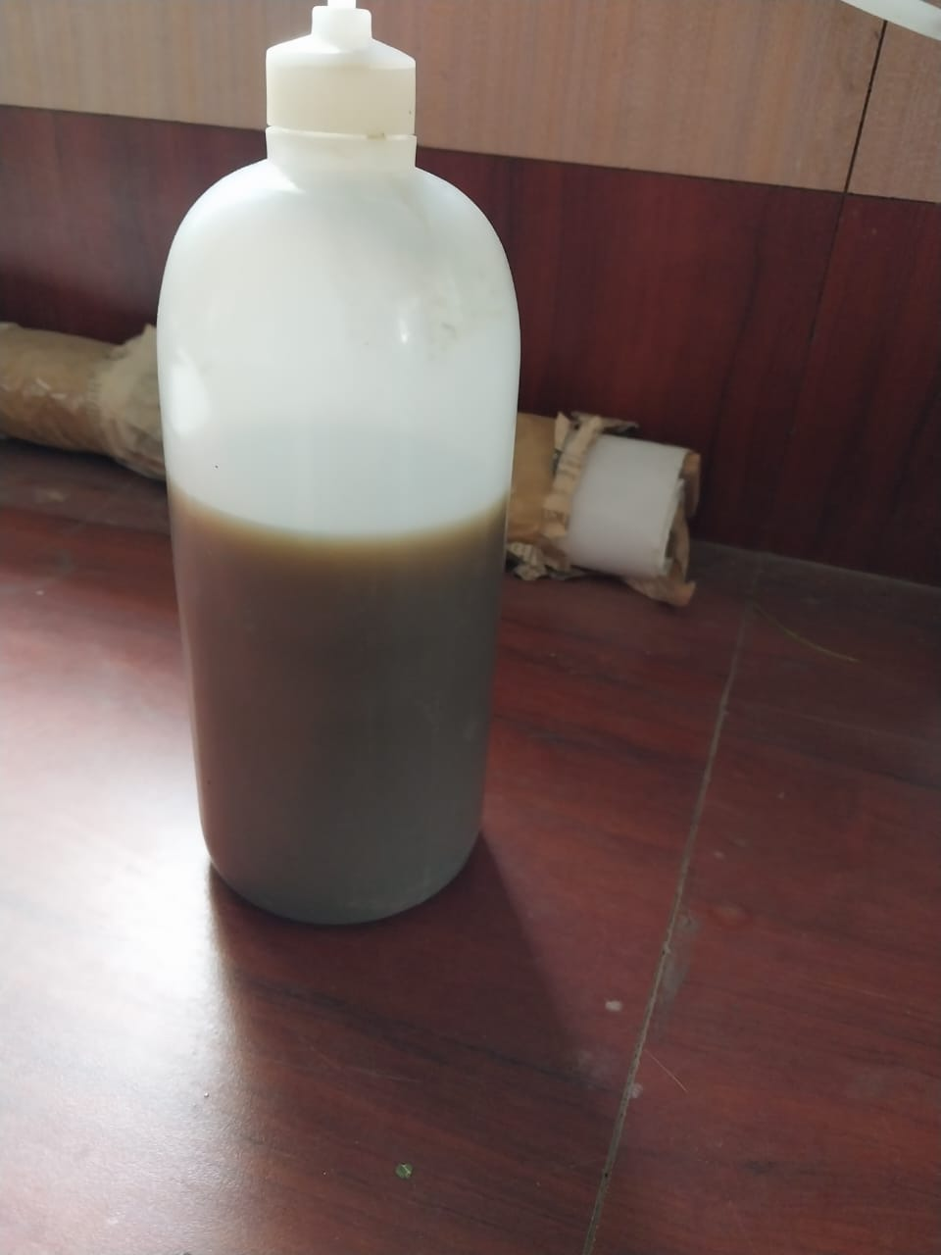
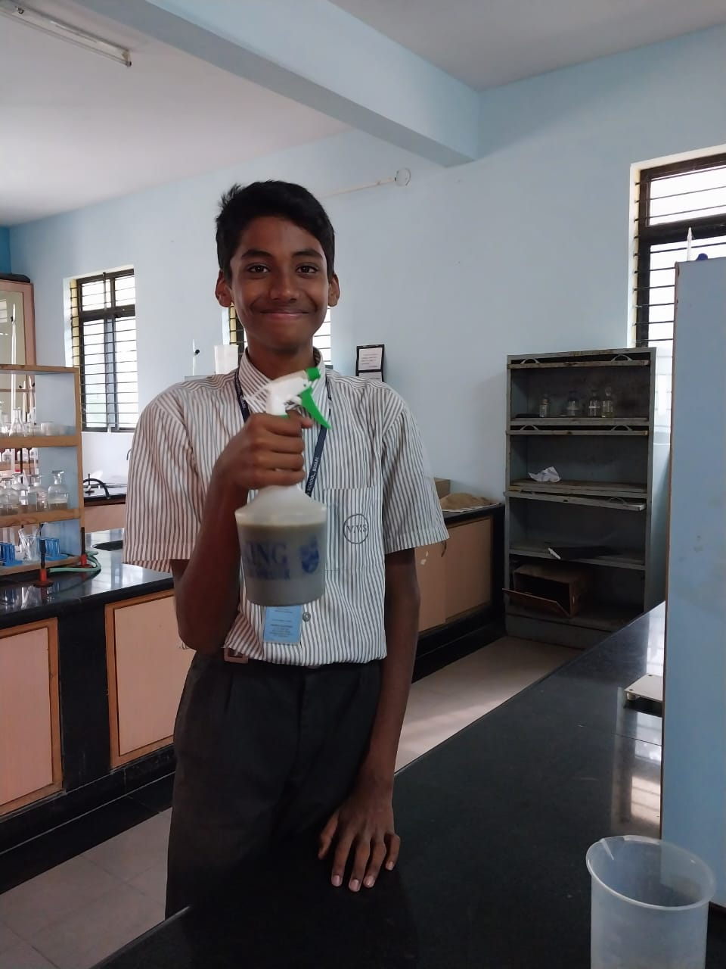
EXTRACTION PROCESS

Slide 15
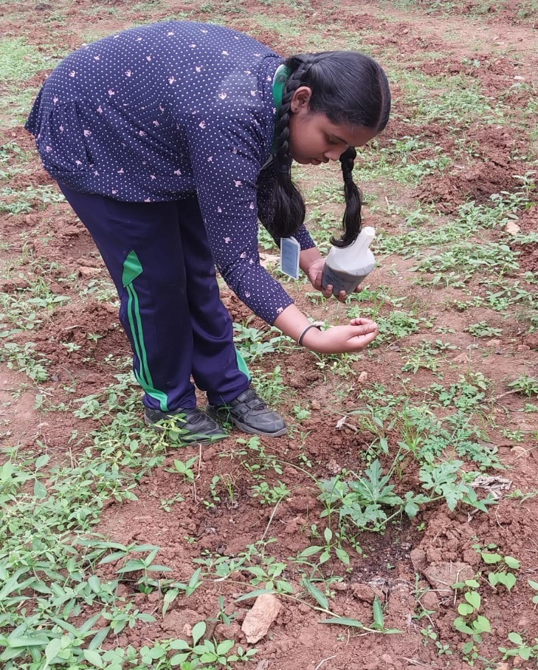
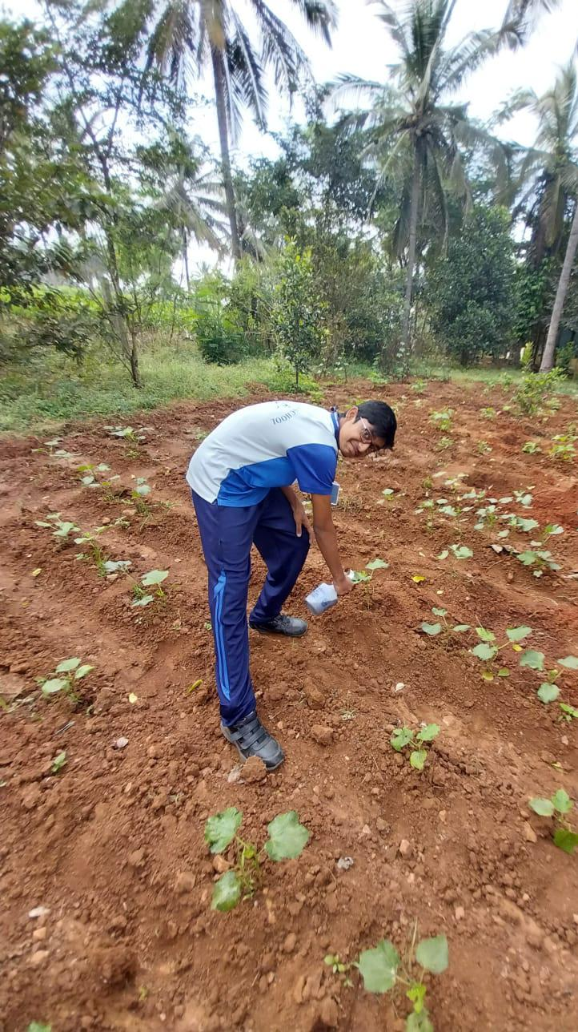
APPLICATION OF BIOPESTICIDES ON THE CROPS
Application on watermelon plants and lady’s finger plants

Slide 16
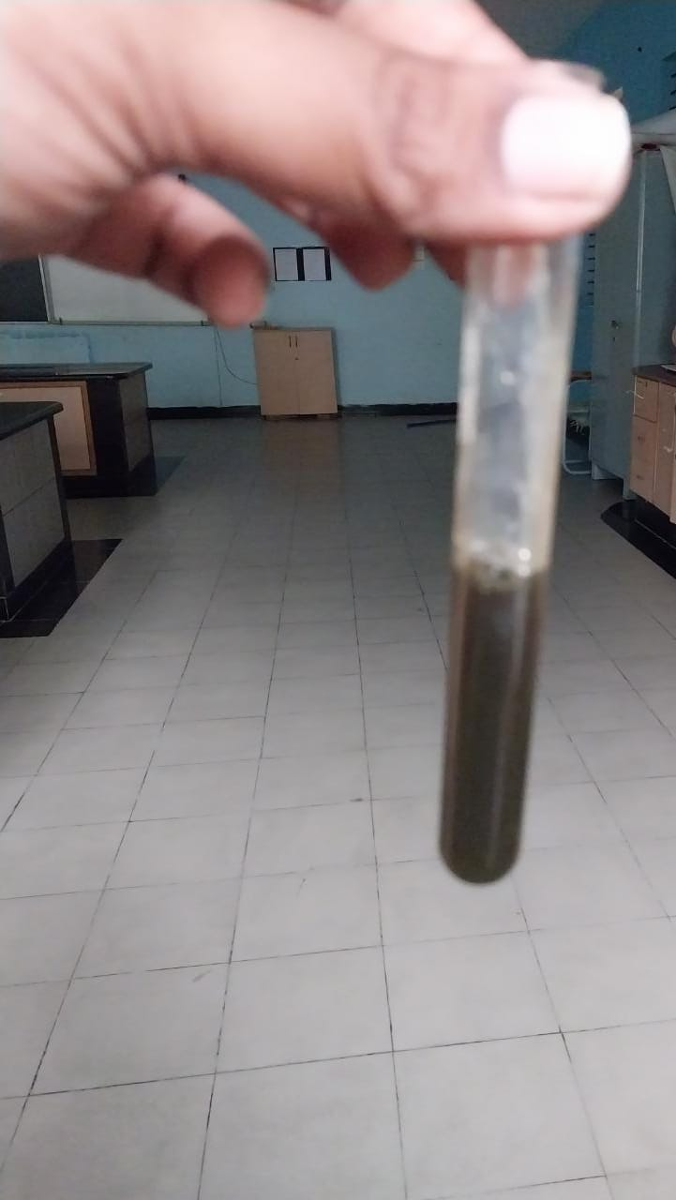
PHYTOCHEMICAL SCREENING
PRESENCE OF GLYCOSIDES IN LEAF EXTRACT
PRESENCE OF TANNINS IN LEAF EXTRACT

Slide 17
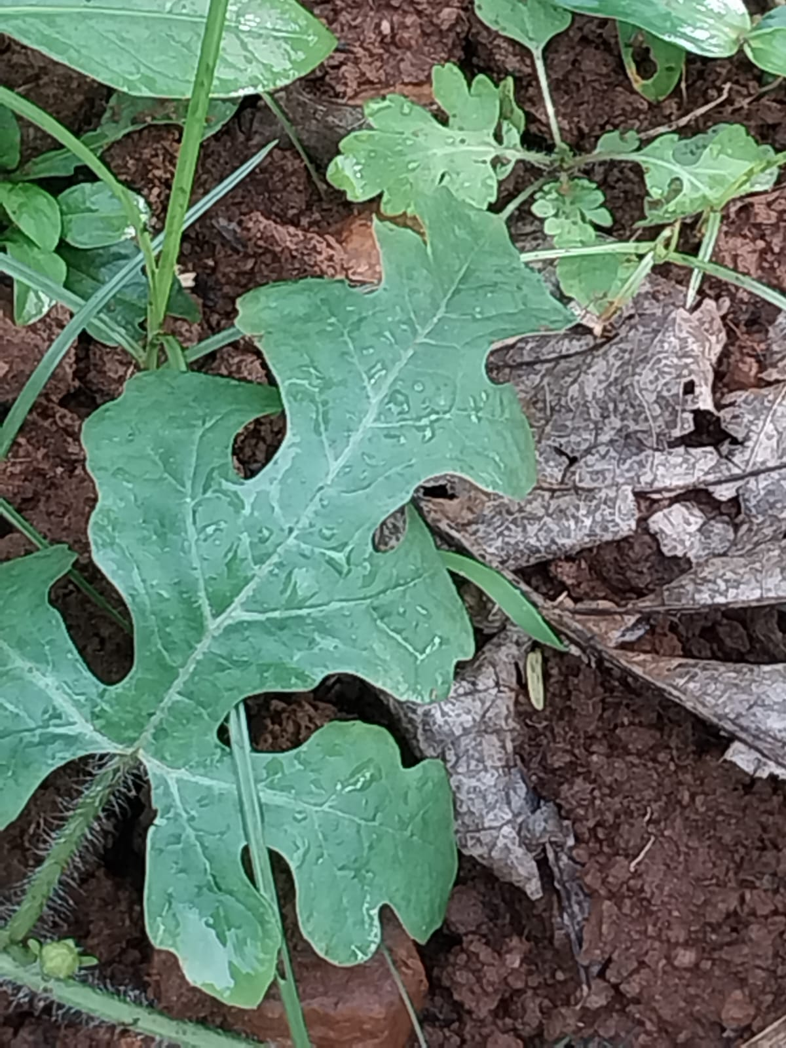
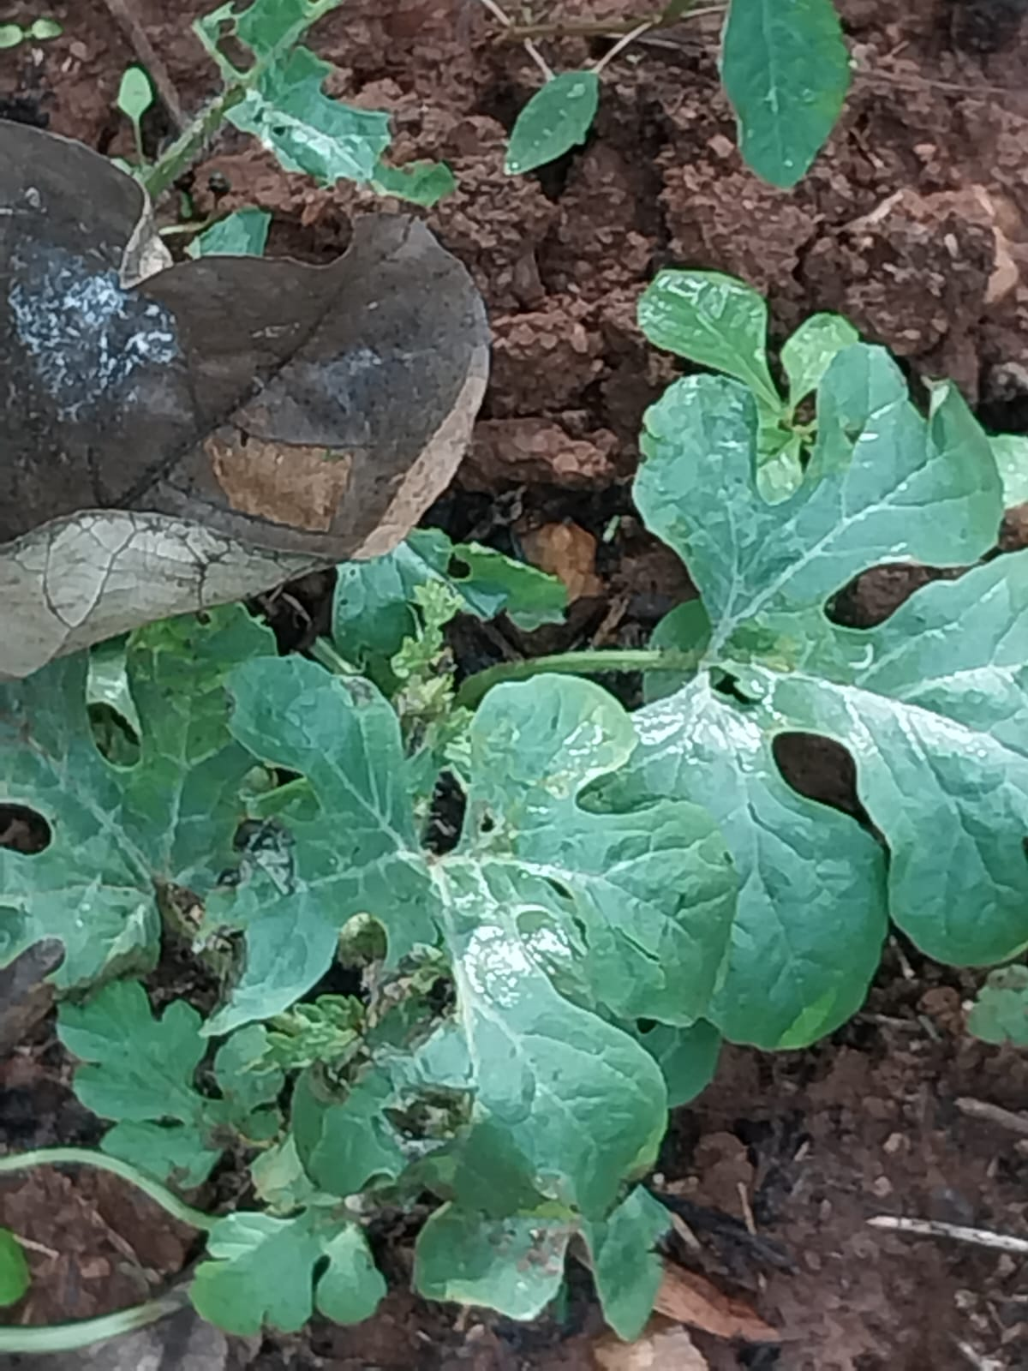
RESULTS AND DISCUSSION
FOURTH AND SEVENTH DAY ON APPLICATION OF BIO-PESTICIDES RESPECTIVELY
They are found to be effective against sucking pests, pod/fruit borers and aphids
RESULTS ON WATER MELON PLANTS

Slide 18
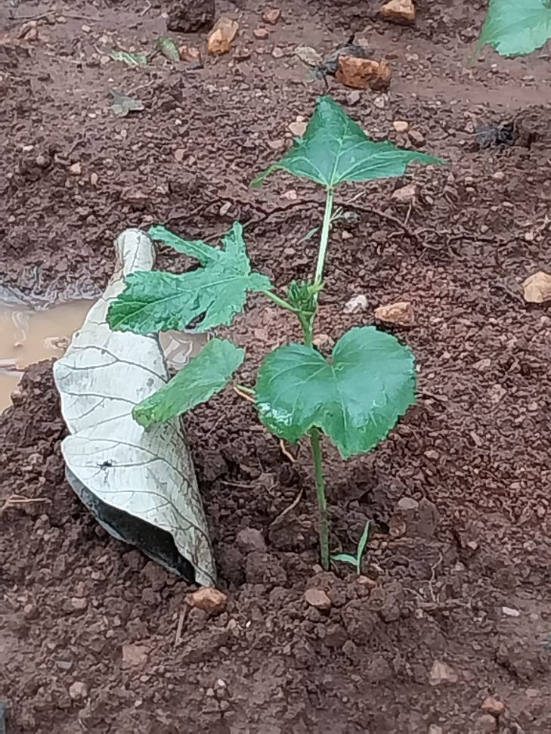
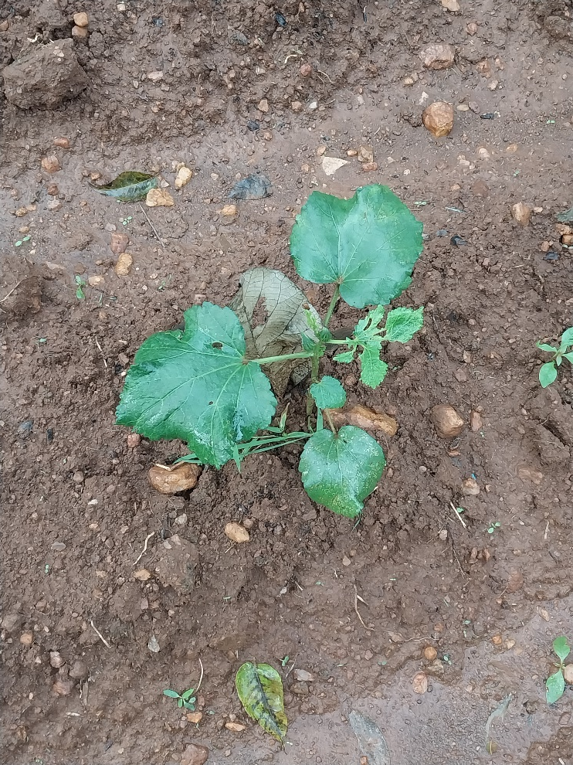
RESULTS AND DISCUSSION
FOURTH AND SEVENTH DAY ON APPLICATION OF BIO-PESTICIDES RESPECTIVELY
They are found to be effective against sucking pests, pod/fruit borers and aphids
RESULTS ON LADY’S FINGER PLANTS

Slide 19
RECOMMENDATIONS
Bio pesticides are eco-friendly and are friendly to non-target species
Bio- pesticides are proved to cause little or no pollution and are relatively cheaper
They are usually inherently less toxic than conventional pesticides
They enhance crop quality and shelf life Bio-pesticides demonstrate Environmental safety

Slide 20
CONCLUSION
Very small quantities can be effective and they tend to break down more quickly, that cause a less pollution
The developing country like in India the agriculture plays an important role, because to maintain our requirement and food it is necessary for Indian people
In our economy this is important to improve the use of bio pesticides
Many types of pesticides are used in low application due to its decompose nature
It decomposes quickly in environment

Slide 21
REFERENCES
International Journal of Advanced Research in Chemical Science (IJARCS)Volume 2, Issue 4, April 2015, PP 25-32. ISSN 2349-039X (Print) & ISSN 2349-0403 (Online)
2. General Techniques Involved in Phytochemical Analysis. K.Sahira Banu Assistant Professor, Department of Chemistry, College of Technology, Namakkal
3. Ginger-garlic extract as a bio-pesticide for organic farming. Just agriculture.
4. Bio-pesticide production and their plant disease management. Department of plant pathology. Rashtriya Krishi Vikas Yojana

Slide 22
Thank You

