Slide 1
Birds
By:
Radhika Thakur
8th B, Vagdevi Vilas School Varthur

Slide 2
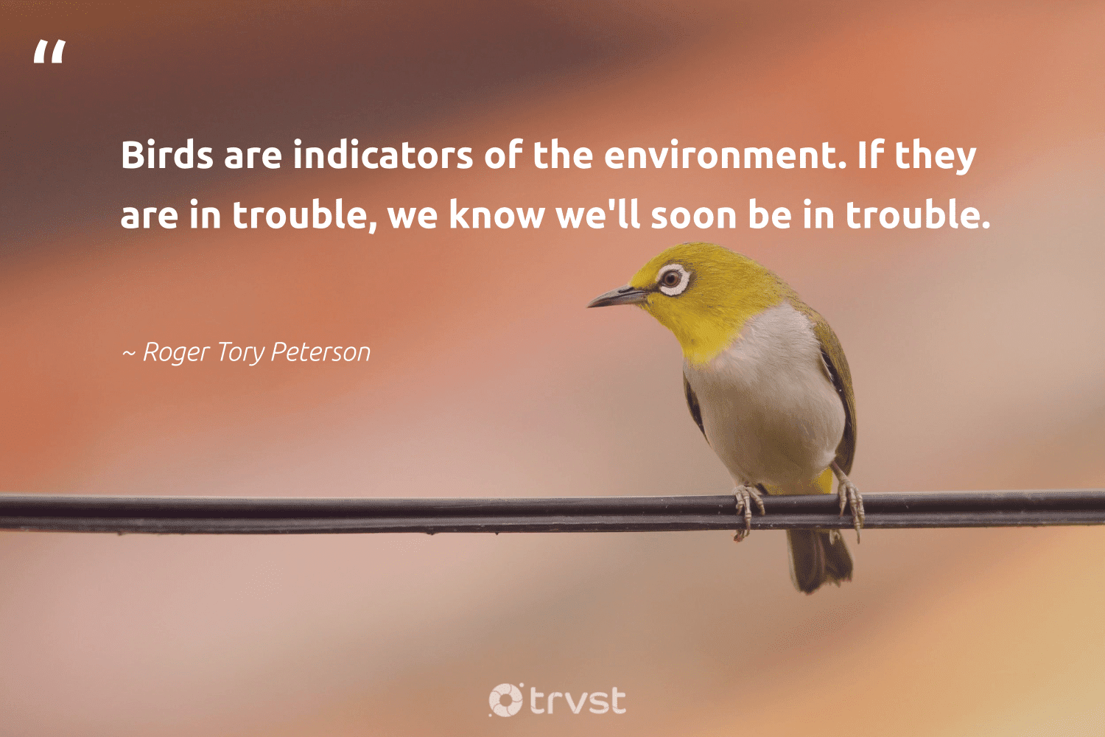
Introduction:
Classification of birds:
Kingdom: Animalia
Phylum: Chordate
Class: Aves
Orders: 23 Orders
Family: 142 Families
Genus: 2057 Genus
Species: 10950 Species
Birds are a group of warm-blooded vertebrates characterised by feathers, toothless beaked jaws, the laying of hard-shelled eggs, a high metabolic rate, a four-chambered heart, and a strong yet lightweight skeleton.
Importance of birds to our ecosystem:
Birds have ecological value as important elements of natural systems. Birds provide insect and rodent control, plant pollination, and seed dispersal which result in tangible benefits to people.

Slide 3
Objectives:
To Identify the various species of birds found in the selected study area.
To study the various behaviors and special characteristics of the identified birds.

Slide 4
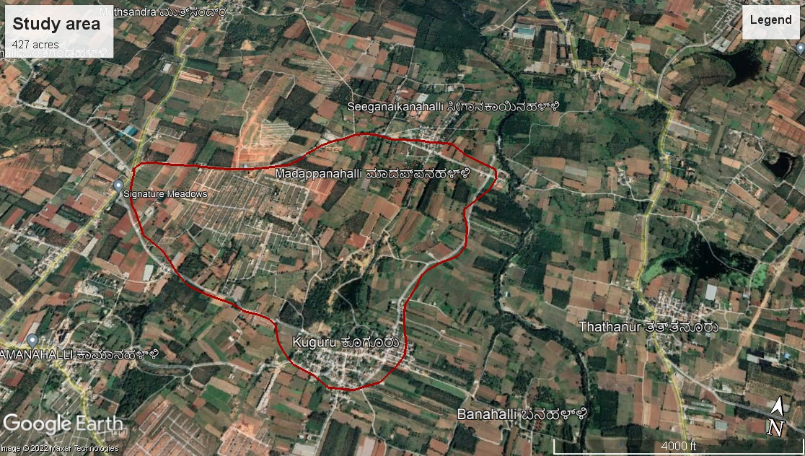
🗺️Location:
Study of birds found in my confined geographical area
The area of study: 427 acres

Slide 5
Methodology and materials used:
The methodology used in this study was:
Capturing pictures/ photography.
Patch Monitoring method
Duration of study: 4 months (July 2022 to November 2022)
Timing of the day: (In summers) 5am-8am & 5pm-7pm
(In winters) 6am-8am & 5pm-6pm
The materials used were :
Binoculars
Photography camera

Slide 6
Major species of birds found in this region:
River tern
Ashy Prinia
Purple sunbird
Cattle egret
Jungle Mynah
Black Kite
Asian Koel
Pied bush chat
The green bee eater
White-throated Kingfisher
Common Tailorbird
Red Whiskered Bulbul
Jungle Babbler
Indian Roller
Greater Coucal

Slide 7
River tern
Scientific name: Sterna aurantia
Habitat: rivers and freshwater lakes, occasionally occurring on estuaries
Breeding: During the breeding season, February to May, it has a deep glossy black head and nape
size: about the size of a pigeon
Color: grey upper parts, black cap on the head, yellow beak
Beak adaptations: long bills to catch fishes
Feet adaptations: relatively short legs
Wing adaptations: narrow wings

Slide 8
Ashy prinia:
Scientific name: Prinia socialis
Habitat: likely to occur in all habitats except for woodlands with a thick canopy.
Colour: purple-grey upperparts and pale yellowish-brown underparts
Size: sparrow-sized bird
Adaptations: it has adapted with human society to live in urban areas and are commonly found sitting on.

Slide 9
Indian sunbird:
Scientific name: Leptocoma zeylonica
Habitat: The purple-rumped sunbird is a common resident breeder in southern India. Habitats with trees, including scrub and cultivated land
Size: less than 10 cm long
Colour: dark maroon upperside with a blue-green crown that glistens at some angles, bright green shoulder patch and violet/purple rump patch

Slide 10
The cattle egret:
Scientific name: Bubulcus ibis
Habitat: The major habitat of the cattle egret is wetlands, grasslands and woodlands. These birds generally avoid arid areas. They are found in croplands and pastures with poor drainage.
Climate zone: tropical and temperate
Size: 46-56 CM
Colour: It has long brownish hair on the crown of its head. The feathers are white with slight brown coloring. Lean and short legs are reddish brown in color. The Cattle egret has a slender reddish beak with a bright yellow top.

Slide 11
Jungle Mynah
Scientific name: Acridotheres fuscus
Habitat: found patchily distributed across much of the mainland of the Indian Subcontinent
Colour: grey-brownish
Size: The jungle myna is a 22 to 24cm
Adaptation: Their flight is strong and direct, and they are gregarious.

Slide 12
Black kite
Scientific name: Milvus migrans
Colour: These birds are generally dark in color. The upper plumage is brown but the head and neck tend to be paler. The patch behind the eye appears darker. The outer flight feathers are black and the feathers have dark cross bars and are mottled at the base.
Size: As compared to eagles, they are smaller in size and weigh less

Slide 13
Asian Koel:
Scientific name: Eudynamys scolopaceus
Habitat: The Asian koel is a bird of light woodland and cultivation
Colour: Adult males glossy black with dull lime-green bill; females and immatures blackish brown with white dots on the wings and strong streaking on head and throat. Adults have ruby-red eyes
Size: 39–46 cm (15–18 in) and weighing 190–327 g (6.7–11.5 oz)

Slide 14
Pied bush chat:
Scientific name: Saxicola caprata
Habitat: It is found in open habitats including scrub, grassland and cultivation
Colour: The male is black except for a white rump, wing patch and lower belly. The female is drab brown and slightly streaked
Size: 13-14 cm.

Slide 15
The Green Bee Eater
Scientific name: Merops orientalis
Climate zones: Tropical and Arid
Habitat: widespread in India, found in most parts of the country except the northwest and northeast. Green Bee-eaters are found in habitats like forests, shrublands, deserts and wetlands.
Colour: The entire plumage is bright green and tinged with blue especially on the chin and throat.
Size: about 9 inches (16–18 cm) long.

Slide 16
White Throated Kingfisher
Scientific name: Halcyon smyrnensis
Habitat: mostly open country in the plains (but has been seen at 7500 ft in the Himalayas) with trees, wires or other perches.
Climate zone: tropical
Colour: bright blue back, wings and tail. Its head, shoulders, flanks and lower belly are chestnut, and the throat and breast are white. The large bill and legs are bright red.
Size: 27–28 cm (10.6–11.0 in) in length

Slide 17
Common Tailorbird:
Scientific name: Orthotomus sutorius
Habitat: forests, shrublands
Size: 10 to 14 centimetres
Colour: bright green upperparts and creamy underparts.

Slide 18
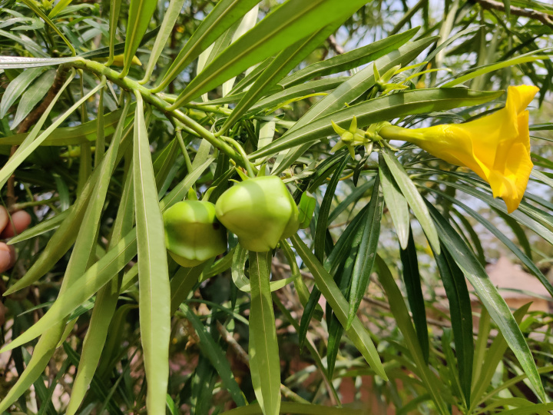
Red Whiskered Bulbul
Yellow oleander
Scientific name: Pycnonotus jocosus
Habitat: These birds don’t migrate and prefer to live in lightly wooded areas, more open country with bushes and shrubs. They also occur in agricultural areas, suburbs, and urban areas.
Climate zone: tropical
Size: 20 centimetres (7.9 in) in length
Colour: brown upper-parts and whitish underparts with buff flanks and a dark spur running onto the breast at shoulder level.

Slide 19
Jungle Babbler
Scientific name: Turdoides striata
Habitat: The jungle babbler is a common resident breeding bird in most parts of the Indian subcontinent and is often seen in gardens within large cities as well as in forested areas.
Lifestyle: Terrestrial
Size: 25 cm
Colour: brownish grey with a yellow-bill

Slide 20
Indian Roller
Scientific name: Coracias benghalensis
Local name: Neelkanth
Habitat: It is often seen perched along roadside trees and wires and is commonly seen in open grassland and scrub forest habitats
Size: body length of 30–34 cm (12–13 in)
Colour: The face and throat are pinkish, the head and back are brown, with blue on the rump and contrasting light and dark blue on the wings and tail.

Slide 21
Greater Coucal:
Scientific name: Centropus sinensis
Habitat: Greater coucals occur in the Indian Subcontinent and Southeast Asia. They don't migrate and can be found in mangroves, shrublands, grasslands near rivers, marshes, or creeks. They also frequently visit cultivated areas and rural gardens.
Climate zone: tropical
Size: 48-53 CM
Colour: Its plumage is black, with a purple gloss and deep rufous coloured wings.

Slide 22
Results
Name of the bird | Scientific name | Family | IUCN status | Feeding habits
1.River tern | Sterna aurantia | Laridae | Near Threatened (Population decreasing) | Carnivores and piscivores
2. Ashy prinia | Prinia socialis | Cisticolidae | Least Concern (Population stable) | Nectarivores
3. Indian Sunbird | Leptocoma zeylonica | Nectariniidae | Least Concern (Population stable) | Nectarivores
4. Cattle egret | Bubulcus ibis | Ardeidae | Least Concern (Population increasing) | Insectivores (mostly) and carnivores
5. Jungle Mynah | Acridotheres fuscus | Sturnidae | Least Concern (Population decreasing) | Insectivores and frugivores
6. Black kite | Milvus migrans | Accipitridae | Least Concern | Carnivores, piscivores, and scavengers
7. Asian koel | Eudynamys scolopaceus | Cuculidae | Least concern (population stable) | Omnivores and Frugivores (as adults)
8. Pied bush chat | Saxicola caprata | Muscicapidae | Least Concern (Population stable) | Insectivores

Slide 23
Results
Name of bird | Scientific name | Family | IUCN status | Feeding habit
9. Green bee-eater | Merops orientalis | Meropidae | Least Concern (Population increasing) | Insectivores (mainly honey bees)
10. White-throated kingfisher | Halcyon smyrnensis | Alcedinidae | Least Concern (Population increasing) | Carnivores and piscivores
11. Common Tailorbird | Orthotomus sutorius | Cisticolidae | Least Concern (Population stable) | Insectivores
12. Red whiskered bulbul | Pycnonotus jocosus | Pycnonotidae | Least Concern (Population decreasing) | nectarivores
13. Jungle Babbler | Turdoides striata | Leiothrichidae | Least Concern (Population stable) | Insectivores
14. Indian Roller | Coracias benghalensis | Coraciidae | Least Concern (Population increasing) | carnivores
15. Greater Coucal | Centropus sinensis | Cuculidae | Least Concern (Population stable) | Insectivores

Slide 24
Data analysis
Classification of birds studied on the basis of feeding habits
Carnivores | Omnivores | Insectivores | Nectarivores
Black kite | Indian Koel | Jungle babbler | Red whiskered bulbul
White throated kingfisher |  | Jungle mynah | Ashy prinia
River tern |  | Green bee eater | Purple rumped sunbird
 |  | Greater coucal
 |  | Cattle egret
 |  | Pied bush chat
 |  | Indian roller
 |  | Common tailor bird

Slide 25
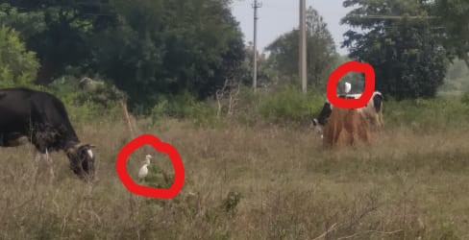
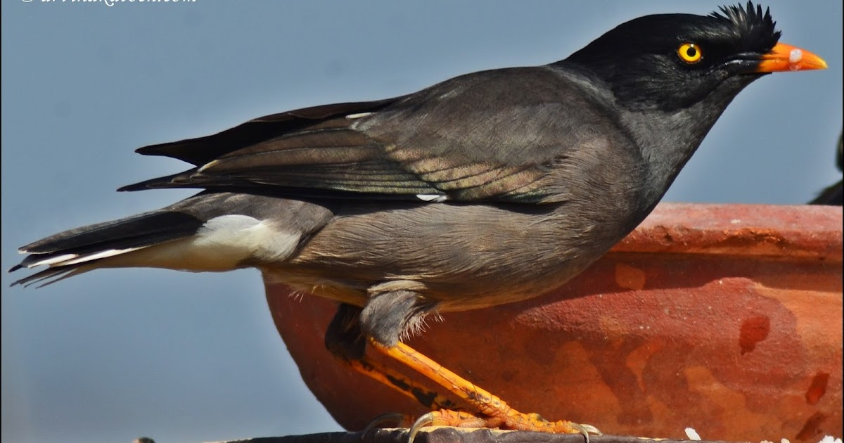
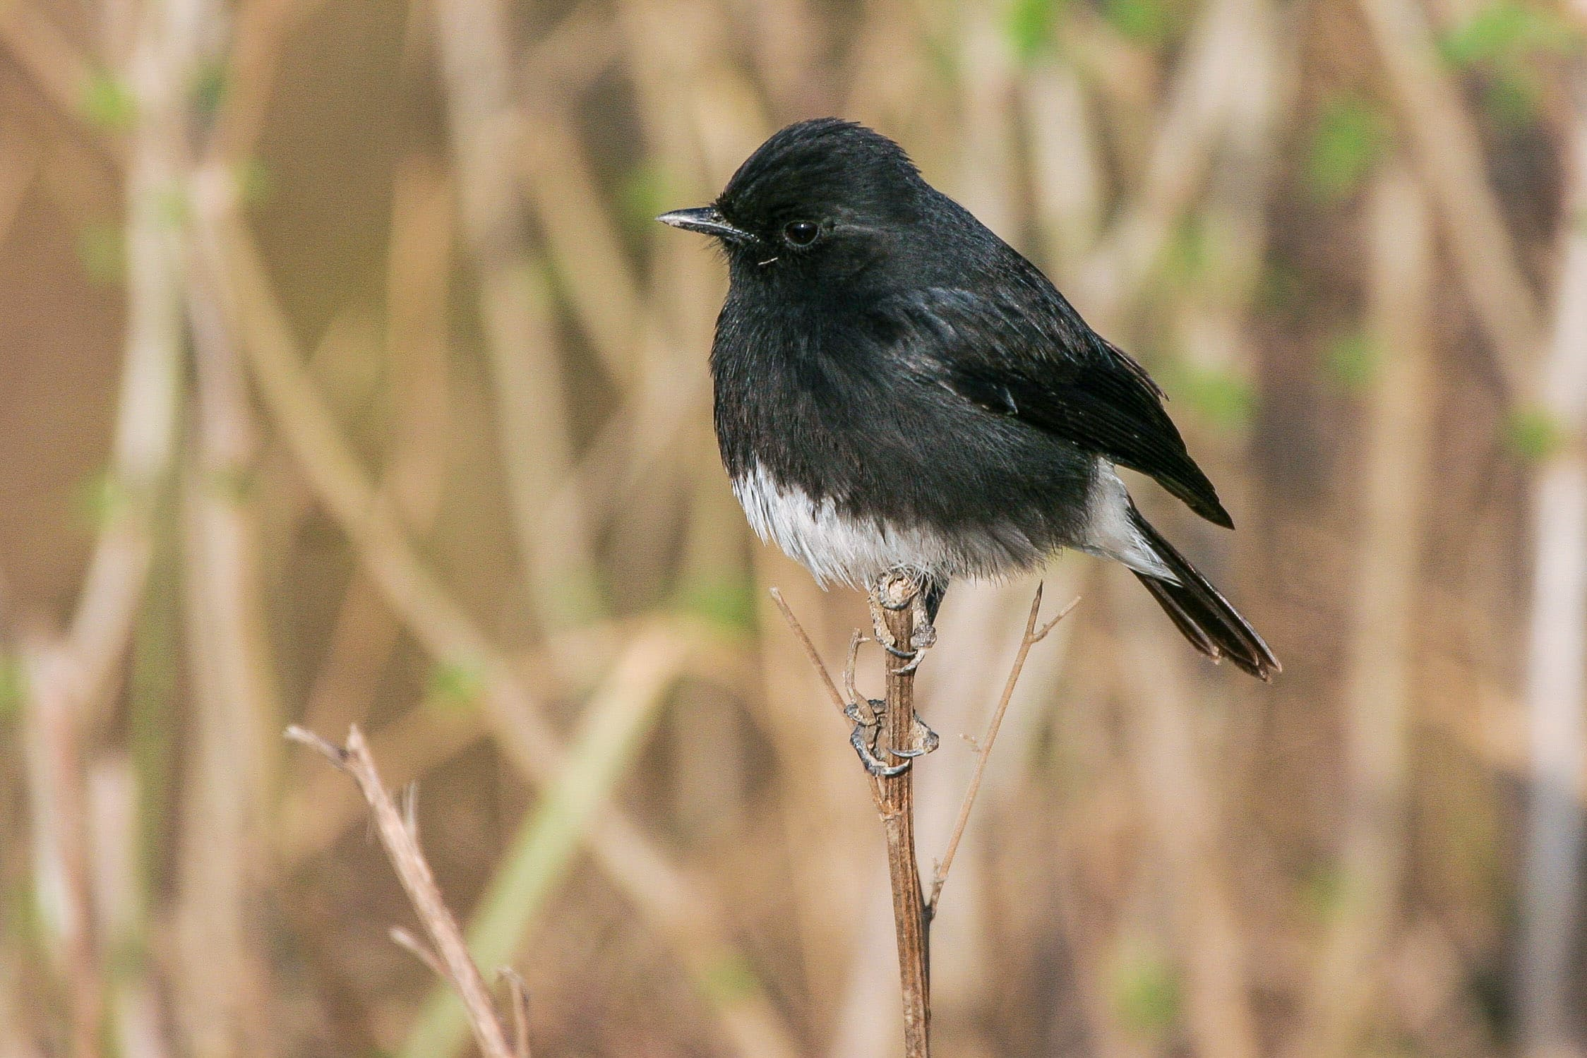
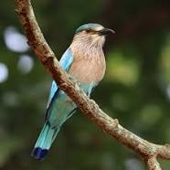
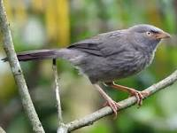
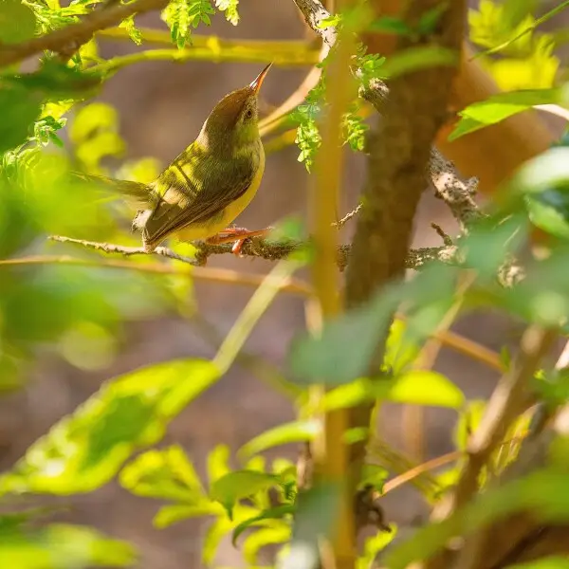
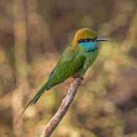
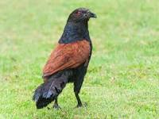
Insectivores
Cattle egret
Jungle mynah
Pied bush chat
Indian roller
Jungle babbler
Common tailor bird
Green bee eater
Greater coucal

Slide 26
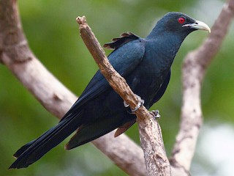
Omnivores
Indian Koel

Slide 27
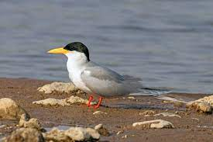
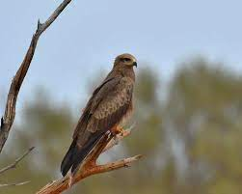
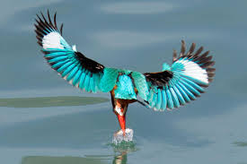
Carnivores
River terb
Black kite
White throated kingfisher

Slide 28
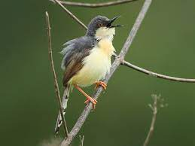
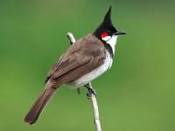
Nectarivores
Red whiskered bulbul
Purple rumped sunbird
Ashy prinia

Slide 29
Observations:
Asian bee eaters are usually found near bee hives because of their habit of eating flying insects.
Birds such as ashy prinia, Indian sunbird and pied bush chat which smaller than the size of a sparrow are extremely active.
Male Indian roller are best known for their aerobatic displays of males during the breeding season (March to June).
The Cattle egrets have an association with the cattles and hence are often seen with cattle and other livestock.
Black kites are opportunistic hunters and are more likely to scavenge. They spend much time soaring and gliding in thermals in search of food. Their angled wing and distinctive forked tail make them easy to identify. They are also vociferous with a shrill whinnying call.
Females lay eggs in the nests of other large birds, including crows, shrikes, and starlings.
The common tailorbird is a songbird found across tropical Asia. Popular for its nest made of leaves "sewn" together
When not nesting Red-whiskered bulbuls spend their days in flocks and roost communally in loose groups of a hundred or more birds. They are more often heard than seen, but will often perch conspicuously especially in the mornings when they call from the tops of trees.
Greater coucals are most active in the warm hours of the morning and in the late afternoon. They sunbathe in the mornings singly or in pairs on the top of vegetation with their wings spread out.

Slide 30
Acknowledgement and Reference Links:
Thanks to IISc for providing us with such an opportunity to present my hobby in the form of a study. Special thanks to our respectable R&D teachers for their all time support.
https://en.wikipedia.org/
https://www.allaboutbirds.org
https://www.google.com/intl/en_in/earth/versions/
Websites visited:
eBird
Inaturalist

Slide 31
By: Radhika Thakur 8th B, Vagdevi Vilas School, Varthur

