Slide 1
SOIL QUALITY
Janya.R- Grade 9
Rajshree Dubey- Grade 9

Slide 2
Soil Quality – Introduction.
Assessing soil quality involves measuring physical, chemical, and biological soil properties and using these measured values to identify properties of the soil that may be inhibiting soil function or to monitor how changes in management are affecting soil functions

Slide 3
Study Area
Locations nearby to
Varthur lake.

Slide 4
Objectives :
To test the quality of the soil taken from nearby to Varthur Lake.
The following tests that are done by us to check the quality of the soil :
pH value test
Moisture test.
Percolation test
NPK test

Slide 5
pH value test
pH is a measure of how acidic or basic the soil is..
Materials Required : Desired soil samples , pH paper , Beaker , Water.
Method : Take a beaker and fill it with 155 mL of water and mix Amount of soil and then stir it well.
Let is rest for 12 hrs.
Later check the pH value by the help of pH paper which indicates the colour of how acidic or basic the soil is.
A soil with a pH of 6 is 10 times more acidic than a soil with a pH of 7, and a pH of 5 is 100 times more acidic than a pH of 7.
plants that do best in acidic soil are : blueberries, rhododendrons, and azaleas.

Slide 6
Percolation test :
This test is performed to check how much amount of water can each type of soil absorb.
Materials Required : Funnel , beaker , Filter paper , Measuring cylinder ,Soil and water.
Place a filter paper inside a funnel and insert the funnel in the mouth of a measuring cylinder.
Note the weight of the soil and add the soil in the filter paper. (50g)
Now , add the exact mL of water as same as the weight of soil. (50mL)
Wait until the excess water is drained out.
Now check the amount of excess water and then compare it with the water taken.
So based on the amount of water of water drained we can draw a conclusion that the WHC of soil is high/low.

Slide 7
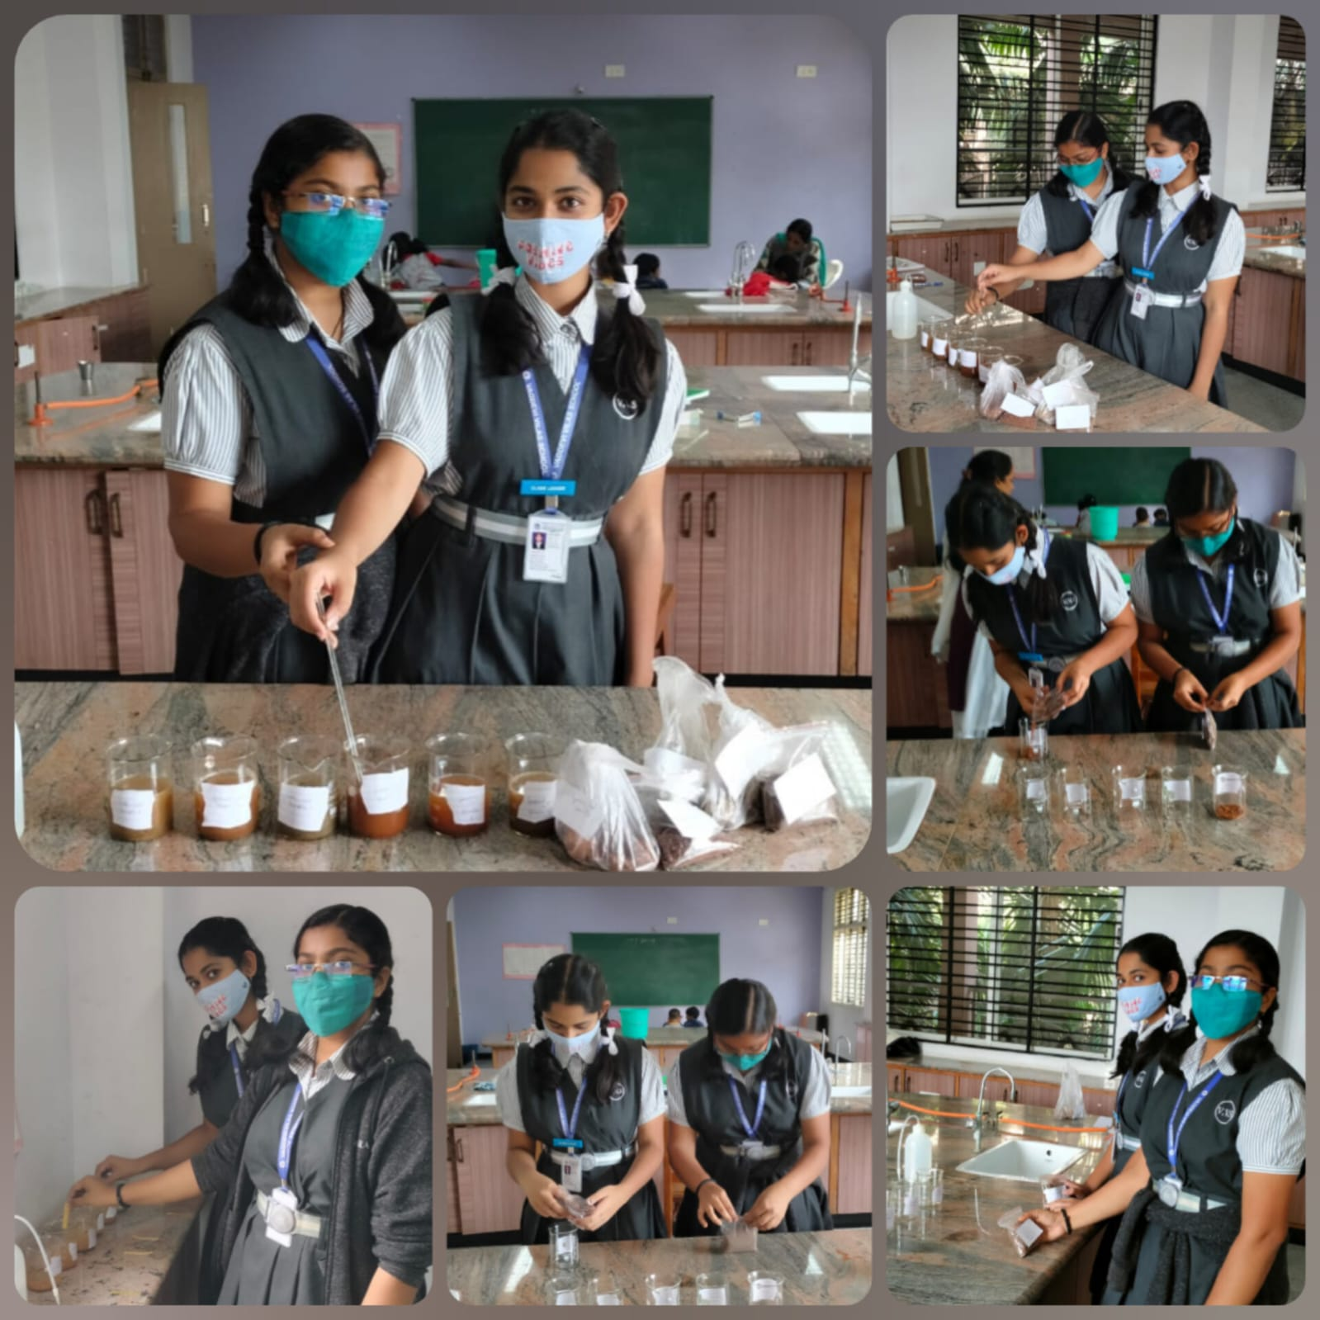
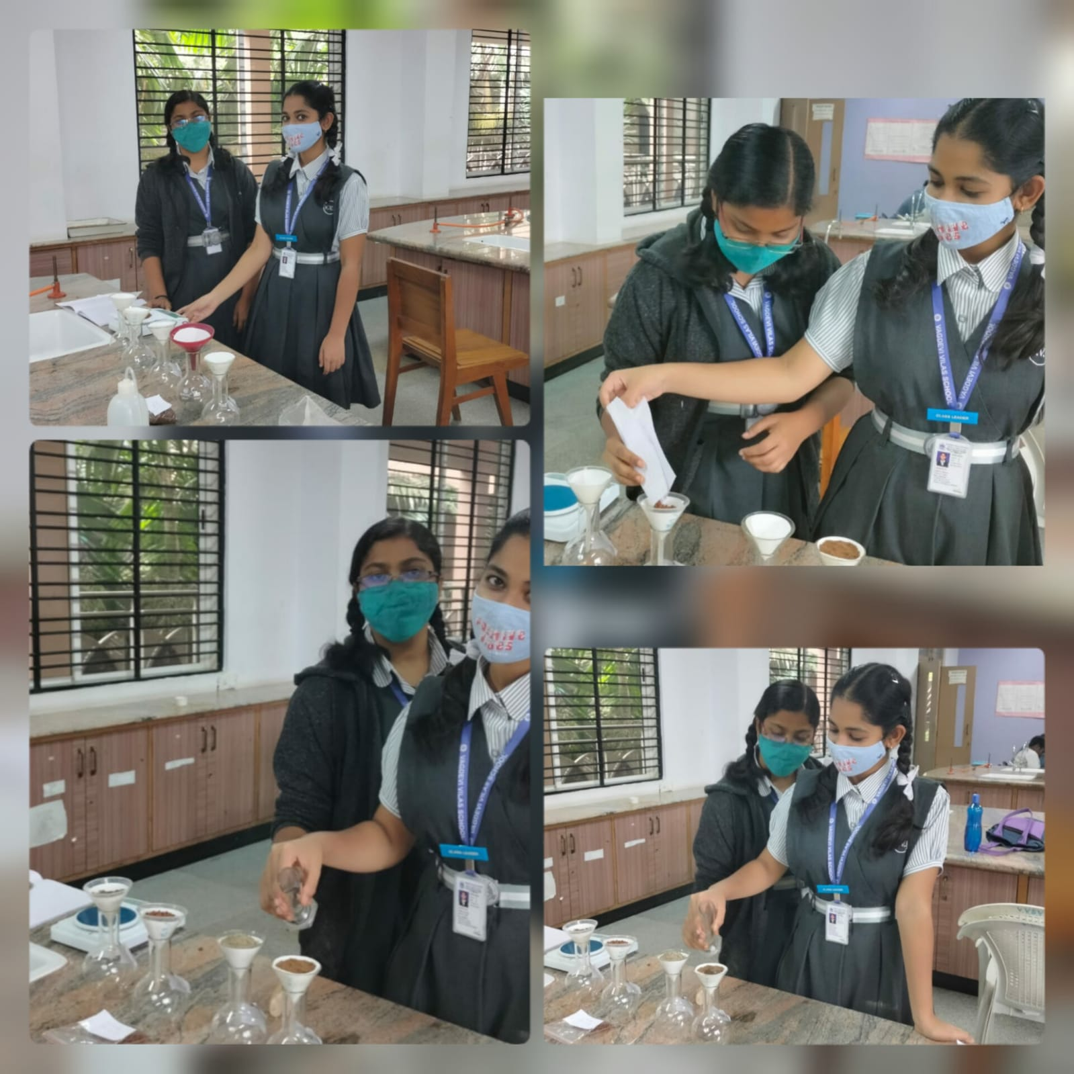
ph Value test :
Percolation test :

Slide 8
Observation of pH value test :-
Serial No. | Solution | Approximate Paper | Nature of pH value substance
1. | Agricultural soil | 7 | Neutral
2. | Lake soil {Sample 1} | 5 | Acidic
3. | Lake soil {Sample 2} | 9 | Basic
4. | Ground Soil {Sample 1} | 5 | Acidic
5. | Ground Soil {Sample 2} | 10 | Basic
6. | Garden Soil {Sample 1} | 5 | Acidic
7. | Garden Soil {Sample 2} | 8 | Basic

Slide 9
Percolation test results :
SL. No. | Soil Types | Weight of soil (X) | Volume of water poured (Y) | Volume of water (Z) collected in the cylinder | Volume of water (Y-Z) retained by the soil. | WHC is percentage Y-z / X x 100 (%)
1. | Agricultural soil | 50g | 50mL | 31 | 19 mL | 38%
2. | Lake soil { sample 1} | 50g | 50mL | 20.7 mL | 29.3 mL | 58.6%
3. | Lake soil {sample 2} | 50g | 50mL | 10.8 mL | 39.2 mL | 78.4%
4. | Ground soil {sample1} | 50g | 50mL | 20.6 mL | 29.4 mL | 58.8%
5. | Ground soil {sample2} | 50g | 50mL | 30.5 mL | 19.5 mL | 39%
6. | Garden soil {sample 1} | 50g | 50mL | 30.2 mL | 19.8 mL | 39.6%
7. | Garden soil {sample 2} | 50g | 50mL | 30.6 mL | 19.4 mL | 38.8%

Slide 10
N.P.K test
Nitrogen amount test :
Take 5c.c of soil in soil mixing tube. Add 25mL of potassium reageant-1 and stir is for 10-15 mins. Add a pinch of decolourizer to the solution and filter it into a colour developing bottle.
Add 1mL of potassium reagent-2 to develop the colour (wait for 2-3 mins).
Shake the test tube lightly before checking. now Check the Nitrogen content by matching the solution colour on the nitrogen colour chart.

Slide 11
Phosphorous test
Phosphorous amount test :
Take 5c.c of soil into the soil mixing tube. Add 25mL of phosphorous reagent – 1 and stir the solution for 10-15 mins. Add a pinch of decolourizer and filter it into a colour developing bottle.
Add 1mL of Phosphorous reagent – 2 to develop the colour (wait for 2-3 mins)
Shake the test tube before checking , now check the phosphorous content by matching the solution colour with the phosphorous colour chart.

Slide 12
Potassium test
Take 5c.c of soil in soil mixing tube. Add 25mL of phosphorous reageant-1 and stir is for 10-15 mins. Add a pinch of decolourizer to the solution and filter it into a colour developing bottle.
Add 1mL of phosphorous reagent-2 to develop the colour (wait for 2-3 mins).
Shake the test tube lightly before checking. Now Check the phosphorous content by matching the solution colour on the phosphorous colour chart.

Slide 13
Moisture Test
This test is done to check how much amount of moisture can the soil hold :
To perform this test : You should take the desired soil sample and add the same amount of water as the soil, now check the weight of the container your adding soil and water into.
Now let the soil dry for few hours and check the weight again.
There much be a difference between the weight of the wet soil and dry soil.
Now the difference is the amount of moisture the soil can hold.

Slide 14
N.P.K test
Type of soil | Amount of Nitrogen : | Amount of Phosphorous : | Amount of Potassium :
Lake Soil {Sample 1} | L1 | L1 | M1
Lake soil {sample 2} | L2 | L2 | H1
Agriculture | H1 | H2 | H2
Ground soil {Sample 1}
Ground soil {Sample 2} | L1 | M1 | L2
Garden soil 1 | M2 | L2 | H1
Garden soil 2 | M1 | M2 | L2

Slide 15
Soil Health Card
Soil Health Card is a scheme launched by the govt. Of India on 19 February 2015. Under the scheme, the government plans to issue soil cards to farmers which will carry crop-wise recommendations of nutrients and fertilizers required for the individual farms to help farmers to improve productivity through judicious use of inputs.

Slide 16
Moisture Test
SL. No. | Weight of empty container W1 | Weight of the container and dry soil
Agricultural soil | 0.93 | 53.68
Lake soil{Sample 1} | 0.93 | 59.09
Lake soil {Sample 2} | 0.93 | 75.86
Ground soil {Sample 1} | 0.93 | 55.67
Ground soil Sample 2 | 0.93 | 55.30
Garden soil 1 | 0.93 | 41.10
Garden soil 2 | 0.93 | 55.08

Slide 17
N.P.K TEST:

Slide 19
Result and discussion :
According to the tests conducted by us, We had taken 7 soil samples for each test and each soil sample had different test results.
By pH test we were able to check the ideal pH level in each type of soil.
By the moisture test we were able to check how much moisture can the soil hold
By the N.P.K test we were able to check how much nitrogen , potassium, phosphorous amounts were present in the soil sample
By the percolation test we were able to check the water holding capacity of the soil sample

Slide 20
Conclusion :
By all these experiments/tests we can conclude that different soil types have different quality..
In terms of quality : Agriculture > Garden > Ground > Lake soil.
By this we can conclude that Agricultural soil has higher nutrients/a good quality as it is used in cultivation of crops due to which they gain nutrients from plants.
Garden soil has the ideal pH level as it watered daily and maintained for the purpose of growing plants.
Ground soil is comparatively less in the amounts of nutrients as the soil sample is taken from where the soil is continuously under the sun.. Due to which the soil gets very dry as a result it kills the micro organisms present in the soil.
Lake soil has very less nutrients as compared to the other samples because the samples are taken from a lake which is polluted due to which the soil contains nutrients to a certain level but is highly acidic.

Slide 21
Acknowledgements :
IISC, Bengaluru
Vagdevi vilas institute
Reference :-
http://www.soilquality.org
soilhealth.dac.gov.in

