Slide 1
Birds in our study area
By- Hari Krishna M.P
Vijay.J.Gowda
From VIII ‘A’
Vagdevi Vilas Nelamangala

Slide 2
Introduction
Birds, birds play an important role in our life as-
They give relief when we see them and our heart feels lighter when we see beautiful environmental things like birds
And also birds play a big role in our ecological system and balance it
And also birds us, humans, in things like Pest control, public health, seed dispersal, ecotourism, environmental monitoring

Slide 3
Objective
Our main goal is to spread awareness about the birds.
Birds are special creatures who are the supporters of human habitat.
This plan of us is a small project to bring awareness about these special creatures.

Slide 4
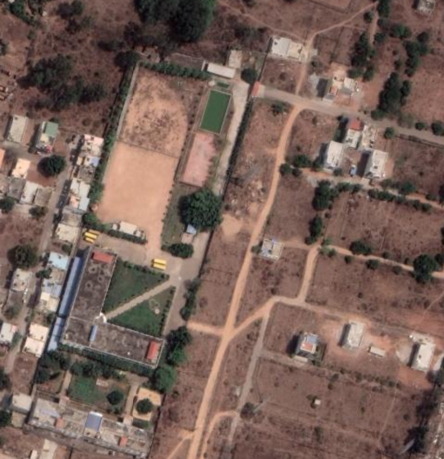
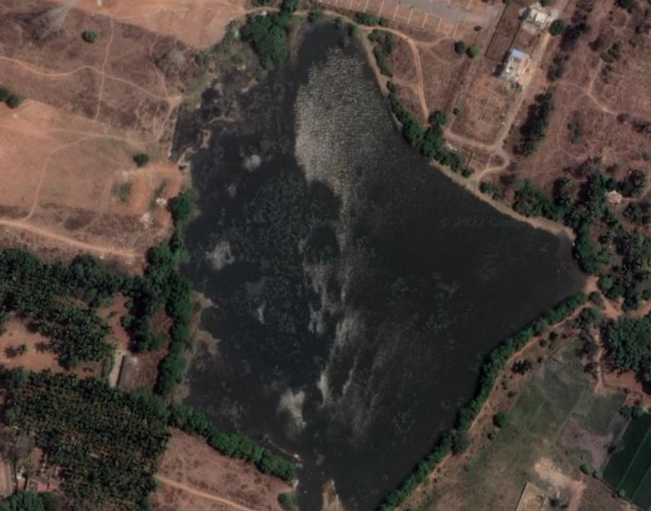
Our study area
 | our Study Area is our school premises (at the left) Nelamangala Lake surroundings (at right)

Slide 5
Materials and Methods
We used our phone and lens camera to click photo
we took the help of the villagers help to find out about the birds and at what time they come out
We identified the bird with the help of some books and also google

Slide 6
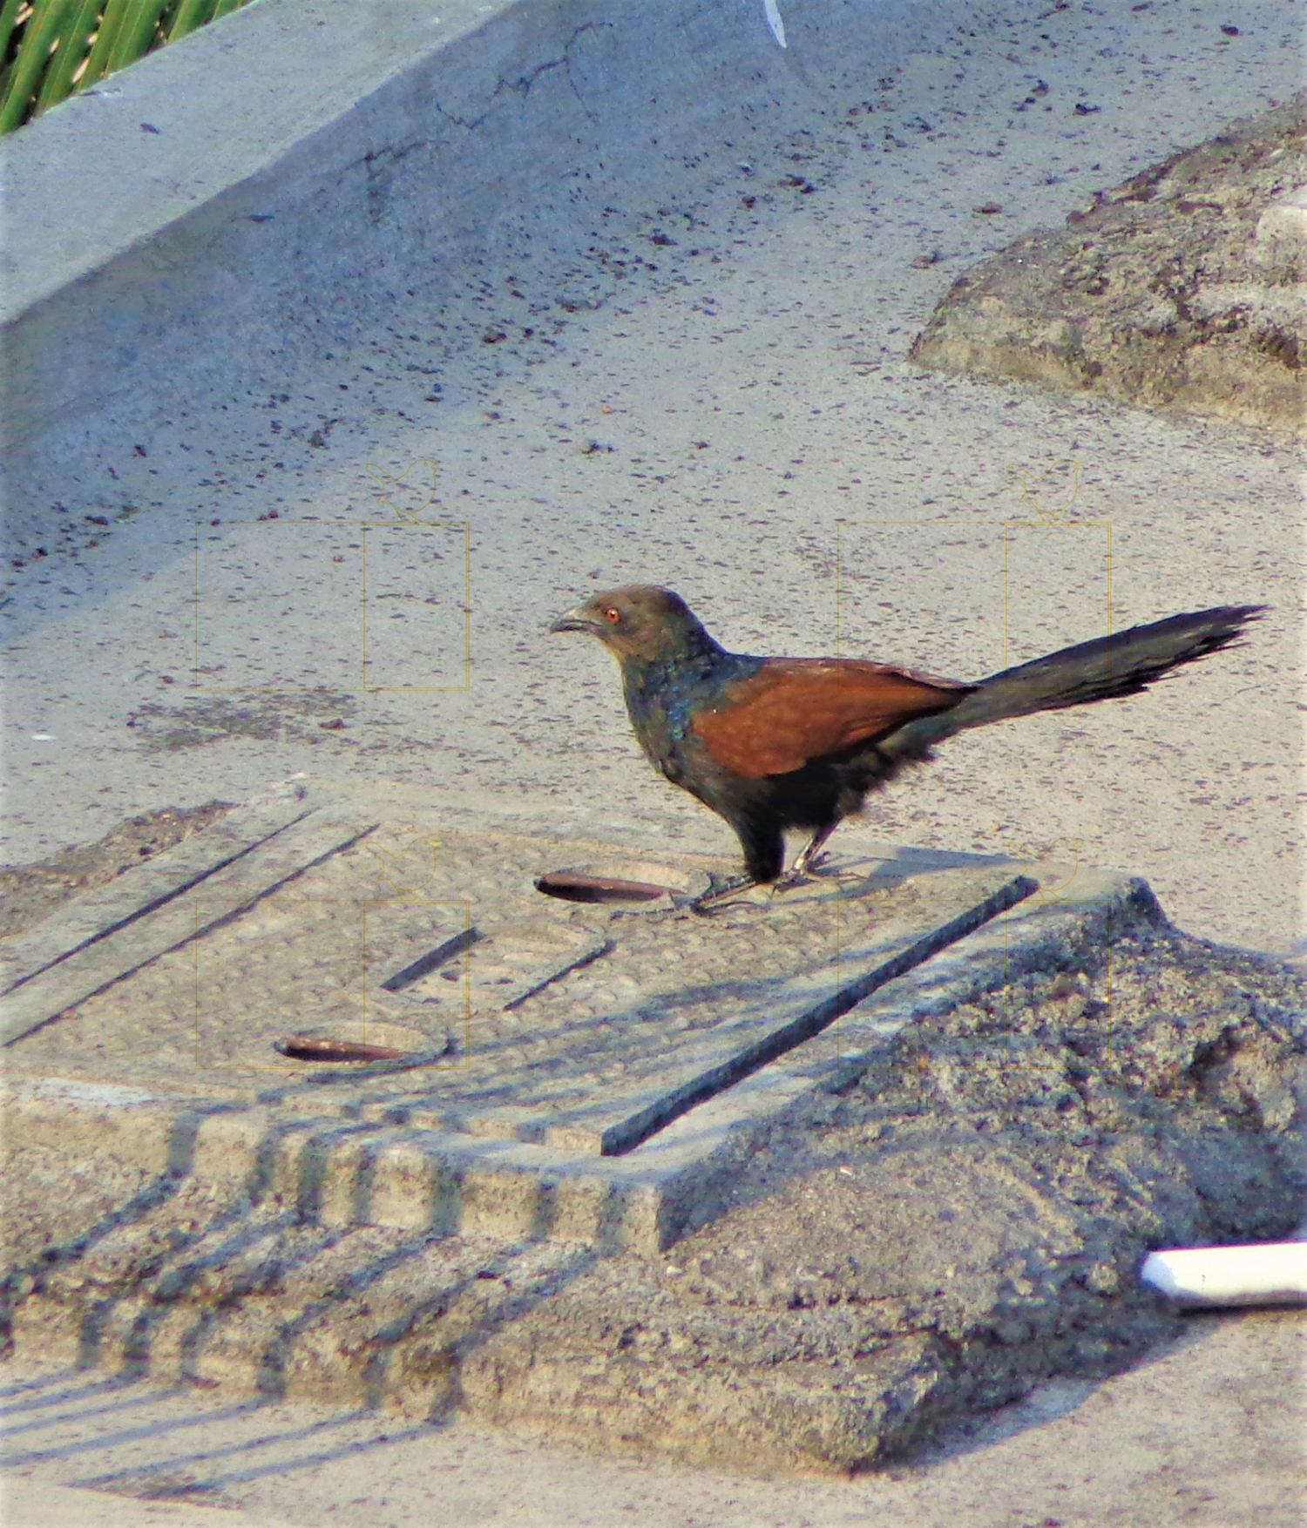
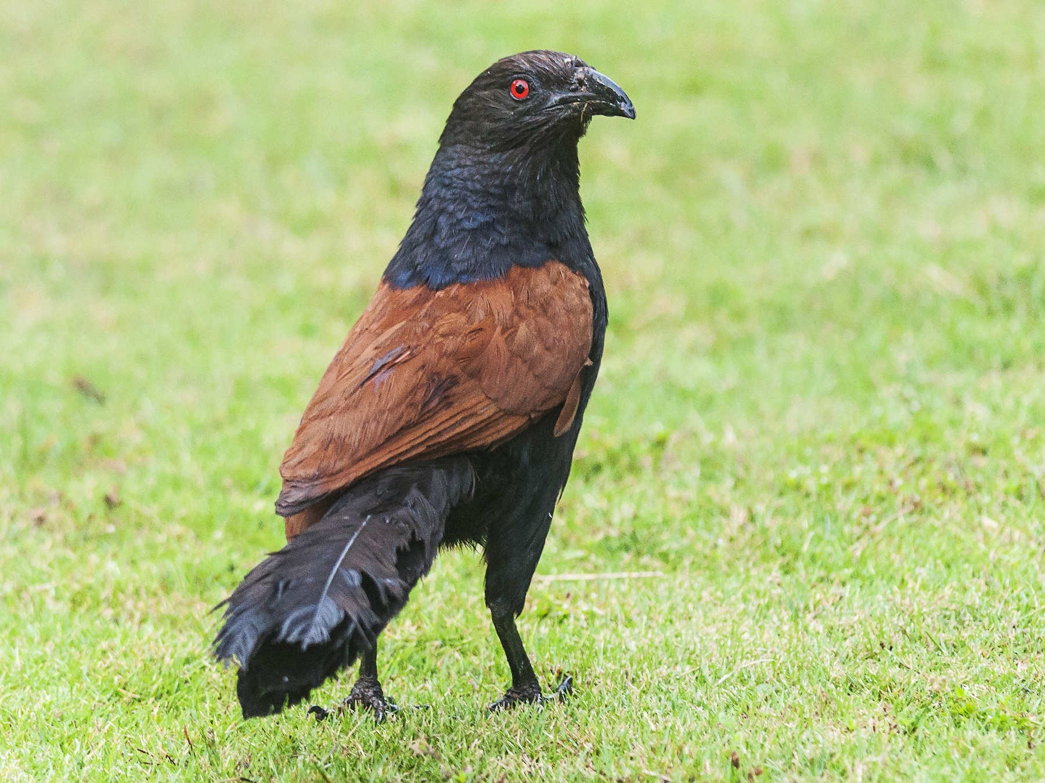
Greater Coucal

Slide 7
The greater coucal
size-45 to 50 cm
resident- near grasslands and forests
Active time- most active morning and afternoon
Binomial name- Centropus sinensis
Food- insects, caterpillars
Breeding- after the monsoon
Nest- it has a large untidy globular mass of leaves and twigs
Eggs- They lay 2 to 4 eggs
Incubation- eggs hatch after 15–16 days

Slide 8
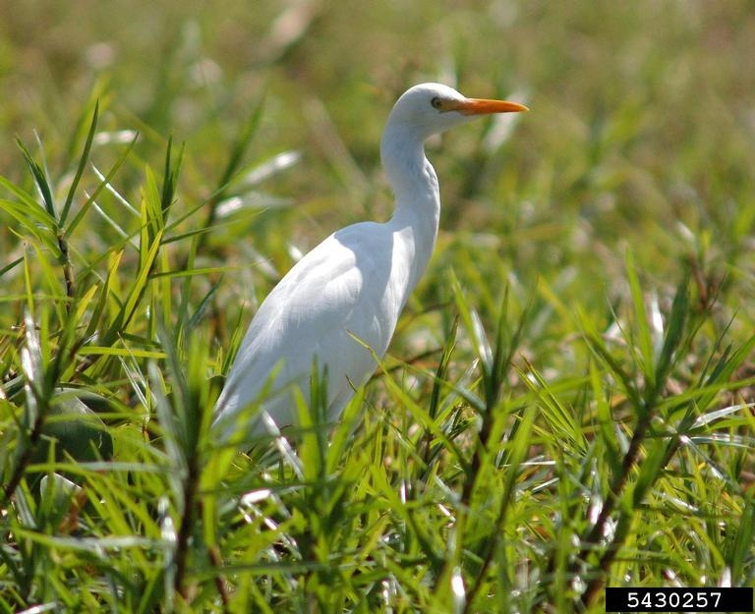
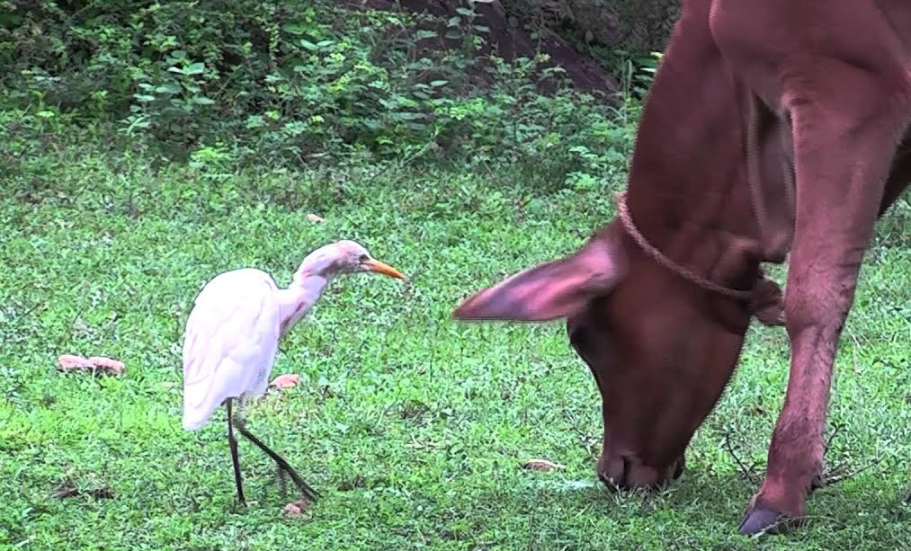
Cattle Egret

Slide 9
Cattle egret
Size- 45 to 55 cm
resident-croplands and ponds
Active time- morning and afternoon
Binomial name- Bubulcus ibis
Food- insects, beetles, etc
Breeding- monsoons in May
Nest- shallow bowl of sticks
Eggs- 2-4 eggs
Incubation-22 to 28 days

Slide 10
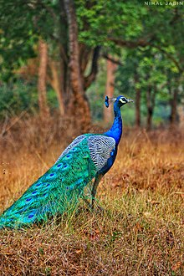
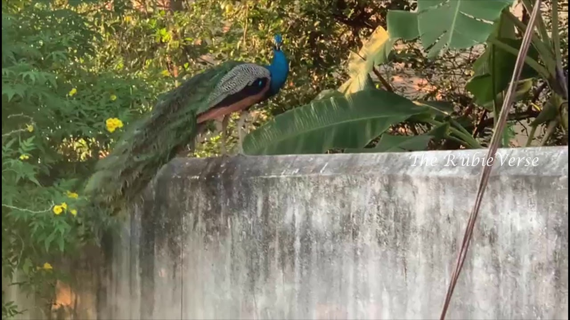
Peacock

Slide 11
Peacock
Size- 100 to 120 cm
resident- farms and agricultural fields
Active time- morning and around dusk
Binomial name- Pavo cristatus
Food- plants, insects, etc
Breeding- usually begins in March
Nest- scrapes a hole in the ground under a shrub
Eggs- four to eight eggs
Incubation- 28 to 30 days

Slide 12
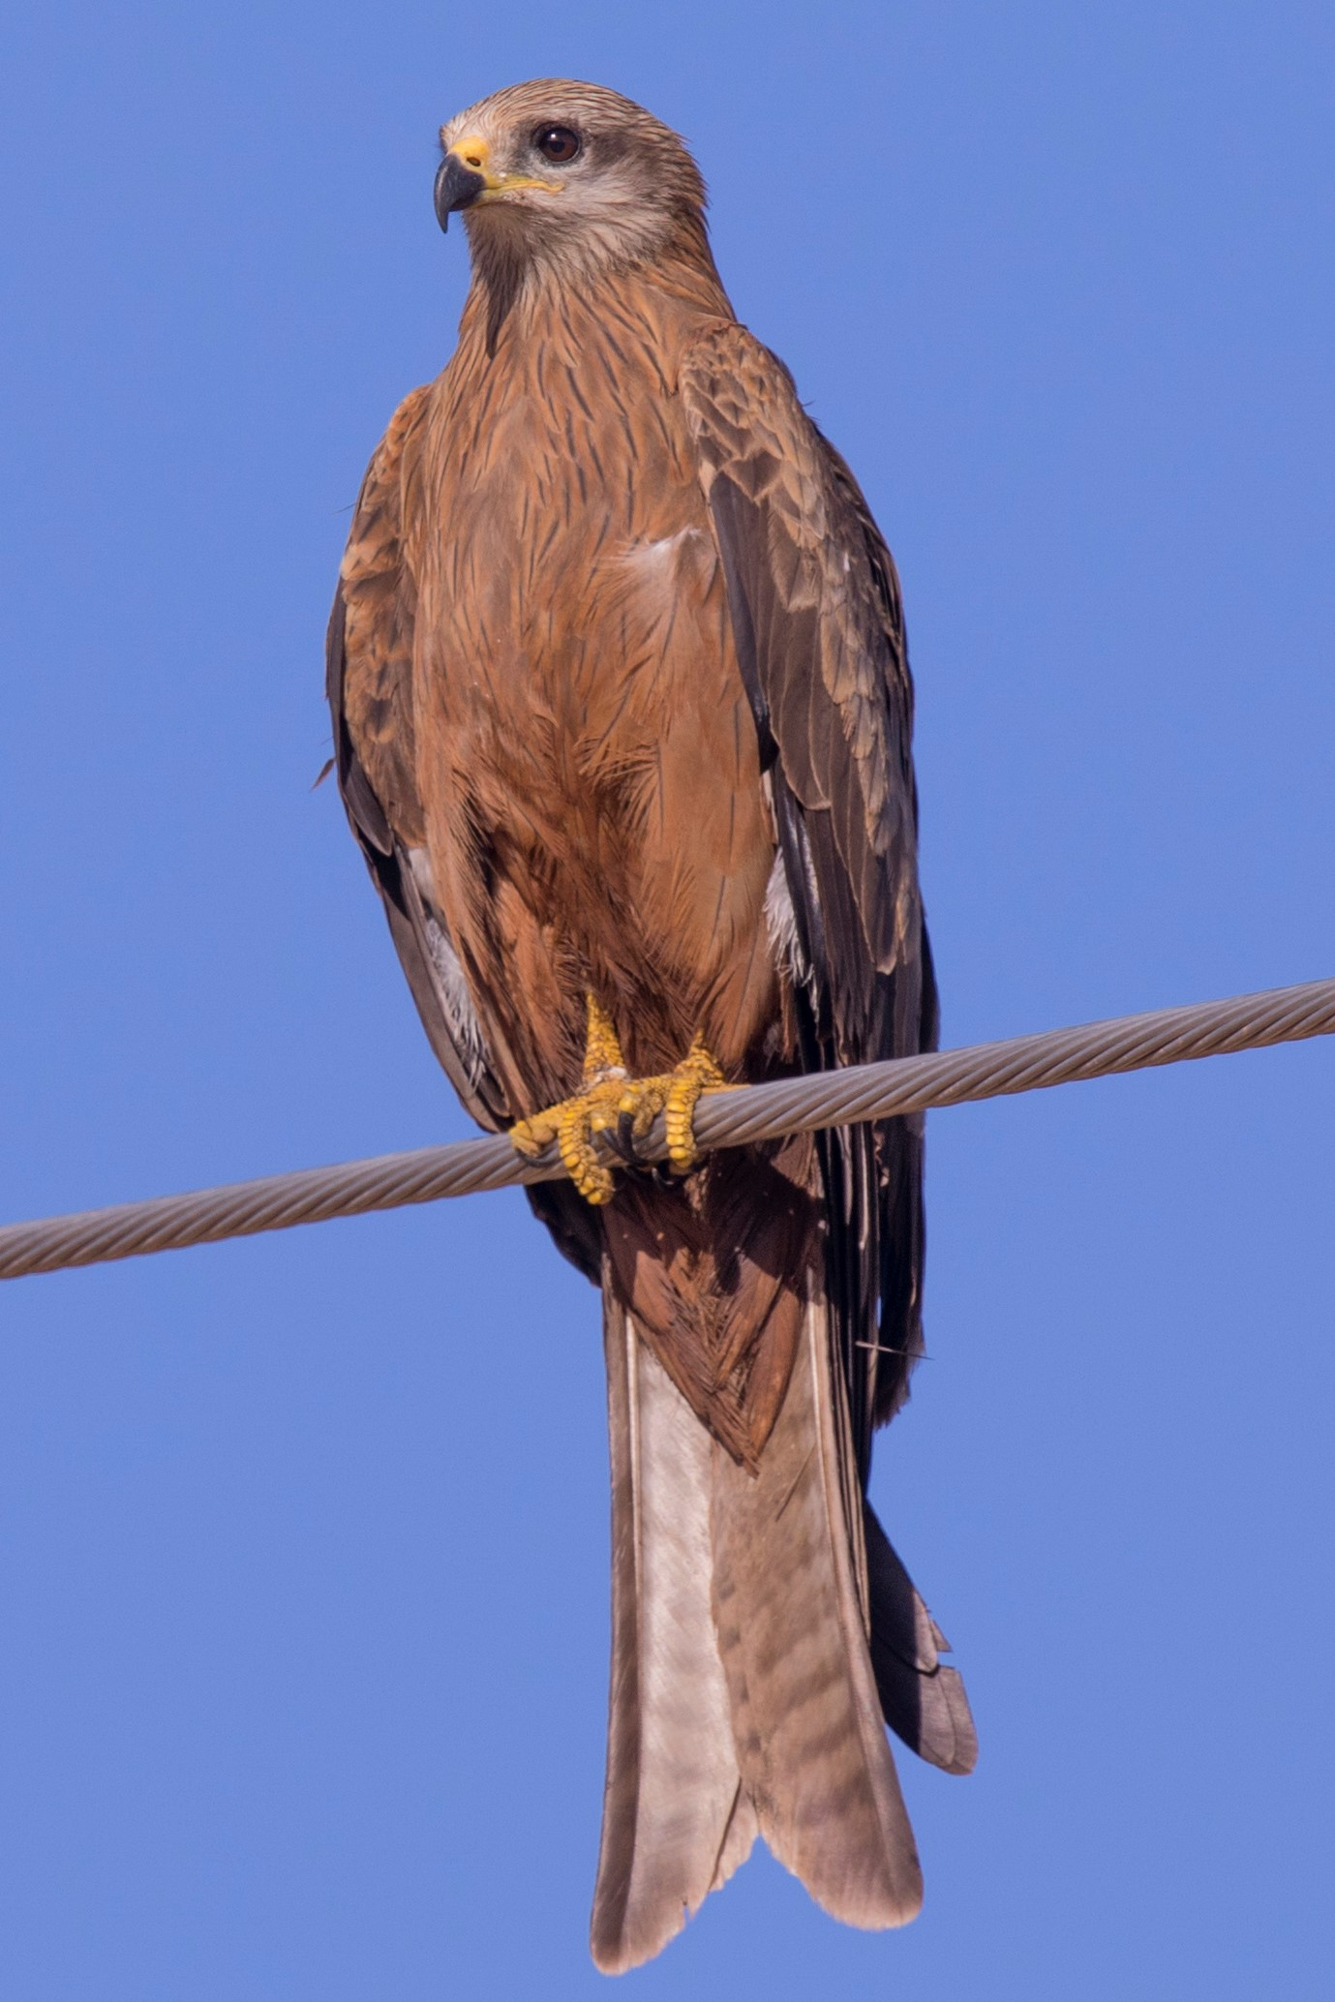
Black kite

Slide 13
Black kite
Size- 140 to 150 cm
resident- commonly found along river edges
Active time- Afternoon and morning
Binomial name- Milvus migrans
Food- fish, reptiles, amphibians, etc
Breeding- January and February
Nest- They are made from sticks and twigs
Eggs- 1–3 eggs
Incubation- 32 days

Slide 14
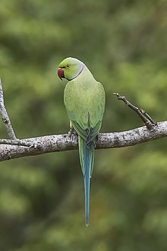
Rose-ringed parakeet

Slide 15
Rose-ringed parakeet
Size- 40 cm
resident- grasslands, savanna, etc
Active time-
Binomial name- Psittacula krameria
Food- fruit, berries, nuts, etc
Breeding- December and January
Nest- over an old woodpecker nest
Eggs- 2-4 eggs
Incubation- three weeks

Slide 16
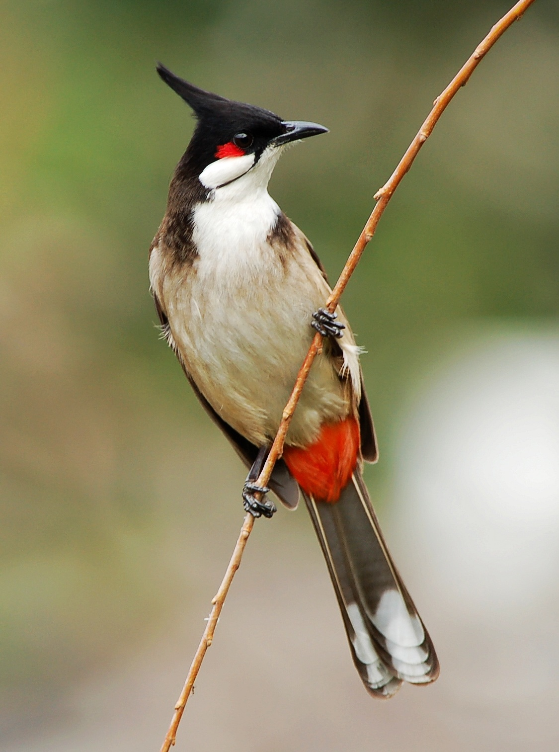
Red-whiskered bulbul

Slide 17
Red-whiskered bulbul
Size- 17-23
resident- hill forests and urban gardens
Active time- Usually morning and evening
Binomial name- Pycnonotus jocosus
Food- fruits, insects, etc
Breeding- April to June
Nest- open cup nest of rootlets, leaves, etc
Eggs- 2-3 eggs
Incubation-22 days

Slide 18
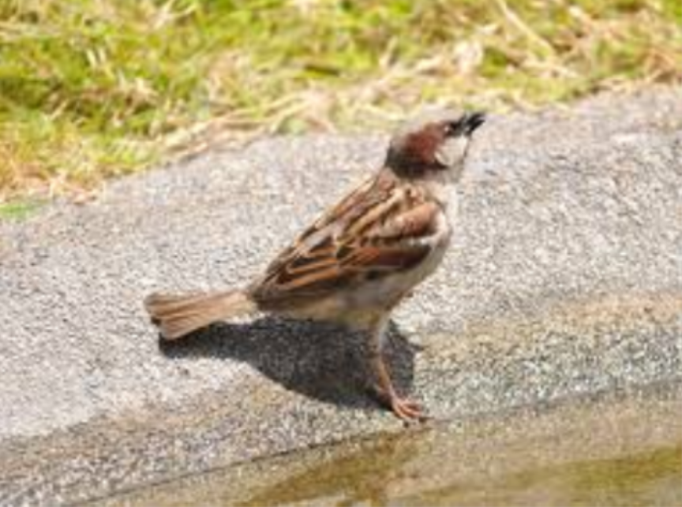
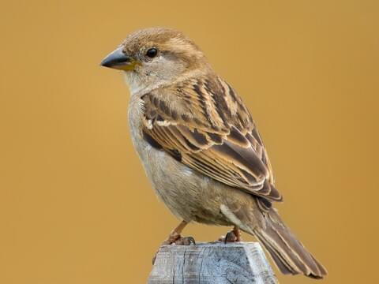
Sparrow

Slide 19
Sparrow
Size- 14 – 18 cm
resident- most places where there are houses Active time-its often seen early morning
Binomial name- Passeridae
Food- grains and seeds
Breeding- September to October
Nest- holes, and crevices of man-made structures
Eggs- two to five eggs
Incubation- 11-14 days

Slide 20
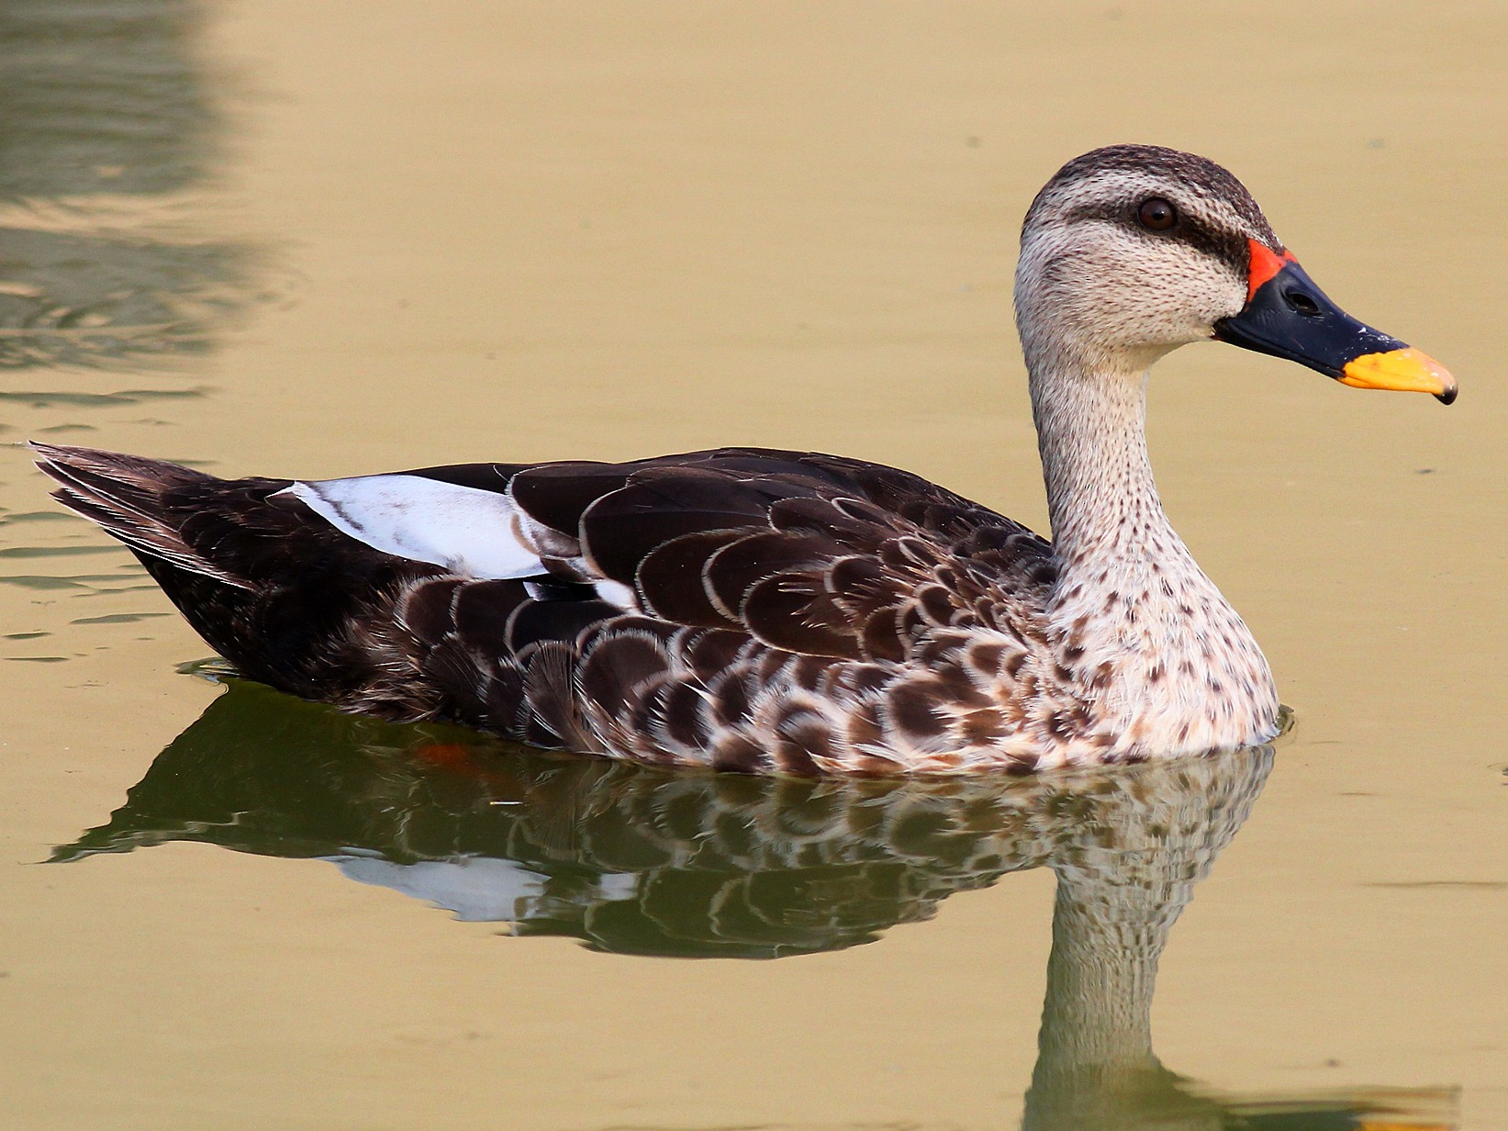
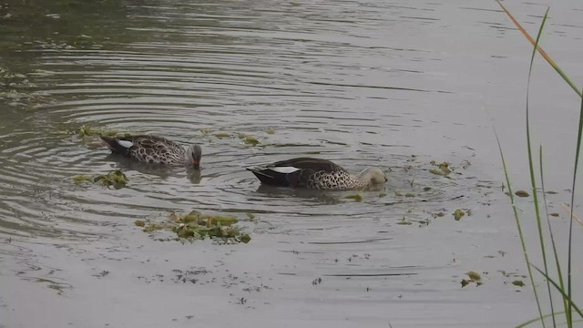
Indian spot-billed duck

Slide 21
Indian spot-billed duck
Size- 55–63 cm
resident- medium-sized wetlands
Active time- morning and at the dawn
Binomial name- Anas poecilorhyncha
Food- plants, as well as invertebrates
Breeding- November to December
Nest- on the ground hidden within in vegetation near water
Eggs- 8-14
Incubation- 26-30 days

Slide 22
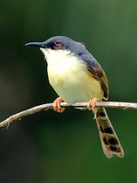
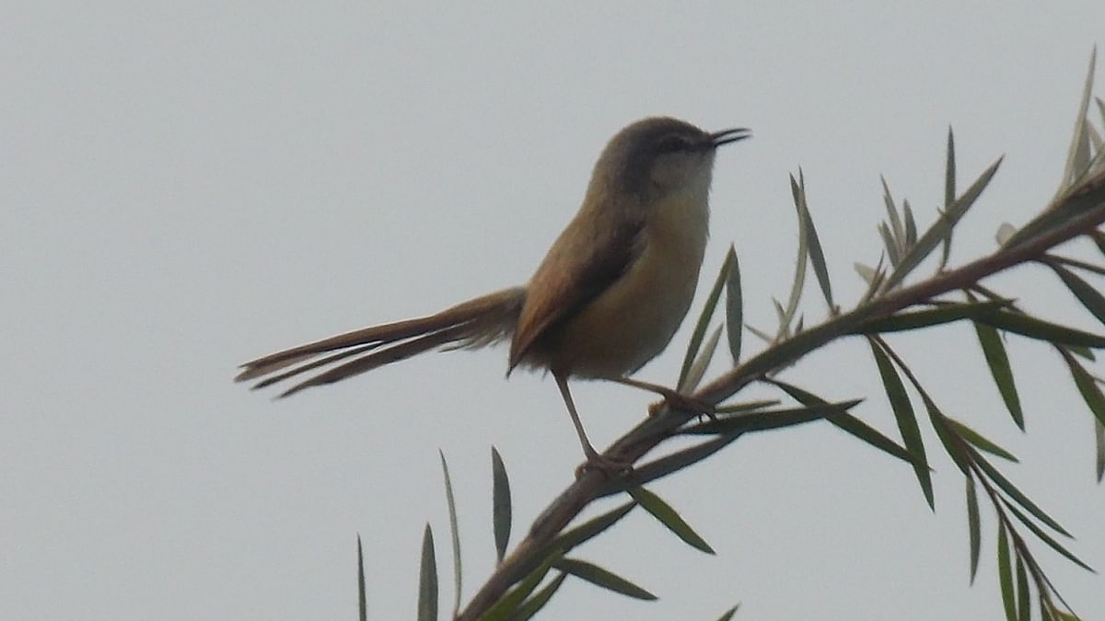
Ashy Prinia

Slide 23
Ashy Prinia
Size- 13–14 cm
Residents- gardens, and backyards.
Active time- Its can commonly be seen in the daytime
Binomial name-Prinia socialis
Food- small invertebrates, flower nectar, etc
Breeding- March to September
Nest- made by sewing several large leaves, etc
Eggs- 3 to 5
Incubation- 12 days

Slide 24
Conclusion
Birds are vital for our ecosystem and its balance, thus we must all keep them safe.
we all must take proper measures to help the birds live and save them from extinction.

Slide 25
References
E-birds.com
Bird book (from our library)
Some locals of our study area
Our biology teacher
The Cornell Lab of Ornithology.

Slide 26
Thank you
“Birds make you smile,
Let them live a while”

