Slide 1
MECHANICAL APPROACH TOWARDS CLEANING WATER BODIES
By:
Rajath Hegde
Dhruthi Rao
Dhrithi Bhat

Slide 2
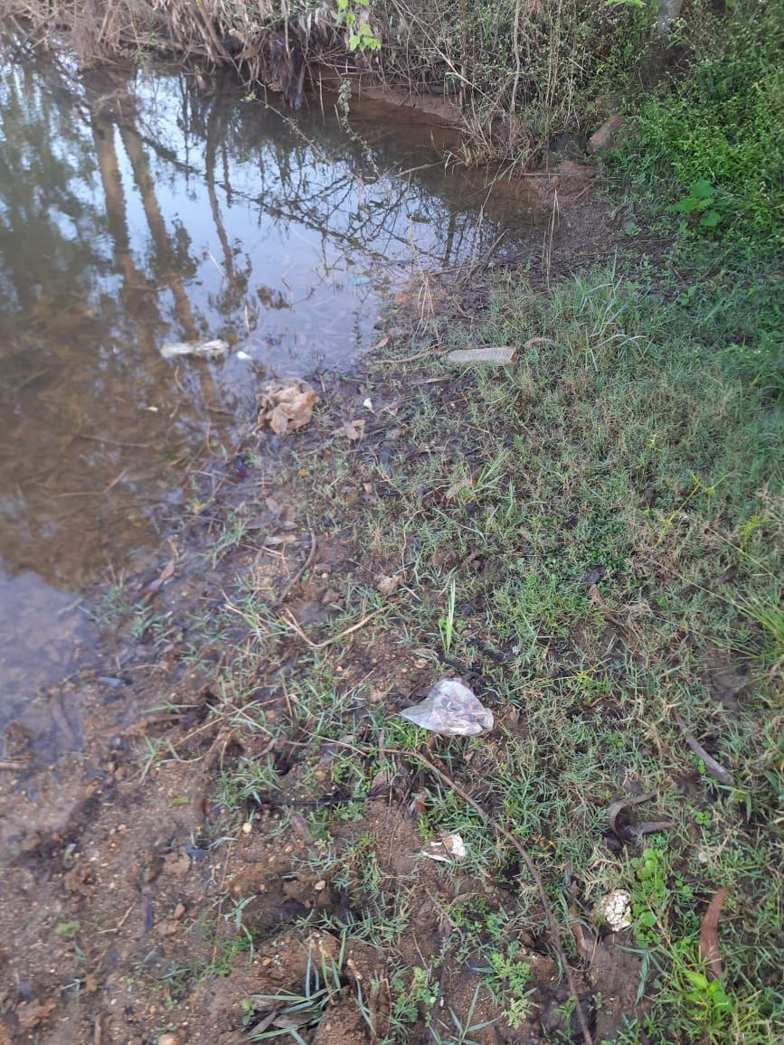
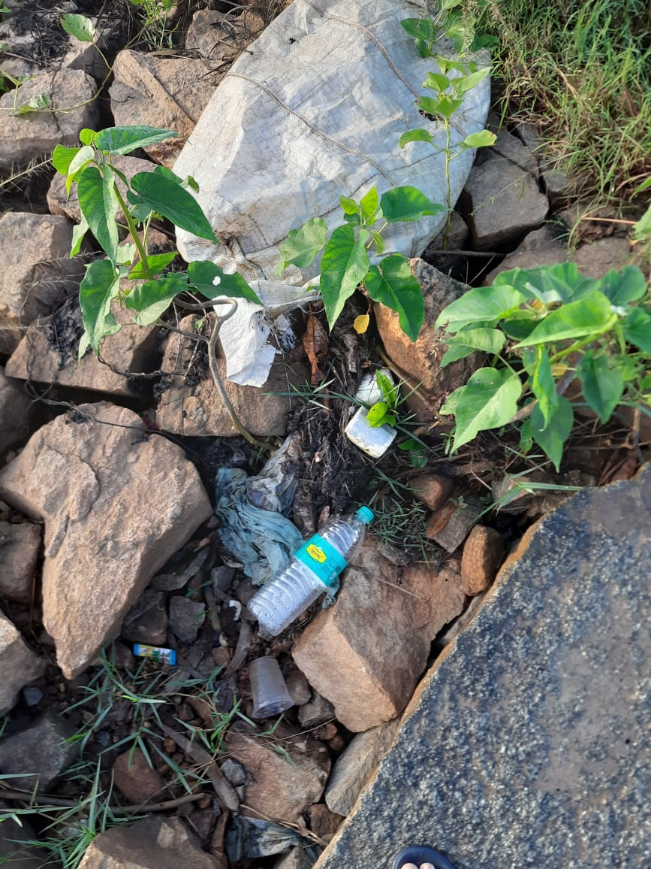
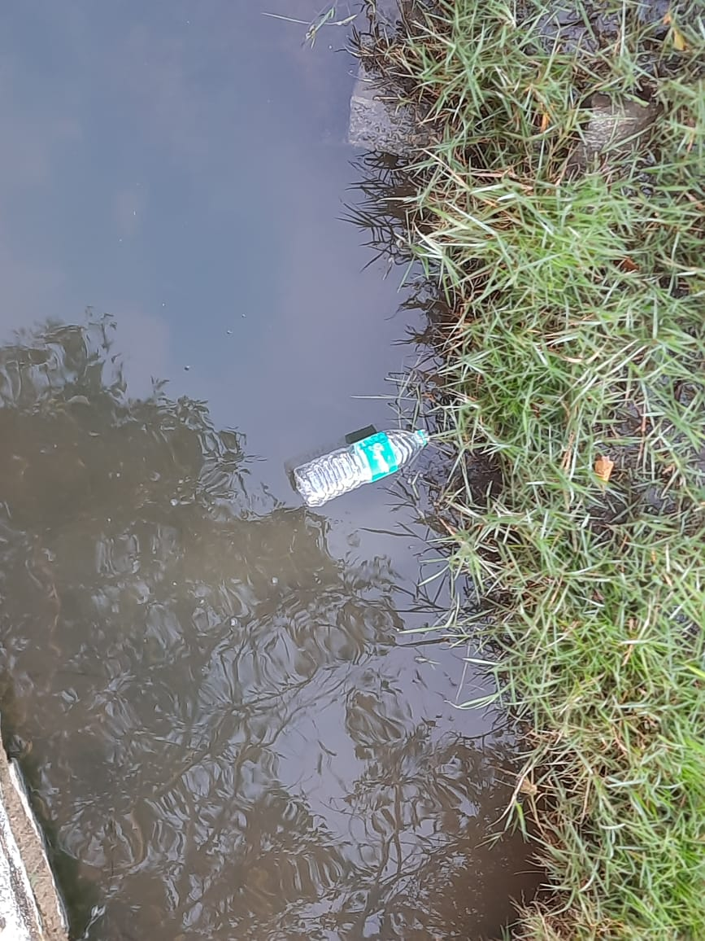
MONITORING OF ECOSYSTEMS: BIG DATA – (REMOTE SENSING DATA), ARTIFICIAL INTELLIGENCE (AI), MACHINE LEARNING (ML) AND DEEP LEARNING TECHNIQUE
Water discharged from factories are highly hazardous due to their chemical composition.
We are going to find a way to clean them for at least the daily consumption (daily chores) of people.

Slide 3
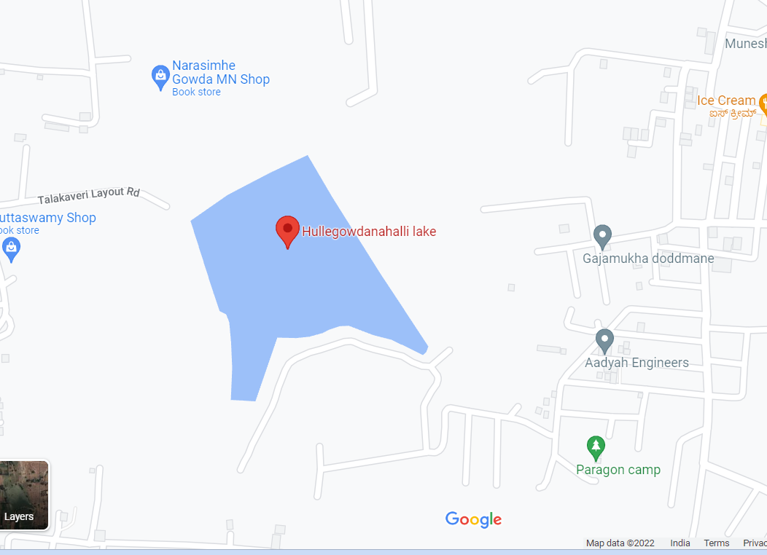
STUDY AREA
HULLEGOWDANAHALLI LAKE:
Located in Nelamangala Taluk, of Bengaluru North in Bengaluru district.
Pollutants found:
Non-decomposable materials,
Eg - plastic bottles, glass pieces, etc.,...

Slide 4
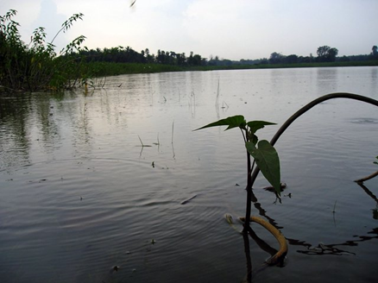
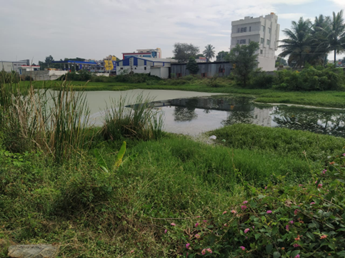
OBJECTIVES
To make our lakes clean and restore it's ecosystem.
To make people aware of the severity of their careless doings.
To make people inspire from our idea and get into cleaning lakes for good.
To provide the animals and birds back their long lost habitat.

Slide 5
We can build the machine by a few simple parts: 1. a sedimentation tank 2. a micro super filter 3. a chlorination tank 4. 2 hoses - one for output and the other for input 5. a pump to pull water from the lake. This machine can be assembled in just a few days and it only costs a few hundred thousands or 2-3 lakhs, which is quite efficient.
MECHANICAL APPROACH TOWARDS CLEANING WATER BODIES

Slide 6
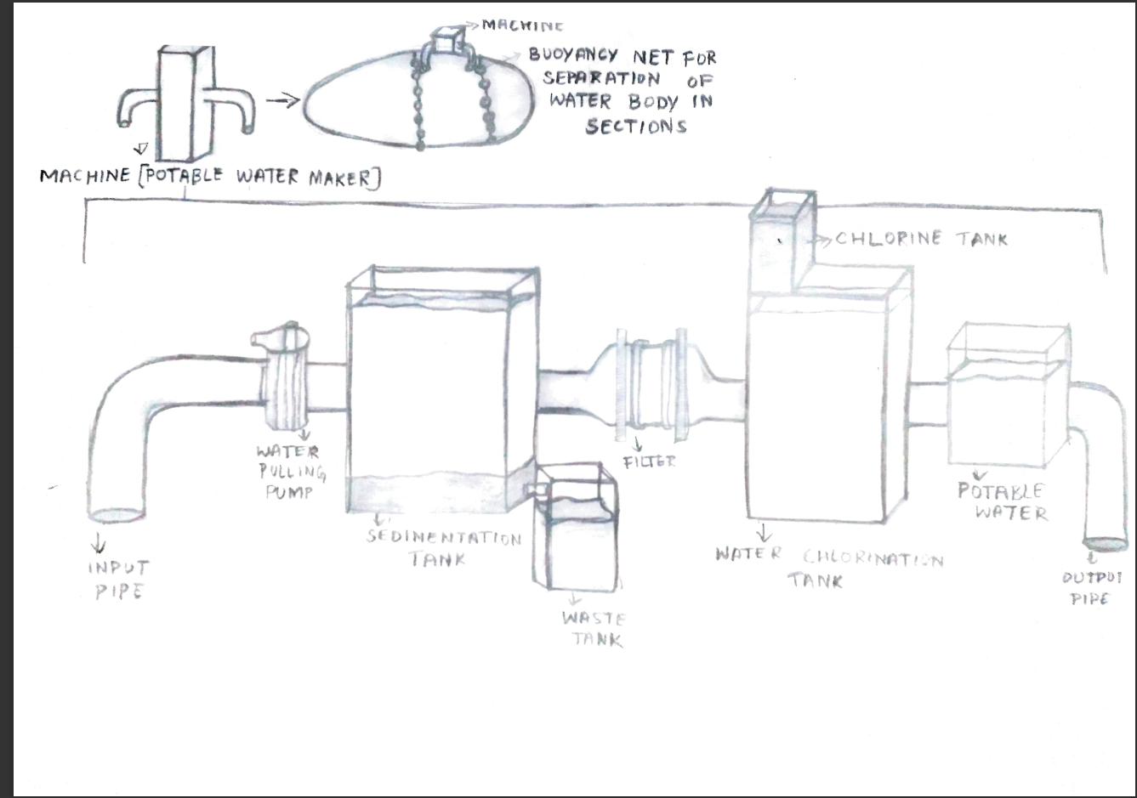
Machine
Buoyancy Nets For Separation Of Water Body In sections
Machine Potable Water Maker
Chlorine Tank
Water Pulling Pump
Filter
Potable Water
Input Pipe
Sedimentation tank
Water Chlorination tank
Out put pipe
Waste Tank

Slide 7
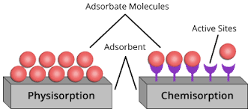
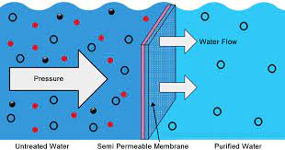
Chemical precipitation can be used to remove dissolved metals.
Chemical coagulation can be used to make the sedimentation process more efficient.
Ion exchange can be used to soften the water.
Adsorption and chemisorption can be used to remove chemical residue from water.
Chemical stabilization can be used to deodorize the water.
Removal Of Chemicals From Water

Slide 8
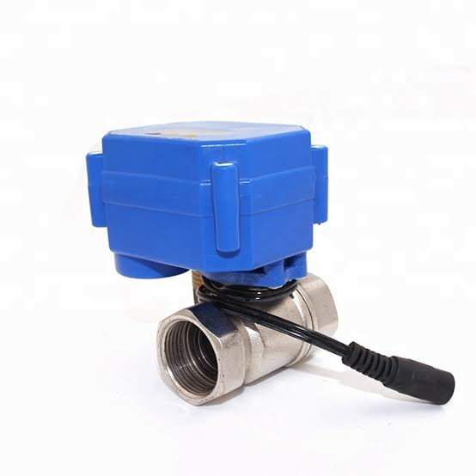
AI, ML & DL APPLICATIONS
AI is the replication of the functions of the human brain.
We can use programming languages such as python, java, etc.
to install complex code commands into the chip of the control
board.
We can use Deep Learning to make the machine perform complex calculations and send commands.
With these commands, the AI can act with the given set of codes.
We can use the Machine Learning to make the machine learn and rectify its mistakes.
The ML can be of various types, the most common one is the Camera method where the machine sends in camera clippings while it works and does not repeat its mistakes .
Coding Helpers
AI – Helpers

Slide 9
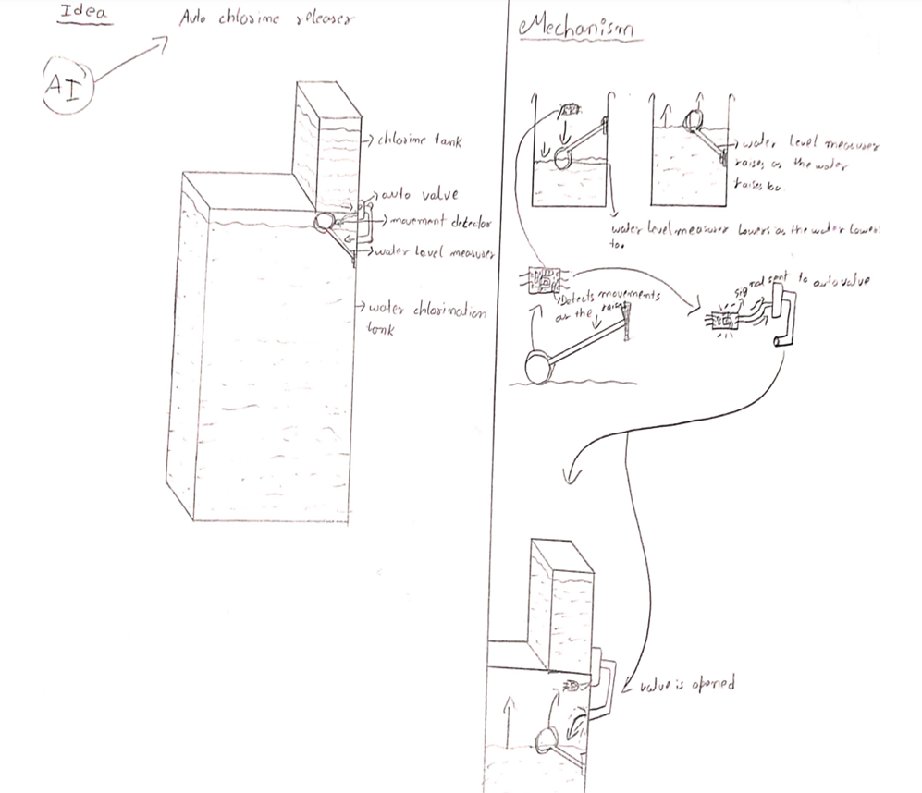
IDEA:
Mechanism – Auto chlorine releaser

Slide 10
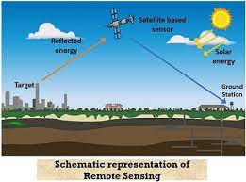
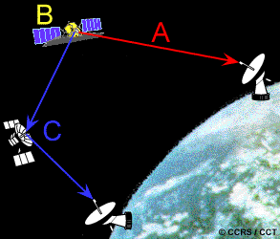
Remote Sensing Controls
Remote sensing is an easy method of redirecting data without any interference.
Easily command-able.
There are 2 ways by which it can work:
1} The natural radiation
2} Signal sending remote
Natural radiation, solar waves can be used to make the machine work in day or night.
Signal sending remote can be used to send signals to a satellite to redirect the info to the machine.
By this way, we can on or off the machine whenever we need.

Slide 11
ADVANTAGES
The whole water body can be cleaned in a span of 2 - 4 months.
Once adapted to the drainage system, it is an investment.

Slide 12
CONCLUSION
We are trading with water. Now it is considered as a commercial commodity.
Very little water is available as potable and freshwater these days which is getting polluted and contaminated rapidly by the conscious human minds.
We have taken water for granted.
So, from now itself, preventing wastage of water, cleaning water, preserving freshwater and maintaining them, and bringing the water bodies back to life is our sole responsibility and duty.
“SAVE WATER!!!”

Slide 13
Picture credits
ACKNOWLEDGEMENT
Parents
R and D Teachers
Principal
IISc
“ SAVE WATER ”
Reference: https://www.thomasnet.com
Internet

