Slide 1
Soil fertility and efficiency
Month
Presented by : HITHASHREE .H
AMEETHA .P
PREETHAM .MC
Vagdevi Vilas School, Nelamangala -562123
-
20XX
Presentation Tagline

Slide 2
Introduction
Soil is the essential thing for the basic survival of the normal human being.
Soil should be given attention and respect. After all soil is the thin skin of the earth where plant grow and feed more that 7 billion of us.
History proves with evidence that the soil is littered , ignored, exploited, and degraded .
One third of the world’s soil is already been damaged by water and wind erosion, nutrition depletion and pollution.
By our own actions we are losing soil faster than nature can create it.

Slide 3
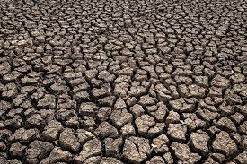
Objectives
We have chosen the area Tumakuru as it is an industrial area.
soil quality should be maintained in this vicinity.
Soil samples that is further proved the quality of soil on the verge.
It also gives a description about the rate of pollution of soil.
precautionary measures should be taken at the earlist to solve this basic problem.

Slide 4
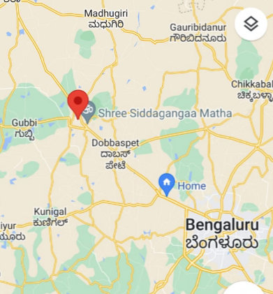
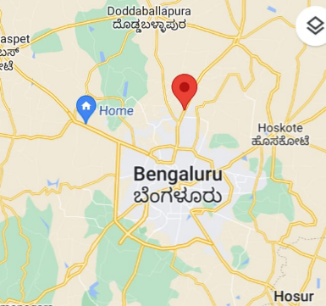
Study Area
TUMAKURU YELAHANKA

Slide 5
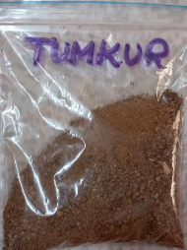
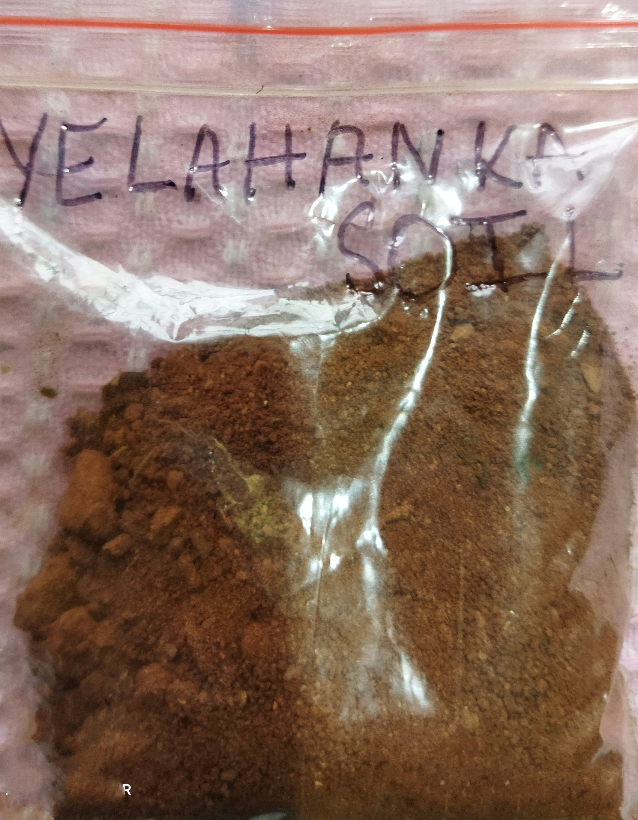
SOIL SAMPLES

Slide 6
QUALITY SOIL IN TUMAKURU DISTRICT
This district is generally an area covered with intensive thick forest with hills.
Major types of soil found here are red loamy soil, red sandy soil and mixed red and black soil.
Red soil has good water holding capacity but has poor lime and bases.
Rainfall distribution during the last few years is varied.
Some parts of Tumakuru also experiences mild desertification due to less rainfall and necessity of heavy agriculture to meet the rising population needs

Slide 7
SURVEY AREA --- TUMAKURU DISTRICT
SALIENT FEATURES
Agricultural land occupies about 56% followed by plantations 25% and open shrubs and forest land covers by 8 and 5 percent.
Nearly 72% area is affected by moderate erosion and by poor management of soil.
According to the latest survey of the place from which soil is taken, the land was actually a cultivable land and agriculture was done a few years back.
But due to the upcoming urbanization the land was sent for construction and now is a barren soil.
The land receives rainfall frequently and once in 3 days in rainy season.

Slide 8
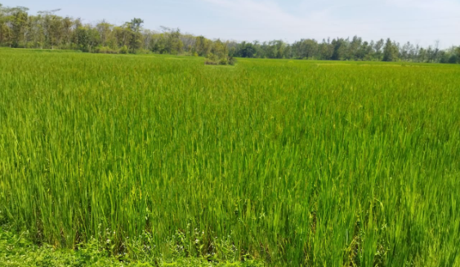
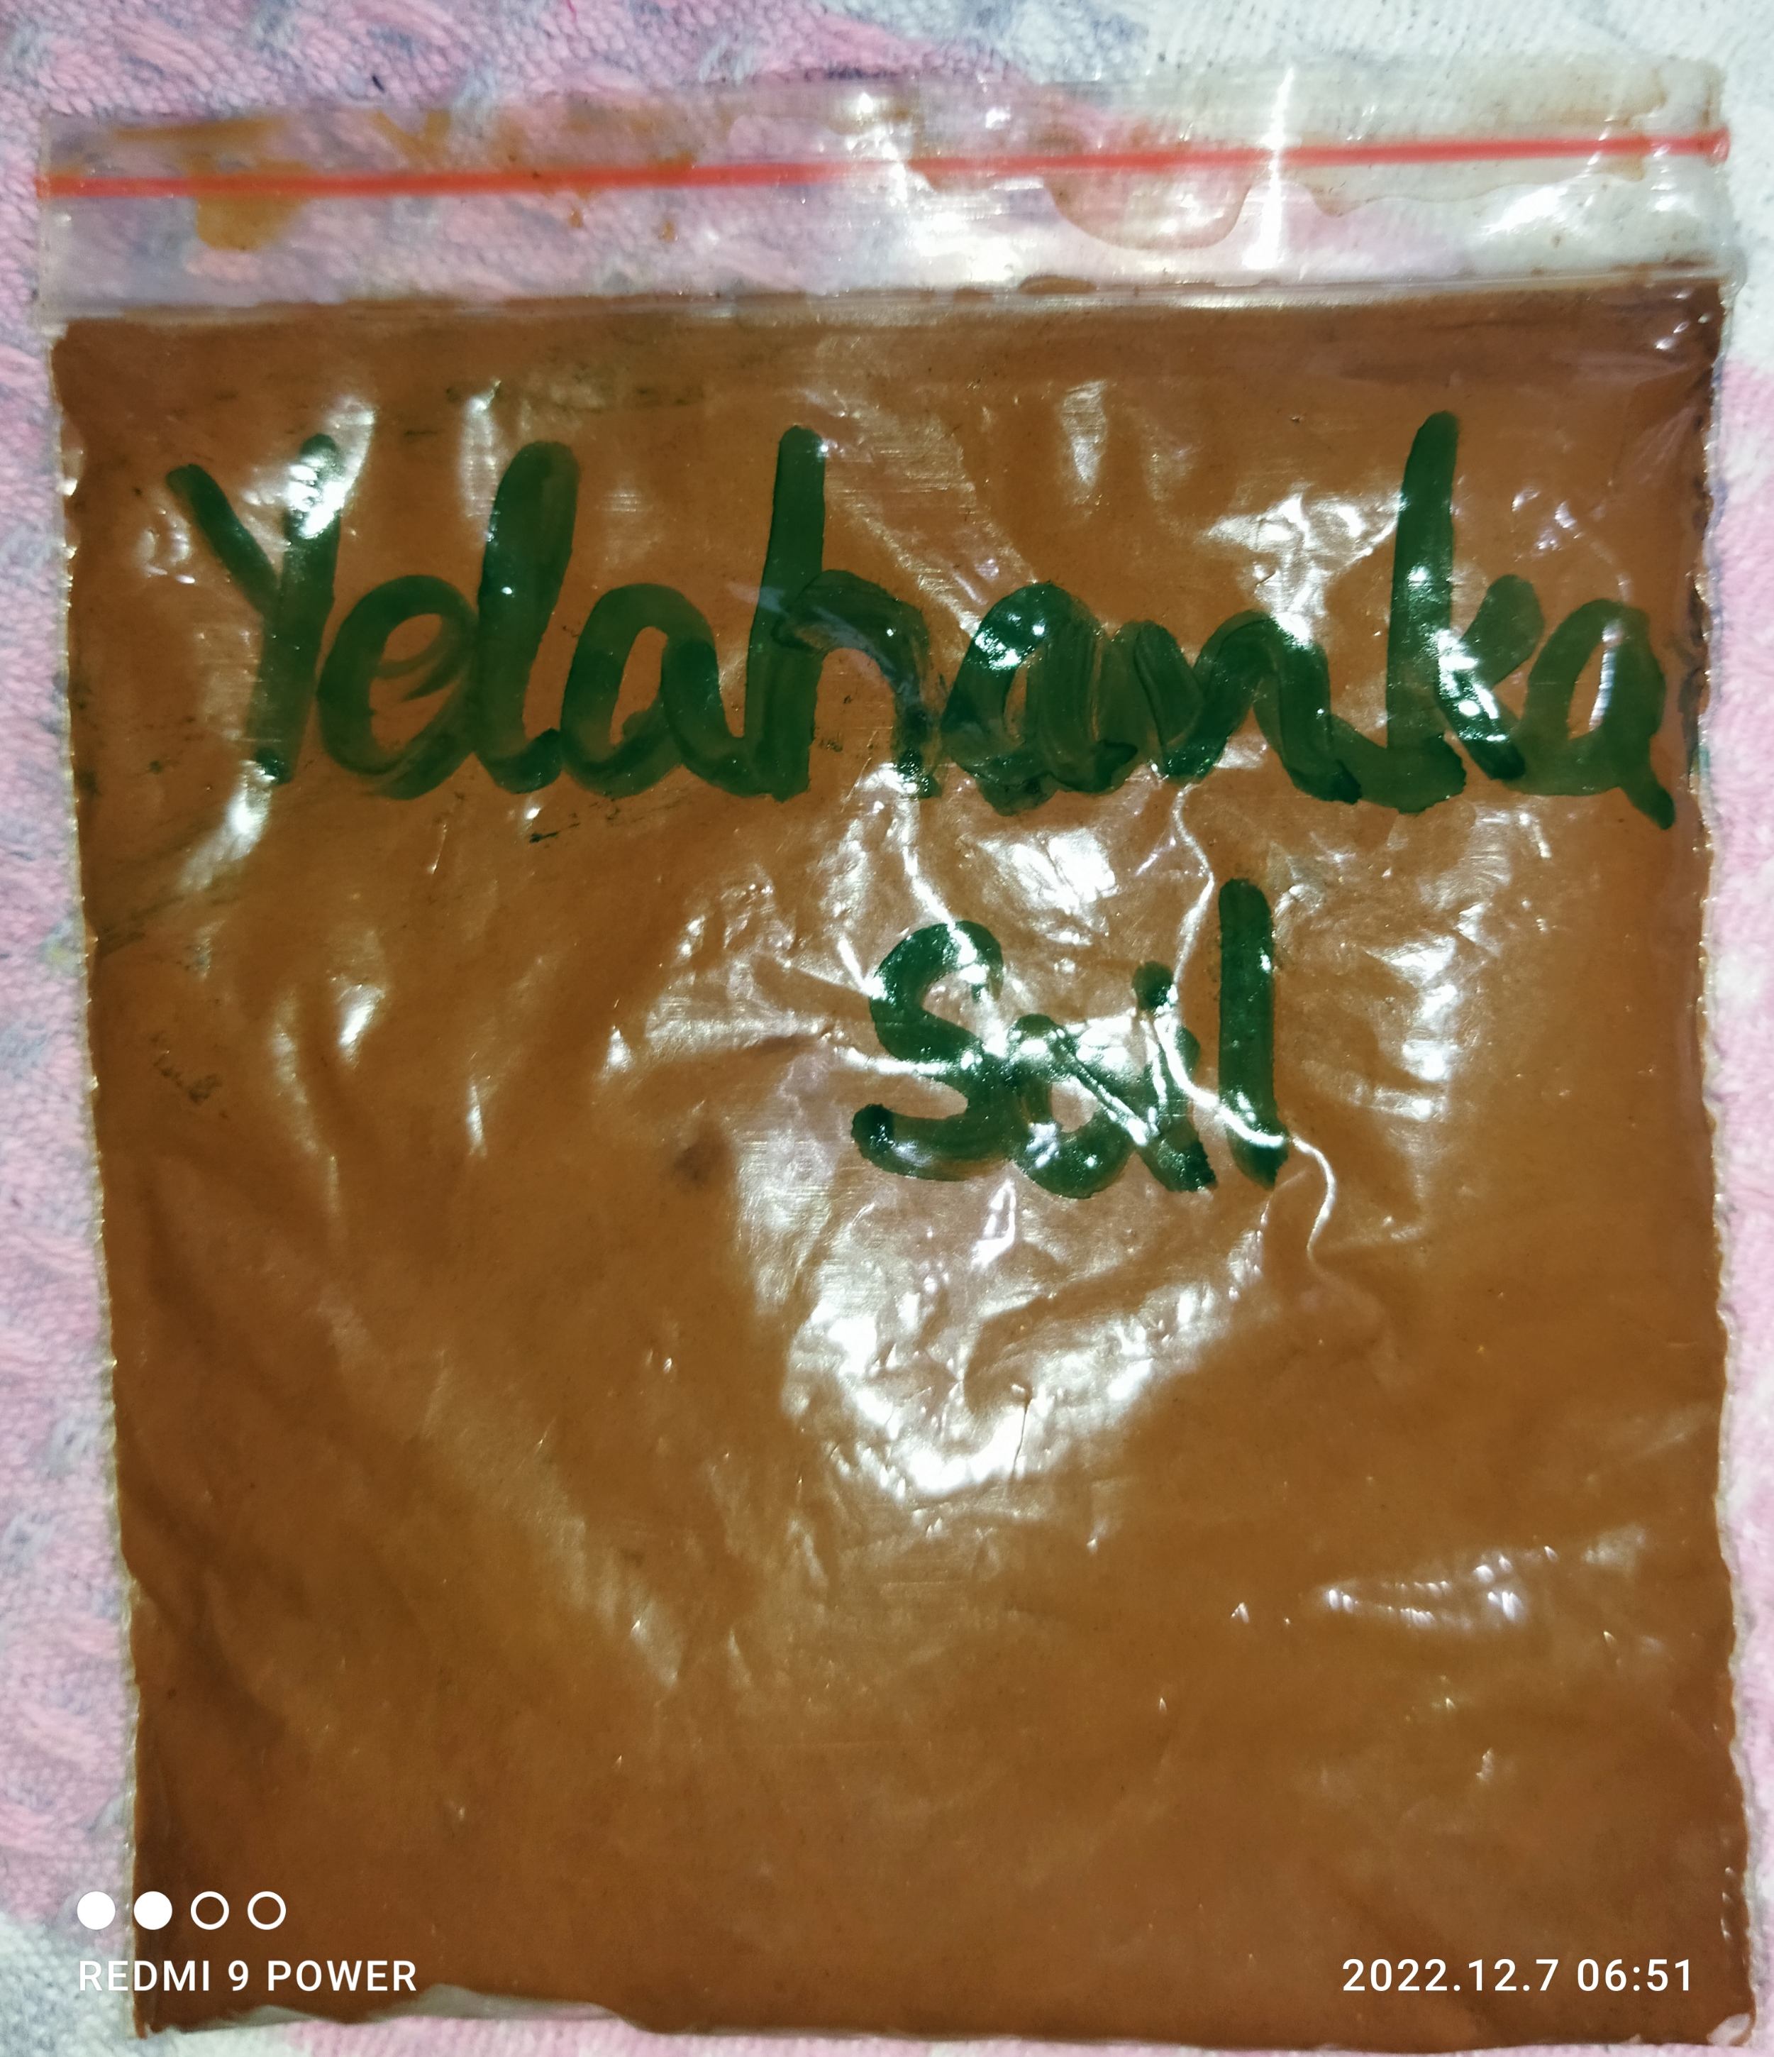
QUALITY OF SOIL FOUND IN YELAHANKA
The soil present in this area was suitable for growing paddy, rice and ragi.
These were cultivated at small scale and irrigation was done with numerous lakes in that area.
Alas, now agriculture is not found due to urbanization of place. But still some people practice agriculture
Agricultural field found

Slide 9
SURVEY AREA : YELHANKA
Climatic conditions
The summer season lasts from March to mid-day with temperature raising from 23 to 38 degree celcius.
The monsoon season starts from June and lasts till the end of October.
Winters are mild and last from November to February.

Slide 10
METHOD AND MATERIALS
pH level of the soil
Percolation rate of soil
Moisture content in the soil
Microscopic view of substances in the soil

Slide 11
pH LEVEL COMPARISON
Soil pH is a measure of the acidity or alkalinity of the soil
Soil can be classified according to their pH value:
6.5 to 7.5 --- neutral
Over 7.5 --- alkaline
less than 6.5 --- acidic
less than 5.5 are considered strongly acidic

Slide 12
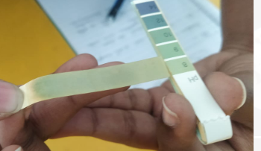
pH level of Tumakuru soil is 8.5 and it is alkaline
The soil is being tested by using the litmus paper and later dipped into the mixture of the soil
The soil is alkaline
Alkaline soils may have problems with deficiency of nutrients such as zinc, copper, manganese.
The main cause of change of pH is due to increase use of fertilizers for nutrients.

Slide 13
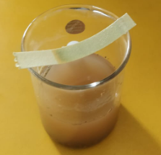
The pH level of the soil of Yelahanka is 6.5 and it is the poor alkaline soil
This area soil is usually reddish brown and is from cultivable agricultural area..

Slide 14
Percolation rate
Percolation is the process by which water moves downward through the soil by gravitational forces.
Percolation rate of Tumakuru soil
Method : 200ml of water was poured into the soil and the time was measured.
Observation : 200ml water took 2 mins 26 sec to seep through the soil.
Percolation rate : 88.49 metre per second

Slide 15
Percolation rate of Yelahanka’s soil
Method : 200ml of water was taken and the time was measured.
Observation : 200ml of water took 3 mins and 44 sec to seep through this soil
Percolation rate: 145.34 metre per second
Reason : As Yelahanka’s soil is a red soil, the water takes time to percolate down because of its moisture holding capacity.

Slide 16
Moisture content in the soil
Method : This was calculated by weighing the wet soil sampled from the field, drying it in the oven and later weighing the dry soil.
Observation of sample 1
Then the Tumakuru soil [250g] was tested for moisture content. It was wet and was later kept in oven .
After checking the lose of moisture content in soil, 25g weight was reduced.

Slide 17
Observation of sample 2
First 250 g of Yelahanka soil was taken and for the moisture test it was kept in oven.
After few minutes the soil was taken out and again it was weighed and 50 g of weight was reduced.
Conclusion: Yelahanka soil contain more moisture compared to Tumakuru soil so agriculture can be easily done in Yelahanka soil.

Slide 18
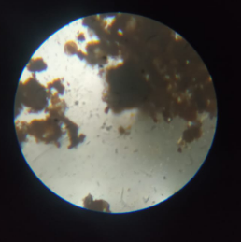
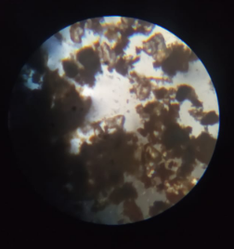
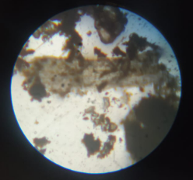
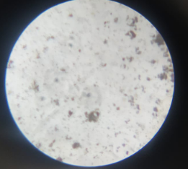
Microscopic view
Nelamangala soil Tumakuru soil Tumakuru soil Yelahanka soil

Slide 19
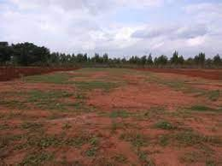
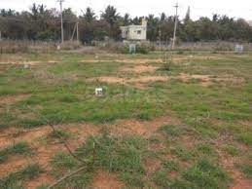
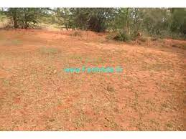
Conservation of soil [Tumakuru]
The process of conservation of soil may include :
Crop rotation
Contour cropping
increase the use of organic manure
Do not release industrial chemicals to the soil
Do not throw non degradable waste into soil in tumakuru

Slide 20
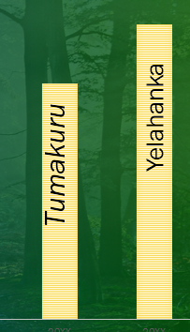
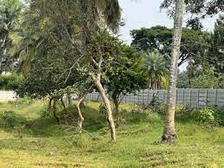
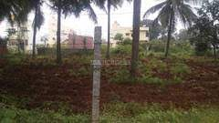
Best soil that can be used for agriculture
pH of Tumakuru soil is 8.5
pH of Yelahanka soil is 6.5
yelahanka
Live lands of yelahanka

Slide 21
CONCLUSION
Therefore Tumakuru’s soil is not perfectly fit for agriculture as it is alkaline in nature but the Yelahanka soil is neither basic nor acidic it is neutral so agriculture can be done here.
Neutral pH soil provides best conditions for microbial action that makes nitrogen, sulfur and phosphorous available for soil.
PROGRESS IS IMPOSSIBLE WITHOUT CHANGE, AND THOSE WHO CANNOT CHANGE THEIR MINDS CANNOT DO ANYTHING

Slide 22
Reference
The references are taken from the books available in school library as well as the live captions and experiments done.

Slide 23
ACKNOWLEDGEMENT
I would convey my heartfelt gratitude to our chairman sir for giving us this opportunity to work on soil.
I would thank our principal sir and R and D teachers for guiding us.
The completion of this project would not be possible without the help of my teachers and their guidance, so I would like to thank them all.

Slide 24
THANK YOU!
Phone
678-555-0143
martensson@example.com

