Slide 1
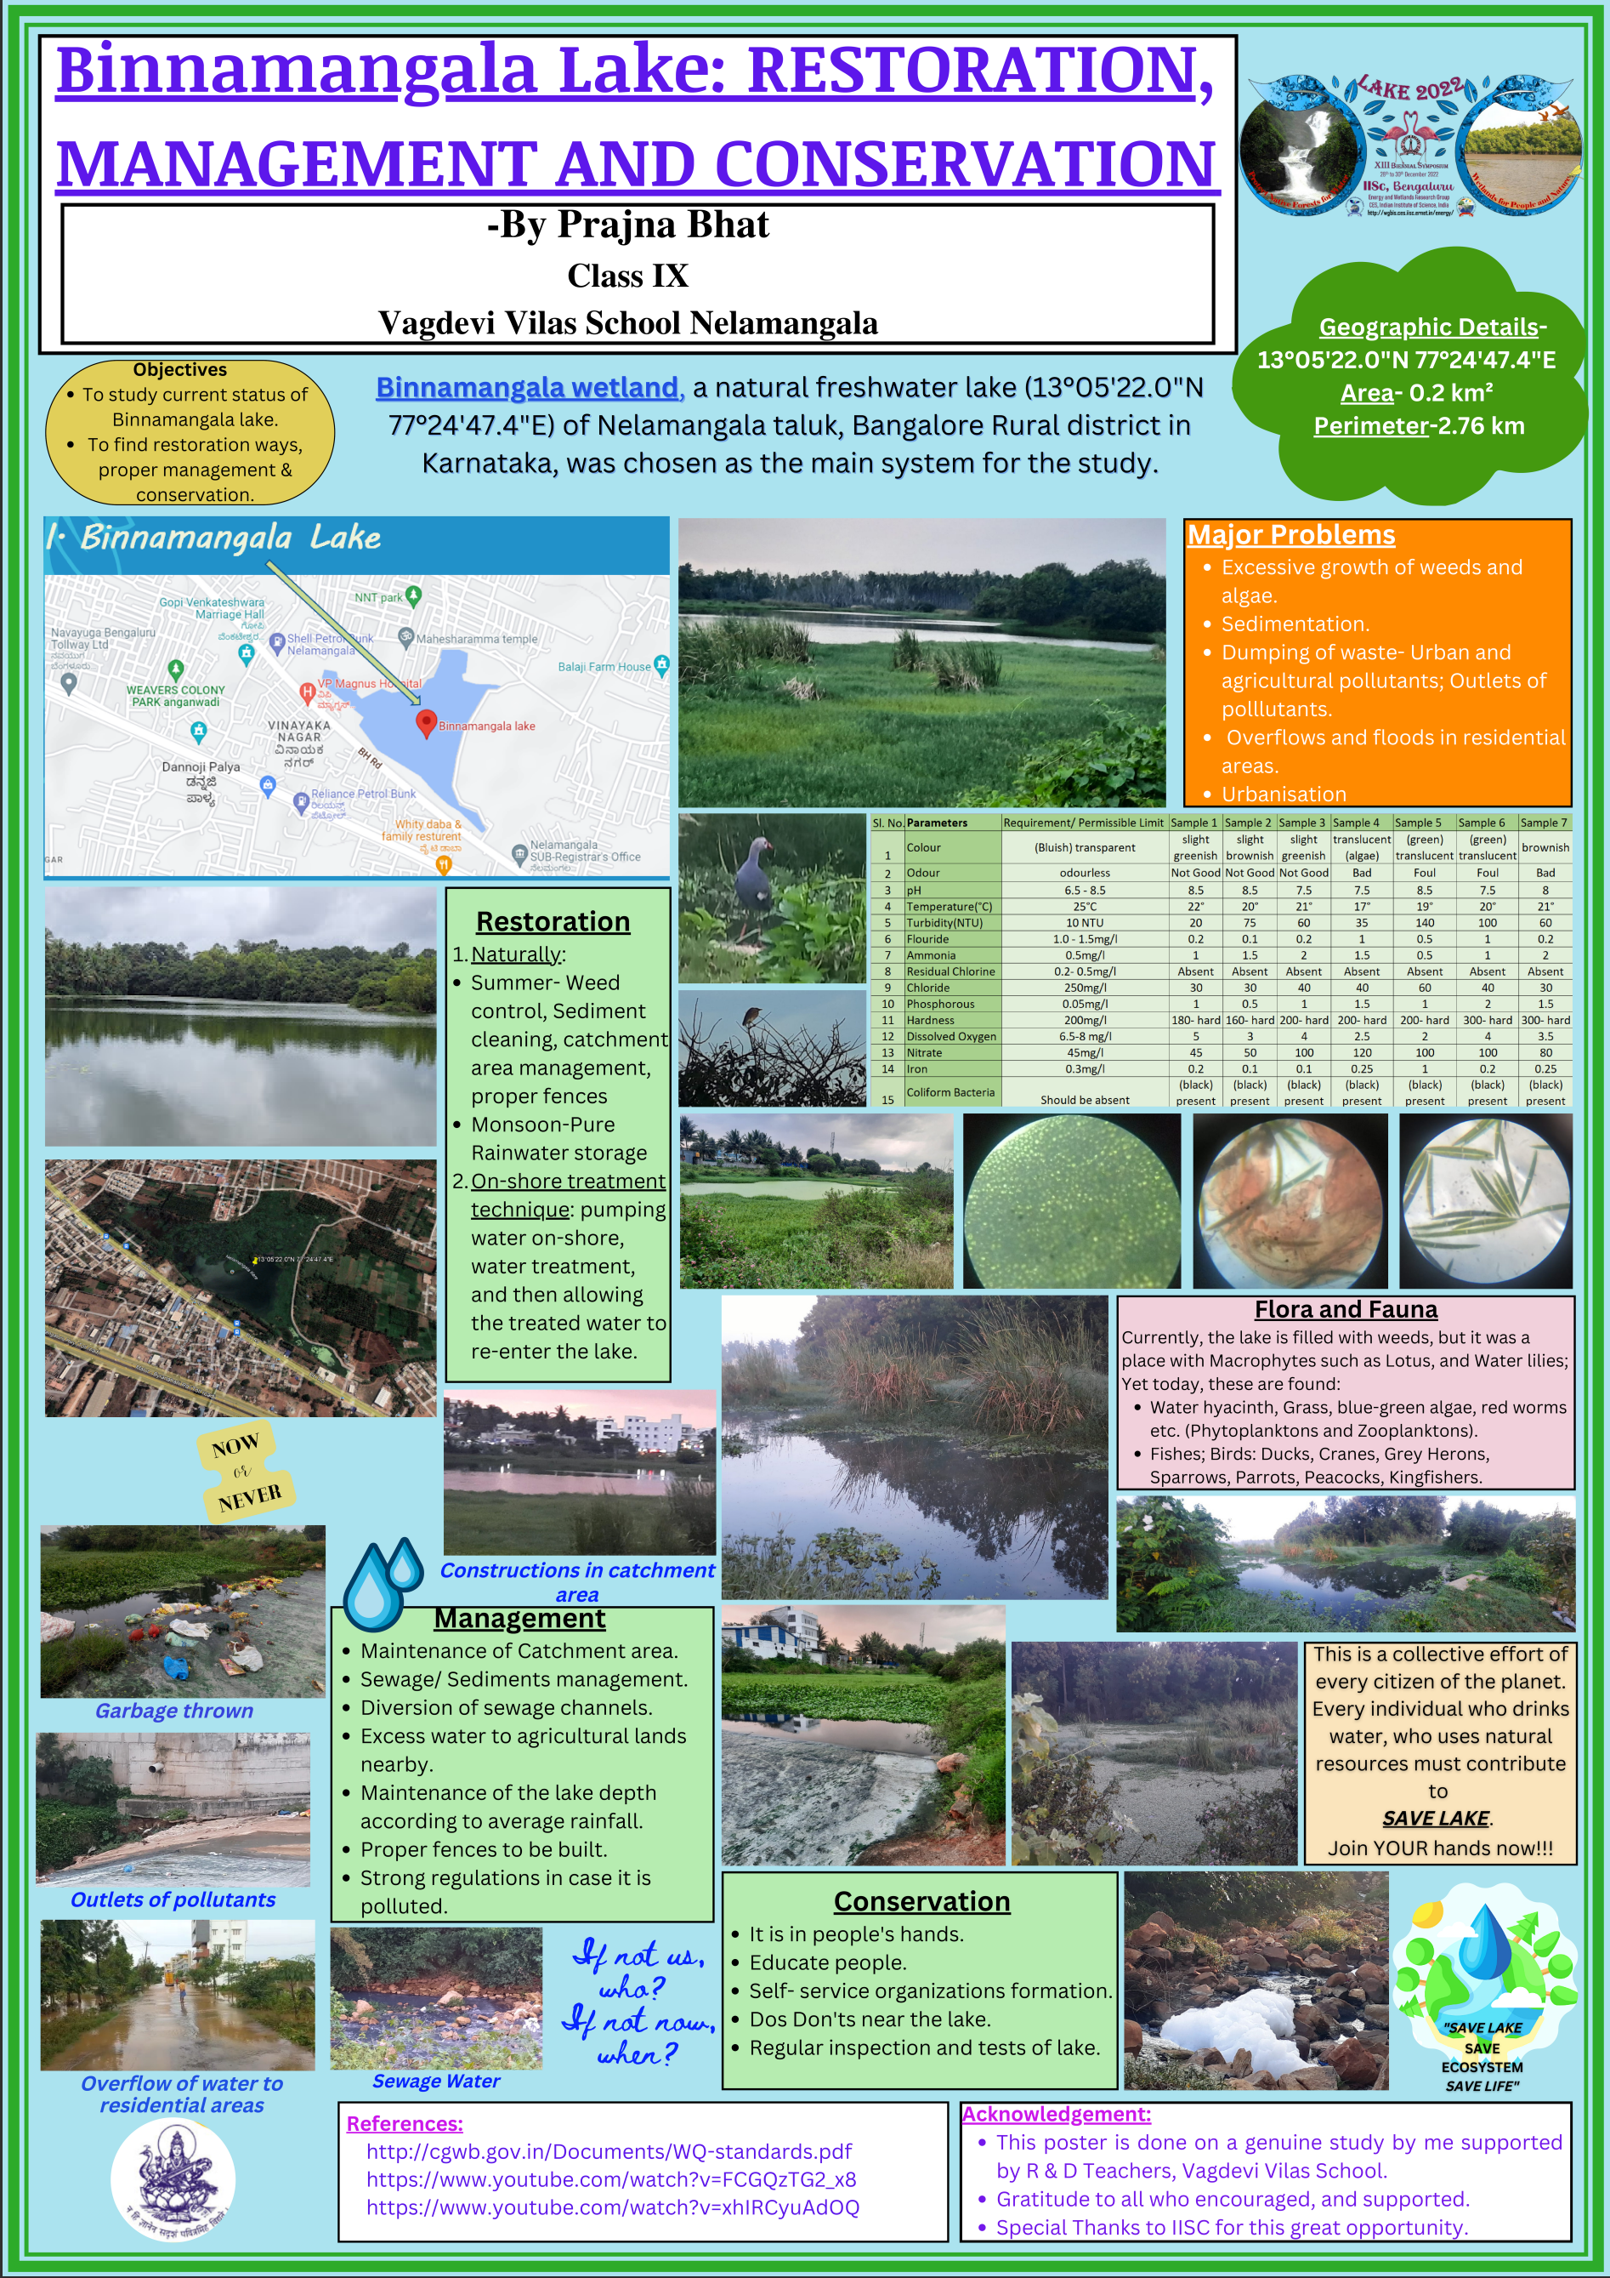
Link to poster:
https://drive.google.com/file/d/1AywoQS0LiJCpIzjwVYx8y6J86yx-w4dL/view?usp=share_link
ecosystem-based adaptation of climate change, December 28-30, 2022

Slide 2
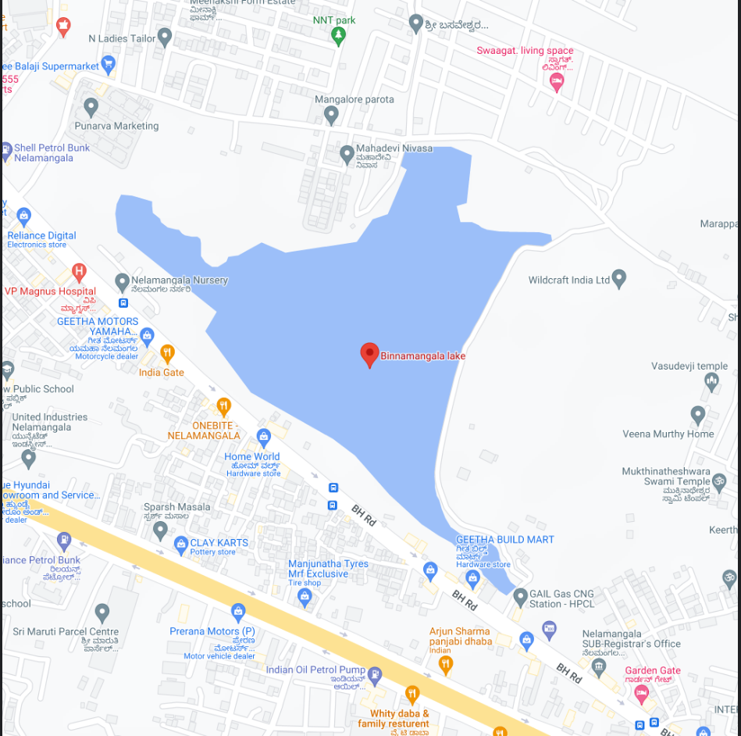
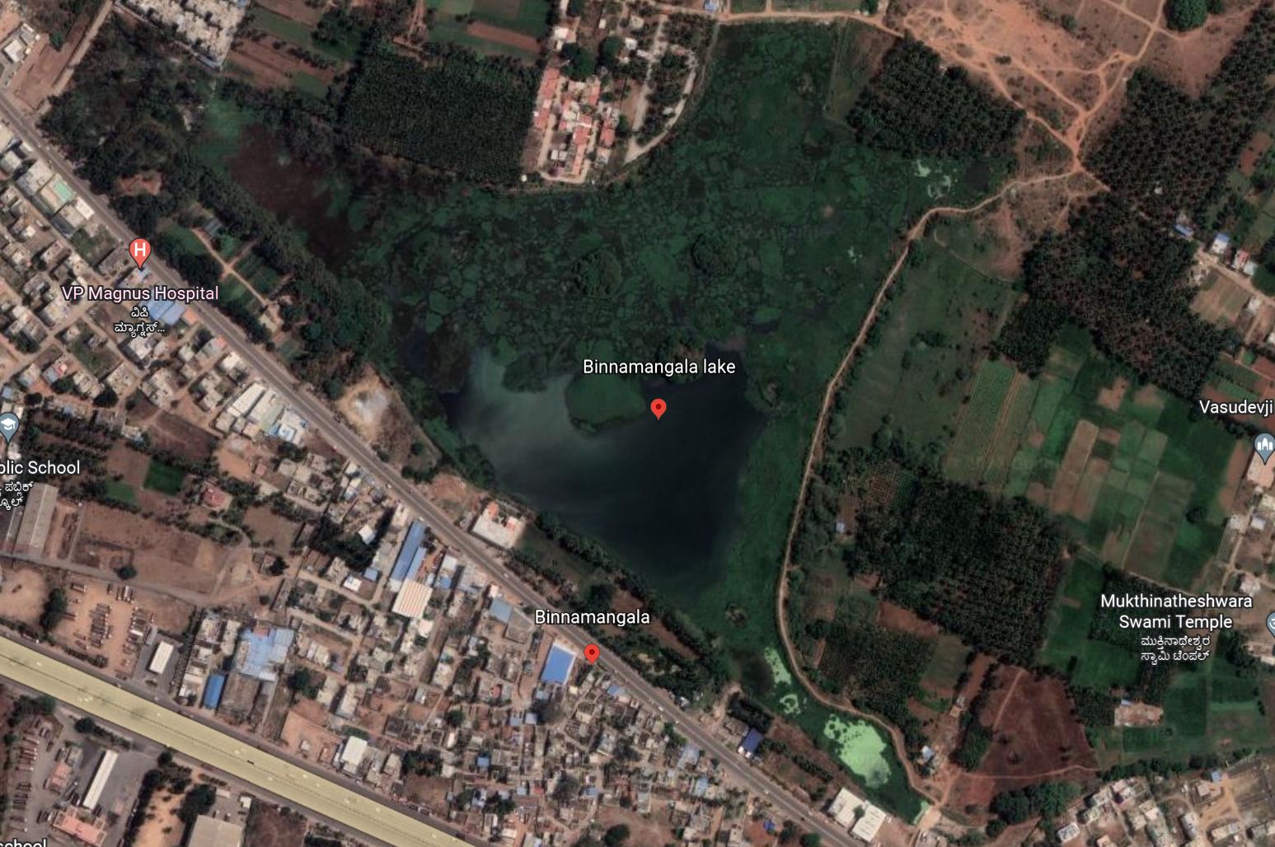
Introduction
Study Area: Binnamangala Lake
Aerial view
Satellite View
Latitude: 13°05'22.0"N Longitude: 77°24'47.4"E
Perimeter: 2.76 km
Area: 0.2 km²/ 48.39 ac/19.58 ha
Objective:
To study current status of Binnamangala lake.
To find restoration ways, proper management and conservation

Slide 3
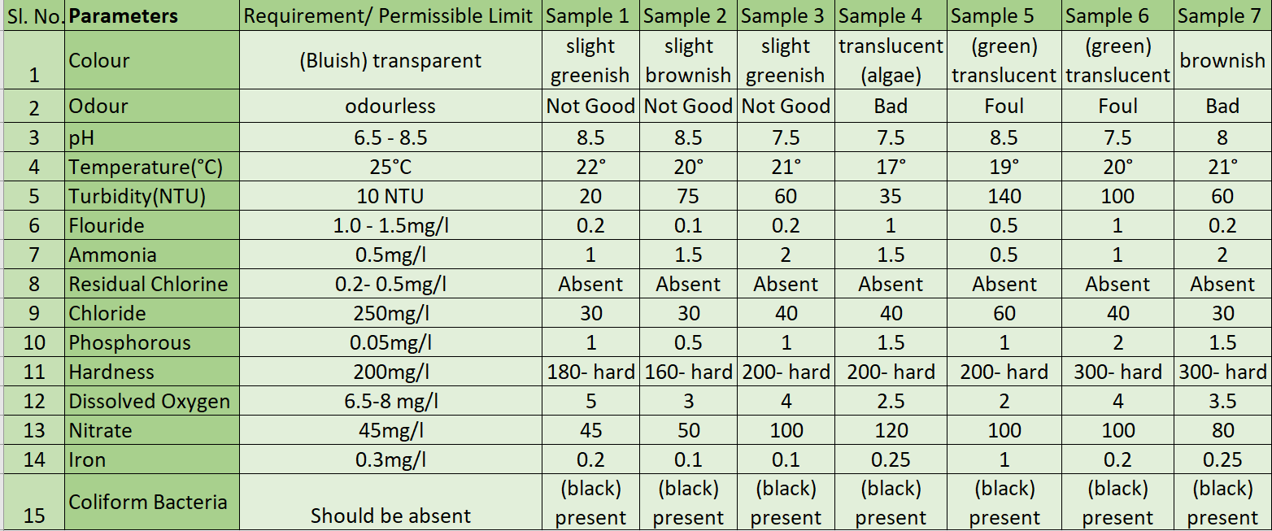
Current Status

Slide 4
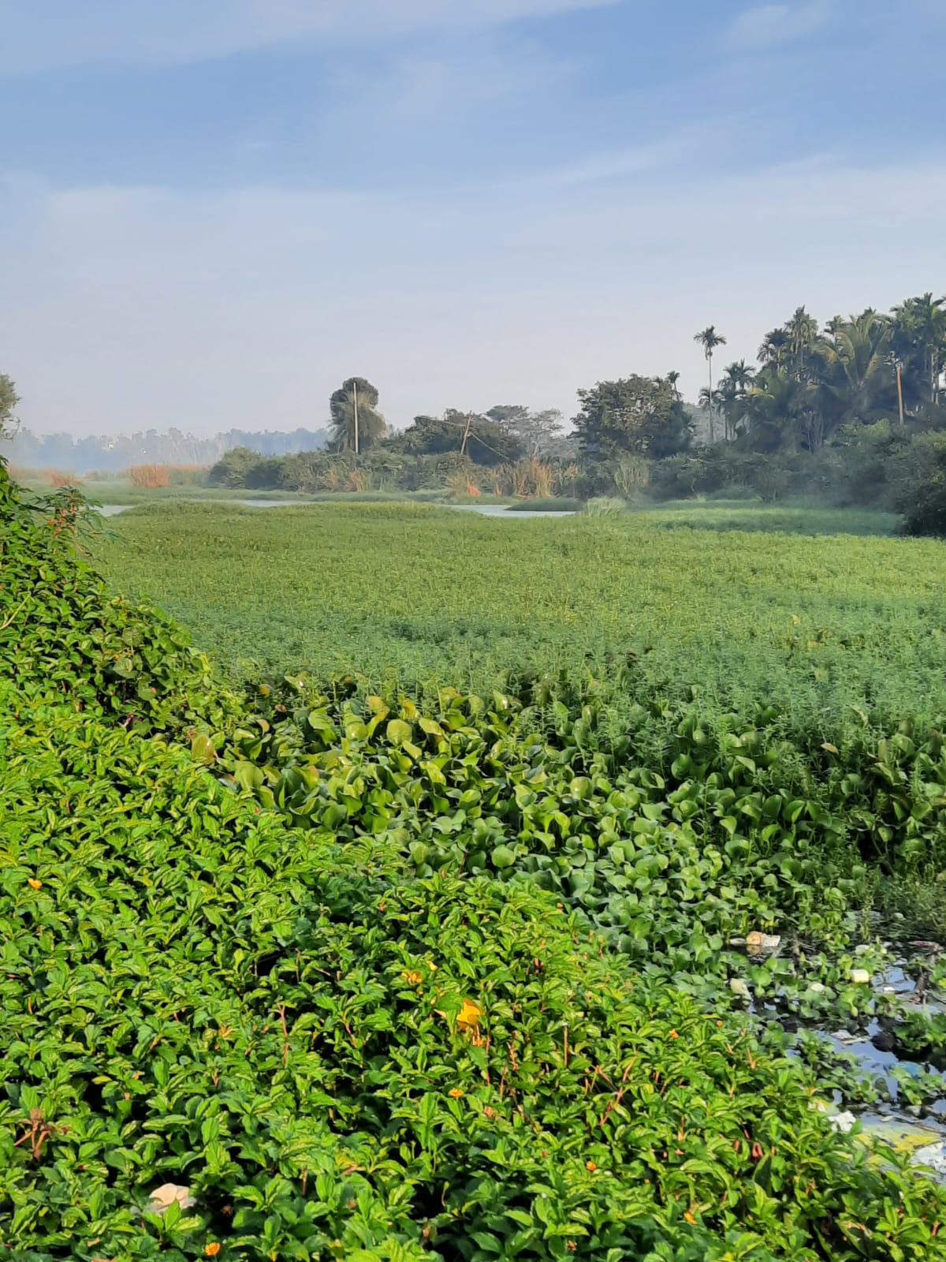
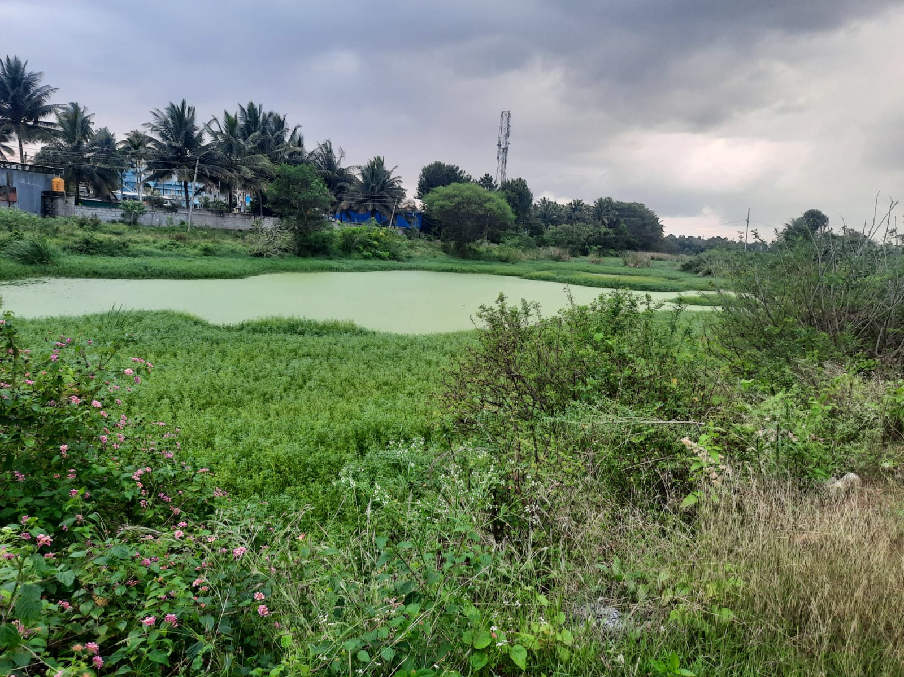
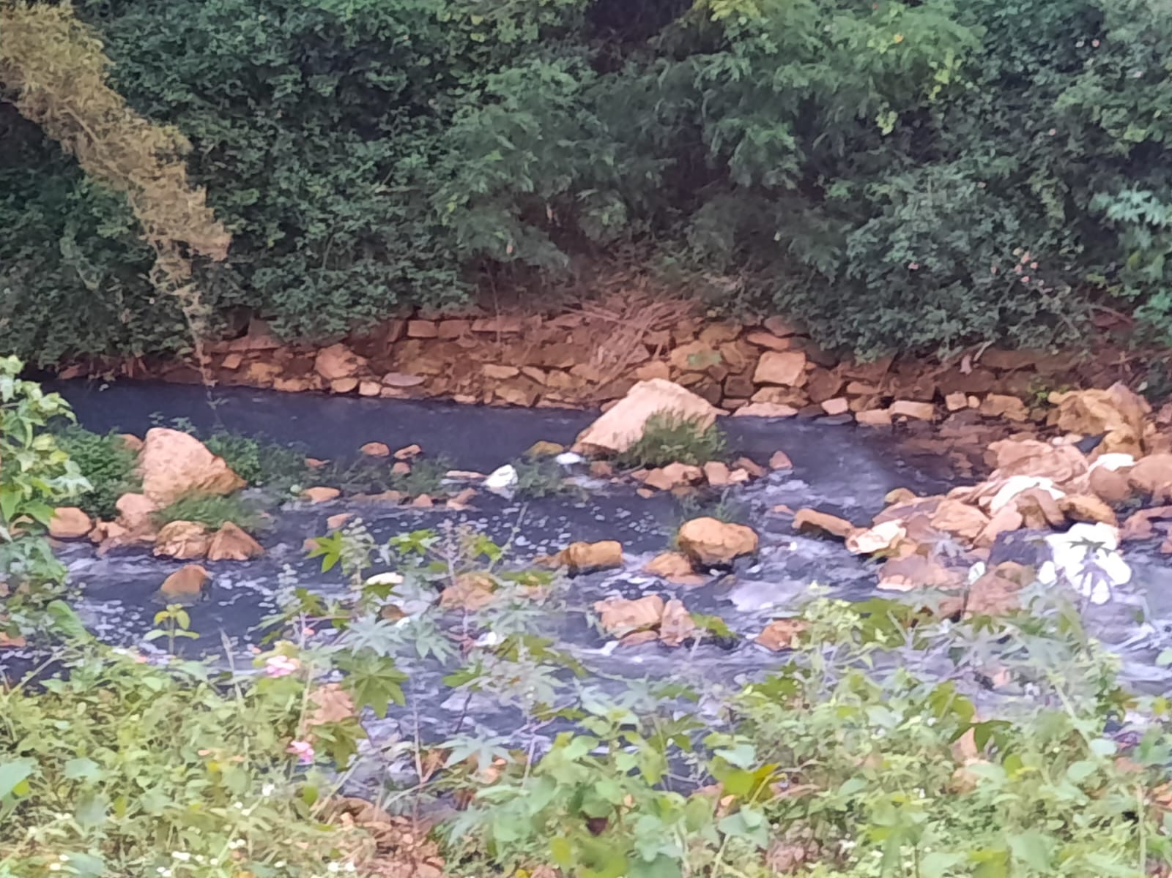
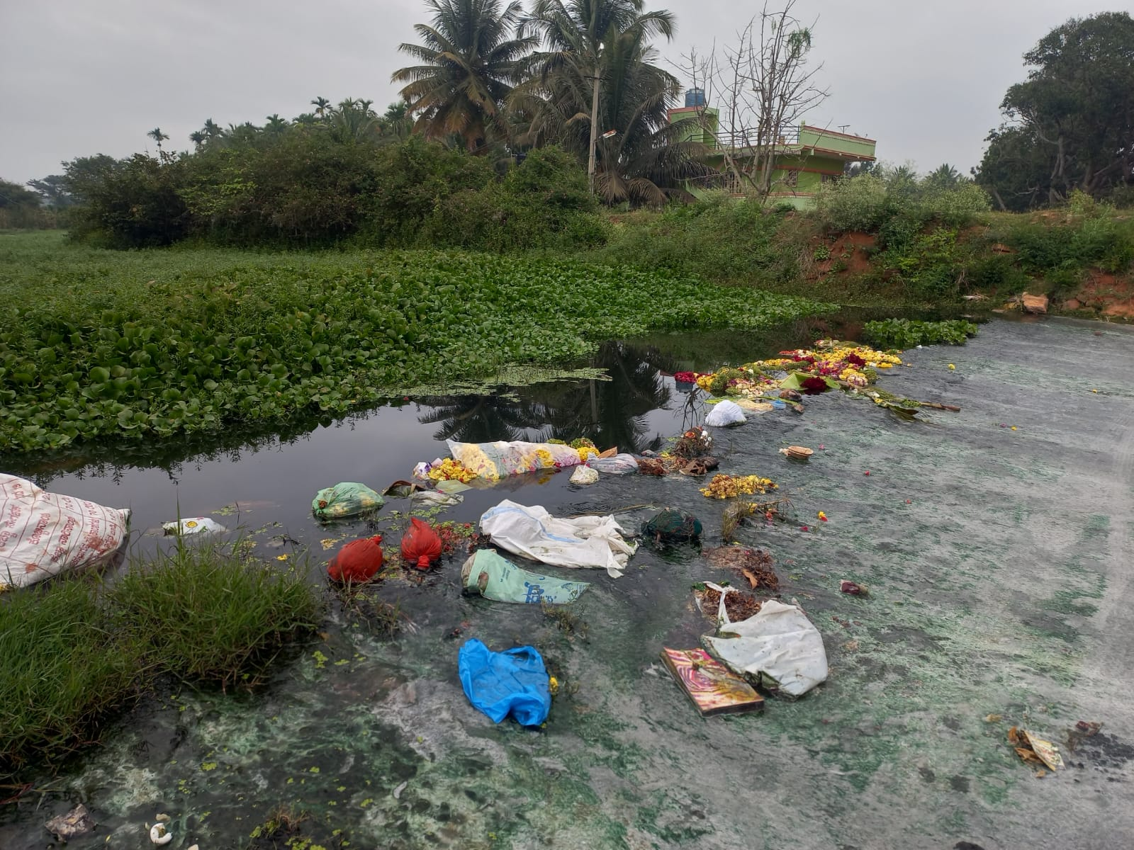
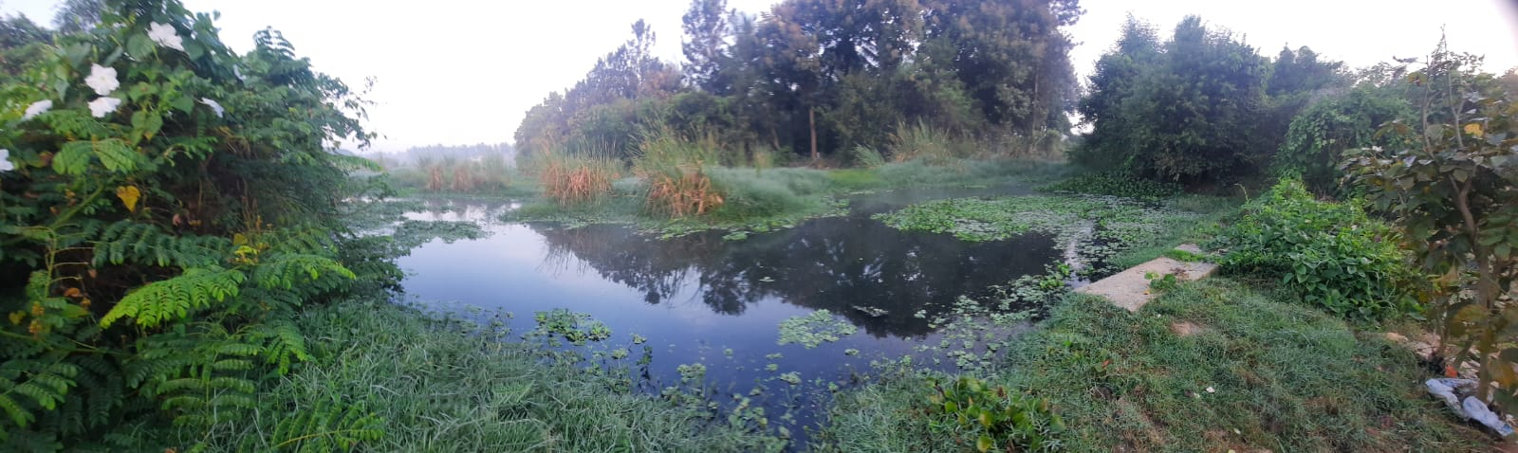
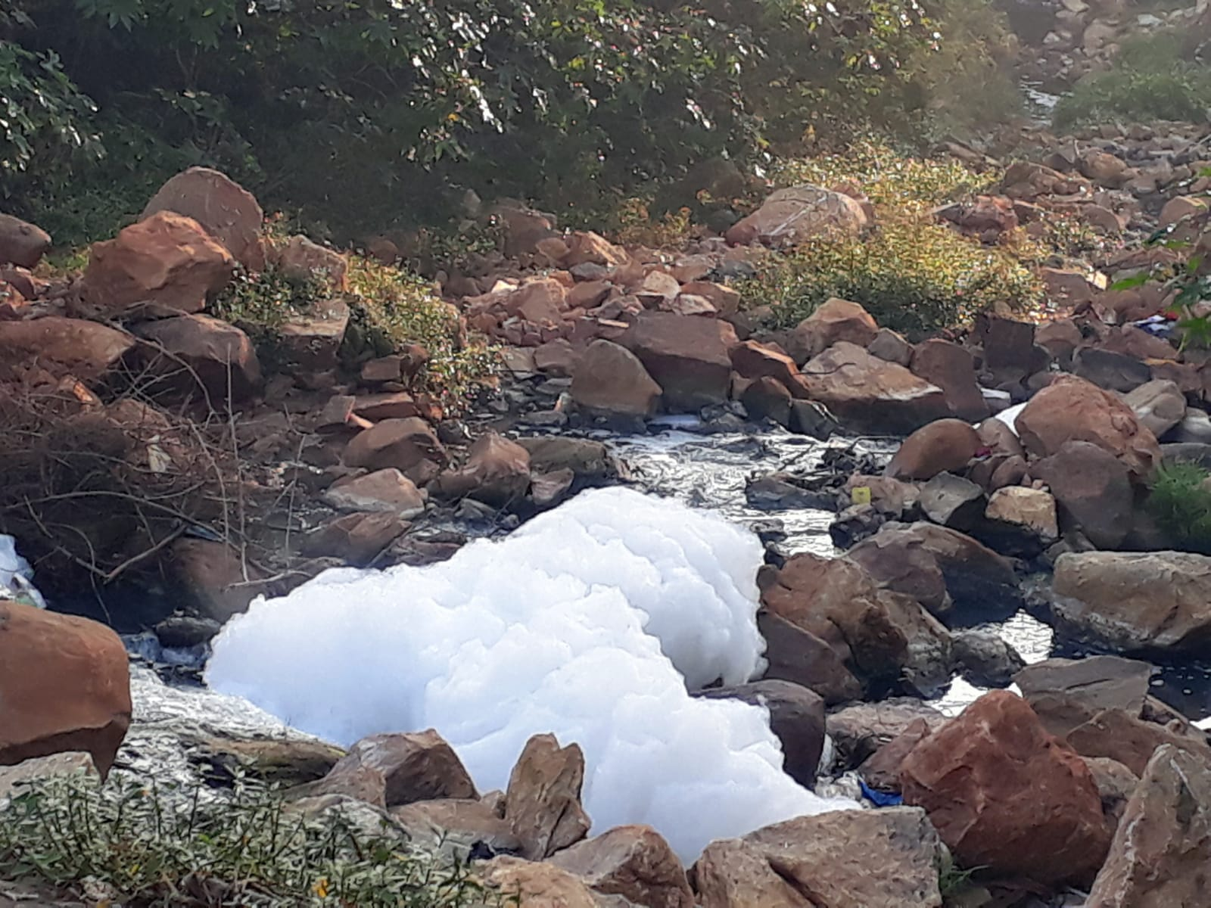
Major Problems

Slide 5
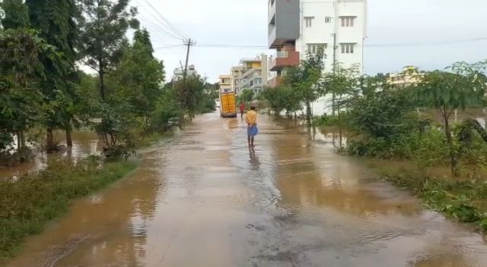
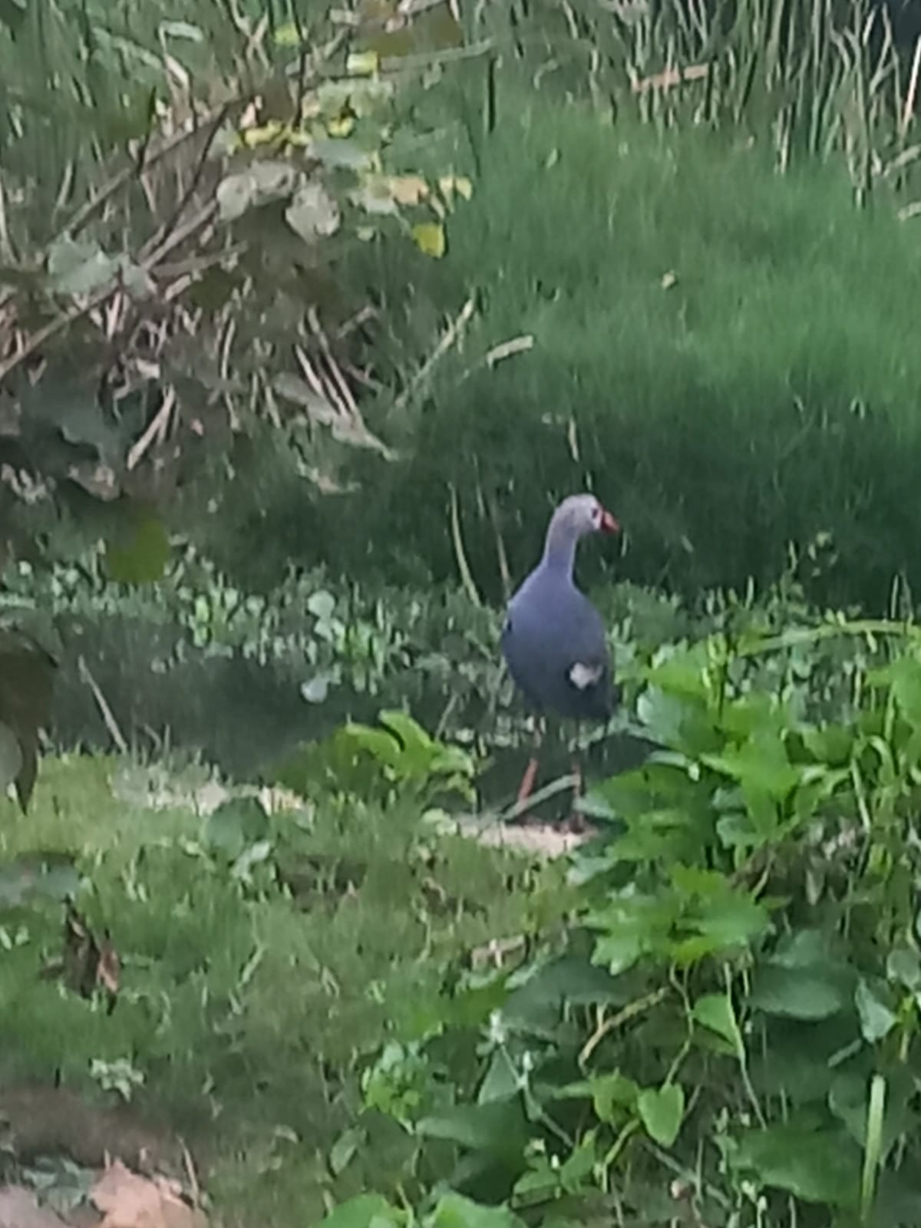
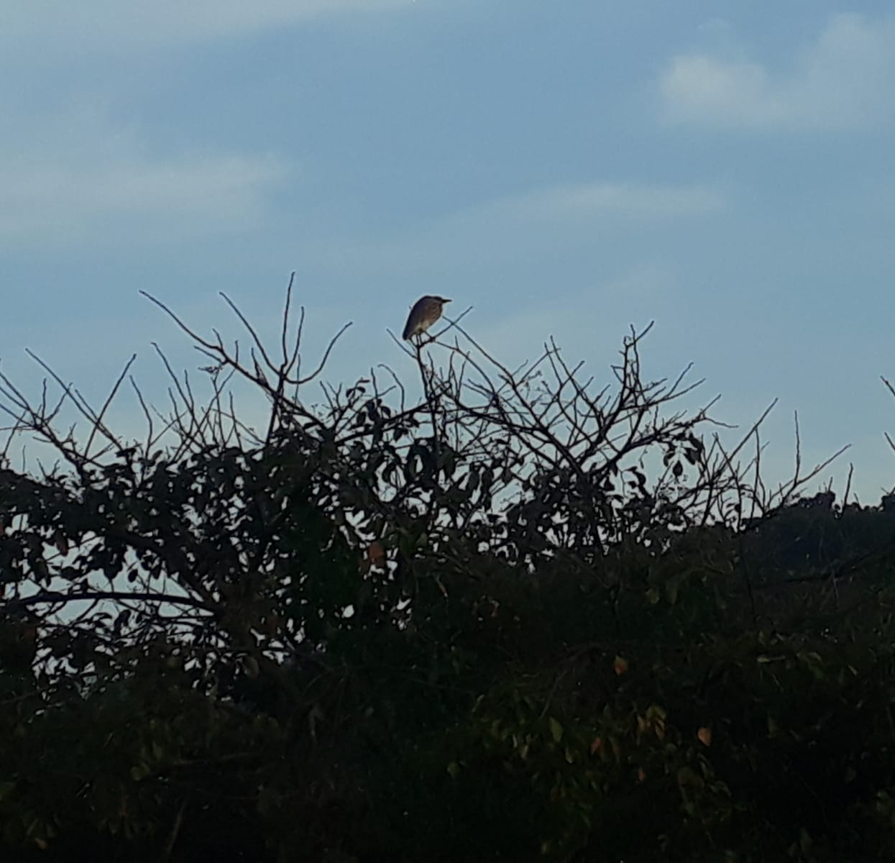
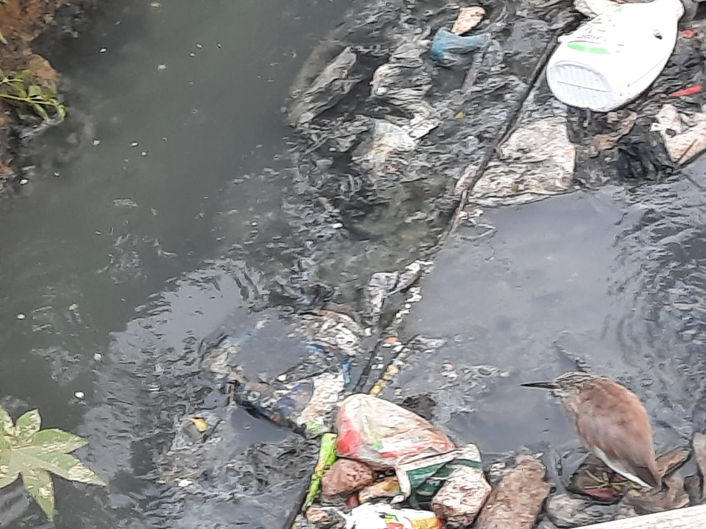
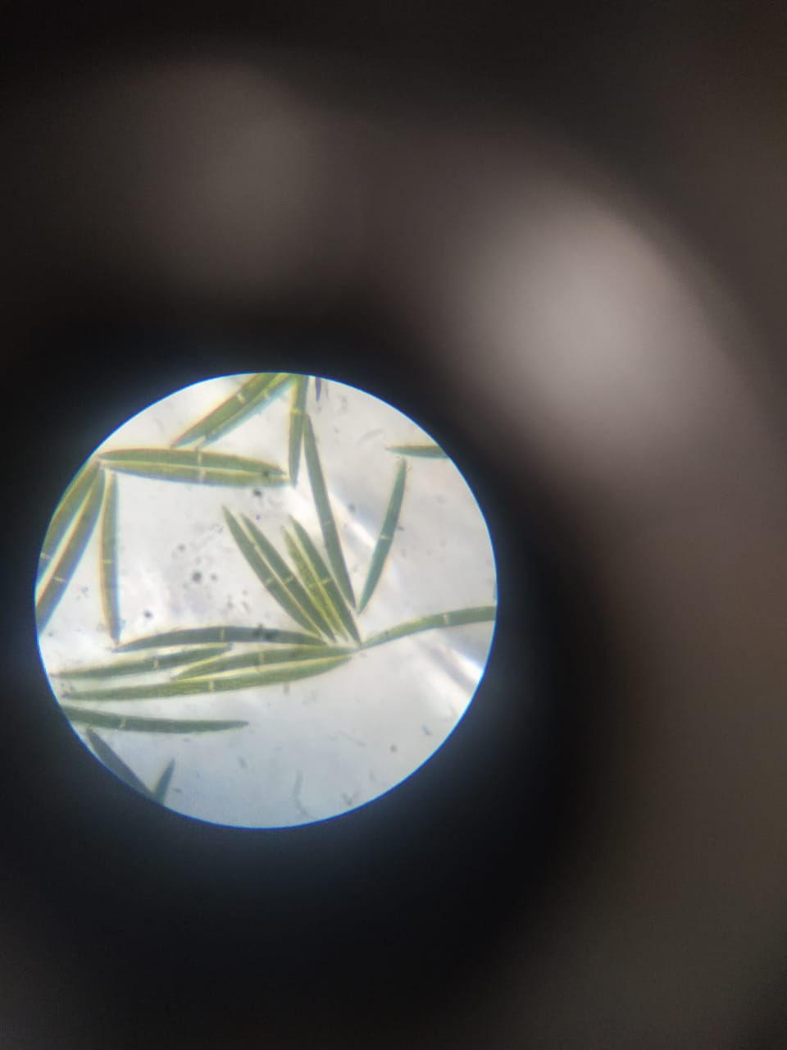
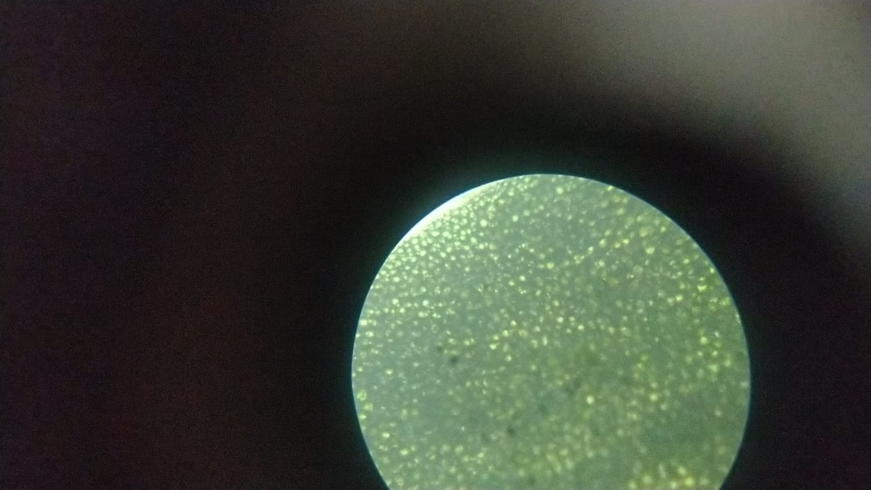
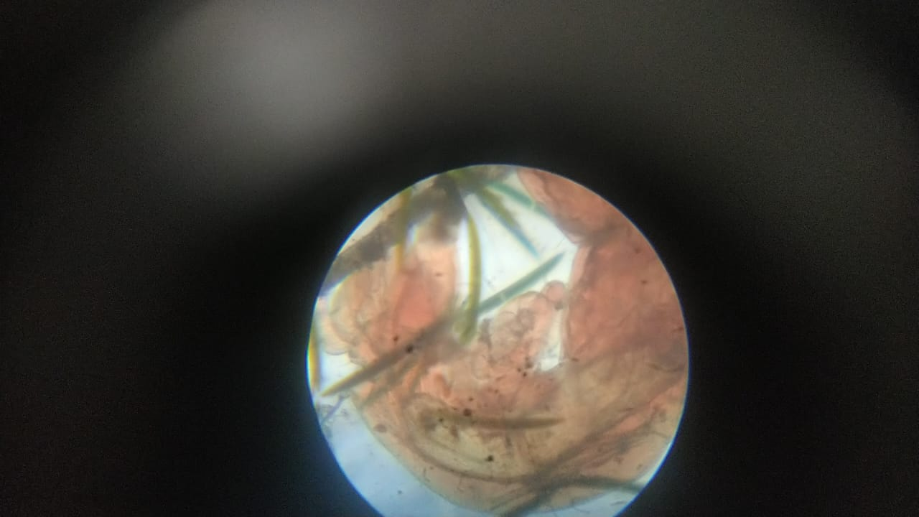
Indian blue moorhen
(Porphyrio poliocephalus)
Indian Pond-Heron (Ardeola grayii)
Closterium
Green algae
Red worm

Slide 6
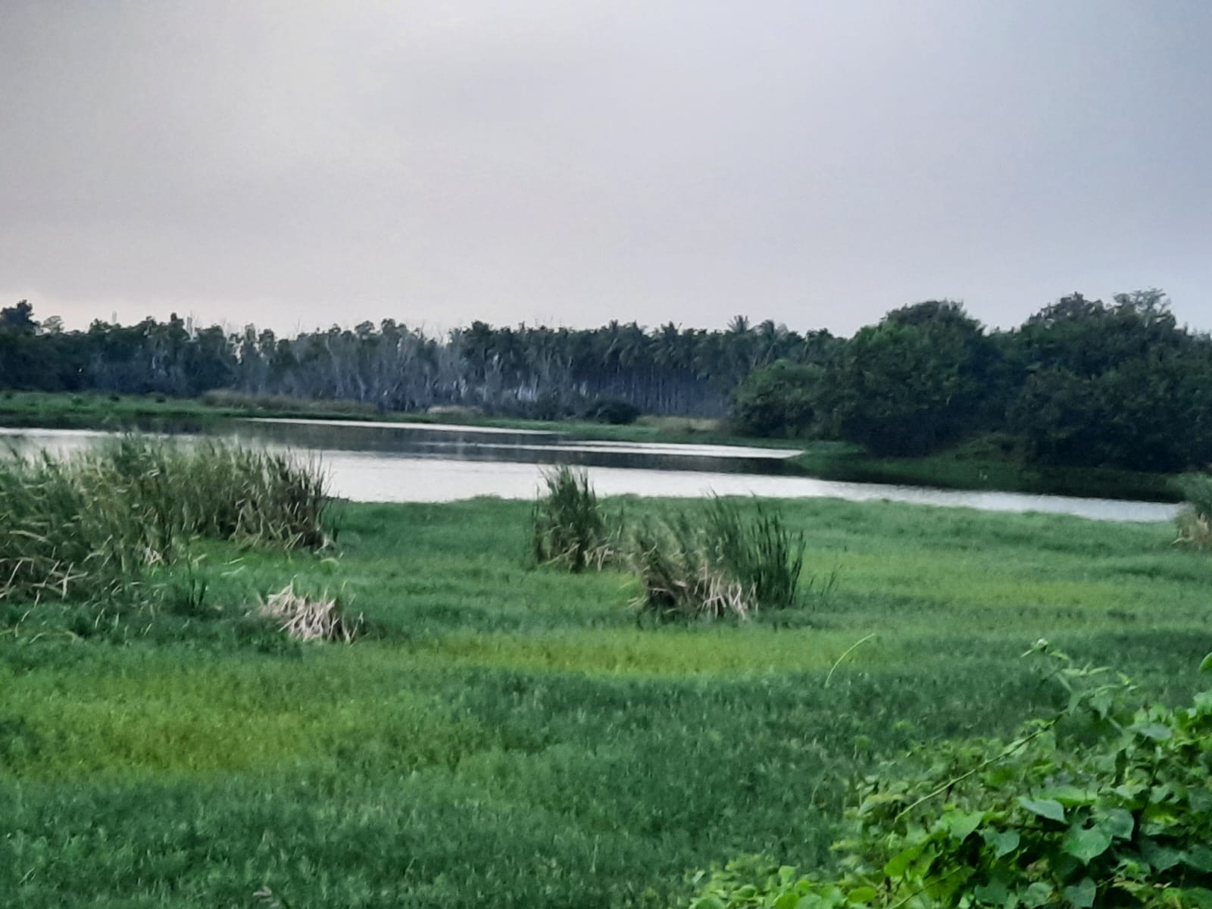
RESTORATION
1. NATURALLY:
Summer:
Weed control
Sediment cleaning
Lake depth
Catchment area management
Fences
Monsoon:
Rain water storage
2. ONSHORE TREATMENT:
Weed control
Pump the water on-shore
Treat the water
Sediment cleaning, Lake depth, Catchment area management, Fences.
Allow treated water to re-enter

Slide 7
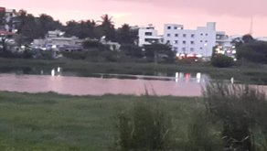
MANAGEMENT
Strong regulations
Regular catchment area management: No human activities, plant trees
Divert and well-build the sewage outlets
Channelize the overflowing water to agricultural lands
Proper fences to avoid erosion

Slide 8
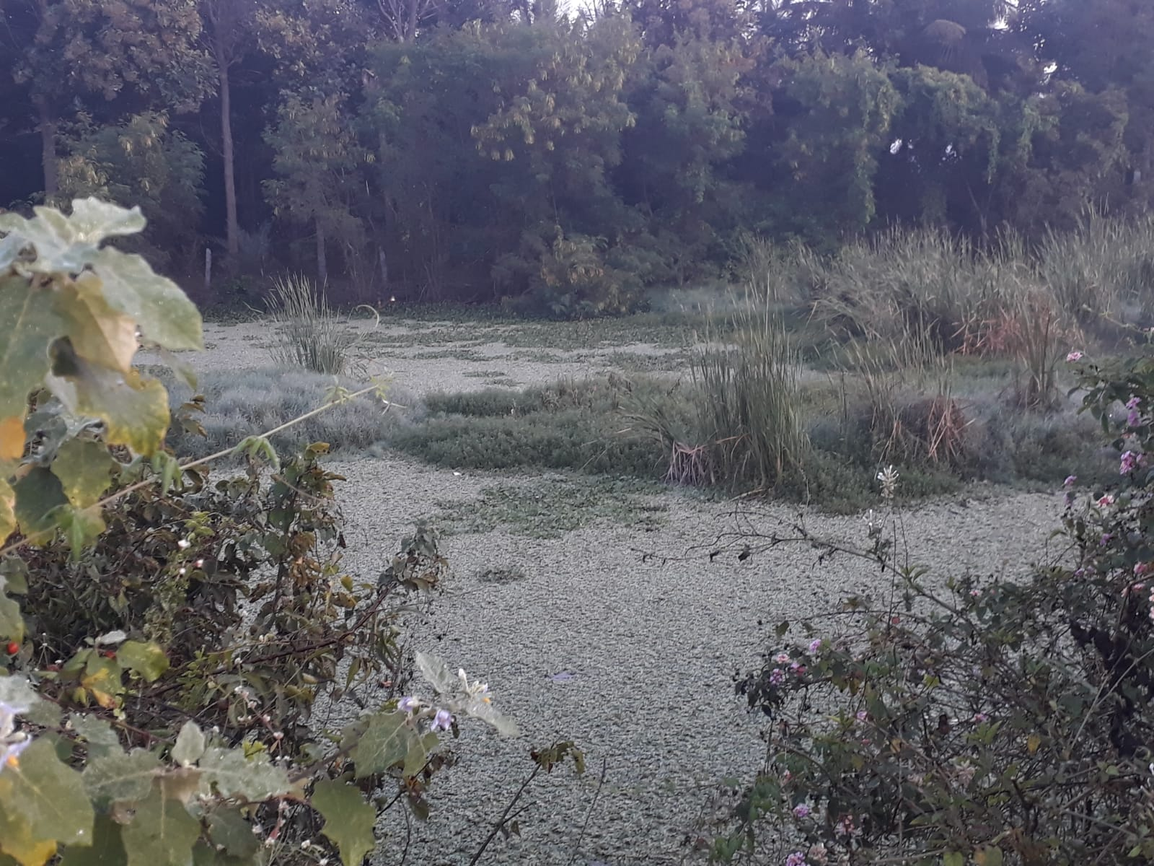
Educational efforts
Self- service organizations
Boards of DOs and DON’Ts
Regular inspections
CONSERVATION
--Now or Never--
Link to poster:
https://drive.google.com/file/d/1foW0MpBr4YWuGvjic9DBJffH6TBlBSnG/view?usp=share_link
Reference:
Each of the photos is taken by me only.
Map: Google map, Google earth

Slide 9
Link to poster:
https://drive.google.com/file/d/1AywoQS0LiJCpIzjwVYx8y6J86yx-w4dL/view?usp=share_link
ecosystem-based adaptation of climate change, December 28-30, 2022

