Slide 1


Prospects of renewable energy (solar , biofuel, bioenergy) conservation of energy
SATHVIK K ADAPPA , SHREEDA MAYYA K. S PUNEETH K of std-8

Slide 2
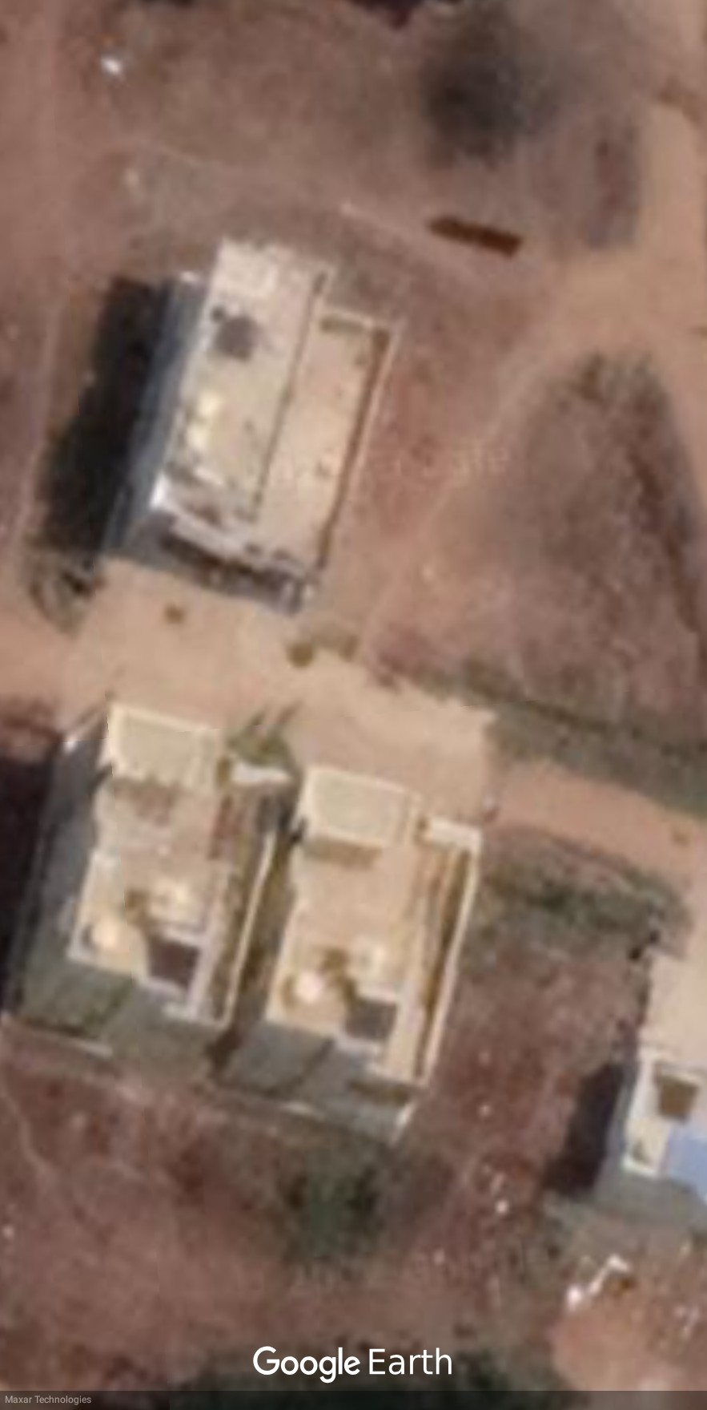

STUDY AREA : KARUNAKARA .K.ADAPPA’S HOUSE

Slide 3
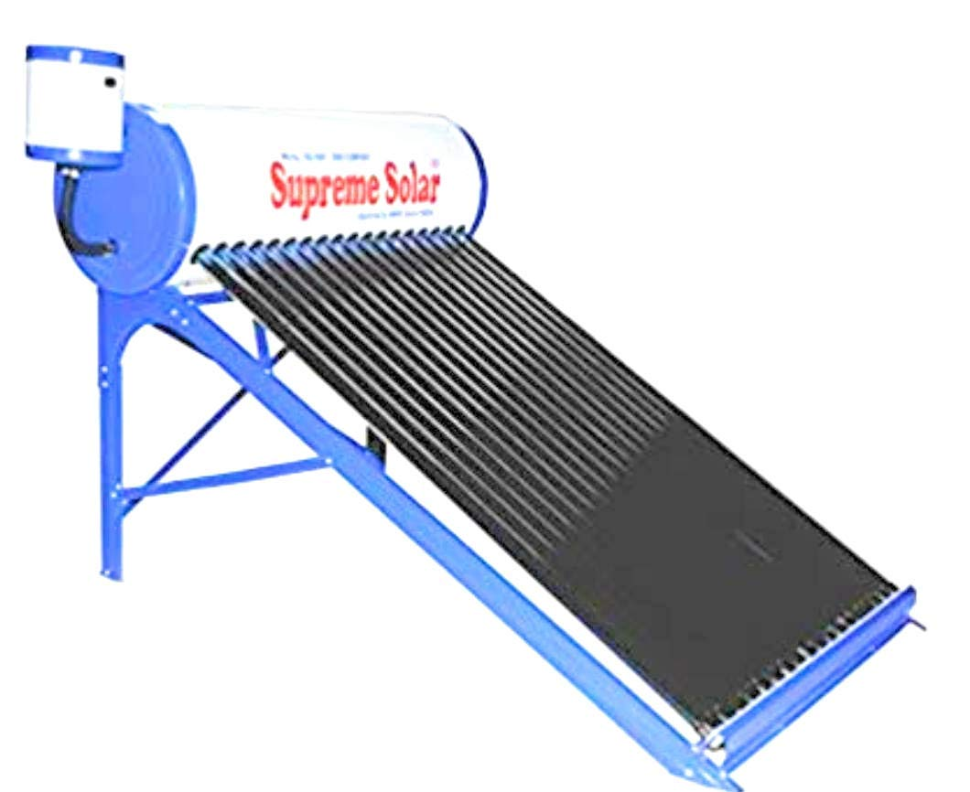
KARUNAKARa .K.ADAPPA’S HOUSE
Karunakara.k.Adappa has a solar water heater .
Before installing solar water heater their electricity bill was 1124.62 rupees per month .
They save 446.63 rupees per month .
Yes because a geyser of 2kw consumes 60 units per month.
After installing the solar heater their electricity bill 677.99 per month.

Slide 4
Profits for an individual by the usage of renewable energy
Per month a house consumes 96 units which costs 714.62 rupees .
A solar panel which generates 4kw per hour can produce 480 units per month .
By the help of just a 4kw solar panel we can save 3,573.1 rupees per month .
Now a family can have a profit of 2858.48 rupees per month .

Slide 5
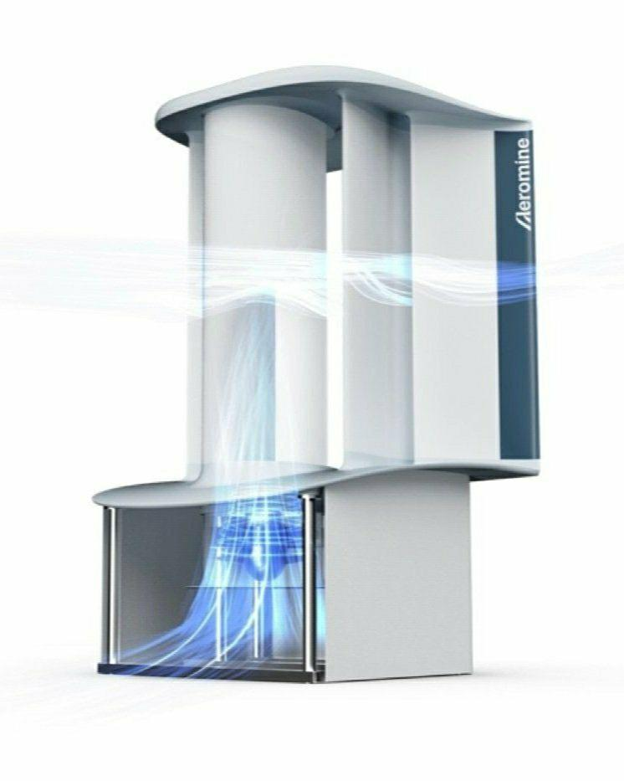
prospects of renewable energy
MOTION LESS TURBINE :
Takes less space and cost less than windmills.
Safe for birds and animals.
Is silent.
Can run at air speeds of 5mph (8kph) but windmills need air speed of 9mph (15kph) to produce electricity.
This type of turbine are meant for roof top like warehouse, data center or malls .

Slide 6
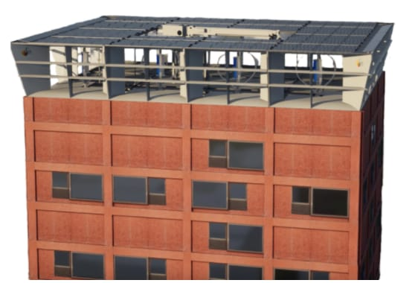
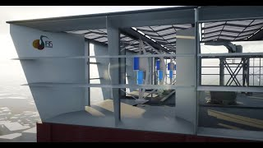
Power nest
Gives more coverage area for solar panels.
Produces more than solar panels working alone.
Its forms a modular “kinetic sculpture” to maximize the amount of energy a single roof can produce .
It has bifacial solar panel over every turbine .
It produces six times more energy than solar panels working alone .
Due to its shape the turbines in it can run at air speeds of 4.5 mph [7.24kph] .
It is meant for large scale industries ,business office or sky scrapers.

Slide 7
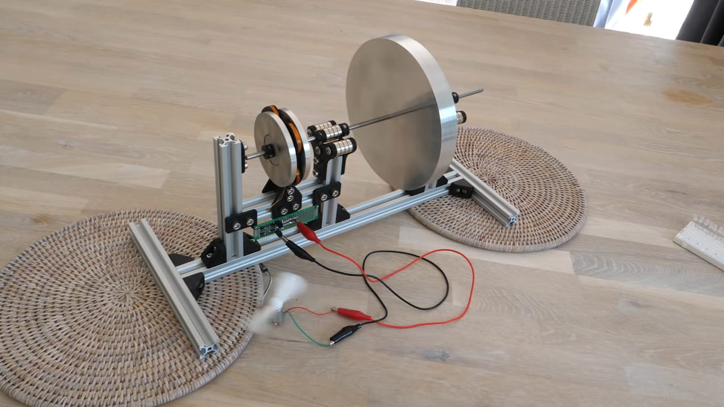
Flywheel battery
They levitate with the help of magnets due to which there is no friction due to which it can generate electricity for a long time .
They can be used in house scale .
Needs a small boost by a motor every 2 hours once .
Efficient for the scale of a house but not for higher like industries, business.

Slide 8
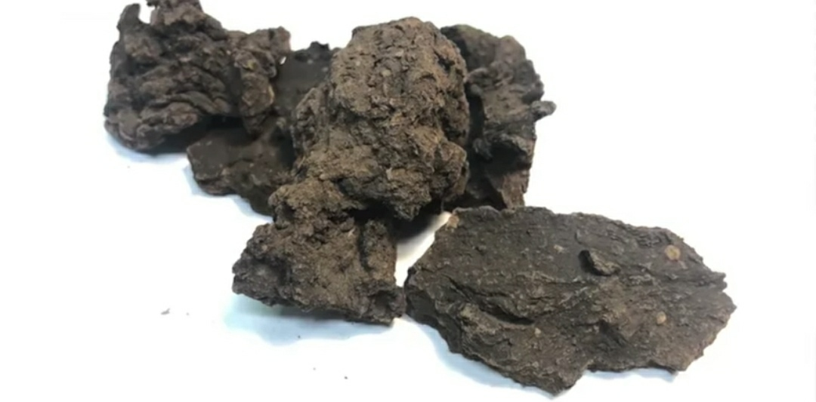
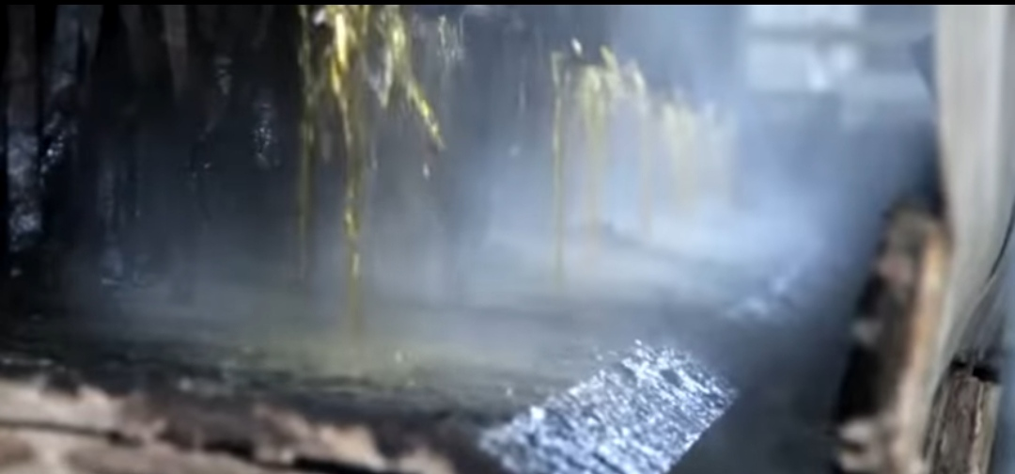
Conservation of energy
Through sewage
There are many ways to conserve energy .
To conserve energy we need to conserve its sources.
It uses method called hydrothermal carbonization [HTC] can help treat sewage water and sludge so that it can be used as energy .
It was identified by Friedrich Bergius in 1930.
This produces a solid which resembles coal and acts like coal it can be its replacement .
There is a HTC processed liquid released which can be used to produce biogas .
It can help the sewage field which reduces the power consumption by 62%.
Some research say its benefits exceeds the benefits of biogas production .

Slide 9
By storing in modern batteries
What is the use of the electricity when you can’t store it properly .
We all need a new mean to store energy .
Yes we have lithium ion batteries but they are expensive and cannot be used in grid scale. They lose their capacity of holding electricity after constant usage .they pose a fire risk.
But there is a solution for it that is “Flow batteries”.
They don’t pose a fire risk are cost efficient and don’t fade over time.

Slide 10
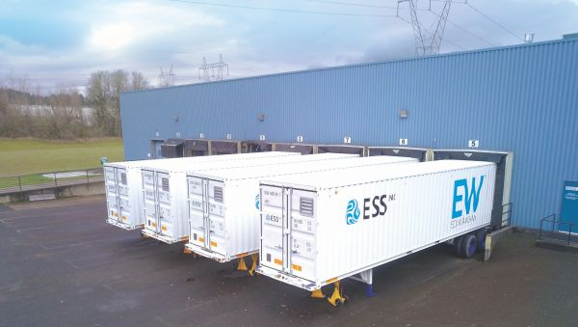
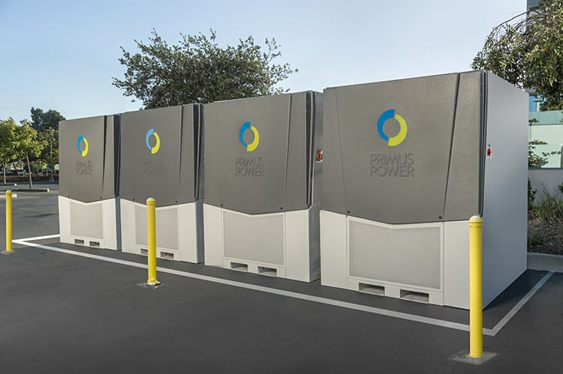
These flow batteries store the energy which can power 5 to 7 house for 5 hours.
Environment friendly and low cost compared to lithium ion batteries .

Slide 11
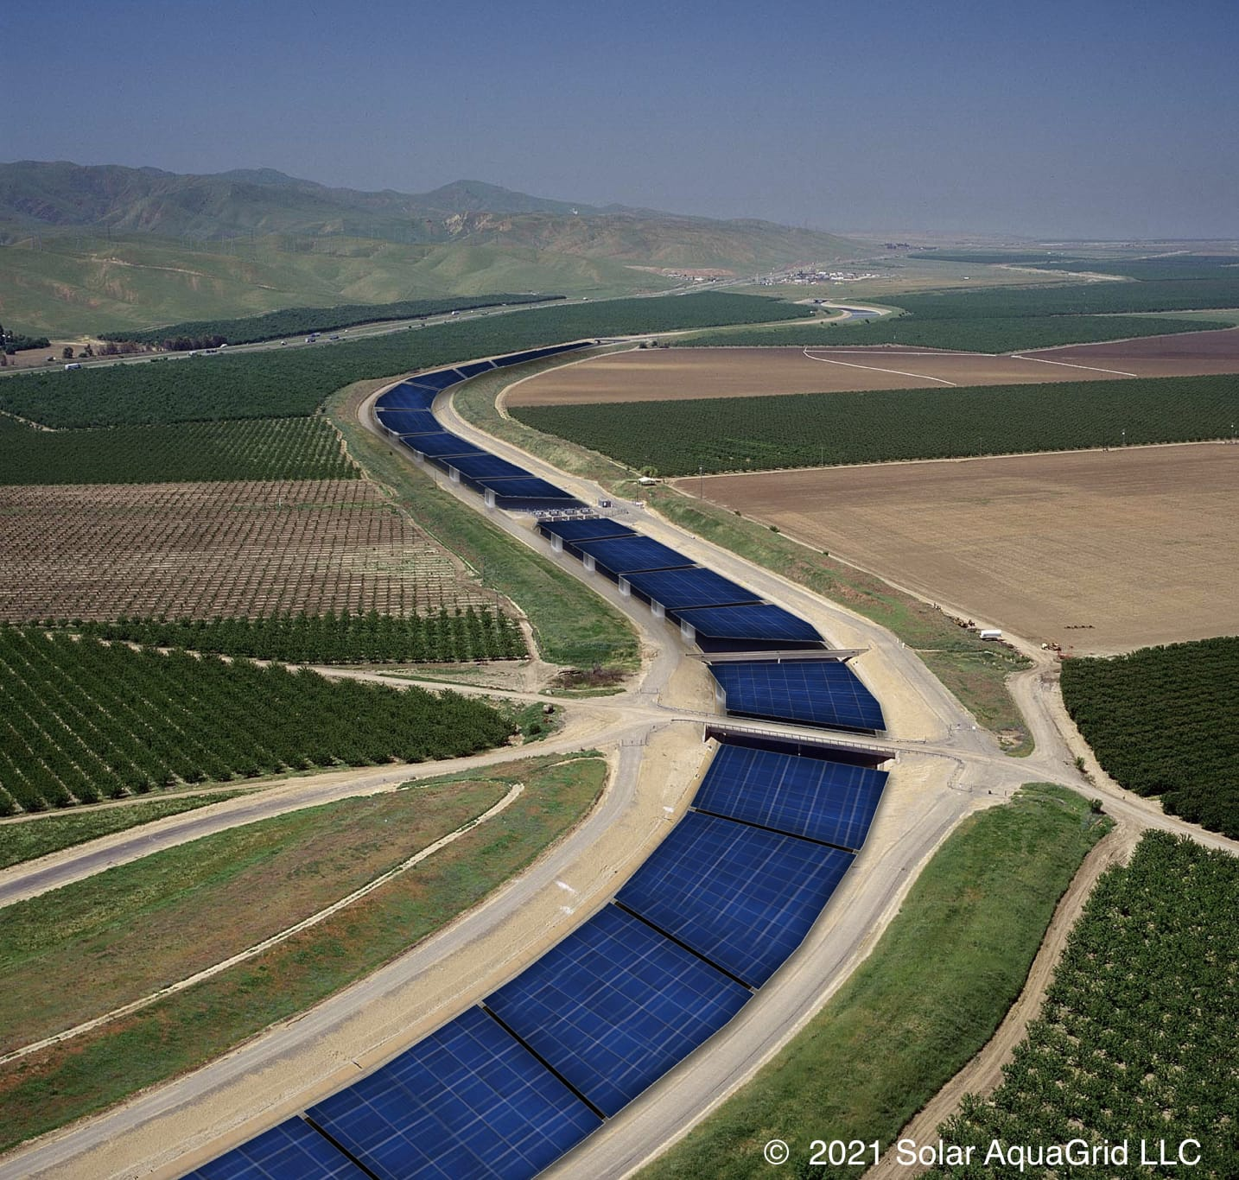
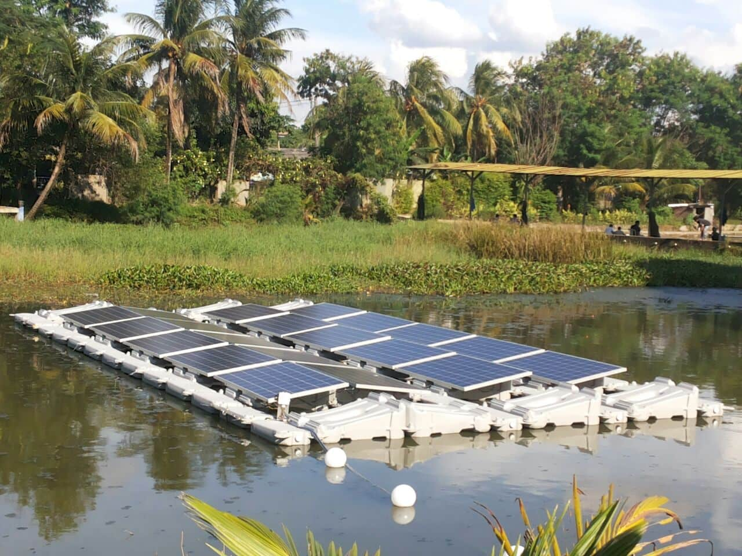
Modern methods to use solar panels
We can cover manmade or calm water bodies using solar .
It benefits us by :
Protecting the water bodies from evaporating in the dry region.
No need to clear land and deforest large areas.
Are fit for every biome.

Slide 12
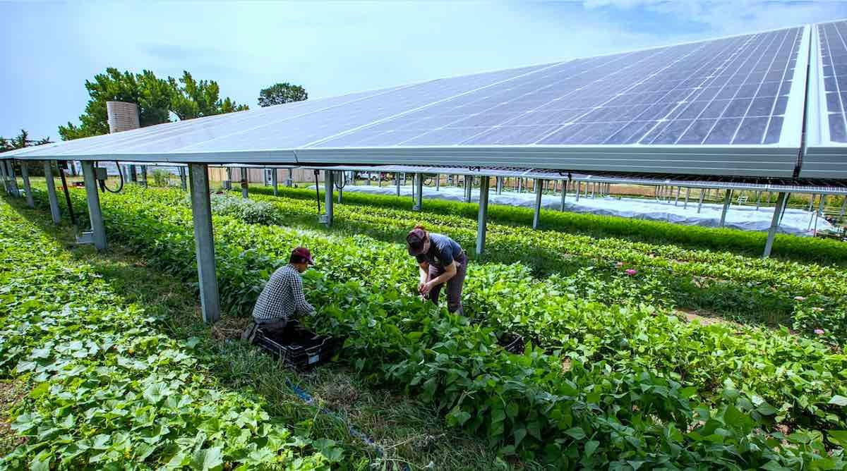
covering farms by solar panels
Save the crops from wind and storms.
Stops the plants from loosing water there by needing less irrigation.
Some plants which need to be covered by plastic can be covered by these solar panels and special panels are made for this reason which has a little spacing between the solar cells in the solar.

Slide 13
Conclusion
We need to use renewable energy in our life even after we are educated about it this much.
Even though we are educated about it we don’t give it importance our carelessness might led to an inhabitable world.
Lets all give importance to this topic in our life.
Now as we all know about it , let’s not just keep it to our selves but also spread it all over the world.

Slide 14
Reference
http://youtu.be/p6CF-umWLZg
http://youtu.be/OkRqVBpO2BQ
R and D STAFF
Science teachers
Energy research and development book

