Slide 1


Climate change adaptation and mitigation strategies
BY:- Vishnu.J.Gowda and Aaryan. R 8th standard
Vagdevi Vilas school Nelamangala

Slide 2
Introduction
Climate change refers to significant long-term changes in the global climate.
The global climate is the connected system of the sun, earth, oceans, wind, rain and snow, forests, deserts and savannas, and everything people do too.
The climate of a place say New York can be described as its rainfall, changing temperatures during the year, and so on.

Slide 3
Objective
Our main goal by presenting this presentation is to eliminate or reduce the risk caused by climate change some of which are:-
Global warming.
Shortage of food.
Extinction of animal species.
Extinction of plant species.
To increase the lifespan of humans, animals, and plants.

Slide 4
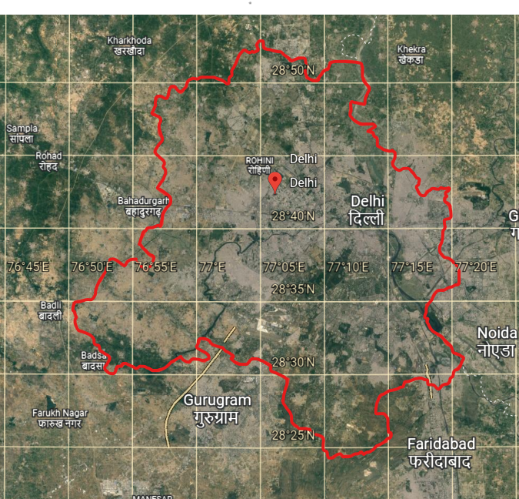
Study area
Delhi
Border coordinates of Delhi are 76.8281 to 77.397574.Latitude 28.8886 to 28.3968 longitude.
Area union territory 1,484 km² (573 sq mi).
Water18 km² (6.9 sq mi)
Elevation 200–250 m (650–820 ft).

Slide 5
Content
Topic | Slide no
Introduction | 2
Objective | 3
Study area | 4
What are Mitigation, Adaptation, and global warming? | 6
Causes of climate change in Delhi | 7-9
Delhi’s pollution level | 10
Adaptation strategies for Delhi’s climate change | 11
Mitigation strategies for Delhi’s climate change | 12-14

Slide 6
What is mitigation?
To prevent the worsening of destruction
To decrease force or intensity. To lower risk
Climate change mitigation refers to the reduction of carbon dioxide emissions.
What is adaptation?
Reacting or changing to fit the new circumstance
Coping with impacts that cannot be avoided
what is global warming?
Global warming is the long-term heating of the earth's surface observed since the pre-industrial period (between 1850 and 1900).
Due to human activities, primarily fossil fuel burning, which increases heat-trapping greenhouse gas levels in earth's atmosphere.

Slide 7
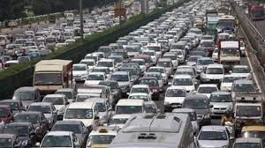
Causes of climate change in Delhi
There are many reasons for climate change in Delhi some of which are they are
One of the main reasons for increasing air pollution levels in Delhi is crop burning by the farmers in Punjab, Haryana, and Uttar Pradesh.
Pollution caused by the traffic in Delhi is another reason contributing to this air pollution and smog.
As the winter season sets in, dust particles and pollutants in the air become unable to move.

Slide 8
Due to stagnant winds, these pollutants get locked in the air and affect weather conditions, resulting in smog.
In Delhi climate is changing rapidly due to some human activity like urbanization and deforestation.
Delhi s growing population has led to led to increase in pollution and greenhouse gas emissions which are contributing to global warming.
Investing less in public infrastructure is another reason for air pollution. In India, investment in public transport and infrastructure is low, leading to congested roads and air pollution.

Slide 9
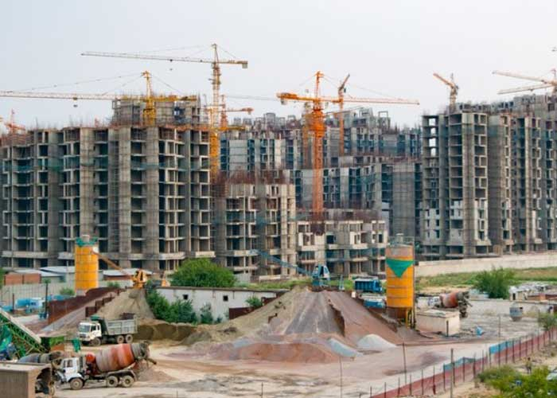
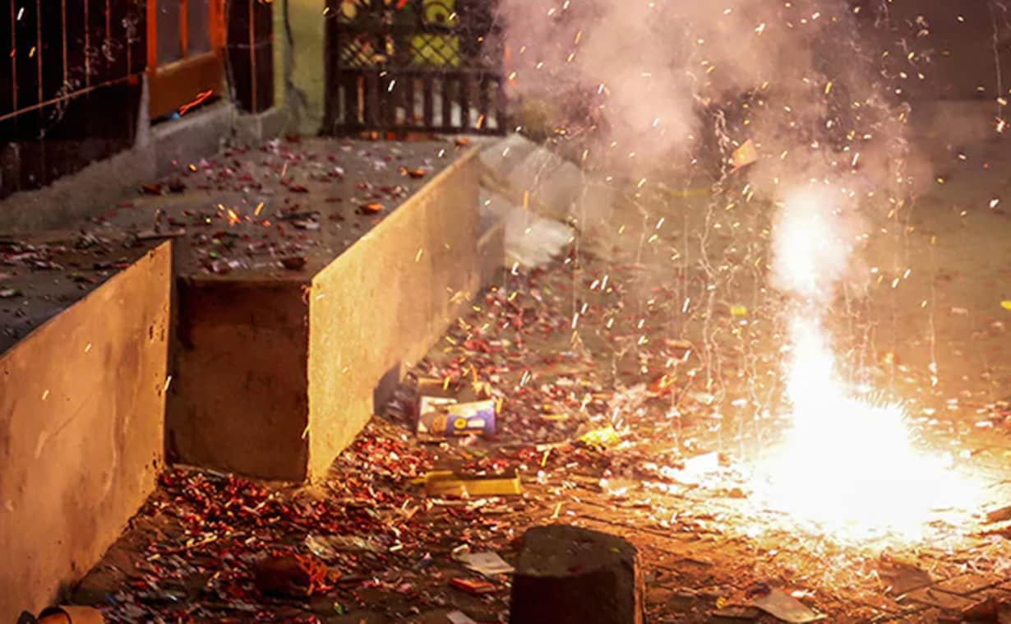
Large-scale construction in delhi is another culprit that is increasing dust and pollution in the air.
Industrial pollution and garbage dumps are also increasing air pollution and building up smog in the air.
Despite the ban on cracker sales, firecrackers were a common sight this diwali. It may not be the top reason for this smog, but it contributed to its build-up.

Slide 10
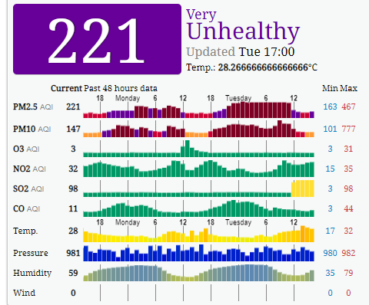
Delhi′s pollution level
Data collected from the aqicn.Org website on 29th of November 2022.

Slide 11
Adaptation strategies for Delhi’s climate change
To adapt to climate change in Delhi we need to do the following
Farmers burn the leftover crops in Punjab, Haryana, and Uttar Pradesh that makes farmers burn their crops in a burner and produce energy from it.
There is a lot of pollution caused by vehicles for that use more public transport than private transport.
For dust and pollution caused by construction we can use materials and methods that create less dust and pollution.
For pollution caused by industries, we should force industries to purify the air, water, or anything before leaving it in the open.
For pollution caused by crackers use green crackers.

Slide 12
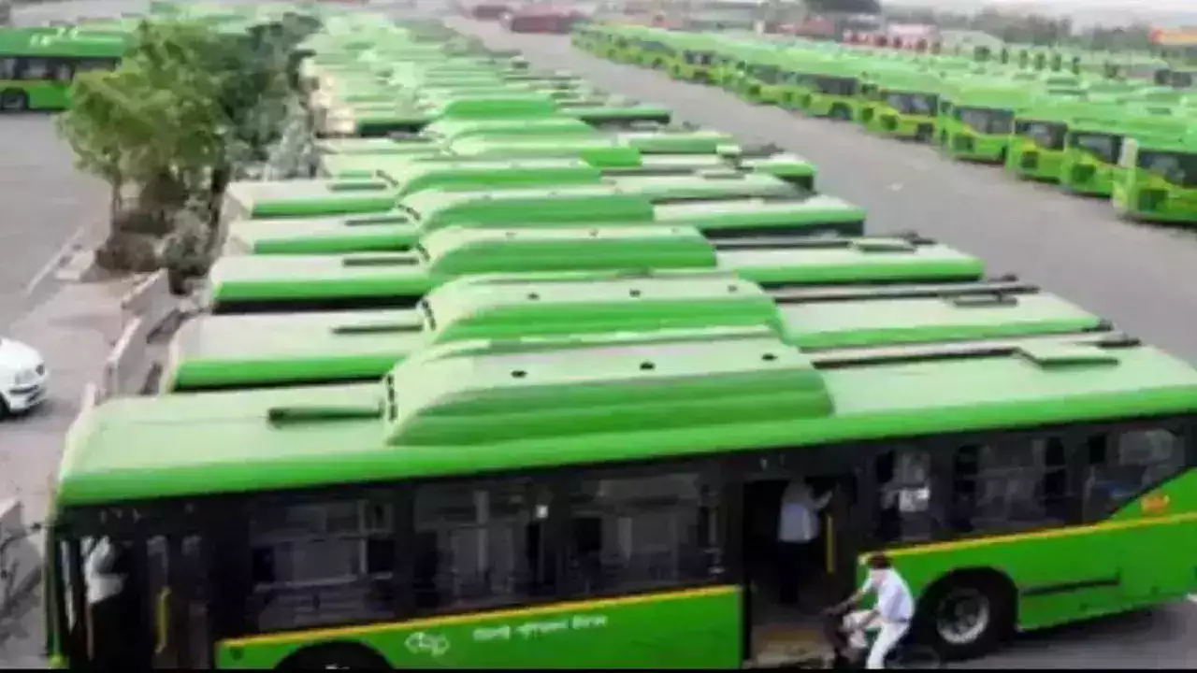
Mitigation strategies for Delhi’s climate change
For pollution caused by burning crops in Punjab, Haryana, and Uttar Pradesh a permanent and best solution are mulching leftover part of crops or feeding them to animals.
For pollution caused by vehicles the best solution is banning combustion vehicles and using electric vehicles.

Slide 13
For a population caused by overpopulation the best solution is shifting big companies which work there to a place where there is not much population.
For pollution caused by construction the best solution is making custom parts of buildings like a hall, kitchen, etc in factories and fixing them on the construction site.
For pollution caused by industries the best solution is strict laws that industries cant throw waste until it is fully purified which should be applied by the government.

Slide 14
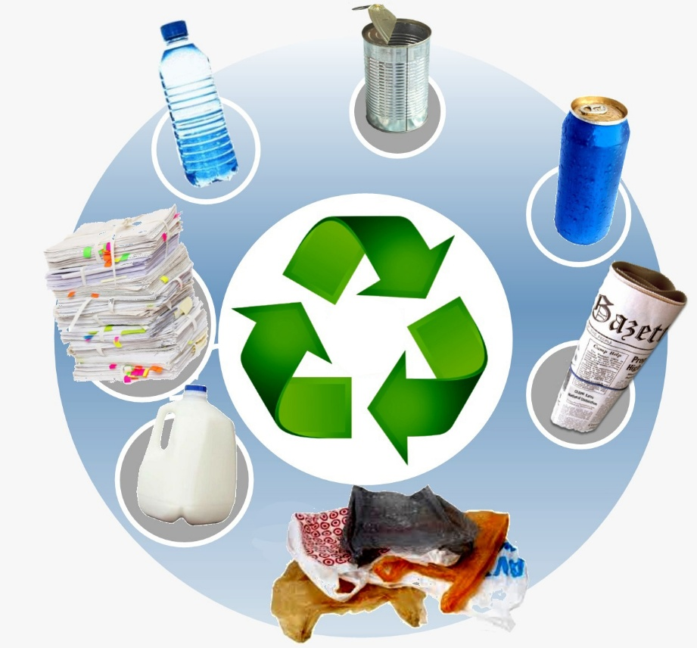


For pollution is caused by dumping waste there are three ways to solve it they are
Recycling of waste.
Using dry waste as fuel to power thermal power plants.
Using wet and degradable waste as a product that can be converted into natural fertilizer which can be sold to farmers at very cheap rates.
For pollution caused by crackers there are 2 ways to solve it they are
Use green crackers or ban crackers.

Slide 15
"Mitigation helps us avoid the unmanageable,
While adaptation helps us manage the unavoidable."
Thank you

