Slide 1


TITLE : sustainable agriculture and organic farming
Participants: Sharika gowda p ,
Triveni BS,
Dhanyashree
GRADE: VIII

Slide 2
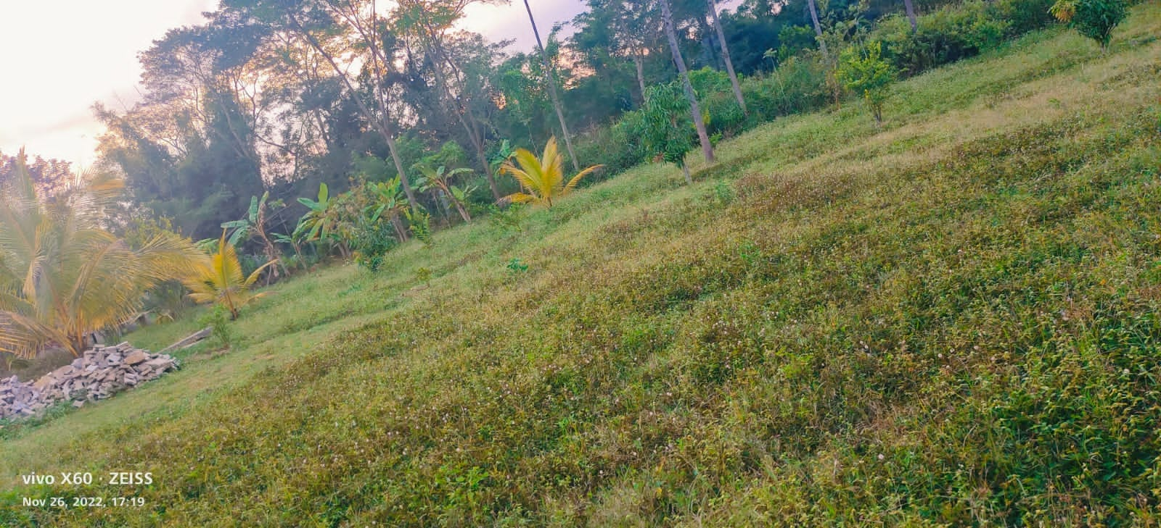
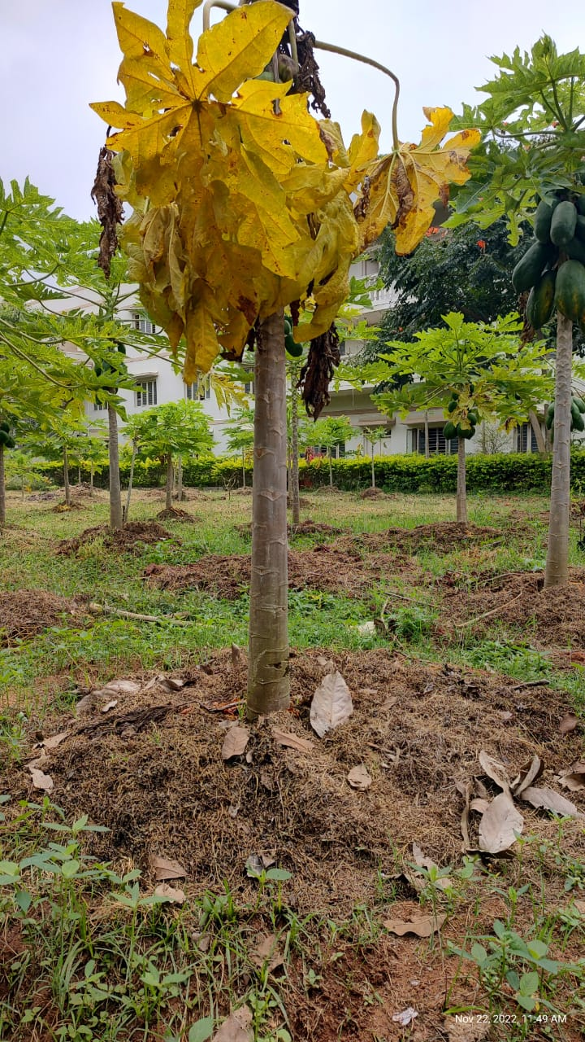
Sustainable agriculture
Long Term
Textiles and Food needs
Method of understanding ecosystem and Farming
Which includes many methods of Farming

Slide 3
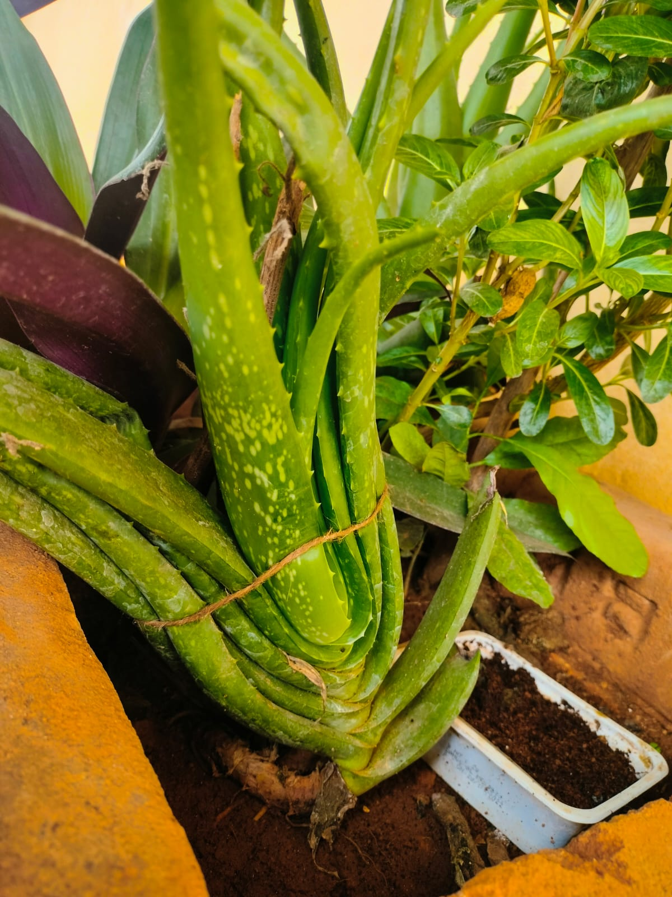
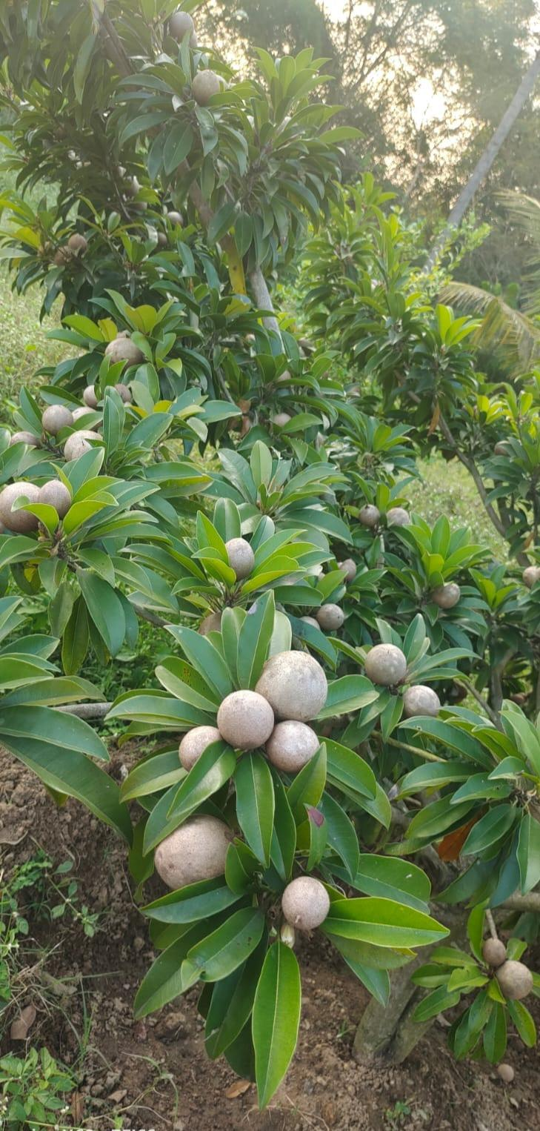
Organic farming
Organic farming is agriculture that :
Makes healthy food
Healthy soil
Healthy environmental benefits
Along with crop productivity

Slide 4
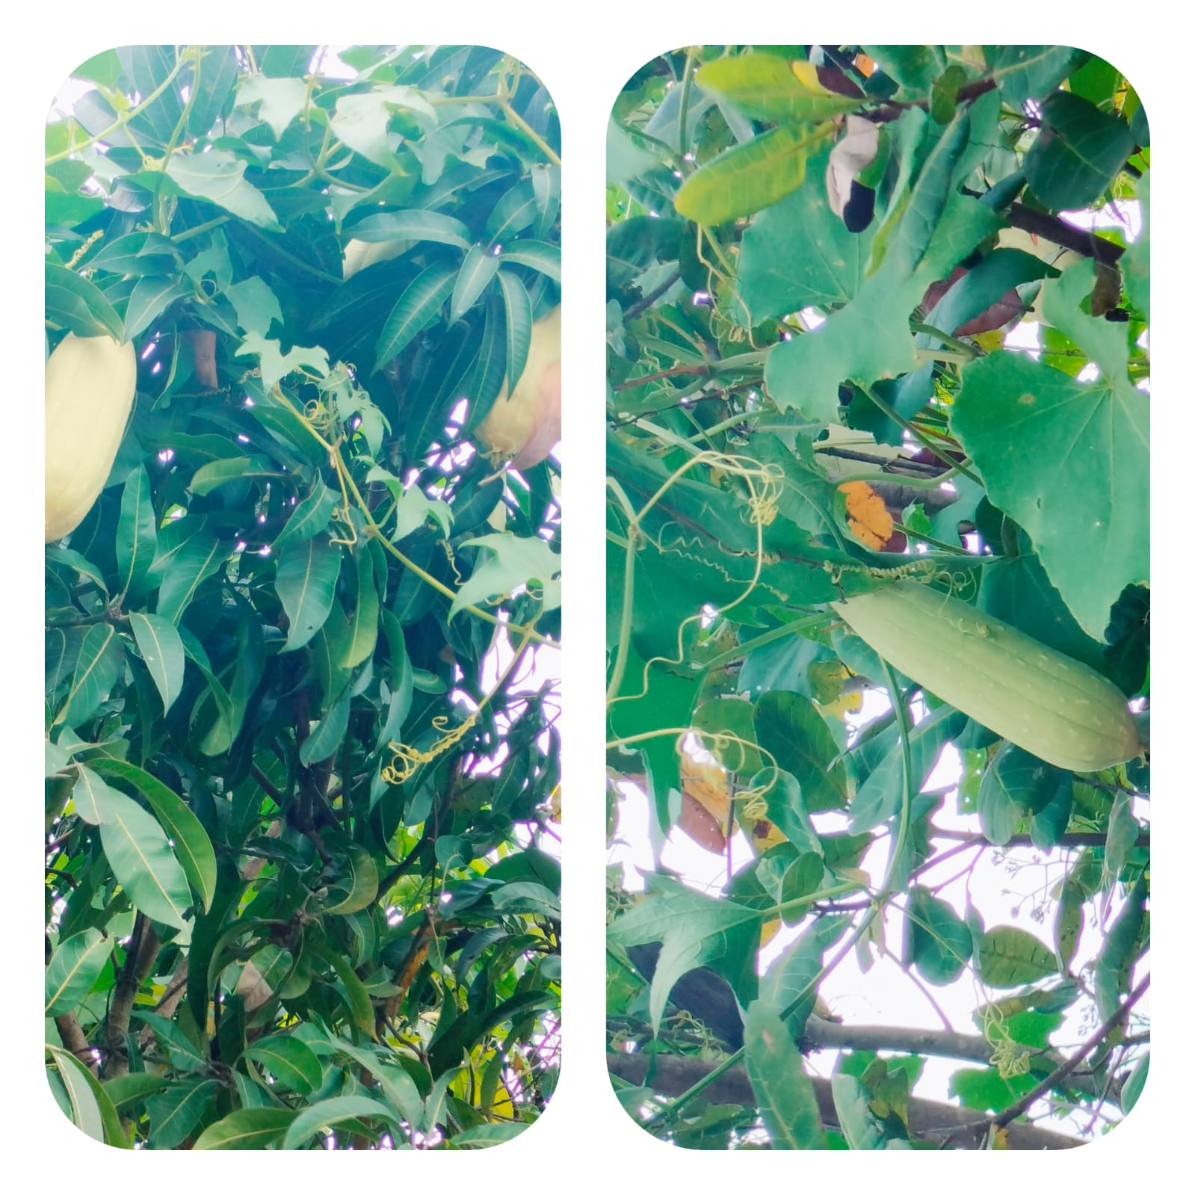
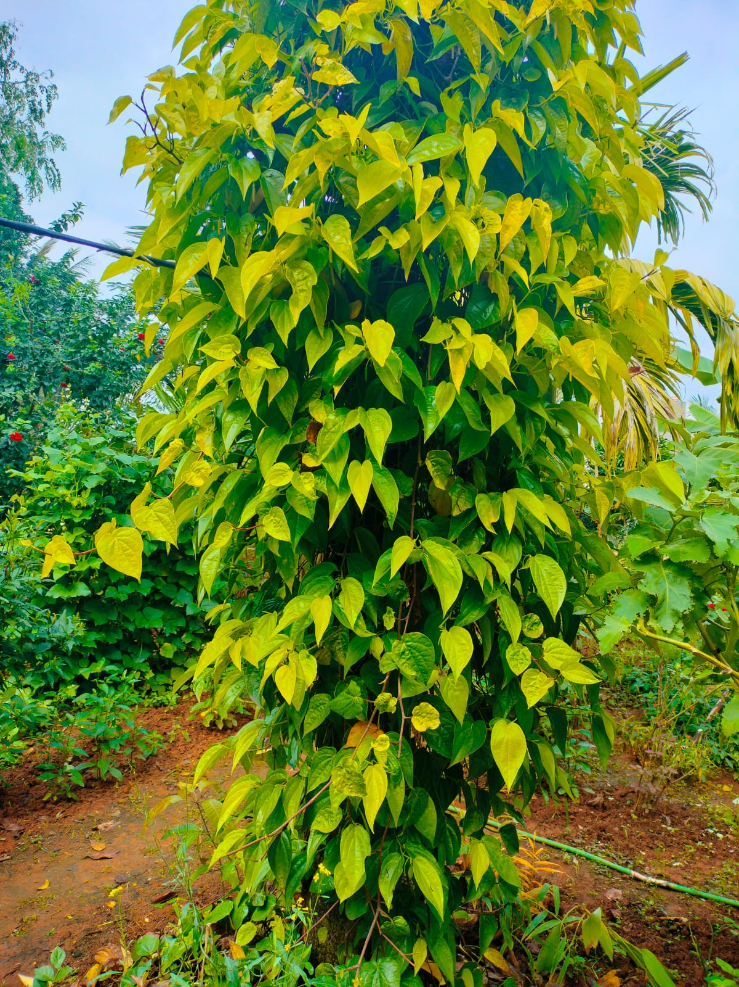
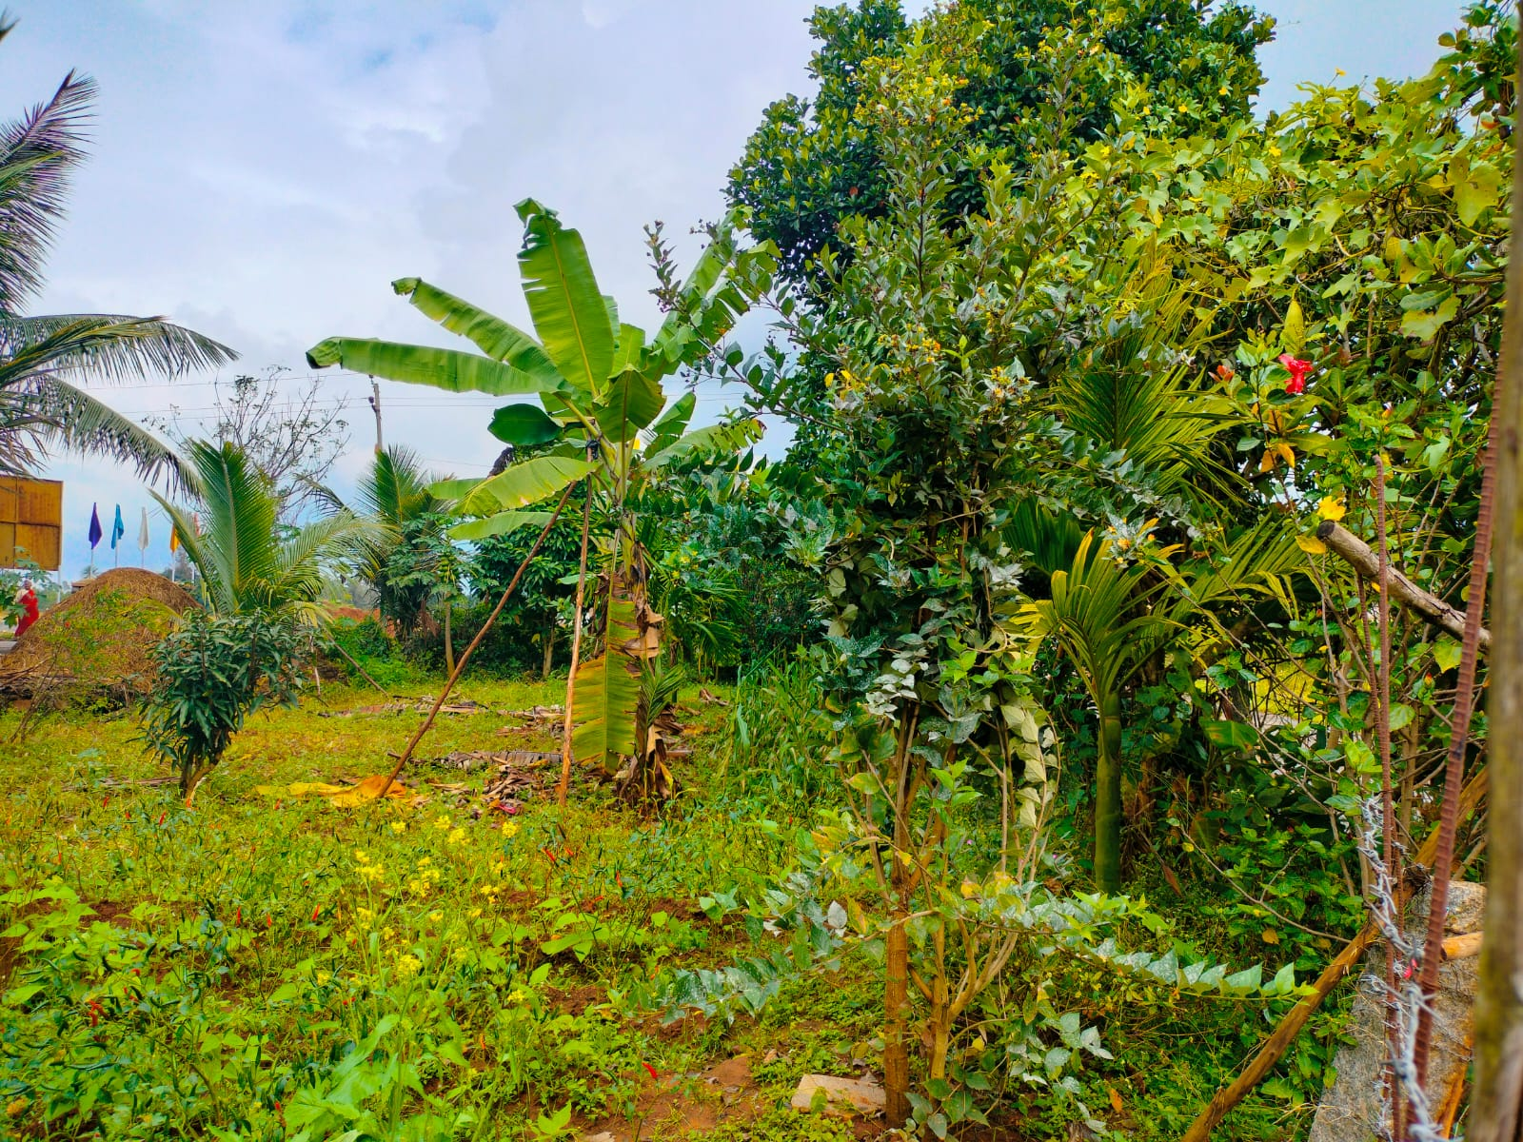
Types of Organic farming :
Integrated farming
Pure farming
Benefits of organic farming:
Healthy food produced
Does not harm livestock
Does not damage ecosystem
Does not reduce soil fertility

Slide 5
Best way of farming
Organic farming | Inorganic farming
Uses of Only manure and organic matters Prepared In own fields | Uses of chemical fertilizers Prepared in factories
It is healthy way of production It gives you humus to soil | It gives more yielding in less time It gives Particular nutrients to the soil
It doesn’t decrease soil fertility | It is more profitable

Slide 6
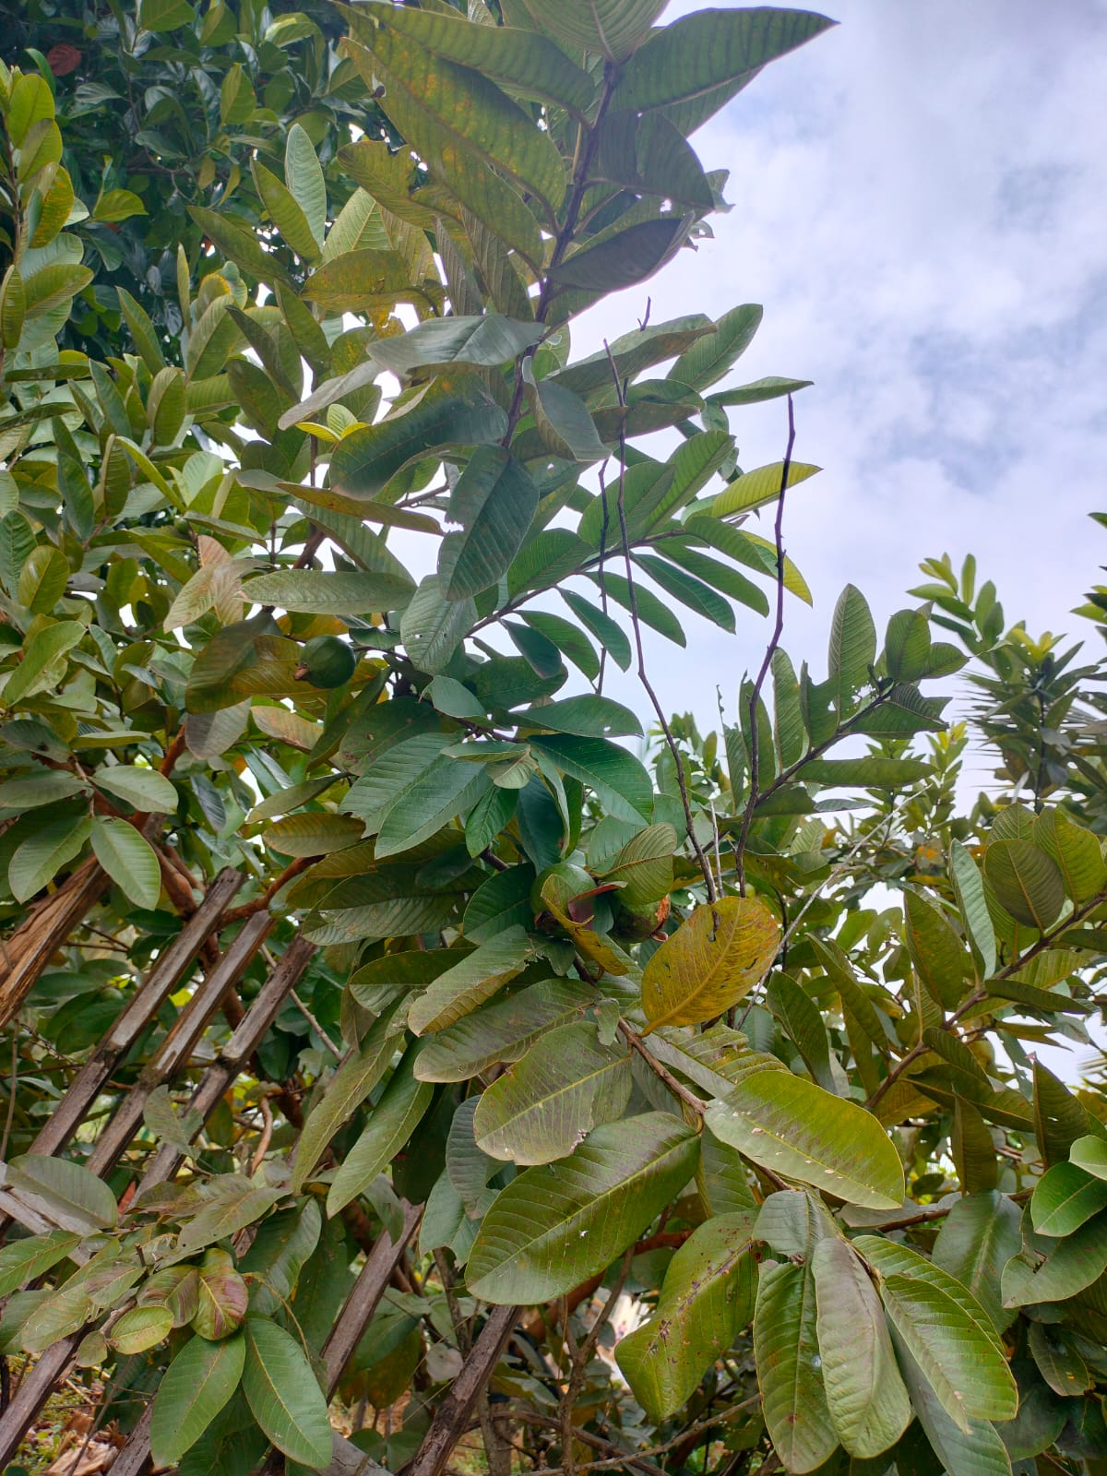
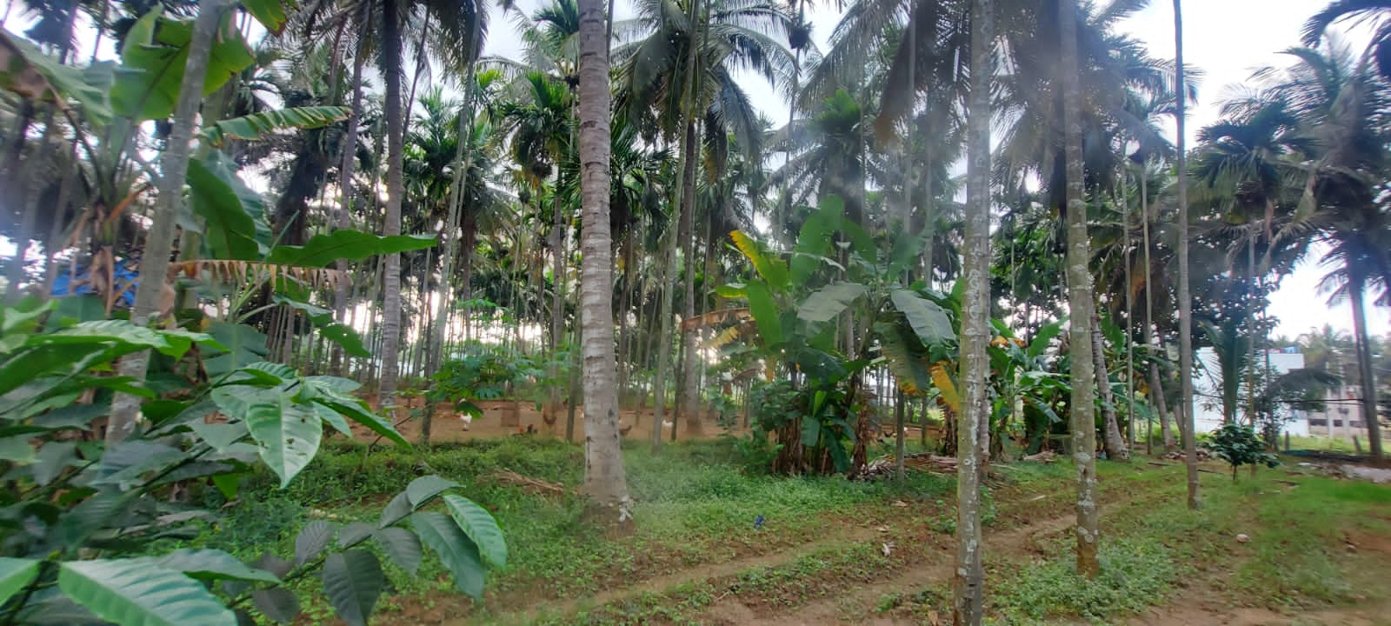
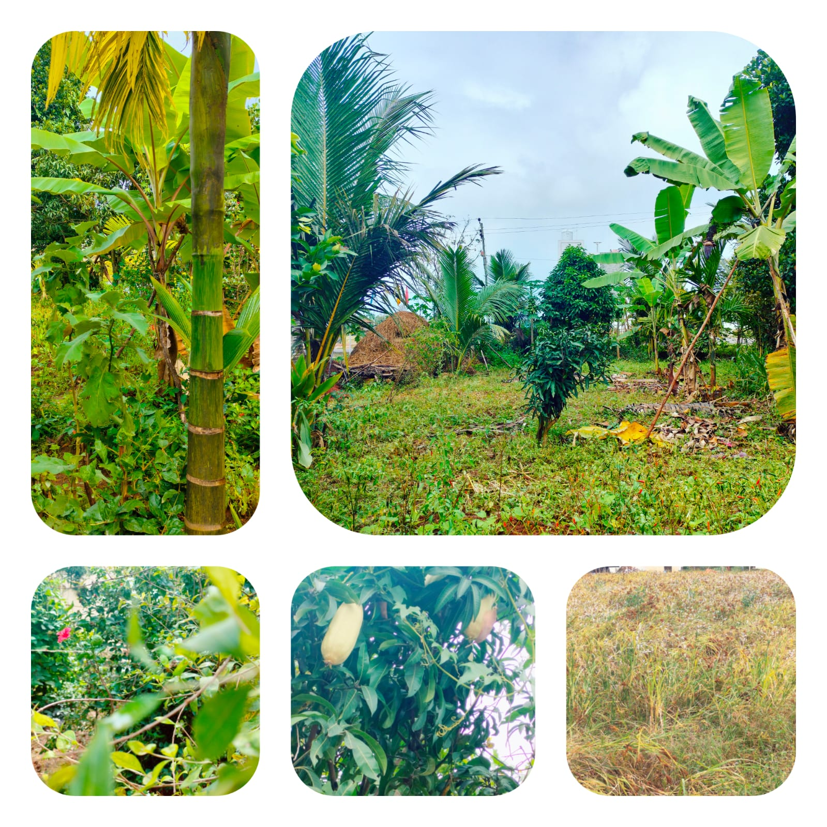
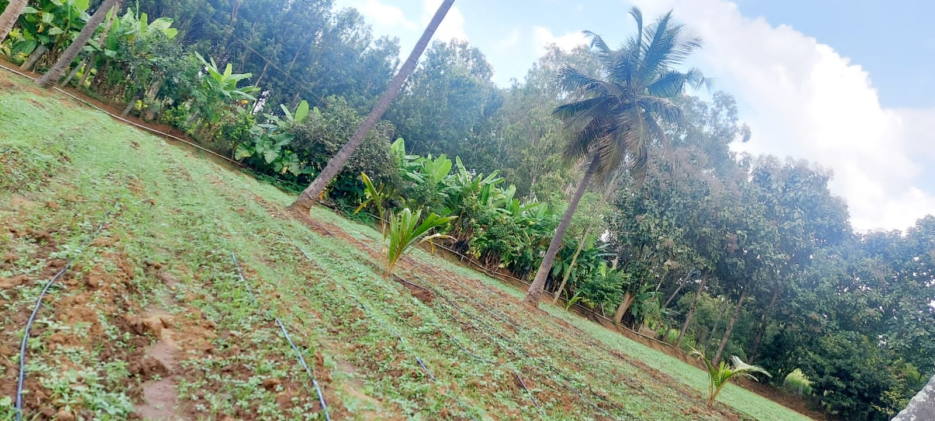
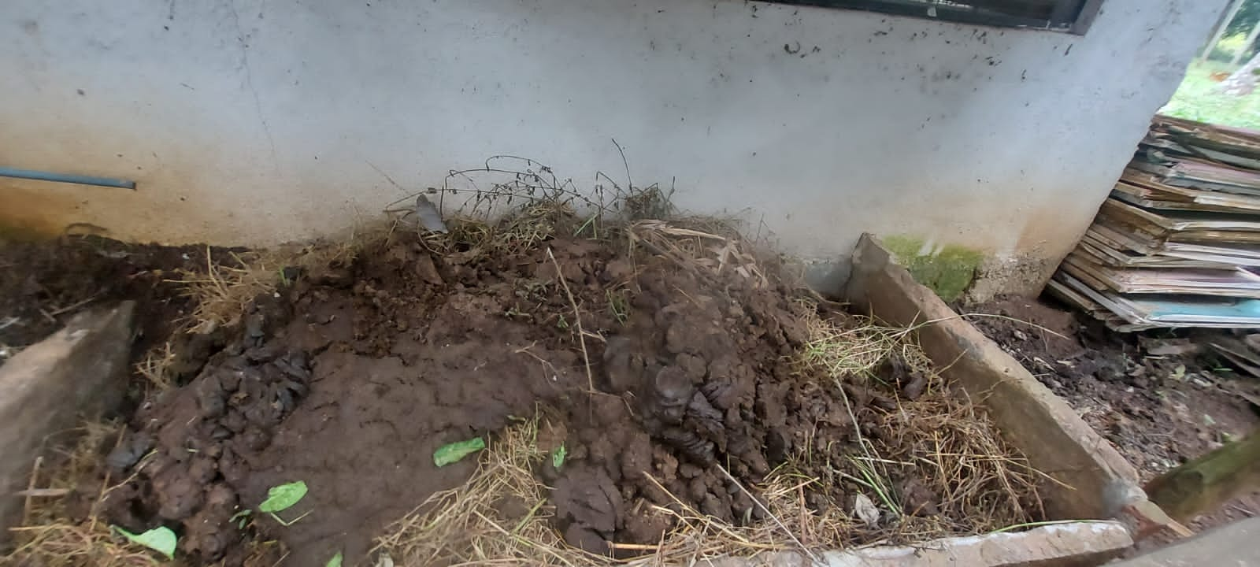
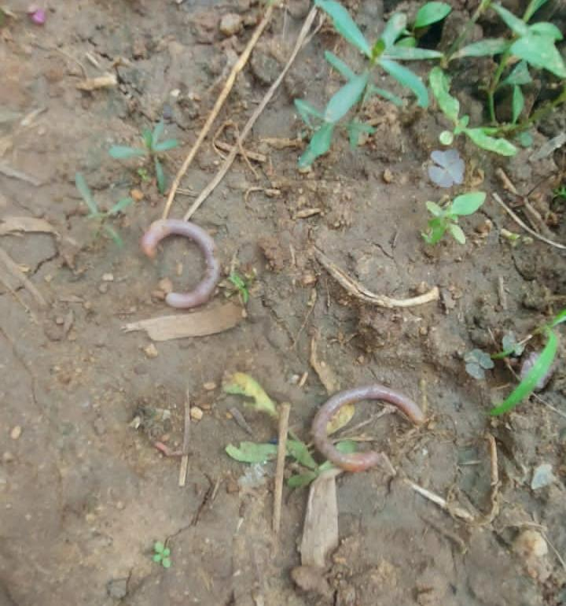

Slide 7
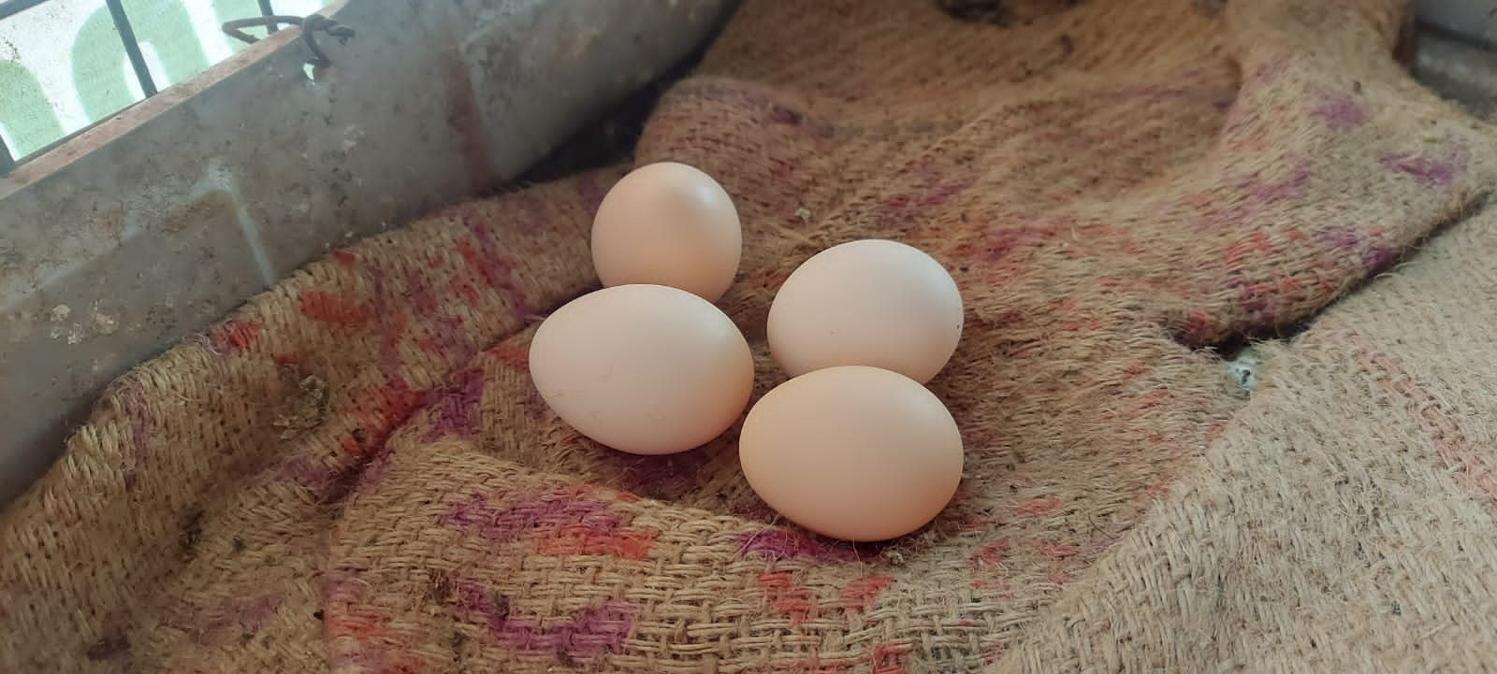
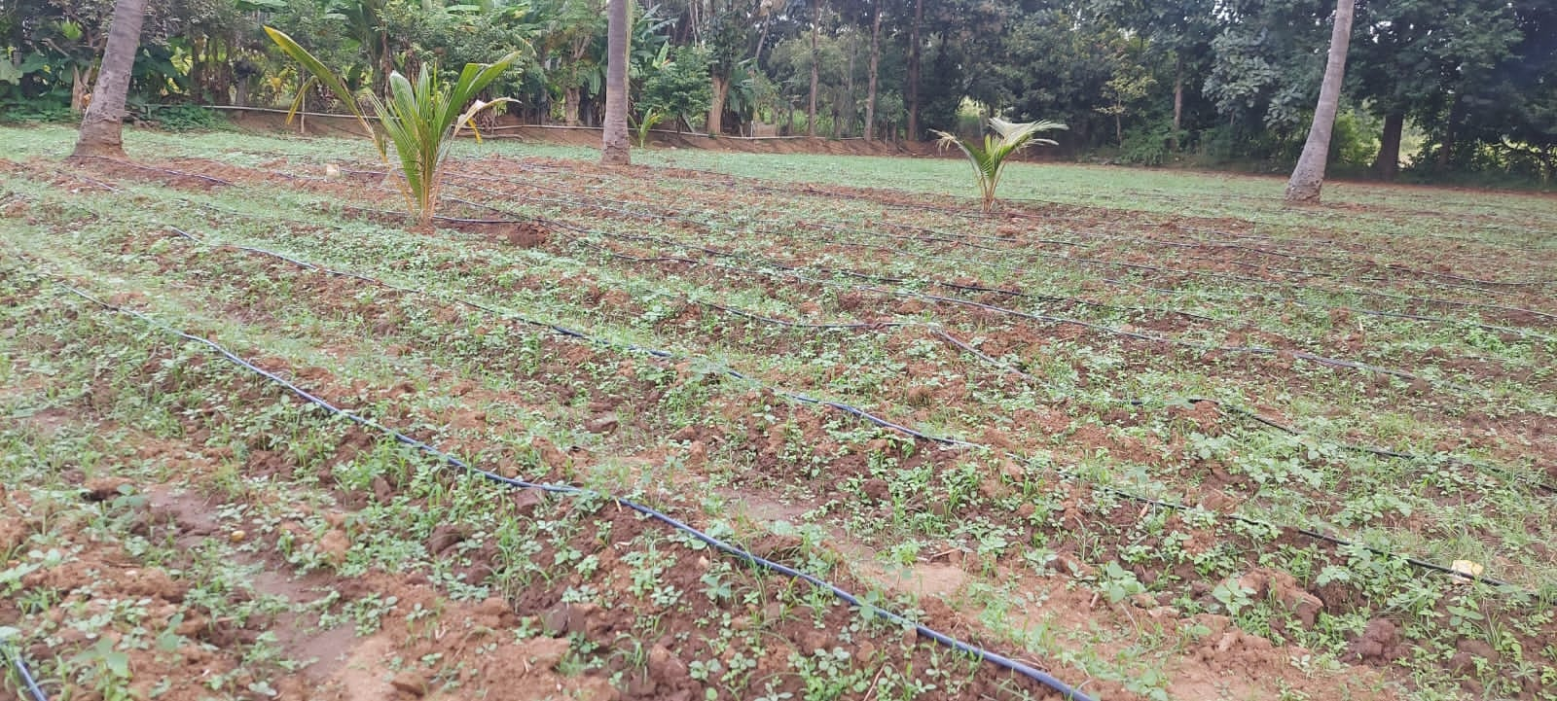

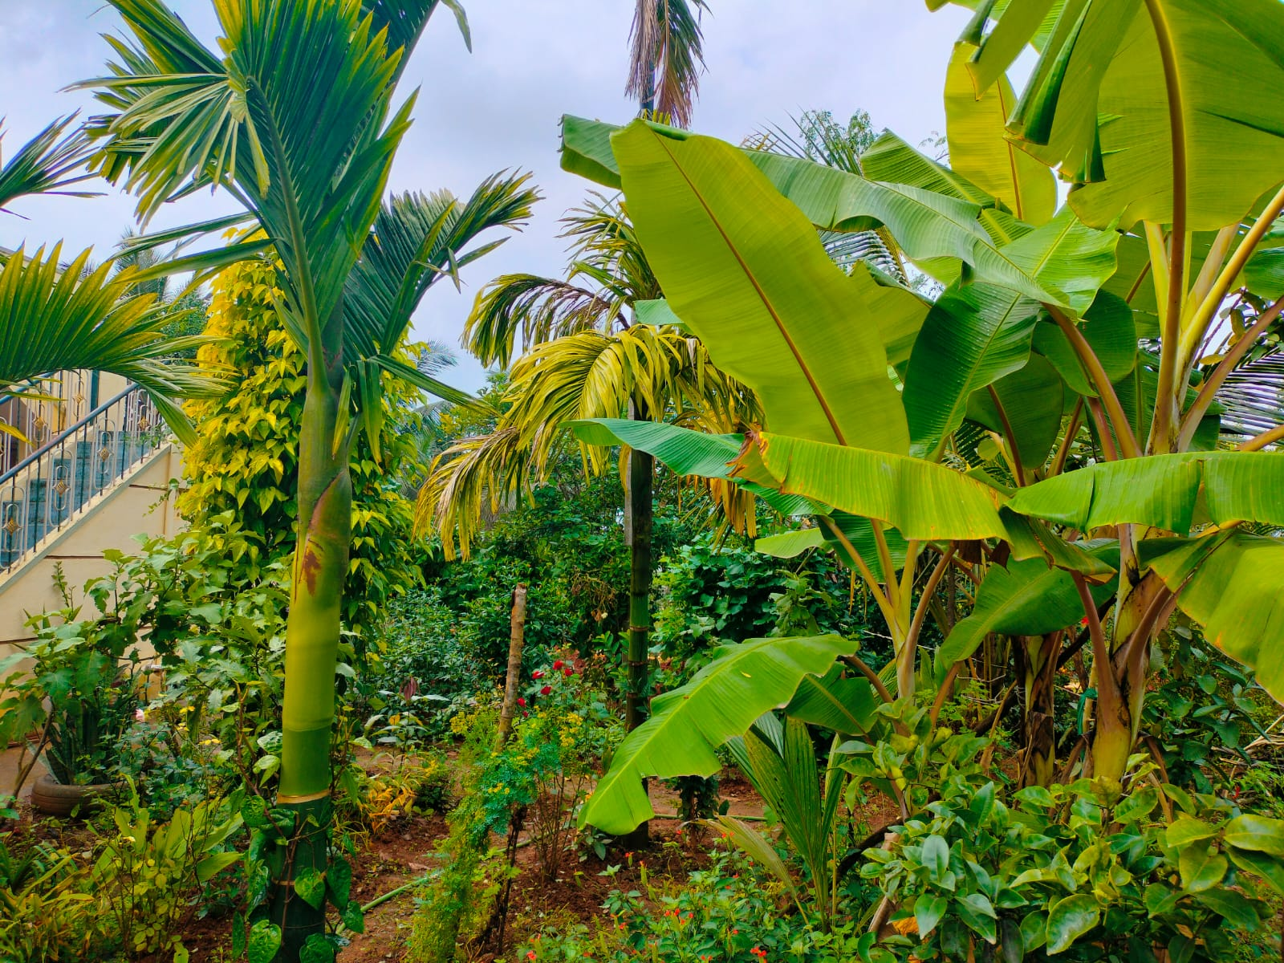
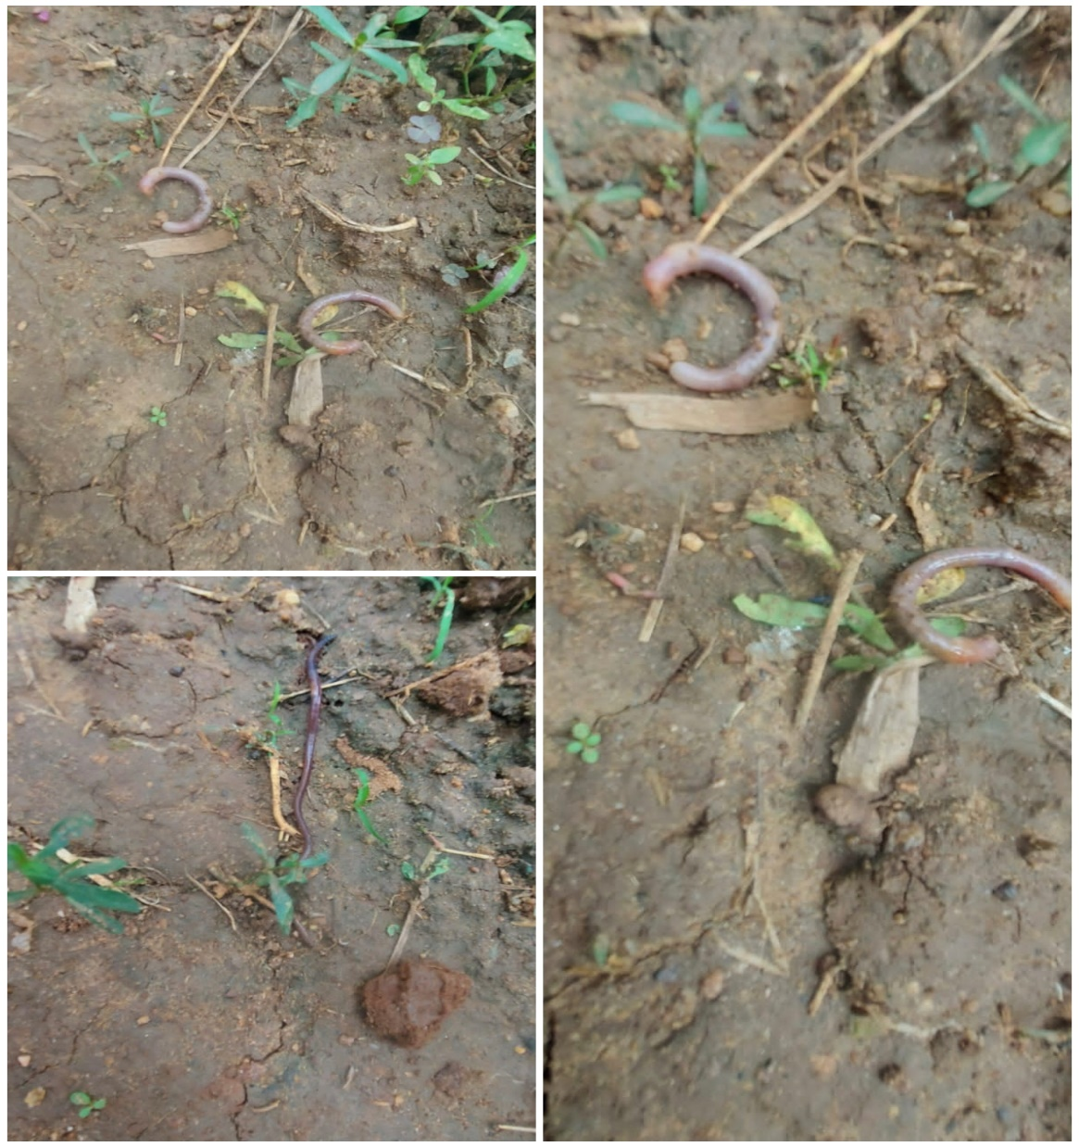
Our visit to farm

Slide 8
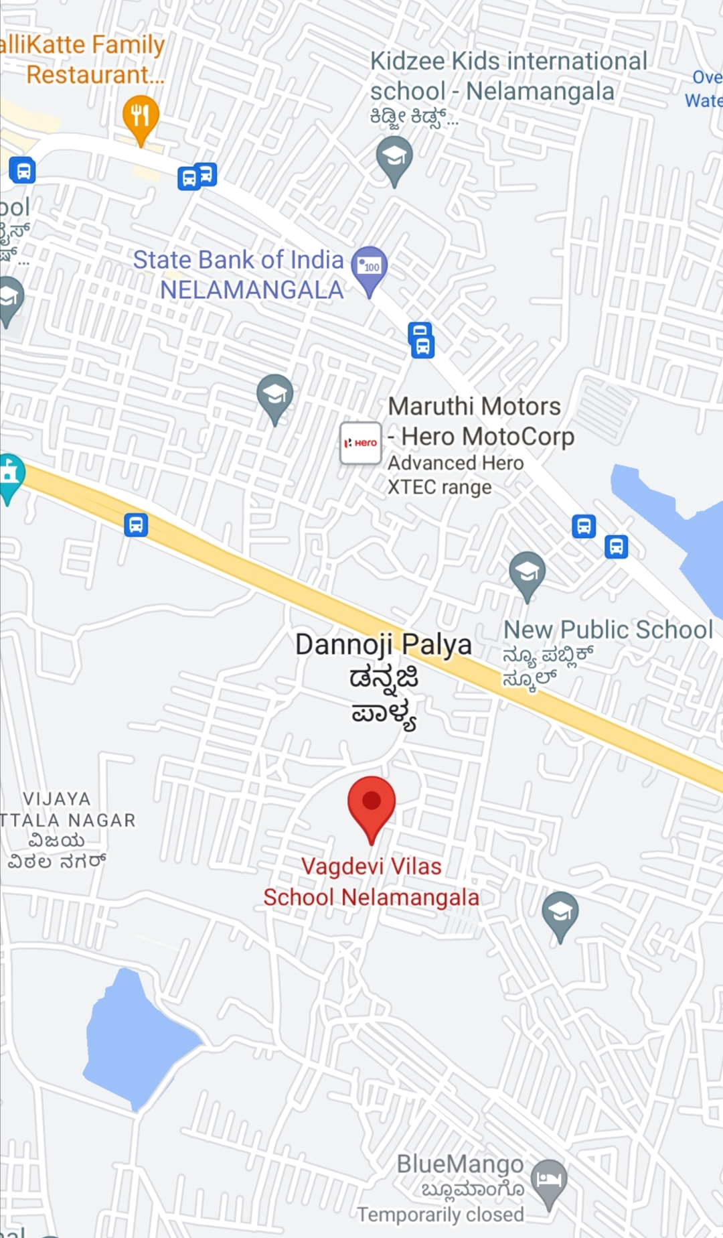
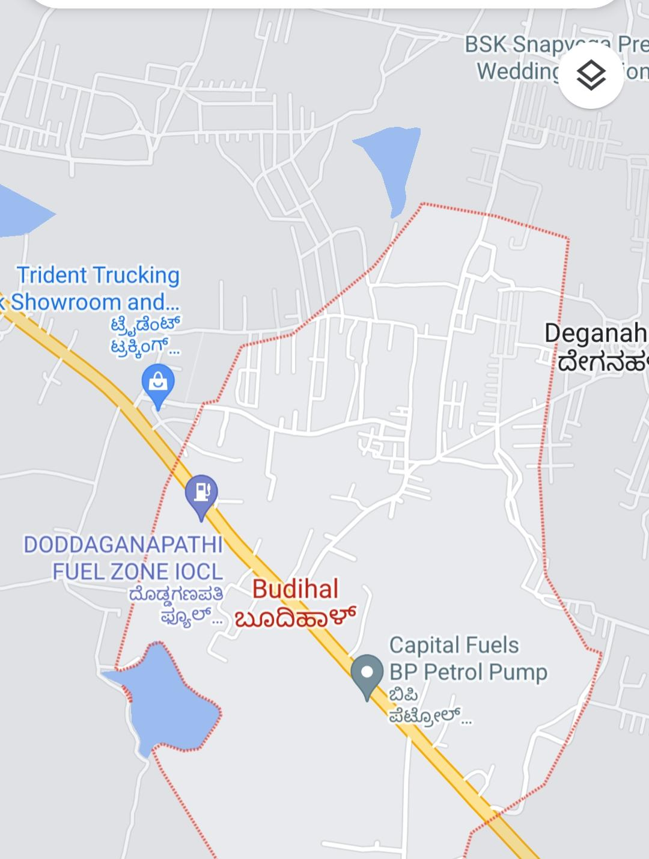
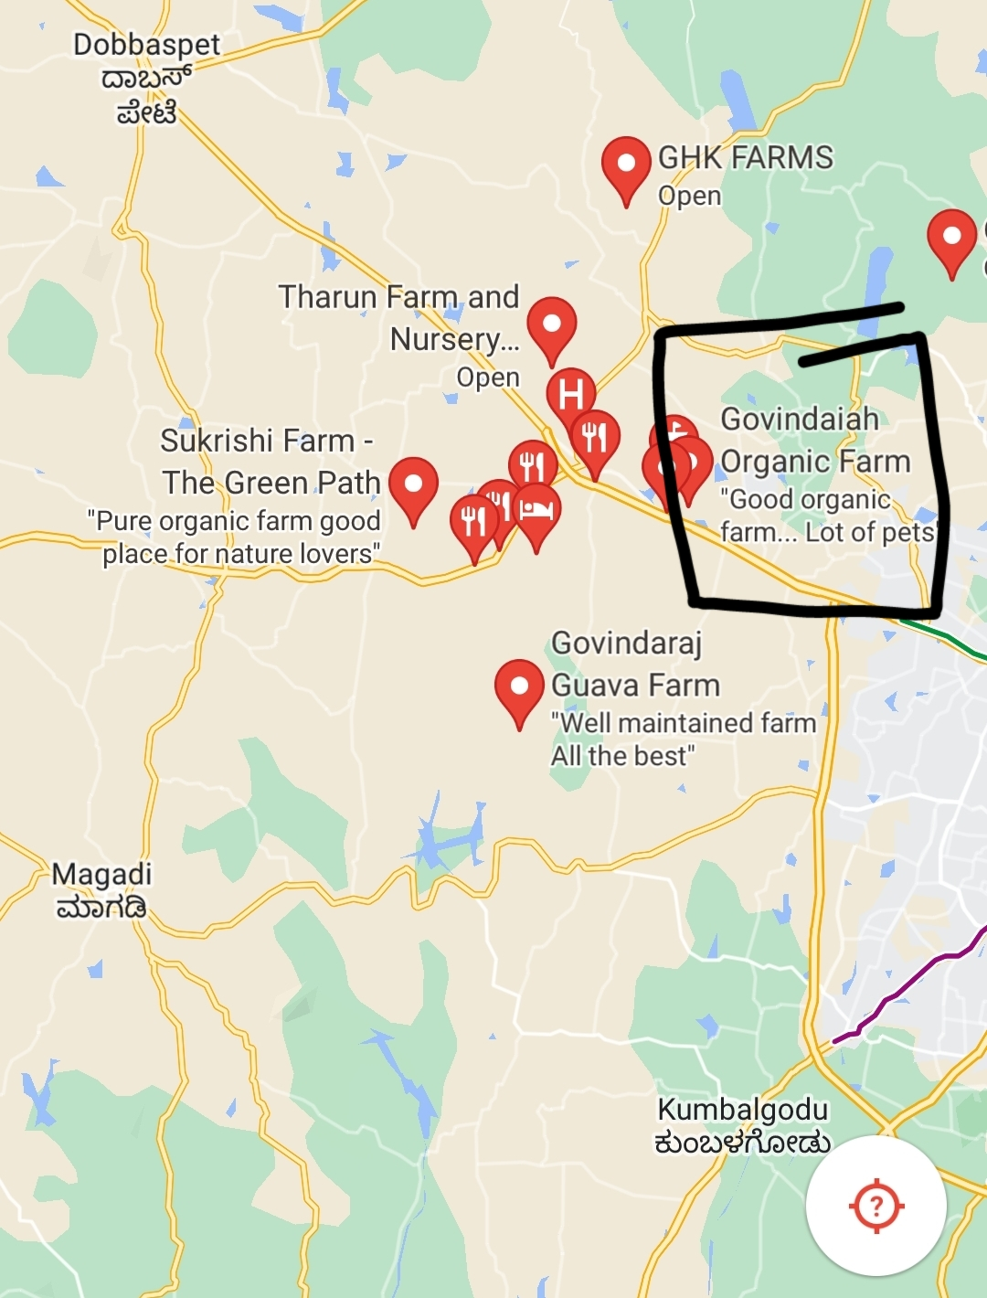
Mapping
Our school papaya plantation
Buddihal vajrakattepalya
Govinda ‘ s farm

Slide 9
Refrence
We visited our neighbourhood farm
Farm keepers and villages gave the information about weather plant species and animal habitat
We collected pictures from there
We read few books from our library

Slide 10
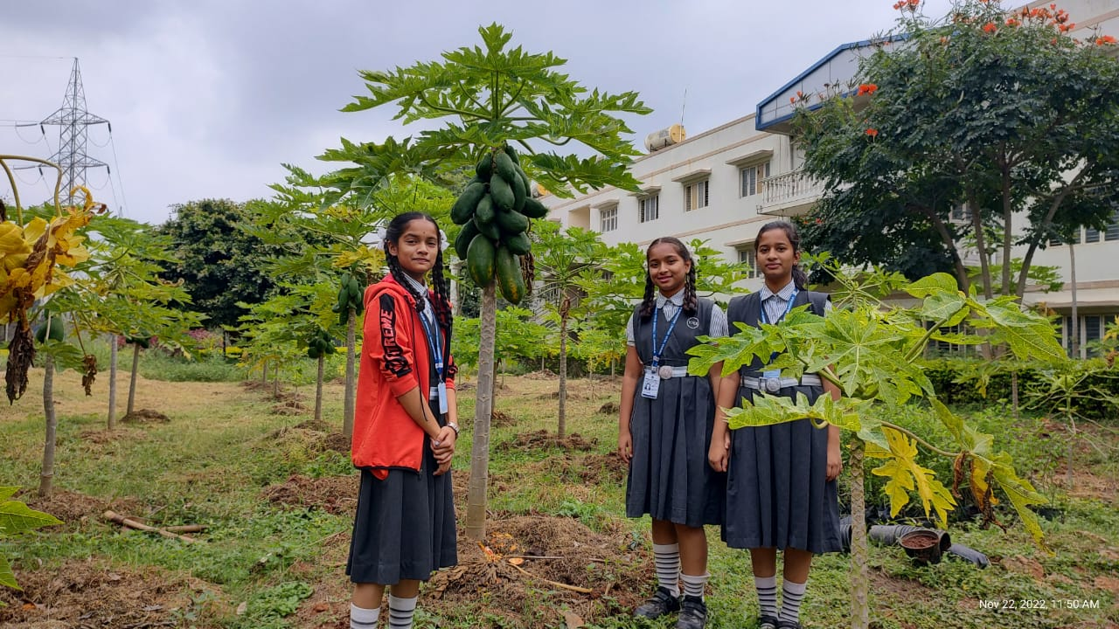
REVIEW
Our visit to farm:
We always had intrest in farming but we constantly tought of doing healthier way of farming.
So we took this particular topic to spread awareness across the world.
Our school had inspired us and encouraged us by showing us the importance of organic farming.
Where our own school is doing farming in an organic way by using only manure, Dry leaves, plant straws.

Slide 11

Credits
We thank our Vagdevi Vilas Institutions our Respected chairman Dr. Harish sir for giving us this wonderful opportunity We thank our principal sir for supporting us in every stage, science teachers R and D teachers and our Parents we Thank you all.😊

Slide 12

Thank you

