Slide 1
Prospects of Renewable Energy & Energy Conservation ( Solar, Bio, Wind, Hydro . . . )
Neha V. Koorse, IX Std, Vagdevi Vilas School Marathahalli

Slide 2
Prospects of Renewable Energy & Energy Conservation | Introduction
Energy - necessary for production and therefore economic growth
Any negative setback to energy supply or energy wastage will have impact on the Economy.
Conventional Energy - fossil energy has limited availability, direct impact on the Environment
Renewable Energy – from sources that are replenishable by themselves – solar, bio, wind, hydel, wave
Energy classification
Energy type
Long term Availability
Conventional Energy
Coal, Ignite, Oil & Gas, Electricity - thermal, hydro, nuclear
Non Renewable Energy
Fossil fuels like coal, oil, nuclear fuels
Non-Conventional / New Energy
Solar, Wind, Tidal, Bio(gas/mass) energy, Tidal, urban waste
Renewable Energy
Solar, Wind, Tidal, Biomass energy
Nature of Availability
Traditional Usage
Primary Resources
Coal, natural gas, oil, biomass, solar, tidal, hydro, wind
Commercial Energy
Coal, Petroleum, Electricity
Secondary Resources
Electrical energy from coal/water, H from hydrolysis
Non-Commercial Energy
Wood, dung, straw in rural

Slide 3
Prospects of Renewable Energy & Energy Conservation | Objective
This project is an attempt to
Explore & Study of different types of non-Conventional or Renewable Energy and their benefits, their influence on environment, and their adoption over the years, and promise for the future.
the progression of Renewable Energy, especially Solar & Bio energy and its prospects in India towards sustainable development
the steps taken to minimize the energy consumption, energy wastage, towards Energy Conservation

Slide 4
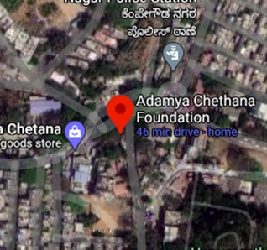
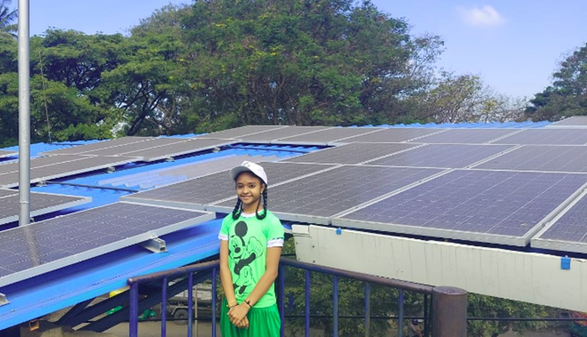
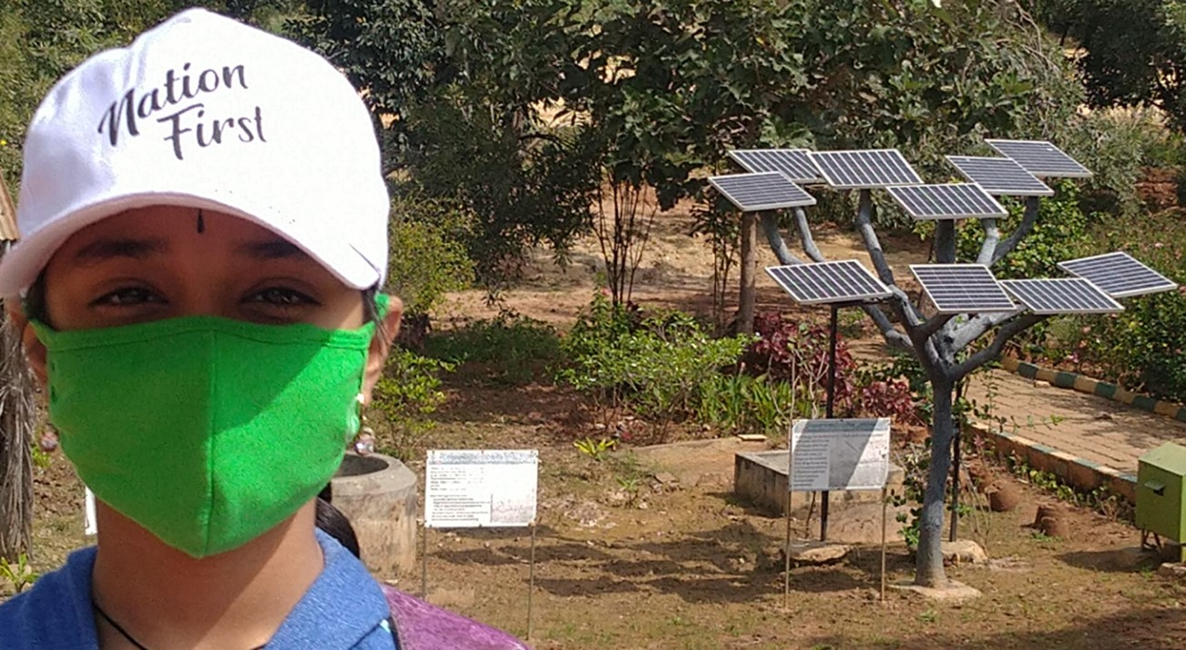
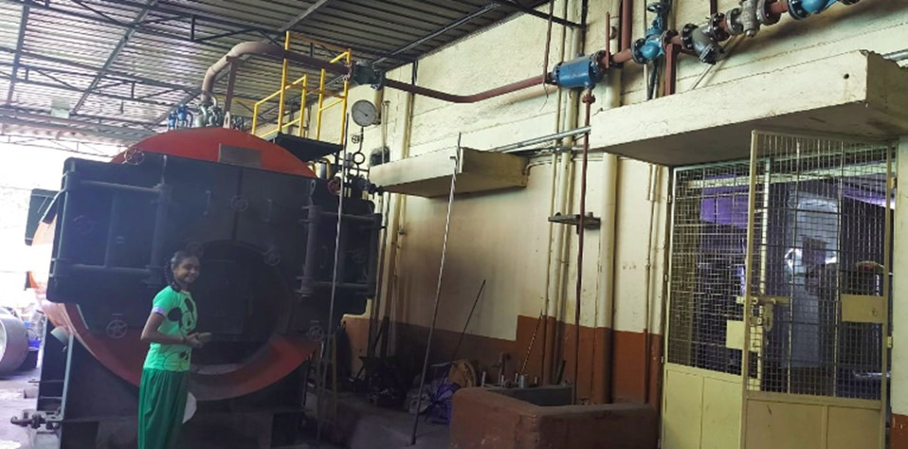
Prospects of Renewable Energy & Energy Conservation | Materials & Methods
Study Area :
Adamya Chethana (ACF), Basavanagudi
for Solar & Bio Energy
Material & Methods :
Site Visits to ACF, Basavanagudi
Study of Renewable Energy based Kitchen and actual Solar Panel, Bio fuel energy installations
Demonstration and explanation of Renewable energy concepts, installations of Solar & Bio Energy at ACF
Research & self study thro’ google web search content & videos

Slide 5
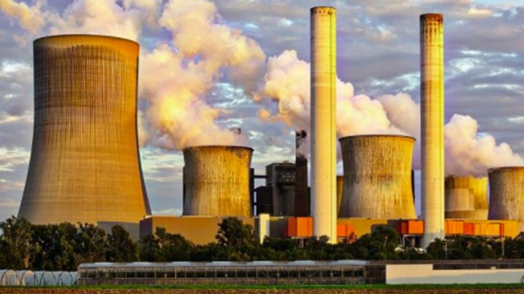
Renewable Energy importance, now more than ever ?
Energy & Environment go hand in hand, have direct relationship
Climate change is a major issue with many energy sources
Peak Energy shortage or demand supply gap as per 18th Electric Power Supply is about 11%, with energy demand increasing by the day
Conventional / Non-Renewable Energy
Most of the Energy(conventional) sources are non-renewable and are getting depleted due to over usage
Energy Production has direct influence on Environment degradation. More so with the extraction of conventional energy like fossil fuels, that result in green house gases causing the acid rains, neuro toxins, smog, global warming resulting in various health hazards like asthma, cancer,
Non-Conventional / Renewable Energy
Available in plenty from natural sources like sun, wind, tides and for long term without the worry of getting depleted
Cleanest source of energy with minimal or no environmental side-effects
Most suited for large scale production as well as small and non-commercial usage
Need of the hour is the wise & new ways of energy generation & utilization without the climatic changes. Prospects of Renewable Energy seems to be the best solution for sustainable development
Notes:
Energy & Environment go hand in hand, have direct relationship
Energy is at the heart of many of our current environmental problems
Peak Energy shortage or demand supply gap as per 18th Electric Power Supply is about 11%

Slide 6
Renewable Energy | Prospects
Available in plenty from natural sources like sun, wind, tides, bio mass/waste and for long term without the worry of getting depleted
Cleanest source of energy with no or little environmental side-effects
Most suited for large scale production and small & non-commercial usage
India is 3rd biggest RE producer in 2021, 3rd largest RE attractive index
Notes:
Energy & Environment go hand in hand, have direct relationship
Energy is at the heart of many of our current environmental problems
Peak Energy shortage or demand supply gap as per 18th Electric Power Supply is about 11%

Slide 7
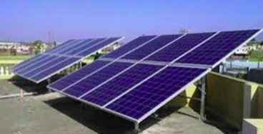
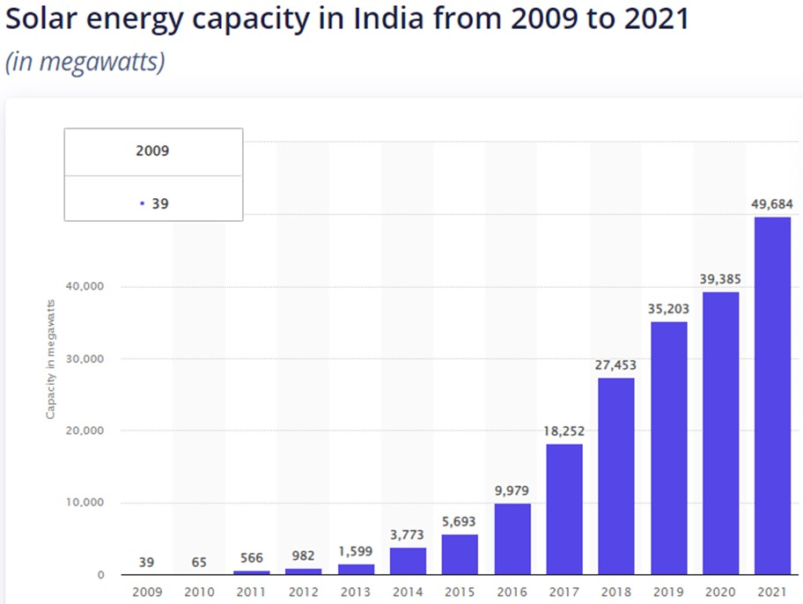
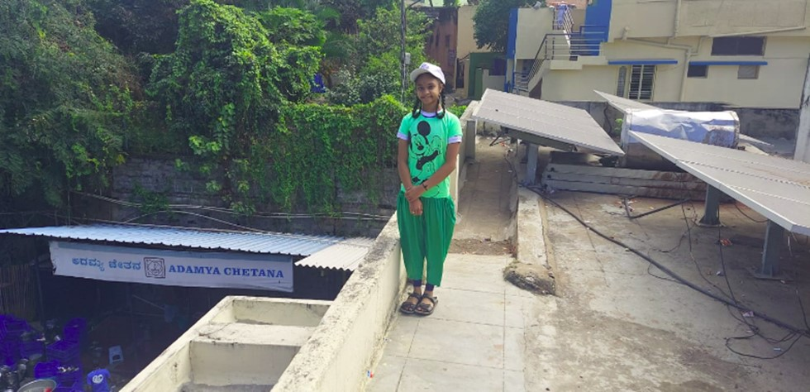
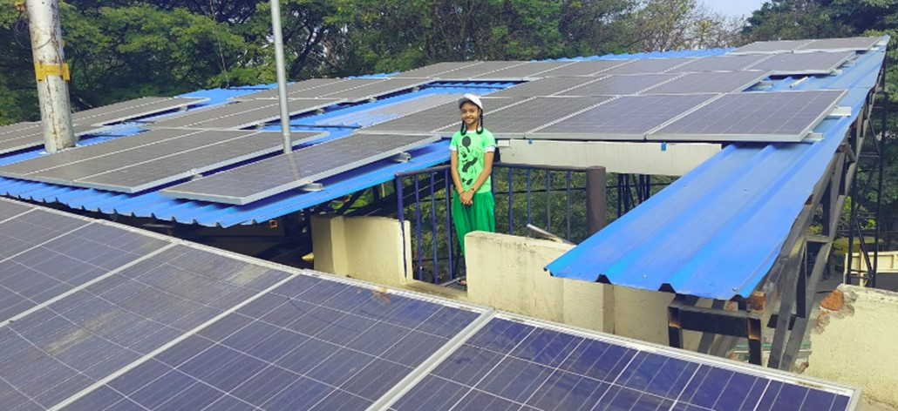
Renewable Energy | Solar Energy
One of the cleanest renewable energy converted from Sun, with no greenhouse emissions
India ranks 4th globally, thx to multiple technology options improving at fast pace,
Efficiency of Solar cells & Reliability of panels are being improvised continuously
Technology Options
Thermal – for heating
Cooking – solar box type cooker, solar parabolic cooker, drying, water heating(flat, tubular),
solar ponds, industrial heating
Photovoltaic, PV – for electricity
Mono crystalline(silicon, most efficient), poly crystalline, thin film
Off grid(with battery), On grid(no battery), Hybrid(both battery + grid)
Solar DC home lighting, Solar Tree, Water pump, Solar hoarding, dusk 2 dawn Solar Street lights & Signal lights
Monthly 5 KW of energy generated at ACF from the Roof Top mounted Solar Panel, replacing Bescom Electricity

Slide 8
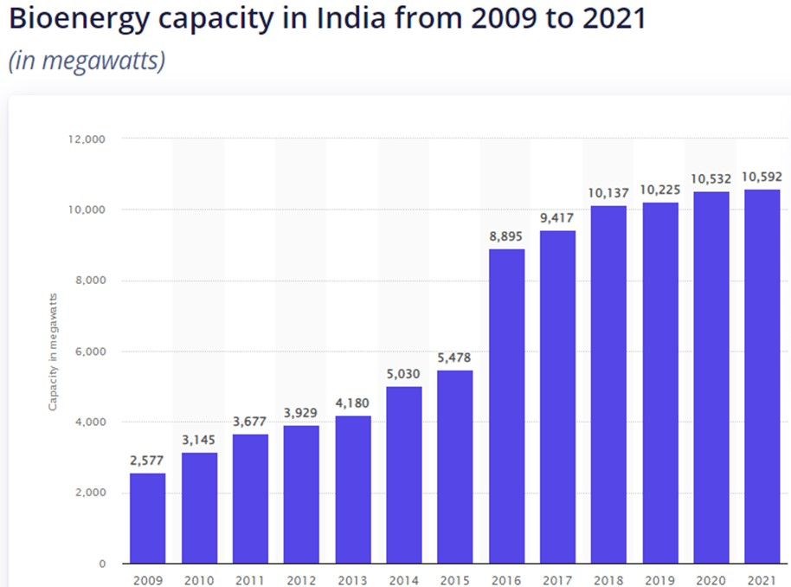
Renewable Energy | Bio Energy (biomass)
Generated from Urban waste, bio mass, wet & solid waste
Can be generated in a small scale or in large scale
India ranks 4th globally, 10.6 GW production
cheaper, less harmful to environment, reduces Urban waste
1,500 Kgs Briquets, pallets from Urban waste used for Steam cooking daily at ACF
Bio gas generated from 100 Kg of waste inhouse is used for small cooking daily at ACF
60 commercial Gas Cylinders and 300 ltrs of Diesel consumption are not only daily savings at ACF, but the reduction of non-renewable energy that emit1,800 Kgs of CO2 into environment daily

Slide 9
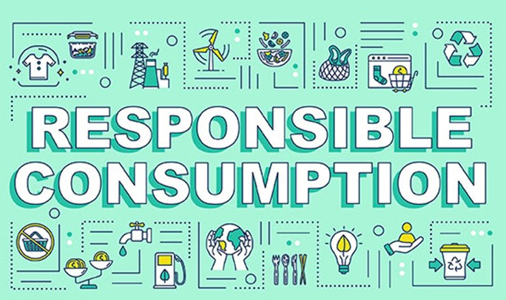
Renewable Energy | Prospects of Energy Conservation
Energy Conservation is not just an Option, it is a MUST, . . . . . . let us be RESPONSIBLE
Use School buses, public transport, cycles
Plant trees in the neighborhood, community, cities for more shades and reduction in temperature
Use energy efficient household appliances & devices that come with Energy Star labels
Turn off lights, geysers, ACs, water flows when not needed
Use LED / CFL / smart bulbs (auto/sensor based)
Energy saved is Energy generated !!

Slide 10
Prospects of Renewable Energy & Energy Conservation | Recommendations & Conclusion
Recommendation
Expand the Solar Energy adoption in the Schools, Offices, households
Educate, Install and use Bio energy, reduce waste
Minimize the non-renewable energy like LPG, Electricity and so on,
Conserve Energy, minimize the energy wastage
Polar or Kolar, go Solar
Conclusion
Embrace the Renewable Energy,
There is only one Planet Earth, let us Save our Earth

Slide 11
References & Credits
Adamya Chethana, Annapurna Kitchen for Solar Energy, Bio gas
R&D, Vagdevi Vilas School,
Ministry of Power, GoI
Statista, a global Survey, and various other resourceful websites
Thank You

