Slide 1
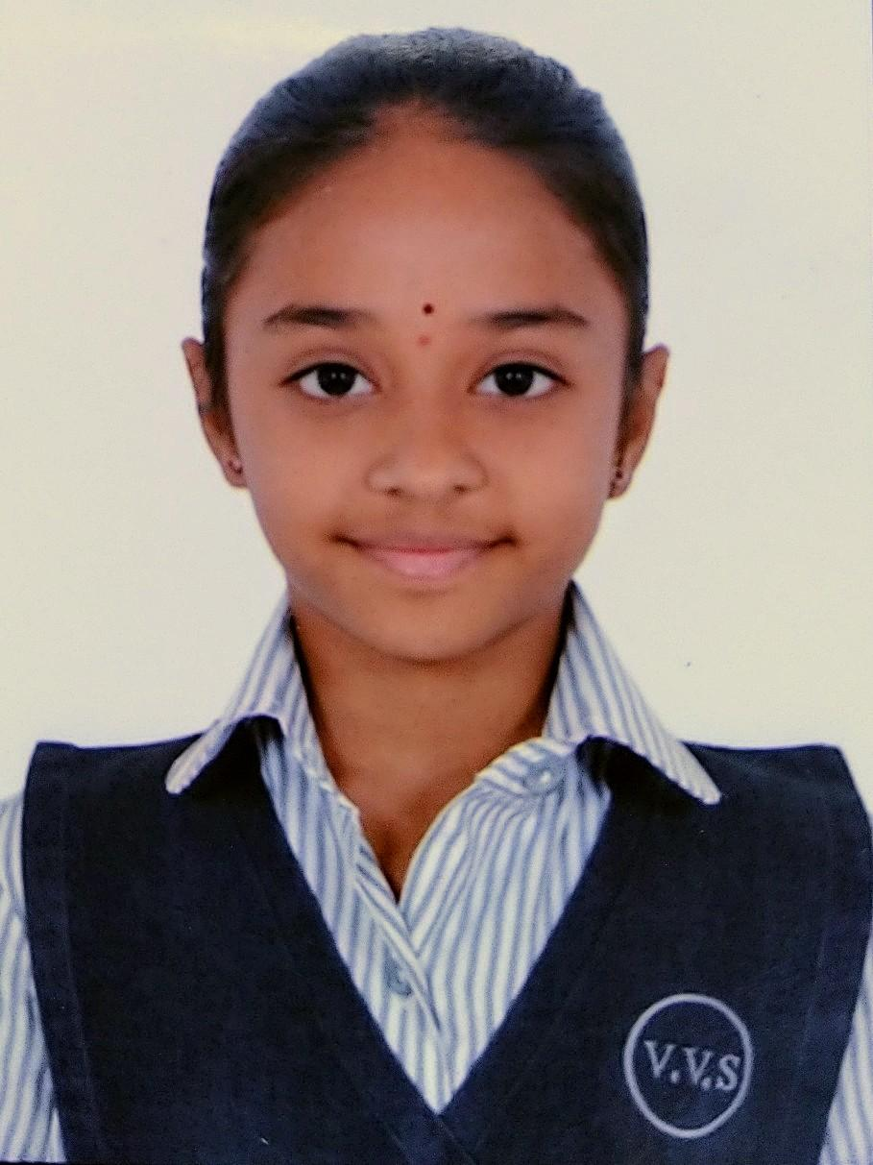
Sustainable Agriculture & Organic Farming
Poster
Neha V. Koorse, IX Std, Vagdevi Vilas School Marathahalli

Slide 2
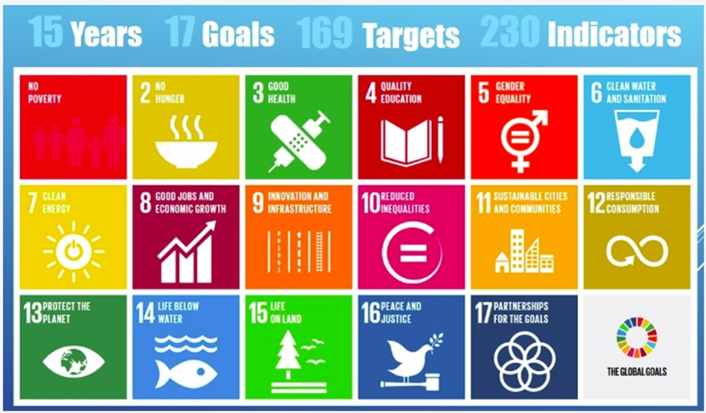
Sustainable Agriculture & Organic Farming | SDG Goal 2 of 17
Sustainable Agriculture
Organic Farming

Slide 3
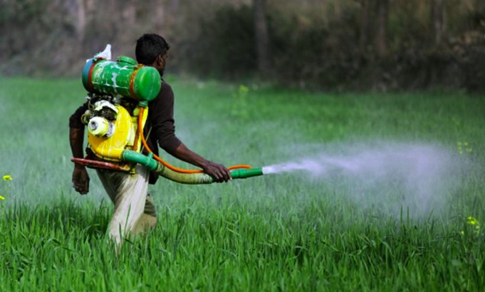
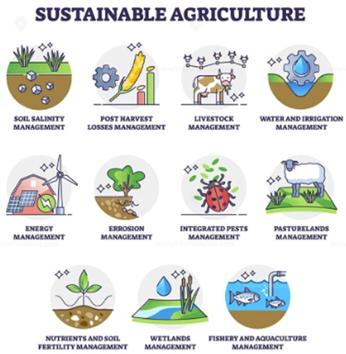
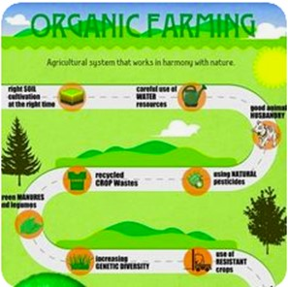
Agriculture Types
Conventional Farming
non-natural based >>
<< nature based >>

Slide 4
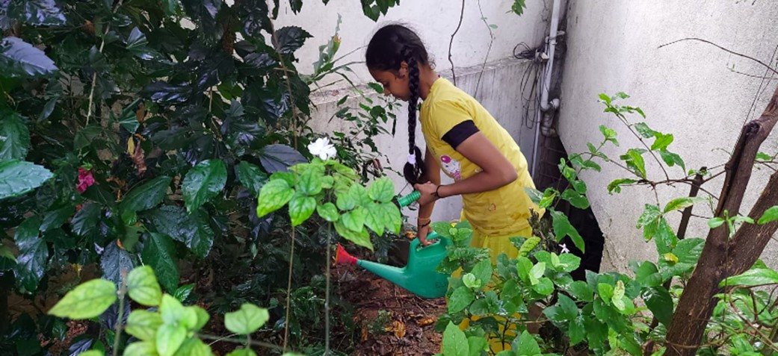
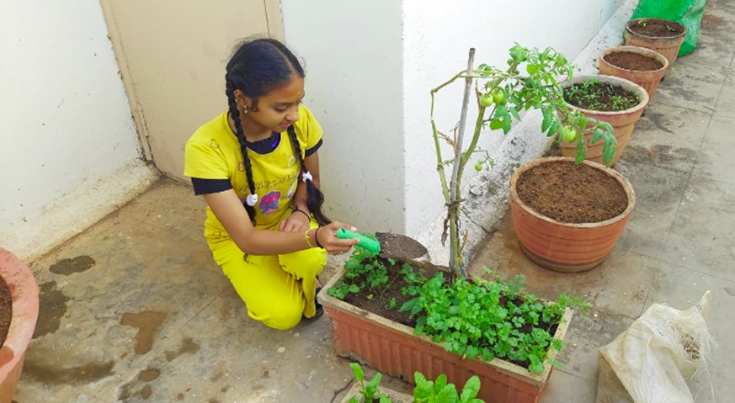
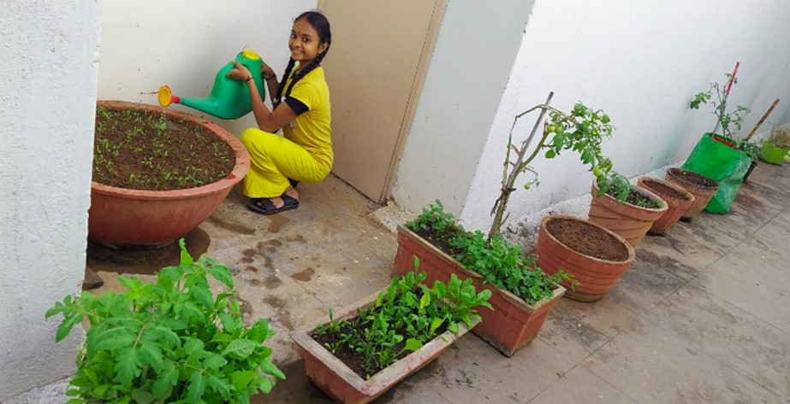
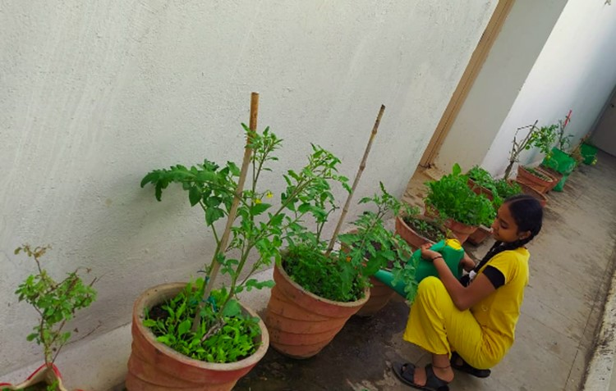
Sustainable Agriculture & Organic Farming | thro Terrace & Backyard Gardening

Slide 5
Sustainable Agriculture & Organic Farming | the Future
Recommendations & Contributions
Collect data, Analyze & Support - Government
Educate farmers on Alternate / Natural Agriculture techniques
Short term transition Support to Farmers
Motivate – Incentivize towards conservation, Outcome based Rewards
Promote, Scale up
Should be covered as Science / Social syllabus for Schools & Colleges
Should be taught as Practical/Field Labs from the early years
Motivate the young generation thro promotions & best practices
Organic Produce should be provided to Schools at discounted price
UG, PG & Research courses on Natural Farming
Encourage, embrace Home & Terrace Veg Gardening
Use Vermicompost, Green waste manures
Thank You

