Slide 1

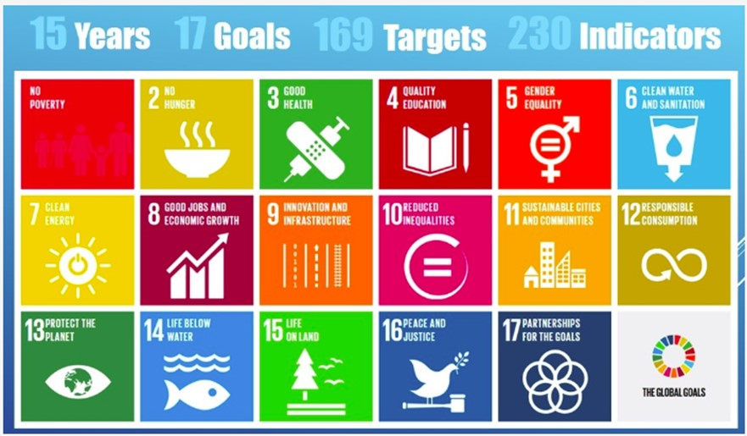



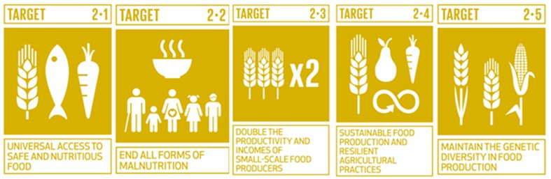








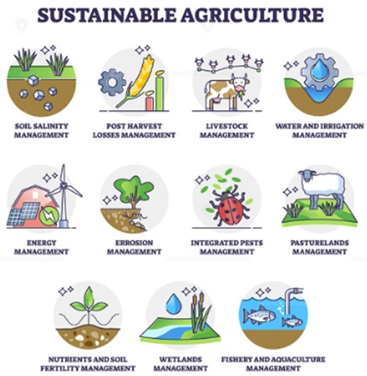
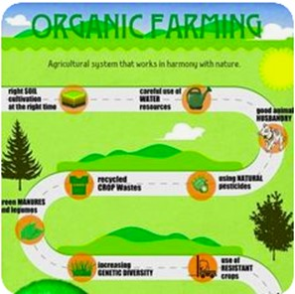
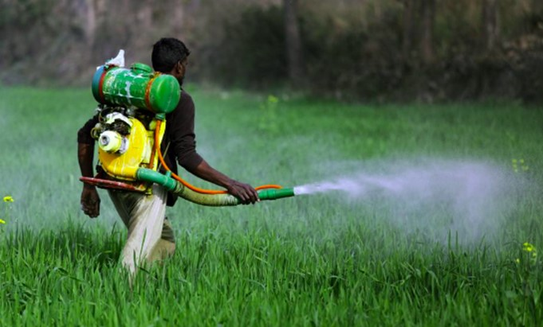
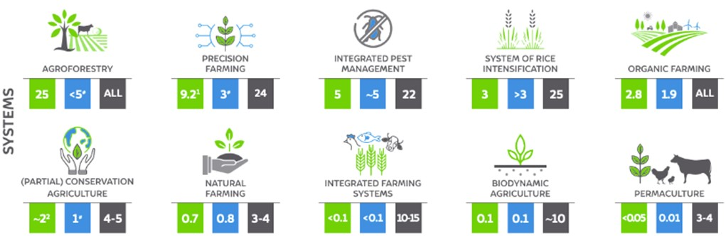
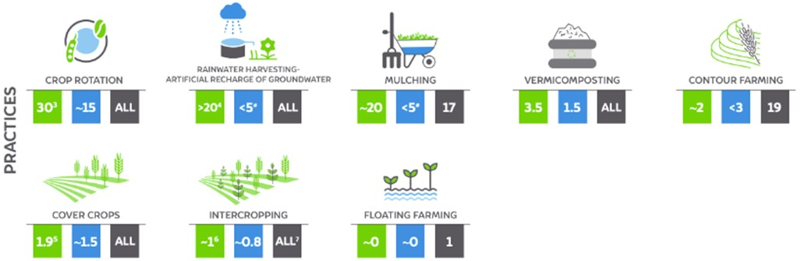

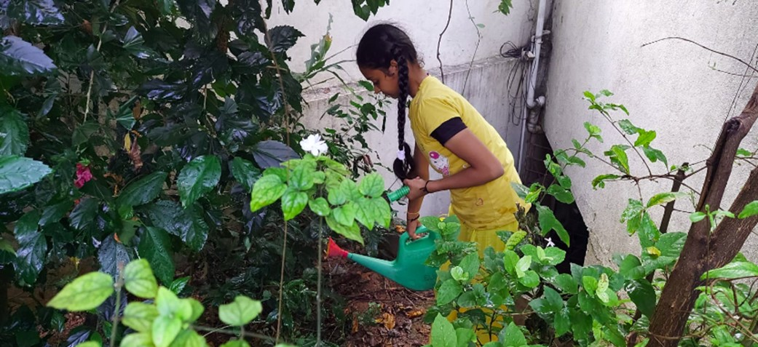
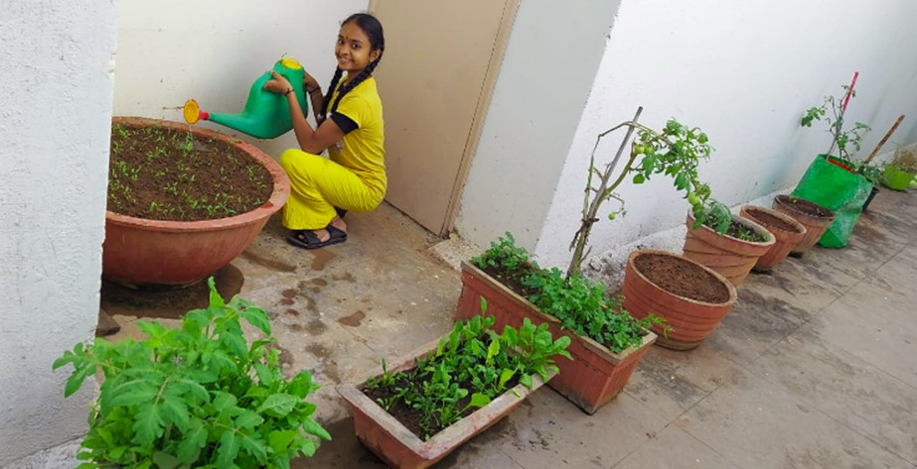
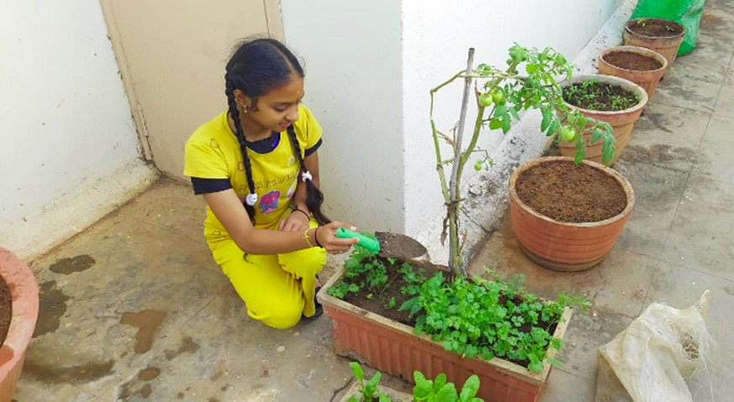
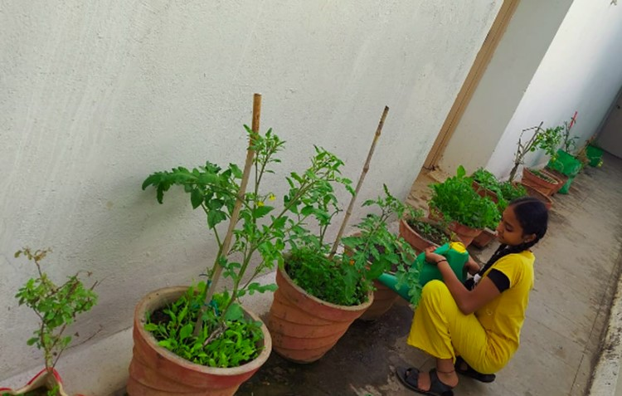

Sustainable Agriculture & Organic Farming
Authors : Neha V. Koorse, IX Std, Vagdevi Vilas School Marathahalli Affiliations : -
Sustainable Agriculture
Sustainable Development Goals – 17 SDGs set by UN in 2015
Organic Farming
Ecosystem restoration
  Natural Resource Conservation & Utilization
  Soil fertility Improvement
Livelihood improvement
Minimal tilling
Ecosystem restoration
  Natural Resource Conservation & Utilization
  Soil fertility Improvement
Minimal synthetic pesticides, fertilizers
Sustainable Agriculture
Organic Farming
Economy
Environment
Society
Conventional Farming, non-natural based
Sustainable Agriculture & Organic Farming Practices & Systems in India – 2021 key Statistics
Recommendations & Contributions
Collect data, Analyze & Support - Government
Educate farmers on Alternate / Natural Agriculture techniques
Short term transition Support to Farmers
Motivate – Incentivize towards conservation, Outcome based Rewards
Promote, Scale up
Should be covered as Science / Social syllabus for School & College
Should be taught as Practical/Field Labs from the School days
Motivate the young generation thro promotions & best practices
Organic Produce should be provided to Schools at discounted price
UG, PG & Research courses on Natural Farming
Home & Terrace Veg Gardening
Vermicompost, Green waste manures
thank you
Ref : | CEEW SAPS India Report 2021, from Google search, Statista, Research Gate
Ack : Mr. Rajendra Hegde, Ms. Sindhu R&D

