Slide 1


Geoinformatics In Ecosystem Management
Presented By: Anushka Kanthi A , Adwaya P Menon, Dhanushree V

Slide 2
INTRODUCTION
Geoinformatics -The term is combination of two words- Geology or Geography and Informatics
powerful technologies to support basic scientific inquiry
address the complex social and environmental challenges through data analysis
It collects and organise the data and then analyse it through computation and geo-visualization

Slide 3
Objectives
Wildlife Protection & Gathering Water Resource Data For a better ecosystem management with the help of GIS
Problems Faced And Solution

Slide 4
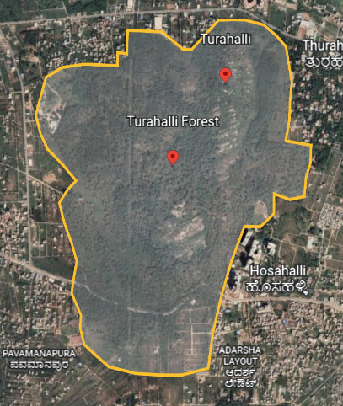
STUDY AREA- TURAHALLI FOREST
AREA:- 590 ACRES
LATITUDE:- 12.8º N
LONGITUDE:-77.5º E
^{REFERENCE LINK:}
https://en.wikipedia.org/wiki/Turahalli_Forest

Slide 5
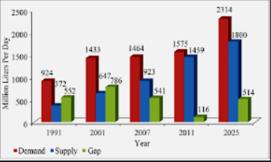
.
.
GATHERING WATER RESOURCE DATA
Water plays a very crucial role in maintaining the ecosystem and balancing the harmony in nature
GIS takes a high contrast picture of water level in a particular field of view, which is sent to the state for proper management of water
https://www.researchgate.net/figure/Demand-and-supply

Slide 6
THREAT 1
Animals move from one side to the other side of the road, in search of food, water, etc.
When animals cross the road they get hit by the vehicle
In general, there are 3 types of losses-
  Human death
  Animal death
  Loss of human property
Continuous monitoring and tracking of animals is difficult due to its large size and fast movement

Slide 7
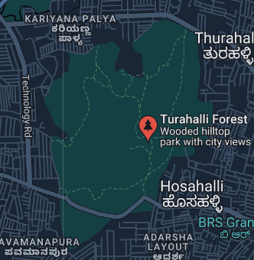
ACCIDENT PRONE ZONES IN TURAHALLI FOREST

Slide 8
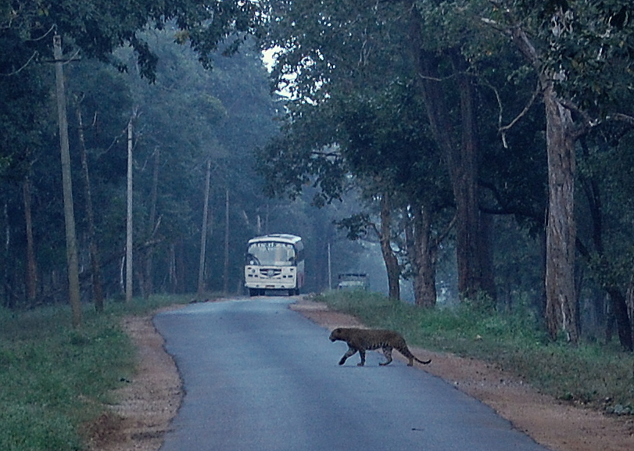
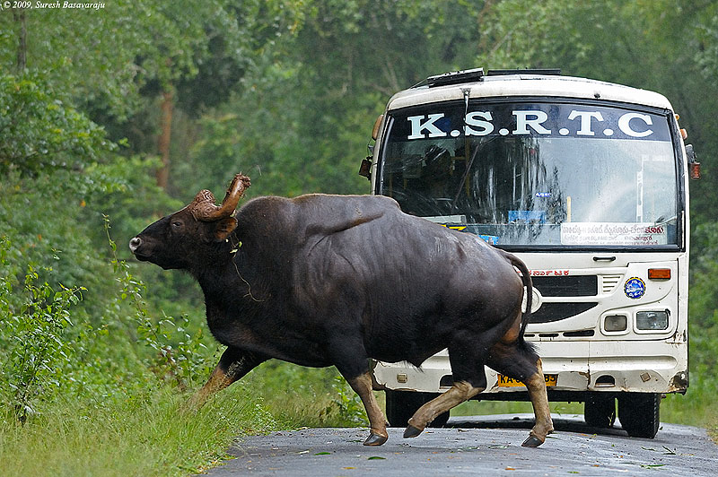
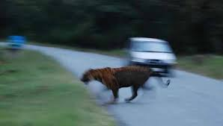
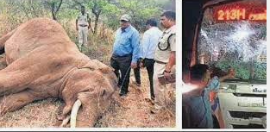
Incidents Occurred Recently
Leopard Crossing road, Mysore — Mananthavadi Highway, Nagarahole
Bull Gaur Crossing Road, Nagarahole
23th May 2022
27th March 2022

Slide 9
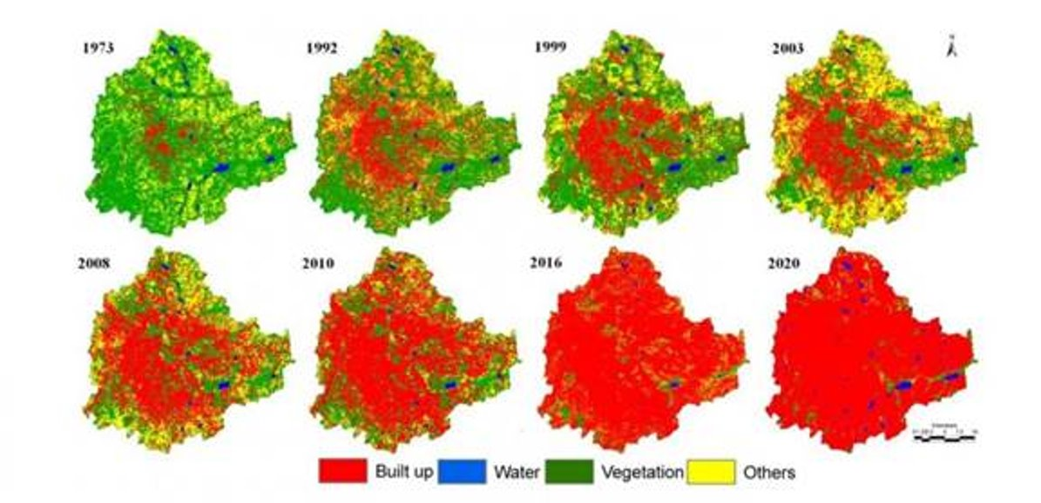
THREAT 2
The animals forcefully were moved into new localities where there aren’t much resources like water, food, etc.
They have no other option rather than coming into the human habitation in search of food and water
Picture Credits: IISc website https://iisc.ac.in/

Slide 10
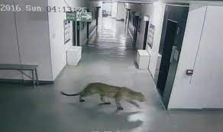
Leopard Entering In School Premises

Slide 11
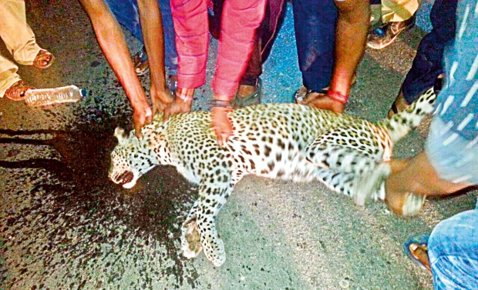
A leopard reported dead by a hit and run case
A leopard was recently spotted near an apartment complex on Bannerghatta Road
The CCTV camera caught the leopard sneaking into the Prestige apartment building for the second night in a row.

Slide 12
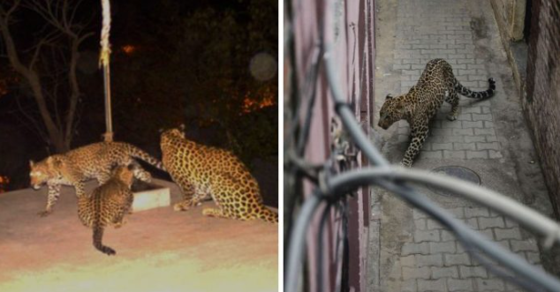
4 Leopards spotted in the city; Authorities on ‘High Alert’
https://metrosaga.com/panic-in-bengaluru-as-4-leopards-spotted-in-the-city-authorities-on-high-alert/
December 3rd 2022

Slide 13
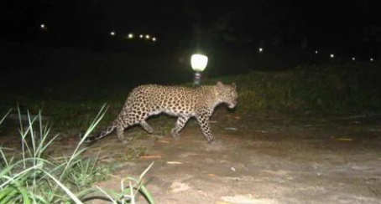
23-yr-old woman killed in leopard attack in Mysuru

Slide 14
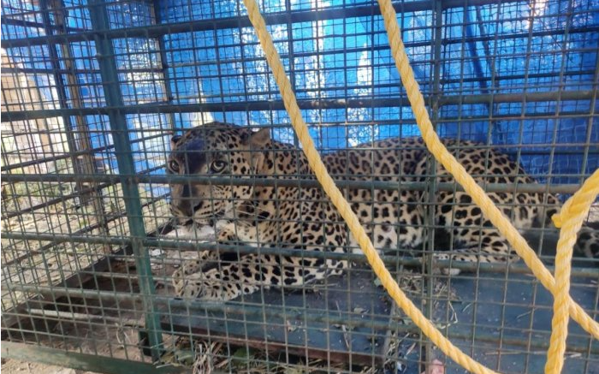
LEOPARD CAUGHT COMING OUT OF TURAHALLI FOREST

Slide 15
Solution for Threat- 1
Each and every time personal visit to the forest to check the water level is not convenient
Hence GIS can help us in checking the level of water of waterbodies
Even they can tell us about the groundwater level is low or high in a particular area

Slide 16
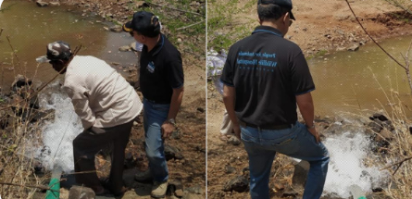
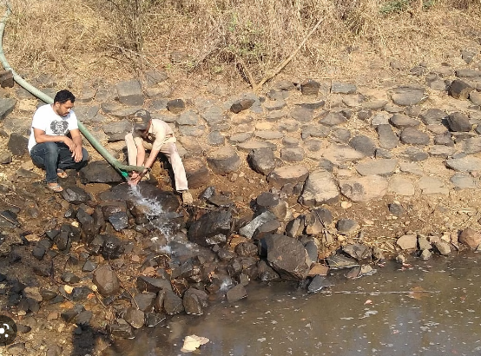
NGO SUPPLYING WATER IN PONDS OF TURAHALLI FOREST
Date : April , 2019

Slide 17
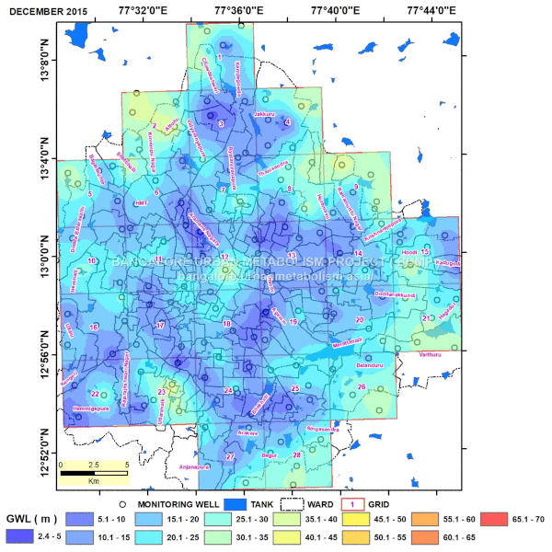
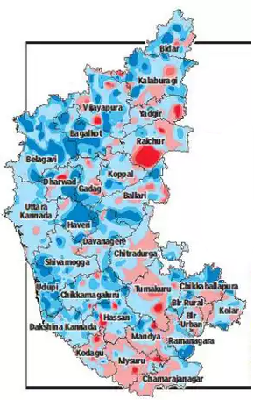
USING GIS TO TRACK GROUNDWATER LEVEL IN BANGLORE
http://bangalore.urbanmetabolism.asia/2017/10/23/groundwater-table-maps/

Slide 18
PROPOSED SOLUTION FOR THREAT 2
GIS helps us to locate the accident prone areas and pre – warns us in any such case
Barricade like structure using barbed wires can be built to prevent the animals from entering the either road.
Vibratory or static sensors to prevent the animals from destroying the barricade.
Buzzing sound and alarm lights to scare the animals
CCTV’s to notify the nearest forest office.

Slide 19
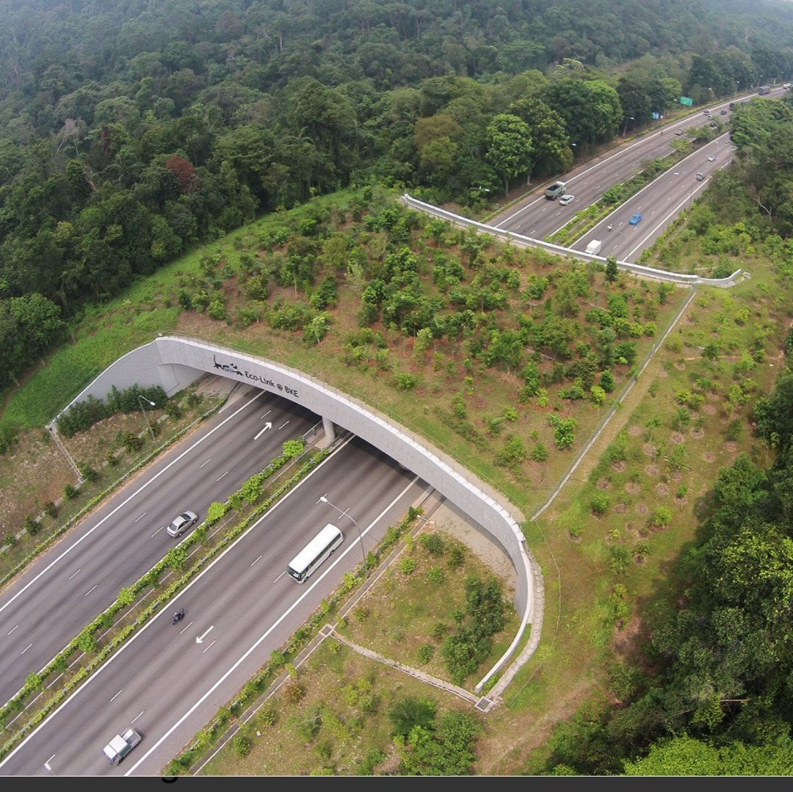

Slide 20

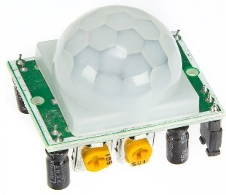
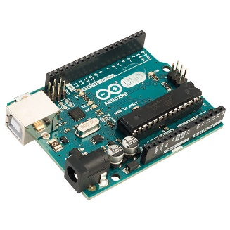
Materials Required:
Materials Required:
Aurdino UNO
Barbed wires
Buzzer
Motion sensor
Vibrator & etc.
Barbed Wires
motion Sensor
Arduino UNO

Slide 21
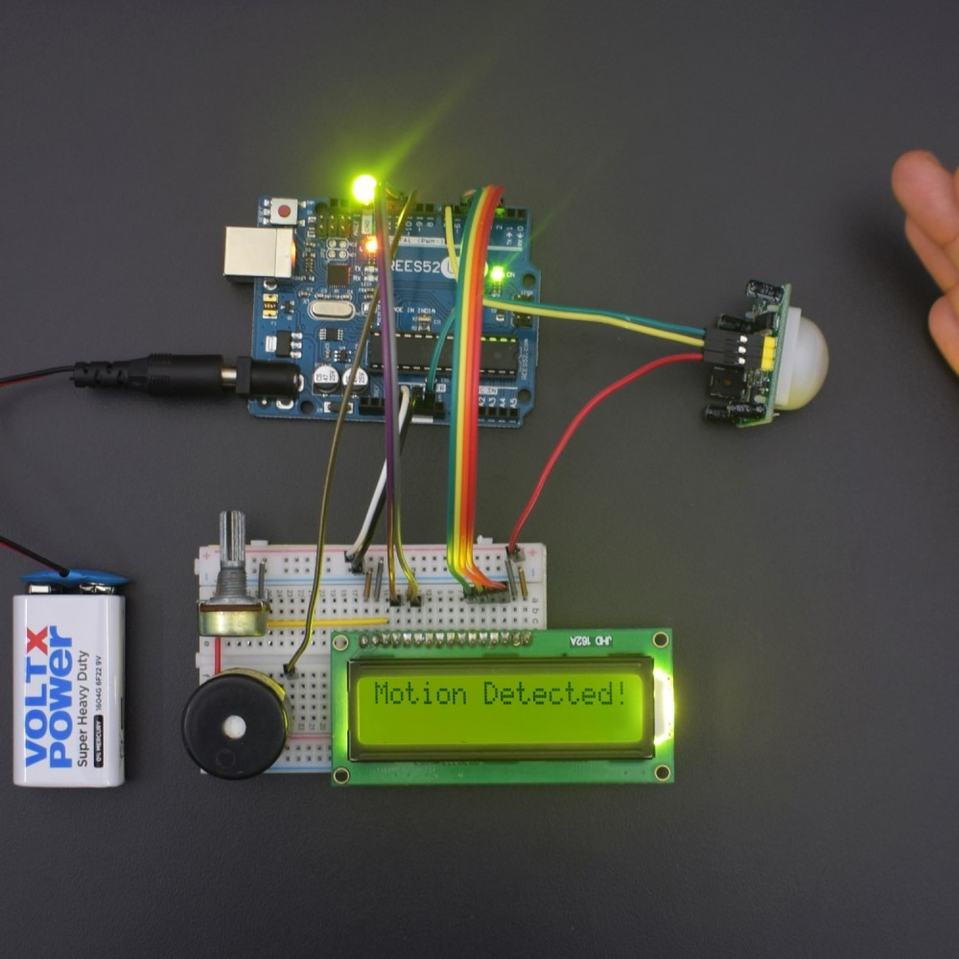
Animal Detected by the motion or static sensor
Sends signal to Arduino UNO 3
Arduino produces the beeping sound after receiving signal from Arduino UNO 3
Using C++, we will program the Arduino board to give a beeping sound when motion is detected

Slide 22
CONCLUSION
GIS is very helpful for our basic needs like google map, Hot spot analysis etc.
It’ll be helpful to use GIS in such a useful, protective way, where we can protect our wildlife from becoming extinct.

Slide 23
REFERENCES:-
https://www.deccanherald.com/metrolife/metrolife-cityscape/encroachment-of-forest-spaces-displaces-wildlife-948049.html
https://thelogicalindian.com/story-feed/get-inspired/ngo-replenishes-ponds-turahalli-forest/
https://www.newindianexpress.com/states/karnataka/2020/dec/07/leopard-on-prowl-stay-indoors-after-dusk-2232751.html
https://iisc.ac.in/
https://en.wikipedia.org/wiki/Turahalli_Forest
https://www.deccanchronicle.com/141014/nation-crime/article/high-speed-horror-leopard-dies-road-accident-bengaluru?page=2
https://www.newindianexpress.com/cities/bengaluru/2022/mar/27/bmtc-bus-crashes-into-elephant-kills-it-2434759.html
https://www.google.com/search?q=animals+getting+hit+by+the+vehicles+in+karnataka&rlz=1C1CHBF_enIN975IN975&source=lnms&tbm=isch&sa=X&ved=2ahUKEwjX6ZiOg_v7AhUkkeYKHY5DA58Q_AUoAnoECAEQBA&biw=1024&bih=625&dpr=1

Slide 24
Acknowledgement
We would like to thank IISc who gave us this platform to express our views, thoughts and opinions
We would also like to thank our school and our R&D teachers who guided us and helped us with this project
We would also thank our parents who supported us till the end of the project

Slide 25


