Slide 1


CASE STUDY ON SHEELAVANTHAKERE LAKE
Bhargav Vishram Nandedkar (Grade IX)
Harish L Jadhav(Grade IX)

Slide 2
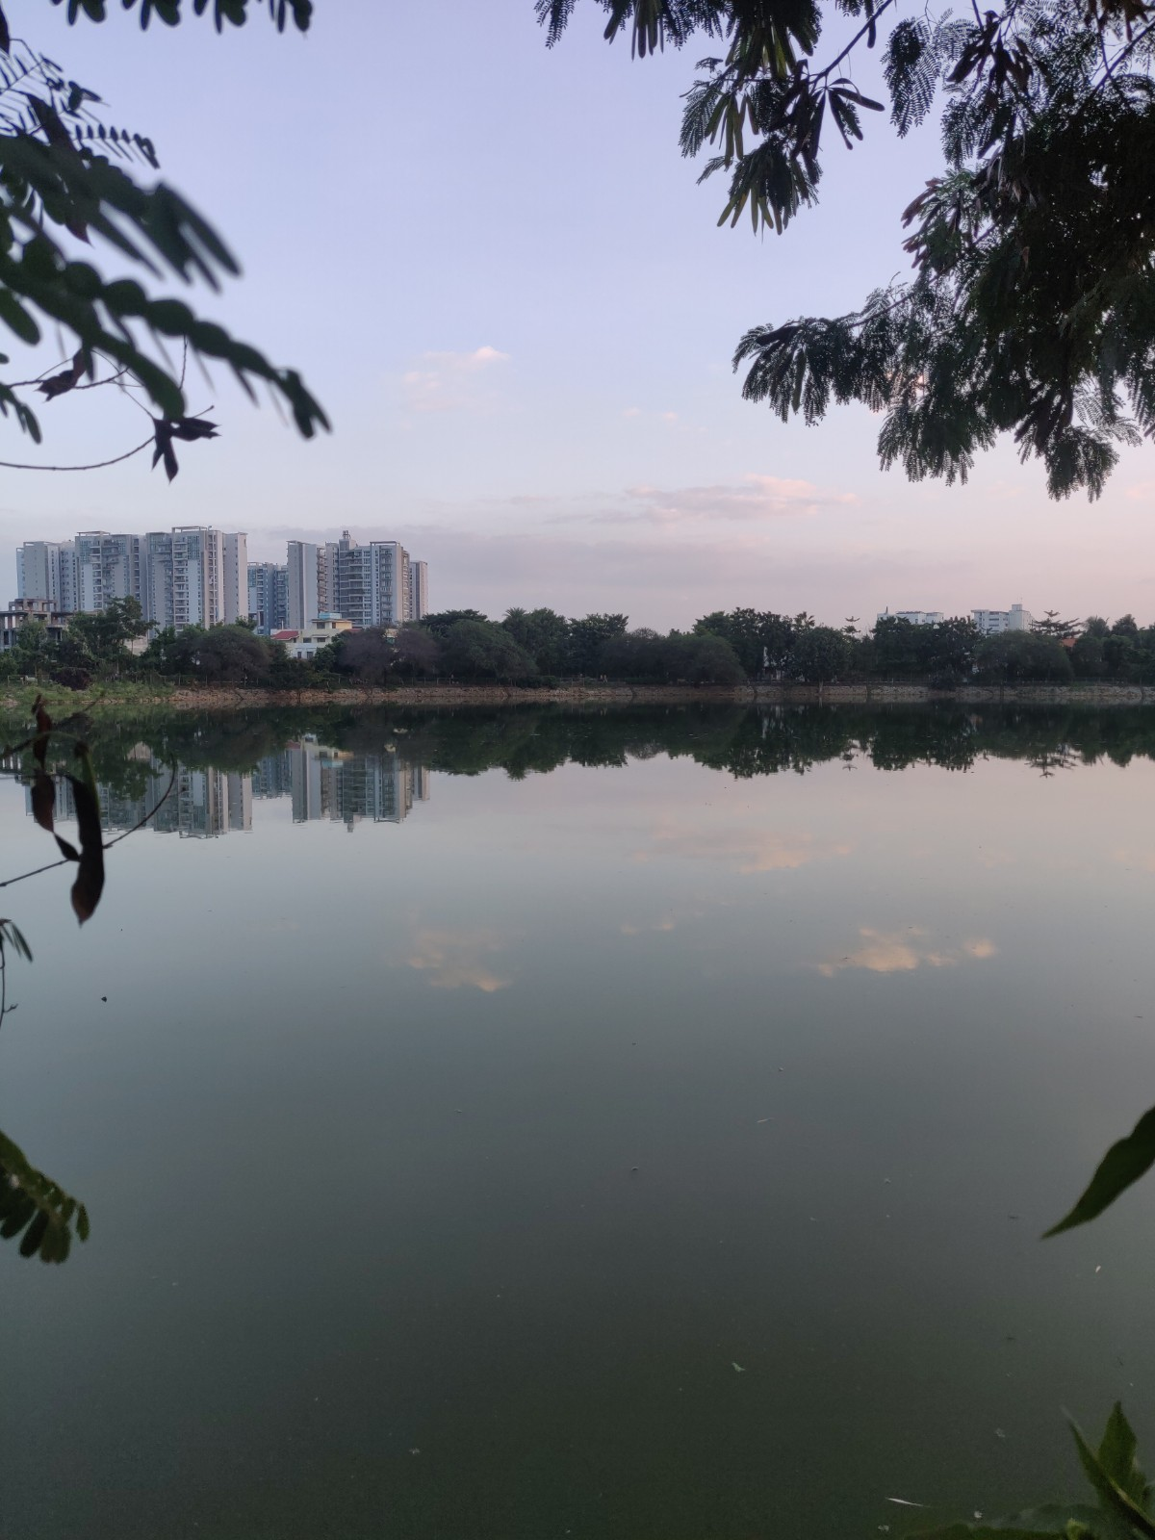
INTRODUCTION

Slide 3
ORIGIN OF THE LAKE AS WE KNOW
Originally, the lake was barren.
The number of trees were very less.
There were also little to no birds as there were no trees to build their nests on.
But this changed soon after. Many corporate employees took up an initiative to save this lake and planted nearly 1000 saplings.
This converted the lake from almost nothing to a lake comparable with one of the most beautiful lakes in Bengaluru.

Slide 4
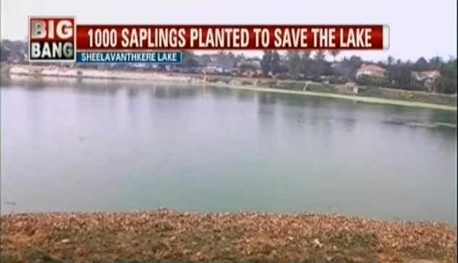
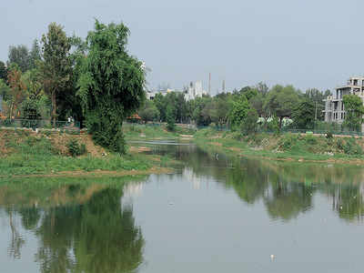
Before VS After

Slide 5
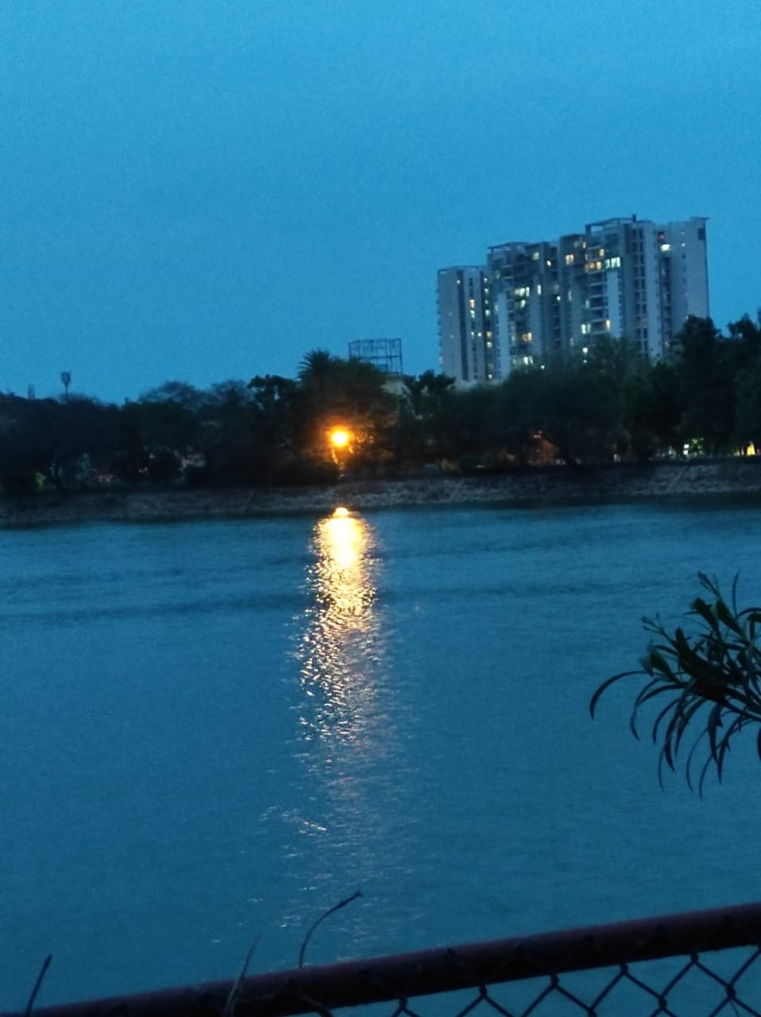
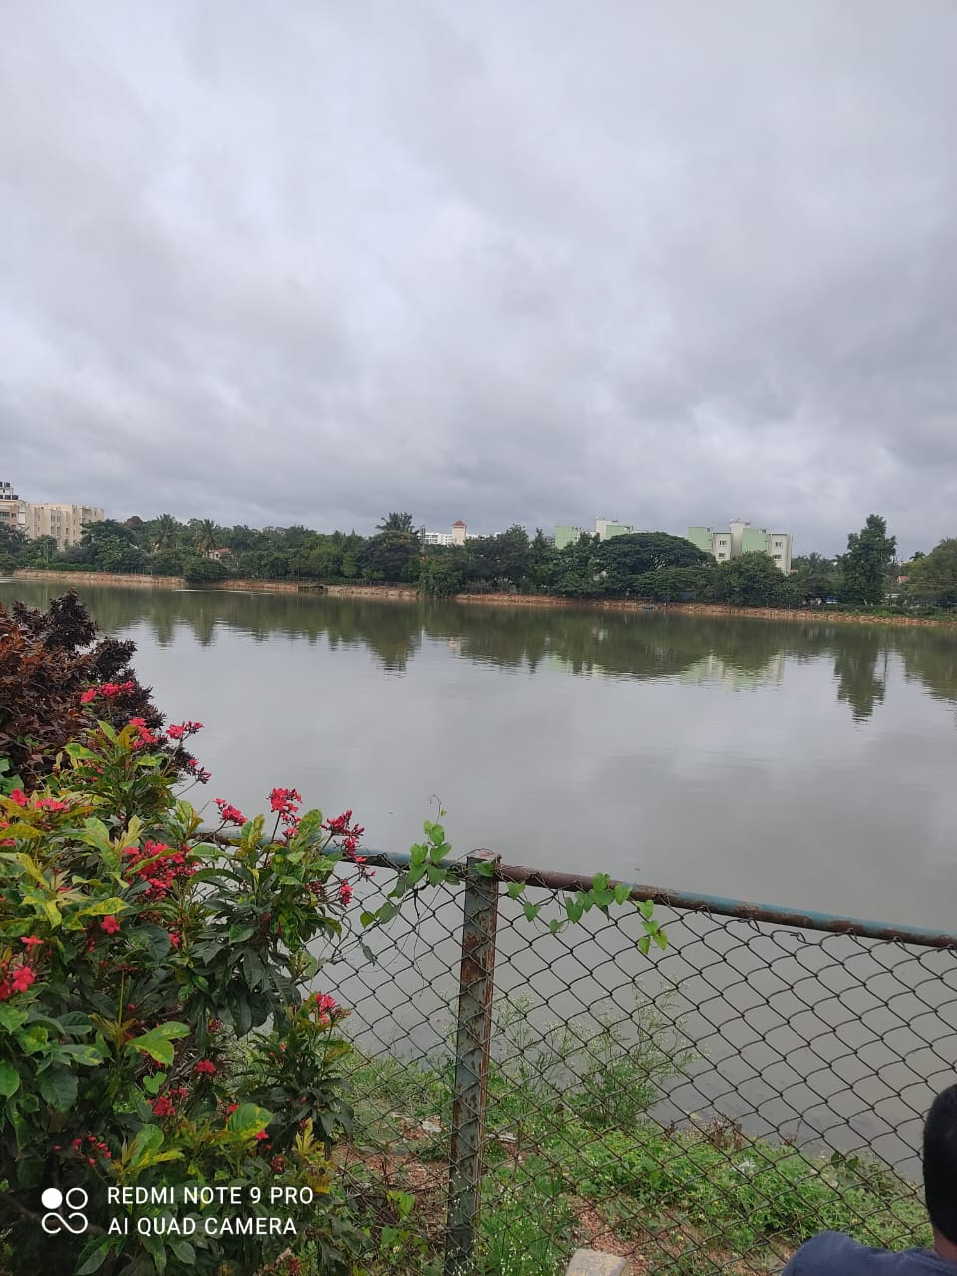
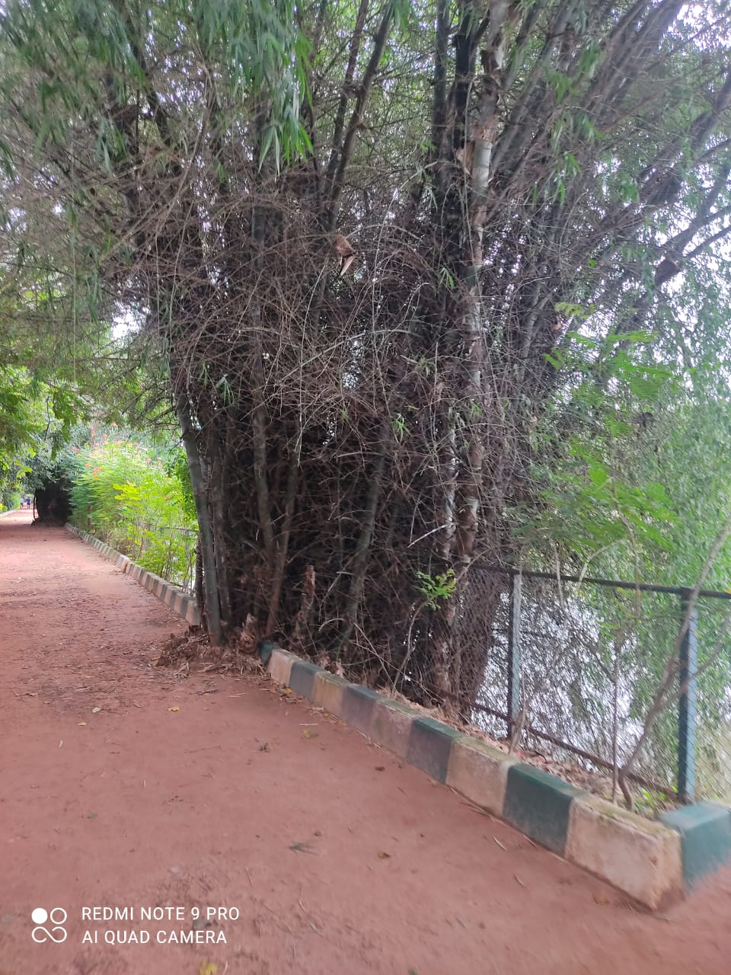
MAY 2022

Slide 6
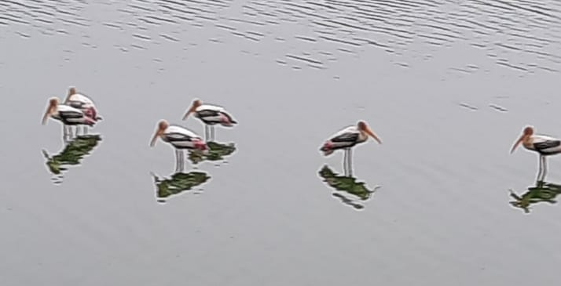
Picture of Painted storks in Sheelavanthakere taken in July

Slide 7
Observed changes in October 2022
There was a decrease in the number of fishes as the water was contaminated.
There was a reduction in the number of birds due to decrease in number of fishes.
There were also comparatively less insects.
The odour was very bad.

Slide 8
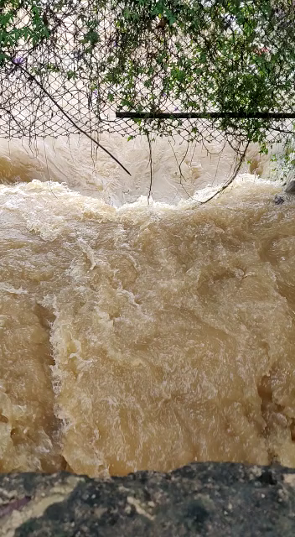
The Problem
Bengaluru was hit by a flood in August end and September
1st week.
This flood affected many water bodies including this lake.
The flood caused solid waste to go into the sewage pipelines.
This blockage created high pressure in the pipes leading to the burst of pipes.
This lead the sewage into the storm water drainage system going into the lake.

Slide 9
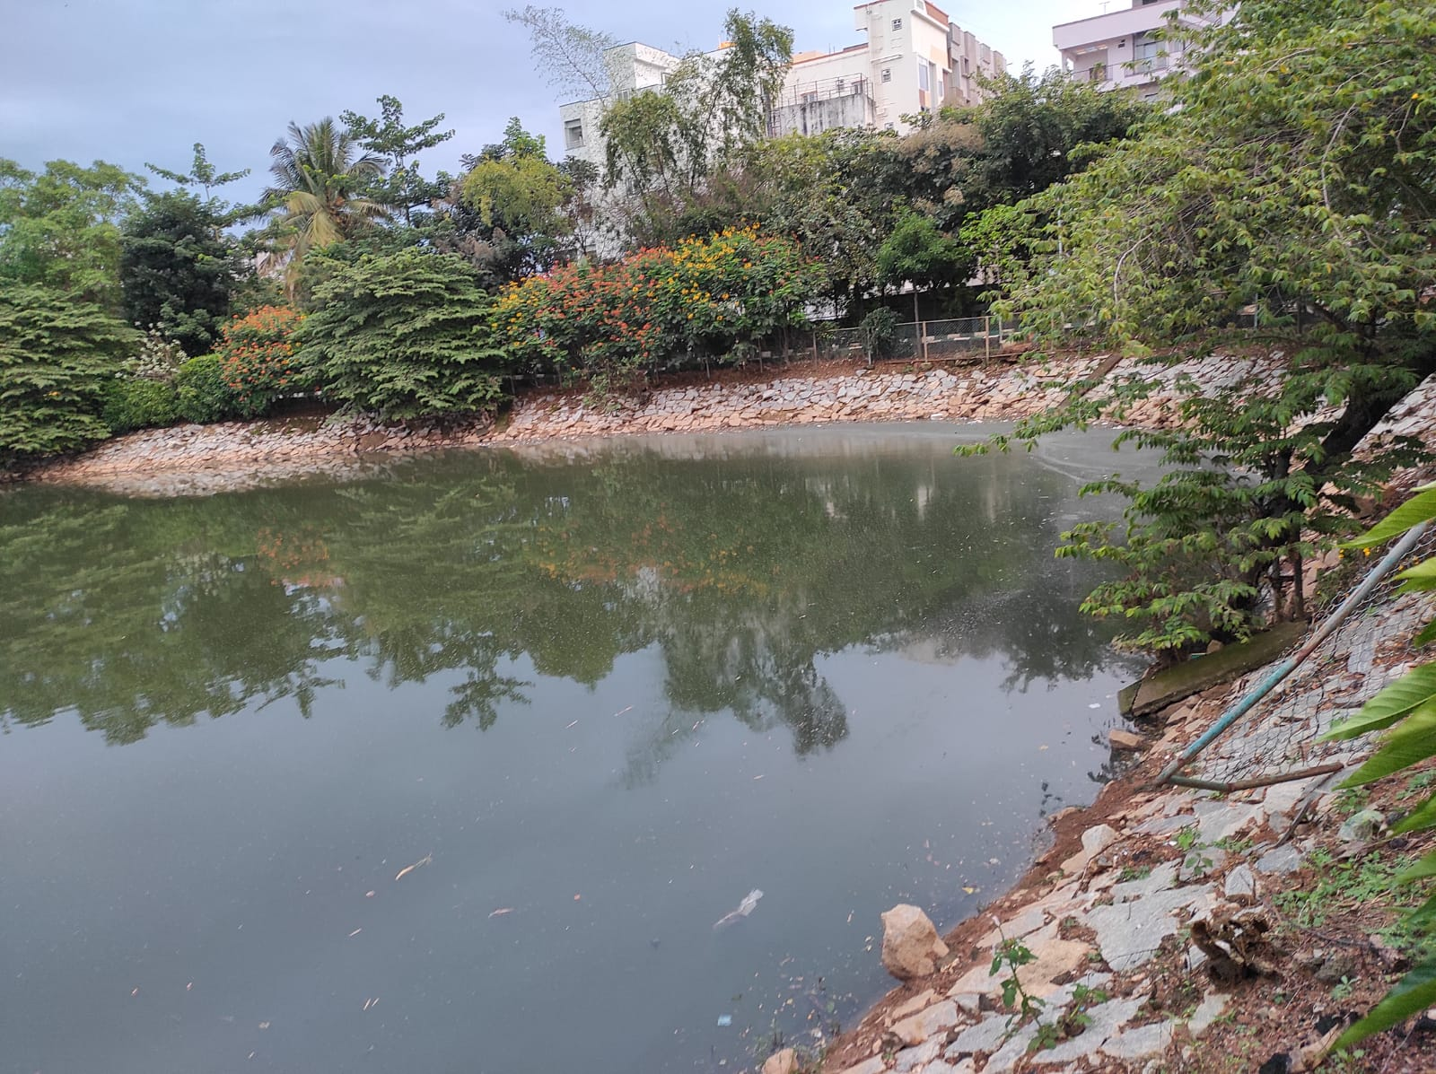
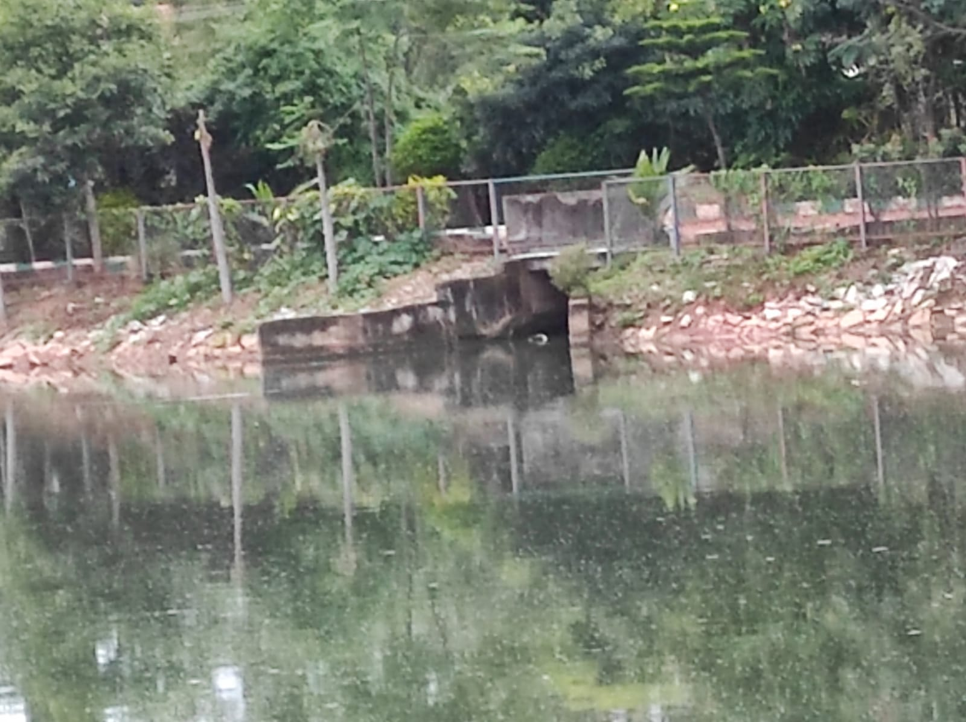
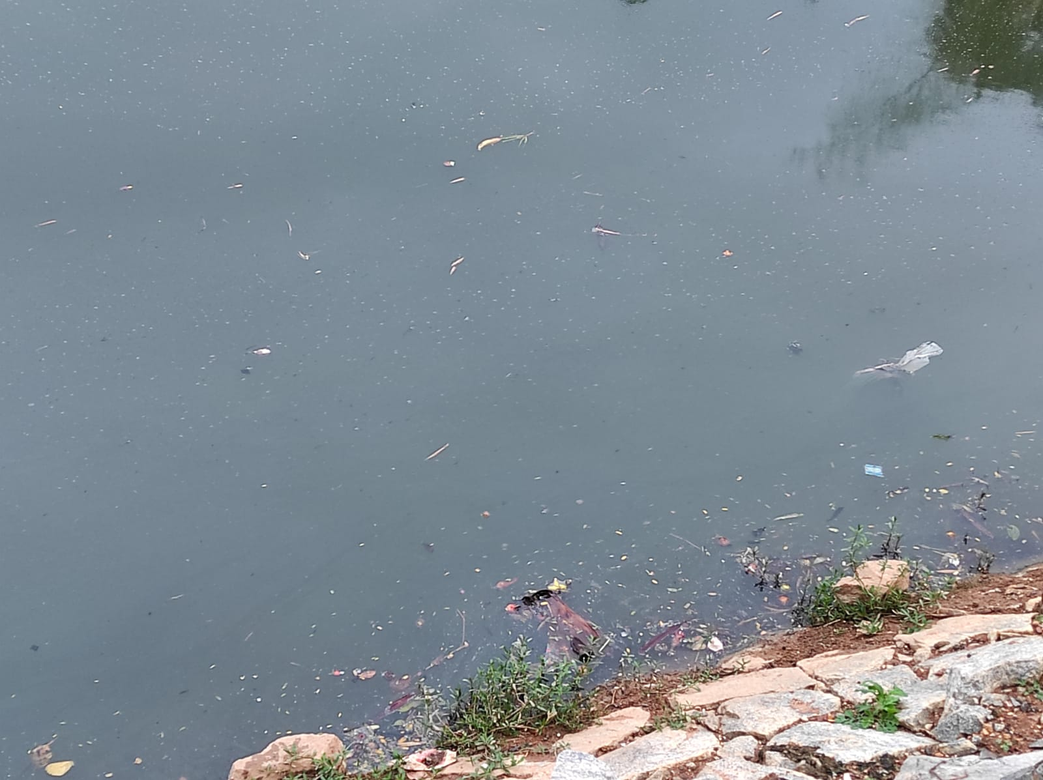
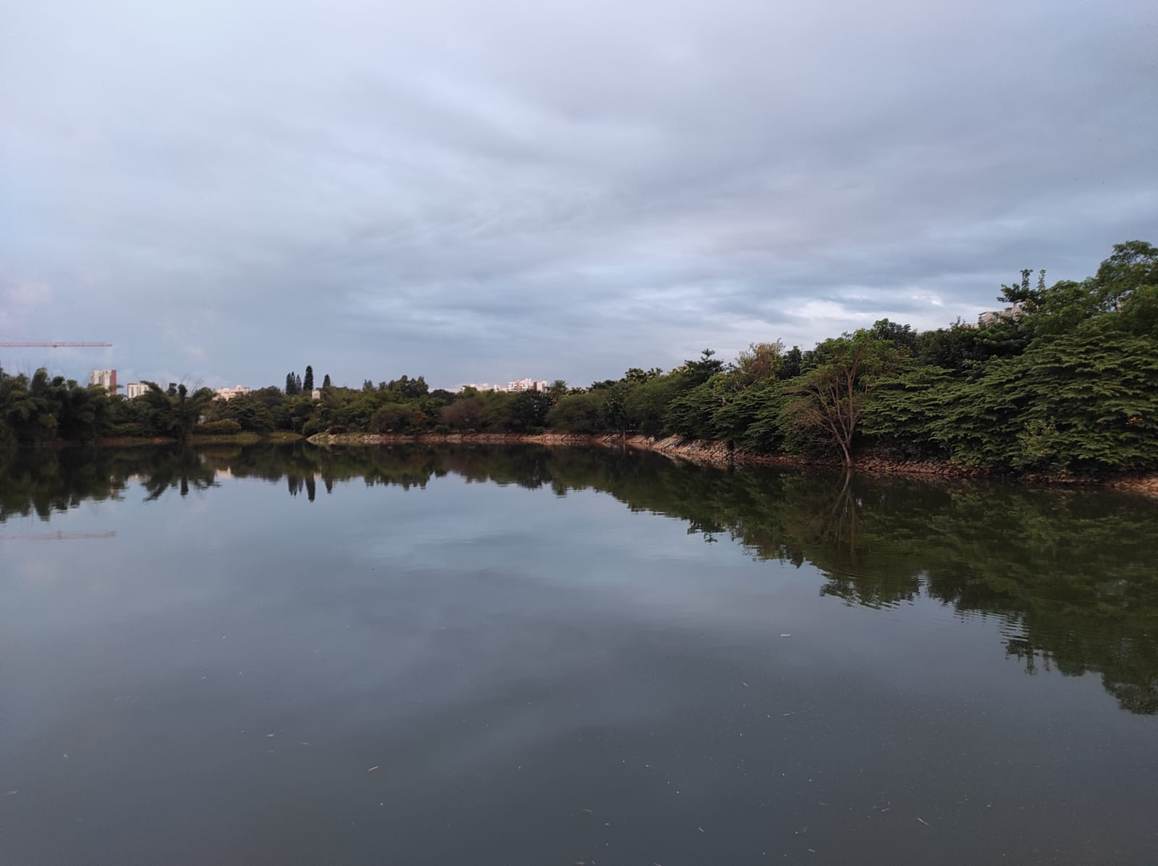
Pictures of the lake after the flood

Slide 10
OBJECTIVES
Find the reason for the reduction in birdlife and aquatic life in and around the lake.
Suggest preventive measures.
Suggest solutions.

Slide 11
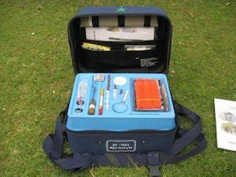
Materials Required
JAL TARA water testing kit.

Slide 12
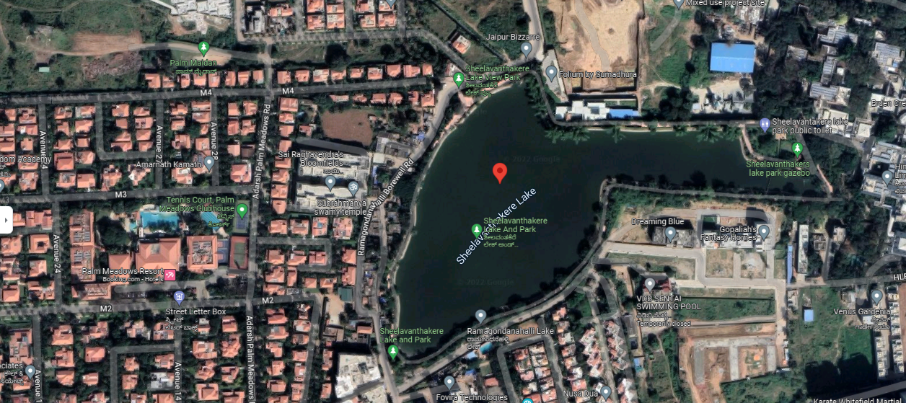
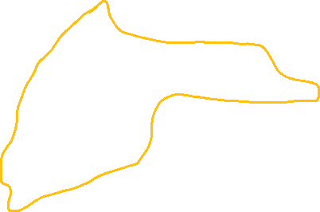
Study Area
This is located in Ramagondanhalli, Whitefield, Bengaluru.
12.96573N, 77.7426E are the
Latitude and longitude of the lake’s highest point in the picture
PERIMETER = 1300m

Slide 13
Species Identification Method
Google Lens

Slide 14
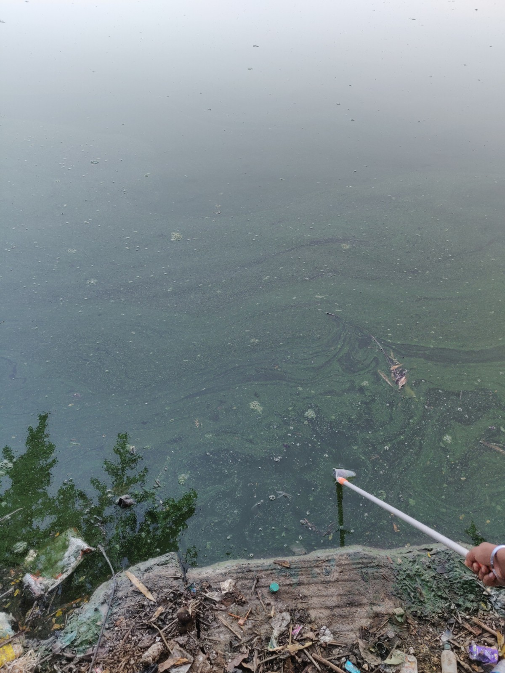
SAMPLE COLLECTION METHOD
A plastic tumbler attached to a
stick.
gloves.

Slide 15
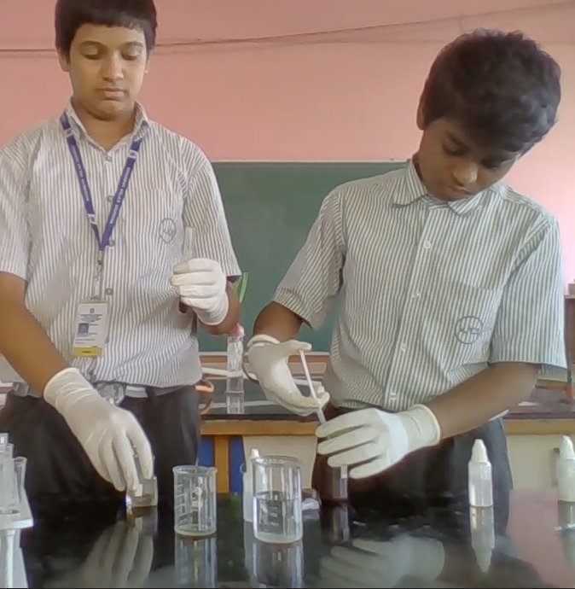
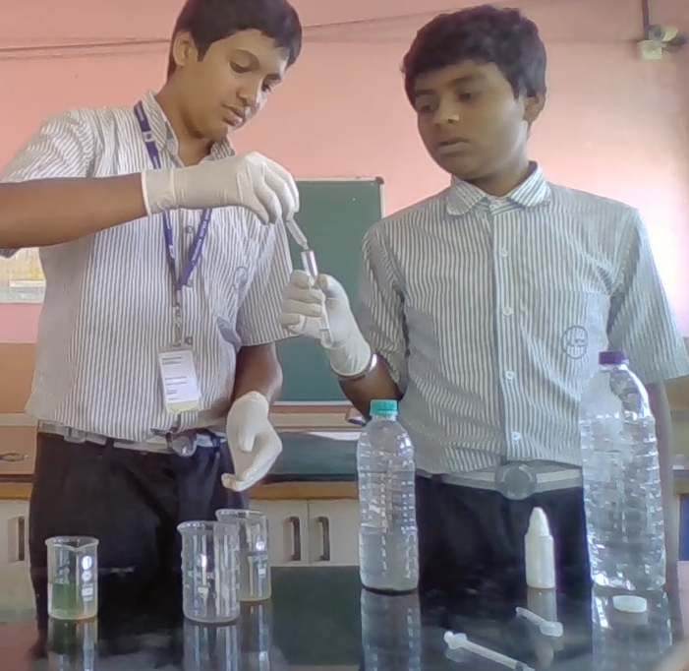
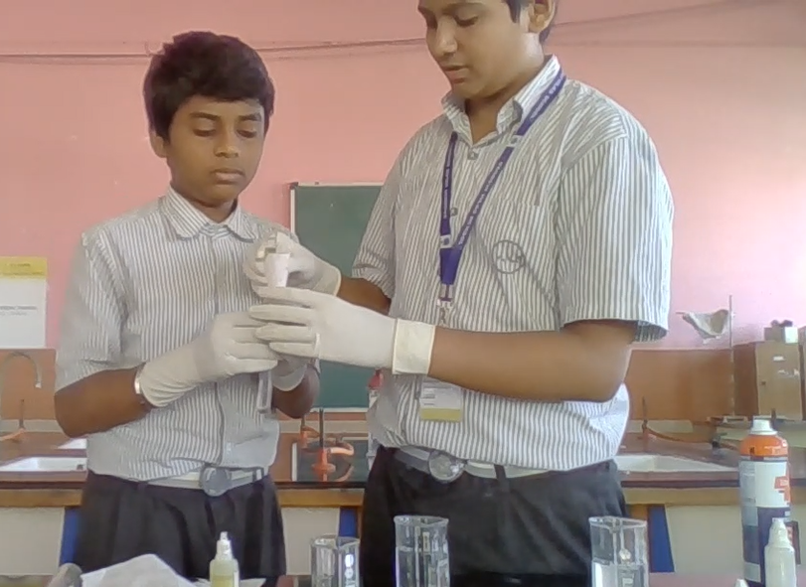
Experimental Methods Used
Pictures of us performing tests on the lake water, drainage 1 water and drainage 2 water

Slide 16
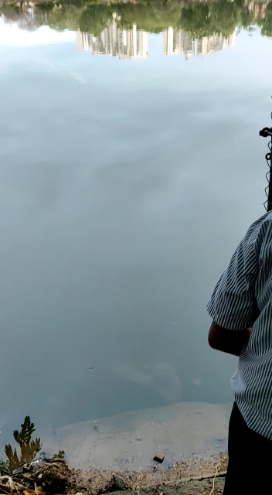
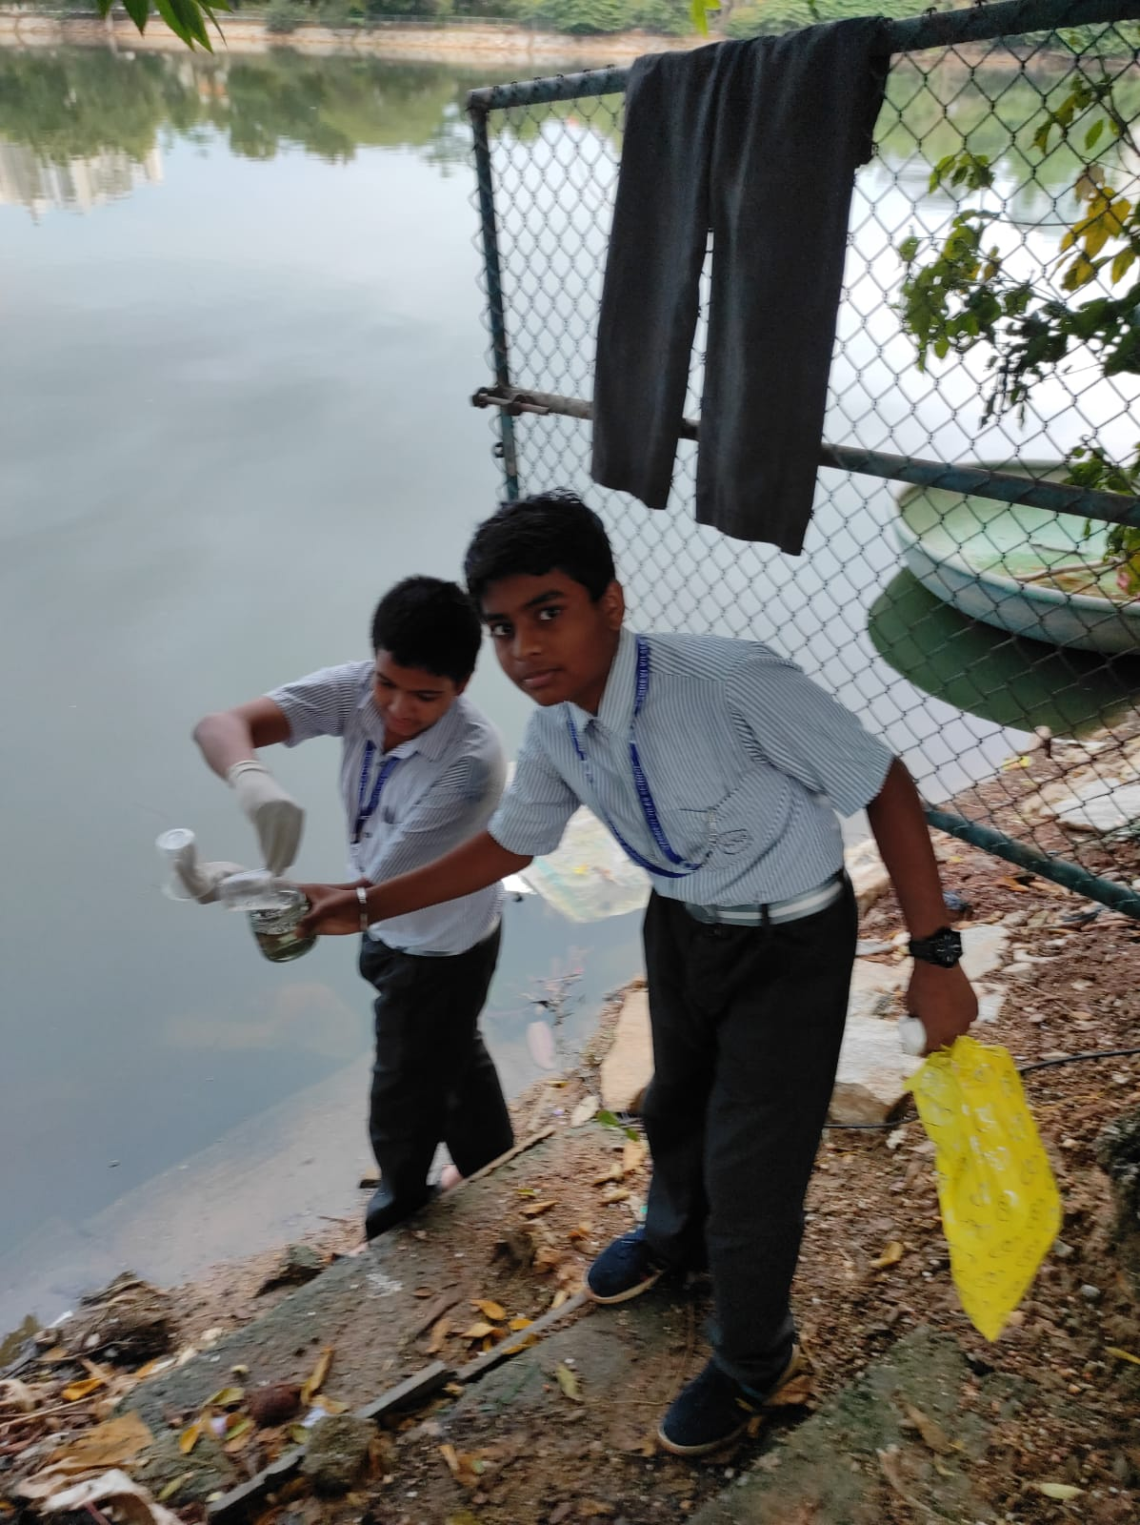
Sample collection photo and video
LAKE WATER SAMPLE 1 (30/10/2022)

Slide 17
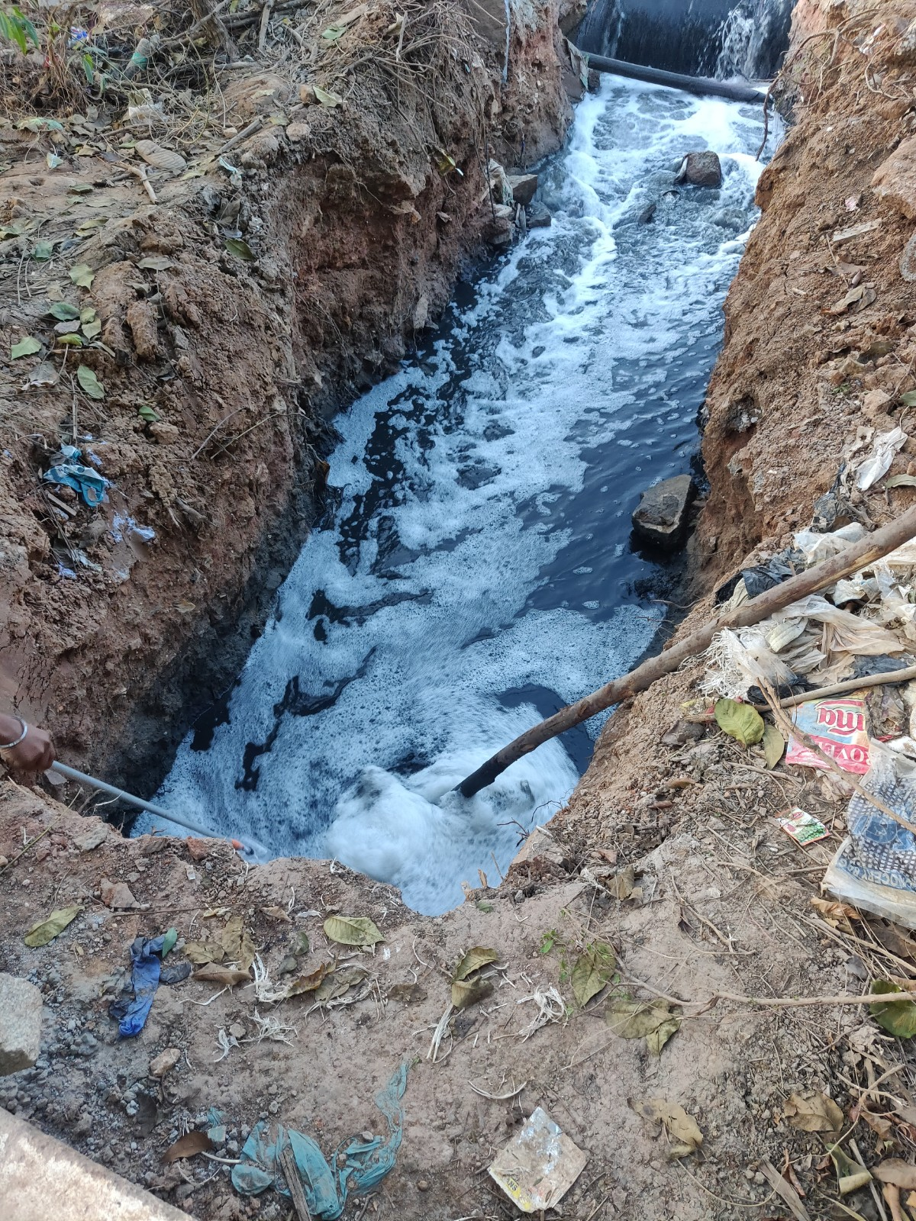
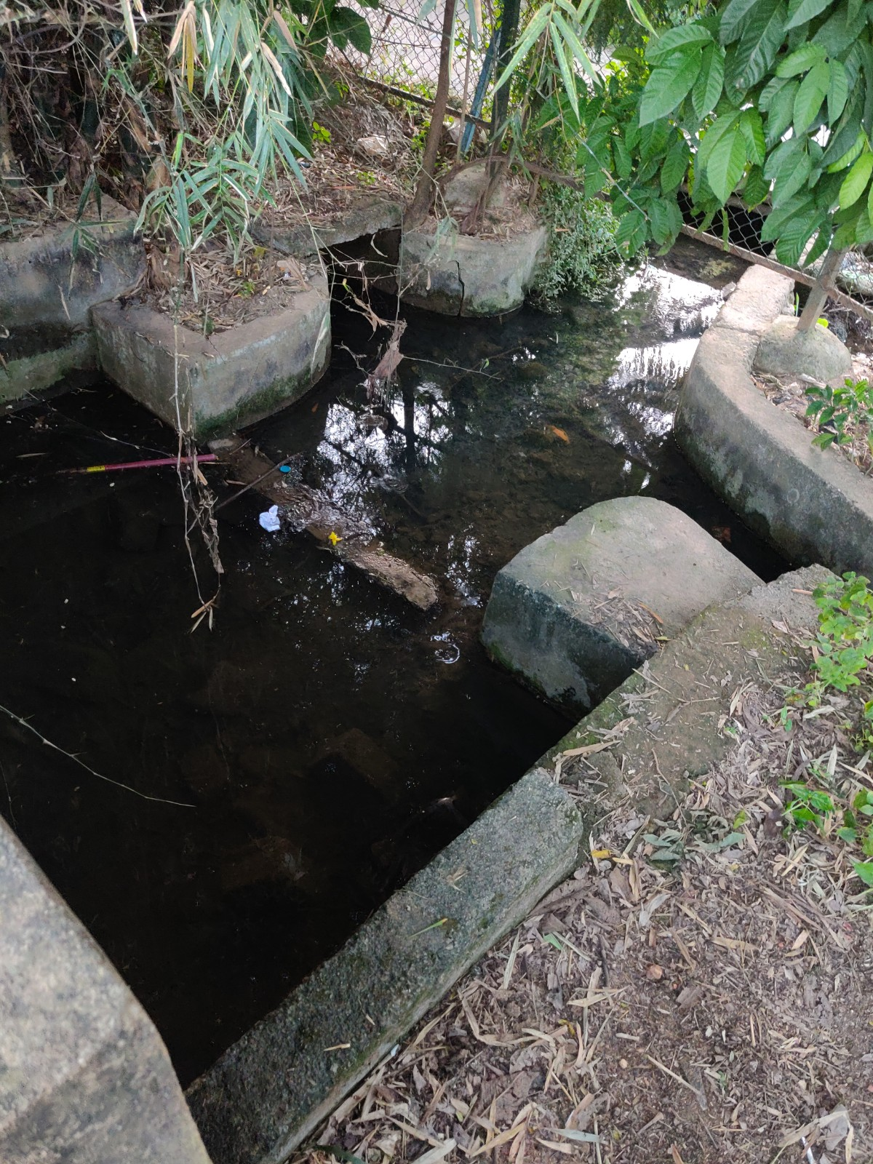
Location of sample collections(2/12/2022)
DRAINAGE 1
LAKE WATER SAMPLE 2
DRAINAGE 2

Slide 18
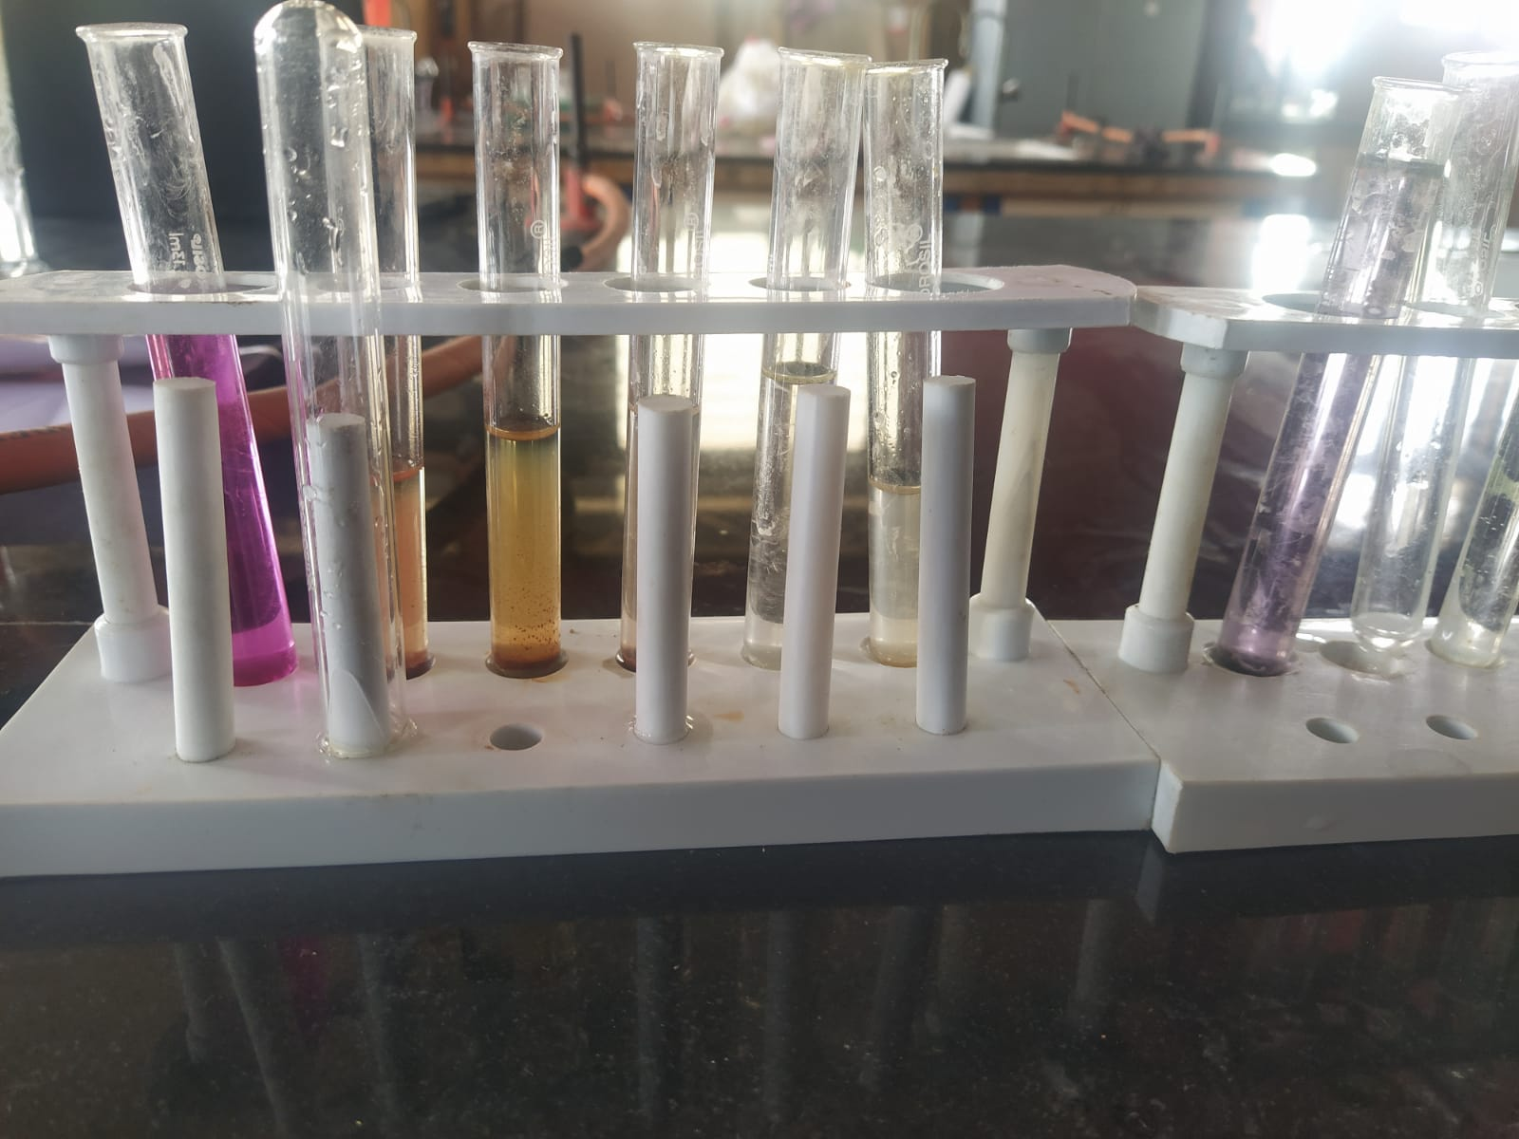
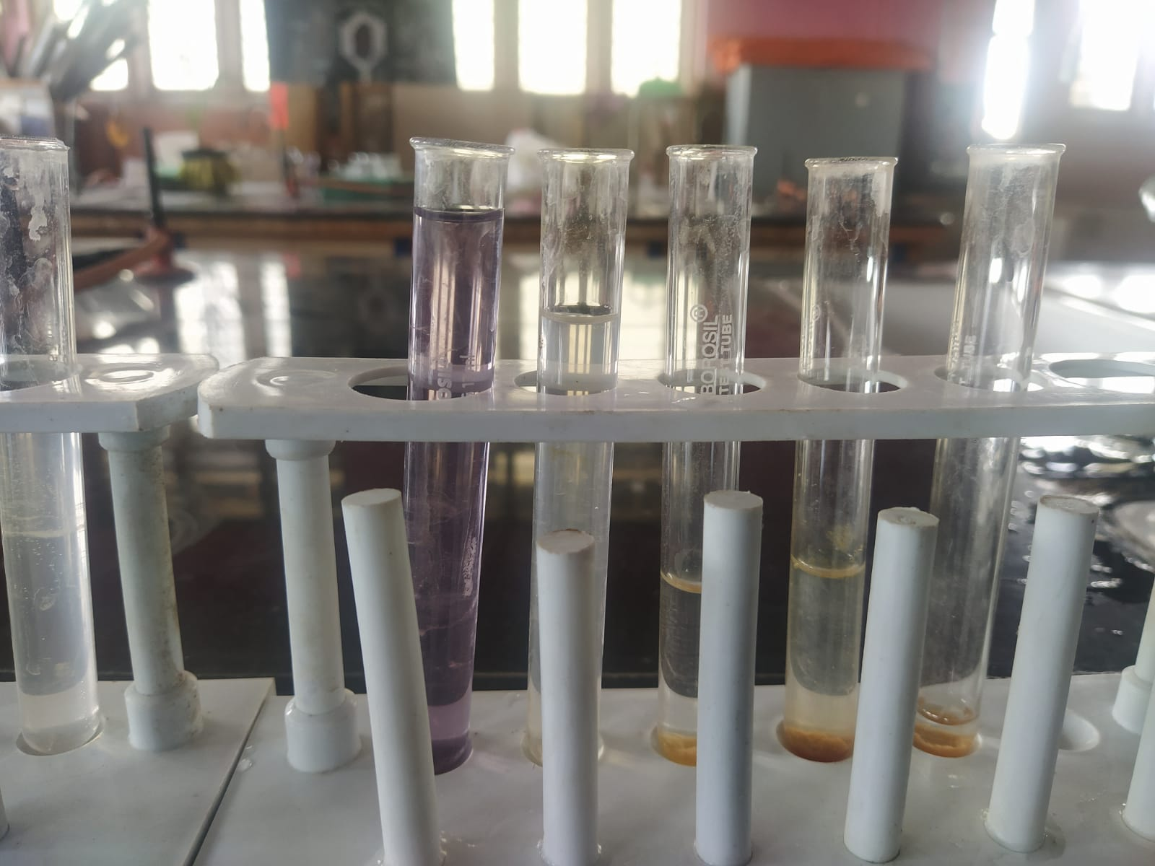
PICTURE OF THE TEST RESULTS

Slide 19
Onsite Parameters
^~ this states that the result is not a major factor required for aquatic life.
Parameters | Required | Lake sample 1 | Lake sample 2 | Drainage 1 sample | Drainage 2 sample
Dissolved Oxygen | 9-7 mg/l shouldn’t be below 4mg/l | 3mg/l | 5mg/l | 0mg/l | 6mg/l
Turbidity | ^~ | 25ntu | >200ntu | 150ntu | 15ntu
Temperature | 20-30centigrade | 24centigrade | 23centigrade | 22centigrade | 24centigrade
PH | 6 – 8.5 | 8 | 7.5 | 8 | 7.5
Odour | None | Slightly bad | Slightly bad | Very bad | negligible
Colour | Transparent or translucent | transparent | green | blackish | transparent

Slide 20
Offsite parameters(VVSM laboratory)
^~ this states that the result is not a major factor required for aquatic life.
Parameters | Required | Lake sample 1 | Lake sample 2 | Drainage 1 sample | Drainage 2 sample
R.Cl | ^~ | 1.3mg/l | 1mg/l | 0.2mg/l | 0mg/l
Chloride | 150-1000mg/l | 567.2mg/l | 709mg/l | 496.3mg/l | 212mg/l
Faecal coliform | Transparent or yellowish | Black | Black | Black | Slightly black
Ammonia | Less than 4mg/l | 0.4mg/l | 0.3mg/l | 0.3mg/l | 0mg/l
Nitrate | ^~ | 0mg/l | 0mg/l | 0mg/l | 10mg/l
Phosphorus | ^~ | none | none | none | none

Slide 21
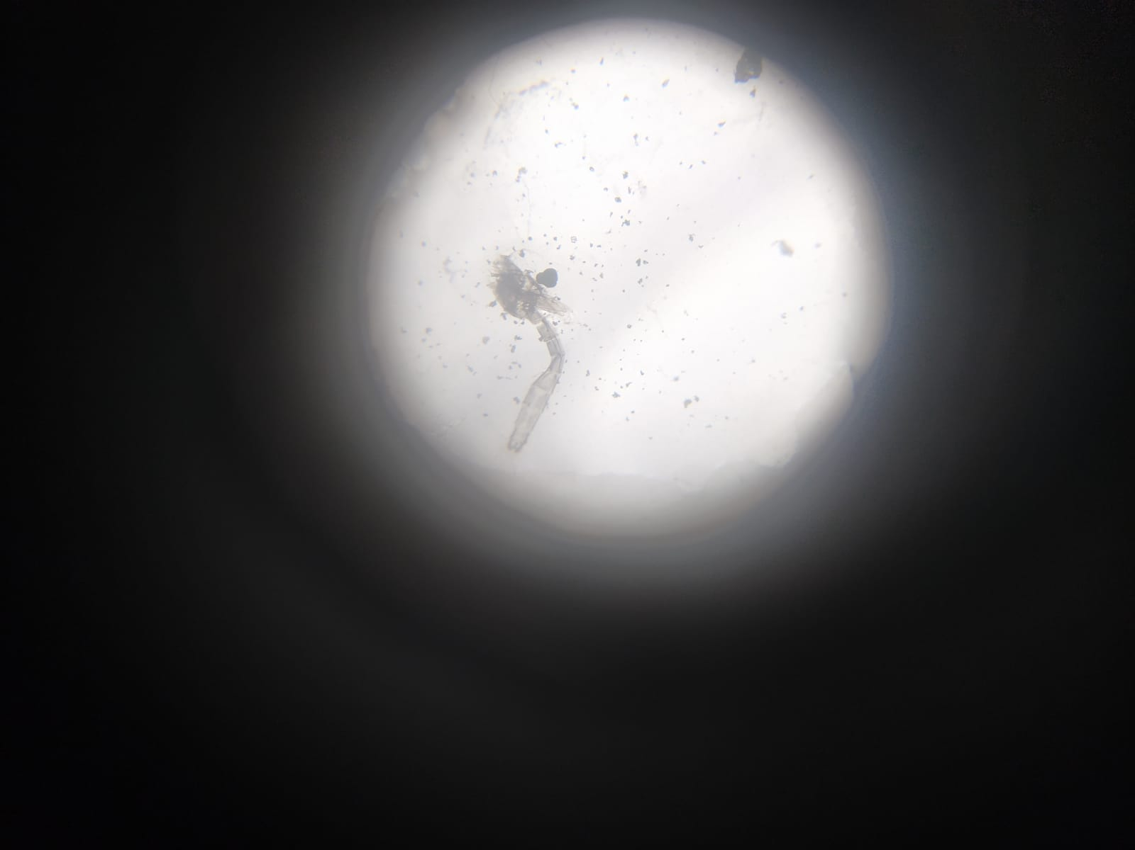
Picture of mosquito larvae in the sample

Slide 22
CONCLUSIONS
Water degradation is caused by the sewage going into the stormwater drainage system.
The overflowing of the lake caused the garbage from the boundaries to enter the lake.
The lake is recovering.

Slide 23
Suggested Preventive Measures
Block the sewage going in the stormwater drainage system.
Anti encroachment of Rajakaluve.

Slide 24
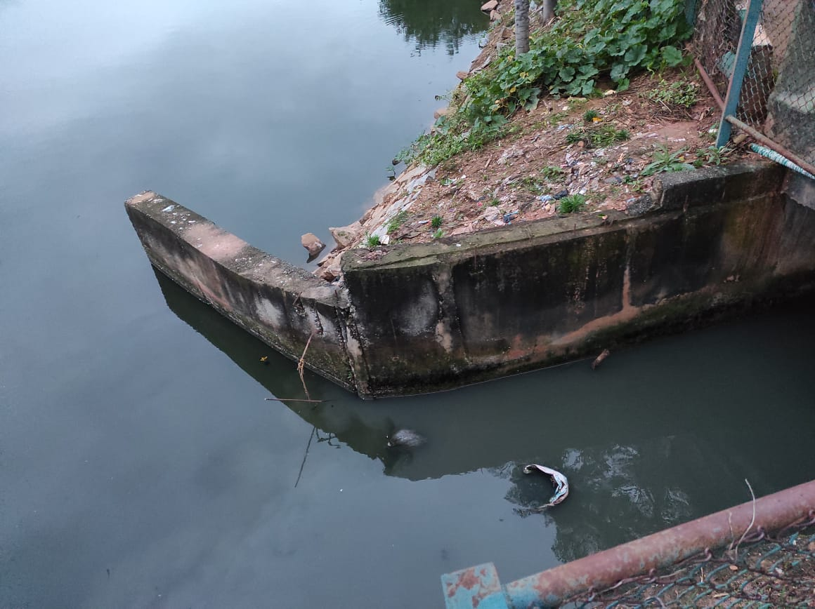
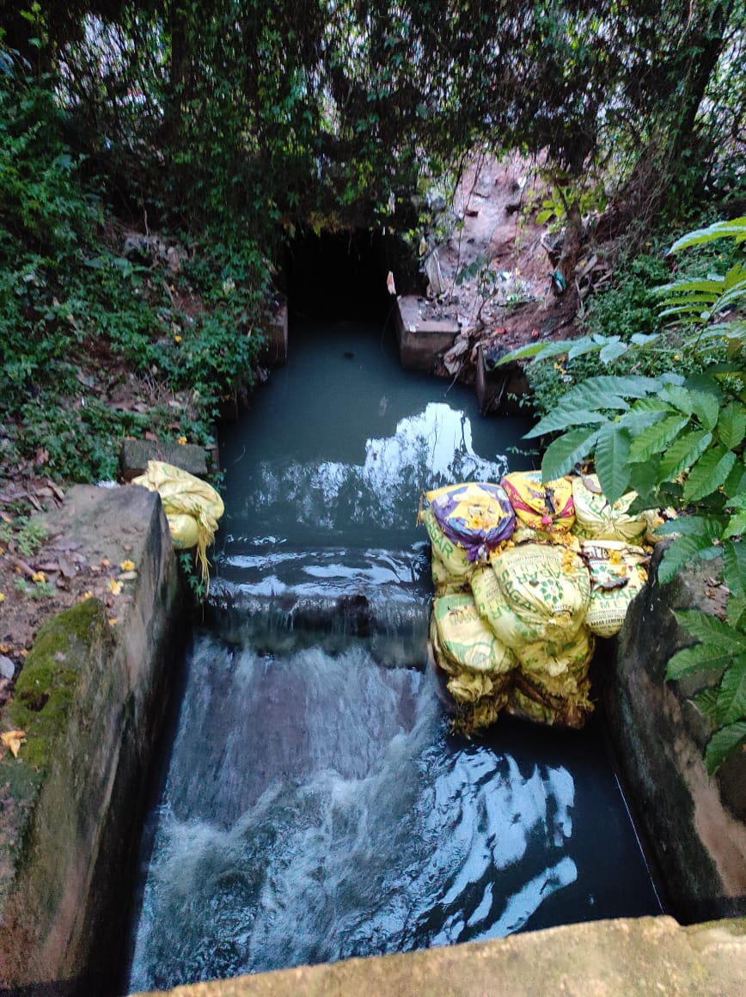
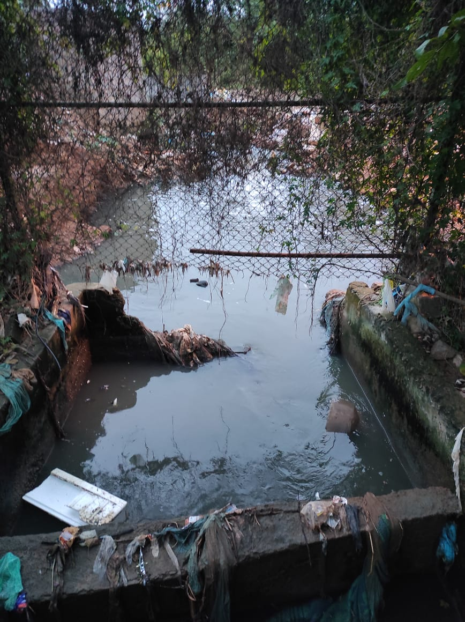
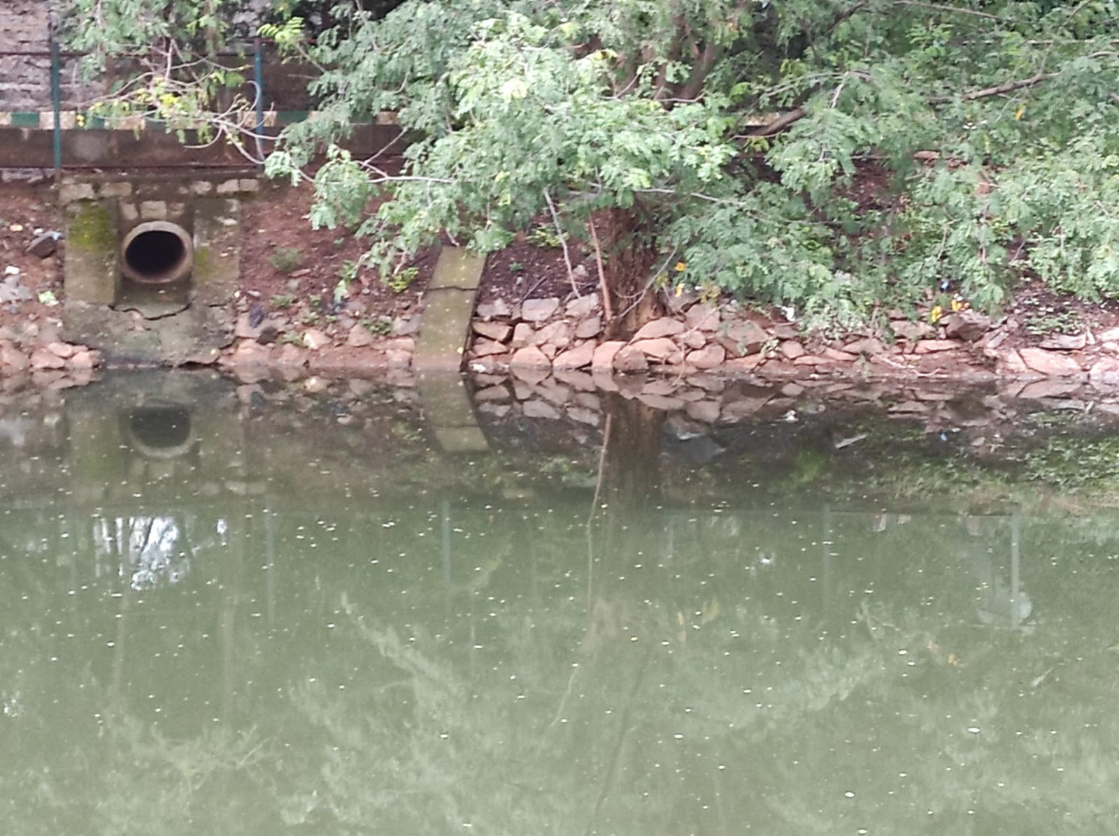
The stormwater drainage system going in the lake

Slide 25
RAJAKALUVE
These streams are connecting the Sheelavantakere to Varthurkere and many other lakes.
They were built by Maharaj Kempe Gowda hundreds of years ago.
These protected the lakes from overflowing.
These also lead to proper rainwater management.
But over time, people started reducing these streams leading to flooding issues.

Slide 26
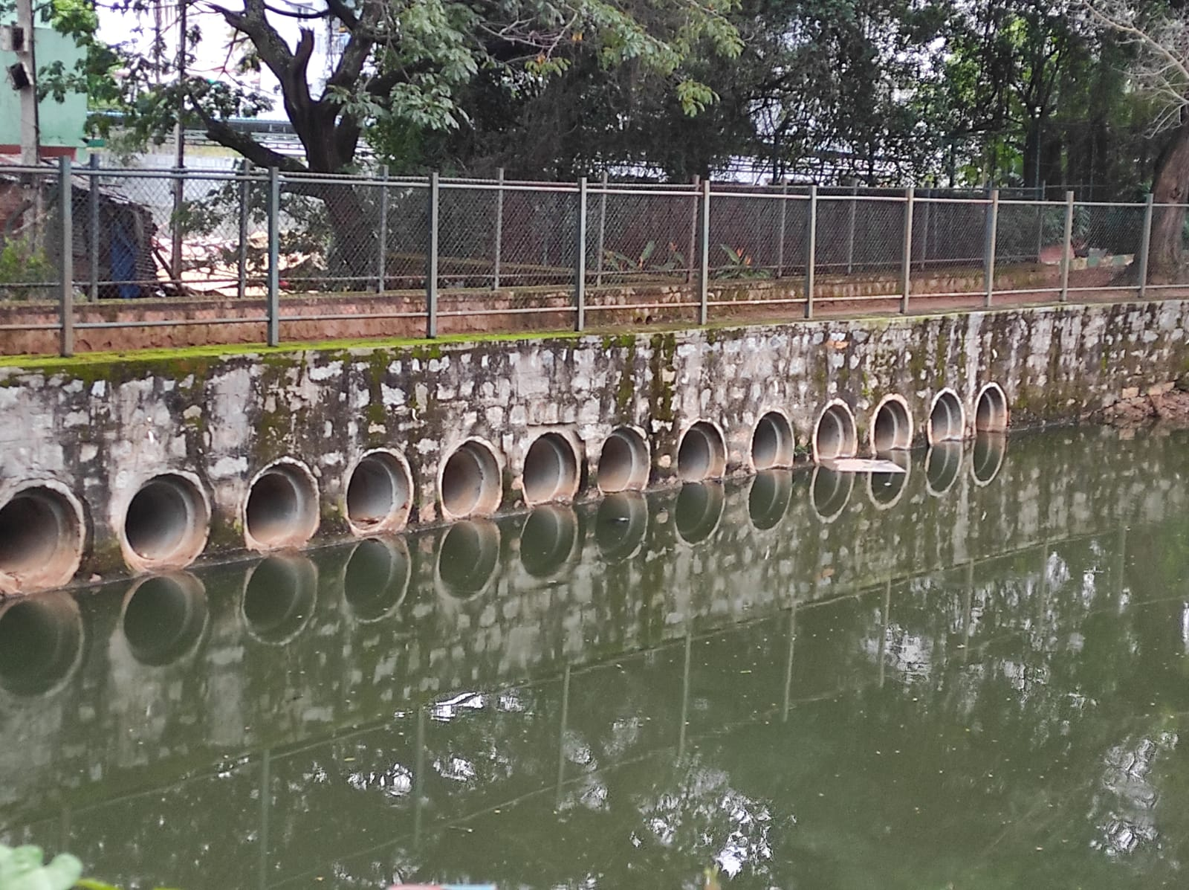
The picture of the Rajakaluve in Sheelavanthakere

Slide 27
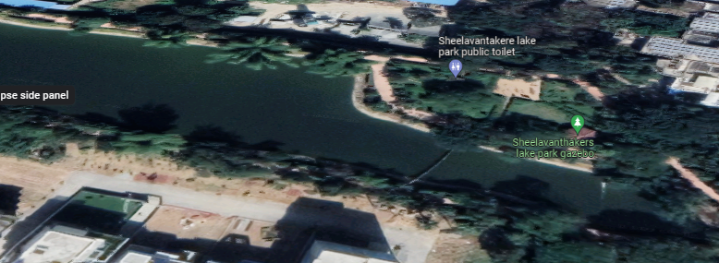
Location of the Rajakaluve from above
The Sheelavanthakere is connected to the lakes through a tunnel type stream in this exact location

Slide 28
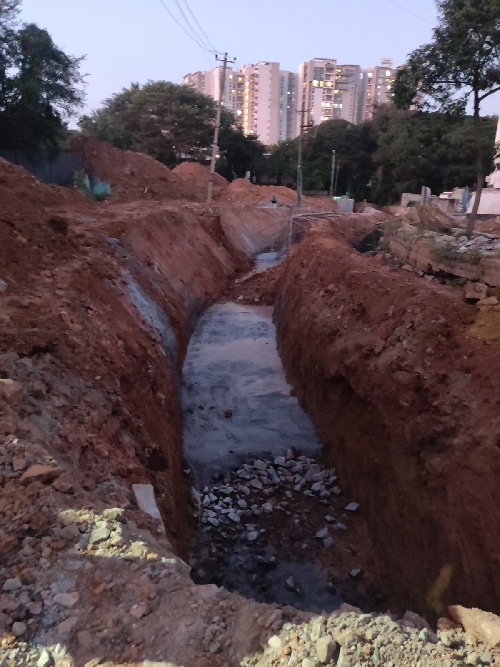
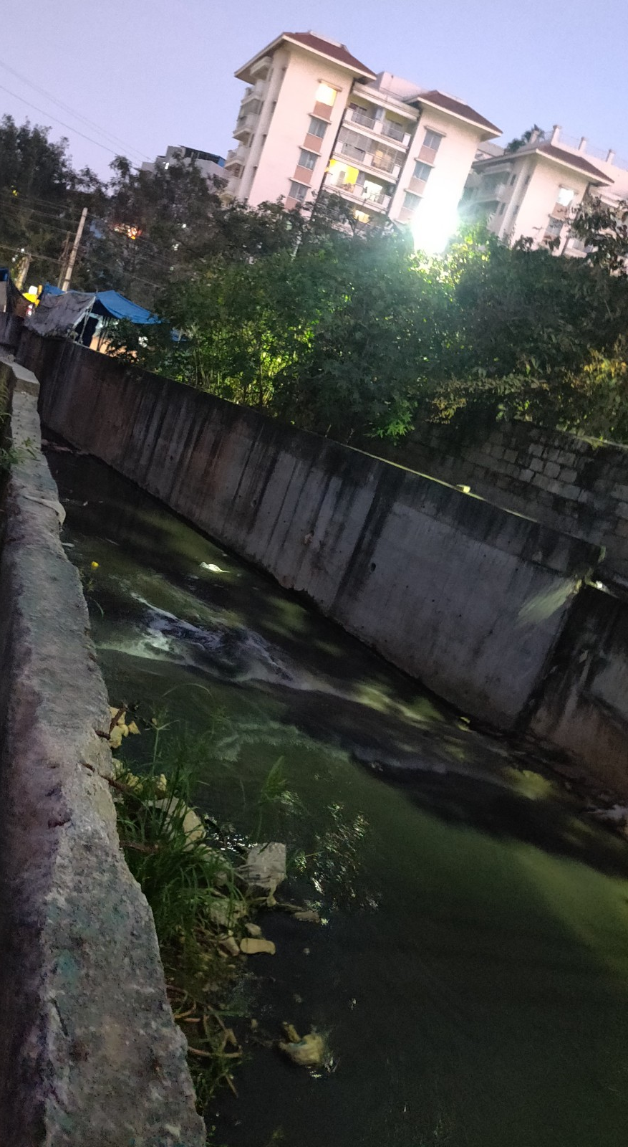
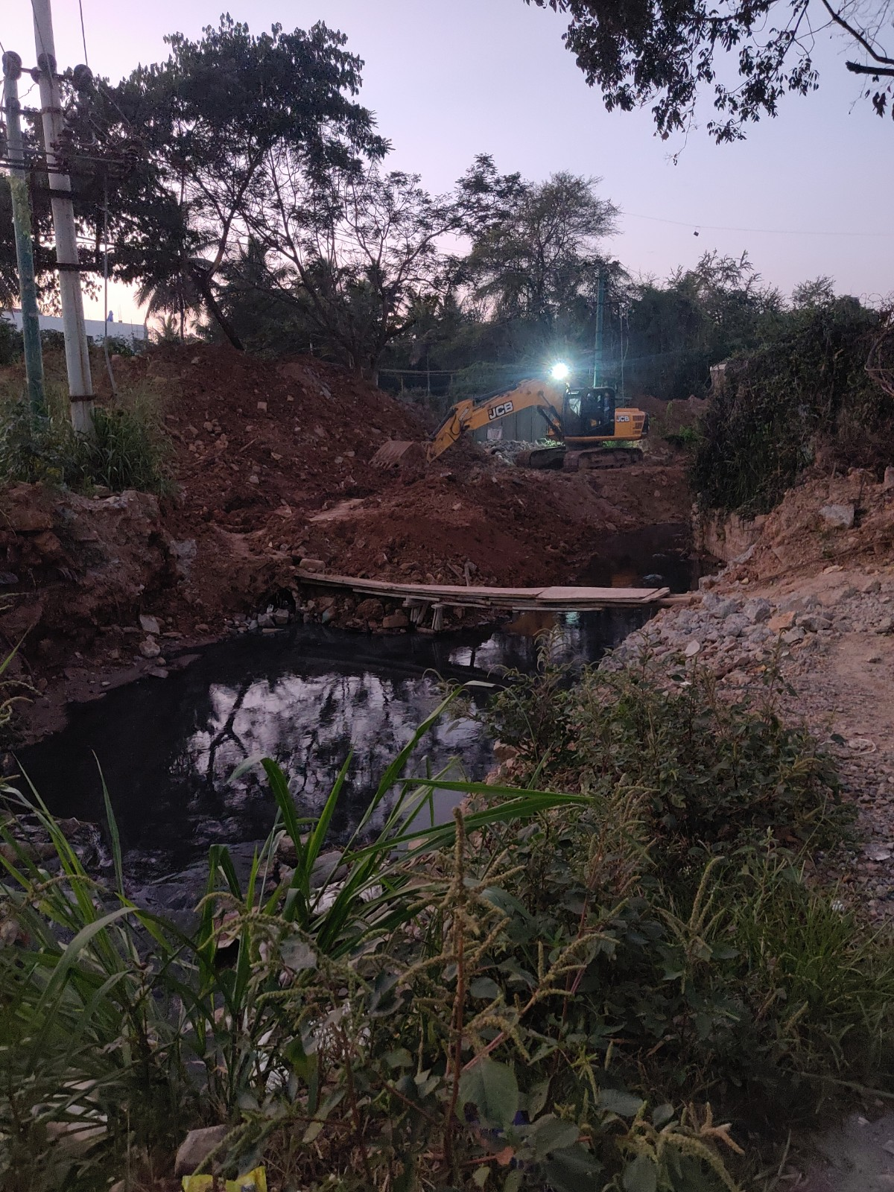
ANTI ENCROACHMENT OF THE RAJAKALUVE

Slide 29
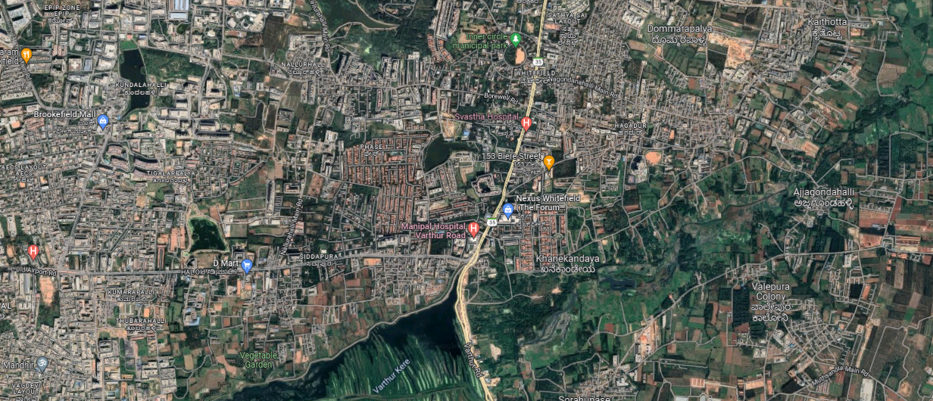

Satellite view of Sheelavanthakere and Varthurkere
VARTHURKERE : 861m
SHEELAVANTHAKERE : 870m

Slide 30
Suggested Solutions
Landscape & Beautify The Lakes.
Boating & Water Treatment Facilities at lakes.
  So that people will like to visit the lakes everyday.
Strict enforcement of the laws & regulations.
More active Green Tribunal.
More encouragement for Corporate Social Responsibility (CSR) activities.
Deeper Education & Awareness Drives.

Slide 31
Acknowledgements
Thanks to IISC for this wonderful initiative.
Thanks to VAGDEVI VILAS SCHOOL MARATHAHALLI and VVS Research and development department to guide us through the journey.
Thanks to all the countless people for giving very helpful suggestions.

Slide 32
REFERENCES
https://www.vvi.edu.in
https://www.researchgate.net/publication/362620018_LAKE_2022_-_XIII_Biennial_Lake_Symposium_Conservation_of_Wetlands_-Ecosystem-based_Adaptation_of_Climate_Change_28_-_30_December_2022_Indian_Institute_of_science_Bangalore_560012_India
https://www.youtube.com/watch?v=OkaN6feCLgY
https://bangaloremirror.indiatimes.com/bangalore/others/bbmp-to-rehabilitate-sheelavanthakere-encroachers/articleshow/73130693.cms
https://www.youtube.com/watch?v=OkaN6feCLgY
https://bangaloremirror.indiatimes.com/bangalore/others/bbmp-to-rehabilitate-sheelavanthakere-encroachers/articleshow/73130693.cms

Slide 33
THANK YOU

