Slide 1


Title : Lake water analysis – CHINNAPPANAHALLI LAKE
Deeksha Perinbam
GRADE - IX
18/12/2022
LAKE 2022: Conservation of wetlands: ecosystem-based adaptation of climate change, December 28-30, 2022
1

Slide 2
Introduction
Chinnappanahalli lake which was once forgotten now sees more 1000 people every day.
This lake also serves as nesting areas for a variety of birds.
This lake a few years back was not in the same state as it is now.
It was one of the many lakes that was depleted due to urbanization, industrialization and encroachments.
To restore this deteriorated lake a rejuvenation project was taken up.
Only after a lot of struggle by a concerned citizen a transformation was possible.

Slide 3
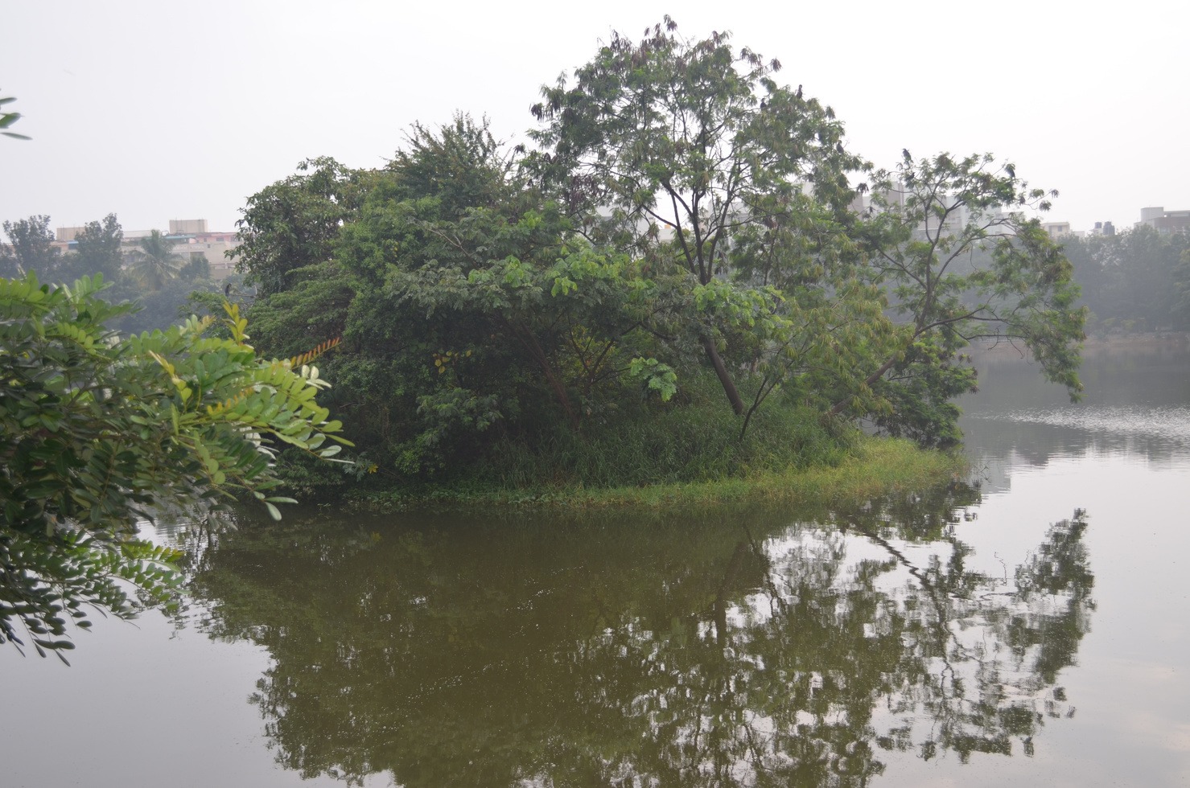
Objectives
To assess the present water quality of the lake.
To examine the role of citizens in the process of restoring and development of lakes.

Slide 4
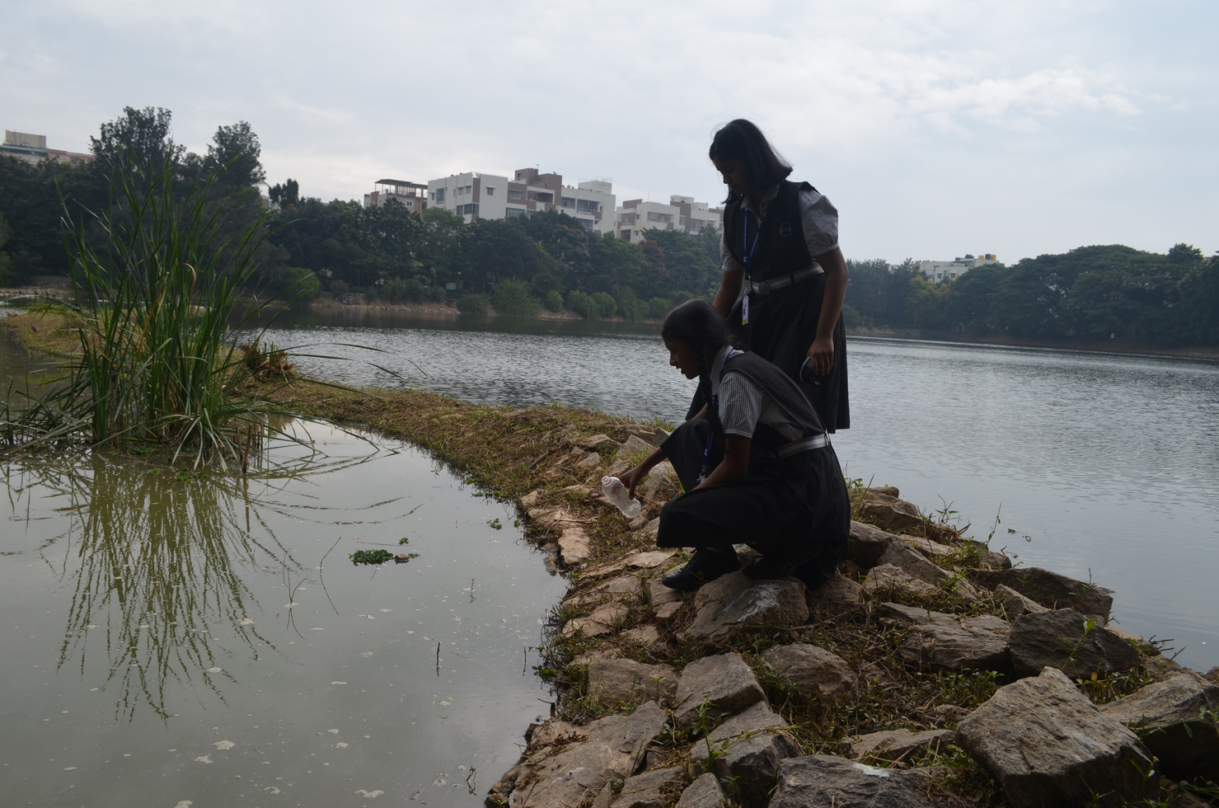
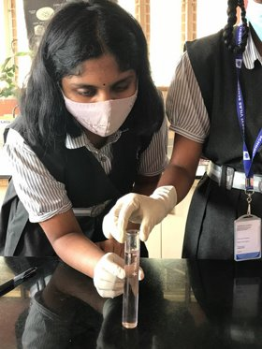
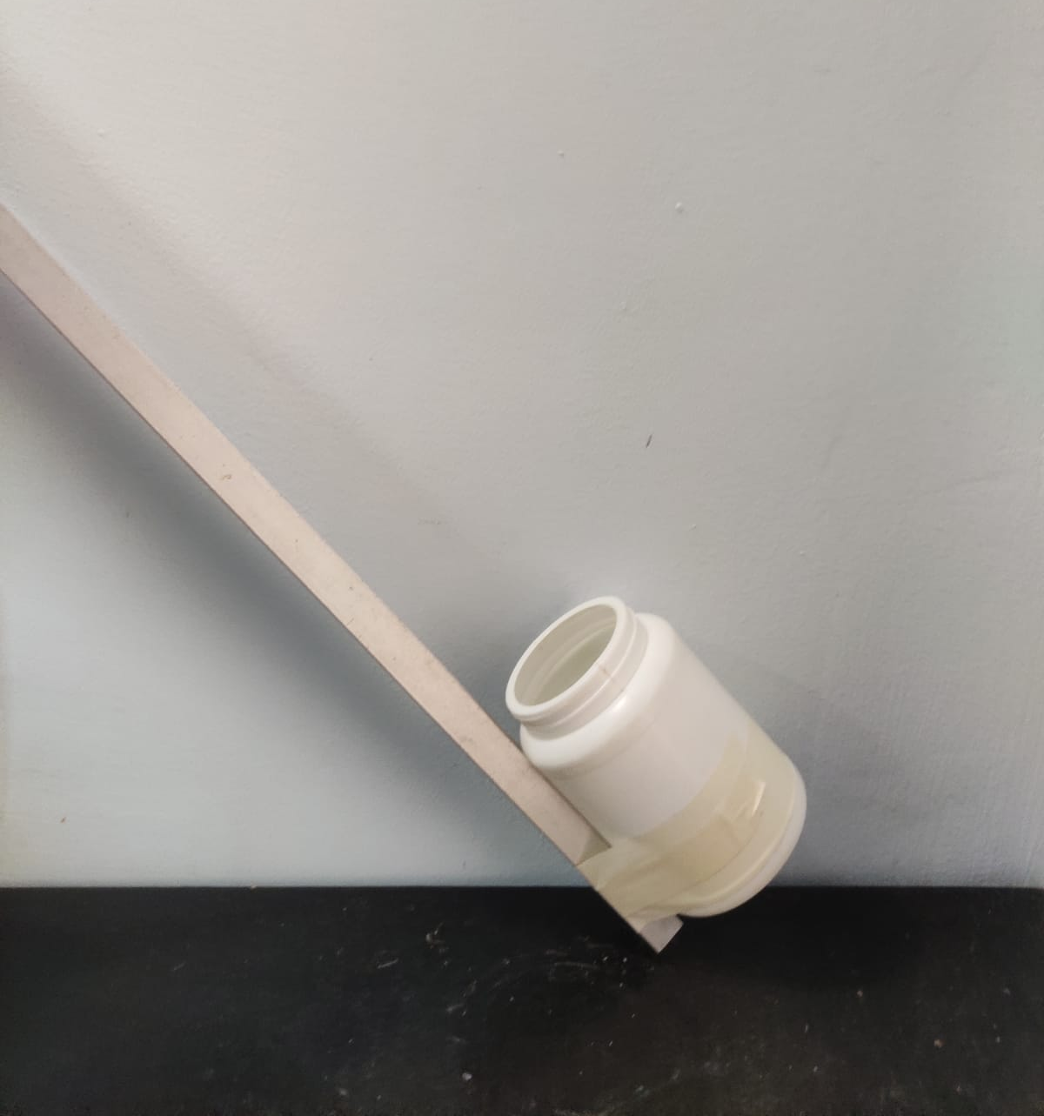
Materials and Methods
Chinnappanahalli lake (located near AECS layout, Bangalore) has been selected as the study area.
Samples have been collected using pole sampling method
The water sample collected has been tested in our school lab under guidance
Bird and plant species have been identified by searching their images using google lens
Equipment used for collecting sample

Slide 5
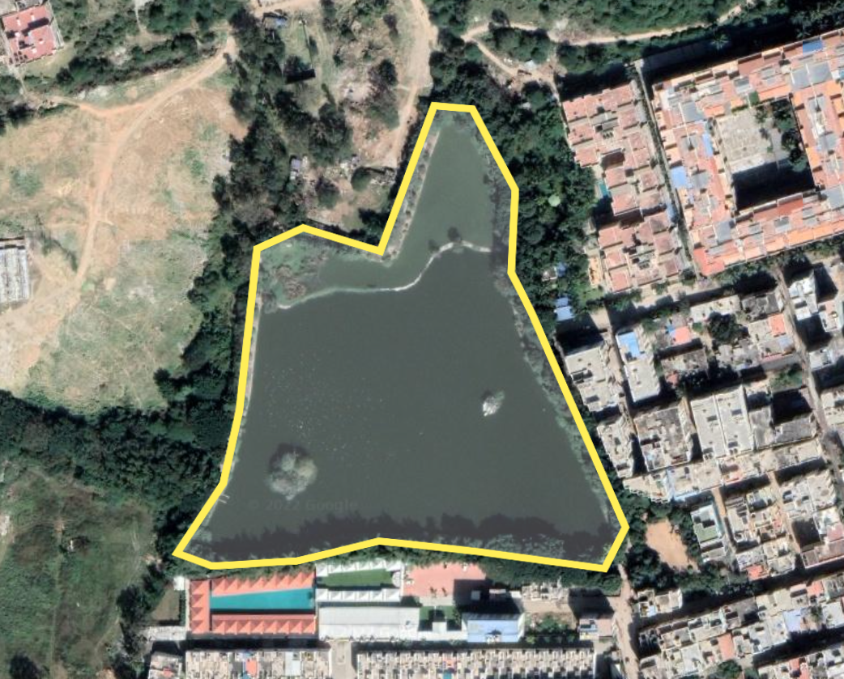
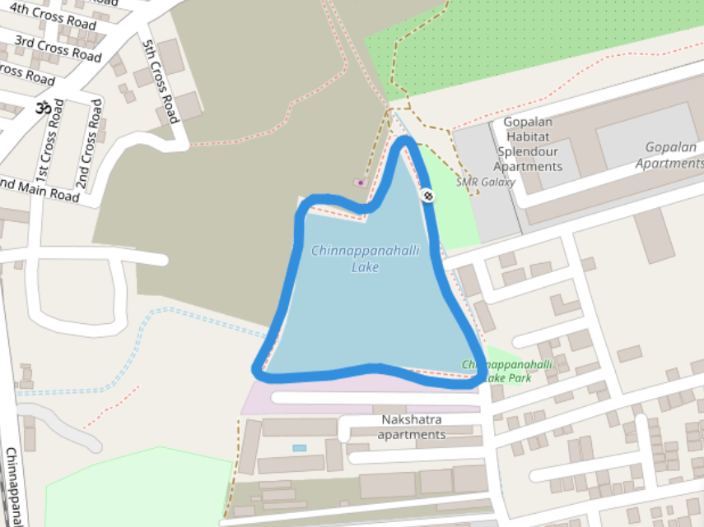
Mapping
Satellite view
Default map view
LATITUDE: 12.9663543N​
LONGITUDE: 77.7073077E
Chinnappanahalli Lake, AECS layout, Bangalore

Slide 6
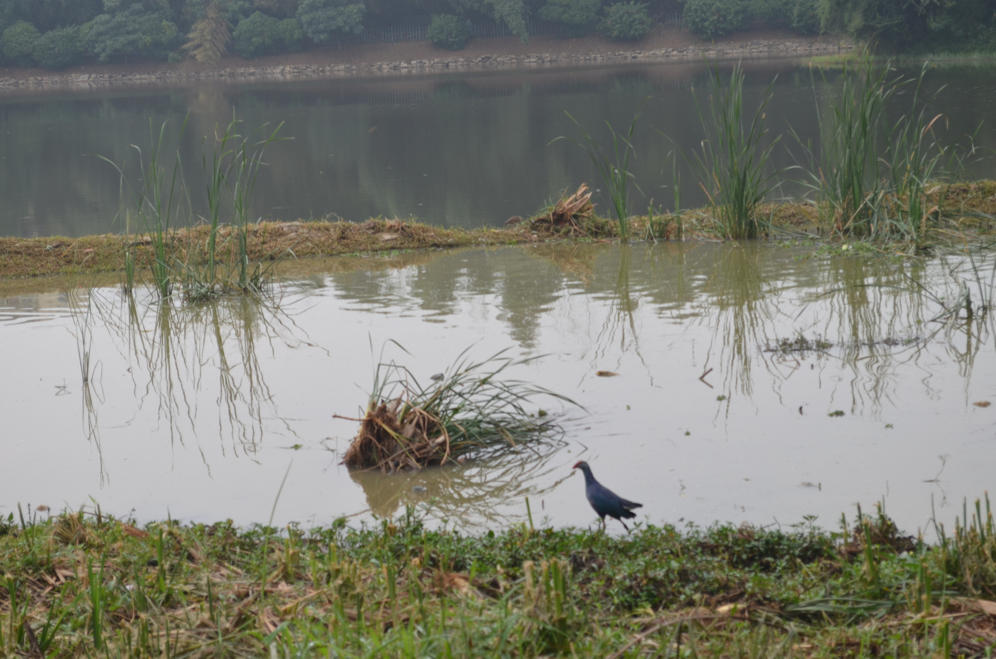
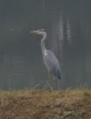
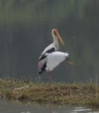
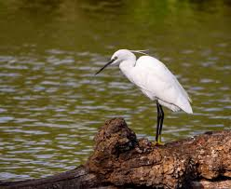
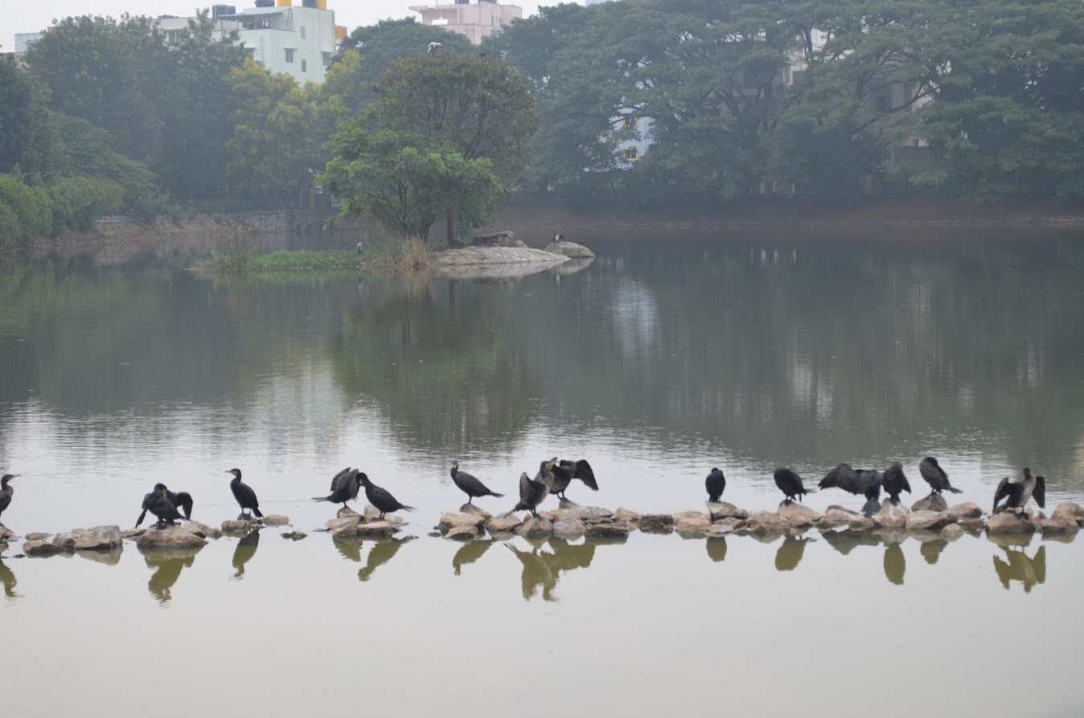
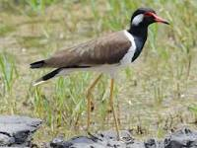
Bird species
Purple Swamphen (Porphyrio poliocephalus)
Grey Heron
Indian Painted Stork (Mycteria leucocephala)
Little Egret ​ (Egretta garzetta)
Red-wattled lapwing​ (Vanellus indicus)
Great Cormorant​ (Phalacrocorax carbo)

Slide 7
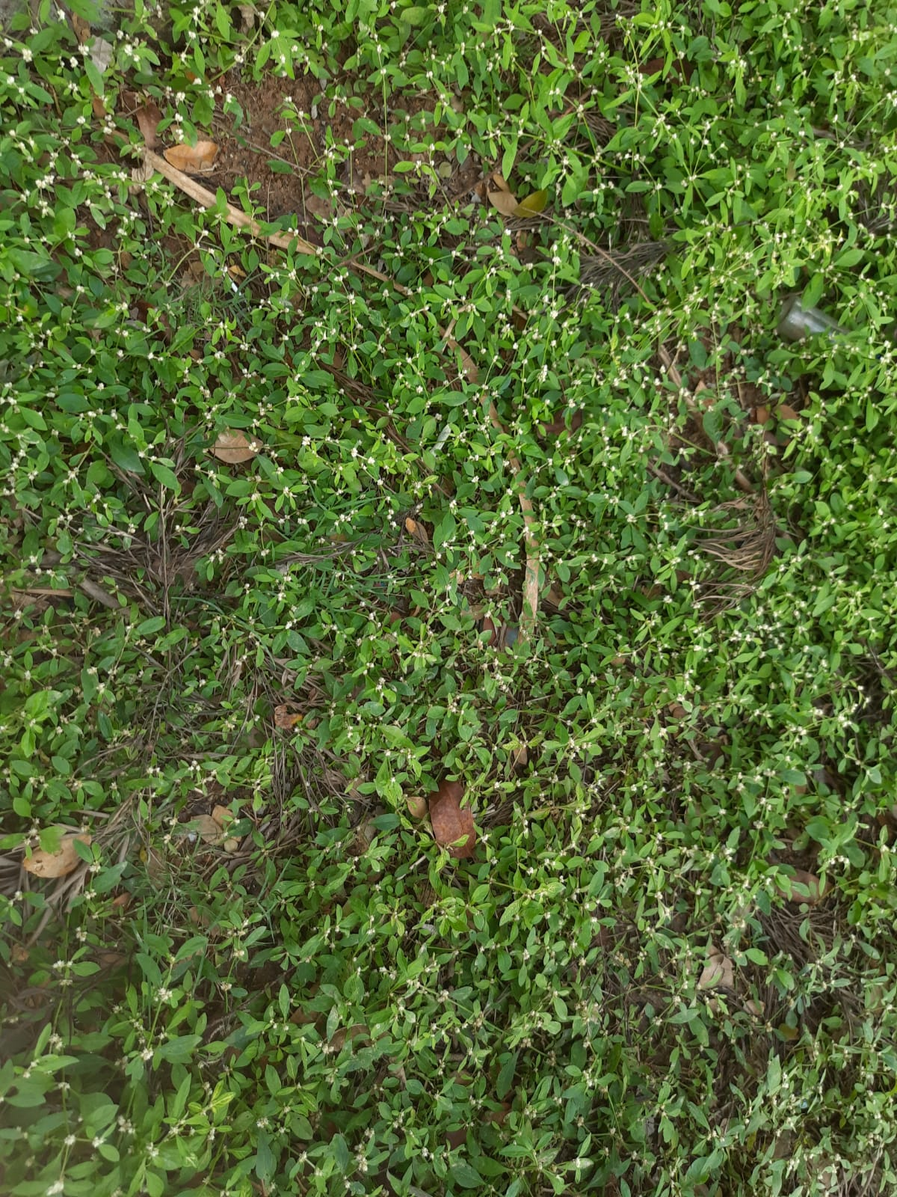
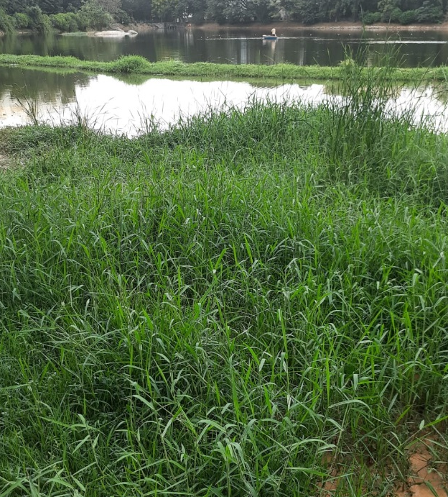
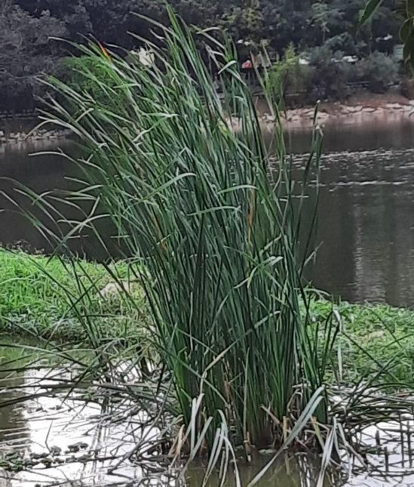
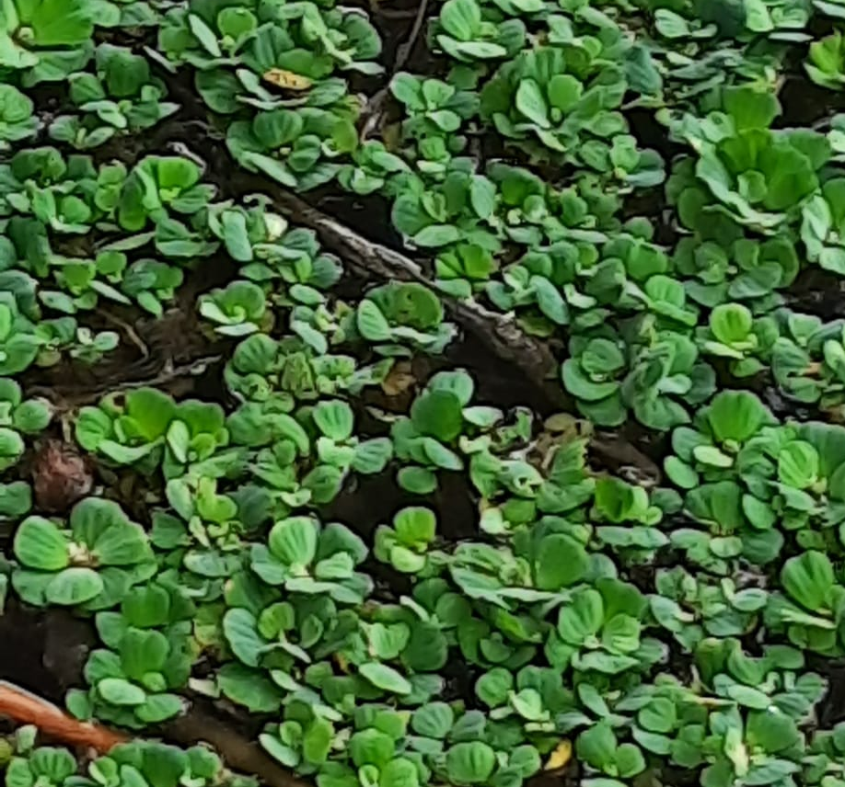
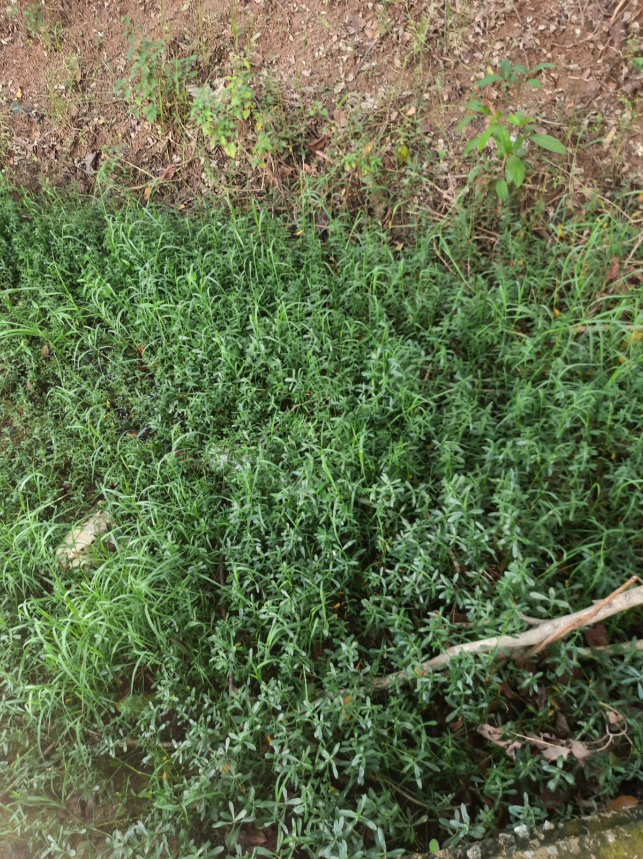
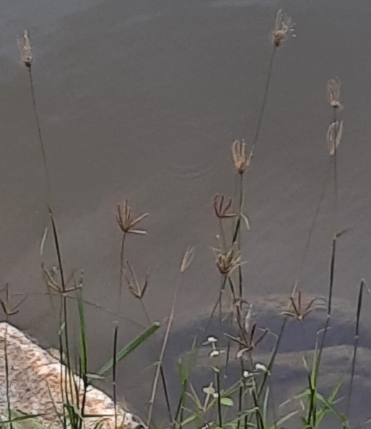
Macrophytes
Sessile Joyweed (Alternanthera sessilis)
Para grass(Brachiaria mutica)
Vetiver (Chrysopogon zizanioides)
Water Lettuce ​ (Pistia stratiotes)
Feathered finger grass​ (Chloris virgata)
Alligator weed (Alternanthera philoxeroides)

Slide 8
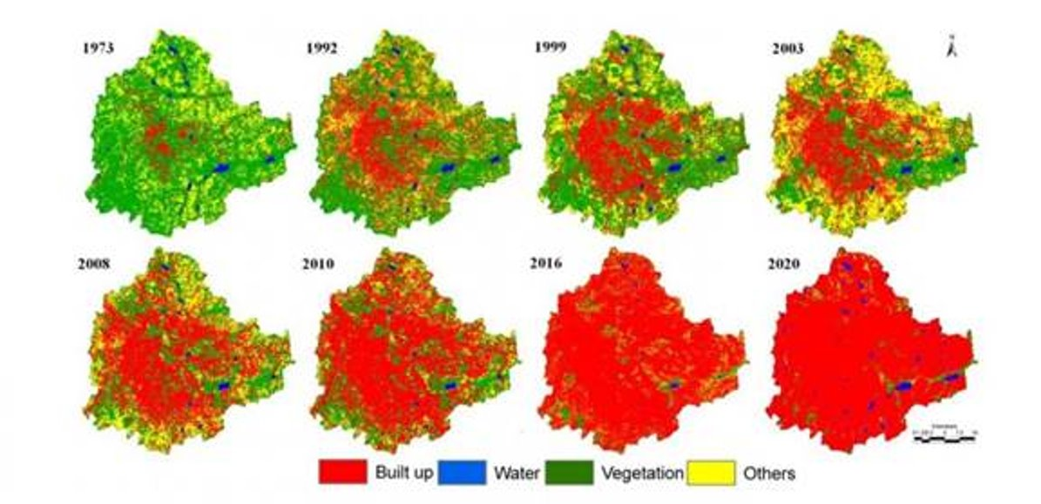
Results and Discussion
Image credits : Corresponding author: T.V. Ramachandra, cestvr@ces.iisc.ernet.in

Slide 9
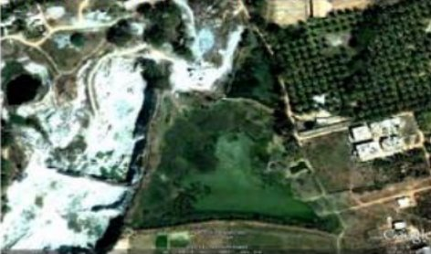
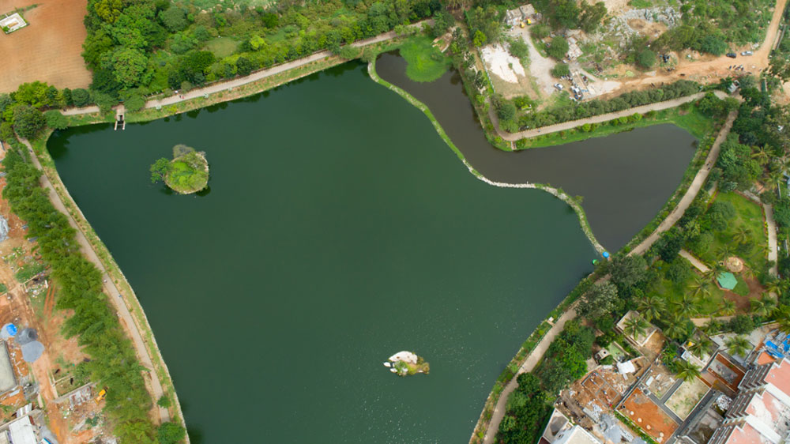
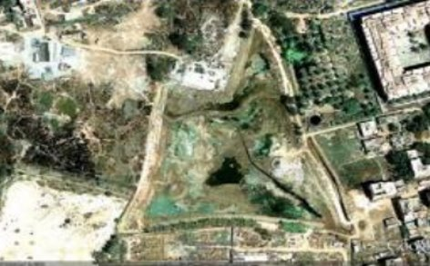
Results and Discussion
2002
2018
2009

Slide 10
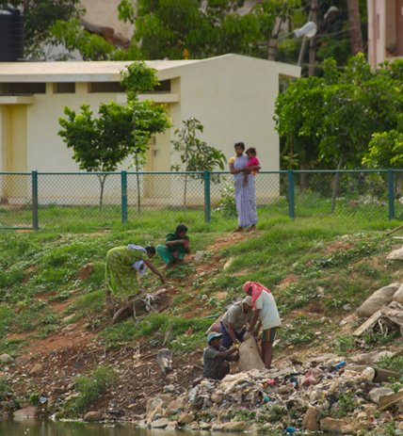
Results and Discussion
The Chinnappanahalli lake Trust
In 2011, Mr. Prabashankar Rai decided to reach out to the authorities to seek help but did not get a positive response.​
He decided to work on the project himself. Thus the Chinnappanahalli lake trust came
into existence.​
Prabashankar had even signed a three-year MoU with the BBMP​
As a part of the MoU, the BBMP sanctioned Rs 50 lakh.​

Slide 11
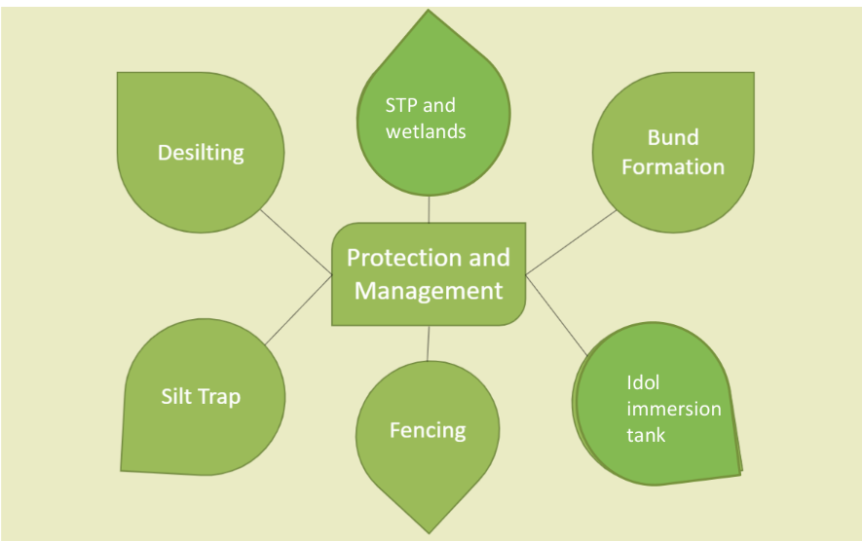
Results and Discussion
According to wakethelake.in
Lake Amenities: ​
• Walk Path​
• Benches​
• Pump​
• Overhead Tank​
• Irrigation Line​​
• Floating Islands
Wetlands
Interventions BBMP:​
• Fence​
• Toilet​
• Desilting​
• Sewage Diversion​
• Silt Trap​
• Walk Path​
• Security Cabin​
• Waste weir​
• Bund formation​
• Benches

Slide 12
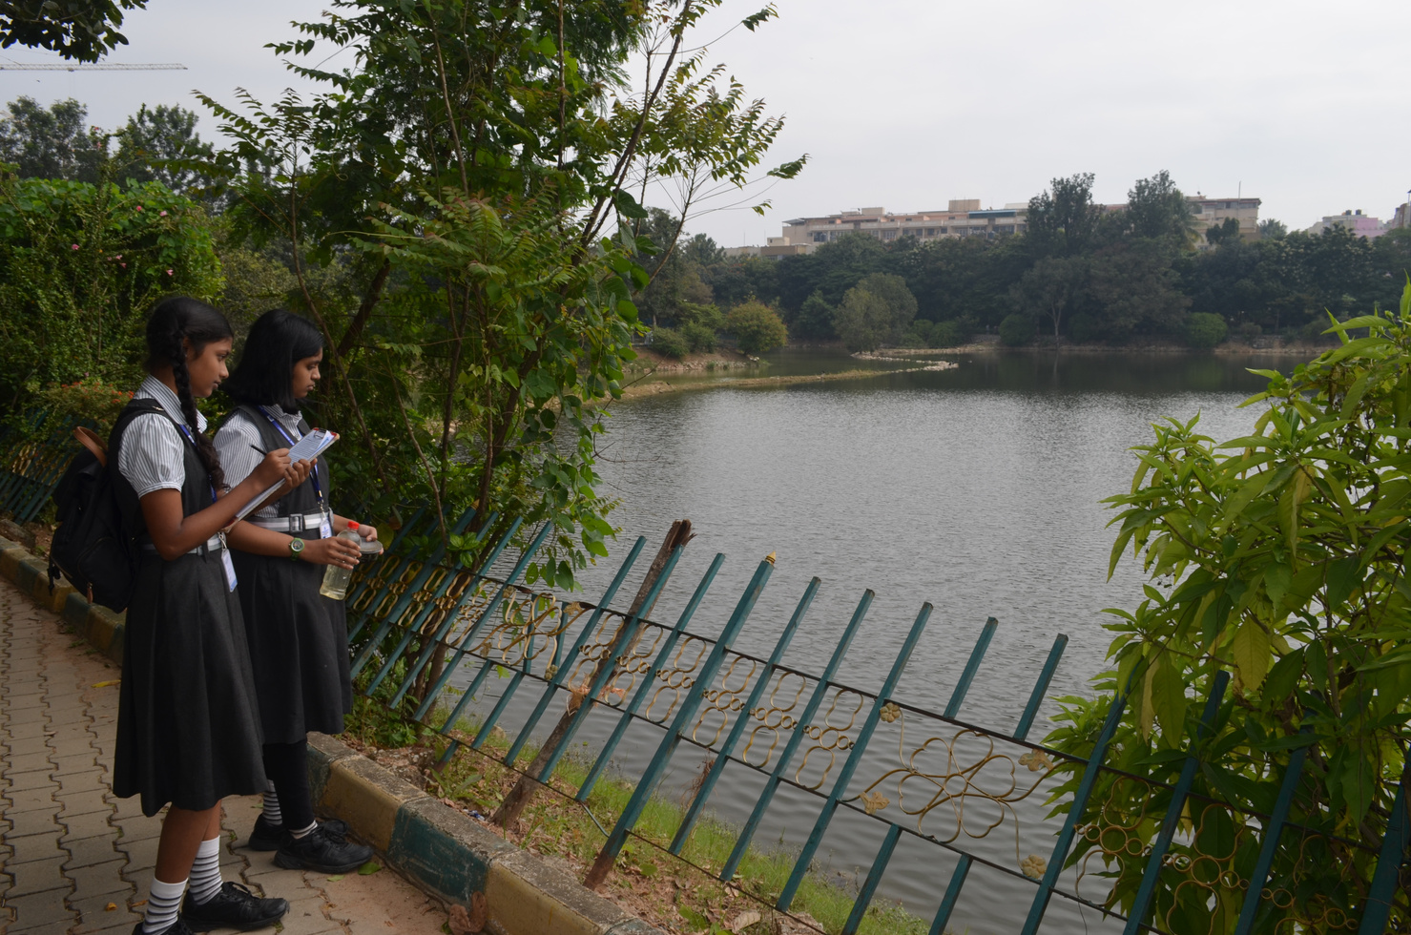
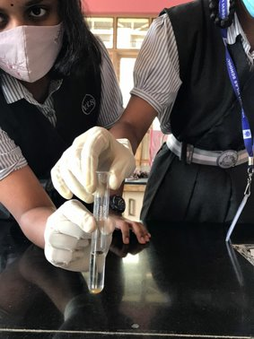
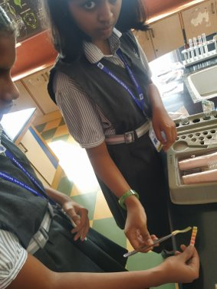
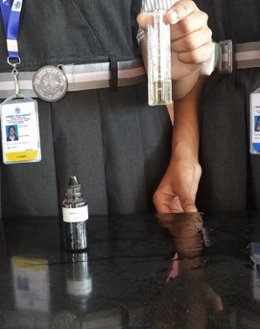

Results and Discussion

Slide 13
Results and Discussion
PARAMETER | INLET 1 | INLET 2 | INLET 3 | OUTLET | DESIRABLE (FOR DRINKING) | TOXIC (FOR AQUATIC LIFE)
PH | 9 | 8.5 | 7 | 8 | 6.5 | <4 or >11
TDS (mg/l) | 462 | 420 | 294 | 294 | 50 – 150 | >600
TURBIDITY(NTU) | 100 | 90 | 40 | 30 | 5 | >50
AMMONIA (mg/l) | 1.0 | 0.5 | 0.3 | 0 – 0.1 | 0.4 | 2.0
NITRATE(mg/l) | 17 | 20 | 4 | 6 | 10 | >40
FLUORIDE(mg/l) | 1.4 | 1.9 | 0.6 | 1.5 | 1.0 | 4.6
IRON(mg/l) | 1.0 | ND | ND | ND | 0.3 | >3
CHLORIDE(mg/l) | 117.2 | 106.3 | 106.3 | 141.8 | 250 | >250
DO(mg/l) |  |  | 5.18 |  | 5 | <5
On-site test Parameters

Slide 14
Problems Faced
Successfully finishing the rejuvenation was not an easy task.
According to the MoU, the BBMP was responsible for maintenance of civil structures, supply of water and electricity and security of the lake. Workers could be seen in the site only after repeated requests, calls and letters.
Apathetic lake users and direct beneficiaries demotivate NGOs willing to take responsibility.
Government civic bodies tossing around responsibility is too a common occurrence.
A High Court order dated March 4th, 2020 required the government to wait for further orders before signing any MoU with any Corporate Entity or NGO.
Now that there are no active MoUs since 2020, It is difficult to get CSR funding for the maintenance for the lake.

Slide 15
Recommendations
Now that there are no active MoUs since 2020, It is difficult to get CSR funding. Therefore the only way the lakes can be maintained are through support from citizens and volunteers.
Small groups of volunteers can create fitness clubs which will attract public support.
Awareness programs should be held through which the seriousness of the condition can be conveyed
Volunteers can be identified through these awareness programs.
This will finally help keeping the lake maintained and create an amicable environment without compromising the ecosystem of the lake.

Slide 16
Conclusion
The idea of lakes being the government's responsibility sounds nice, but a practical approach is necessary.
Citizen groups bring transparency and accountability to the application of funds for crucial improvements and not cosmetic ones.
If it were not for citizens’ interventions, Bengaluru would have fewer lakes left today.
But without the support and participation of public, even NGOs find it difficult to take responsibility.
While addressing issues regarding pollution we must also parallelly focus on creating accountable and responsible citizens.
As only with the support of people any conservative measure taken will be effective.

Slide 17
References
https://www.deccanherald.com/city/life-in-bengaluru/87-of-lakes-restored-by-bbmp-in-poor-state-iisc-study-790659.html
https://mgiep.unesco.org/article/the-bangalore-lake-diaries
https://bengaluru.citizenmatters.in/experts-recommend-urgent-steps-to-save-lakes-7414
https://www.ijert.org/research/water-quality-assessment-of-bellandur-lake-in-bangalore-city-karnataka-india-IJERTV3IS030379.pdf
http://ksdl.karnataka.gov.in/ldakarnataka/WorkshopSeminars/Presentation_Bru%E2%80%8Bhat%20Bangalore%20Mahanagara%20Palike%E2%80%8B/BBMP_Presentation.pdf
https://wgbis.ces.iisc.ernet.in/energy/water/paper/ETR77/section6.html
https://lakesofindia.com/2021/04/21/why-do-we-need-to-rejuvenate-our-lakes/
https://bangaloremirror.indiatimes.com/bangalore/cover-story/please-dont-go-bengaluru-needs-thousands-of-warriors-like-prabhashankar-rai-not-one-less/articleshow/58567168.cms
https://www.wakethelake.in/contact-us
https://www.deccanherald.com/city/life-in-bengaluru/87-of-lakes-restored-by-bbmp-in-poor-state-iisc-study-790659.html
https://www.researchgate.net/publication/343054468_EFFICACY_OF_REJUVENATION_OF_LAKES_IN_BENGALURU_INDIA
https://wgbis.ces.iisc.ernet.in/energy/water/paper/Decaying_lakes_of_Bengaluru/index.html

Slide 18
Acknowledgement
I would like to thank IISc for providing this wonderful opportunity. This has helped me learn a lot of new things I wouldn’t have learnt otherwise.
I would also like to thank our school, teachers and R&D department for their support throughout.
Most importantly I Would like to thank Prabhashankar sir who helped to give a shape to this project.
Last but not the least, I would like to thank my parents without whom this wouldn’t have been possible.

Slide 19
Thank You

