Slide 1
Title : Lake Water Analysis – Kundalahalli Lake
c
S Sruthi, S A Varshini, Meenakshi S M - VIII A

Slide 2
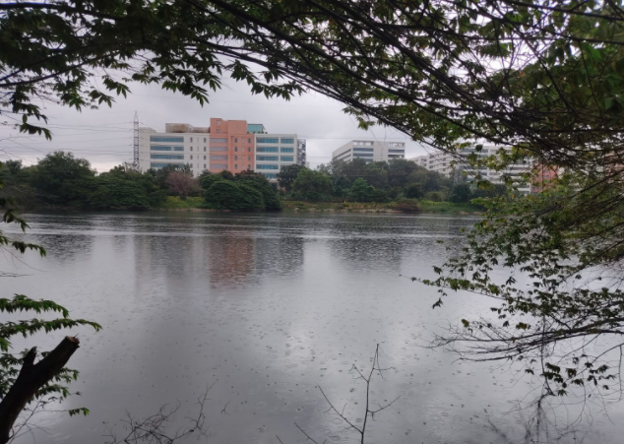
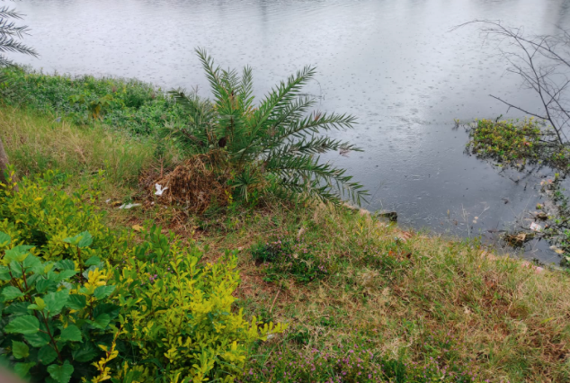
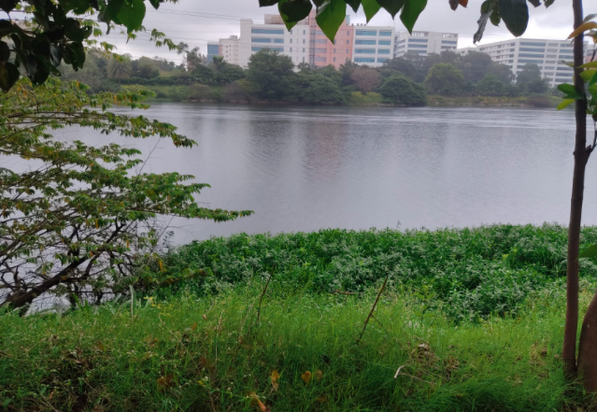
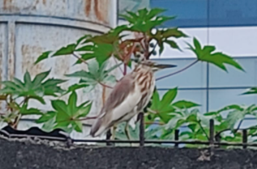
Introduction
Kundalahalli lake is located in Bengaluru, Karnataka and is spread across 10.48 hectares.
It used to be a sewage dumping site for surrounding areas, as for 2019 (from Deccan herald news article).
It is surrounded by tech-parks, multi-storied buildings and slums.

Slide 3
Objectives
To study the quality of water.
To check for presence of microorganisms.
To check for presence of chemicals.
To find ways to purify the lake water to preserve natural habitats and freshwater sources.

Slide 4
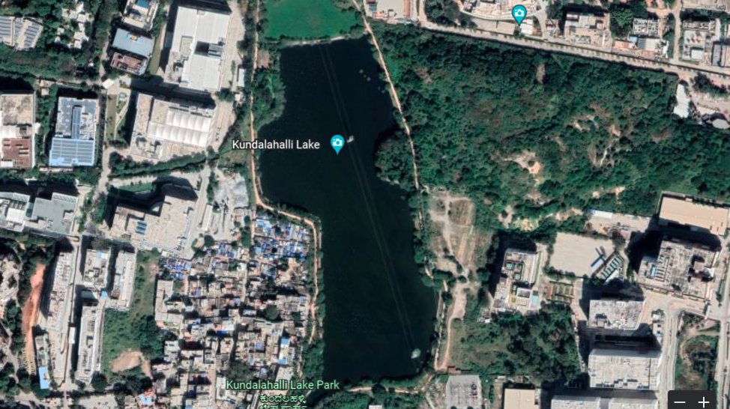
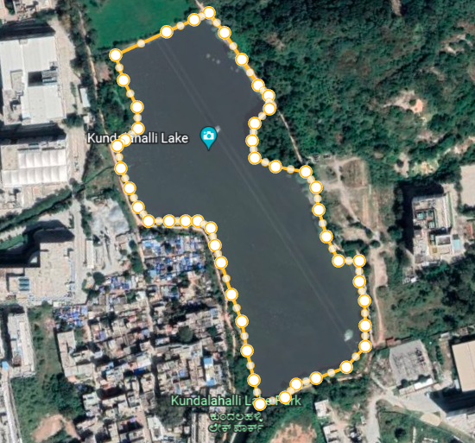
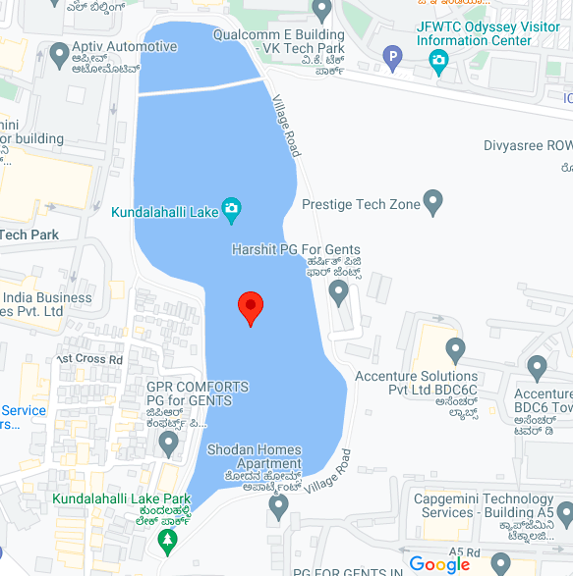
Materials and Methods
Study Area
The perimeter of Kundalahalli lake 1,511.59 m
The area is 17.45 acres
Longitudes - 12.9693° N, 77.7205° E

Slide 5
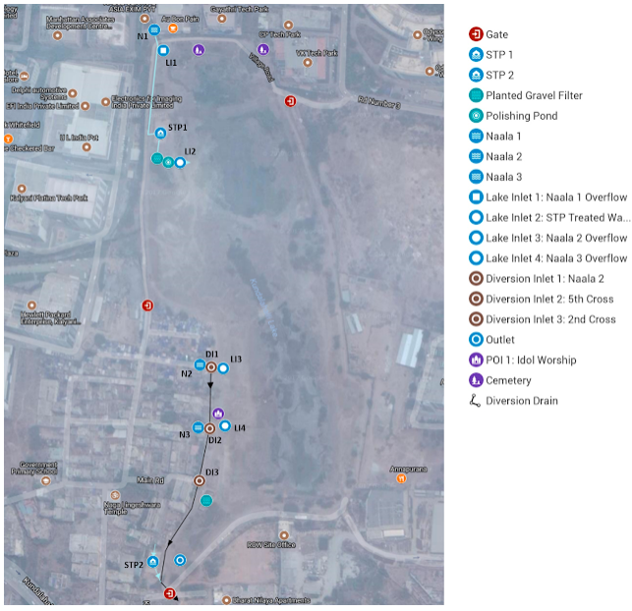
A map showing the inlets and outlets in Kundalahalli Lake
(1)

Slide 6
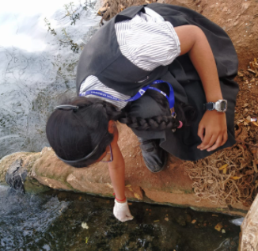
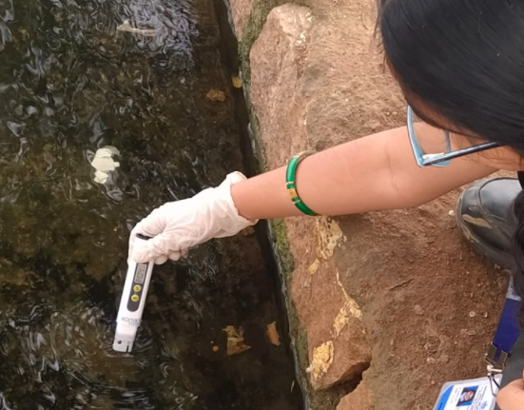
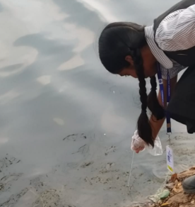
Sample collection Method
On-site tests
pH | pH Paper
Temperature | Laboratory Thermometer
TDS | TDS Meter
pH
Temperature
TDS

Slide 7
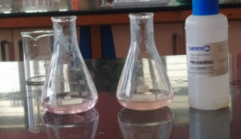
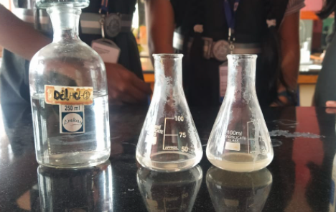
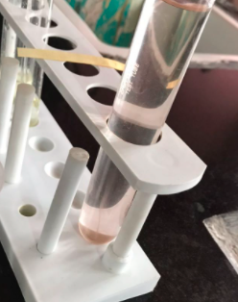
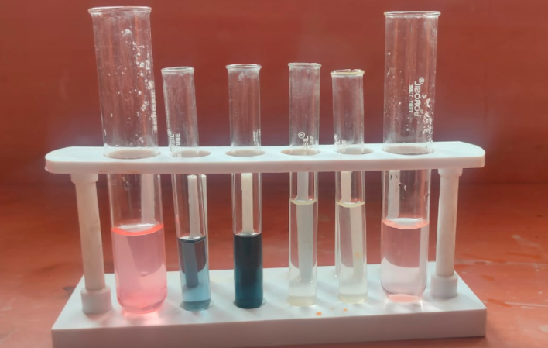
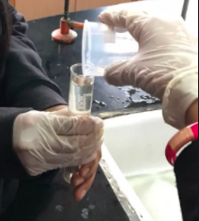
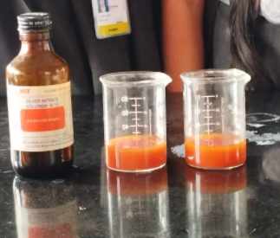
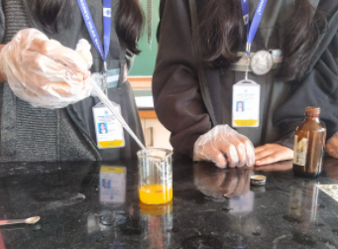
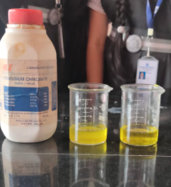
Experimental Method
Off-site tests
Alkalinity | Methyl Orange, Phenolphthalein, HCl
Hardness | EDTA, Eriochrome Black T Indicator
Chloride | Silver Nitrate, Potassium Chromate
Fluoride | Zirconium Alizarin
Chlorine | Orthotolidine
Iron | Ammonium acetate Buffer, Phenanthroline reagent

Slide 8
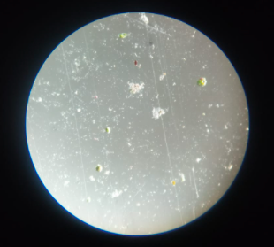
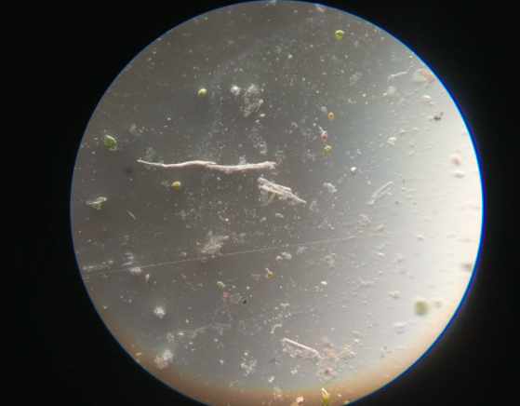
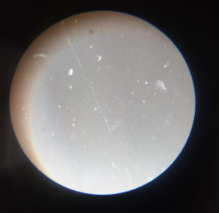
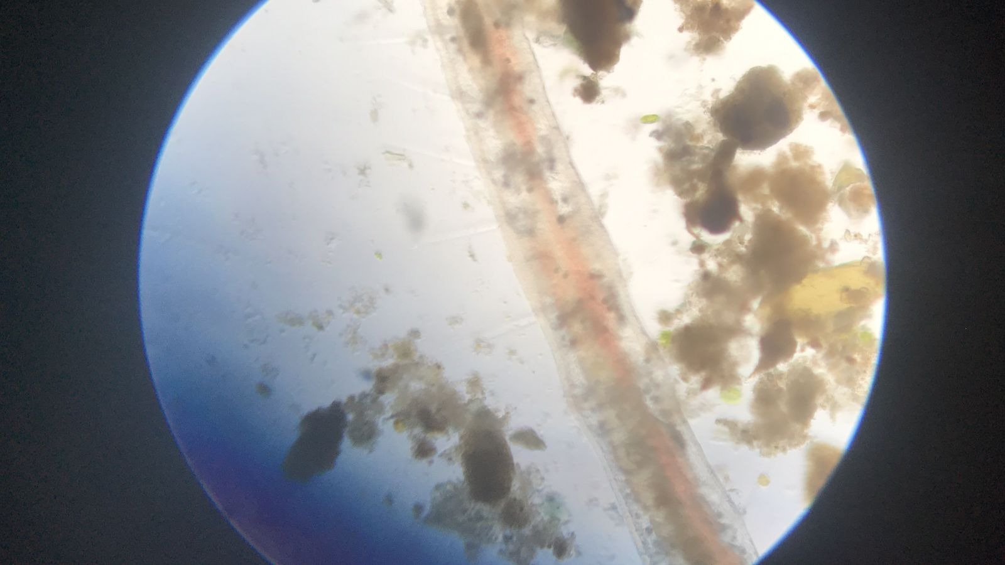
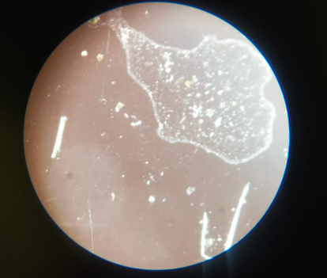
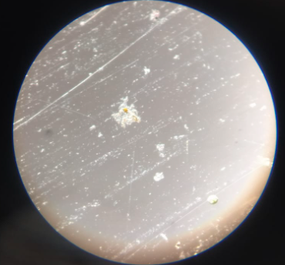
Microscopic View

Slide 9
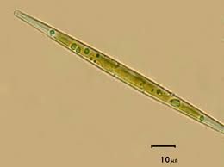
Microorganisms found in the Lake
Name | Number | Family | Description | Pictures
Chlorococcum Amblystomatis (Algae) | 11 | Chlorococcaceae | A single-celled green algae found in freshwater ponds, it is the only known example of an intracellular endosymbiont microbe in vertebrates.
Synedra Diatom (Algae) | 6 | Fragillariaceae | Synedra is a diatom which has long, needle-like cells that exist in single or in radiate colonies. Each cell has two long, plate-like plastids.
Barnacle Larvae (Zooplankton) | 2 | Thecostraca | Barnacles attach themselves to a symbiont such as a whale, sea snake or a crustacean. They have two larval stages, the nauplius and cyprid before maturing into an adult.

Slide 10
On-site Parameters
Test Name | Sample 1 |  | Sample 2 |  | BIS Standards
Air Temperature | 28°C |  | 28°C |  | Moderate
Water temperature | 23°C |  | 25°C |  | Moderate
PH test | 9 |  | 8.5 |  | 6.5-8.5
TDS | 463 mg/l |  | 404 mg/l |  | 500 mg/l
Turbidity | 65 NTU |  | 50 NTU |  | 1 NTU
Off-site Parameters
Test Name |  | Sample 1 |  | Sample 2 |  | BIS Standards
Alkalinity | 437 mg/l CaCO3 |  | 303 mg/l CaCO3 |  | 200 mg/l CaCO3
Hardness | 436 mg/l CaCO3 |  | 370 mg/l CaCO3 |  | 200 mg/l CaCO3
Chloride | 352 mg/l |  | 350 mg/l |  | 250 mg/l
Fluoride | 0.6 ppm |  | 0.3 ppm |  | 1 ppm
Chlorine | 0.2 ppm |  | 0.2 ppm |  | 0.2 ppm
Iron | 1 mg/l |  | 0.3 mg/l |  | 0.3 mg/l
Results and Discussion

Slide 11
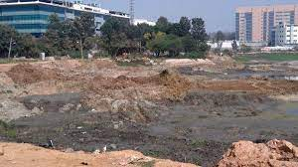
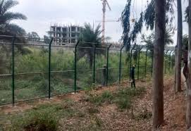
Initiatives taken by the government
In 2016, the BBMP and local residents began work to restore Kundalahalli lake. The lake has been dry-dredged to remove the build-up of sewage from the lakebed.
During the revival of lake water, over 1000 tonnes of sludge was removed from the lake.
STPs were installed at various points of the lake. One of the chambers runs entirely on gravity.
BBMP has also built a fence around the lake’s perimeter to prevent further dumping of waste.

Slide 12
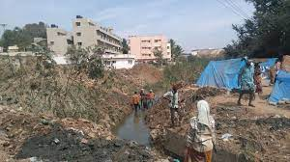
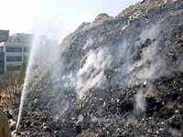
Major Problems faced in Kundalahalli Lake
Many living nearby the lake are facing many health hazards due to the excessive dumping of waste into the lake.
Kundalahalli Lake used to be a habitat for various birds, but the pollution has put their habitat in danger.
During the heavy rains, polluted rain water flowed into the lake making it toxic and threatening the aquatic life.

Slide 13
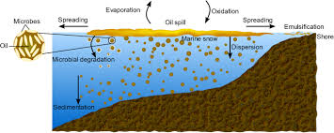
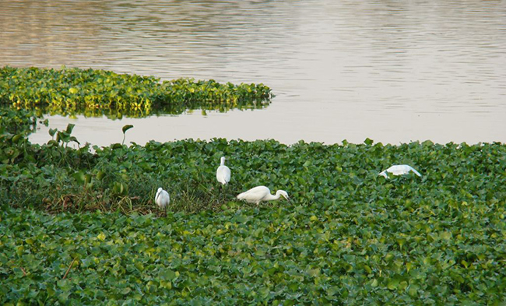
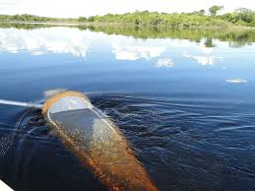
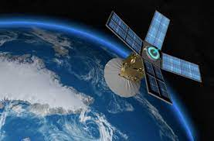
Recommendations
Natural methods to purify the lake water sustainably – for example –
Bioremediation - biotechnical process, which cleans up contamination
Nualgi Technology – Alternative to algaecide, helps to naturally balance algae and plankton
Plankton net to control excessive phytoplankton.
Artificial Intelligence to monitor lakes.
Better Security and Protection to preserve the wildlife and aquatic life

Slide 14
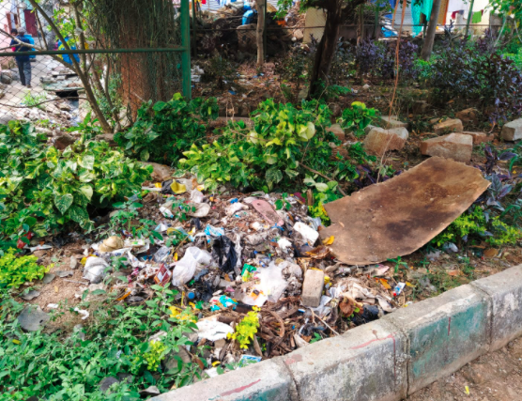
Conclusion
The Lake water is contaminated and polluted due to human activities.
Various chemicals and living organisms can be seen in the water sample.
The restoration of the lake and the natural habitat can be done through natural and sustainable methods.
Lakes are our ‘breathing spaces’ and our ‘lifeline’. It is our duty to protect it and refrain from polluting it.

Slide 15
References
Websites
www.wikipedia.com
www.thehindu.com
wgbis.ces.iisc.ac.in
www.psymbolic.com
http://biometrust.blogspot.com/2017/08/kundalahalli-lake-report.html (1)
http://nbrienvis.nic.in/ViewGeneralLatestNews.aspx?Id=2452
https://www.deccanchronicle.com/nation/current-affairs/090119/hold-your-breath-you-are-near-kundalahalli-lake.html
https://wgbis.ces.iisc.ernet.in/energy/water/paper/ETR77/section7.html
Digital Books:
Algae in Water Supplies by C. Mervin Palmer
A Guide to Marine Coastal Plankton and Marine Invertebrate Larvae by DeBoyd L. Smith
YouTube videos:
https://www.youtube.com/watch?v=B319MMQ8M84 - Know your Ecosystem- EIACP MoEFCC - PRE LAKE 2022 CONFERENCE

Slide 16
Acknowledgement
We are thankful to IISc for giving us this wonderful opportunity
A special thanks to our school and teachers who have supported us in the research
Our heartfelt gratitude to our parents, for their encouragement and support
Last but not the least, we would like to thank our friends for motivating us throughout the project.

Slide 17
Thank you

